Slide 1
Hypertext Markup Language (HTML)

Slide 2
Learning objectives
Create and edit HTML files for webpages in a text editor.
Explain and use different elements, tags and attributes.
create a webpage about Wales using HTML.

Slide 3
HTML
Hypertext Markup Language (HTML) is the language that we use to create web pages.
HTML contains elements that are usually made up of pairs of tags: an opening tag <tag> and a closing tag </tag> and content and attributes between them.
This tutorial will introduce you to some of the most common elements and tags.
We are going to create a simple web page about Wales using a text editor We will then be able to view the page in a web browser (we will use Microsoft’s Edge but you can use any browser).

Slide 4
Wales website
We are going to create a web page about Wales using a text editor.
We will then view the page in a web browser

Slide 5
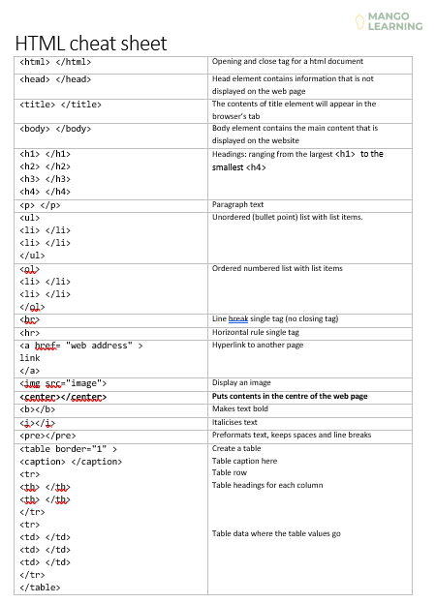
HTML cheat sheet
Use this HTML cheat sheet to help write your webpages.
HTML-cheat-sheet.docx

Slide 6
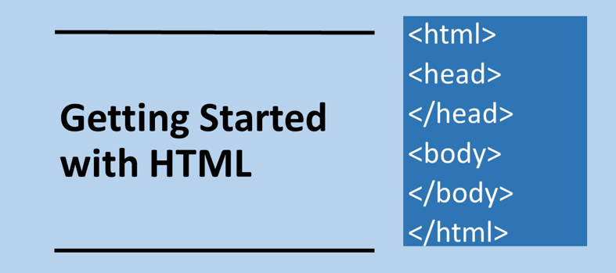

Slide 7
Wales website: 1. Setup the file
Crete a folder called website
Open your text editor and save the file in your website folder and name it wales.html
At the very to of top file write: <!DOCTYPE html> This is the doctype declaration that is needed to let the browser know what type of document it is.
We are now is a position to start writing out HTML file.

Slide 8
Body and head elements
A basic page needs to contain at least the <html> and <body> tags. Tags can be nested within tags.
For anything to be displayed on the webpage the elements need to be within the body tag <body>
The <head> tag contains information that you do not wish to have displayed.
Do not worry about white space. HTML just ignores this so you can format as you wish (although there is a convention, but we will ignore this for the time being).

Slide 9
Wales website: 2. A basic page
Add the following code into wales.html
<html>
<!– A website about Wales -->
<head>
<title> Wales </title>
</head>
<body>
<h1>Wales</h1>
<p> This is a web page about Wales </p>
</body>
</html>
HTML open tag
Comment will be ignored
Head: its content will not
be displayed on the page. The contents of title element will appear in the web browser tab
Body: contents will appear on web page
<h1> Heading: this will make the text appear large
<p> Paragraph where to place the main body of the text
body close tag
HTML close tag

Slide 10
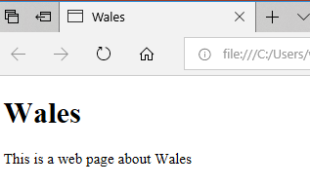
Wales website: 3. Viewing the page
Save and view wales.html
Open file explorer and double click on wales.html to view. Your webpage should look like this:
Title appears in tab
Heading
Paragraph

Slide 11
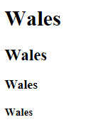
Headings Tags
Heading tags allow different size text to be displayed on the webpage. <h1> is the largest through to <h4>
<h1>Wales</h1>
<h2>Wales</h2>
<h3>Wales</h3>
<h4>Wales</h4>

Slide 13
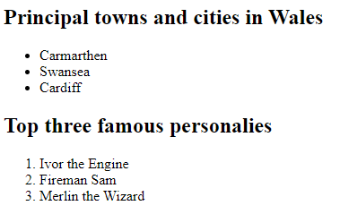
Wales website: 4. Adding a List
To add a list with bullet point we can use the tag <ul> and its corresponding close tag </ul> which refers to an unordered list.
To add a numbered (ordered) list we use the tag <ol>.
<li> refers to list item.
Add the following HTML. Make sure it is between the <body> tags.
Save wales.html and view in the browser
<h2>Principle towns and cities in Wales</h2>
<ul>
<li> Carmarthen </li>
<li> Swansea </li>
<li> Cardiff </li>
</ul>
<h2>Top three famous personalities</h2>
<ol>
<li> Ivor the Engine </li>
<li> Fireman Sam </li>
<li> Merlin the Wizard </li>
</ol>

Slide 14
Wales website: 5. Adding hyperlinks
Add hyperlinks to other sites.
<br> adds a line break. Note that it is a single tag it does not have a closing tag.
Add the following HTML. Make sure it is between the <body> tags.
Save wales.html and view in the browser
<h2> Further information </h2>
<a href= “http://www.bbc.co.uk/news/wales” > News about Wales </a>
<br>
<a href= “https://www.visitwales.com” > Visit Wales </a>

Slide 15
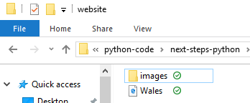
Wales website: 6. Imags setup
In you website folder create a subfolder called images. Find an image on the web that is associated with Wales and save it into the images folder. My image is called daffodils.jpg. Yours might be called something different.

Slide 16
Wales website: 6. Adding an image
Add an image using the <img> tag. <img> is also a single tag, but contains attributes.
Create a subfolder called images. And put an image in that folder. You will need to specify the source attribute src which is the name of the image including the path
The width and height attributes are not necessary, but you may need them if you image is very large. The values refer to the number of pixels. Change the values if necessary
Add the following HTML. Make sure it is between the <body> tags.
Save wales.html and view in the browser
<h2> Emblem of Wales </h2>
<img src="images/daffodils.jpg" width="300" height="200" >

Slide 18
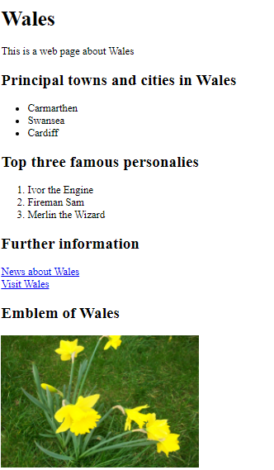
Complete HTML listing
<!DOCTYPE html>
<html>
<!-- A website about Wales -->
<head>
<title> Wales </title>
</head>
<body>
<h1>Wales</h1>
<p> This is a web page about Wales </p>
<h2>Principal towns and cities in Wales</h2>
<ul>
<li> Carmarthen </li>
<li> Swansea </li>
<li> Cardiff </li>
</ul>
<h2>Top three famous personalities</h2>
<ol>
<li> Ivor the Engine </li>
<li> Fireman Sam </li>
<li> Merlin the Wizard </li>
</ol>
<h2> Further information </h2>
<a href="http://www.bbc.co.uk/news/wales"> News about Wales </a>
<br>
<a href="https://www.visitwales.com"> Visit Wales </a>
<h2> Emblem of Wales </h2>
<img src="images/daffodils.jpg" width="300" height="200" >
</body>
</html>

Slide 20
Make
Create another webpage about another country.
Use all the same elements as for the Wales web page
Use a hyperlink to link the two pages together.
<a href="japan.html"> Japan </a>

Slide 21
Reference: Adding a Table
<table border="1" >
<caption> Mountains in Wales </caption>
<tr>
<th> Mountain </th>
<th> Height ASL (m) </th>
<th> Location </th>
</tr>
<tr>
<td> Snowdon </td>
<td> 1085 </td>
<td> Snowdonia National Park </td>
</tr>
<tr>
<td> Pen Y Fan </td>
<td> 886 </td>
<td> Brecon Beacons National Park </td>
</tr>
</table>
Indicates table has two columns and we include border.
If border is not specified table has no border.
Caption
Table row 1
Table header tag
End of table row 1
Table row 2
Table data tag
Table row 3

Slide 22
Reference Formatting
<body bgcolor=”#FF0000”> Change colour of backgroud. The colour is specified in
hexadecimal: Use numbers 0-9 and letter A-F Have a play
around with these and see what happens.
<br> Line break. Single tag.
<hr> Horizontal Rule. Single tag.
Put another element between these tags for formatting
<center> </center> Puts contents in the centre of the web page
<b> </b> Makes text bold
<i> </i> Italisises text
<pre> </pre> Preformats text, keeps spaces and line breaks

