Slide 1
The genetic basis of variation (DO NOT OPEN YOUR WORKSHEET YET!)
Describe the differences between continuous and discontinuous variation.
Explain the basis of continuous and discontinuous variation by reference to the number of genes which influence the variation.
Explain that both genotype and environment contribute to phenotypic variation (no calculations of heritability will be expected).

Slide 2
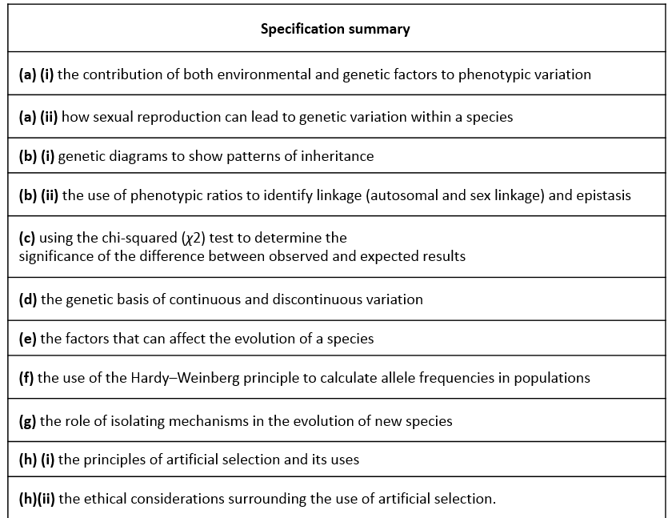
Studied earlier in this unit
We’re going to revisit with a focus on this
Write as many key terms as you can on the whiteboard, that are linked to variation
Now try and define them all without looking anything up

Slide 3
Did you include.......
Phenotype
Genotype
Meiosis
Crossing over
Independent assortment
Fertilisation
Zygote
Autosomal linkage
Homozygous
Heterozygous
Gene
Allele
Dominant
Recessive
Monohybrid
Dihybrid
Continuous
Discontinuous
Genetic factors
Environmental factors
Interspecific variation
Intraspecific variation
Polygenic
Monogenic
Epistasis
Incomplete dominance
Codominance

Slide 4

What do you remember about variation?

Slide 5
Intraspecific variation is the variation within a species.
Variation is the difference that exists between organisms.
Discontinuous variation is when there are two or more distinct categories, and each individual falls into one of these categories. There are no intermediates.
Genetic factors.
Variation
Environmental factors.
Interspecific variation is the variation between different species.
Continuous variation is when the individuals in a population vary within a range (e.g. height, waist circumference, fur length).

Slide 6
Phenotypic variation
This is the variation which occurs in an organism’s phenotype (i.e. the characteristics it displays).
It is influenced by several factors:
Genotype
The environment
A combination of genotype and the environment

Slide 7
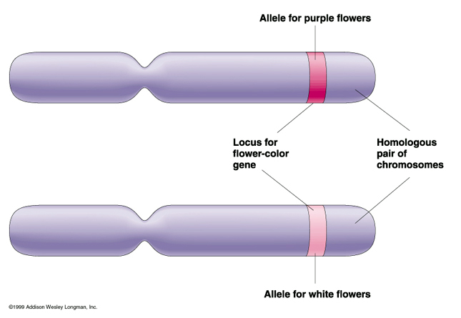
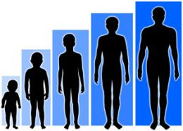

Genotype
Different species have different genes/alleles etc.
Remember, the alleles an organism has make up its genotype, and differences in genotype result in phenotypic variation (e.g. human blood group).
Inherited characteristics which show continuous variation are usually influenced by many genes. These are called polygenic characteristics (e.g. human height).
Inherited characteristics which show discontinuous variation are usually influenced by only a small number of genes. These are called monogenic characteristics (e.g. flower colour).

Slide 8

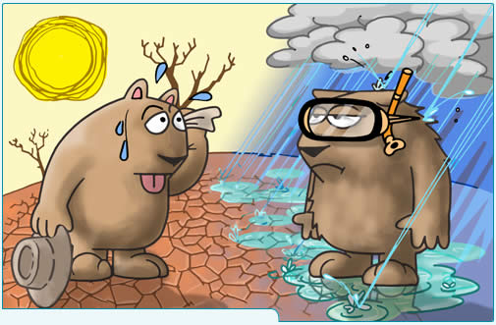

  Environment
  Characteristics controlled by environmental factors (climate, food, lifestyle) can change an organism’s life.
  Accent, ears pierced.
  Epigenetics.

Slide 9
  Genotype and the environment
  Genotype tends to influence the characteristics the organism is born with, but environmental factors can influence how these characteristics develop.
  Most phenotypic variation is caused by a combination of genotype and environmental factors.
Venn diagram to explain how environmental and genetic factors influence variation. Make sure you use examples.
  This type of variation is usually continuous.
  e.g height of pea plants and human body mass.

Slide 10
  Variation application questions
MAOA is an enzyme that breaks down monoamines in humans. Low levels of MAOA have been linked to mental health problems. MAOA production is controlled by a single gene, but taking anti-depressants or smoking can reduce the amount produced.
Is MAOA production monogenic or polyygenic?
Patient X has mental health problems linked to low MAOA levels. Are these problems likely to be due to the patients genotype, the environment or both? Explain your answer.
Answers
a) monogenic
b) Both. MAOA production is controlled by a gene, but is also influenced by the environment (e.g. smoking or anti-depressants)
2. A study was conducted into how smoking during pregnancy affects the birth mass of new born babies, depending on the genotype of the mother. The results showed that women who smoked during the entire pregnancy had babies with a mean reduction in birth mass of 377 g. But the reduction was as much as 1285 g among women with certain genotypes.
What can be concluded about the influence of genotype and environmental factors on birth mass? Give evidence from the study to support your answer.
Answer - Environmental factors affect birth mass (smoking); 377 g. However, those who had certain genotypes saw a reduction of over 3 times, to as much as 1285 g when they smoked. Thus due to both genes and the environment working together.

Slide 11
  Scrap paper quiz.
Write the following answers on scrap paper, along with your name.
Are traits that show continuous variation usually monogenic or polygenic?
What type of variation do traits that are influenced by both genotype and the environment tend to show?

