Slide 1
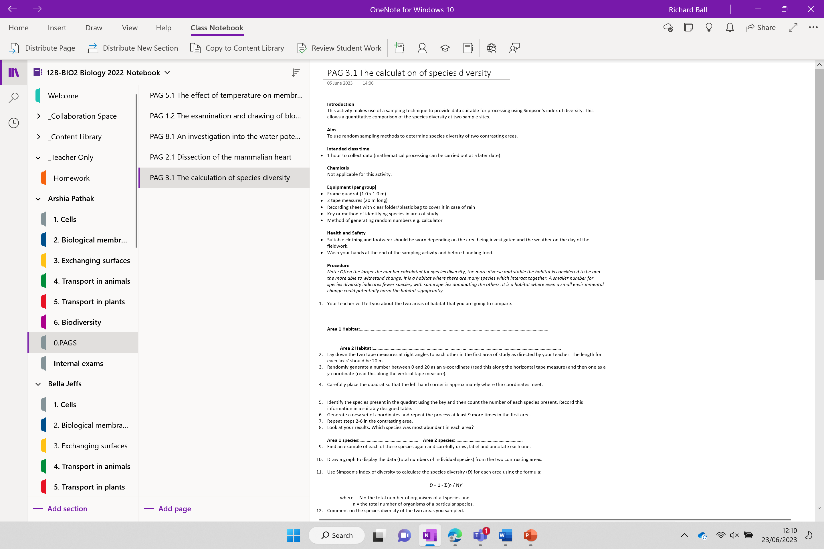
PAG Write up
This has been set as an assignment
You will need to use all the data you gathered from your field day
This must be completed in full by Tuesday 4th July to sign off you year 12 PAG book

Slide 2


Slide 3
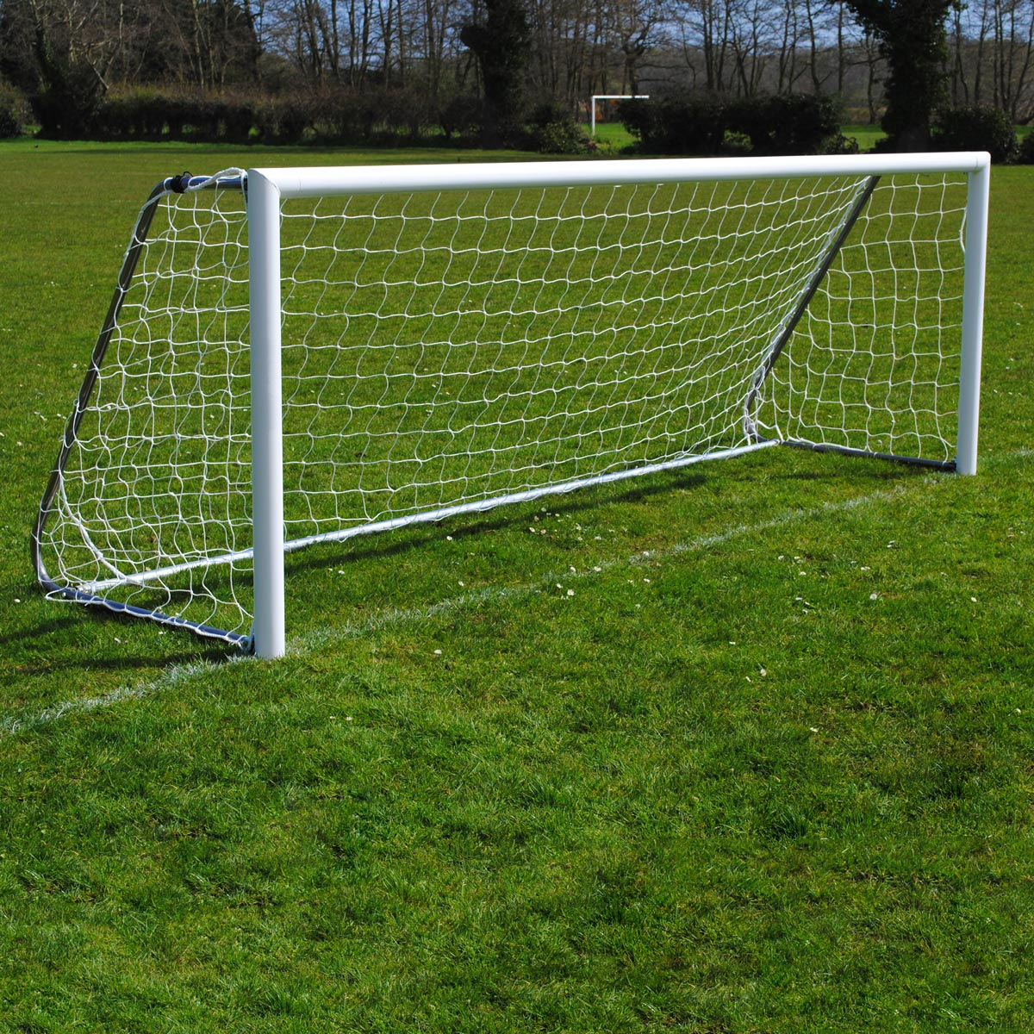

Golgi apparatus
gi

Slide 4
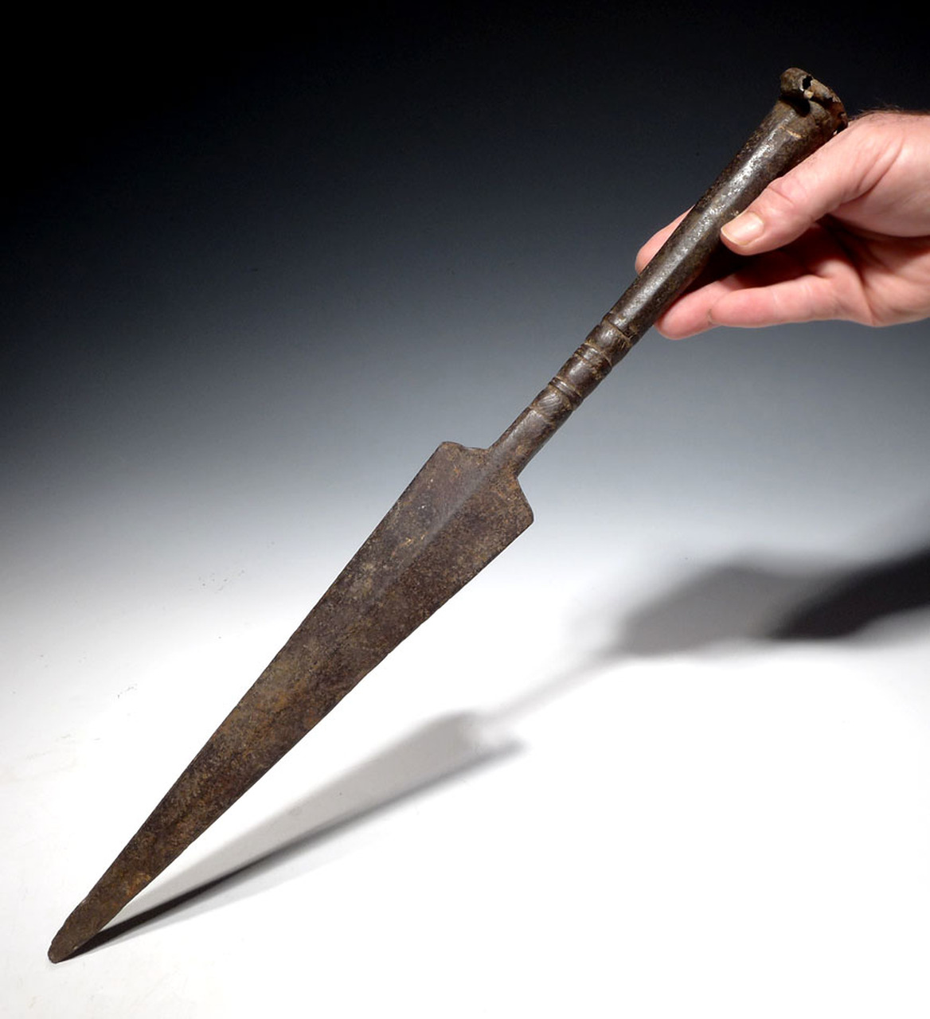


Spearman's rank
‘s

Slide 5
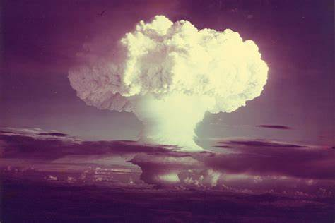

nucleotide
leo

Slide 6

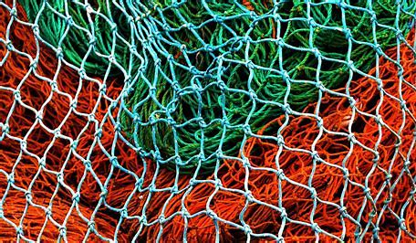
Sweep nets

Slide 7
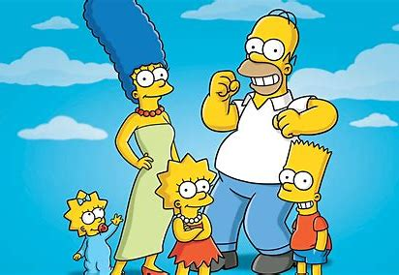
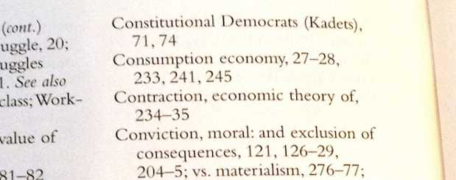
Simpsons index

Slide 8

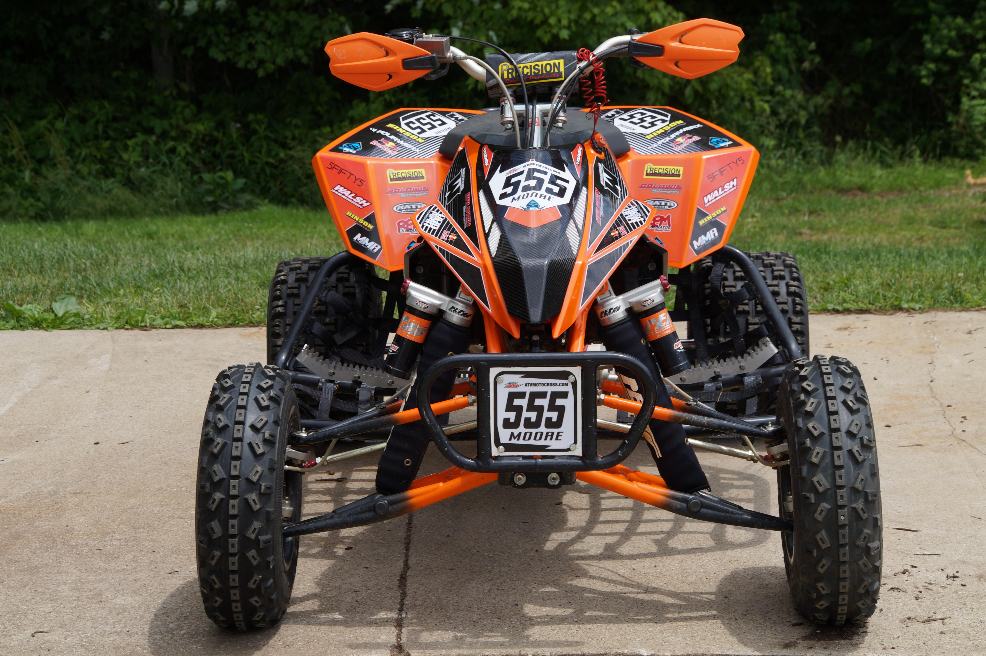
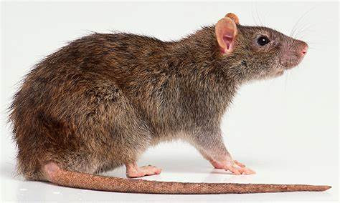
Frame quadrat

Slide 9
Final slide

Slide 10

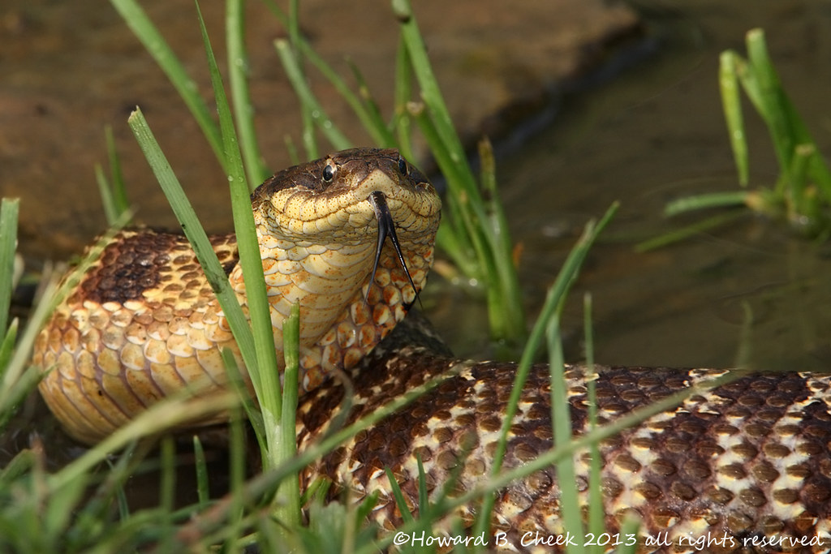
Histone
e

Slide 11
PAG Write up
This has been set as an assignment
You will need to use all the data you gathered from your field day
This must be completed in full by Tuesday 4th July to sign off you year 12 PAG book

Slide 12
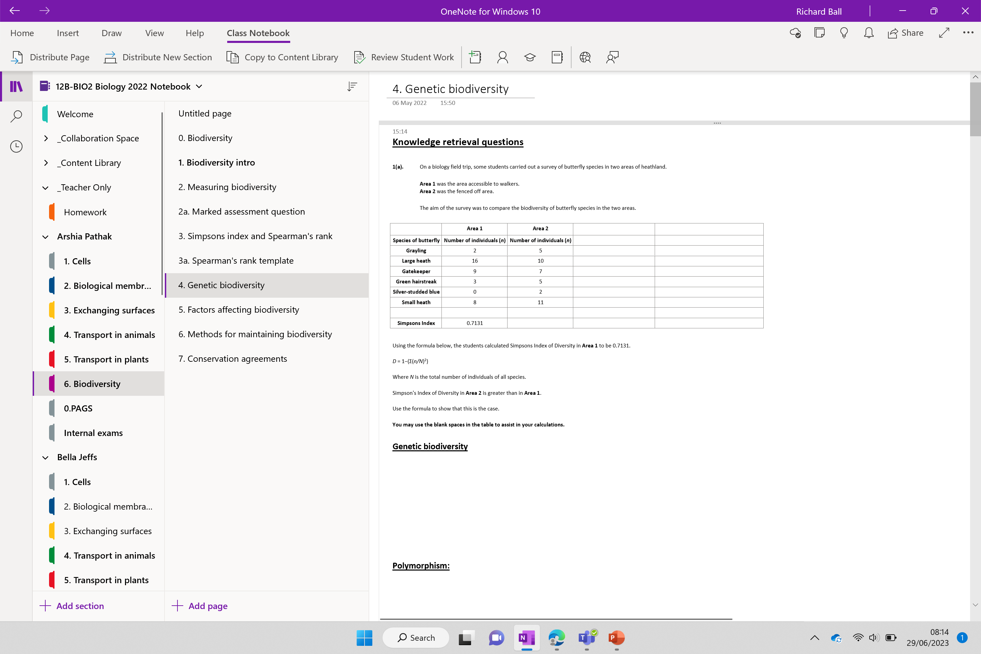

Slide 13
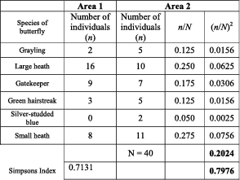
Knowledge retrieval questions
On a biology field trip, some students carried out a survey of butterfly species in two areas of heathland.
Area 1 was the area accessible to walkers.
Area 2 was the fenced off area.
The aim of the survey was to compare the biodiversity of butterfly species in the two areas.
Simpson's Index of Diversity in Area 2 is greater than in Area 1.
Use the formula to show that this is the case. D = 1−(Σ(n/N)²)
You may use the blank spaces in the table to assist in your calculations.
Notes:
RICHNESS VS EVENESSS QUESTIONS FIRST

Slide 14
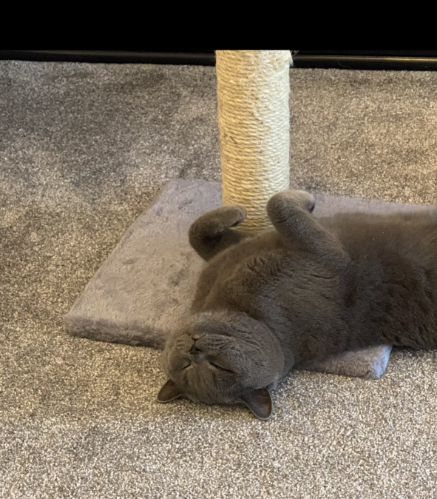
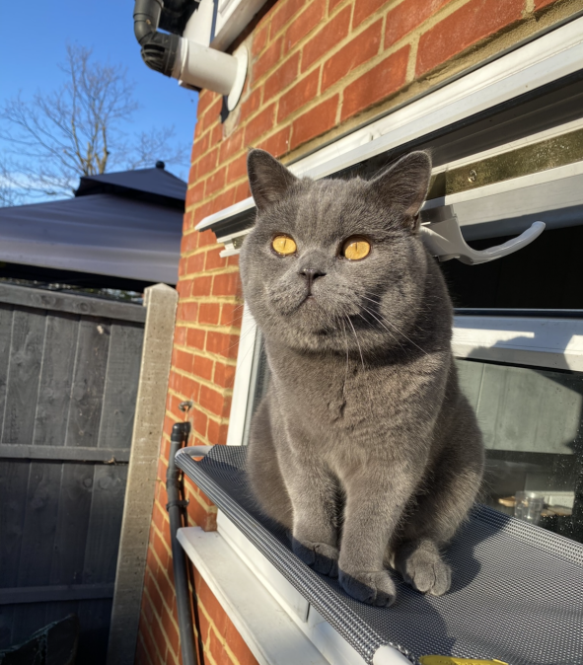
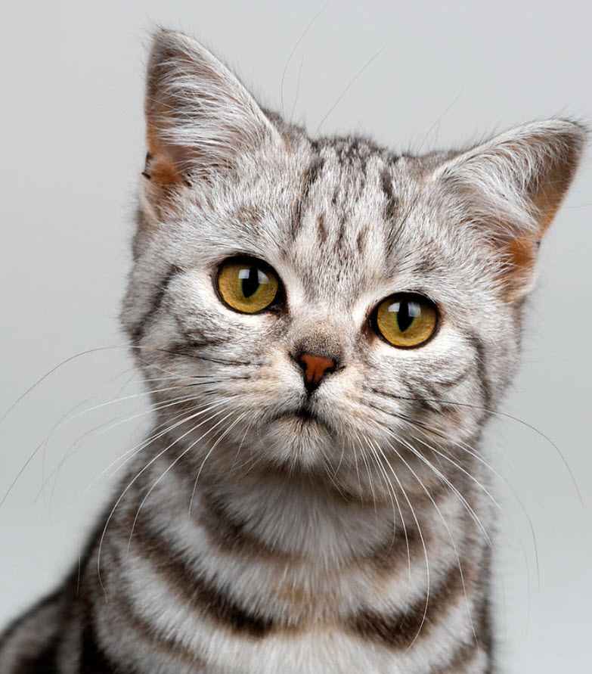
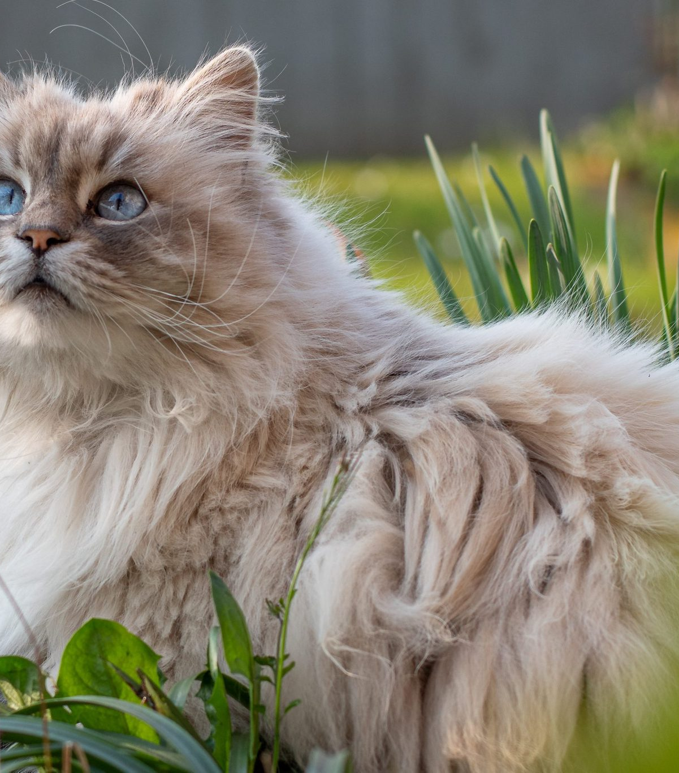

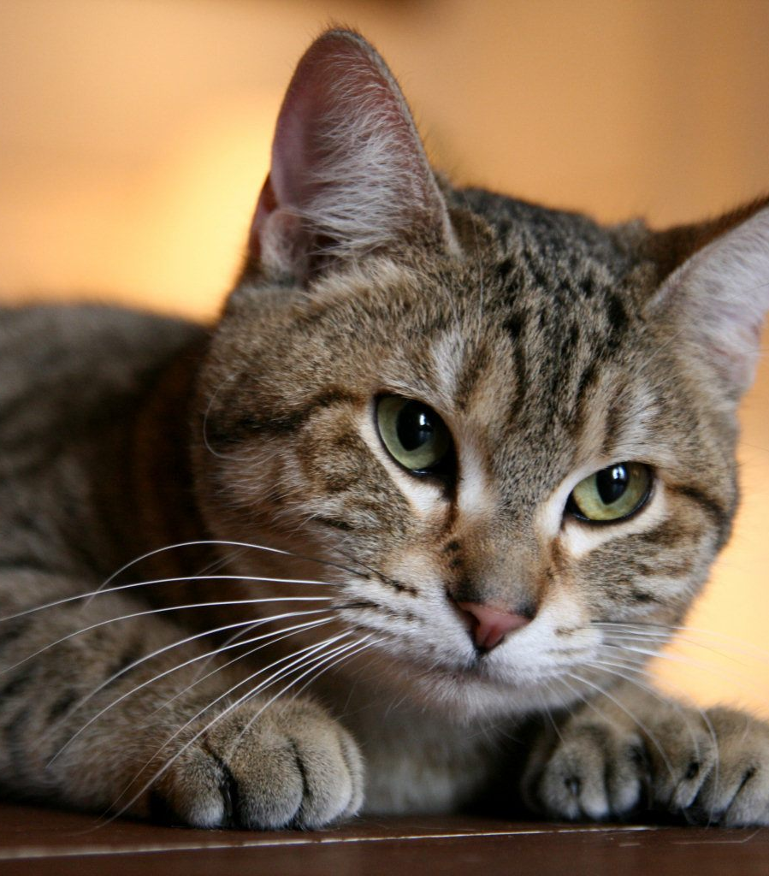
Genetic Biodiversity

Slide 15
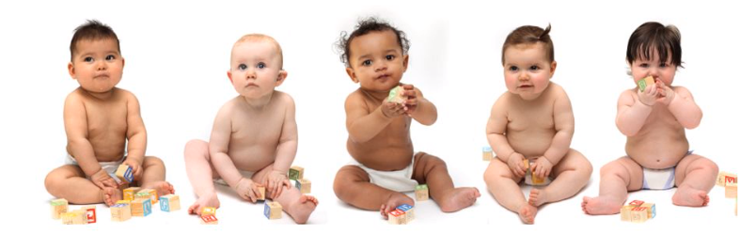
Genetic biodiversity: the proportion of gene variants within a species

Slide 16
Polymorphism
Many
variations
Locus
the specific site on a chromosome where a gene is found

Slide 18
Key terms
Polymorphism:
Two or more alleles that occupy the same locus in a population (*when a gene has two or more alleles).
This leads to phenotype variation, eg blood groups, dog breeds, flower colour, and increases genetic diversity.

Slide 19
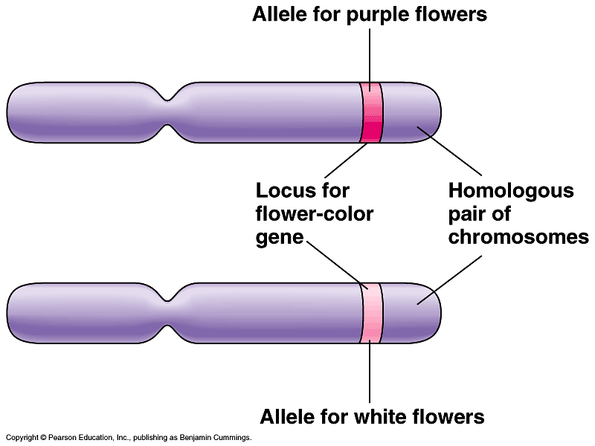
Polymorphism:
Two or more alleles occupy the same locus
Notes:
Homologous - having the same relation, relative position, or structure.

Slide 20
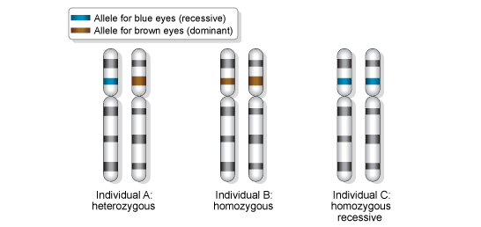
Key terms
Polymorphism:
Two or more alleles occupy the same locus
Loci: The position of a gene on a chromosome
Gene position
“The number of genes that have alleles” is just another way of saying “the proportion of gene loci are polymorphic”
b B
B B
b b
*Loci - a particular position or place where something occurs or is situated.
Notes:
Normally the genes have two alleles but there are many such examples in which a gene carry more than two alleles. For e.g. in human ABO blood grouping is controlled by the gene I in which it have three alleles i.e, IA, IB and i by which it regulate the type of blood group a person have.

Slide 21
Key terms
Polymorphism:
Two or more alleles occupy the same locus in a population (when a gene has two or more alleles).
This leads to phenotype variation, eg blood groups, dog breeds, carrot colour, and increases genetic diversity.
Monomorphism:
When a gene has only one type allele. Most genes are ‘monomorphic’ this ensures that the basic structure of a species is similar (e.g the hox gene – body plan)
*Technically for two version of alleles this is called dimorphic

Slide 22
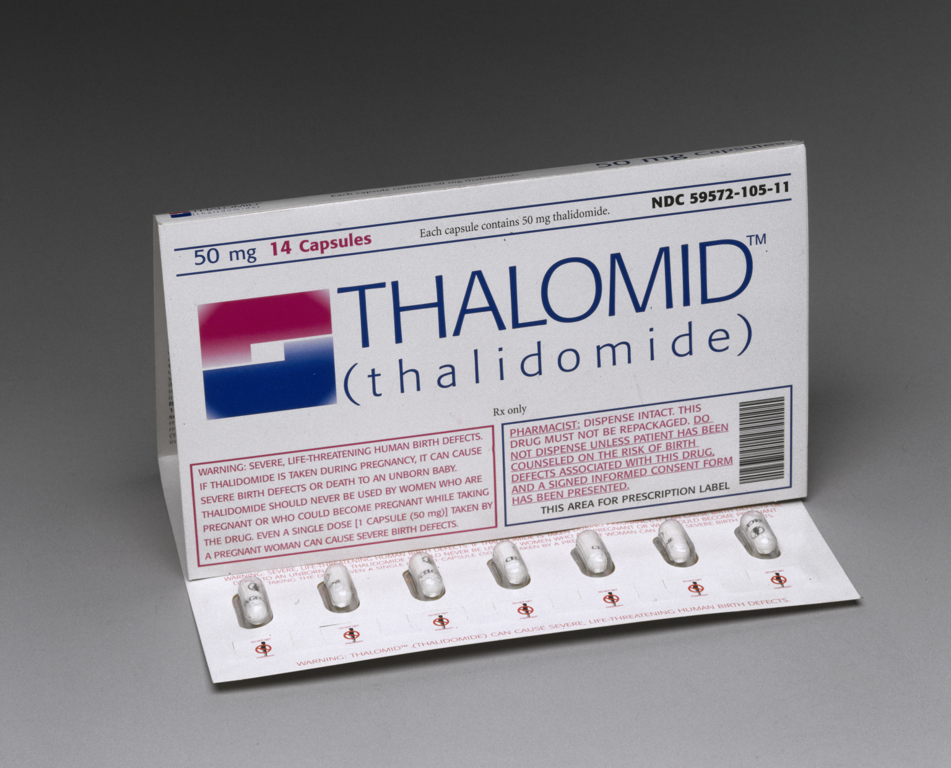
Interfered withs hox gene

Slide 23
Remind me!
Monomorphic Gene
Loci
Polymorphic Gene
Most genes are monomorphic

Slide 24
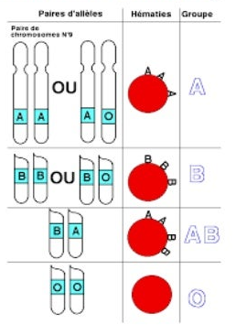
Understanding Genetic Biodiversity
Individuals of the same species have the same genes but they may have different versions of the genes (alleles).
EXAM TIP:
Do NOT use genes and alleles interchangeably. The variation in the same species is due to the difference in alleles

Slide 25
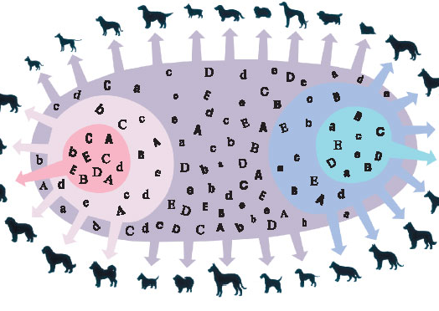
Why is having a large gene pool within a species important?

Slide 26

Explain which population of frog is more likely to survive if we introduce a change to the environment
High temperature
High temperature
Pollutants
Pollutants
Low O₂
Low O₂

Slide 27
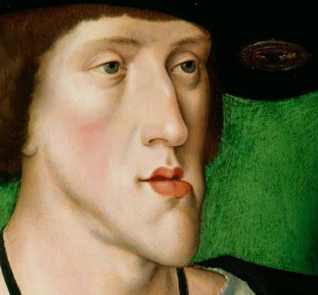
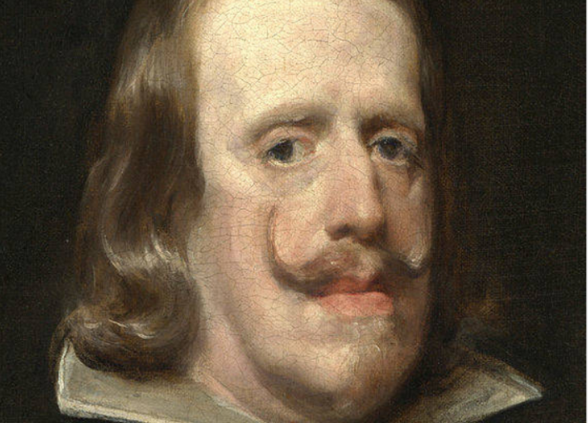
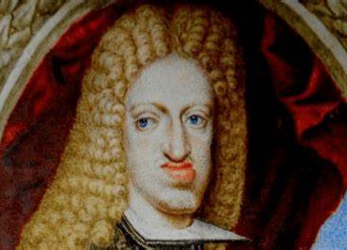
Habsburg family
Notes:
Inbreeding likely led to the Habsburg jaw because of what's called genetic homozygosity — or the inheritance of the same form of a gene from both parents, the authors suggest. Genetic homozygosity occurs more often when relatives mate, because they share a greater proportion of genes.

Slide 28
Importance of genetic diversity
…………… populations have greater genetic diversity (larger ……….. pool)
……………… populations have lower ……………. diversity (shallow gene pool)
Greater genetic ………………. (large gene pool) ……………….. the chance of some organisms having the traits/genes to ……………..
Genes in small population (smaller gene pools) become more uniform and any disabilities in the genes are more likely to be …………………… as phenotypes

Slide 29
Importance of genetic diversity
Large populations have greater genetic diversity (larger gene pool)
Small populations have lower genetic diversity (shallow gene pool)
Greater genetic diversity (large gene pool) increases the chance of some organisms having the traits/genes to survive
Genes in small population (smaller gene pools) become more uniform and any disabilities in the genes are more likely to be expressed as phenotypes

Slide 30
Handedness
A new study, conducted by scientists from the University of Oxford for the first time has identified the genetic differences associated with left-handedness, a trait found in 10% of the human population.
What's more, those genetic variants result in differences in brain structure, which might mean that left-handed people have better verbal skills than the right-handed majority.

Slide 31


Slide 32
Would it possible to lose or increase a trait within a population (like left handedness) completely by chance?

Slide 33
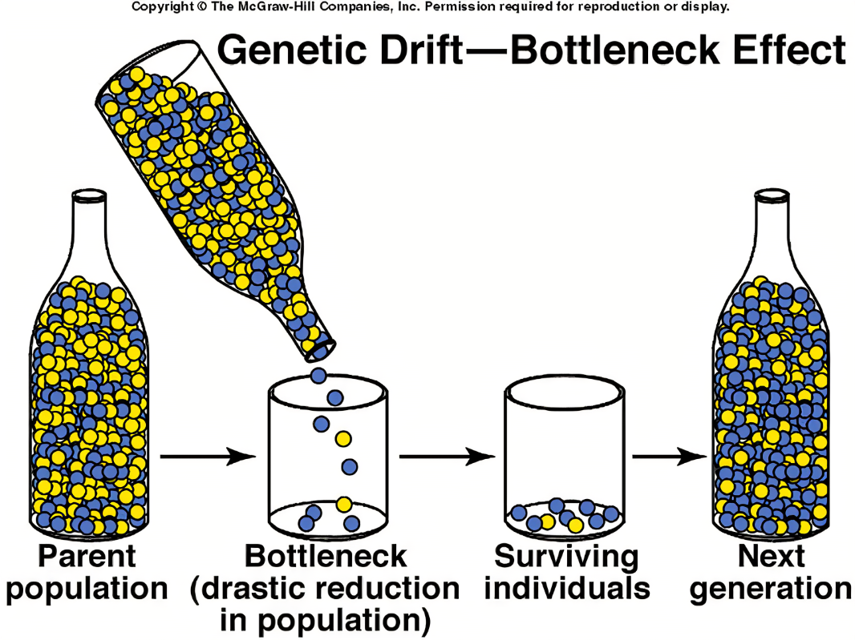
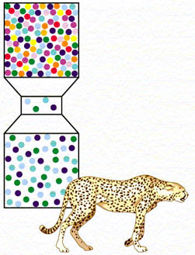
Genetic drift – change in frequency of an existing gene

Slide 34
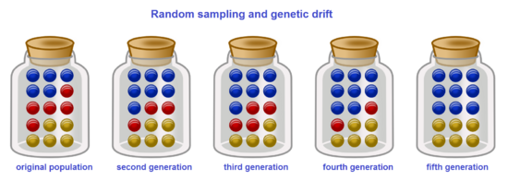
Genetic drift
Can happen in all populations
Has a drastic effect in small populations
Driven by chance, not selection
Two main types are Founder effect and Genetic bottlenecks

Slide 35
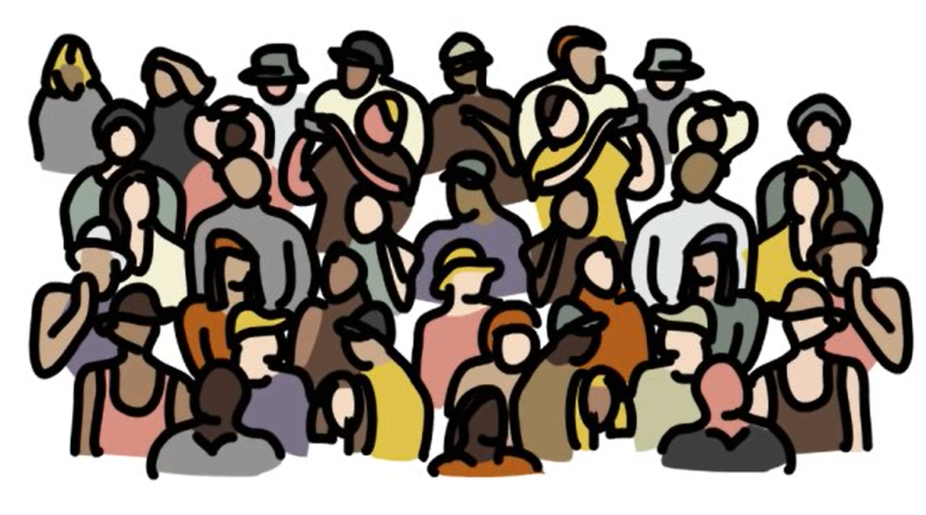
Bottleneck effect
Darwinville
95 right-handed
5 left-handed
A random occurrence destroys part of the population (storm, poaching, disease)
The random occurrence happened to kill all of the left handed people
The new, smaller population has a reduction in the gene pool due to a random event

Slide 36
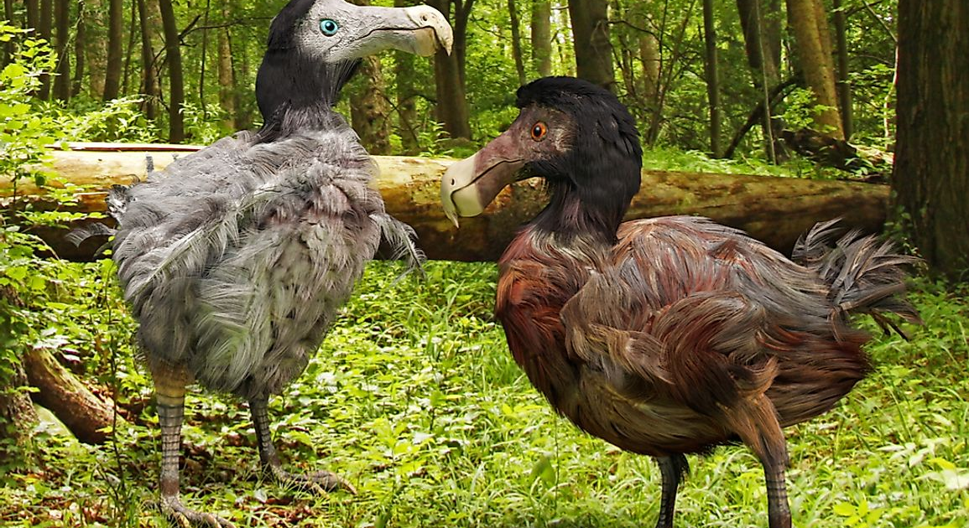
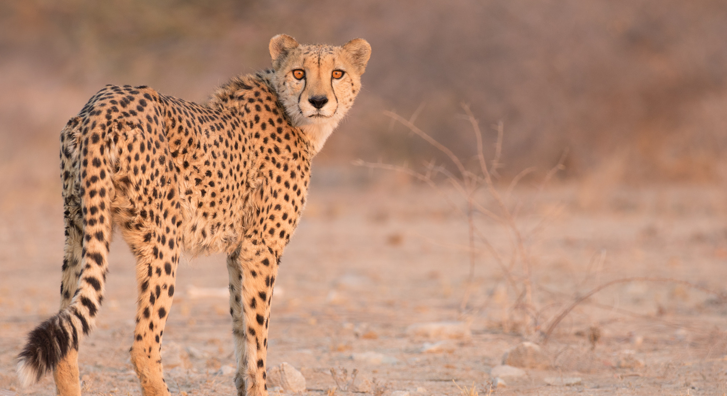
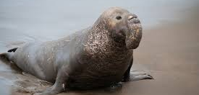
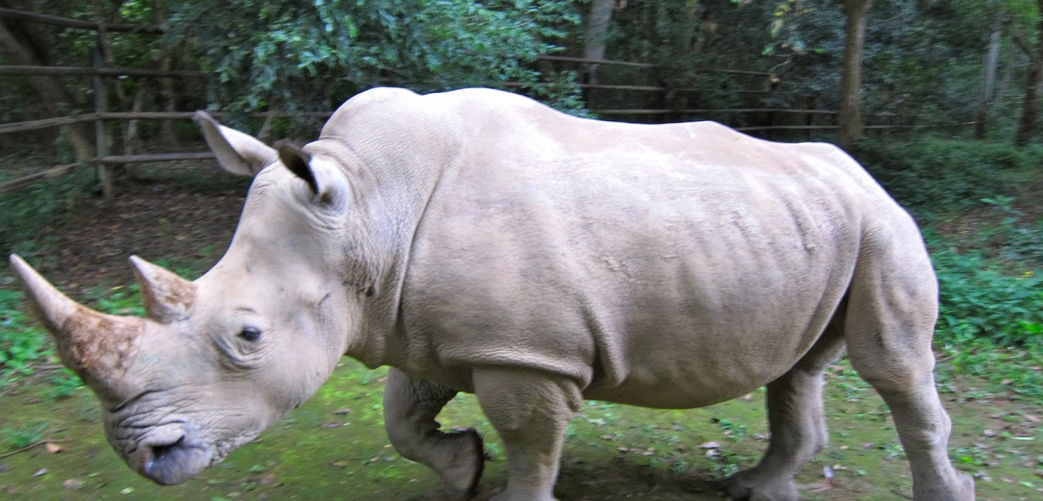

Slide 37
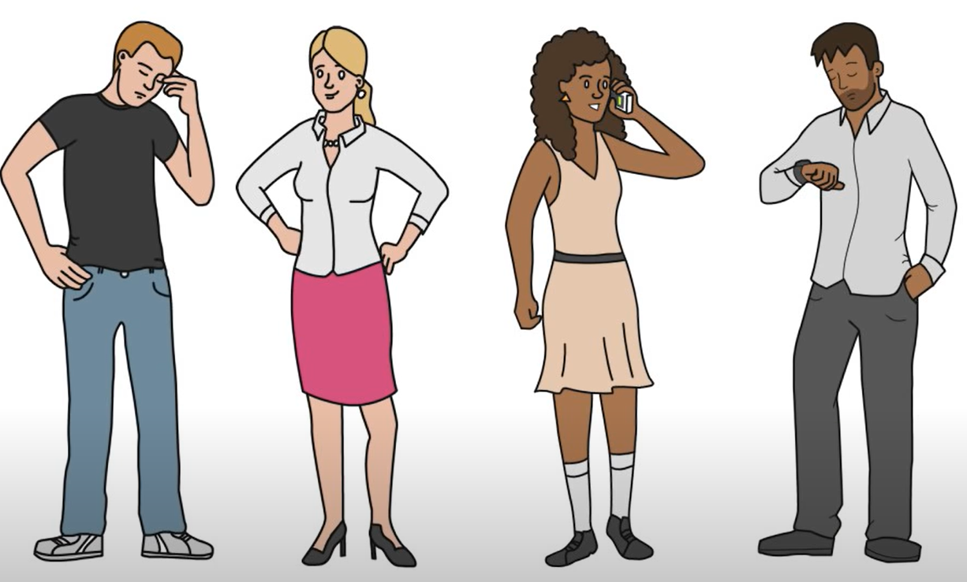
Founder effect
Darwinville
95 right-handed
5 left-handed
A small group leaves the population to start a new colony who happen to all be left handed.
The gene frequency for left handedness has increased.
Drastically changing the gene pool

Slide 38
Link: decreasing population numbers, inbreeding and extinction events
When a population number drops (destruction of habitat, new species introduced, pollution etc)
Increases the likelihood of Inbreeding
Disabilities or undesirable traits are passed on more frequently
Species become more vulnerable to environmental changes
Leading to possible extinction events
Extinction events are usually preceded by a drop in genetic biodiversity
Drop in genetic biodiversity → Extinction

Slide 39
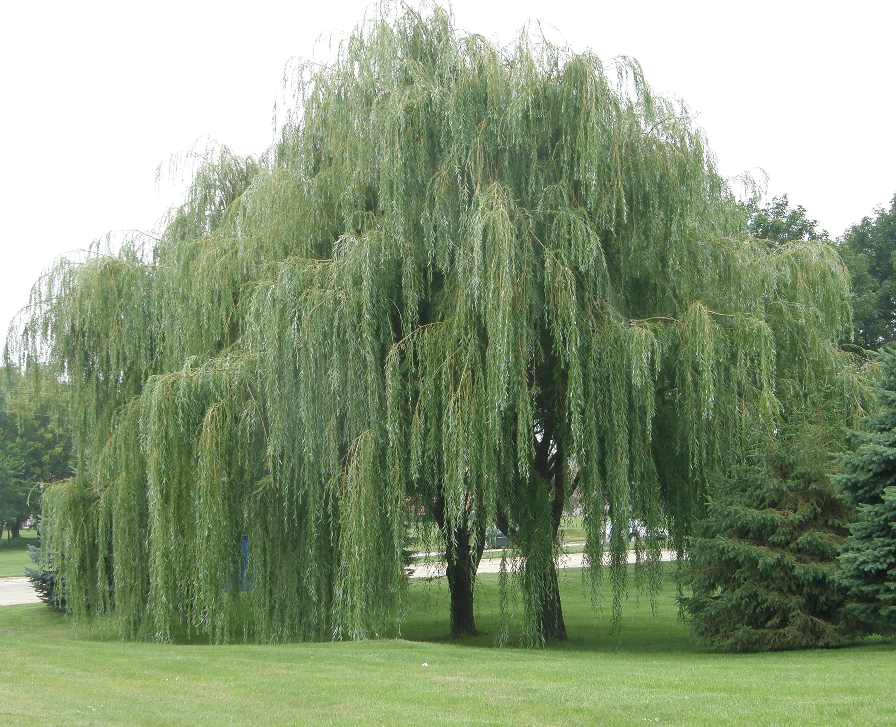
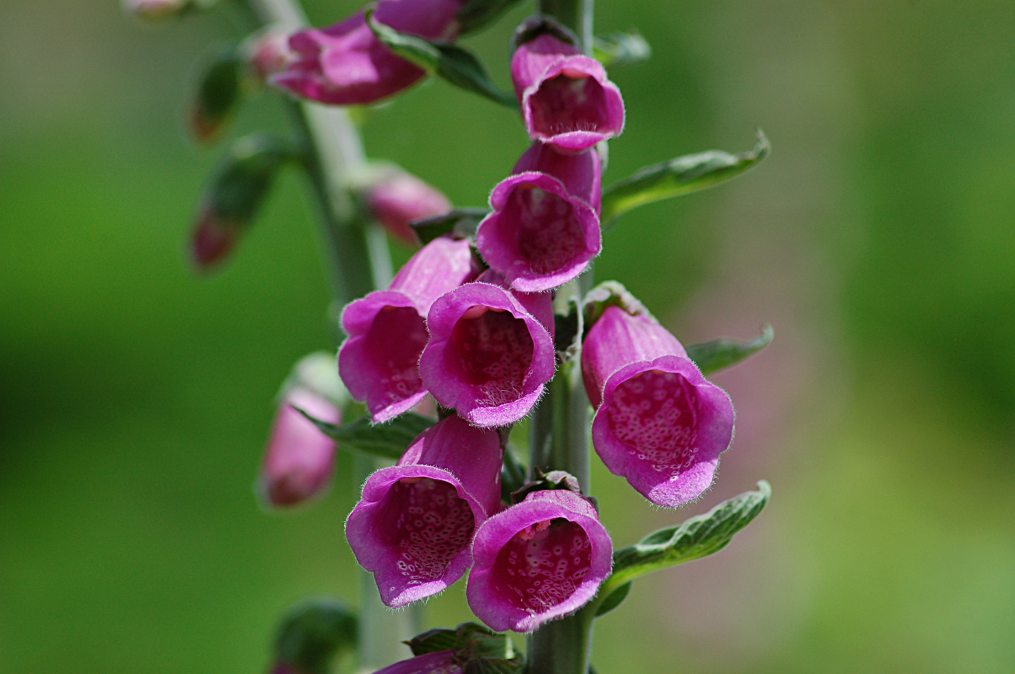
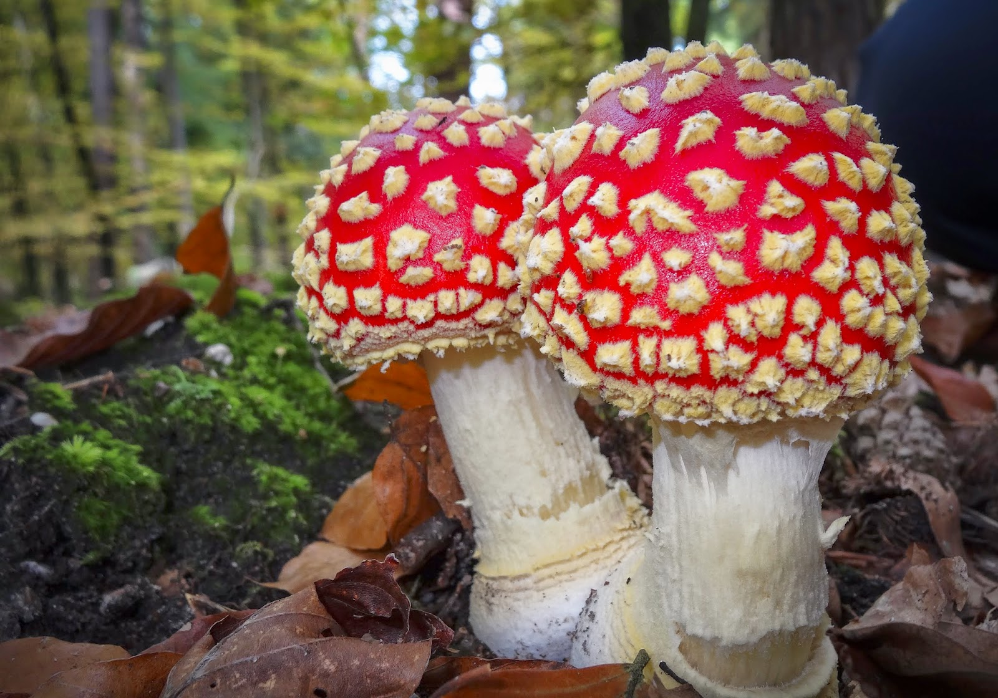
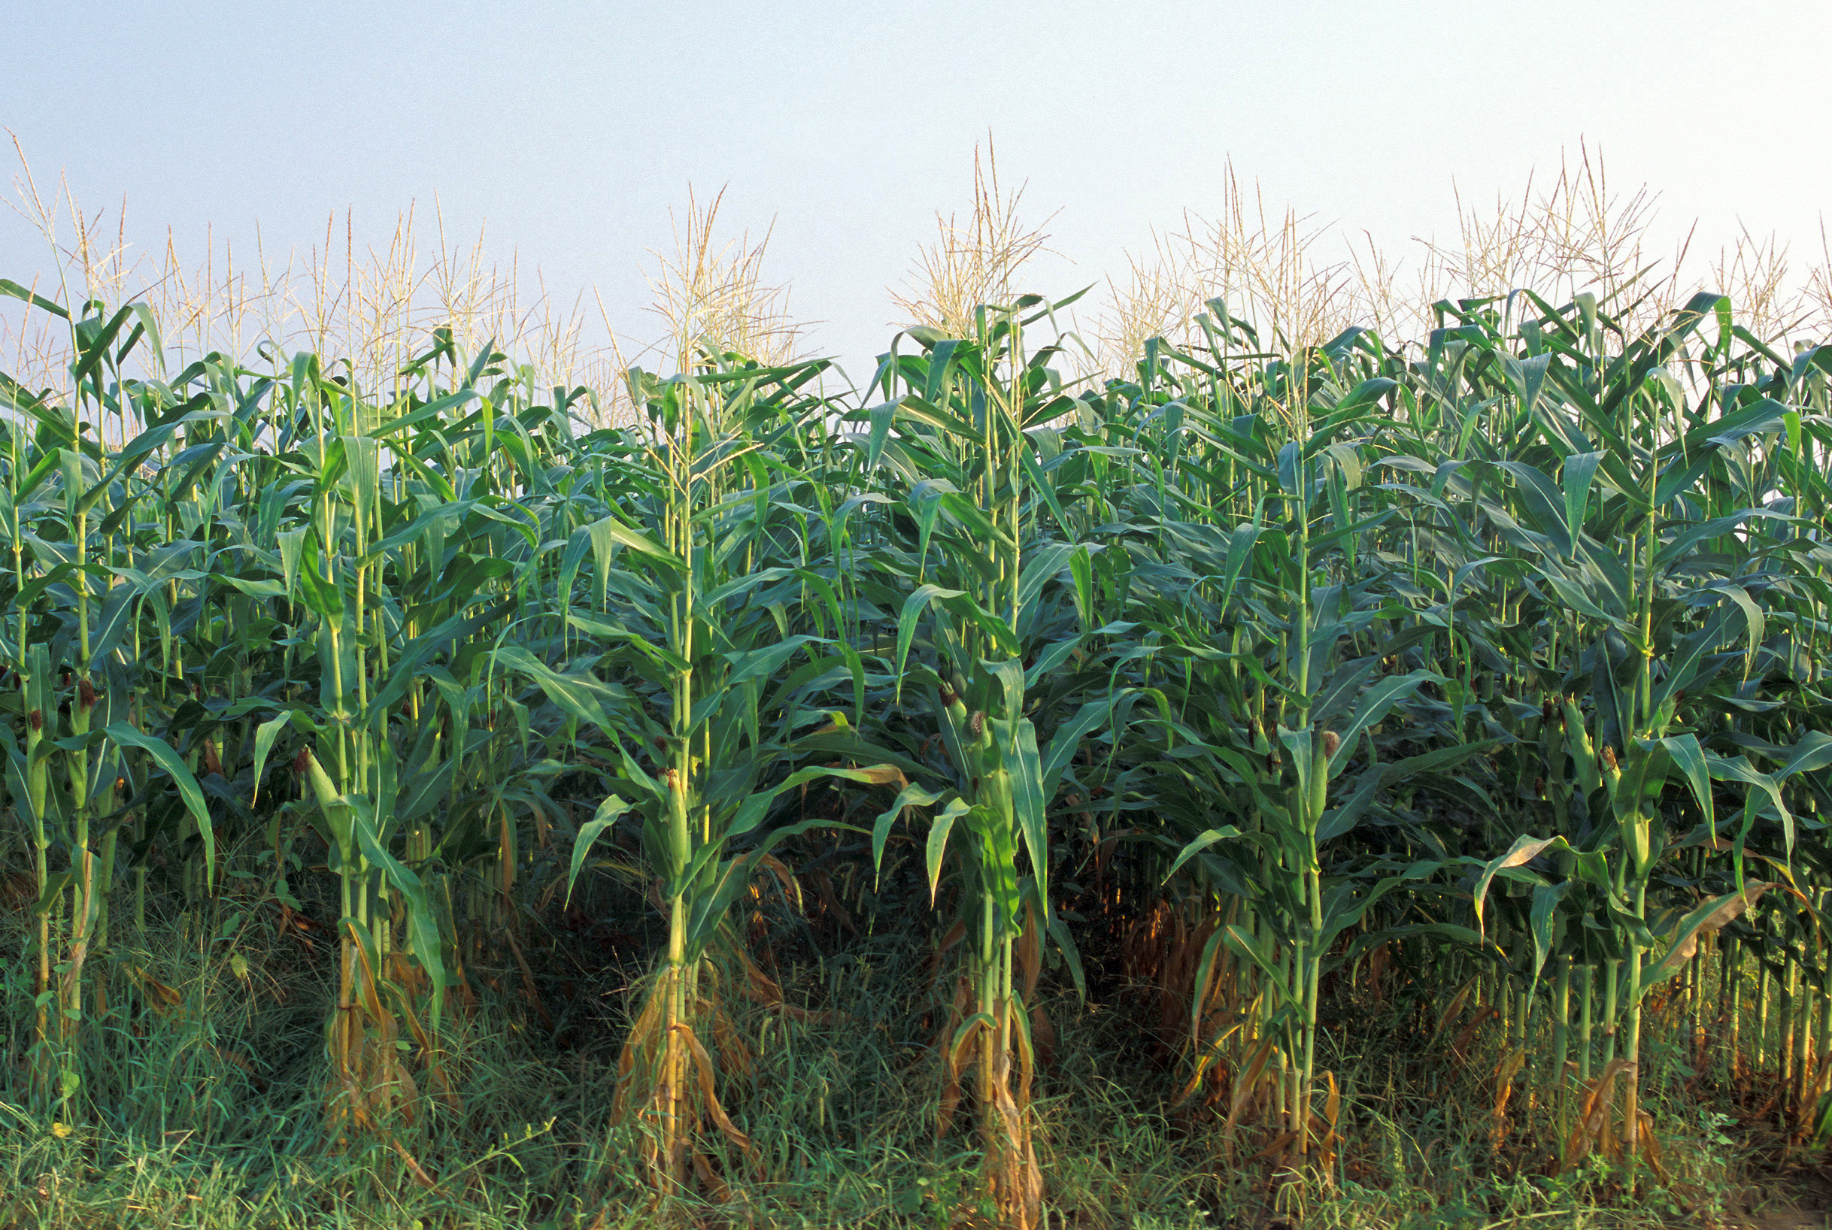
Preserving genetic diversity
Increases the chances of finding new things like:
Drugs
Antibiotics
Bio fuels
New resistant crops

Slide 40
Calculating Genetic Biodiversity:
The proportion of polymorphic genes can be calculated using the following formula:
Proportion of polymorphic gene loci = Total number of Polymorphic Gene Loci ÷ Total number of all gene loci (x100%)
The greater the proportion of polymorphic gene loci, the greater the genetic biodiversity within a species.

Slide 41

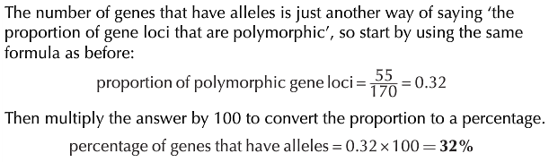
Calculating genetic diversity
Worked examples:

Slide 42





Slide 43
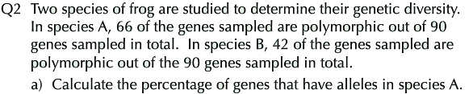



Slide 44
Additional questions

Slide 45
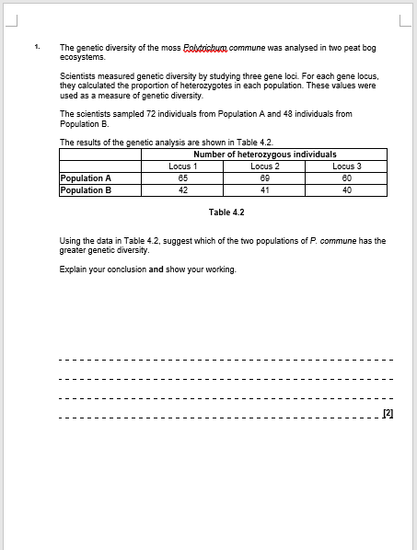
Additional questions

Slide 46
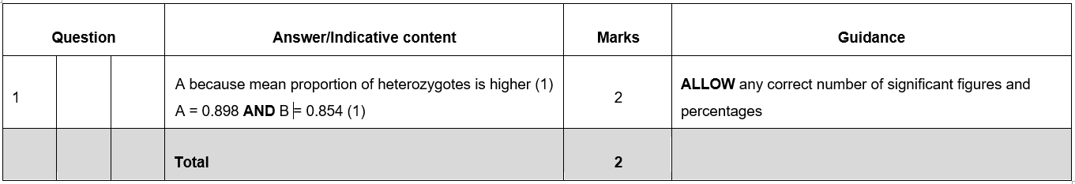

Slide 47
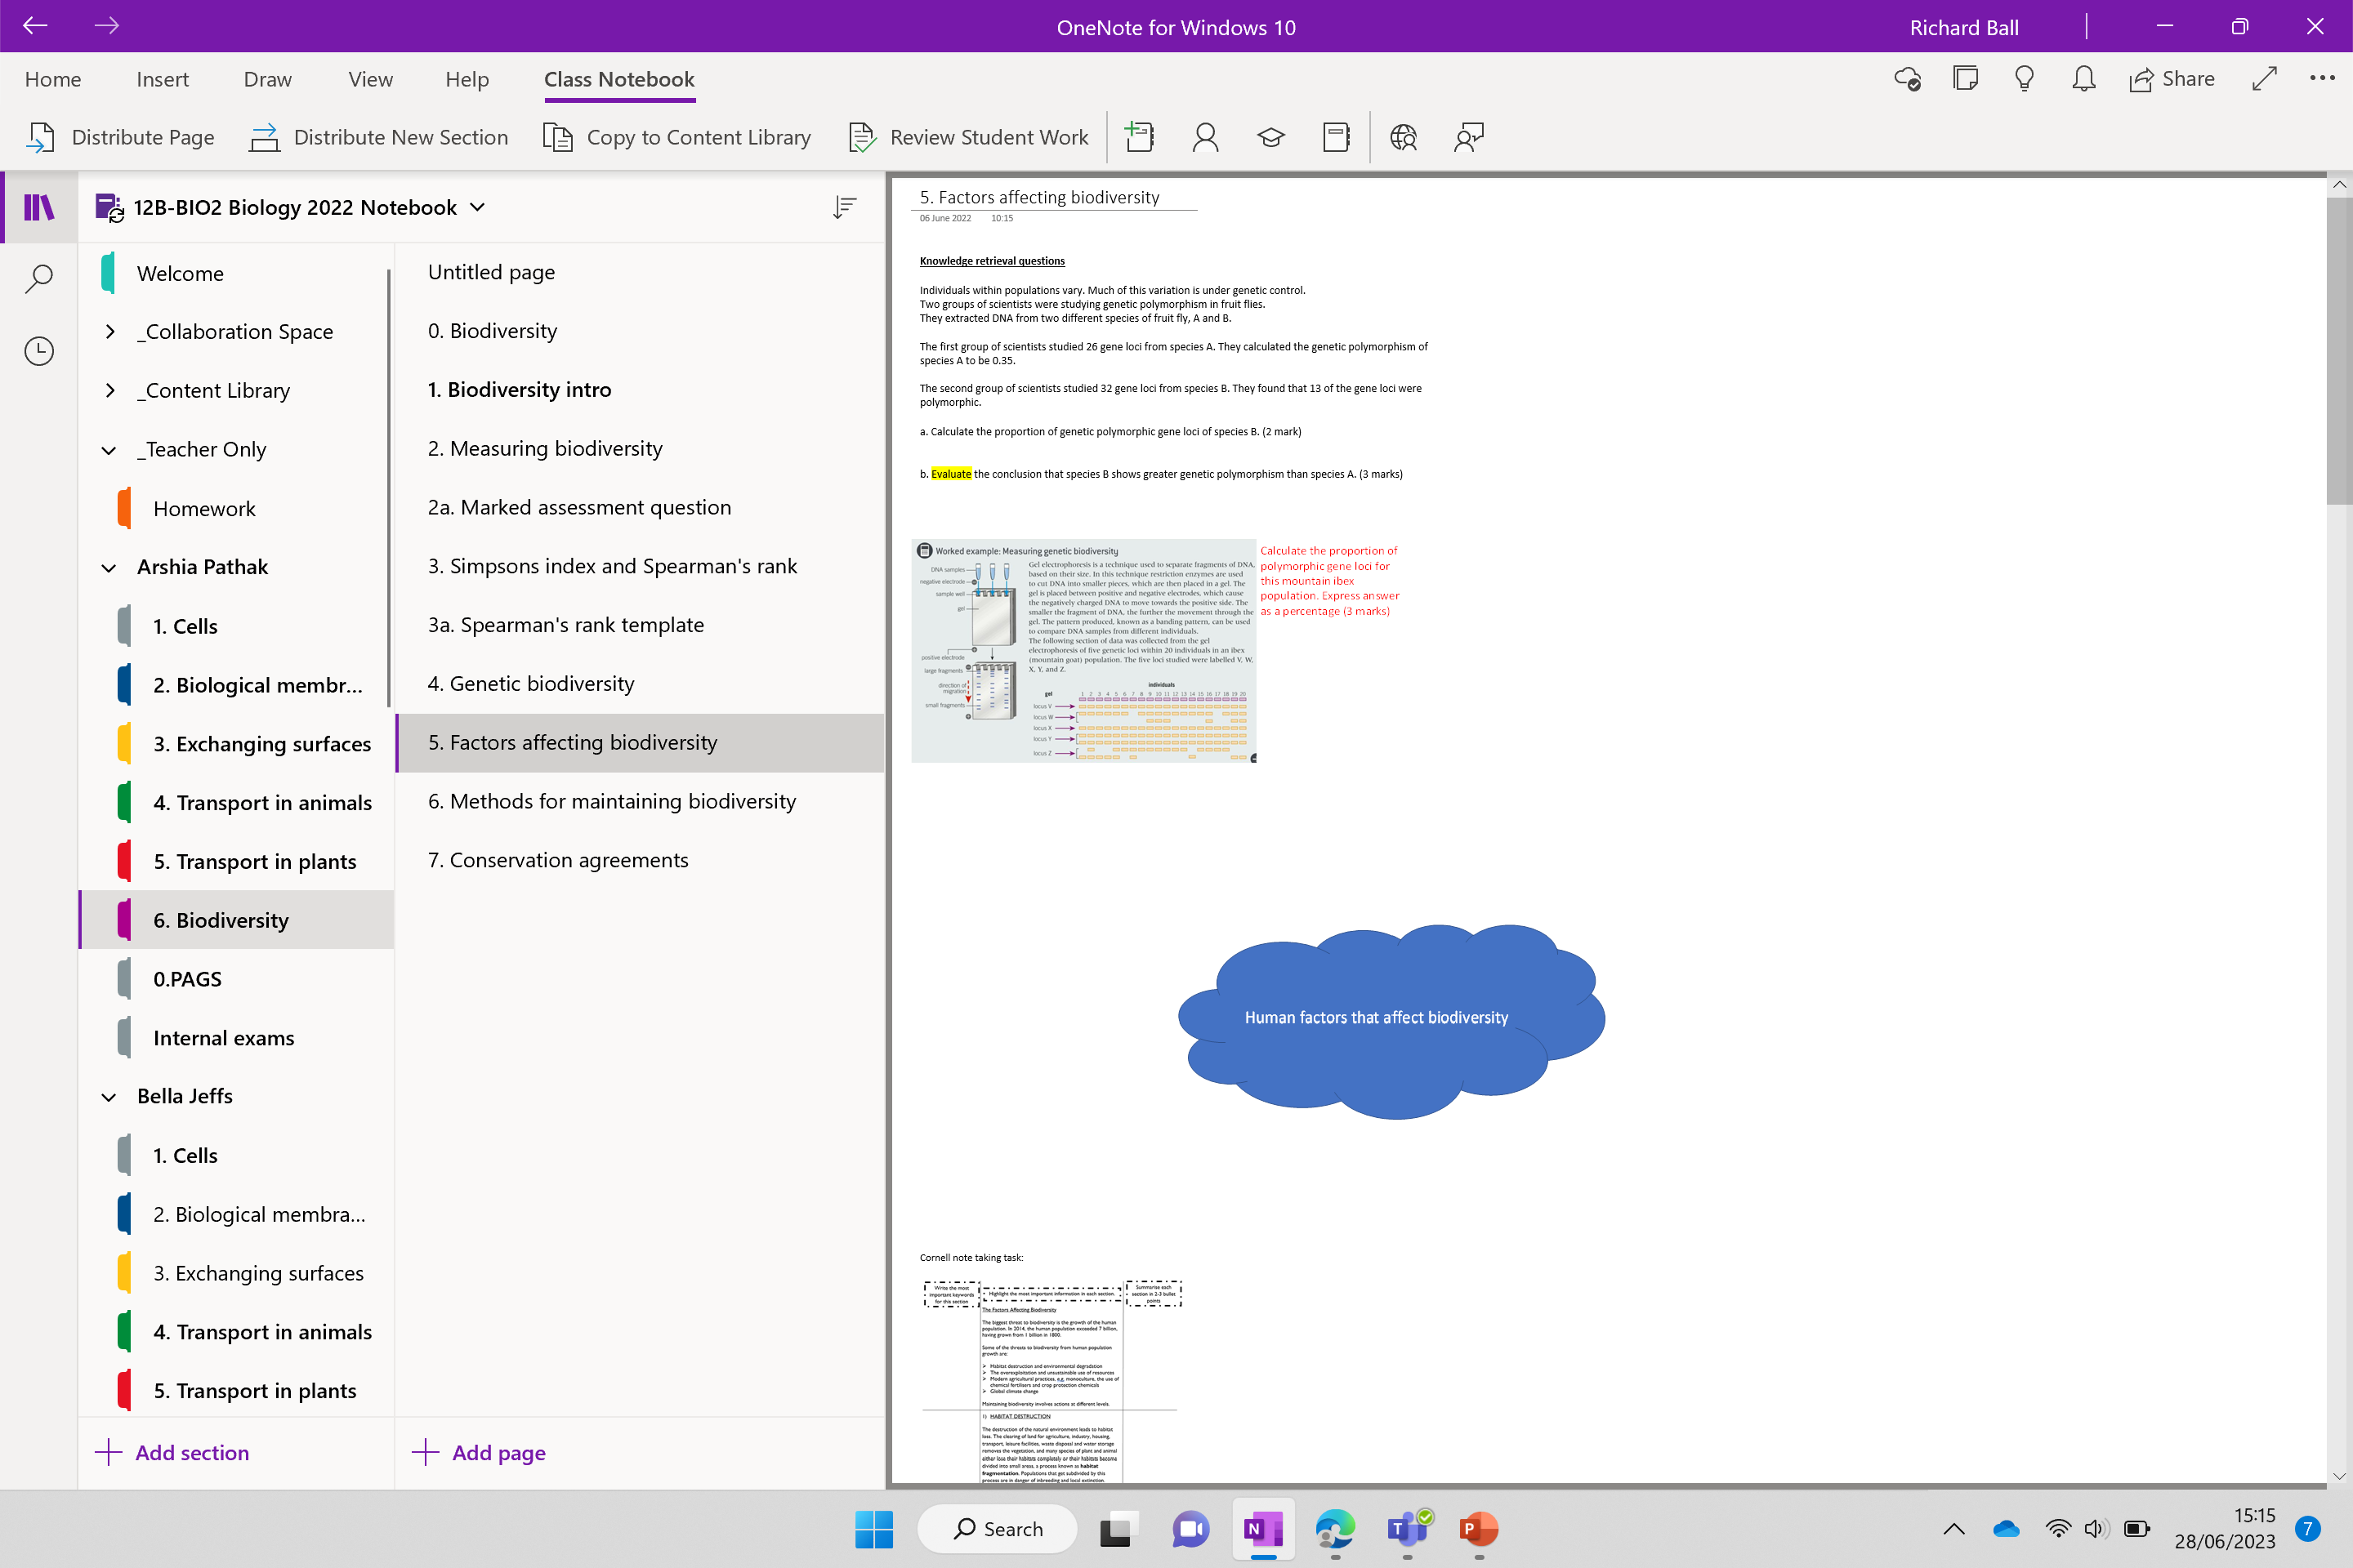

Slide 49
Golgi apparatus
gi

Slide 50
Spearman's rank
‘s

Slide 51
nucleotide
leo

Slide 52
Sweep nets

Slide 53
Simpsons index

Slide 54
Frame quadrat

Slide 55
Final slide

Slide 56
Histone
e

