Slide 1
Forces and Their Effects
Paper 2

Slide 2
9.1 Interaction of Objects
Key Q
What are contact and non contact forces?
Key Term | Definition
Forces | A push or pull that acts on an object due to the interaction with another object. It is a vector quantity.
Contact Forces | A force that acts when objects are physically touching.
Non-Contact Forces | A force that acts when objects are not touching.

Slide 3
9.1 Interaction of Objects
Gravitational Force
Friction
Air Resistance
Electromagnetic Force
Magnetic Force
Water Resistance
Tension
Normal Contact Force
Contact Force | Non-Contact Force
Friction Air Resistance Water Resistance Tension Normal Contact Force | Gravitational Force Electromagnetic Force Magnetic Force

Slide 4
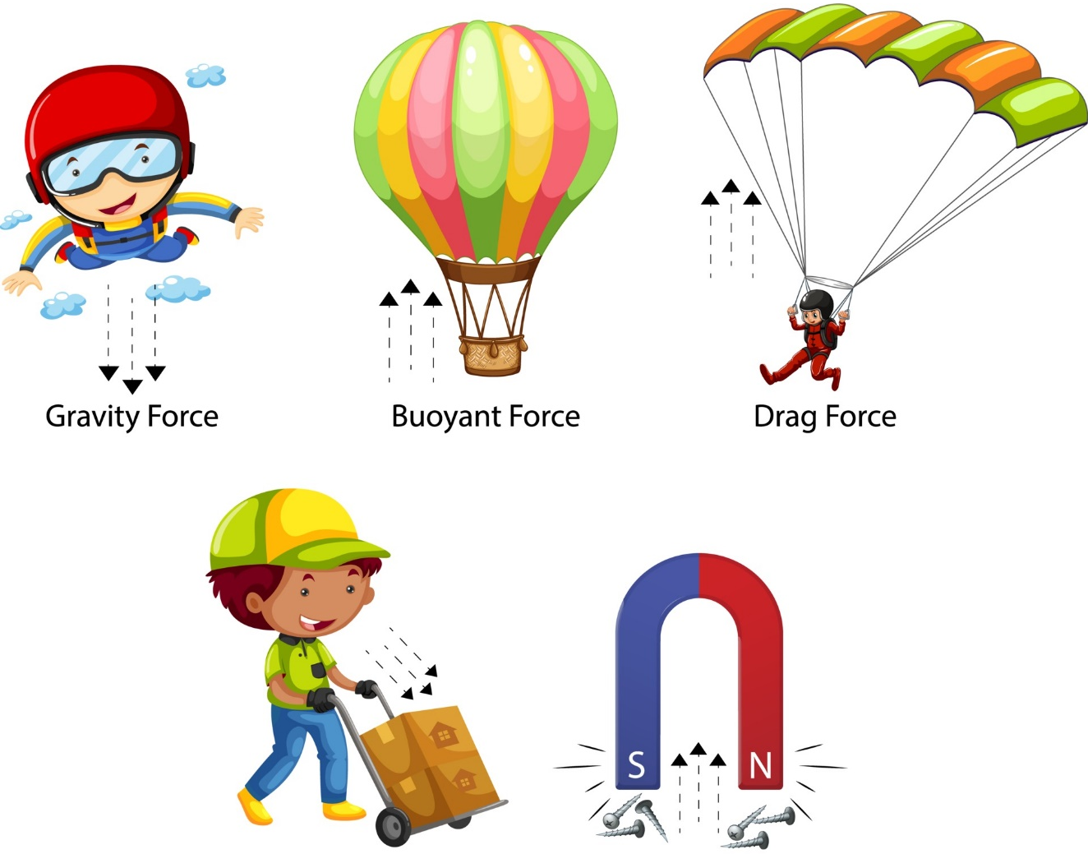
9.1 Interaction of Objects
Key Q
When do forces arise?
Forces arise from an interaction between two objects.
When two objects interact both experience a force.

Slide 5
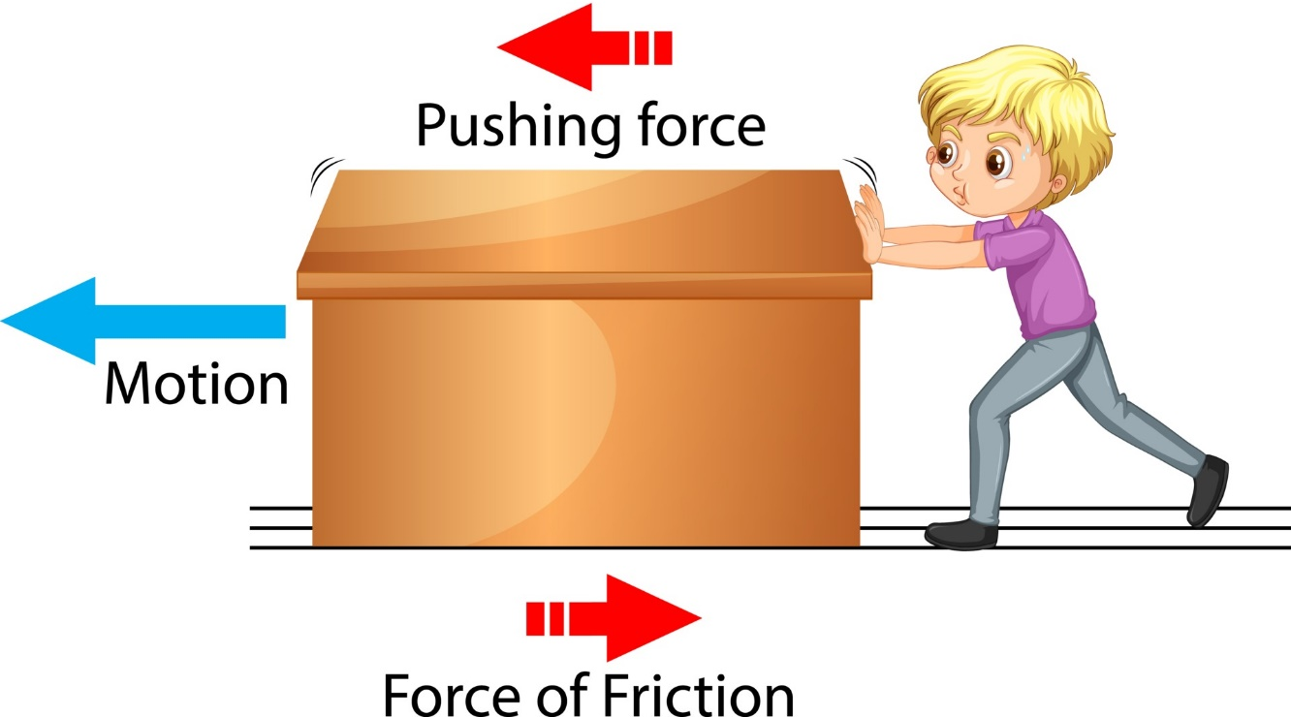
9.1 Interaction of Objects
Key Q
What is friction?
Friction is the interaction between two surfaces that slide relative to each other.
Each surface experiences a force in the direction that prevents relative movement.

Slide 6
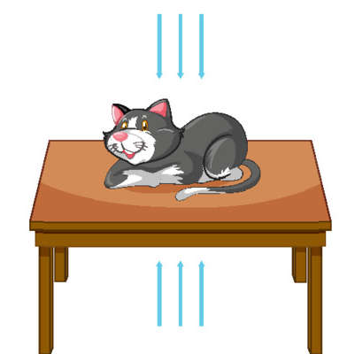
9.1 Interaction of Objects
Key Q
What is normal contact force?
There is an interaction between an object and the surface it is resting on.
The object pushes down on the surface and the surface pushes up on the object with an equal force.
This is called normal contact force.

Slide 7

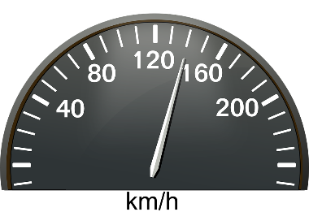
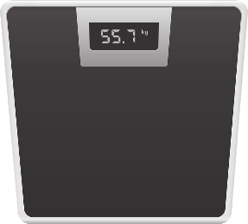
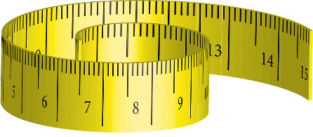

9.2 Vectors and Scalars
Key Q
What are scalar and vector quantities?
Key Term | Definition
Scalar Quantity | A quantity with magnitude (size) only.
Vector Quantity | A quantity with both magnitude (size) and direction.

Slide 8
9.2 Vectors and Scalars
Key Q
How can we model vector quantities?
The length of the arrow represents the magnitude.
A vector quantity may be represented by an arrow.
The direction of the arrow represents the direction of the vector quantity.
Key Term | Definition
Scalar Quantity | A quantity with magnitude (size) only.
Vector Quantity | A quantity with both magnitude (size) and direction.

Slide 9
9.2 Vectors and Scalars
Momentum
Acceleration
Force
Mass
Displacement
Density
Temperature
Energy
Weight
Distance
Velocity
Speed
Scalar Quantities | Vector Quantities
Mass Density Temperature Energy Distance Speed | Momentum Acceleration Force Displacement Weight Velocity

Slide 10
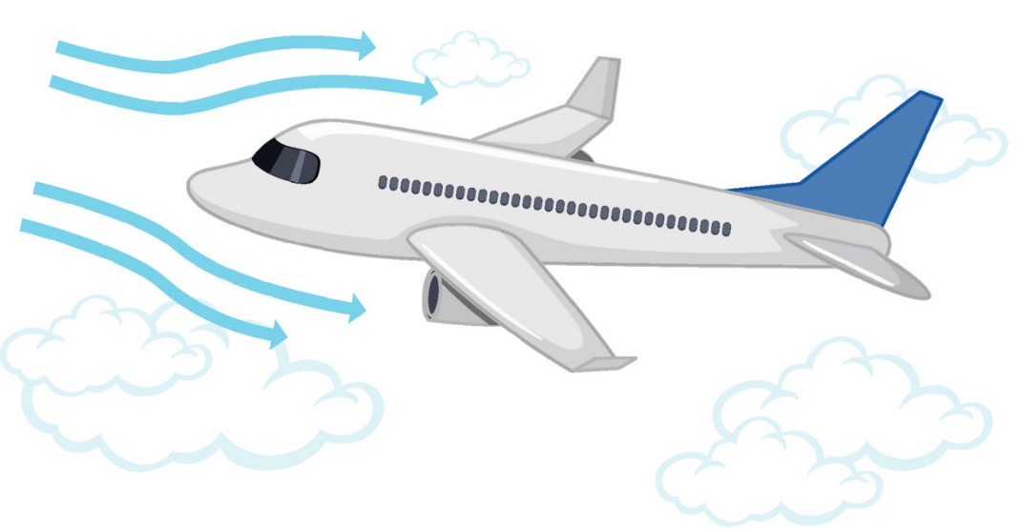
9.3 Vector Diagrams
Key Q
What are resultant forces?
1000N forward force from engine.
750N
Key Term | Definition
Resultant Force | The single force that could replace all the forces acting on an object.

Slide 11
9.3 Vector Diagrams
Key Q
What is a resultant force and how are they calculated?
1000N forward force from engine.
750N
If the forces are acting in the same direction add them together.
If the forces are acting in opposite directions subtract one away from the other.

Slide 12
9.3 Vector Diagrams
Key Q
What is a resultant force and how are they calculated?
1000N forward force from engine.
750N
Resultant force acting on this plane:
-
=
1000N
750N
250N

Slide 13
9.3 Vector Diagrams
Task
Determine the resultant force for the following scenarios.
Scenario | Calculation | Resultant Force | Direction of Resultant Force
A parachutist has a weight of 70N and air resistance as they fall is 18N. | 70-18 | 52 | Down
A force of 18N and 12N both act to the right. | 18 +12 | 30 | Right
A car has a forward force of 100N. Air resistance is 22N and friction between the car and road is 32N. | 100 – (22+32) | 46 | Forward
A book is pushed to the left with a force of 8N. Friction is 2N. | 8 - 2 | 6 | Left

Slide 14

9.3 Vector Diagrams
Key Q
Resistance acts in the opposite direction of motion
Air Resistance
What forces act on objects?
Within your exams you need to be prepared to identify and label forces acting on objects.
For example:
Weight acts downwards on an isolated object
Weight

Slide 15
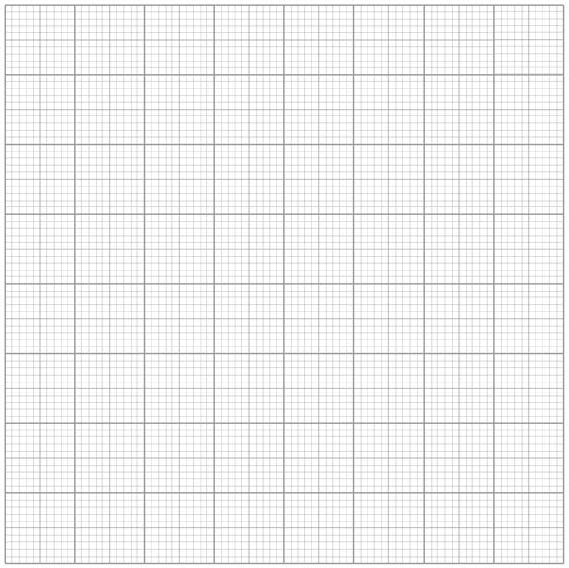
9.3 Vector Diagrams
Key Q
How do we calculate the resultant force if forces are not acting on a straight line? (H Only)
You would draw a vector diagram to find the magnitude and direction of the force.
60N
Resultant Force
Measure the length of this force using a ruler to determine the size of the force.
A skydiver jumps from an aeroplane.
There is a resultant vertical force of 300 N on the skydiver.
There is a horizontal force from the wind of 60 N.
304-308N
300N

Slide 16
9.4 and 9.5 Forces on Objects
Key Q
What are free body force diagrams?
Air Resistance
A free body diagram models the forces acting on an object.
The object can be shown as a box or a dot.
The forces are shown as thin arrows pointing away from the box or dot
Weight
It helps to have the arrows drawn to scale where possible.

Slide 17
9.6 and 9.7 Moment of a Force
Key Q
What are moments?
Moment of a Force = Force x Distance
M = F x d
Newton -Metres
Metres
Nm
Force
m
N
Key Term | Definition
Moment | A turning effect of a force.

Slide 18
9.7 Moment of a Force
Calculate moment when force is 750N and distance is 135cm.
Convert Units | 135cm = 1.35m
Write down the formula. | Moment = Force x Distance
Substitute Values | Moment = 750 x 1.35
Do the Maths | Moment = 1,012.5
Round and add units. | 1013Nm
Usually 1 mark for this.
Substitute before you do any rearranging or calculations 1 mark for doing this.
Answer to 2 s.f which is the same as the values in the qu.

Slide 19
9.7 Moment of a Force
Calculate moment of a force when... | Force is 10N and distance is 10cm | Force is 1.2kN and distance is 0.8m | Force is 24N and distance is 15cm.
Convert Units | 10cm = 0.1m | 1.2kN = 1200N | 15cm = 0.15m
Write down the formula. | M = F x d | M = F x d | M = F x d
Substitute Values | M = 10 x 0.1 | M = 1200 x 0.8 | M = 24 x 0.15
Do the Maths | 1 | 960 | 3.6
Round and add units. | 1Nm | 960Nm | 3.6Nm

Slide 20
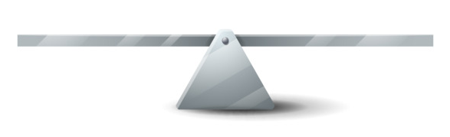
9.8 Moment of a Force
Key Q
What are the rotational forces acting on this object?
..is equal to the sum of the anti clockwise moment.
The sum of the clockwise moment…

Slide 21
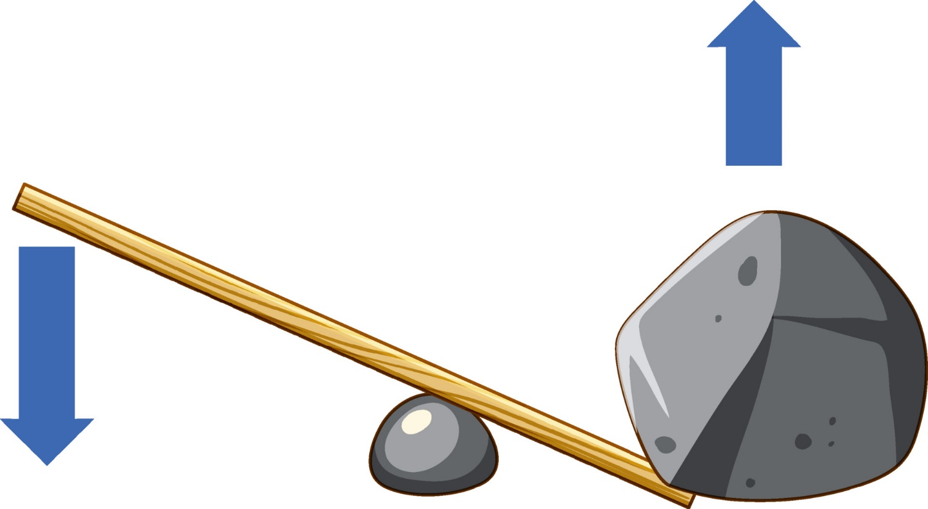
9.9 Gears
Key Q
What are levers?
Levers are a simple machine consisting of a pivot, effort and load.
Load
Effort
Pivot

Slide 22

9.9 Gears
Key Q
What are gears?
Gears are toothed wheels used with other axles at different speeds.
As one gear turns, the other gear must also turn.
Where the gears meet, the teeth both move in the same direction.

Slide 23
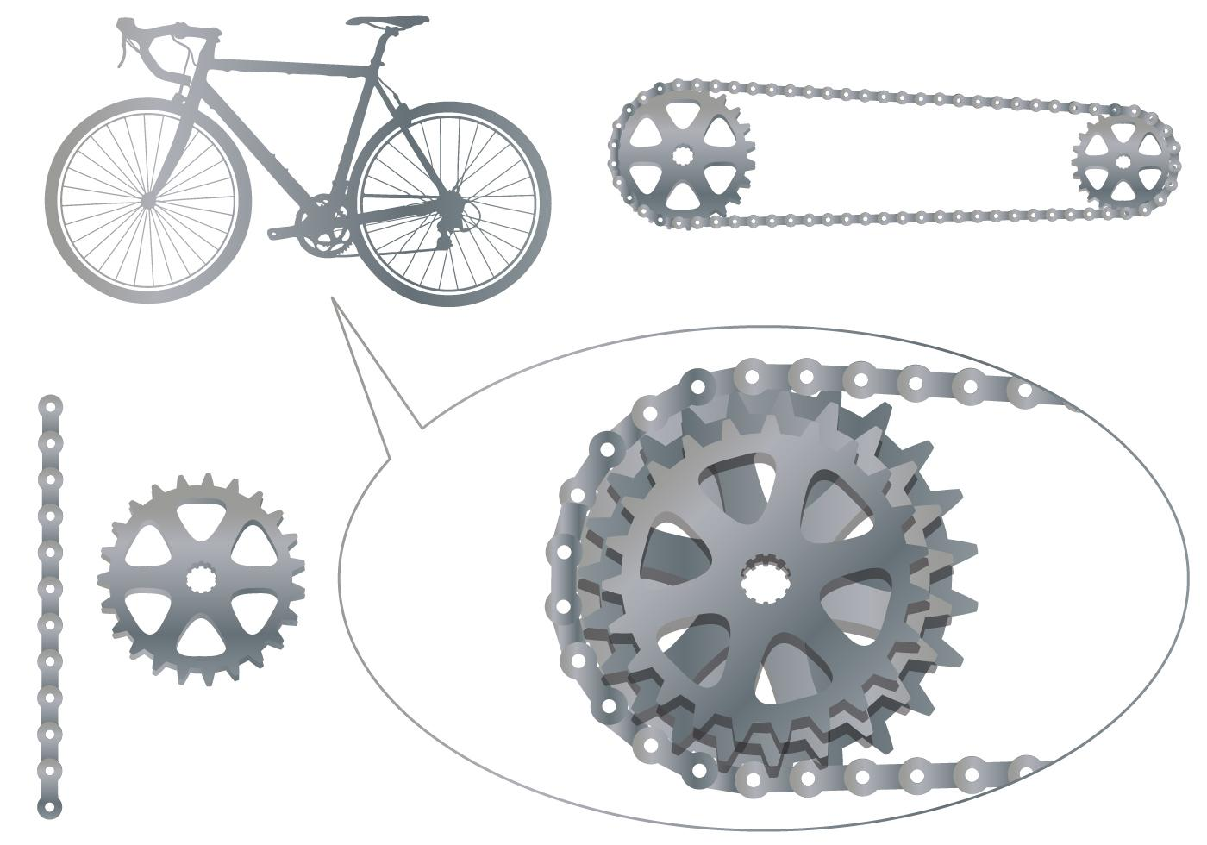
9.9 Gears
Key Q
The forces acting on the teeth are identical for both gears, but their moments are different
What are gears?
If the driven gear is made larger it will rotate more slowly but with a greater moment.
If the driven gear is made smaller, it will rotate more quickly but with a smaller moment.

Slide 24
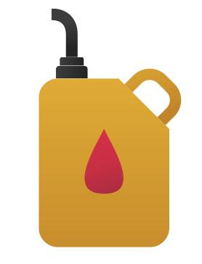
9.10 Reducing Unwanted Transfers
Key Q
How can we reduce unwanted energy transfers?
We can use lubricants
This reduces friction between surfaces.
Surfaces will now slide over each other more smoothly.
Less energy will be wasted as heat.

