Slide 1
Energy: Forces Doing Work
Paper 2

Slide 2

8.1 Energy Store Changes
Scenario:
An object projected upwards.
Energy Changes
Kinetic Energy
Gravitational Potential Energy

Slide 3
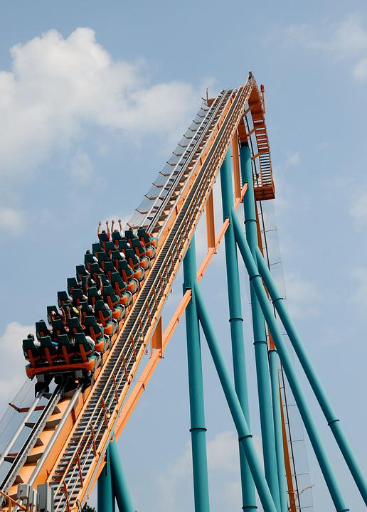
8.1 Energy Store Changes
Scenario:
An object projected up a slope.
Energy Changes
Kinetic Energy
Gravitational Potential Energy

Slide 4
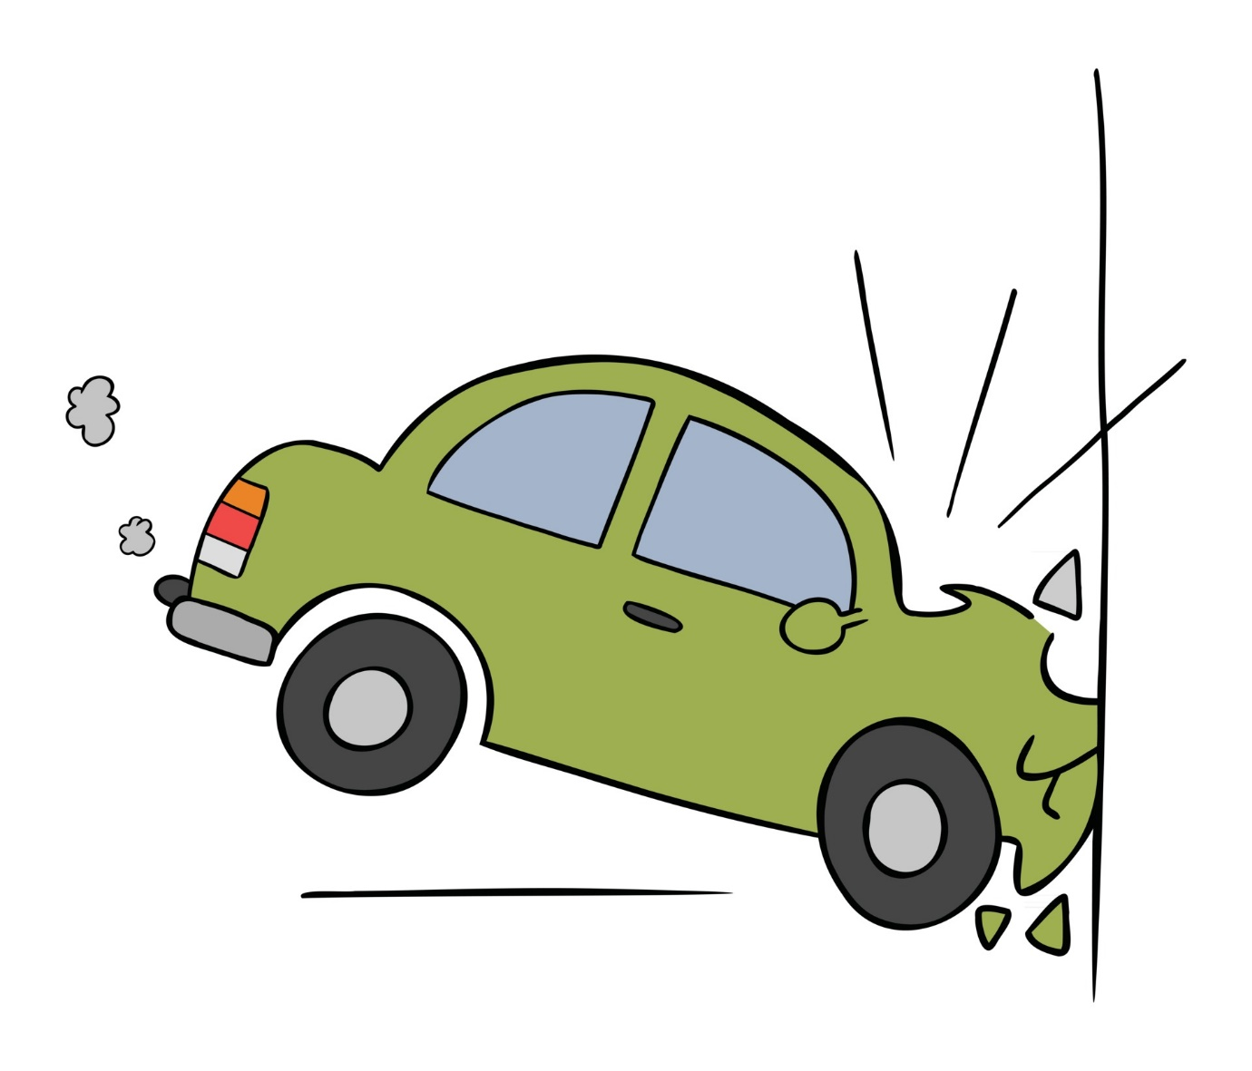
8.1 Energy Store Changes
Scenario:
A moving object hitting an obstacle
Energy Changes
Kinetic Energy
Sound Waves
and
Thermal Energy

Slide 5
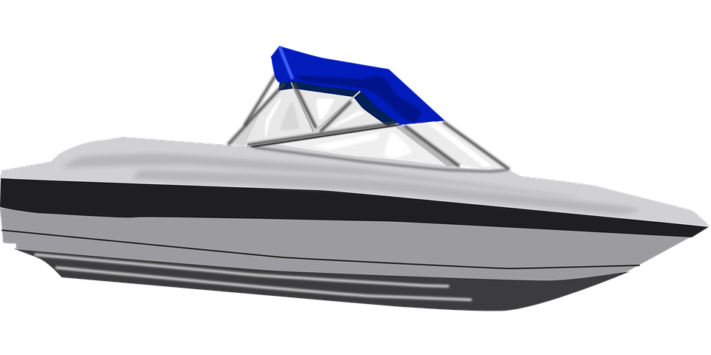
8.1 Energy Store Changes
This depends on the context!
Scenario:
An object accelerated by a constant force.
Energy Changes
Chemical Energy
Kinetic Energy

Slide 6

8.1 Energy Store Changes
This depends on the context!
Scenario:
An object accelerated by a constant force.
Energy Changes
Gravitational Potential Energy
Kinetic Energy

Slide 7
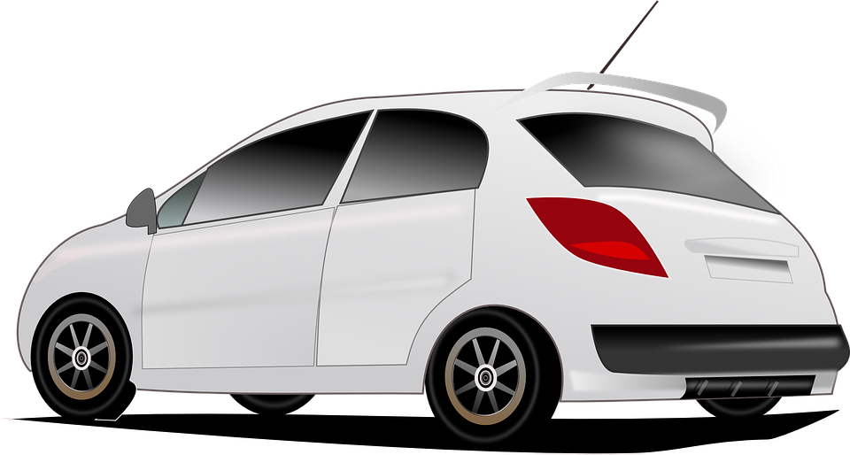
8.1 Energy Store Changes
Scenario:
A vehicle slowing down.
Energy Changes
Kinetic Energy
Thermal Energy

Slide 8

8.1 Energy Store Changes
Scenario:
Bringing water to a boil in an electric kettle.
Energy Changes
Electric Current
Thermal Energy

Slide 9

8.2 Energy Transfers
Key Q
How can we represent energy transfers as diagrams?
Sankey diagrams start off as one arrow that splits into two or more points.
This shows how all of the energy in a system is transferred into different stores.
The width of the arrow is drawn to scale to show the amount of energy.

Slide 10
8.3 Energy Transfers
Key Q
What is the law of the conservation of energy?
This means that when ever there are energy transfers in a closed system, that there is no net change to the total energy.
Energy In = Energy Out
Key Term | Definition
Law of the Conservation of Energy | A law that states that energy can be transferred usefully, stored or dissipated, but cannot be created or destroyed.

Slide 11
8.4 Energy Transfers
Key Q
How can energy in a system be changed?
Energy is transferred by one for the different energy pathways:
Mechanical Work
This is when a force moves an object.
This is when a charge moves due to potential difference.
Electrical Work
Occurs due to temperature differences
Heating
Radiation
Energy transferred as a wave

Slide 12
8.5 Work Done
Key Q
What is work done?
When a force causes an object to move through a distance work is done on the object.
A force does work on an object when the force causes a displacement of the object.
SO
Key Term | Definition
Work Done | Energy transferred by a force.

Slide 13
8.5 Work Done
Key Q
What is work done?
One joule of work is done when a force of one newton causes displacement of one metre
1 Joule = 1 Newton-metre
Work done against the frictional forces acting on an object will cause a rise in the temperature of the object.

Slide 14
8.6 Work Done
Key Q
Newtons
What is work done?
N
Work Done = Force x Distance
W = F x s
Joules
Metres
J
m
You may need to convert units!

Slide 15
8.7 Energy Change & Work Done
Worked Example
Calculate force when work done is 320kJ and the distance is 8m
Convert Units | 320kJ = 320,000
Write down the formula. | W = F x s
Substitute Values | 320,000 = F x 8
Do the Maths | F = 320,000 / 8
Round and add units. | 40,000J
Usually 1 mark for this.
Substitute the values into your equation
Units included.

Slide 16
8.7 Energy Change & Work Done
Task
Complete the calculations for the following questions.
 | Calculate work done when force is 72N and the distance is 150cm | Calculate force when work done is 1.3kJ and the distance is 2.7m | Calculate distance when work done is 92J and force is 0.1kN
Convert Units | 150cm = 1.5m | 1.3kJ = 1300J | 0.1kN = 100N
Write down the formula. | W = F x s | W = F x s | W = F x s
Substitute Values | W = 72 x 1.5 | 1300 = F x 2.7 | 92 = 0.1 x s
Do the Maths | W = 108 | F = 1300 / 2.7 =481.481481 | s = 92 / 0.1
Round and add units. | 108J | 481.5N | 920m

Slide 17

8.8 Gravitational Potential Energy
Key Q
What is gravitational potential energy?
Key Term | Definition
Gravitational Potential Energy | The energy stored in an object at a height.

Slide 18
8.8 Gravitational Potential Energy
Key Q
What is the equation that you would use to calculate gravitational potential energy?
Newtons per kilogram
You may need to convert units!
N/kg
Gravitational Potential Energy = Mass x Gravitational Field Strength x Height
E_{p} = m x g x h
Joules
Metres
Kilograms
J
m
kg

Slide 19
8.8 Gravitational Potential Energy
Key Q
What is the equation that you could use to calculate weight?
Weight = Mass x Gravitational Field Strength
You could be given weight in N. To find GPE multiply this by height.

Slide 20
8.8 Gravitational Potential Energy
Worked Example
A 350g book is lifted 2.8m when gravitational field strength is 9.8N/kg. Calculate the GPE.
Convert Units | 350g = 0.35kg
Write down the formula. | E_{p} = m x g x h
Substitute Values | E_{p} = 0.35 x 9.8 x 2.8
Do the Maths | E_{p} = 9.604
Round and add units. | 9.6J
Usually 1 mark for this.
Substitute before you do any rearranging. 1 mark for doing this.
Show each step that you do. 1 mark available here.
Answer to 2 s.f which is the same as the values in the qu.

Slide 21
8.8 Gravitational Potential Energy
Worked Example
Calculate mass when a block is raised 7.21m and have 1.10kJ of GPE. Gravitational field strength is 9.8N/kg(5)
Convert Units | 1.1kJ = 1100J
Write down the formula. | E_{p} = m x g x h
Substitute Values | 1100 = m x 9.8 x 7.21
Do the Maths | 1100 = m x 70.658 m = 1100 / 70.658 m = 15.5679470124
Round and add units. | 15.6kg
Usually 1 mark for this.
Substitute before you do any rearranging. 1 mark for doing this.
Show each step that you do. 2 marks available here.
Answer to 3 s.f which is the same as the values in the qu.

Slide 22
8.8 Gravitational Potential Energy
Task
Complete the calculations for the following questions.
 | Calculate the GPE when height is 30cm, mass is 12kg and g is 9.8N/kg. | Calculate the GPE when height is 3.2m, mass is 888g and g is 9.8N/kg. | Calculate height when mass is 125g, g is 9.8N/kg and GPE is 320J
Convert Units | 30cm = 0.3m | 888g = 0.888kg | 125g = 0.125kg
Write down the formula. | E_{p} = m x g x h | E_{p} = m x g x h | E_{p} = m x g x h
Substitute Values | E_{p} = 12 x 9.8 x 0.3 | E_{p} = 0.888 x 9.8 x 3.2 | 320 = 0.125 x 9.8 x h
Do the Maths | E_{p} = 35.28 | E_{p} = 27.84768 | 320 = 1.225 x h h = 320 / 1.225 h = 261.2244897959
Round and add units. | 35J | 27.8J | 261m

Slide 23

8.9 Kinetic Energy
Key Q
What is kinetic energy?
Key Term | Definition
Kinetic Energy | The energy of a moving object.

Slide 24
8.9 Kinetic Energy
Key Q
What is the equation that you would use to calculate kinetic energy?
Kilograms
kg
You may need to convert units!
Kinetic Energy = 0.5 x Mass x Speed²
E_{k} = ½ x m x v²
Joules
Metres per second
J
m/s

Slide 25
8.9 Kinetic Energy
Worked Example
A 750g book is thrown and has an initial speed of 12m/s. Calculate its kinetic energy. (4)
Convert Units | 750g = 0.75kg
Write down the formula. | E_{k} = ½ x m x v²
Substitute Values | E_{k} = ½ x 0.75 x 12²
Do the Maths | E_{k} = 0.5 x 0.75 x 144 E_{k} = 54
Round and add units. | 54J
Usually 1 mark for this.
Substitute before you do any rearranging. 1 mark for doing this.
Show each step that you do. 1 mark available here.
Answer to 2 s.f which is the same as the values in the qu.

Slide 26
8.9 Kinetic Energy
Worked Example
A 1300kg car has 1.2kJ of kinetic energy. Calculate it speed (5)
Convert Units | 1.2kJ = 1200J
Write down the formula. | E_{k} = ½ x m x v²
Substitute Values | 1200 = ½ x 1300 x v²
Do the Maths | 1200 = 650 x v² v² = 1200 / 650 v² = 1.8461538462 v = √1.8461538462 V = 1.35873244
Round and add units. | 1.4m/s
Usually 1 mark for this.
Substitute before you do any rearranging. 1 mark for doing this.
Show each step that you do. 2 marks available here.
Answer to 2 s.f which is the same as the values in the qu.

Slide 27
8.9 Kinetic Energy
Task
Complete the calculations for the following questions.
 | Calculate kinetic energy when mass is 880g and speed is 5m/s | Calculate kinetic energy when mass is 450g and speed is 9m/s | Calculate speed when a toy has 88J of kinetic energy and a mass of 120g
Convert Units | 880g = 0.88kg | 450g = 0.45kg | 120g = 0.12kg
Write down the formula. | E_{k} = ½ x m x v² | E_{k} = ½ x m x v² | E_{k} = ½ x m x v²
Substitute Values | E_{k} = ½ x 0.88 x 5² | E_{k} = ½ x 0.45 x 9² | 88 = ½ x 0.12 x v²
Do the Maths | E_{k} = 0.44x 25 = 11 | E_{k} = 0.225x 81 =18.225 | 88 = 0.06x v² v² = 88 / 0.06 v² = 1,466.66667 v = √1466.66667 v = 38.2970844
Round and add units. | 11J | 18J | 38J

Slide 28

8.10 Dissipation of Energy
Key Q
What is the law of the conservation of energy?
However..
In all system changes energy is dissipated.
The energy is stored in less useful ways.
For example in this TV energy is wasted as thermal energy.

Slide 29

8.11 Mechanical Processes
Key Q
How is energy wasted in mechanical processes?
Mechanical processes become wasteful when they cause a rise in temperature.
Energy is dissipated into the surroundings as heat.

Slide 30
8.12 Power
Key Q
What is power?
Key Term | Definition
Power | The rate at which energy is transferred or the rate at which work is done.

Slide 31
8.13 Power
Key Q
What is power?
Joules
Seconds
J
s
Power = Work Done / Time
P = W / t
Watts
W
Key Term | Definition
Power | The rate at which energy is transferred or the rate at which work is done.

Slide 32
8.13 Power
Key Q
What is power?
Energy Transferred = Work Done
So…
Key Term | Definition
Power | The rate at which energy is transferred or the rate at which work is done.

Slide 33
8.13 Power
Key Q
What is power?
Joules
Seconds
J
s
Power = Energy Transferred/ Time
P = E / t
Watts
W
Key Term | Definition
Power | The rate at which energy is transferred or the rate at which work is done.

Slide 34
8.13 Power
Key Q
What is power?
Power = Work Done / Time
Power = Energy Transferred / Time
An energy transfer of 1 joule per second is equal to a power of 1 watt!
Key Term | Definition
Power | The rate at which energy is transferred or the rate at which work is done.

Slide 35
8.13 Power
The electrical generators can provide 1.5 x 10⁹W of power for a maximum of 5 hours. Calculate the energy transferred. (3)
Usually 1 mark for this.
Convert Units | 5 hours = 5 x 60 x 60 = 18,000s
Write down the formula. | P = E / t
Substitute Values | 1.5 x 10⁹ = E / 18,000
Do the Maths | E = 1.5 x 10⁹ x 18,000 = 2.7 x 10¹³
Round and add units. | 2.7 x 10¹³ J
Substitute before you do any rearranging. 1 mark for doing this.
Show each step that you do.
Answer to 2 s.f which is the same as the values in the qu.

Slide 36
8.14 Watts and Joules
Key Q
What is the relationship between watts and joules?
Watts (W)
Joules (J)
One watt is equal to one joule per second (J/s)

Slide 37
8.15 Efficiency
Key Q
This could either be in watts or joules.
What is efficiency?
Efficiency = Useful Output / Total Input
Key Term | Definition
Efficiency | The fraction of the energy supplied which is transferred in a useful form.

Slide 38
8.15 Efficiency
The total power input to the solar cell is 2.4 W when the efficiency is 0.20. Calculate the useful power output of the solar cell. (3)
Convert Units | -
Write down the formula. | Efficiency = Useful Output/Input
Substitute Values | 0.2 = Useful Output/ 2.4
Do the Maths | Useful Output = 0.2 x 2.4
Round and add units. | 0.48W
Substitute before you do any rearranging. 1 mark for doing this.
Answer to 2 s.f which is the same as the values in the qu.

