Slide 1
Astronomy
Paper 1

Slide 2
7.1 Weight
Key Q
What is the equation that you would use to calculate weight?
Weight = Mass x Gravitational Field Strength
W = m x g
Newtons
Newtons per kilogram
Kilograms
N
N/kg
kg
Key Term | Definition
Weight | The force acting on an object due to gravity.

Slide 3
7.1 Weight
Key Q
What is the gravitational field strength on different space objects?
Space Object | Gravitational Field Strength (N/Kg) | Space Object | Gravitational Field Strength (N/Kg)
Mercury | 3.7 | Uranus | 9.0
Venus | 8.8 | Neptune | 11.7
Earth | 9.8 | Sun | 293.0
Mars | 3.7 | Moon | 1.7
Jupiter | 24.7 | Ceres | 0.27
Saturn | 10.5 | Pluto | 0.49

Slide 4
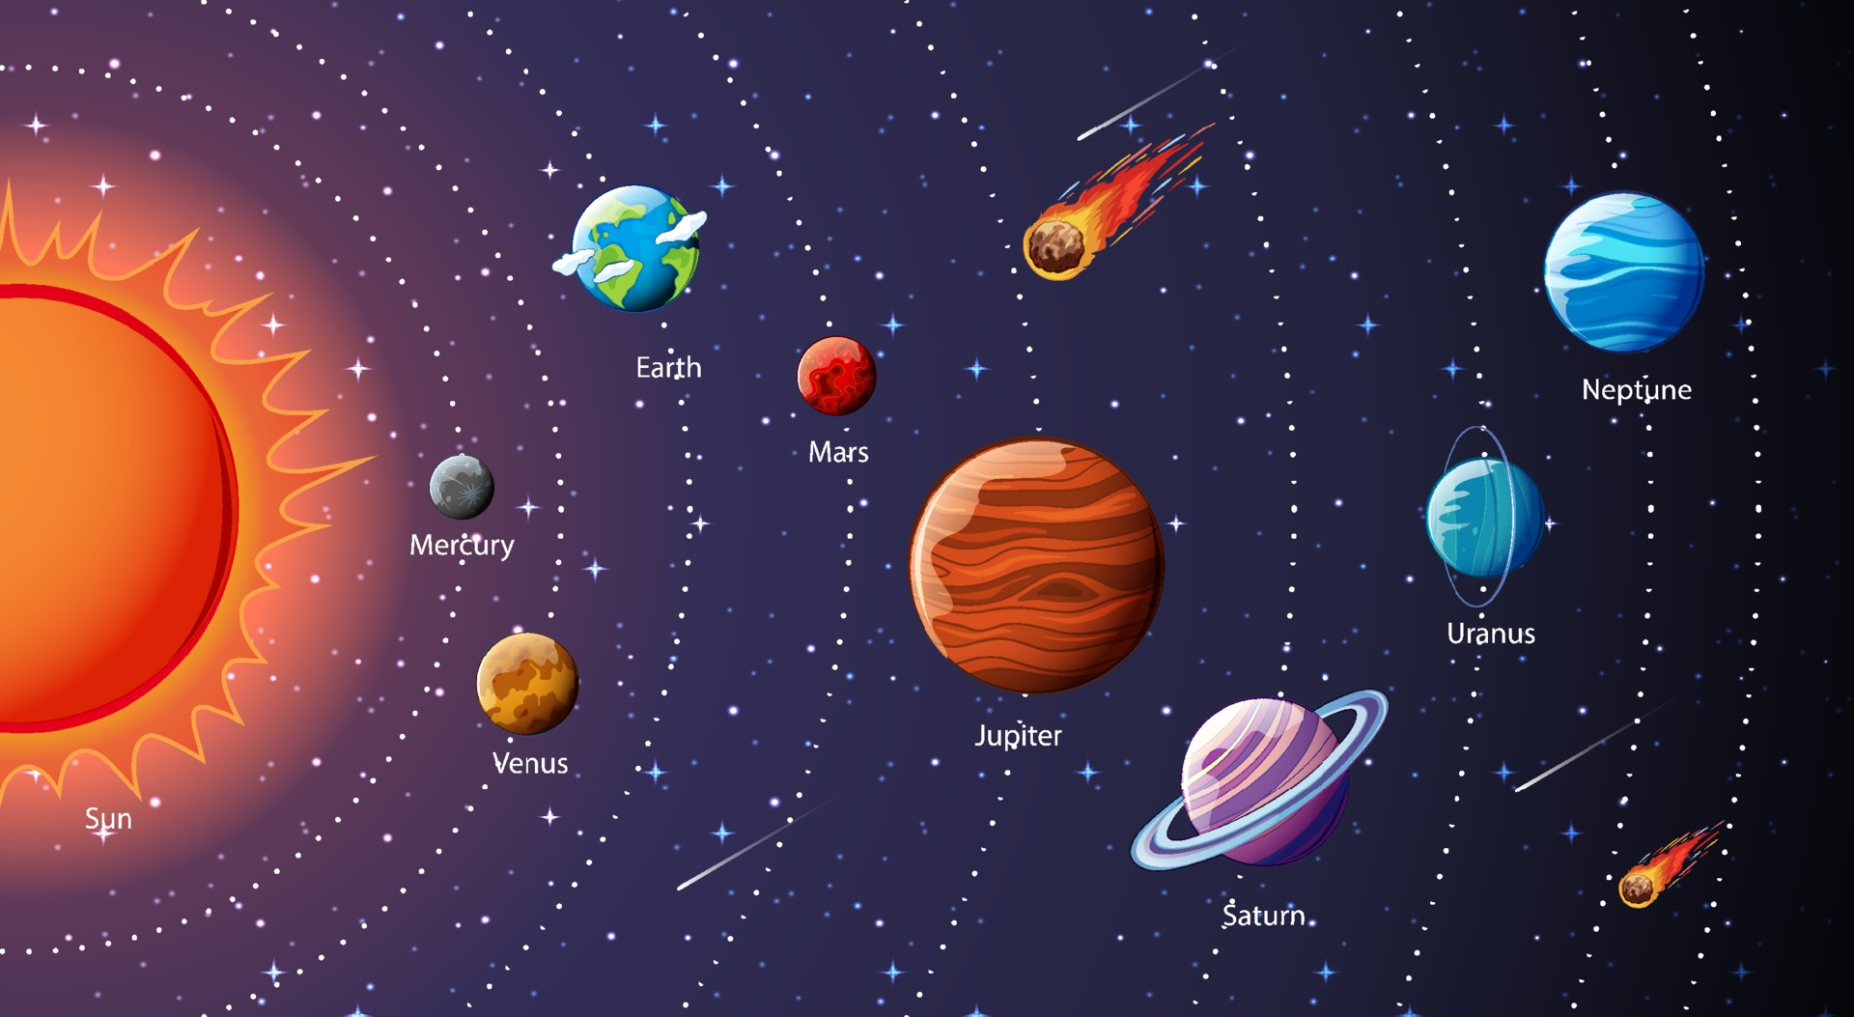
7.2 Solar System
Within our solar system there is one star, the Sun, plus the eight planets and the dwarf planets that orbit around the Sun.
Natural satellites, the moons that orbit planets, are also part of the solar system.
Our solar system is a small part of the Milky Way galaxy.
The Sun was formed from a cloud of dust and gas (nebula) pulled together by gravitational attraction.

Slide 5
7.3 Solar System
Key Q
What is the order of the planets?
Mercury
Venus
Earth
Mars
Jupiter
Saturn
Uranus
Neptune

Slide 6
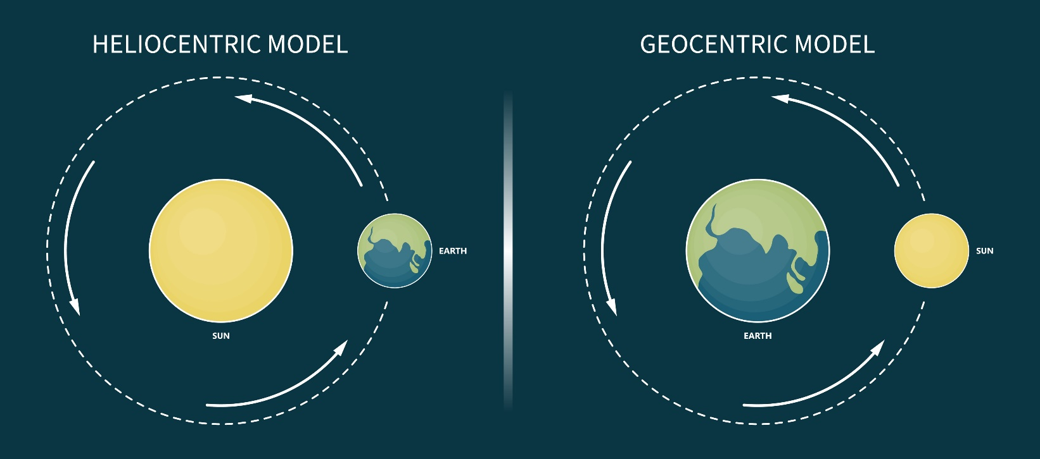
7.4 Knowledge of our Solar System
Key Q
What are our early models of the solar system like?
Early models of the solar system had the earth at the centre with everything orbiting around it.
Evidence to support this theory included:
There was only naked eye evidence
The Sun/Moon planets appear to move across the sky in the same direction each day.

Slide 7
7.4 Knowledge of our Solar System
Key Q
Why was the geocentric model replaced over time?
The model was replaced with the heliocentric model in which planets orbit the Sun.
Galileo observed moons orbiting Jupiter.
Galileo's observations was enough to disprove the geocentric method but wasn’t enough to prove the heliocentric.
Nicolas Copernicus made detailed observations with telescopes and changed the model to have the Sun at the centre of the solar system.

Slide 8
7.4 Knowledge of our Solar System
Key Q
What other ideas about our solar system have changed over time?
Planets have moons
Earth is not flat
Earth rotates
Planets aren’t wandering stars
Pluto is no longer a planet
Orbits are elliptical
More planets than previously thought
There is more than one solar system

Slide 9
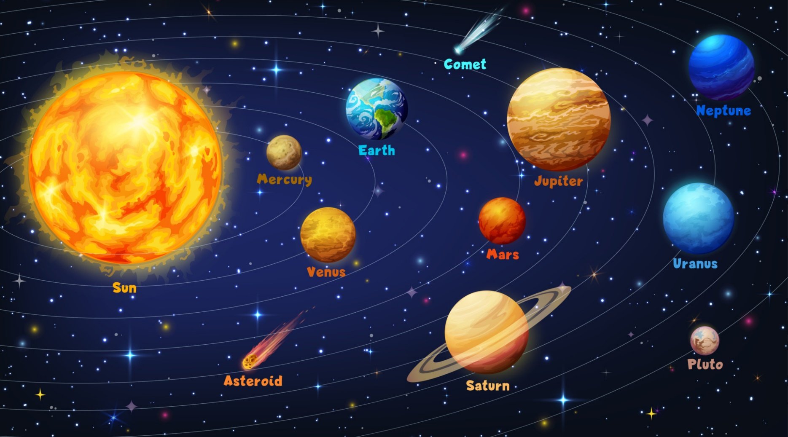
7.5 Orbits
Key Term | Description of Orbit
Planet | Elliptical orbit (almost circular)
Moon | Elliptical orbit
Artificial Satellites | Elliptical (almost 0)
Comets | Elliptical orbit

Slide 10
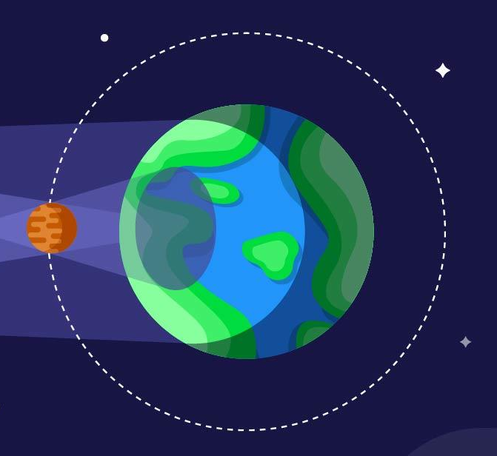
7.6 Circular Orbits
Key Q
What happens during a circular orbit?
For circular orbits the force of gravity can lead to changing velocity, but unchanged speed.
The force of gravity causes the satellite to accelerate.
The acceleration causes a change in direction.
The velocity changes because direction changes.
The speed does not change.

Slide 11
7.6 Circular Orbits
Key Q
How do objects maintain circular orbits?
Gravity provides the force that allows planets and satellites to maintain their circular orbits.
For an object to remain in a steady circular orbit around an object it needs to be going at the right speed.
This is because an object orbiting another maintains its orbit if there is a balance between its velocity and the gravitational pull of the object it is orbiting.

Slide 12
7.7 Stable Orbits
For a stable orbit, the radius must change if the speed changes.
The gravitational attraction between two objects decreases with distance.
This means that the closer the two objects are to each other, the stronger the force of gravity between them.
If the force between them is greater, a greater acceleration will occur.
The greater the acceleration, the greater the change in velocity - this causes the object to move faster.

Slide 13
7.7 Stable Orbits
For a stable orbit, the radius must change if the speed changes.
Objects in small orbits travel faster than objects in large orbits.
In order to change orbital speed, an object must change the radius of its orbit at the same time, to maintain a stable orbit.

Slide 14
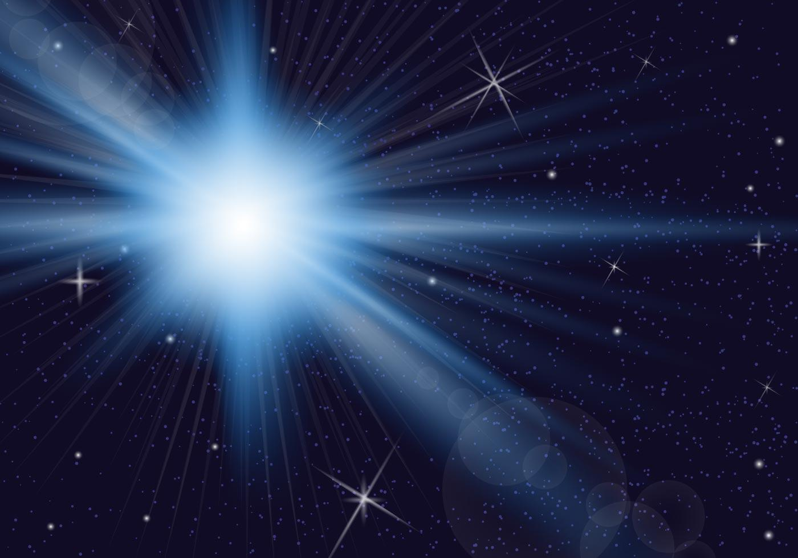
7.8 Steady State vs Big Bang
Key Q
What is the Steady State and Big Bang theory?
Big Bang theory suggests that the Universe originated from a very small, extremely hot and dense region.
The whole Universe then expanded outwards and continues to do so.

Slide 15
7.8 Steady State vs Big Bang
Key Q
What is the Steady State and Big Bang theory?
The Steady State theory says that the Universe has always existed.
It says that the Universe is expanding and constantly creating matter as the Universe expands.

Slide 16
7.9 Evidence for Big Bang
Key Q
What is our evidence for the Big Bang theory?
Further evidence for the Big Bang is the presence of cosmic background radiation.
It is believed that it is the remains of radiation produced shortly after the Big Bang which is now thinly spread across the whole Universe.

Slide 17
7.9 Evidence for Big Bang
Key Q
What is our evidence for the Big Bang theory?
Galaxies show a red-shift
But more distant galaxies show bigger red-shift.
Galaxies moving away suggest the Universe is expanding
More distant galaxies are moving away faster.
The Universe therefore was once all in one place.

Slide 18
7.10 Evidence for Big Bang
Key Q
Why is the Big Bang theory the current accepted model for the origin of the Universe?
Evidence | Does It support Big Bang theory? | Does it support the Steady State theory?
Distant galaxies have greater red shift | Yes | Yes
CMBR is everywhere | Yes | No

Slide 19
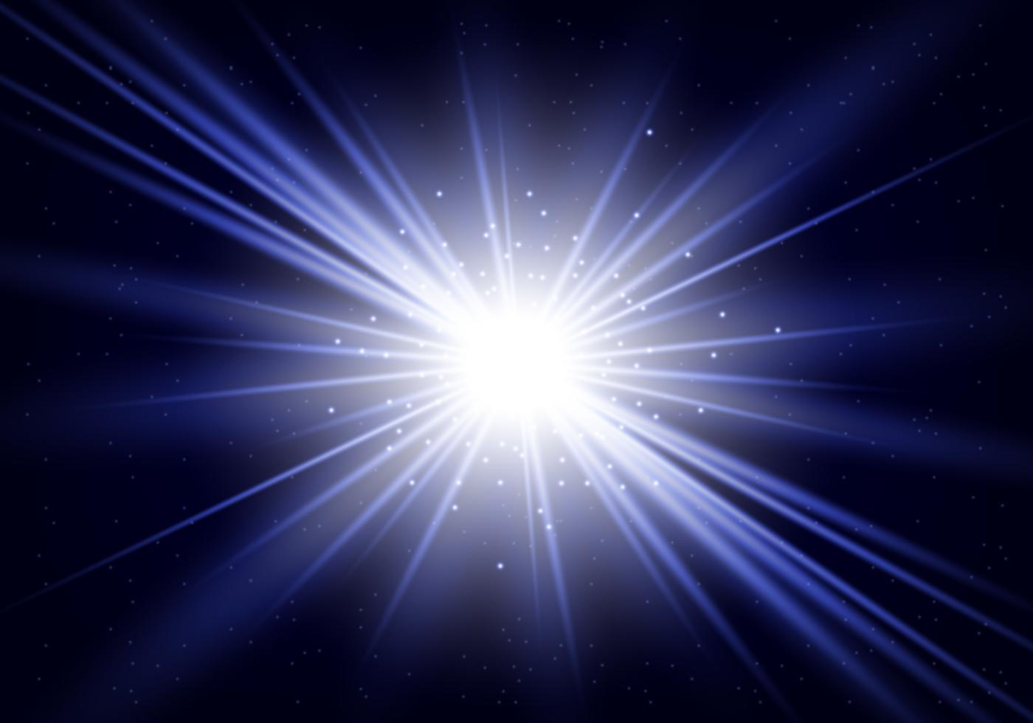
7.10 Evidence for Big Bang
Key Q
Why is the Big Bang theory the current accepted model for the origin of the Universe?
There is more evidence currently supporting it and so it is now the accepted theory.

Slide 20
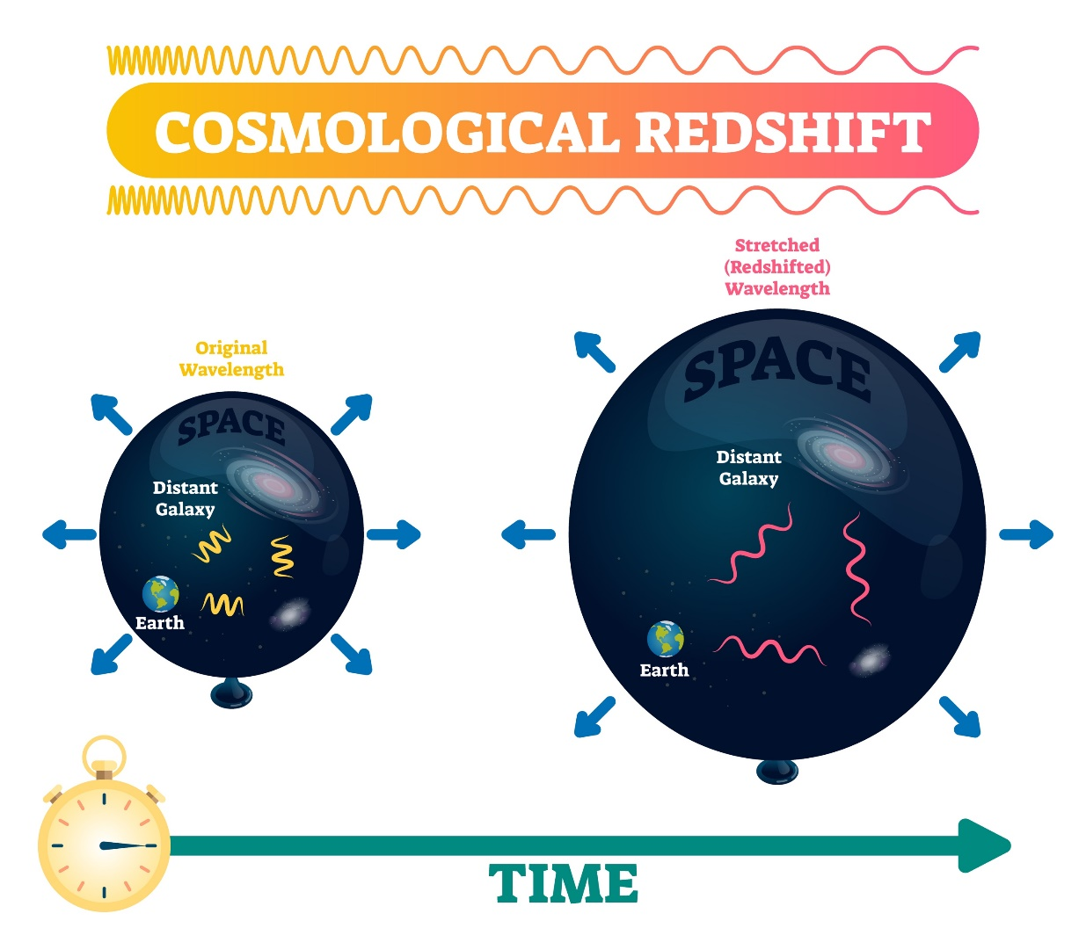
7.11 Red Shift
There is an observed increase in the wavelength of light from most distant galaxies.
The further away the galaxies, the faster they are moving and the bigger the observed increase in wavelength.
This effect is called red-shift.
The observed red-shift provides evidence that space itself (the universe) is expanding and supports the Big Bang theory.

Slide 21
7.12 Red Shift
Galaxies tend to show red shift.
Galaxies closer to our own show some red shift.
The further away from our galaxy the other is the greater the red shift observed.

Slide 22
7.13 Red Shift
Key Q
What is our evidence for the Big Bang theory?
Galaxies show a red-shift
But more distant galaxies show bigger red-shift.
Galaxies moving away suggest the Universe is expanding
More distant galaxies are moving away faster.
The Universe therefore was once all in one place.

Slide 23
7.14 Big Bang and Steady State
Key Q
How do the Big Bang and Steady State theory account for the red-shift of galaxies?
Both theories state that the universe is expanding.
This means that red-shift supports both theories.

Slide 24
7.15 CMB Radiation
Key Q
What is our evidence for the Big Bang theory?
Evidence for the Big Bang is the presence of cosmic background radiation.
It is believed that it is the remains of radiation produced shortly after the Big Bang which is now thinly spread across the whole Universe.

Slide 25

7.16 Life of a Star
Key Q
How is a star formed?
Dust and gas are pulled together due to gravitational attraction.
This is a protostar. The temperature is lower and the star emits no radiation.
As mass increases the heat and pressure will increase also.
Eventually the heat and pressure are so great that the fusion of nuclei will start to occur.
The star has now entered the main sequence part of its life.

Slide 26
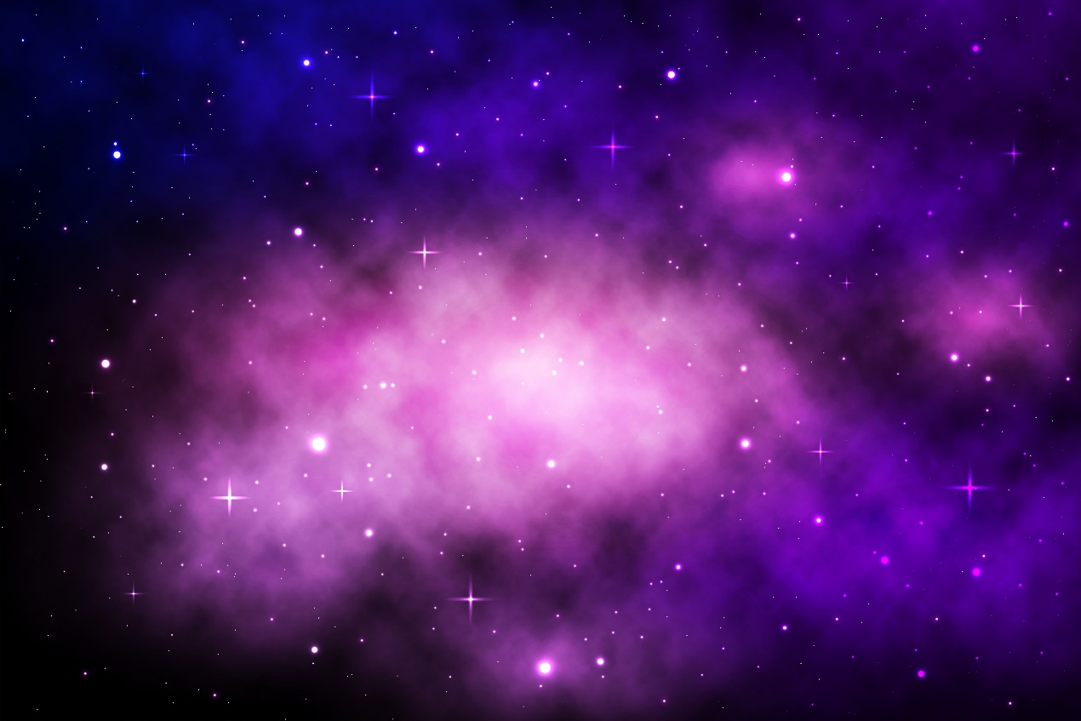
7.16 Life of a Star
Key Q
What are nebulas?
Nebulas are a cloud of gas and dust in outer space.
If the nebula is large enough nebulas can collapse under gravity to form a protostar.

Slide 27
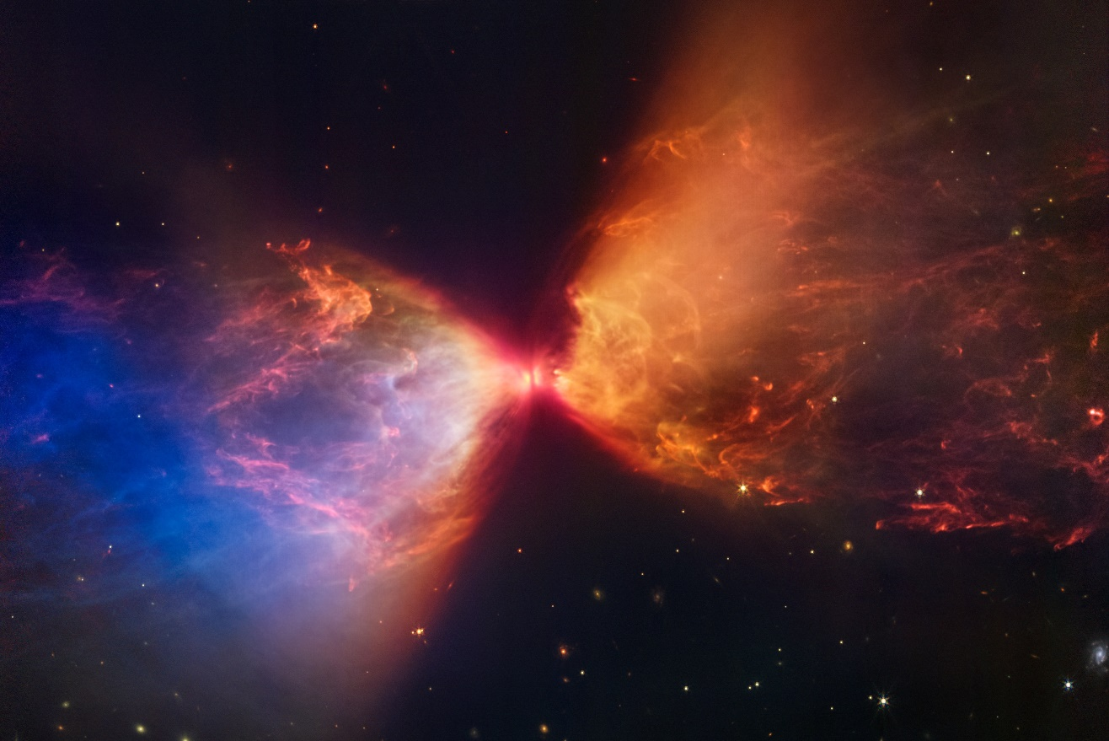
7.16 Life of a Star
Key Q
What is a protostar?
This is a star that is formed from the dust within a nebula
Fusion has not yet started in this star.

Slide 28
7.16 Life of a Star
Key Q
What will happen to our Sun once its stable period has ended?
The hydrogen fuel has been used up.
Its temperature will decrease while its luminosity increases.
It will change to a red giant.
Its temperature will increase and its luminosity will decrease.
It will become a white dwarf.
It will cool and become a black dwarf.

Slide 29
7.17 Life of a Star
Key Q
How does a star remain stable?
There are two forces which are in equilibrium.
Gravity makes the sun contract inwards.
There is also a force due to radiation pressure which making the sun expand.

Slide 30
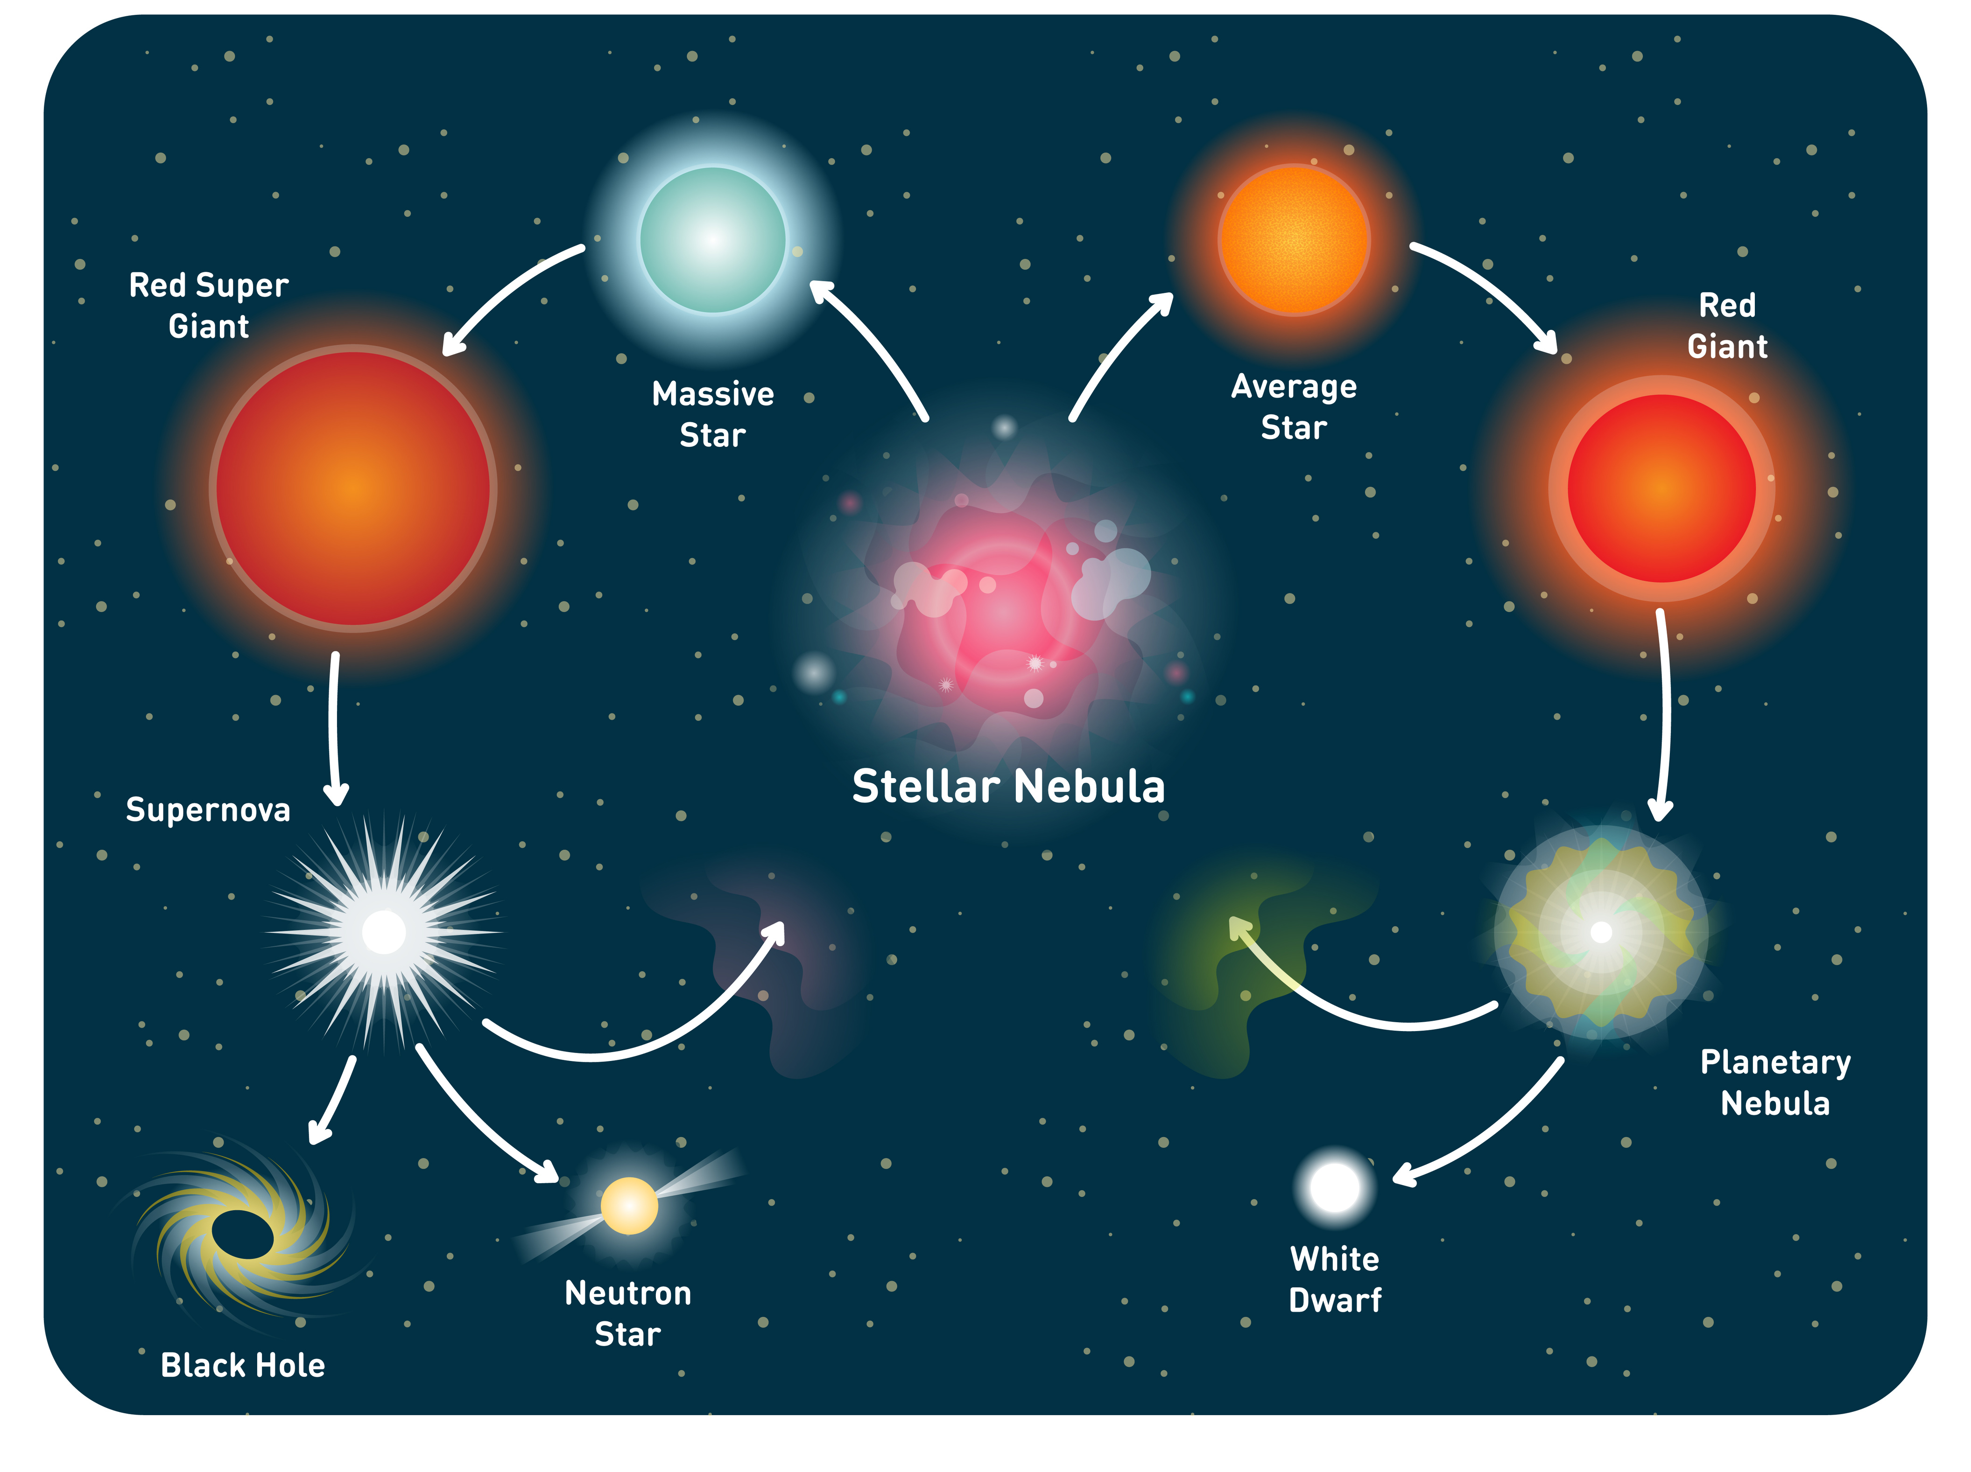
7.18 Life of a Star
A star goes through a life cycle. The life cycle is determined by the size of the star.
Fusion processes in stars produce all of the naturally occurring elements.
Elements heavier than iron are produced in a supernova.
The explosion of a massive star (supernova) distributes the elements throughout the universe.

Slide 31
7.18 Life of a Star
Key Q
What will happen to stars larger than our Sun once its stable period has ended?
The hydrogen fuel has been used up.
It will become a red supergiant
It will then explode in a supernova scattering elements across the universe
Depending on the size of the star it will then either become a neutron star…
..or a black hole

Slide 32
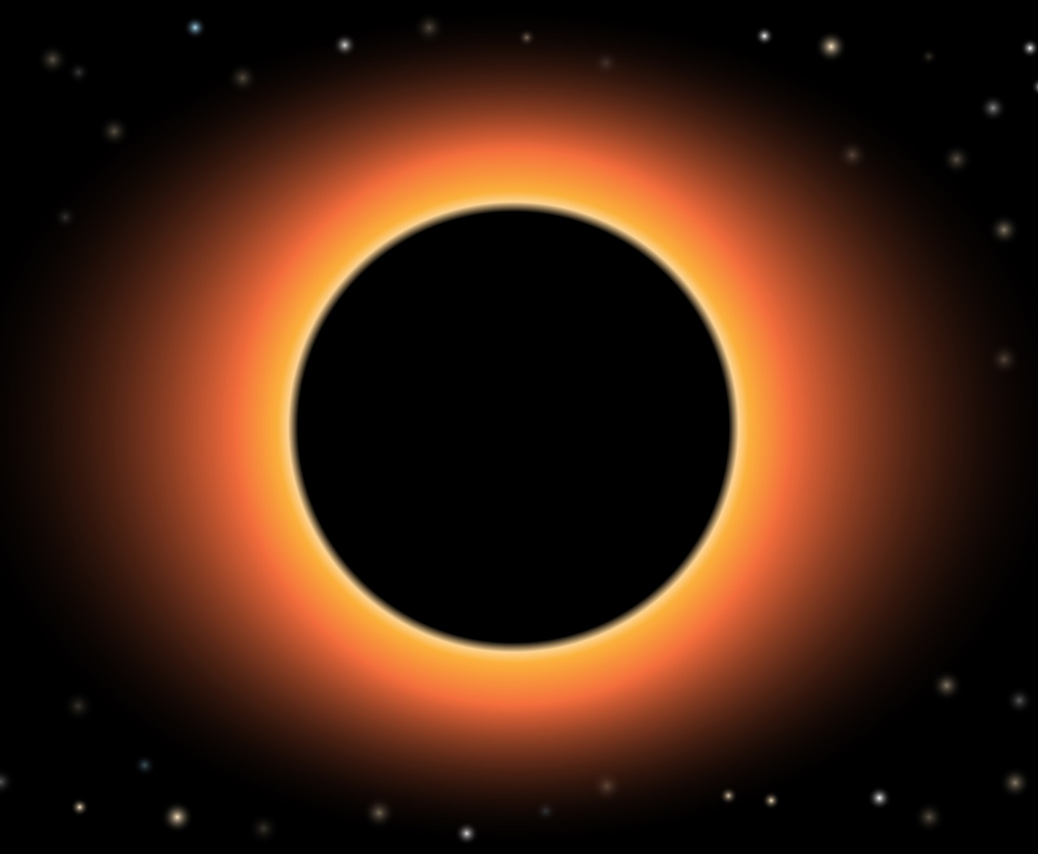
7.18 Life of a Star
Key Q
What is a black hole?
A black hole is a concentrated mass that is made when the centre of a very big star collapses.
All the matter of the star becomes squeezed into a tiny space.
Gravity is incredibly high and so not even light itself can escape its gravitational pull

Slide 33
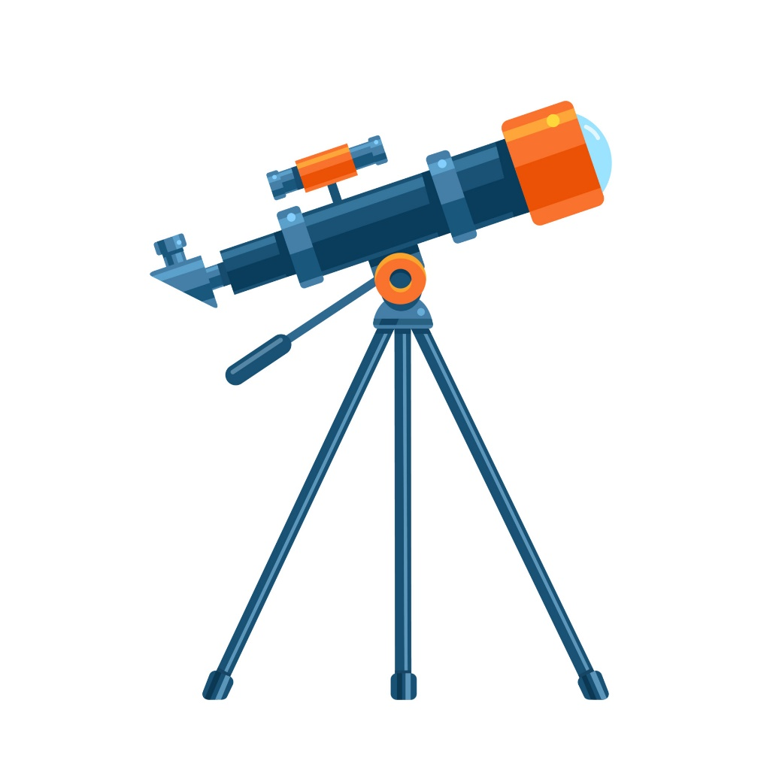
7.19 Observing the Universe
Key Q
How have the methods of observing the Universe changed over time?
First observations of our Universe were made by eye.
When the telescope was invented much more detailed observations could be made, and it became possible to see objects much further away.
Telescopes have become even more advanced so that we can see items from even further away.

Slide 34
7.19 Observing the Universe
Key Q
How have the methods of observing the Universe changed over time?
Some modern telescopes now can detect other electromagnetic spectrums, rather than just light.
We are now able to detect radiowaves, infrared and X-ray emissions from distant stars and galaxies.

Slide 35

7.19 Observing the Universe
Key Q
How have the methods of observing the Universe changed over time?
Lots of electromagnetic waves in space do not penetrate our atmosphere.
With telescopes in orbit around the planet these can be used to detect parts of the EM spectrum that don’t penetrate through the atmosphere.
The Hubble Space Telescope detects both visible light as well as infrared and ultraviolet.

