Slide 1
Radioactivity
Paper 1

Slide 2
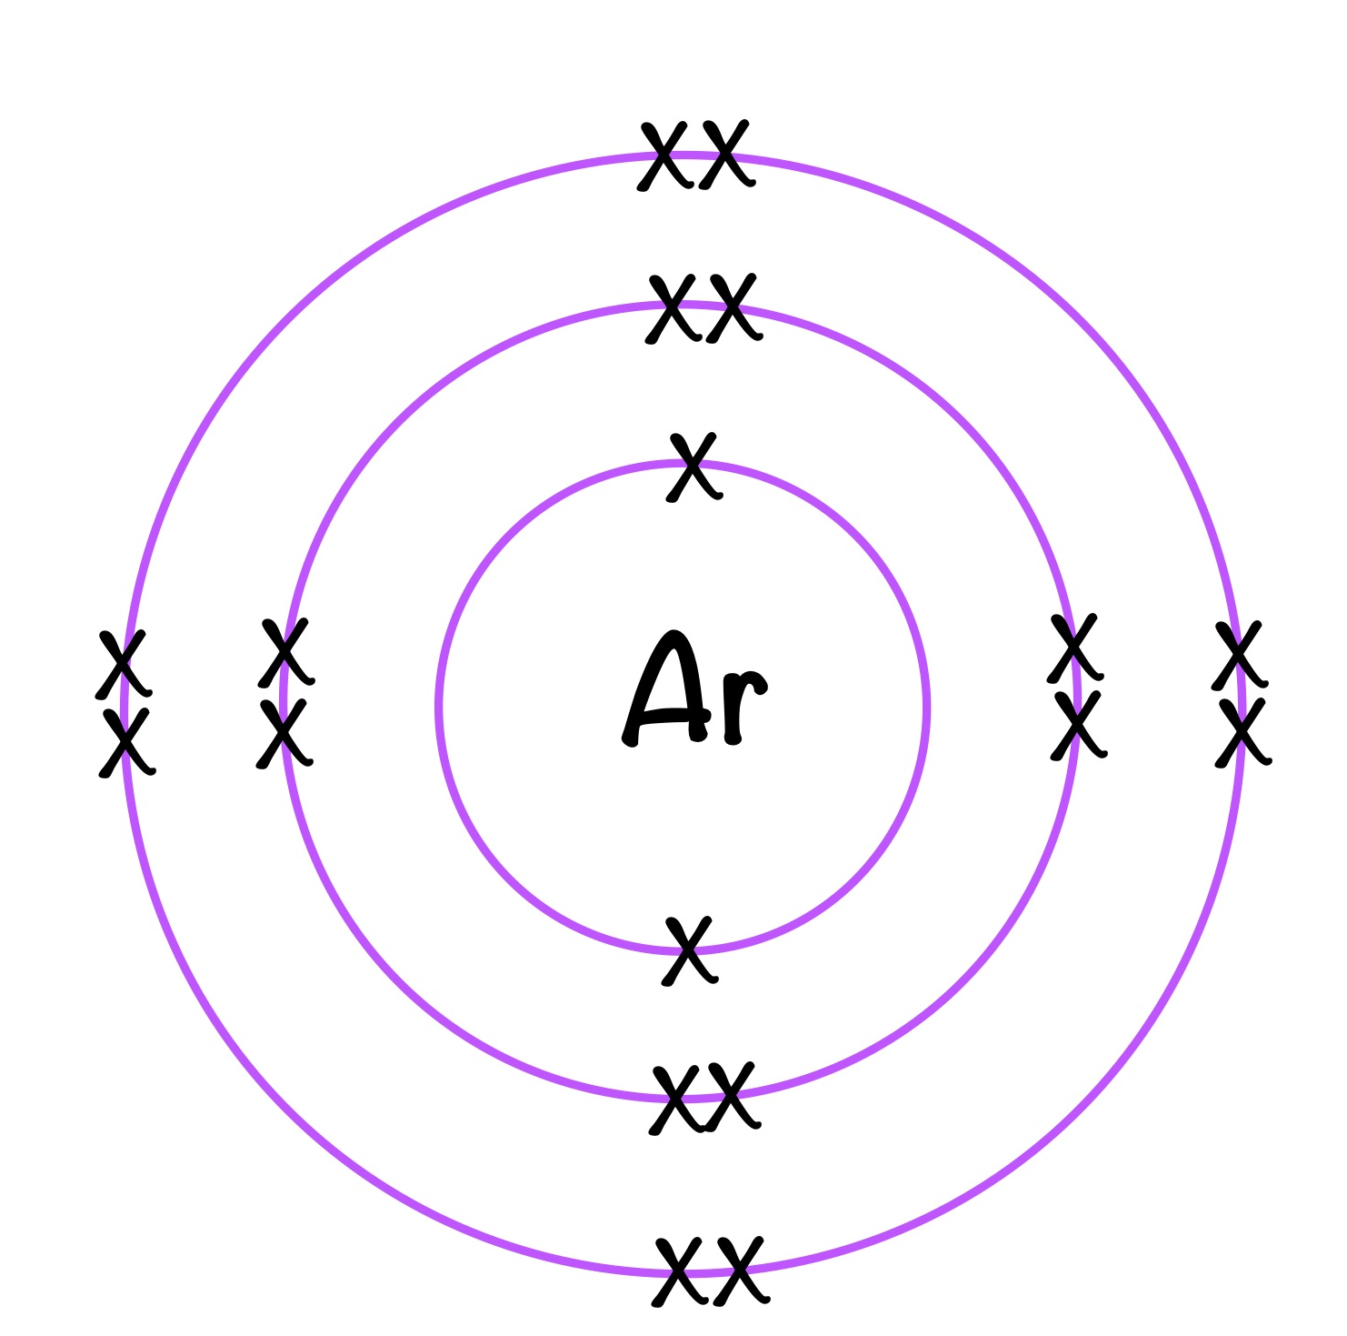
6.1 Structure of the Atom
Key Q
What is the structure of an atom?
Atoms are very small, having a radius of about 1 × 10⁻¹⁰ metres.
It is a positively charged nucleus composed of both protons and neutrons surrounded by negatively charged electrons.
The radius of a nucleus is less than 1/10 000 of that of the atom

Slide 3
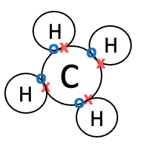
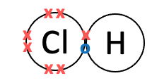
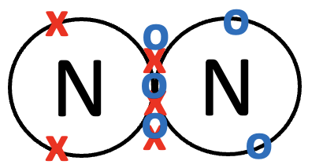
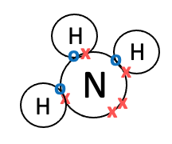
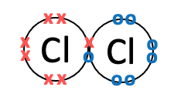
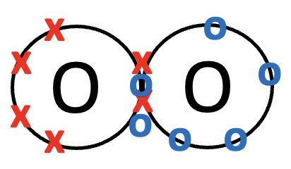
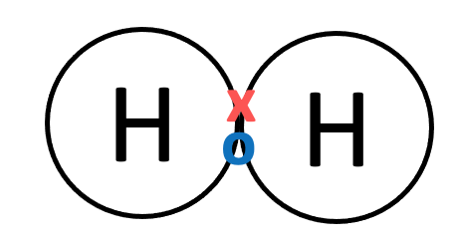
6.2 Size of Atoms and Molecules
Key Q
What is the approximate size of molecules?
Small atoms and molecules are all slightly different.
The diameters are slightly different, but are all about 10⁻¹⁰ m.
The size of these atoms is said to have an order of magnitude of 10⁻¹⁰.

Slide 4
6.3 Nuclei of Isotopes
Key Q
What does this each tile on the periodic table tell us about the atom?
The symbol Na tells us that this atom is called sodium.
23
Na
11
The atomic number 11 tells us that sodium has 11 protons.
As sodium has 11 protons, it must also have 11 electrons.
The relative mass of 23 tells us that it has 23 protons and neutrons all together. As the atom has 11 protons this means the atom has 12 neutrons.

Slide 5
6.4 Nuclei of Isotopes
Mass number
23
Na
Atomic number
11
Key Term | Definition
Mass Number | The total number of protons and neutrons in an atom.
Isotope | Atoms with the same atomic number but different mass number due to having a different number of neutrons.

Slide 6
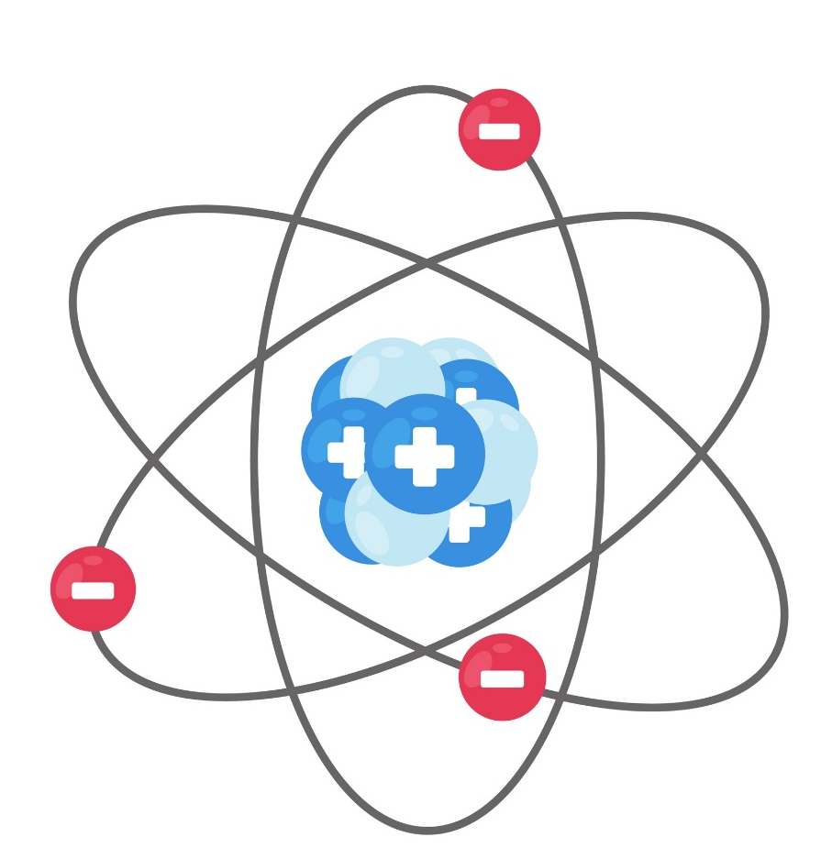
6.5 Mass of Subatomic Particles
Key Q
What is relative mass of subatomic particles?
Particle | Relative Mass
Proton | 1
Neutron | 1
Electron | Tiny

Slide 7
6.5 Mass of Subatomic Particles
Key Q
Why are atoms neutral?
Particle | Relative Charge
Proton | +1
Neutron | 0
Electron | -1
Key Term | Definition
Atomic Number | The number of protons in an atom.
All atoms of a particular element have the same number of protons.

Slide 8
6.6 Neutral Atoms
Key Q
Why are atoms neutral?
Particle | Relative Charge
Proton | +1
Neutron | 0
Electron | -1
In an atom the number of electrons is equal to the number of protons in the nucleus.
This means that atom has no overall electrical charge.
Key Term | Definition
Atomic Number | The number of protons in an atom.
All atoms of a particular element have the same number of protons.

Slide 9
6.7 Orbiting Electrons
Key Q
What is the structure of an atom?
Most of the mass is concentrated in the nucleus.
The electrons are arranged at different distances from the nucleus (different energy levels).

Slide 10
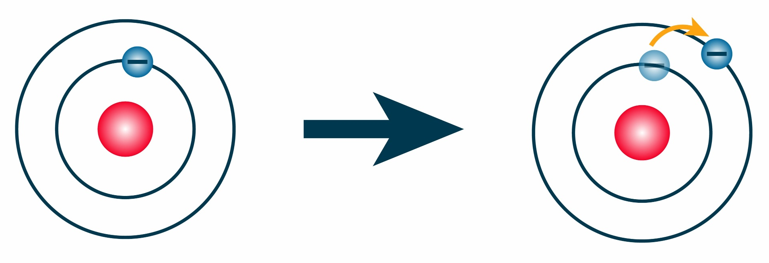
6.8 Orbiting Electrons
The electron arrangements may change with the absorption of electromagnetic.
Here electromagnetic radiation has been absorbed and so the electron moves further from the nucleus
When an electron moves to a lower energy level and closer to the nucleus there is emission of electromagnetic radiation.

Slide 11
6.9 Forming Ions
Key Q
How do positive ions form?
+
x
x
x
Li
Li
x
x
Atoms turn into positive ions if they lose one or more outer electron(s).

Slide 12
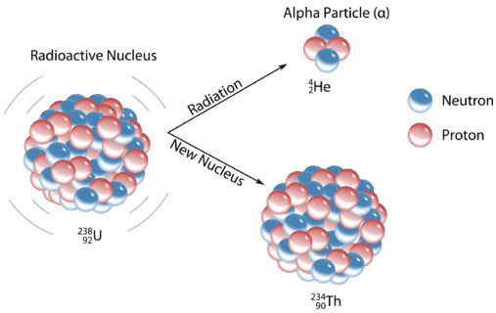
6.10 Radioactive Decay
Key Q
What is radioactive decay?
Key Term | Definition
Radioactive Decay | The random process in which the nucleus gives out radiations as it changes to become more stable.

Slide 13
6.11 Radioactive Decay
Key Q
What are the different types of radiation?
Key Term | Definition
Radioactive Decay | The random process in which the nucleus gives out radiations as it changes to become more stable.
Alpha
Beta -
Beta +
Gamma

Slide 14
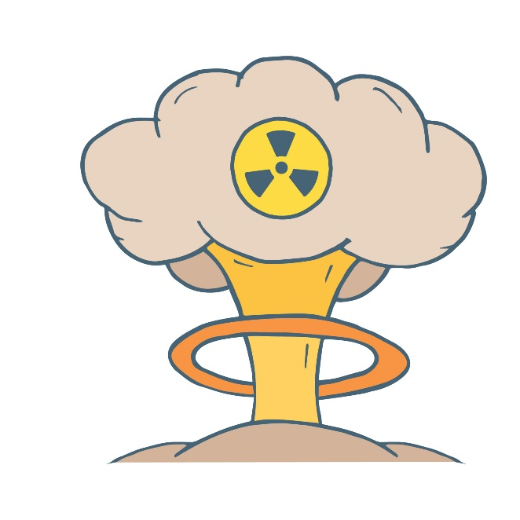

6.12 Background Radiation
Key Q
What is background radiation?
Key Term | Definition
Background Radiation | Low level nuclear radiation that is always present.

Slide 15

6.13 Background Radiation
Key Q
What are sources of background radiation?
Cosmic Rays From Space
Natural Sources
Rocks

Slide 16
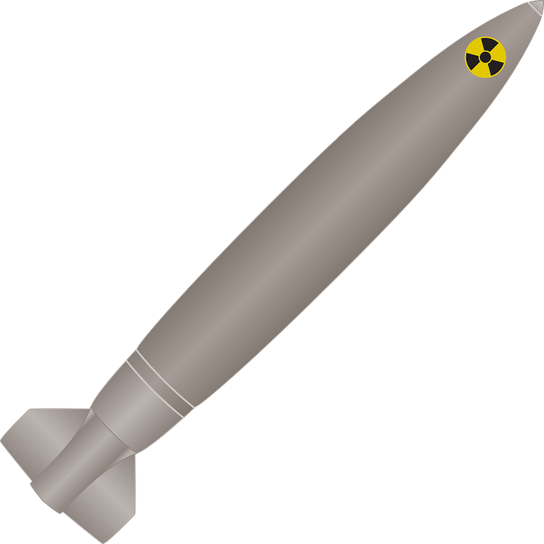
6.13 Background Radiation
Key Q
What are sources of background radiation?
Man Made Sources
Fallout from nuclear weapons
Testing and nuclear accidents

Slide 17
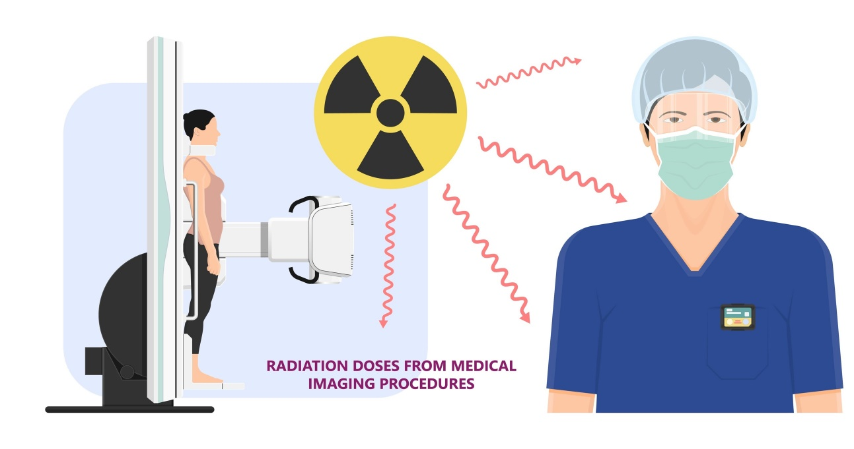
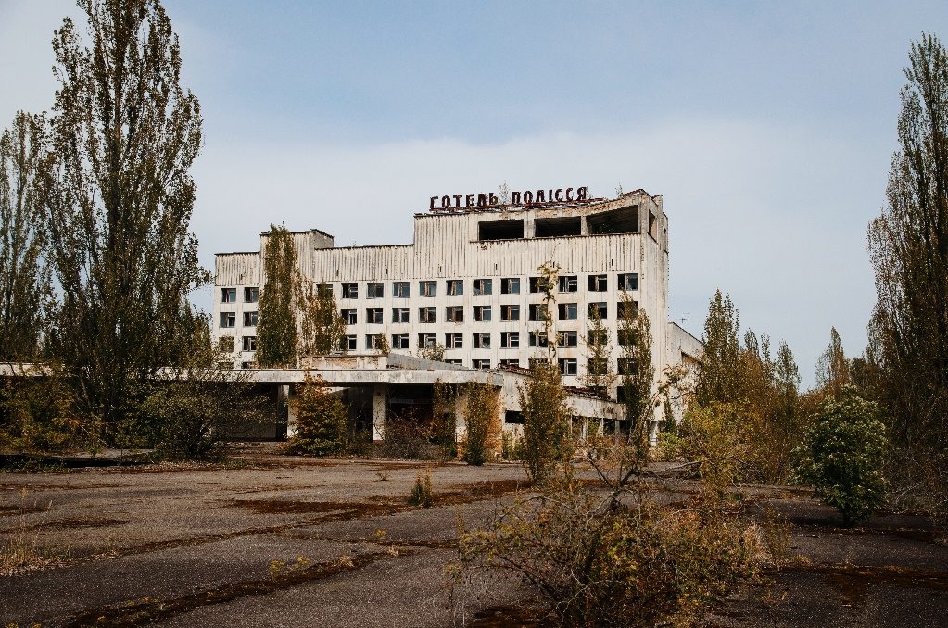
6.13 Background Radiation
Key Q
What can affect the radiation dose a person is exposed to?
Occupation
Location

Slide 18
6.14 Detecting Radiation
Key Q
What is activity and count rate?
Key Term | Definition
Radioactive Decay | The random process in which the nucleus gives out radiations as it changes to become more stable.
Activity | The rate at which a source of unstable nuclei decays. It is measured in becquerels.
Count Rate | The number of decays recorded each second by a detector.

Slide 19
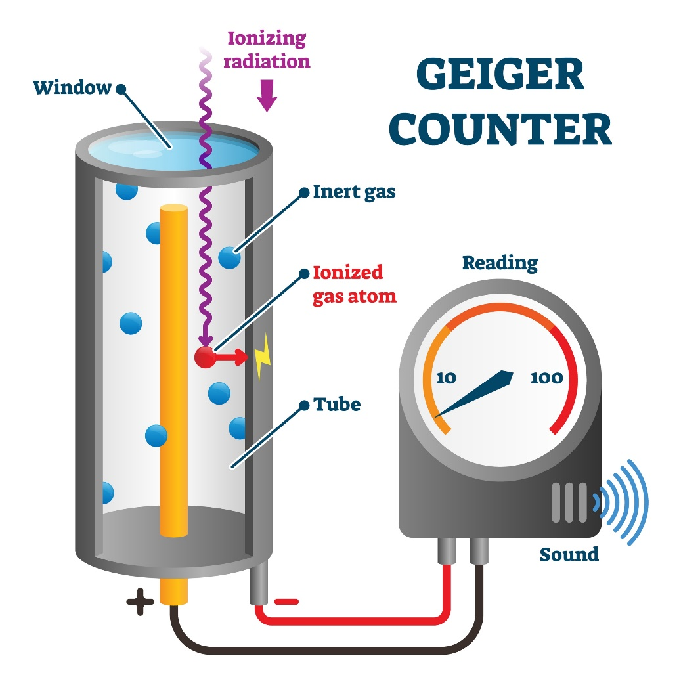
6.14 Detecting Radiation
Key Q
How is count rate measured?
Geiger muller tubes can be used to detect and measure radiation

Slide 20
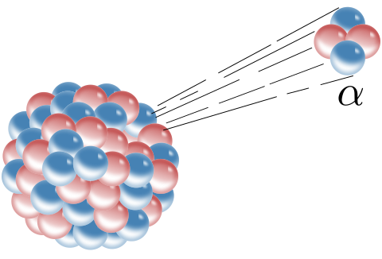
6.15 Radiation
Key Q
What are the different types of radiation?
It has a range of between 3-5cm in air.
Alpha Particle
Most ionising
Absorbed by the skin and a sheet of paper
It is a helium nucleus made up of 2 protons and neutrons.
Symbol for an alpha particle is 𝛼

Slide 21
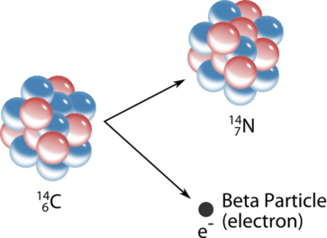
6.15 Radiation
Key Q
What are the different types of radiation?
It has a range of 15cm in air.
Less ionising than alpha.
Beta Particle
A high-speed electron that is ejected from the nucleus as a proton turns into a neutron.
Absorbed by a thin sheet of aluminium
Symbol for a beta particle is β

Slide 22
6.15 Radiation
Key Q
What are the different types of radiation?
Travels large distances in air.
Gamma
Most penetrating. Can be stopped by thick lead and concrete.
Least ionising
No charge
Electromagnetic radiation from the nucleus.
Symbol for gamma radiation is γ

Slide 23
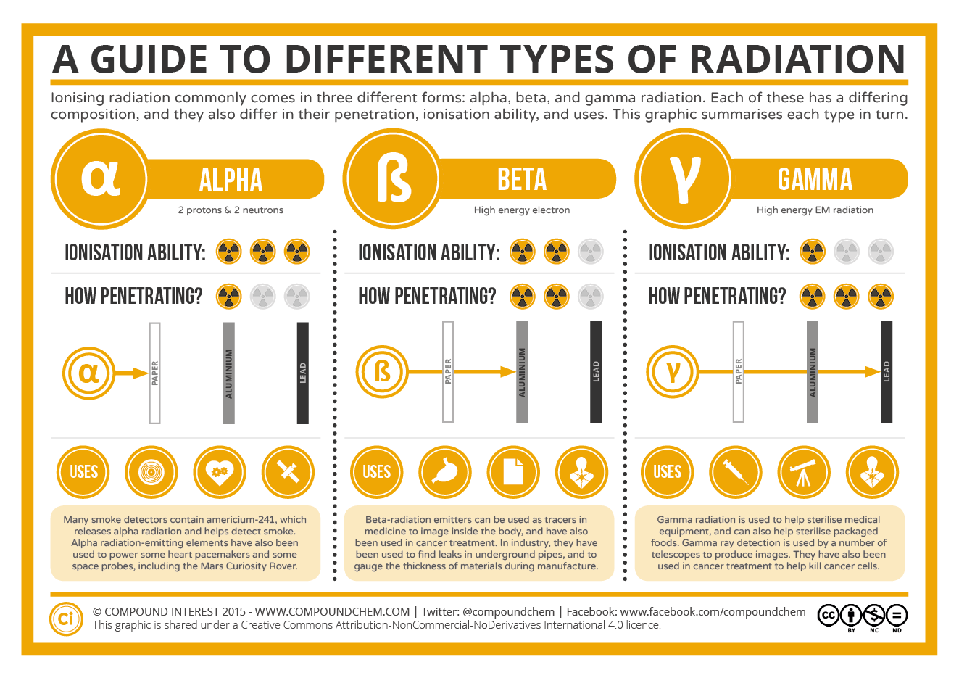
6.16 Comparing Radiation
To summarise...

Slide 24
6.16 Comparing Radiation
Task
Complete the summary for the different types of radiation.
Radiation | Symbol | Description | Range | Penetrating Power | Ionising Power
Alpha | 𝛼 | A particle that consists of two neutrons and two protons. It is the same as helium nucleus. | 3-5cm | Least penetrating. Absorbed by the skin and a sheet of paper. | Most ionising.
Beta | β | A high-speed electron that is ejected from the nucleus as a neutron turns into a proton. | 15cm | Can penetrate air and paper. Stopped by a thin sheet of aluminium. | More ionising than gamma, less ionising than alpha.
Gamma | 𝛾 | Electromagnetic radiation from the nucleus. | Long | Most penetrating. Can be stopped by thick lead or concrete. | Least ionising

Slide 25
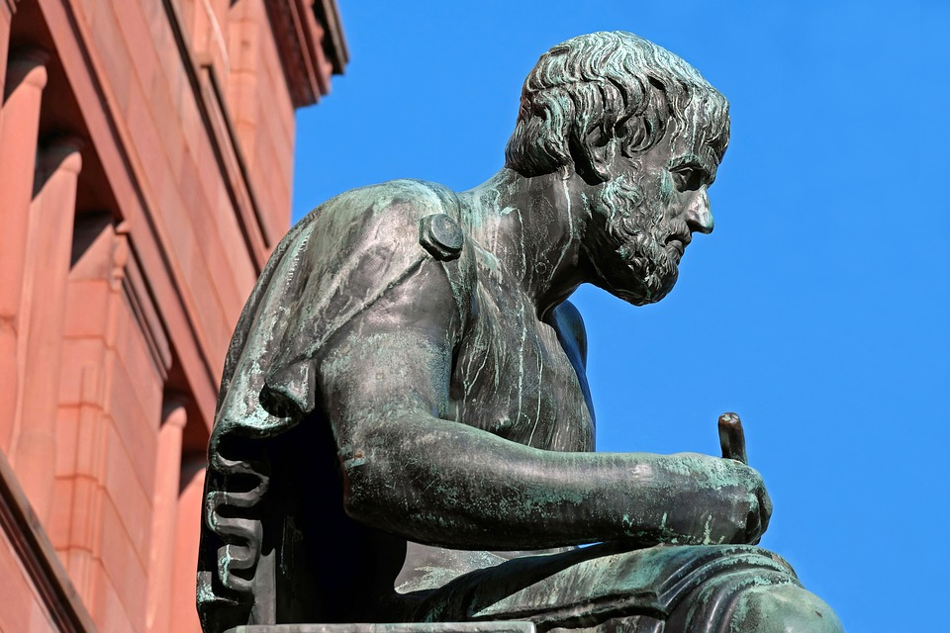
6.17 Changing Atomic Model
Key Q
How has the atomic model changed over time?
The modern model of the atom has developed over time.
Aristotle was an ancient Greek philosopher who suggested there were 4 elements. These were earth, air, fire and water.

Slide 26
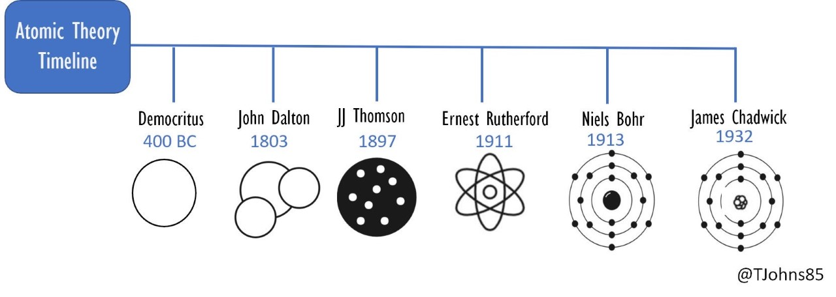
6.17 Changing Atomic Model
Ideas about the model of the atom have changed over time.
This is because new experimental evidence leads to scientific models being changed or relaced.
Dalton suggested that atoms were tiny spheres that could not be divided.
Electrons had not been discovered yet!

Slide 27
6.17 Changing Atomic Model
Ideas about the model of the atom have changed over time.
This is because new experimental evidence leads to scientific models being changed or relaced.
JJ Thompson discovered the electron. He then went on to suggest the Plum Pudding Model. This was the idea that the atom was a ball of positive charge with negative electrons embedded in it.
The discovery of the electron led to this new model!

Slide 28
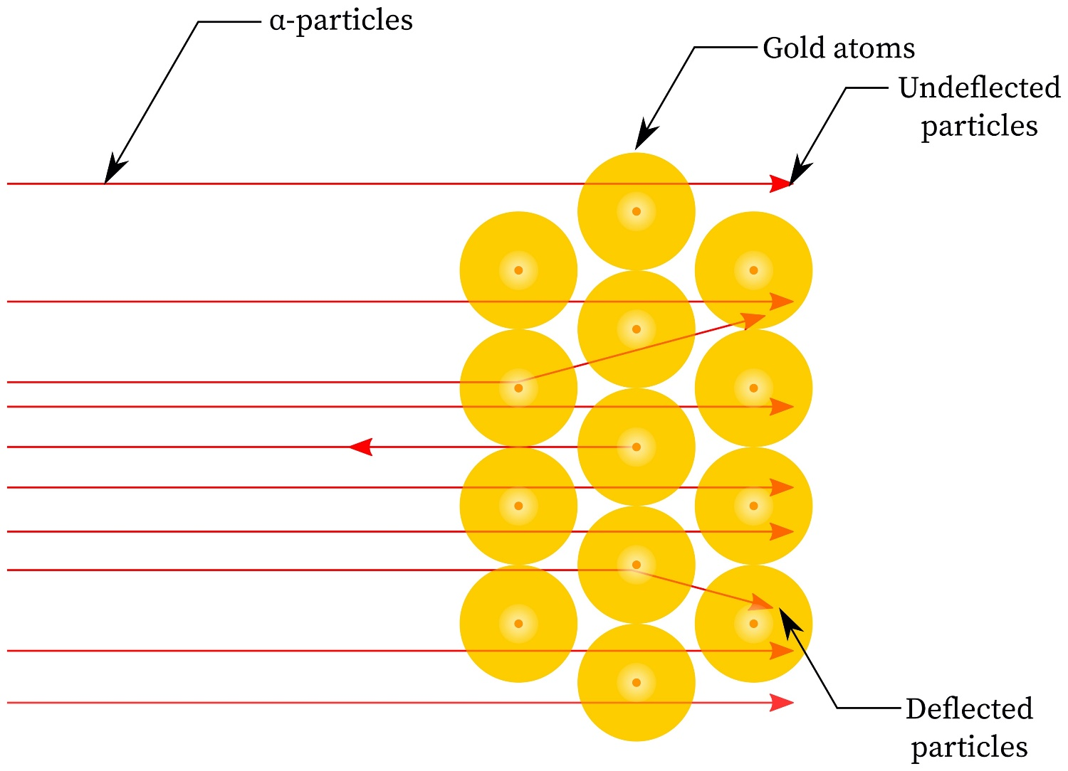
6.17 Changing Atomic Model
Alpha Particle Scattering Experiment

Slide 29
6.17 Changing Atomic Model
Alpha Particle Scattering Experiment
This proved that there was a small concentrated mass in the centre of the atom
This proved that most of the atom was empty space
This proved that the nucleus was positive

Slide 30
6.17 Changing Atomic Model
Alpha Particle Scattering Experiment
The results from the alpha particle scattering experiment led to the conclusion that the mass of an atom was concentrated at the centre (nucleus) and that the nucleus was charged. This nuclear model replaced the plum pudding model.

Slide 31
6.17 Changing Atomic Model
Ideas about the model of the atom have changed over time.
This is because new experimental evidence leads to scientific models being changed or relaced.
Rutherford carried out an experiment known as the alpha particle scattering experiment. From this the nuclear model of the atom was suggested.

Slide 32
6.17 Changing Atomic Model
Ideas about the model of the atom have changed over time.
This is because new experimental evidence leads to scientific models being changed or relaced.
Niels Bohr then adapted this model by suggesting that electrons orbit the nucleus at specific distance.

Slide 33
6.17 Changing Atomic Model
Ideas about the model of the atom have changed over time.
This is because new experimental evidence leads to scientific models being changed or relaced.
James Chadwick then went on to prove the existence of neutrons.

Slide 34
6.17 Changing Atomic Model
Models were rejected, modified and extended as new evidence became available.
Scientists suggested explanations, made predictions based on their explanations and built on each other’s work.

Slide 35
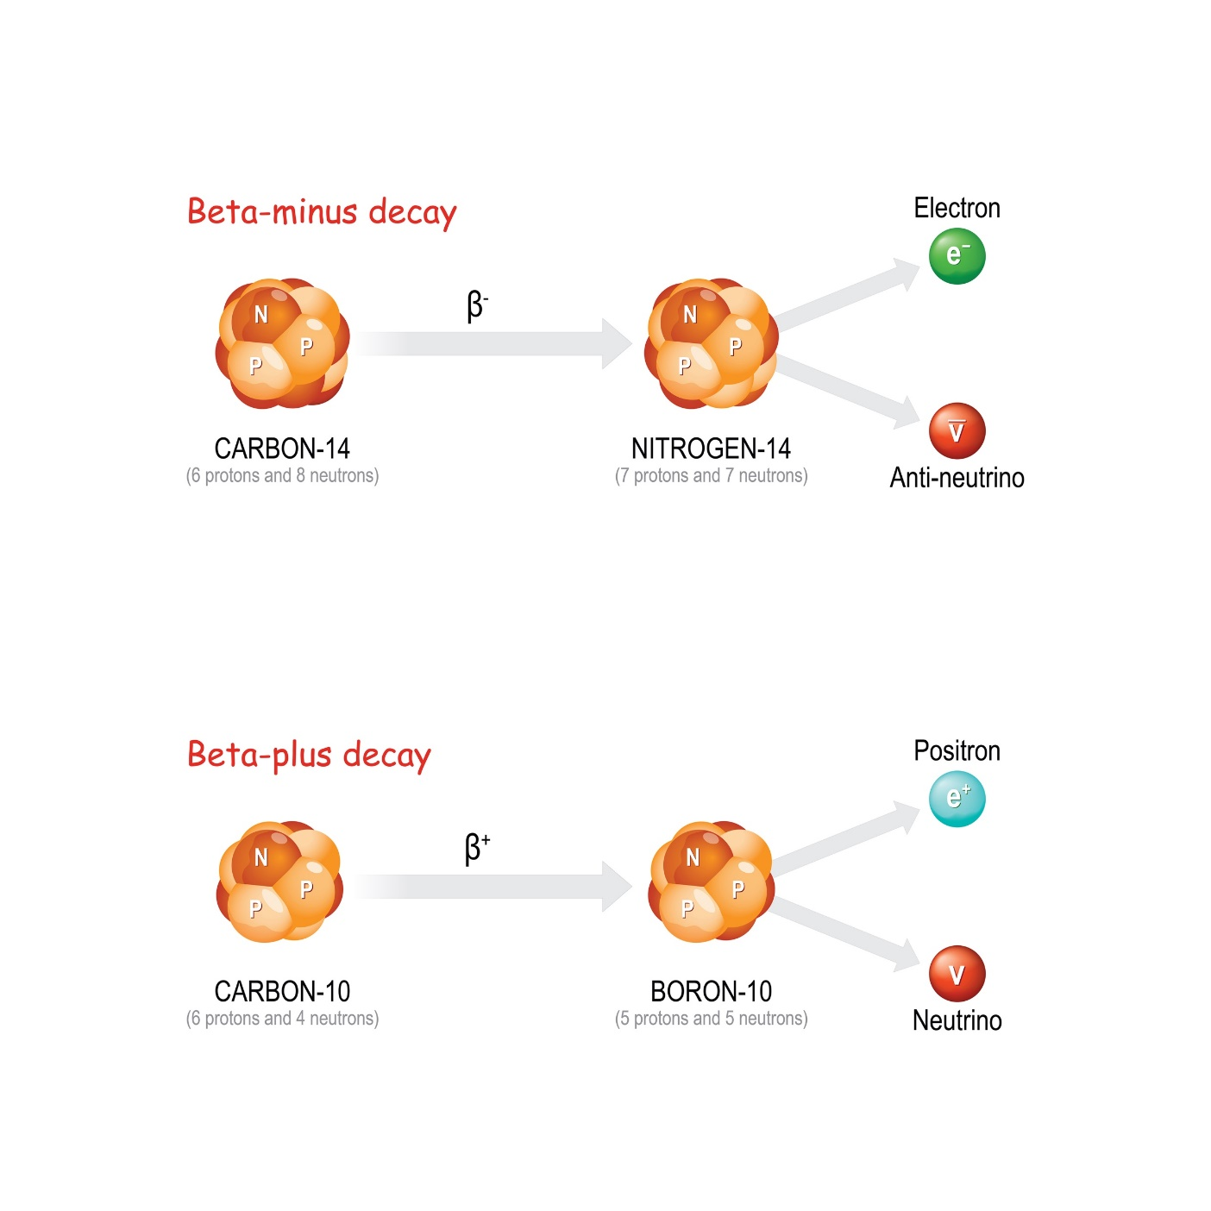
6.18 Beta - Decay
Key Q
What is beta positive decay?
During β⁻ decay a neutron becomes a proton plus an electron.

Slide 36
6.19 Beta + Decay
Key Q
What is beta positive decay?
During β⁺ decay a proton becomes a neutron plus a positron.

Slide 37
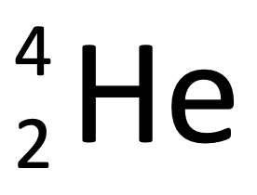
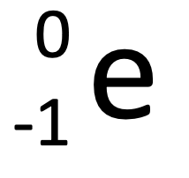
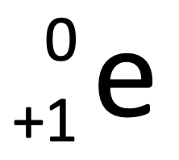
6.20 Radioactive Decay
Key Q
What happens to mass number and atomic number when radioactive decay happens?
Type of Decay | Emitted from Nucleus | Mass of Nucleus | Atomic Number
Alpha |  | Decreases by 4 | Decreases by 2
Beta - |  | No change | Increases by 1
Beta + |  | No change | Decreases by 1
Gamma | Electromagnetic Wave | No change | No change

Slide 38
6.21 Radioactive Decay
Key Q
What happens to nuclei that have undergone radioactive decay?
Nuclei that undergo radioactive decay will often undergo nuclear rearrangement.
This means that the substance could become a different element.
They may also have a loss of energy as gamma radiation.

Slide 39
6.22 Nuclear Equations
Key Q
What are nuclear equations?
Nuclear equations are ways of representing radioactive decay.
He
0
-1
e
4
2
Alpha particle
Beta particle
The emission of the different types of nuclear radiation may cause a change in the mass and /or the charge of the nucleus.

Slide 40
6.22 Nuclear Equations
Key Q
What happens during alpha decay?
Alpha Decay of Radon
+
Radon
Polonium
He
219
86
215
84
4
2
Alpha decay causes the mass and charge of the nucleus to decrease

Slide 41
6.22 Nuclear Equations
Key Q
What happens during beta - decay?
Beta - Decay of Carbon
+
Carbon
Nitrogen
e
14
6
14
7
0
-1
Beta decay does not causes the mass of the nucleus to change but does causes the charge of the nucleus to increase.

Slide 42
6.22 Nuclear Equations
Task
Complete the following nuclear equations for alpha decay of:
Po
+
_
_
Pb
206
82
He
210
84
4
2
U
+
238
92
_
_
Th
He
234
90
4
2
Pb
+
_
_
Hg
210
82
206
80
He
4
2
Ra
+
_
_
Rn
222
86
He
226
88
4
2

Slide 43
6.22 Nuclear Equations
Task
Complete the following nuclear equations for beta - decay of:
La
+
e
_
_
Ce
140
57
140
58
0
-1
Ba
+
_
_
La
139
56
139
57
0
-1
e
Cs
+
_
_
Ba
137
55
137
56
0
-1
e
H
+
_
_
He
3
1
3
2
0
-1
e

Slide 44
6.22 Nuclear Equations
Task
Complete the table comparing alpha and beta decay.
Type of Decay | Particle Emitted From Nucleus | Mass of Nucleus | Charge of Nucleus
Alpha |  | Decreases | Decreases
Beta - |  | Unchanged | Increases
He
4
2
0
-1
e
In both alpha and beta decay a new element is made.

Slide 45
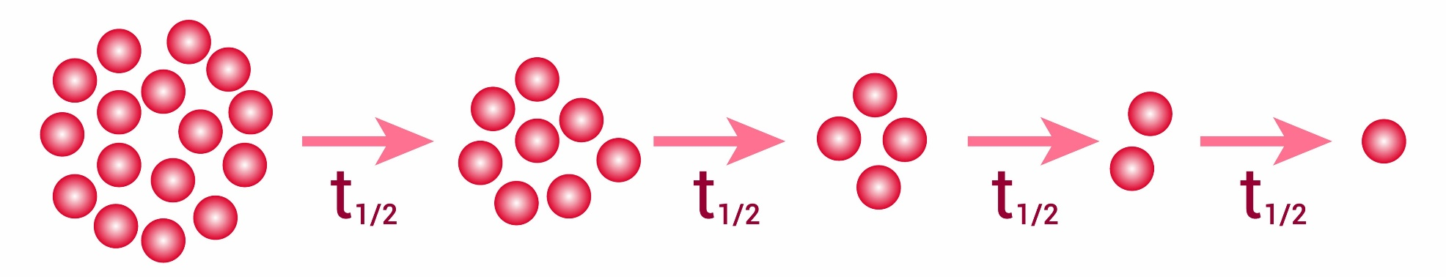
6.23 Activity
Key Q
What does this diagram show?
The activity of a radioactive source decreases with time.
Radioactive decay is random.

Slide 46
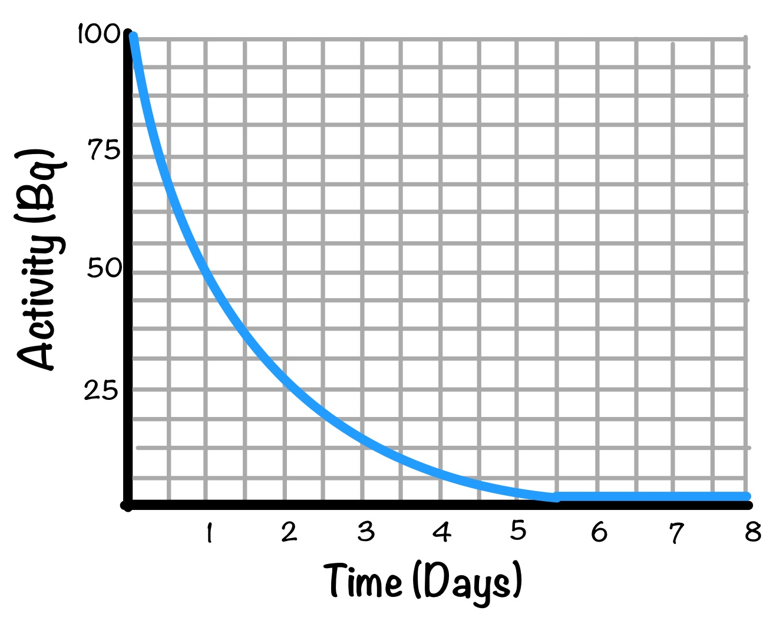
6.23 Activity
Key Q
What does this graph show?
For each radioactive isotope there is a different constant change that any nucleus will decay.
Over time the activity of radioactive sources decreases, as the number of undecayed nuclei decreases

Slide 47
6.24 Unit of Activity
Key Q
What is the unit of activity?
The activity of a radioactive source decreases with time.
Radioactive decay is random.
The unit for activity is becquerel (Bq)

Slide 48
6.25 Half Life
Key Q
What is half life?
The time it takes for the number of nuclei of the isotope in a sample to halve.
OR it is the time it takes for the count rate from a sample containing the isotope to fall to half.

Slide 49
6.26 Half Life
Key Q
What is half life?
It cant be predicted when a particular nucleus will decay.
Half life enables the activity of a large number of nuclei to be predicted during radioactive decay.

Slide 50
6.27 Calculating Half Life
Key Q
How can the half life of an isotope be determined using a graph?
This substance has a half life of 1 day.
1 day
1 day

Slide 51
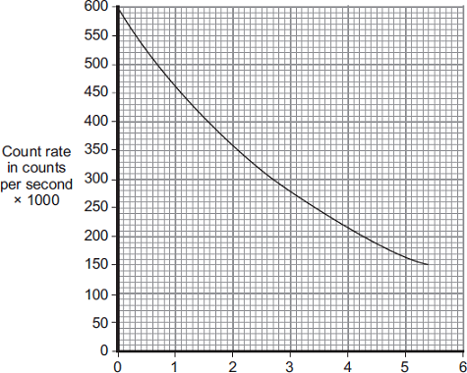
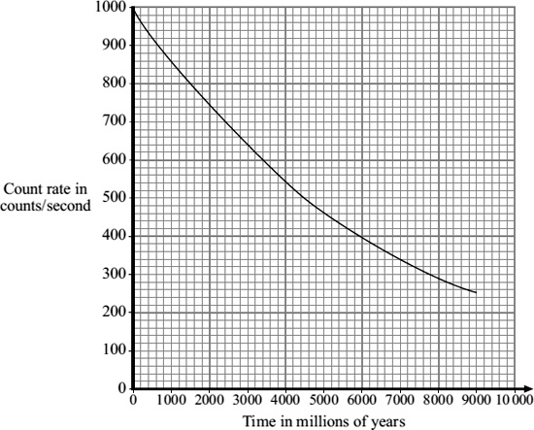
6.27 Calculating Half Life
Task
Determine the half life for these different isotopes.
2.7 days
4500 million years

Slide 52
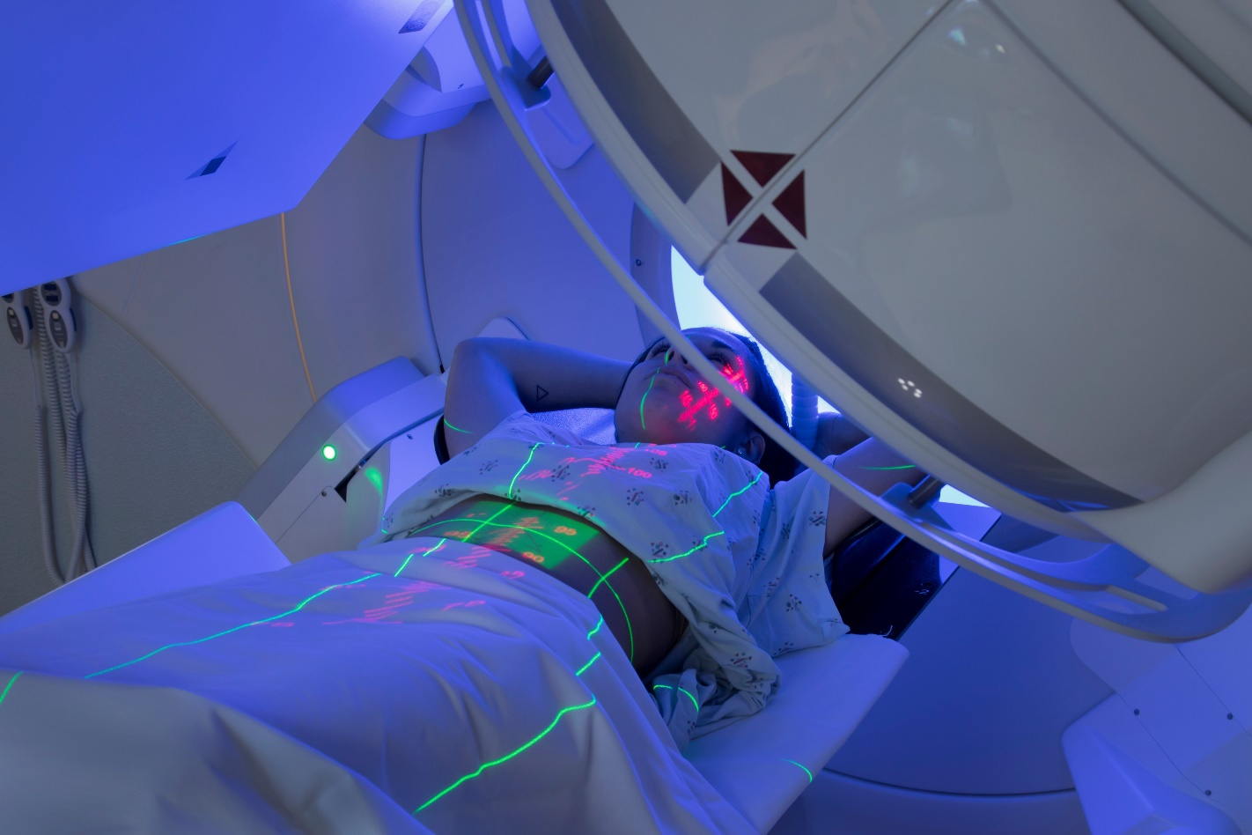
6.28 Uses of Radiation
Key Q
What uses to we have for nuclear radiation?
Control or destruction of unwanted tissue.
This image shows radiotherapy. Radiation is being used to kill cancerous cells.
Radiation needs to be used that has a half life long enough to destroy cells, but not too long as this could lead to further damage.

Slide 53
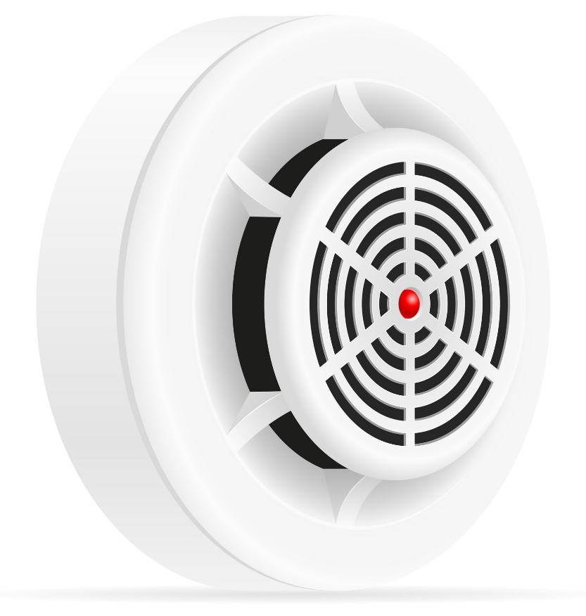
6.28 Uses of Radiation
Key Q
What uses to we have for nuclear radiation?
Smoke detectors work using alpha radiation.
A household smoke alarm measures the movement of alpha particles across a small gap.
If smoke enters the detector, it will absorb the alphas and the detector will measure a drop in the number getting across the gap.
This drop in measurement will trigger the alarm to sound.

Slide 54

6.28 Uses of Radiation
Key Q
What uses to we have for nuclear radiation?
Radiation can also be used to irradiate food.
This is when food is exposed to ionising radiation.
Bacteria living on the food are killed and so the food will last longer before beginning to decay.
We can also use a similar process to sterilise medical equipment.

Slide 55
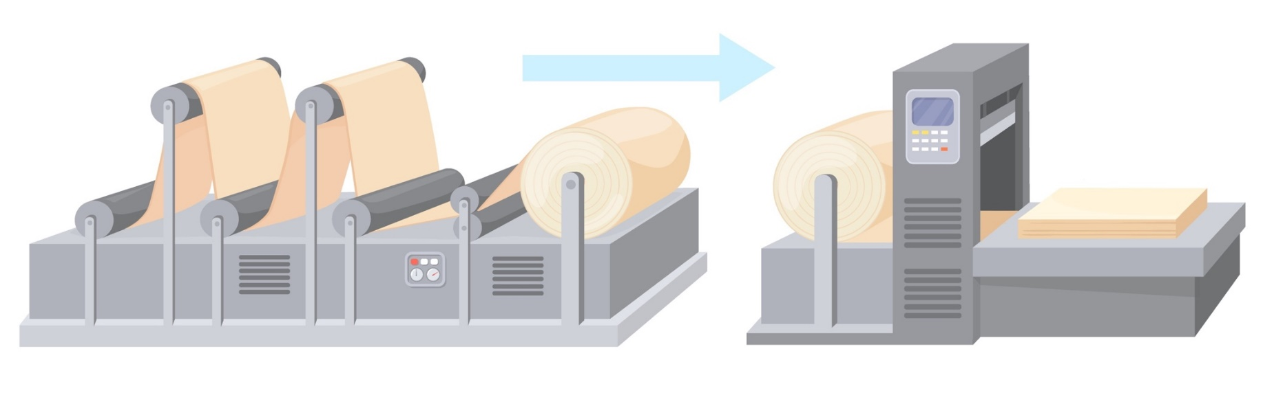
6.28 Uses of Radiation
Key Q
What uses to we have for nuclear radiation?
This allows it to be used to gauge the thickness of a material by measuring the amount of radiation that passes through.
Radiation is absorbed as it passes through materials.

Slide 56
6.28 Uses of Radiation
Key Q
What uses to we have for nuclear radiation?
This is commonly used with beta minus emitters in industry, for paper milling and the production of aluminium foil.

Slide 57
6.28 Uses of Radiation
Key Q
What uses to we have for nuclear radiation?
If the foil is too thick it absorbs more beta particles.
The detector receives less beta particles.
This sends a signal to the rollers to increase the force on the foil, making it thinner.

Slide 58
6.28 Uses of Radiation
Key Q
What uses to we have for nuclear radiation?
If the foil is too thin it absorbs less beta particles.
The detector receives more beta particles.
This sends a signal to the rollers to decrease the force on the foil, making it thicker.

Slide 59
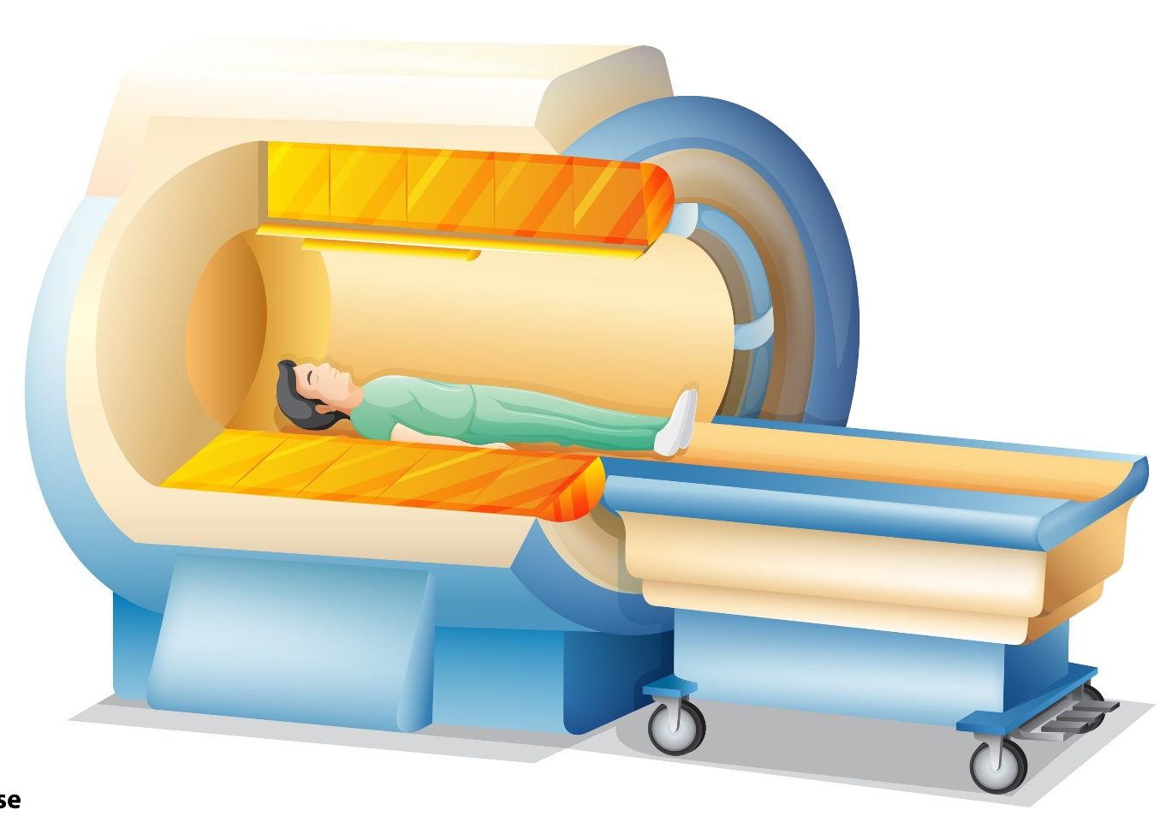
6.28 Uses of Radiation
Key Q
What uses to we have for nuclear radiation in medicine?
Exploration of internal organs.
Examples include CT scans and using radioactive substances as tracers.

Slide 60
6.28 Uses of Radiation
Key Q
What uses to we have for nuclear radiation in medicine?
Positron emission tomography (PET) scans use a positron emitter as the contamination tracer.
These tracer materials, such as fluorine-18, have very short half-lives, and need to be manufactured in the hospital and injected into the patient’s blood soon after manufacture.

Slide 61
6.28 Uses of Radiation
Key Q
What uses to we have for nuclear radiation in medicine?
The positrons emitted will react with electrons in the patient’s body and produce gamma rays which can be detected outside the body.
Multiple detections can build up a picture of the movement of the tracer inside the body.

Slide 62
6.28 Uses of Radiation
Key Q
What are the advantages and disadvantages of using radiation as tracers?
Advantages | Disadvantages
Radioactive isotopes can be used as medical tracers. | Isotopes may not go to where they are wanted.
Use of an isotope with a short half life can reduce exposure. | It can be difficult to fully remove the contamination.
Imaging process can replace more invasive surgical procedures. | It could potentially damage other cells.

Slide 63
6.28 Uses of Radiation
Key Q
What are the advantages and disadvantages of using gamma radiation to sterilise?
Advantages | Disadvantages
Sterilisation can be done without high temperatures. | It may not kill all bacteria on the object.
It can be used to sterilise equipment that would melt if heated. | The people working with the ionising radiation could be harmed.

Slide 64
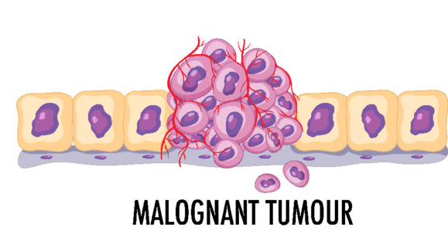
6.29 Dangers of Radiation
Key Q
What are the hazards of radiation?
Radioactive materials are hazardous.
Nuclear radiation can ionise chemicals within a body, which changes the way that cells behave.
This can lead to cancer

Slide 65
6.29 Dangers of Radiation
Key Q
What are the hazards of radiation?
Radiation can also deposit large amounts of energy into the body, this damages and destroys cells also.

Slide 66

6.29 Dangers of Radiation
Key Q
What are the hazards of radiation?
Whilst ionising radiation can cause cancer it can also be used for imaging inside the body and to kill cancerous cells.

Slide 67
6.30 Dangers of Radiation
Radioactive isotopes have a very wide range of half-life values.
If a substance has a short half life, activity decreases quickly and so the risk of harm decreases quickly also.

Slide 68

6.31 Safety
Key Q
How can we manage the risks of radiation?
Wear protective clothing.
Keep radioactive sources in lead lined boxes when not in use.
Avoid contact with bare skin.
Wear face masks
Monitor exposure using badges
Limit time exposed to radiation.

Slide 69
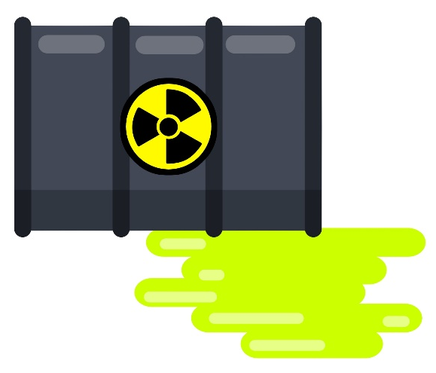
6.32 Contamination and Irradiation
Key Q
What is contamination and irradiation?
Key Term | Definition
Contamination | The unwanted presence of materials containing radioactive atoms on other materials.
Irradiation | The process of exposing an object to nuclear radiation.

Slide 70
6.32 Contamination and Irradiation
Key Q
What are the differences between contamination and irradiation?
 | Contamination | Irradiation
When It Occurs | When the radioactive source is on or in the object. | When an object is exposed to a source of radiation outside the object.
Does The Object Become Radioactive? | A contaminated object will be radioactive for as long as the source is on or in it. | The object will not become radioactive itself.
Stopping Radiation. | Once an object is contaminated it can become very difficult to remove or block the radiation. | Can be protected from irradiation by moving away from the radioactive source or blocked with a shield. As soon as the source of radiation is removed the irradiating effect stops.

Slide 71
6.33 Treating Tumours
Key Q
How can tumours be treated with radiation?
Where Radiation is Applied | Internally | Externally
Type of Radiation Used | Alpha | Gamma
Justification | Short range and low penetration so needs to be close to tumour, | High penetration and range and so can penetrate the body to reach the tumour.

Slide 72
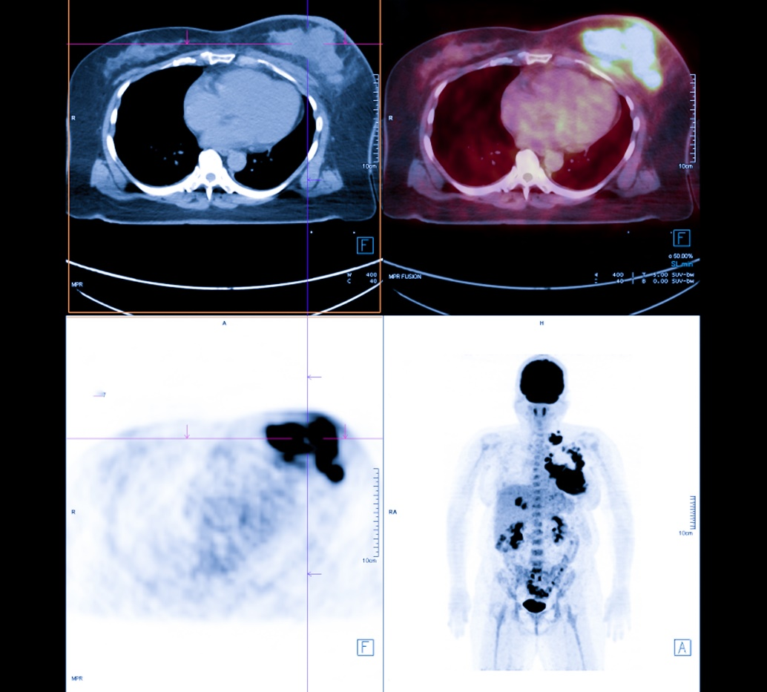
6.34 Uses of Radiation
Key Q
What uses do we have for radioactive substances in medical diagnosis?
Fluroine-18 is used in PET scans. It is attached to glucose, injected into the blood and accumulates around tumours.

Slide 73
6.34 Uses of Radiation
Key Q
What uses do we have for radioactive substances in medical diagnosis?
Fluroine-18 emits positrons as it decays.
When the positron hits an electron, they annihilate each other.
This produces a gamma ray.
This gamma ray can be detected outside the body.
These are detected by sensors around the patient's body.

Slide 74
6.35 PET Scans
Key Q
Why do isotopes used in PET Scans need to be produced nearby?
Fluorine-18 is used in PET scans, and it has a very short half life.
This means it has to be produced nearby so that it can be used as quickly as possible.
It decays too quickly to travel long distances.

Slide 75
6.36 Evaluating Nuclear Power
Key Q
What are the advantages and disadvantages of these non renewable energy resources?
Energy Resource | Advantages | Disadvantages
Nuclear Fuel | Very reliable. Does not produce greenhouse gases and so does not contribute towards global warming. Nuclear fuel released a large amount of energy per kg of fuel. | Produce radioactive waste which will need to be disposed of safely and correctly. Long start up time. Higher decommissioning costs.

Slide 76
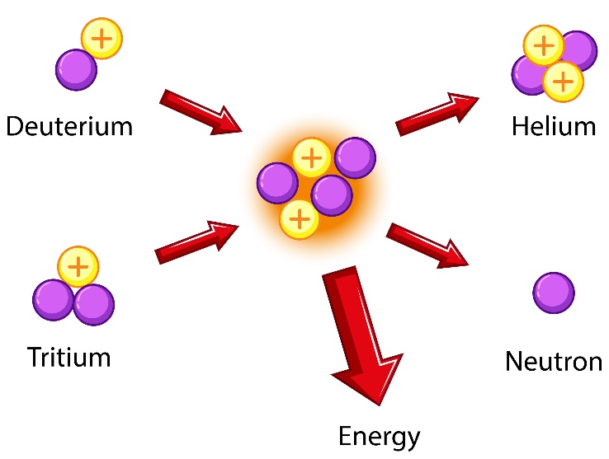
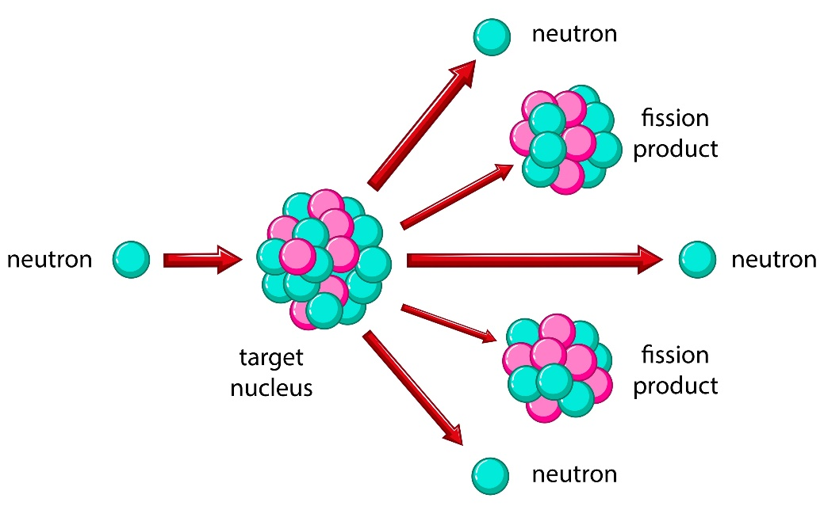
6.37 Nuclear Power
Key Q
What are examples of nuclear reactions?
Fusion
Radioactive Decay
All of these reactions are a potential source of energy!
Fission

Slide 77

6.38 Fission
Key Q
What is nuclear fission?
Nuclear fission is the splitting of a large and unstable nucleus.
Spontaneous fission is rare.
Usually for fission to occur the unstable nucleus must first absorb a neutron.

Slide 78
6.38 Fission
Key Q
What is nuclear fission?
The nucleus undergoing fission splits into two smaller nuclei roughly equal in size.
Two or three neutrons plus gamma rays are also emitted.
Energy is released by the fission reaction.

Slide 79
6.38 Fission
Key Q
What is nuclear fission?
All of the fission products have kinetic energy.
The neutrons may go on to start a chemical reaction.

Slide 80
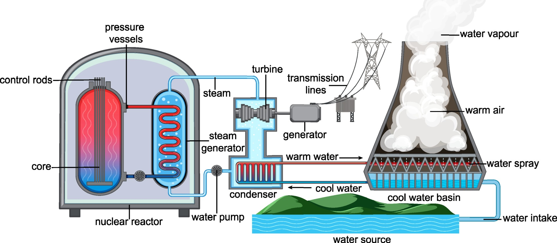
6.39 Controlled Nuclear Reaction
Key Q
What happens in a nuclear reactor?
In a nuclear reactor, a neutron is absorbed into a nucleus (typically uranium-235). This causes the nucleus to become uranium-236, which is very unstable.
The entire nucleus splits into smaller daughter nuclei and 2 or 3 neutrons.
These neutrons go on to collide with other uranium nuclei and cause more reactions. This is a chain reaction.

Slide 81
6.39 Controlled Nuclear Reaction
Key Q
What happens in a nuclear reactor?
The fast moving neutrons carry most of the energy from the reaction with them.
Before the neutrons can collide with fresh uranium nuclei, they need to be slowed down.

Slide 82
6.39 Controlled Nuclear Reaction
Key Q
What happens in a nuclear reactor?
This is so that the energy can pass on to other components in the nuclear reactor, which is used to heat water to drive the turbines that then turn the generators.

Slide 83
6.39 Controlled Nuclear Reaction
Key Q
What do the different parts of a nuclear power station do?
The nuclei of the nuclear fuel begin to split when they are hit by an incoming neutron.
The nuclear fuel (Uranium-235) is held in rods in the reactor core.

Slide 84
6.40 Controlled Nuclear Reaction
Key Q
What do the different parts of a nuclear power station do?
The graphite core slows down the neutrons so that they are more likely to be absorbed by the fuel rods.
The graphite core is next to the fuel rods.

Slide 85
6.40 Controlled Nuclear Reaction
Key Q
What do the different parts of a nuclear power station do?
The control rods absorb neutrons and stop them from travelling between fuel rods.
This means that they control the speed of the chain reaction.
The control rods can be raised and lowered which means we can control the speed of the chain reaction.

Slide 86
6.41 Heat from Fission
Key Q
What do the different parts of a nuclear power station do?
Water is boiled and this drives turbines in the power station.
The coolant is heated up by the energy released from the fission reactions.

Slide 87
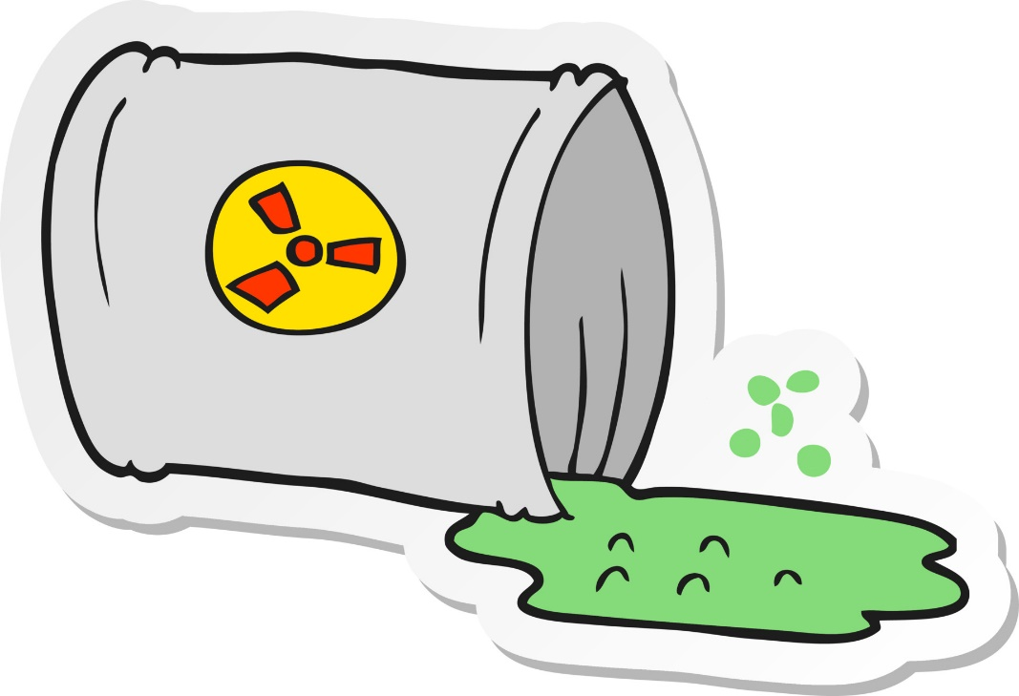
6.42 Products of Fission
Key Q
What are the products of fission?
The products of nuclear fission are radioactive!
This means that nuclear power stations produce nuclear waste.

Slide 88

6.43 Fusion
Key Q
What is nuclear fusion?
Nuclear fusion is the joining of two light nuclei to form a heavier nucleus.
In the process some of the mass may be converted into the energy of radiation.
Fusion is the energy source for stars.

Slide 89
6.44 Comparing Fission and Fusion
Key Q
What are the similarities and differences between fission and fusion?
 | Fission | Fusion
Process | One heavy nuclei splits to release energy | Two light nuclei combine to release energy.
Energy Released | Releases less energy | Releases more energy
Radioactivity of Products | Products are radioactive | Products are not radioactive
Energy Need for Process To Occurs | Needs a lot less energy than fusion | Needs more energy than fission

Slide 90
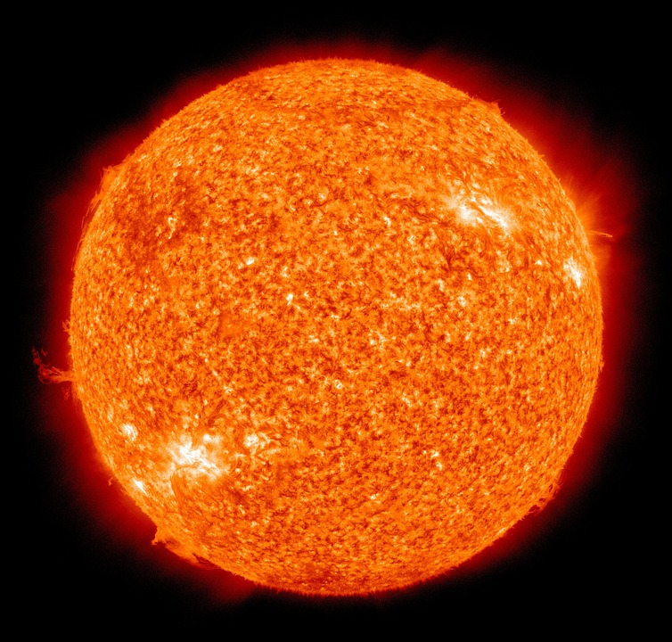
6.45 Conditions for Fusion
Key Q
What are the conditions that nuclear fusion takes place?
Nuclear fusion only takes place at high temperatures and high pressures.
This is due to the electrostatic repulsion of protons

Slide 91
6.45 Conditions for Fusion
Key Q
What are the conditions that nuclear fusion takes place?
The need for a very high temperature and pressure makes it very difficult to build a practical and economic fusion power station.
For fusion to occur at the lower pressures in a reactor on Earth, the temperature would need to be between 100 and 200 million degrees.
Fusion has been achieved on Earth, but currently its not financially viable.

