Slide 1
Light and EM Spectrum
Paper 1

Slide 2
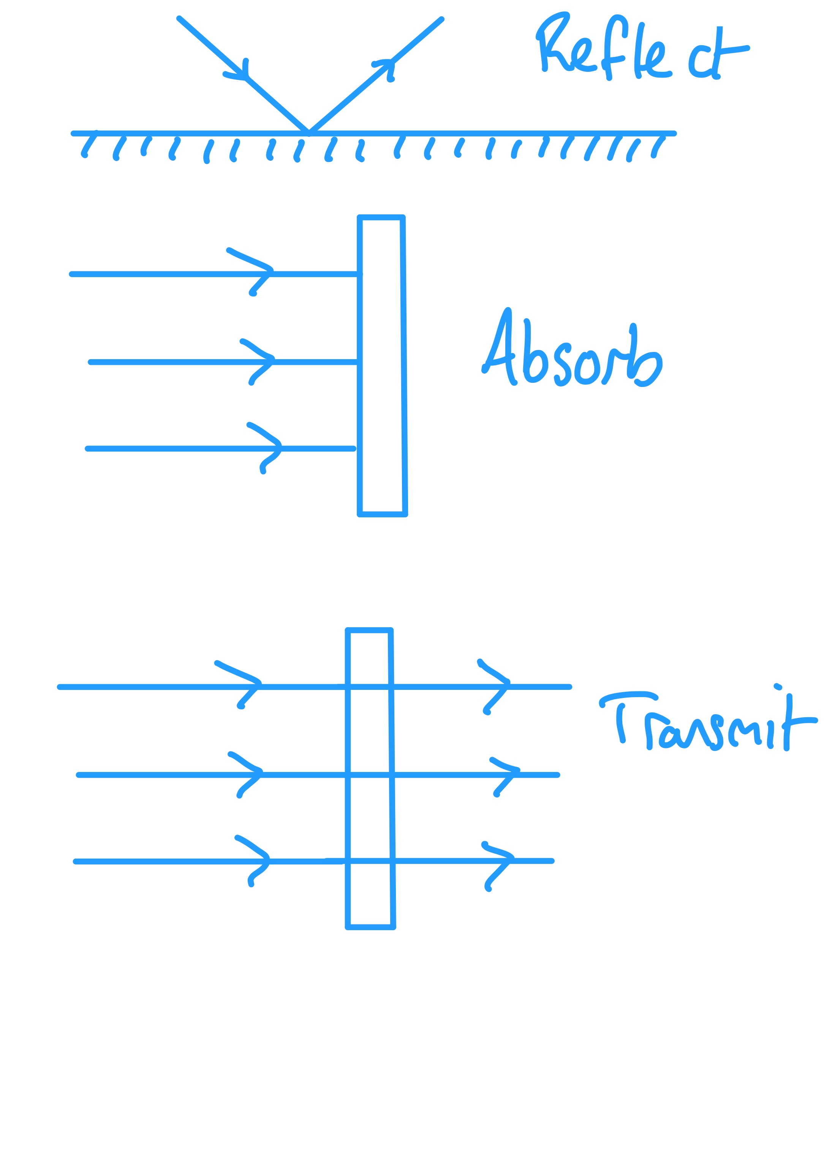
5.1 Ray Diagrams
Key Q
What can happen to waves at the boundary between two materials?
Absorption
Transmission
Reflection
Key Term | Definition
Material Interface | The boundary between two different materials.

Slide 3
5.1 Ray Diagrams
Define each of these key terms and construct a diagram for each.
Task
Key Term | Definition | Diagram
Transmit | When a wave passes through a material.
Absorb | When a wave is taken into a material.
Reflect | When a wave bounces off the material at the same angle that it hit.

Slide 4
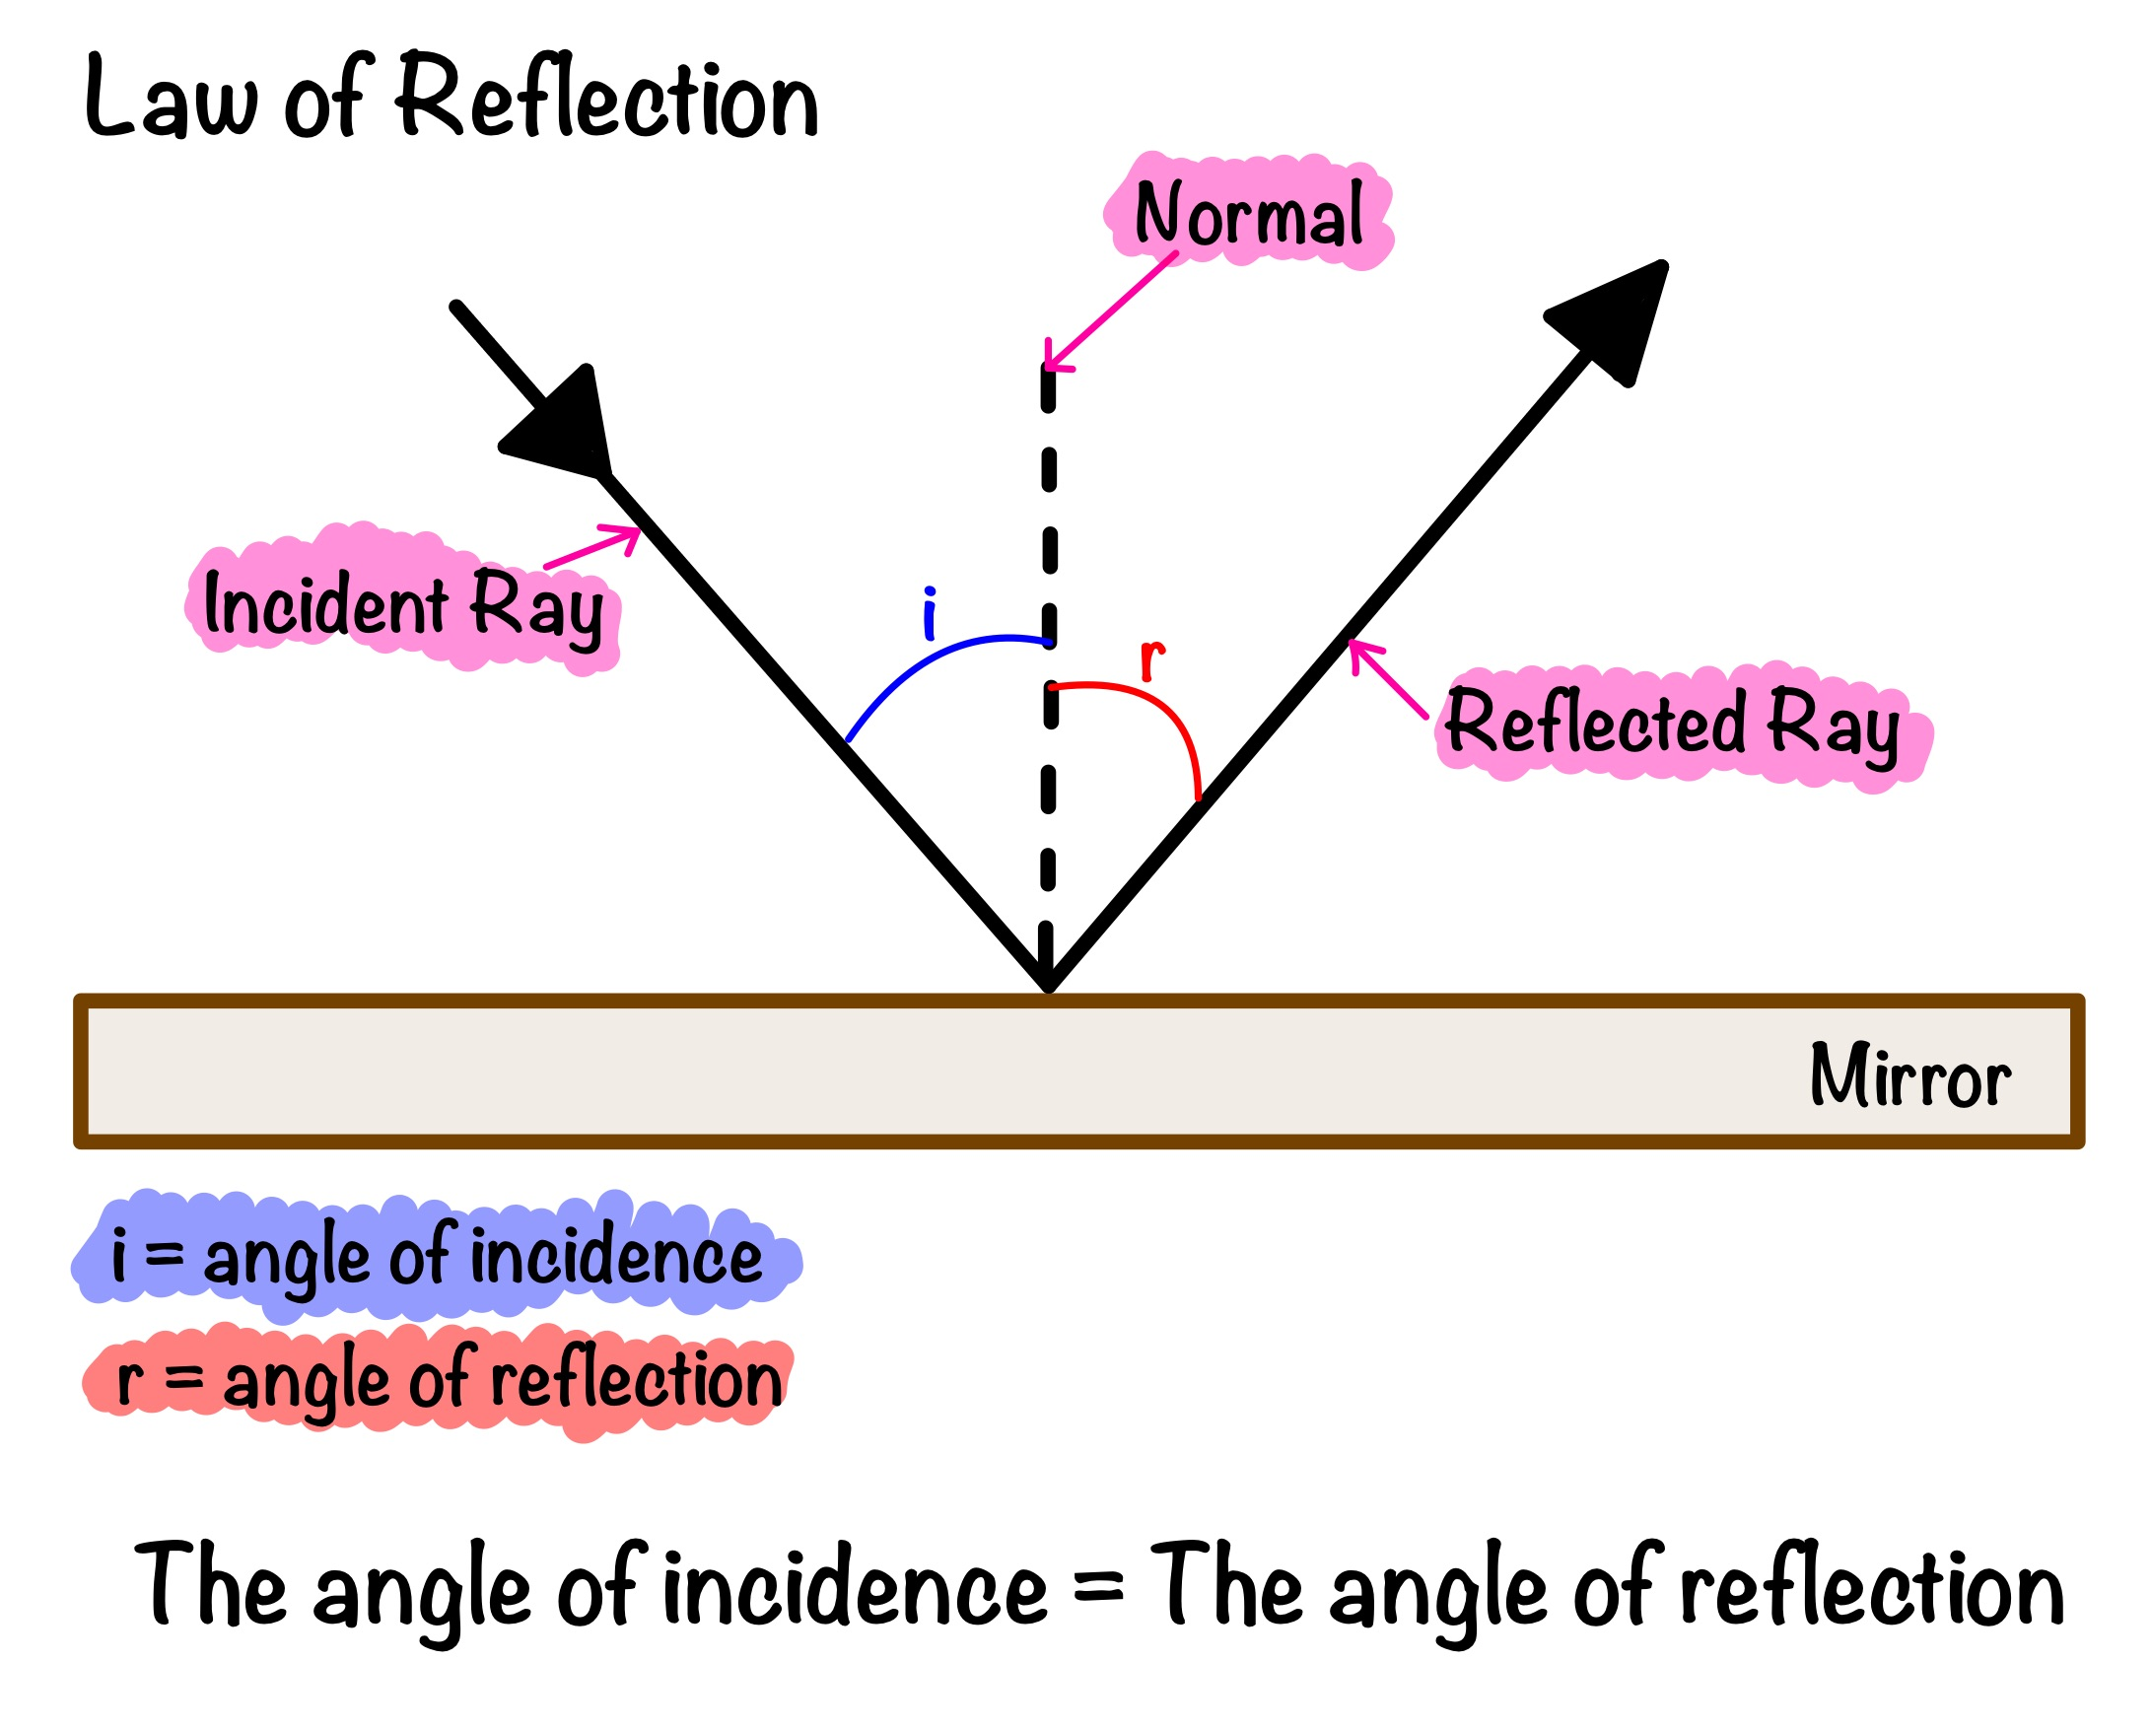
5.1 Ray Diagrams
Construct your own diagram to model reflection.
Task

Slide 5
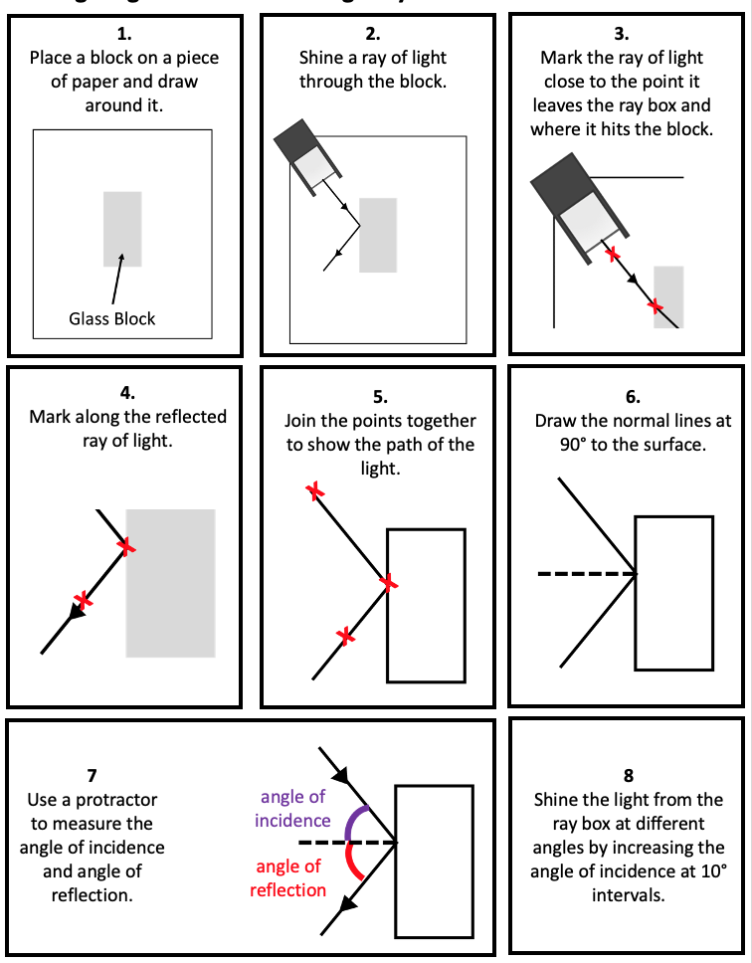
5.1 Ray Diagrams
Construct a method to investigate the reflection of a wave at a surface.
Task
This ray of light should be as narrow as possible to give the most accurate results.
A narrow ray makes it easier to determine where the centre of the ray is.

Slide 6
5.1 Ray Diagrams
Construct a method to investigate the reflection of a wave at a surface.
Task

Slide 7
5.1 Ray Diagrams
Construct a method to investigate the reflection of a wave at a surface.
Task

Slide 8
5.1 Ray Diagrams
Key Q
How can random errors occur when investigating reflection?
Struggling to determine the centre point of the ray.
Not putting the mirror back in the right place after taking some measurements.
Random errors can lead to uncertainty.
Key Term | Definition
Uncertainty | The interval within which the true value of a quantity can be expected to lie. It is determined by finding the range of data and dividing by 2.

Slide 9
5.1 Ray Diagrams
Determine the uncertainty for the following data sets.
Task
Data Set | Range | Uncertainty
52cm, 55cm, 48cm, 60cm, 58cm | 12cm | ±6cm
12°, 8°, 6°, 13°, 10°, 8°, 10° | 7° | ±3.5°
88°, 80°, 78°, 76°, 84°,80°, 74° | 14° | ±7°
22cm, 21cm, 22cm,21cm, 21cm | 1cm | ±0.5cm
48m, 52m, 55m, 42m, 58m, 43m, 50m | 16m | ±8m

Slide 10
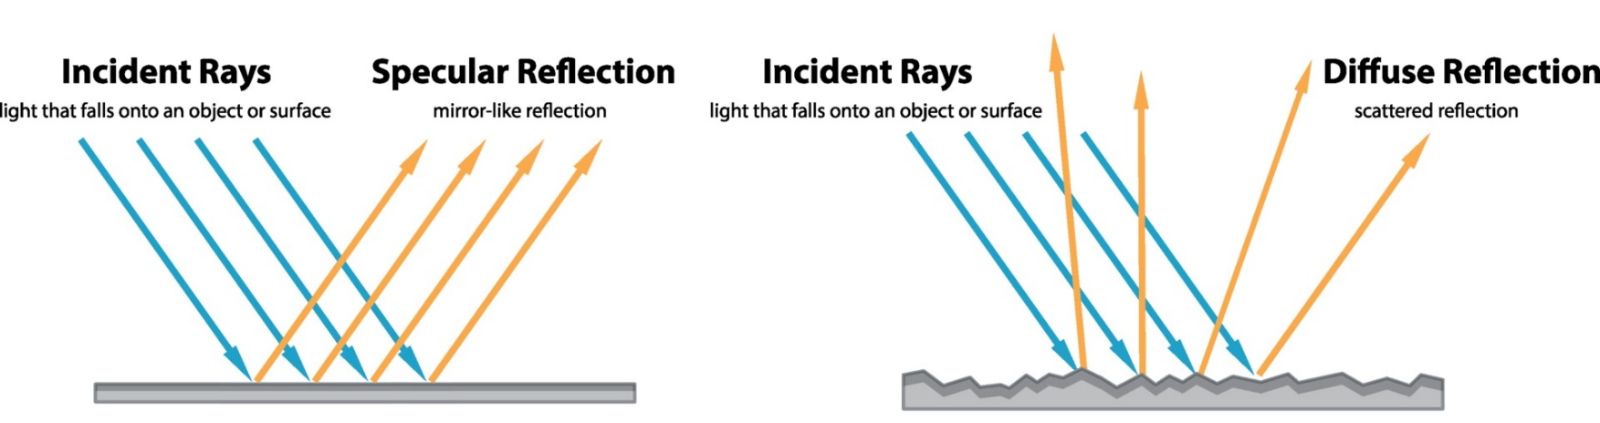
5.2 Specular and Diffuse Reflection
Key Q
What are specular and diffuse reflection?
Key Term | Definition
Specular Reflection | Reflection from a smooth surface.
Diffuse Reflection | Reflection from a rough surface.

Slide 11
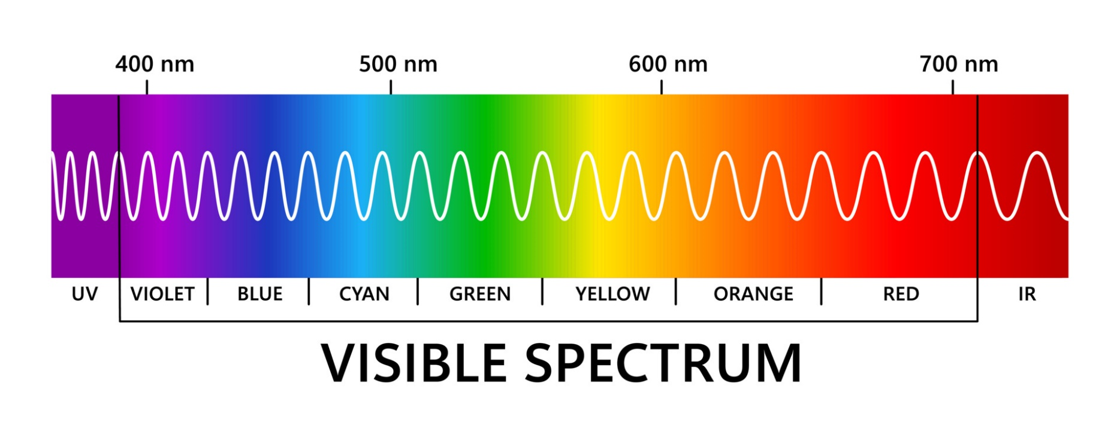
5.3 Colour of Light
Key Q
What is visible light?
Visible light is part of the electromagnetic spectrum.
Each colour within the visible light spectrum has its own narrow band of wavelength and frequency.

Slide 12
5.3 Colour of Light
Key Q
What is visible light?
Violet light is a higher frequency and a shorter wavelength
Red light has a lower frequency and a lower wavelength.

Slide 13
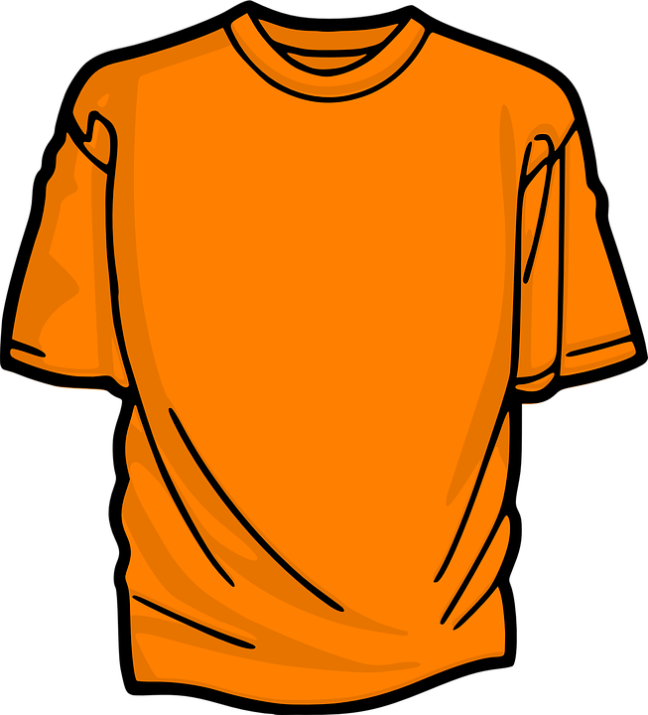
5.3 Colour of Light
Key Q
What determines the colour of an opaque object?
The colour of an opaque object is determined by which wavelengths of light are more strongly reflected.
For example, this t-shirt is strongly reflecting orange light.
Wavelengths that are not reflected are absorbed.

Slide 14
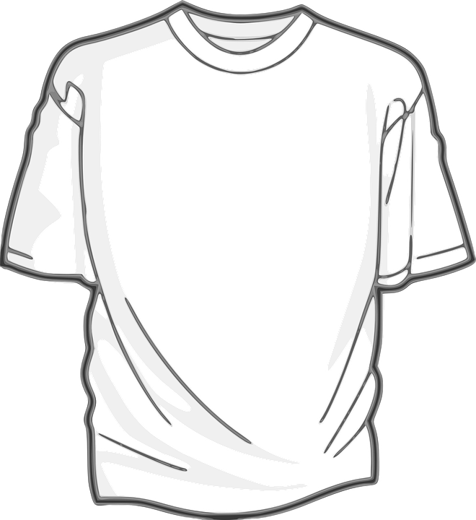
5.3 Colour of Light
Key Q
What determines the colour of an opaque object?
If all wavelengths are reflected equally the object appears white.

Slide 15
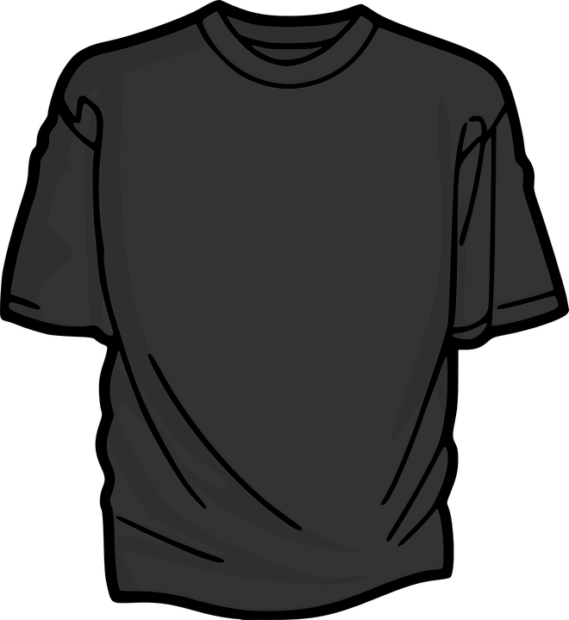
5.3 Colour of Light
Key Q
What determines the colour of an opaque object?
If all wavelengths are absorbed the objects appears black.

Slide 16
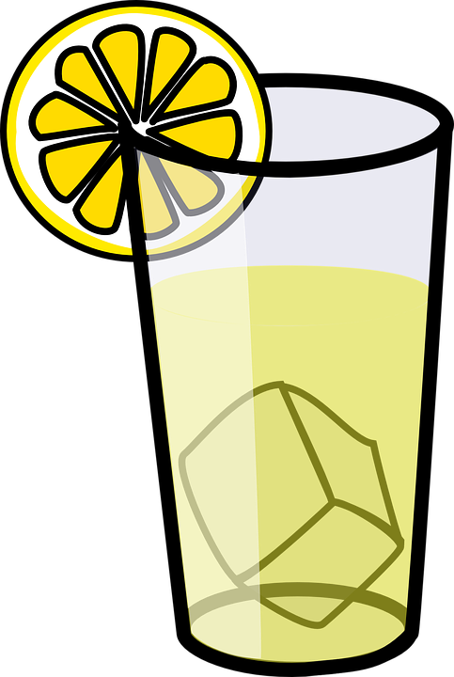
5.3 Colour of Light
Key Q
What determines the colour of an opaque object?
Objects that transmit light are either transparent or translucent.

Slide 17
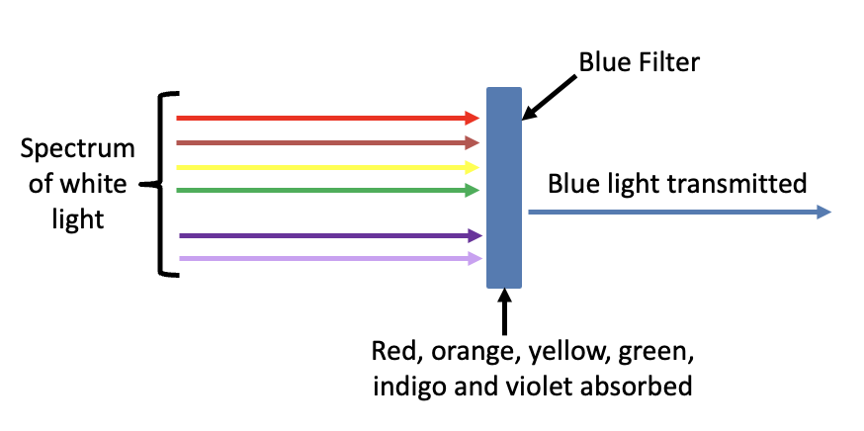
5.3 Colour of Light
Key Q
How do coloured filters work?
Colour filters work by absorbing certain wavelengths (and colour) and transmitting other wavelengths (and colour).

Slide 18
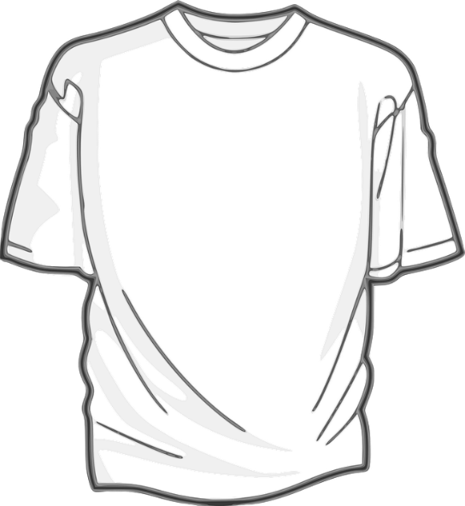

5.3 Colour of Light
Key Q
What colour would each of these objects appear under a blue light?
This t shirt would appear blue as it would reflect the blue light.§
This t shirt would appear black as it would absorb the blue light.

Slide 19
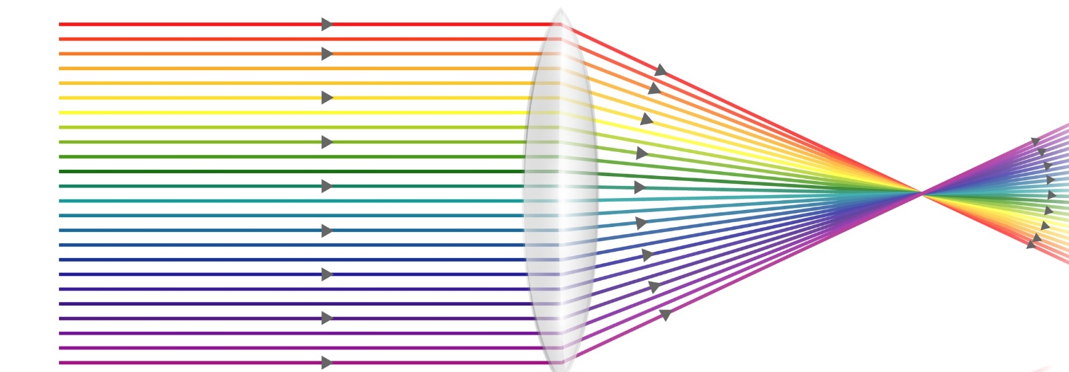
5.4 Lens Power
Key Q
How do lenses work?
A lens forms an image by refracting light.
In a convex lens, parallel rays of light are brought to a focus at the principal focus.
The distance from the lens to the principal focus is called the focal length.

Slide 20
5.4 Lens Power
Key Q
How do lenses work?
The greater the power of a lens the shorter the focal length!

Slide 21
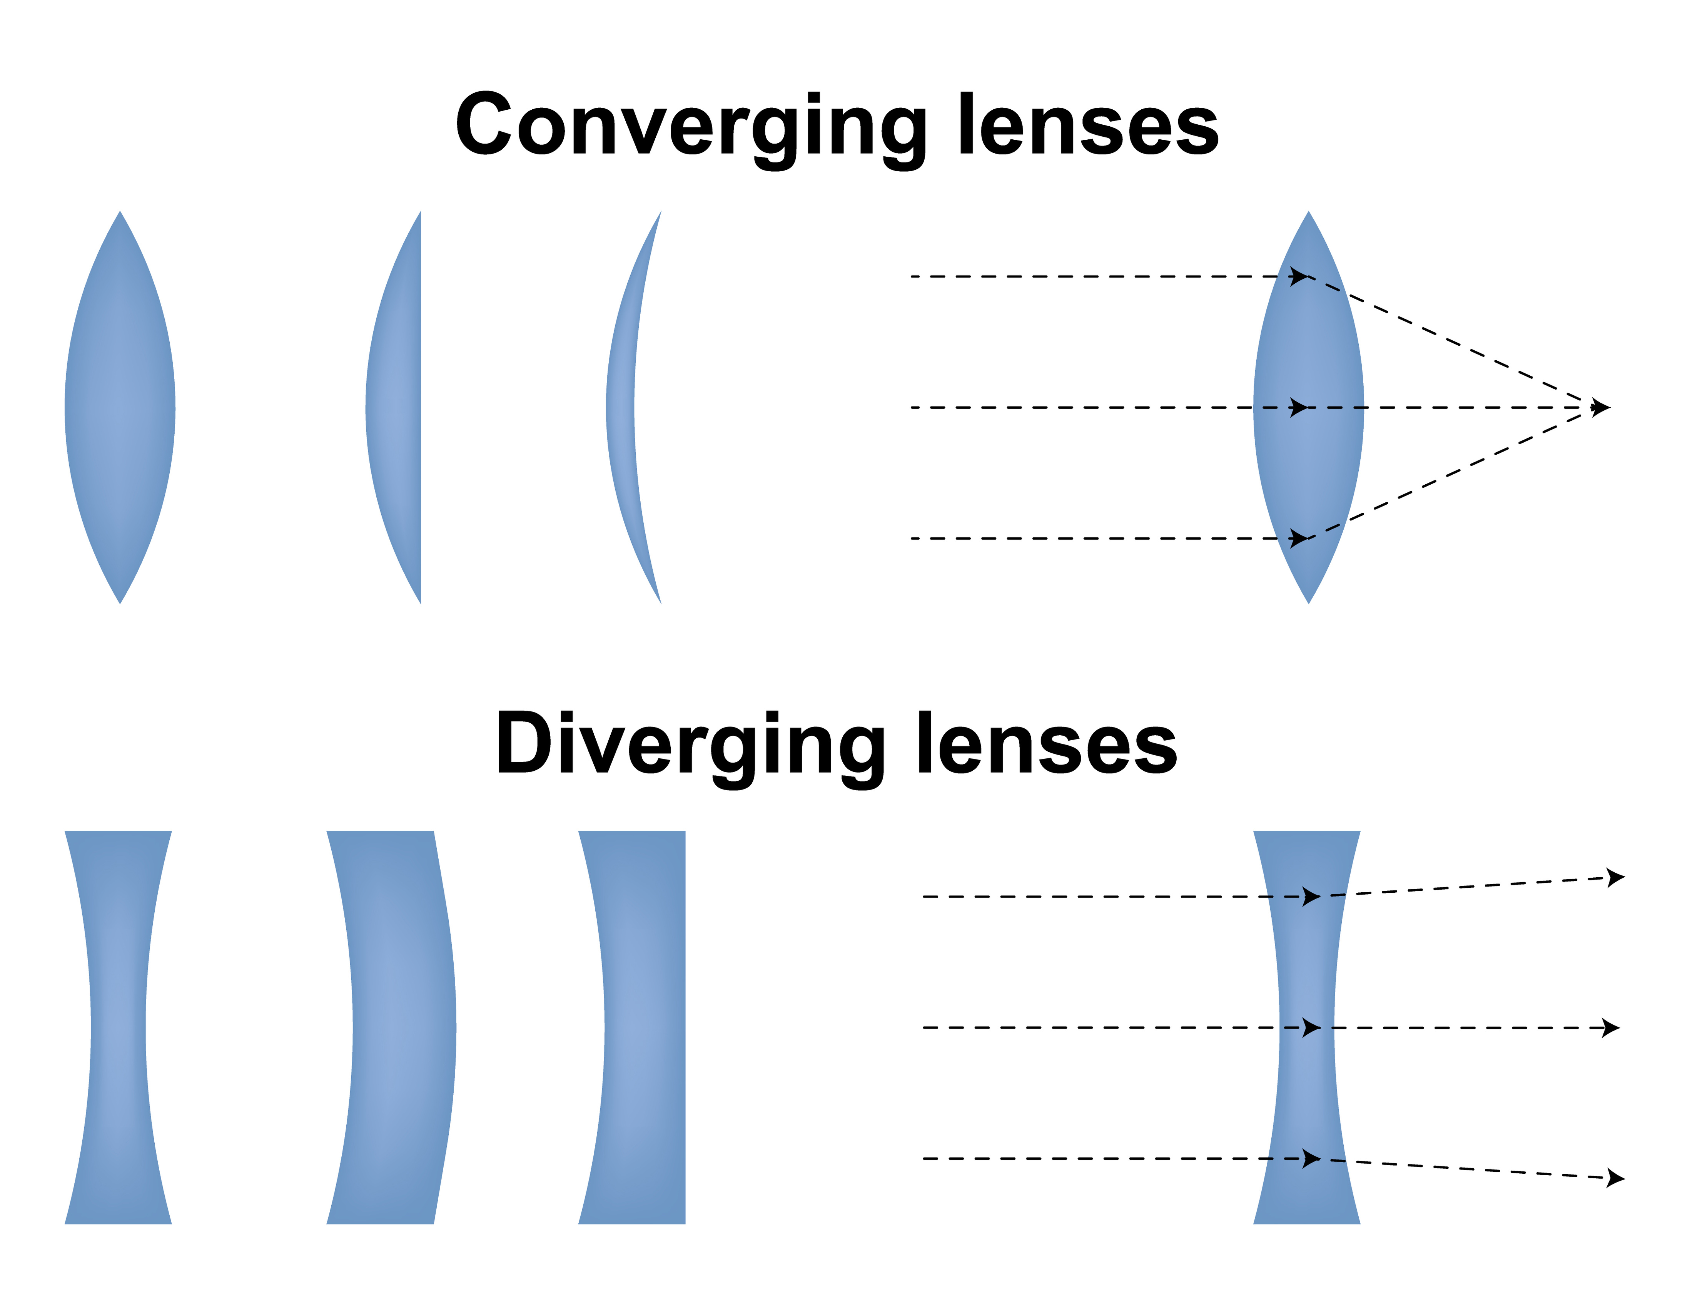
5.5 Lens Diagrams
Key Q
How do lenses work?
Lens | Diagram | Symbol | Type of Image Produced
Convex |  |  | Real of Virtual
Concave |  |  | Virtual

Slide 22
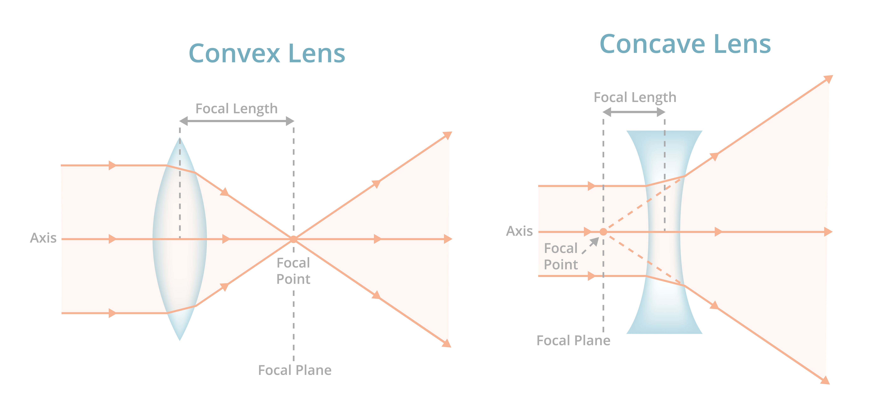
5.5 Lens Diagrams
Key Q
What are the differences between convex and concave lenses?
A convex lens is thicker in the middle than it is at the edges.
Parallel light rays that enter the lens converge.
They come together at a point called the principal focus.

Slide 23
5.5 Lens Diagrams
Key Q
What are the differences between convex and concave lenses?
A concave lens is thinner in the middle than it is at the edges.
This causes parallel rays to diverge.
They separate but appear to come from a principle focus on the other side of the lens.

Slide 24

5.5 Lens Diagrams
Key Q
How are ray diagrams for concave and convex lenses constructed?
Identify the type of lens that it is.
This is a convex lens and so the rays of light will converge as they pass.
F
F

Slide 25
5.5 Lens Diagrams
Key Q
How are ray diagrams for concave and convex lenses constructed?
F
F
Draw a straight line from the top of the object to the lens
This is a converging lens so extend this line to the Focal point beyond the lens

Slide 26
5.5 Lens Diagrams
Key Q
How are ray diagrams for concave and convex lenses constructed?
F
F
Draw a diagonal line from the top of the object through the cross.
Identify the point that the two line intersects.

Slide 27
5.5 Lens Diagrams
Key Q
How are ray diagrams for concave and convex lenses constructed?
This image is:
Real
Reduced
Upside down
F
F

Slide 28
5.5 Lens Diagrams
Key Q
How are ray diagrams for concave and convex lenses constructed?
Identify the type of lens that it is.
This is a convex lens and so the rays of light will converge as they pass.
F
F

Slide 29
5.5 Lens Diagrams
Key Q
How are ray diagrams for concave and convex lenses constructed?
F
F
Draw a straight line from the top of the object to the lens
This is a converging lens so extend this line to the focal point beyond the lens

Slide 30
5.5 Lens Diagrams
Key Q
How are ray diagrams for concave and convex lenses constructed?
F
F
Draw a diagonal line from the top of the object through the cross.
The object is in front of the focal point and so the lines will not converge beyond the lens

Slide 31
5.5 Lens Diagrams
Key Q
How are ray diagrams for concave and convex lenses constructed?
F
F
Extend the lines backwards.
These are imaginary lines and so are drawn as dashed line
Identify the point that these intersects

Slide 32
5.5 Lens Diagrams
Key Q
How are ray diagrams for concave and convex lenses constructed?
This image is:
Virtual
Enlarged
Upright
F

Slide 33
5.5 Lens Diagrams
Key Q
How are ray diagrams for concave and convex lenses constructed?
Identify the type of lens that it is.
This is a concave lens and so the rays of light will diverge as they pass.
F
F

Slide 34
5.5 Lens Diagrams
Key Q
How are ray diagrams for concave and convex lenses constructed?
F
F
Draw a straight line from the top of the object to the lens
This is a diverging lens so the ray of light will spread out.

Slide 35
5.5 Lens Diagrams
Key Q
How are ray diagrams for concave and convex lenses constructed?
F
F
Draw a diagonal line from the top of the object through the cross.
Identify the point that these intersects

Slide 36
5.5 Lens Diagrams
Key Q
How are ray diagrams for concave and convex lenses constructed?
F
F
This image is:
Virtual
Reduced
Upright

Slide 37
5.6 Lens Images
Key Q
What are real and virtual images?
Key Term | Definition
Real Image | An image that is formed where the rays of light are focused that can be projected onto a screen.
Virtual Image | An image that appears to come from behind the lens.

Slide 38
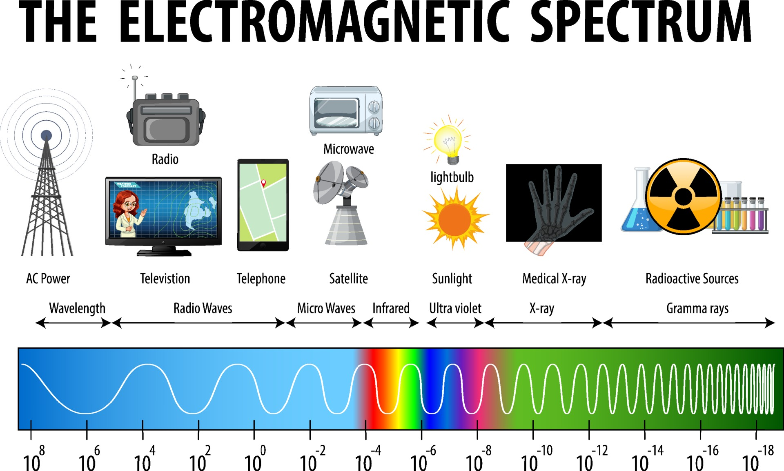
5.7 Electromagnetic Waves
Key Q
What are electromagnetic waves?
Key Term | Definition
Electromagnetic Waves | Transverse waves that transfer energy from the source to the waves to an absorber.

Slide 39
5.8 Electromagnetic Waves
Key Q
What is the electromagnetic spectrum?
Electromagnetic waves are grouped in the electromagnetic spectrum.
This is a continuous spectrum of all the types of electromagnetic waves that travel at the same velocity through a vacuum or air.

Slide 40
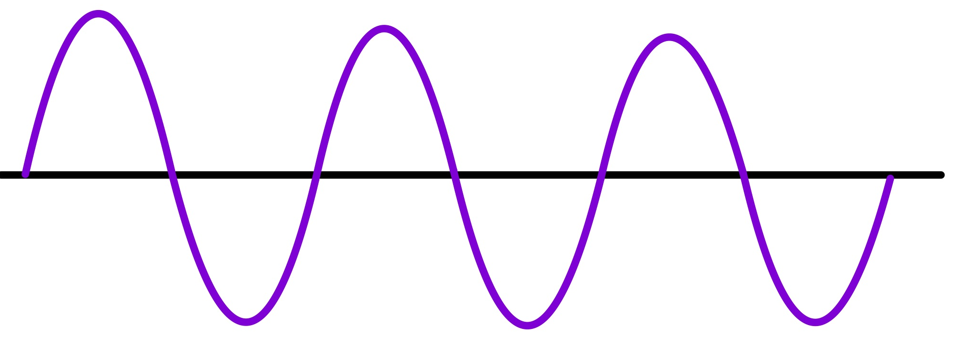
5.8 Electromagnetic Waves
Key Q
How do electromagnetic waves transfer energy?
Energy is transferred by electromagnetic waves as radiation.
All forms of electromagnetic radiation transfer energy from the source to the absorber.
This takes places without any need to particles and so can take place in a vacuum.

Slide 41
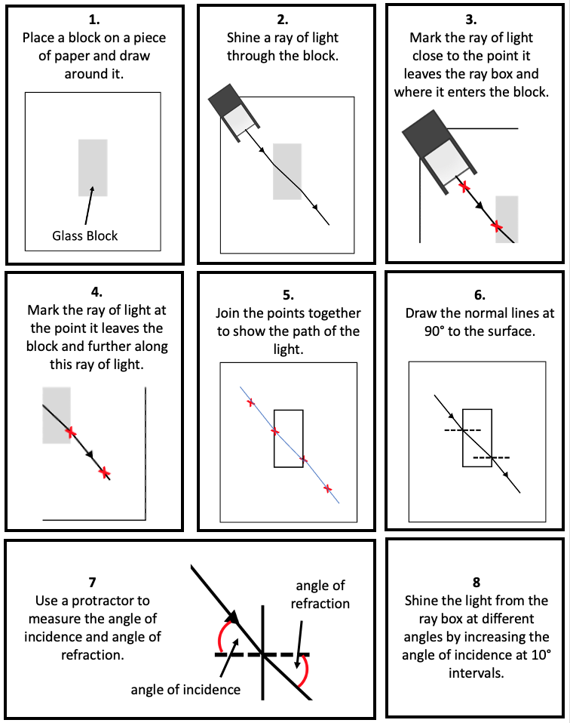
5.9 Core Practical
Construct a method to investigate the refraction of light through a block.
Task
This ray of light should be as narrow as possible to give the most accurate results.
A narrow ray makes it easier to determine where the centre of the ray is.

Slide 42
5.9 Core Practical
Construct a method to investigate the refraction of light through a block.
Task

Slide 43
5.9 Core Practical
Construct a method to investigate the refraction of light through a block.
Task

Slide 44
5.10 Groups in EM Spectrum
Key Q
What are electromagnetic waves?
Key Term | Definition
Electromagnetic Waves | Transverse waves that transfer energy from the source to the waves to an absorber.

Slide 45
5.11 Electromagnetic Spectrum
Long Wavelength
Short Wavelength
Our eyes only detect visible light and so detect a limited range of electromagnetic waves.
Low Frequency
High Frequency
The waves that form the electromagnetic spectrum are grouped in terms of their wavelength and their frequency.

Slide 46
5.11 Electromagnetic Spectrum
Key Q
What do all electromagnetic waves have in common?
They are all transverse waves.
They all travel at the same speed.
They can all travel through a vacuum.
They can all be refracted, reflected, absorbed and transmitted.

Slide 47
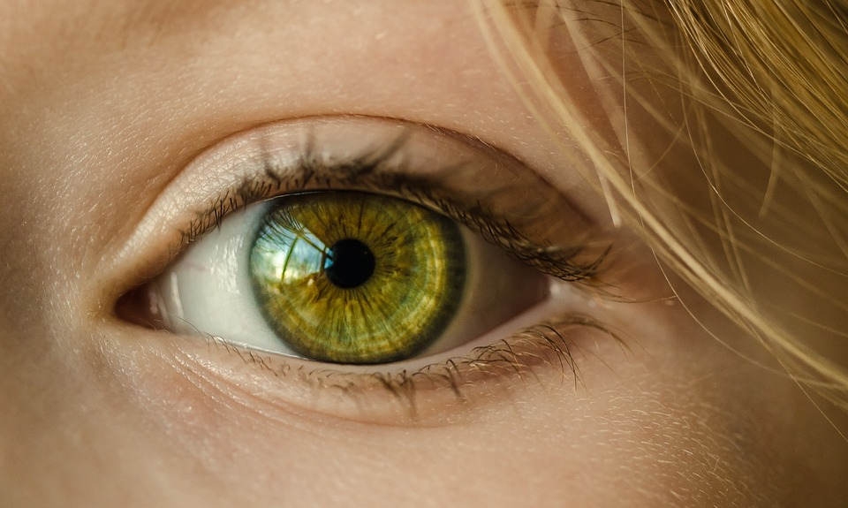
5.12 Electromagnetic Spectrum
Key Q
What can our eyes detect on the electromagnetic spectrum?
Our eyes are only able to detect visible light on the electromagnetic spectrum.
This is because the eye is only able to detect a very limited number of frequencies.

Slide 48
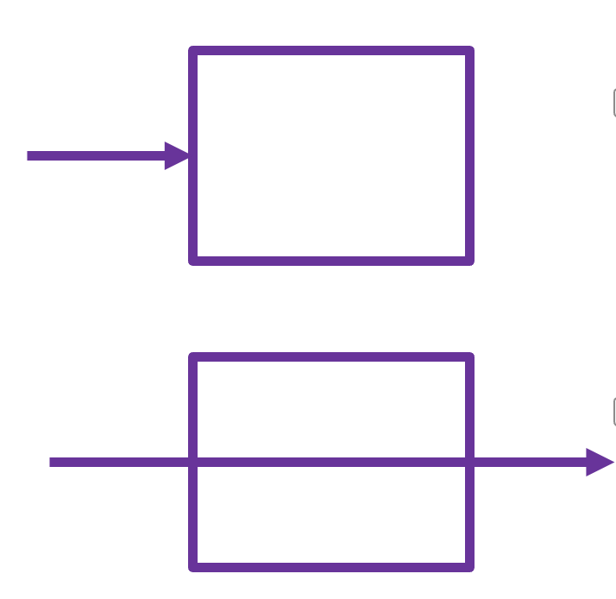
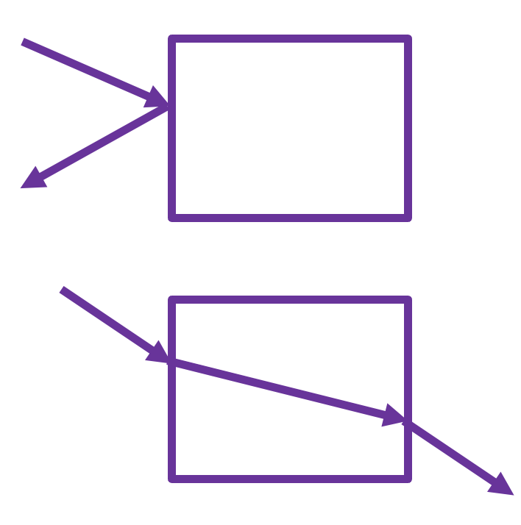
5.13 Transmission and Absorption
Key Q
What is the effect of different wavelengths on absorption and transmission?
Different substances may absorb, transit, refract or reflect waves in ways that vary with wavelength.

Slide 49
5.14 Velocity of EM Waves
Key Q
How does the speed of electromagnetic waves vary in different substances?
All parts of the electromagnetic spectrum travel at the same speed.
In air they travel at 3.0x10⁸m.
When they enter denser materials, they slow down. This is why refraction occurs.

Slide 50
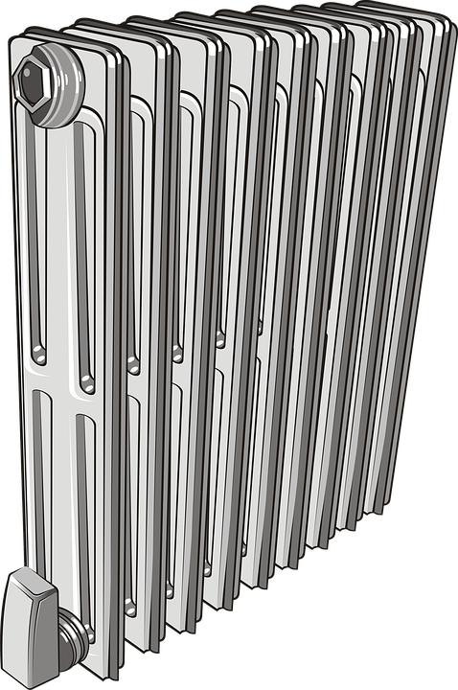
5.15 Bodies
All bodies (objects) emit radiation.
The intensity and wavelength distribution of any emission depends on the body's temperature.

Slide 51
5.16 Radiation
Key Q
What does it mean when waves are transmitted or absorbed?
Absorbed is when a wave is taken into a material.
Transmitted is when a wave passes through a material.

Slide 52
5.16 Radiation
Key Q
How does the surface of an object affect the radiation emitted from it?
White and shiny materials are poor emitters and poor absorbers of infrared radiation.
Black and matt materials are good emitters and good absorbers of infrared radiation.

Slide 53
5.17 Radiation
Scenario | Explanation in Terms of Infrared Radiation
A body is at a constant temperature. | The body is absorbing radiation at the same rate at which is it emitting radiation.
The temperature of a body is increasing | The body absorbs radiation faster than it emits radiation.

Slide 54
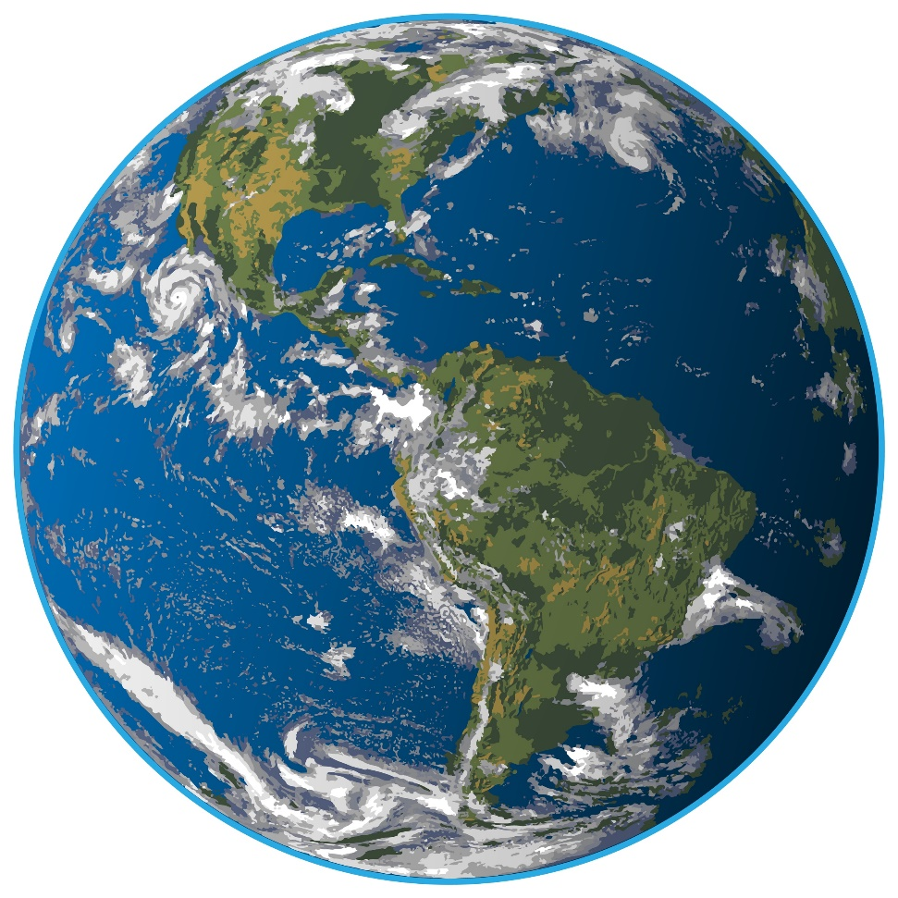
5.18 Temperature of Earth
Key Q
What does the temperature on Earth depend on?
The rates of absorption and emission of radiation.
Reflection of radiation into space.

Slide 55
5.18 Temperature of Earth
Key Q
What has happened to the temp of the Earth over the last 200 years in terms of radiation?
Temperatures on Earth are increasing.
This is because in the past the radiation emitted into space was equal to the radiation absorbed from space.
Today there is less emission into space and so there is an overall net absorption of radiation.

Slide 56
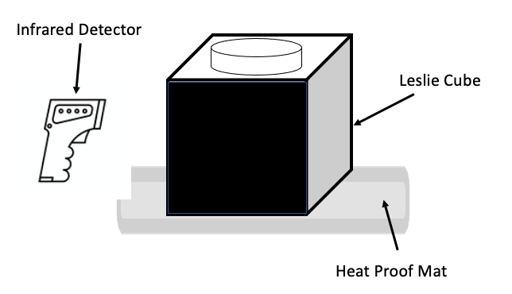
5.19 Core Practical
Key Q
How can we investigate the the amount of infrared radiation radiated by different surfaces?
Place the Leslie cube on a heat proof mat.
Fill the cube with very hot water and replace the lid.
Use an infrared detector to record the amount of radiation from each surface.
Construct a bar chart to display the results.

Slide 57
5.19 Core Practical
Key Q
How do we ensure that the results are valid in this investigation?
For valid results repeats need to be taken.
This is to be able to identify outliers and calculate averages.
There also need to be control variables.
Detector should be the same distance from the surface each time.
For example the infrared detector should be held the same distance from each surface.

Slide 58
5.19 Core Practical
Key Q
What does it mean when waves are transmitted or absorbed?
Absorbed is when a wave is taken into a material.
Transmitted is when a wave passes through a material.

Slide 59
5.19 Core Practical
Key Q
How does the surface of an object affect the radiation emitted from it?
White and shiny materials are poor emitters and poor absorbers of infrared radiation.
Black and matt materials are good emitters and good absorbers of infrared radiation.

Slide 60
5.19 Core Practical
Key Q
How can we investigate the the amount of infrared radiation radiated by different surfaces?
White surfaces will emit less infrared.
Black surfaces will emit more infrared.
Matt surfaces will emit more infrared.
They are good emitters.
Shiny surfaces will emit less infrared.
They are poor emitters.

Slide 61
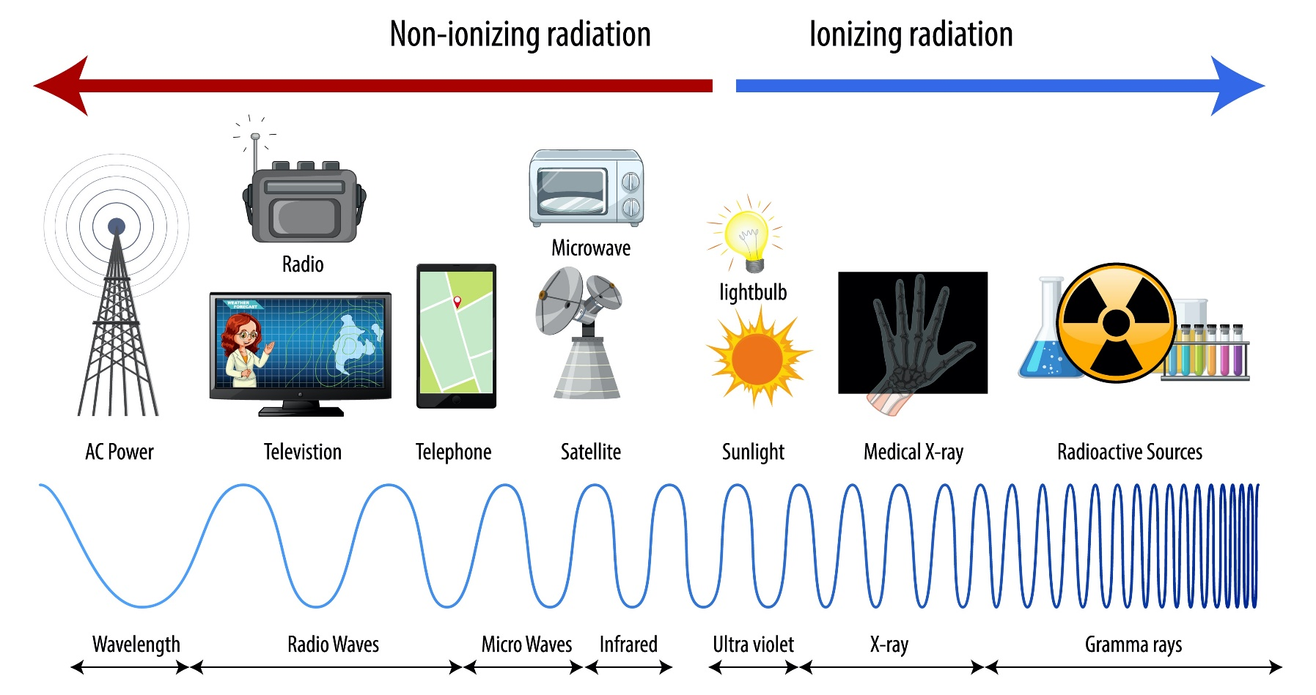

5.20 Dangers of EM Spectrum
Key Q
What are the risks of some of the parts of the electromagnetic spectrum?
Some parts of the electromagnetic spectrum are ionising which means that they pose a health risk.
The higher the frequency the greater the risk.

Slide 62
5.21 Dangers of EM Spectrum
Key Q
What are the risks of some of the parts of the electromagnetic spectrum?
Infrared radiation can cause burns.
Microwaves can be used to heat food, this can cause burns also.

Slide 63
5.21 Dangers of EM Spectrum
Key Q
What are the risks of some of the parts of the electromagnetic spectrum?
Ultraviolet waves, X-rays and gamma rays can have hazardous effects on human body tissue.
Ultraviolet waves can cause skin to age prematurely and increase the risk of skin cancer.
X-rays and gamma rays are ionising radiation that can cause the mutation of genes and cancer.

Slide 64

5.22 Uses of EM Waves
Key Q
What are the different uses that we have for electromagnetic waves?

Slide 65
5.22 Uses of EM Waves
Key Q
What are the different uses that we have for electromagnetic waves?
Radiowaves, microwaves and infrared radiation are all relatively safe.
They all have wavelengths longer than visible light and a lower frequency.
They are all used for communication purposes.

Slide 66

5.22 Uses of EM Waves
Key Q
How are radiowaves used in communication?
Radiowaves are used for:
Radios
Television

Slide 67
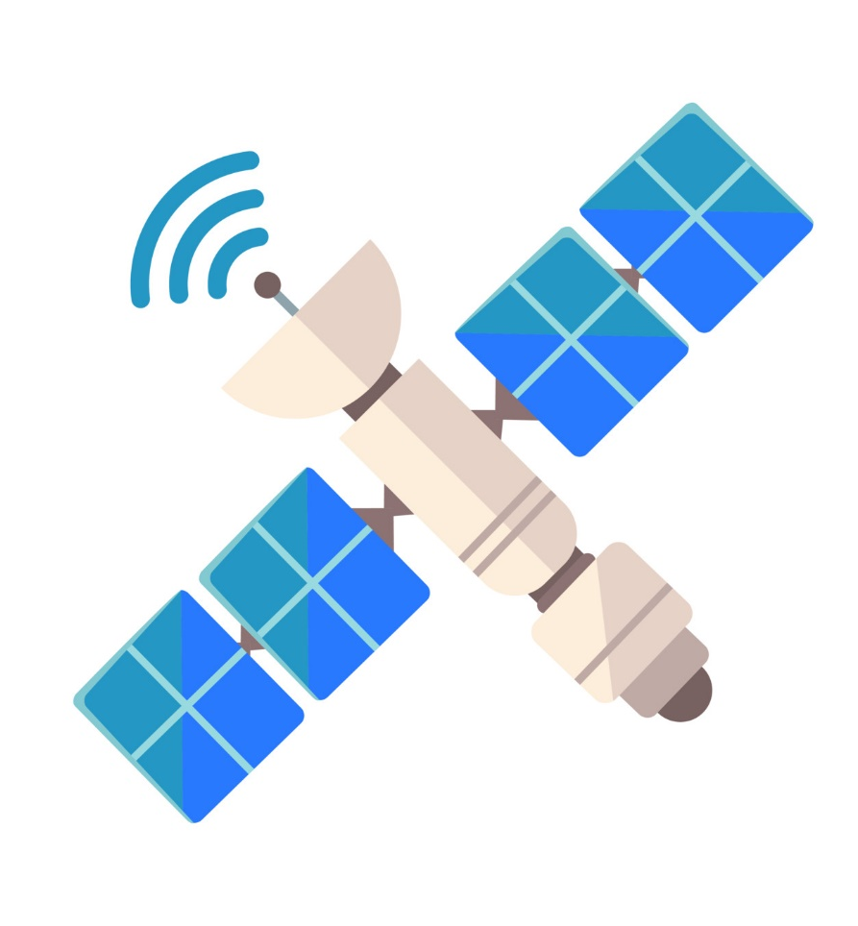
5.22 Uses of EM Waves
Key Q
How are microwaves used in communication?
Microwaves are used for:
Satellite Communications

Slide 68
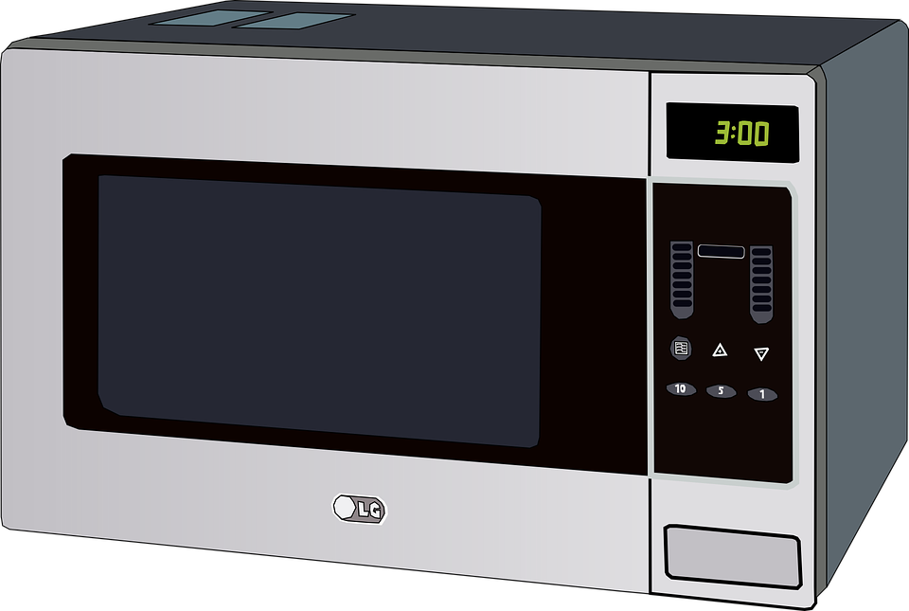
5.22 Uses of EM Waves
Key Q
What other uses are there for microwaves?
Microwaves are also used for:
Cooking Food

Slide 69
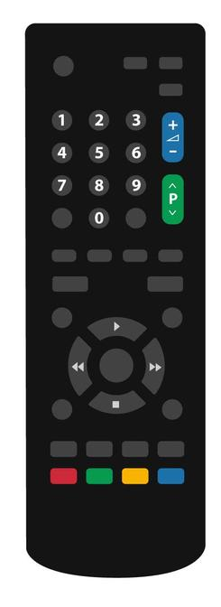
5.22 Uses of EM Waves
Key Q
When is infrared used in communication?
Infrared is used for:
Remote Controls
Optical Fibres

Slide 70
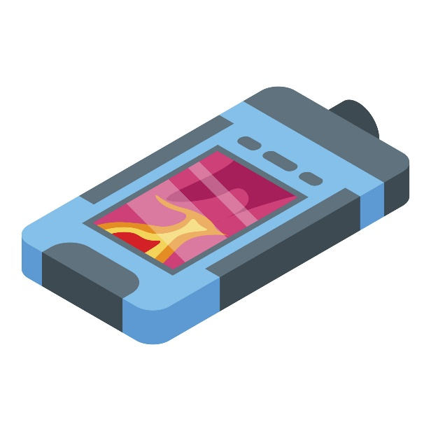
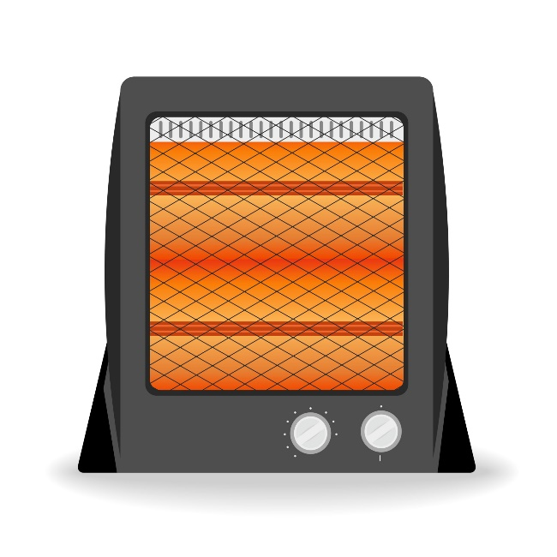
5.22 Uses of EM Waves
Key Q
What other uses are there for infrared?
Infrared are also used for:
Heaters
Cooking Food
Infrared Cameras/Security Systems

Slide 71
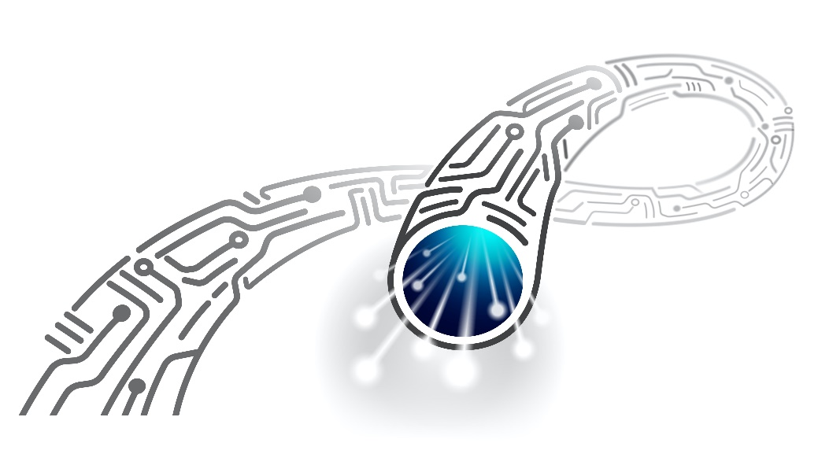
5.22 Uses of EM Waves
Key Q
How is visible light used in communication?
Visible light is used for:
Fibre Optic Communications
Photography
Vision

Slide 72
5.22 Uses of EM Waves
Key Q
What are the different uses that we have for electromagnetic waves?
Ultraviolet, X-rays and gamma rays are all ionising and so do have risks.
They all have wavelengths shorter than visible light and have a higher frequency.
They are also used for different purposes.

Slide 73

5.22 Uses of EM Waves
Key Q
What are the uses for ultraviolet radiation?
Ultraviolet can be used for:
Energy Efficient Bulbs
Sun Tanning
Detecting Forgery
Disinfecting Water

Slide 74
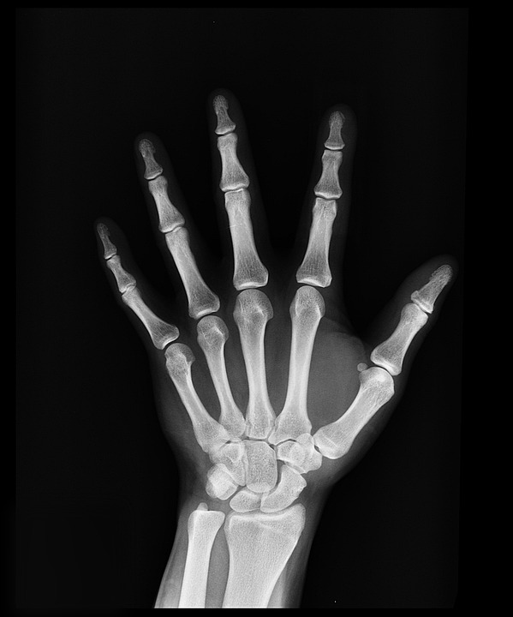
5.22 Uses of EM Waves
Key Q
What are the uses for X-Rays?
X-Rays can be used for:
Medical Imaging
Detecting Broken Bones
Airport Security

Slide 75
5.22 Uses of EM Waves
Key Q
What are the uses for gamma rays?
Gamma rays can be used for:
Medical treatments to kill cancerous cells
To sterilise equipment
As medical tracers

Slide 76
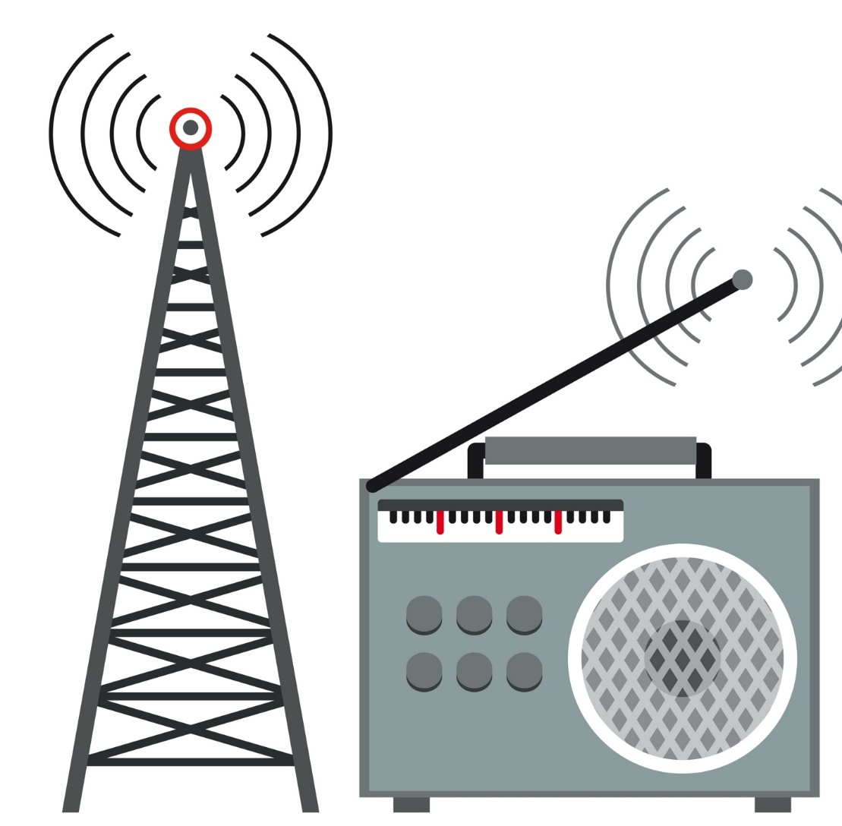
5.23 Radiowaves
Key Q
How are radiowaves produced?
Radio waves can be produced by oscillations in electrical circuits.
The radio wave generated will have the same frequency as the oscillations as the electric current.

Slide 77
5.23 Radiowaves
Key Q
How can radiowaves induce a current?
When radiowaves are absorbed they will create an alternating current.
This alternating current will have the same frequency as the radio wave itself.

Slide 78
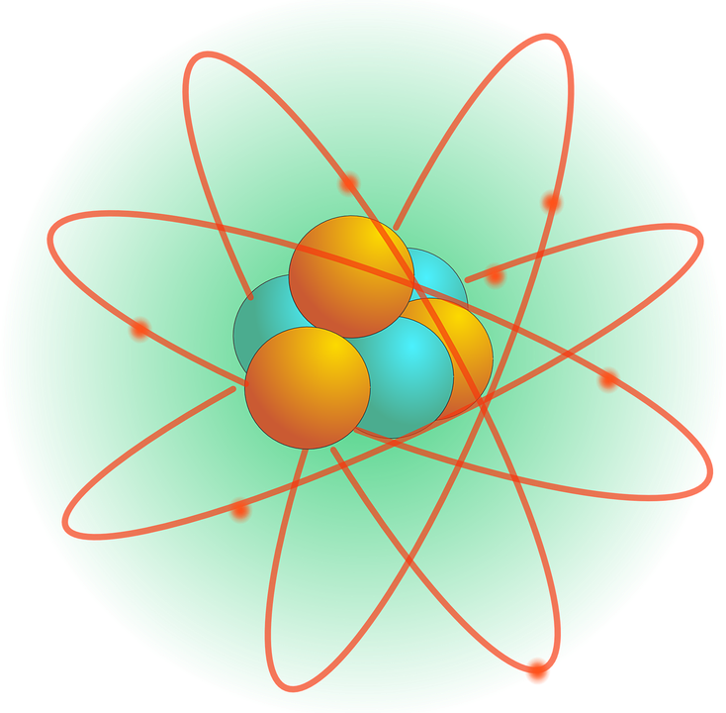
5.24 Changes in the Atom
Changes in the atom and in a nuclei can generate radiations over a wide frequency range.
Changes in the atom and in a nuclei can also be caused by absorption of a range of radiations.

