Slide 1
Waves
Paper 1

Slide 2
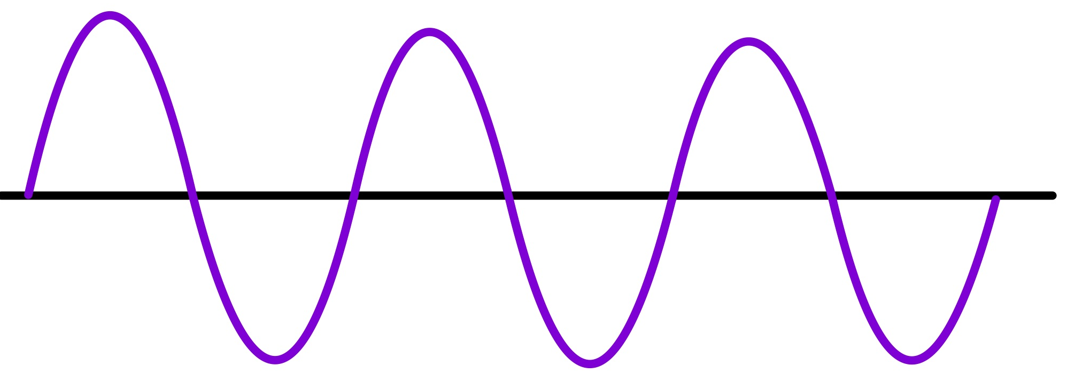
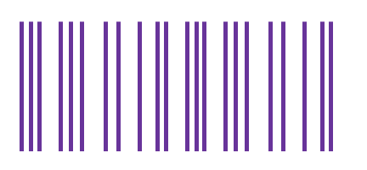
4.1 Waves
Key Q
What are waves?
Waves transfer energy and information without transferring matter.
Waves can be used to transfer energy between stores.

Slide 3

4.2 Waves
Key Q
How can we prove that it is the wave travelling and not water itself?
Place a floating object such as a rubber duck on the surface of the water.
You would observe the duck moving up and down as the waves pass but staying in the same place if the water doesn’t move.

Slide 4

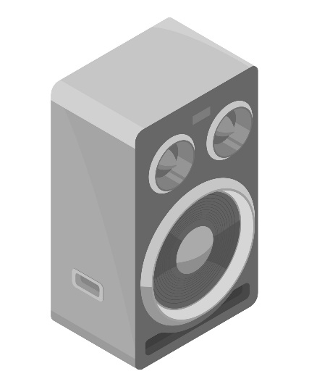
4.2 Waves
Key Q
How can we prove that it is the wave travelling and not air itself?
A vibrating drum skin doesn’t move air away to create a vacuum around the drum.
A loudspeaker doesn’t cause a gust of wind.

Slide 5
4.3 Wave Key Terms
Key Q
What are the different parts on this transverse wave?
The distance from a point on one wave to the equivalent point on the adjacent wave.
Wavelength
Amplitude
The maximum displacement of a point on a wave away from its undisturbed position.

Slide 6
4.3 Wave Key Terms
Key Q
What are the different parts on this longitudinal wave?
Rarefaction
Area of low pressure due to particles being far apart
Compression
Area of high pressure due to particles being close together

Slide 7
4.3 Wave Key Terms
Key Q
What is amplitude and wavelength?
Wavelength
Amplitude
Key Term | Definition
Amplitude | The maximum displacement of a point on a wave away from its undisturbed position.
Wavelength | The distance from a point on one wave to the equivalent point on the adjacent wave.

Slide 8
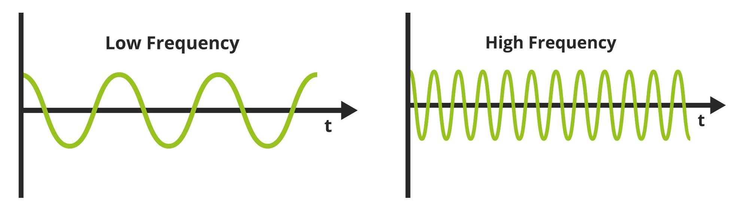
4.4 Wave Key Terms
Key Q
What is frequency and period?
Key Term | Definition
Frequency | The number of waves passing a point each second
Period | Time taken for one complete wave to be produced.

Slide 9
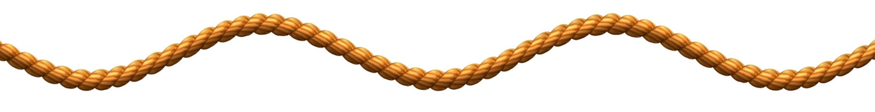
4.5 Transverse and Longitudinal
Key Q
What are transverse waves?
For some waves the disturbance of the medium as the wave passes is at right angles to its direction of motion.
This is a transverse wave.
An example of a transverse wave include water wave, S waves and electromagnetic waves

Slide 10

4.5 Transverse and Longitudinal
Key Q
What are longitudinal waves?
For other waves the disturbance of the medium as the wave passes is parallel to its direction of motion.
This is a longitudinal wave.
Examples of longitudinal waves include the compression pulses of a slinky spring, sound and p-waves

Slide 11
4.5 Transverse and Longitudinal
Key Q
What are transverse and longitudinal waves?
Type of Wave | Diagram | Example
Transverse |  | Ripples on the surface of water and light
Longitudinal |  | Sound Waves Ultrasound Waves

Slide 12
4.5 Transverse and Longitudinal
Key Q
What are the differences between these waves?
Transverse
Longitudinal
Do not have areas of compression and rarefaction.
Have areas of compression and rarefaction.

Slide 13
4.5 Transverse and Longitudinal
Key Q
What are the differences between these waves?
Transverse
Longitudinal
Can travel through a vacuum
Unable to travel through a vacuum.

Slide 14
4.5 Transverse and Longitudinal
Key Q
What are the differences between these waves?
Transverse
Longitudinal
Direction of Vibrations
Direction of Vibrations
Direction of Wave
Direction of Wave
The vibrations are at right angles to the direction of wave travel
The vibrations are parallel to the direction of the waves travel

Slide 15
4.5 Transverse and Longitudinal
Key Q
What are the differences between transverse and longitudinal waves?
Property | Transverse | Longitudinal
Areas of Compression and Rarefaction | No areas of their compression of rarefaction | Has areas of compression and rarefaction
Travelling in Vacuums | Can travel in vacuums | Unable to travel through vacuums
Direction of Travel | Vibrations at right angles to direction of wave travel | Vibration parallels to direction of the wave travel

Slide 16
4.6 Wave Speed
Key Q
What is wave speed?
Hertz
Hz
Wave Speed = Frequency x Wavelength
v = f x λ
Metres per second
m/s
Metres
m
Key Term | Definition
Wave Speed | The speed at which the energy is transferred through a medium.

Slide 17
4.6 Wave Speed
Key Q
How else can wavespeed be determined?
Wave Speed = Distance / Time
v = x x t
Metres per second
m/s
Seconds
s
Metres
m
Key Term | Definition
Wave Speed | The speed at which the energy is transferred through a medium.

Slide 18
4.6 Wave Speed
Determine the speed of a wave when frequency is 25Hz and wavelength is 22mm (3 marks)
Convert Units | 22mm = 0.022
Write down the formula. | v = f x λ
Substitute Values | v = 25 x 0.022
Do the Maths | v = 0.56
Round and add units. | 0.56m/s
Usually 1 mark for this.
Answer to 2 s.f which is the same as the values in the qu.

Slide 19
4.6 Wave Speed
Calculate the frequency of a wave when the wave speed is 12m/s and the wavelength is 12mm
Convert Units | 12mm = 0.012
Write down the formula. | v = f x λ
Substitute Values | 12 = f x 0.012
Do the Maths | f = 12 / 0.012 f = 1000
Round and add units. | 1000Hz
Usually 1 mark for this.
Substitute before you do any rearranging. 1 mark for doing this.
Show each step that you do. 2 marks available here.

Slide 20
4.6 Wave Speed
Calculate wave speed when... | The frequency is 17Hz and wavelength is 0.2m | The frequency is 35Hz and wavelength is 15cm | The frequency is 1.2kHz and wavelength is 2mm
Convert Units | - | 15cm = 0.15 | 1.2kHz = 1200Hz 2mm = 0.002
Write down the formula. | v = f x λ | v = f x λ | v = f x λ
Substitute Values | v = 17 x 0.2 | v = 35 x 0.15 | v = 1200 x 0.002
Do the Maths | 3.4 | 5.25 | 2.4
Round and add units. | v = 3.4m/s | v = 5.3m/s | v = 2.4m/s

Slide 21
4.6 Wave Speed
Calculate wavelength when... | Wave speed is 12m/s and frequency is 500Hz | Wave speed is 5m/s and frequency is 2.8kHz | Wave speed is 75m/s and frequency is 3.1kHz
Convert Units | - | 2.8kHz = 2800Hz | 3.1kHz = 3100Hz
Write down the formula. | v = f x λ | v = f x λ | v = f x λ
Substitute Values | 12 = 500 x λ | 5 = 2800 x λ | 75 = 3100 x λ
Do the Maths | λ = 12/500 =0.024 | λ = 5/2800 =0.001785714286 | λ = 75/3100 =0.02419354839
Round and add units. | λ = 0.024m | λ = 0.0018m | λ = 0.024m

Slide 22
4.6 Wave Speed
Key Q
How can wavespeed be determined using distance and time?
Wave Speed = Distance / Time
v = x x t
Metres per second
m/s
Seconds
s
Metres
m
Key Term | Definition
Wave Speed | The speed at which the energy is transferred through a medium.

Slide 23
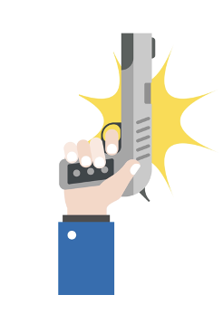
4.7 Wave Speed
Key Q
How can we measure the speed of sound waves in air?
2 people stand 500m apart.
1 person fires a gun into the air and raises their other hand into the air at the same time.
The second person records how long it takes for them to hear the bang.
Divide the distance by the time to determine the speed of sound.

Slide 24
4.7 Wave Speed
Key Q
How can we measure the speed of sound waves in air?
2 people stand 500m apart.
1 person fires a gun into the air and raises their other hand into the air at the same time.
The values will be recorded will be dependent on the reaction time of the observer and so the reaction time won’t be completely accurate.
The second person records how long it takes for them to hear the bang.
Divide the distance by the time to determine the speed of sound.

Slide 25
4.8 Calculating Depth and Time
Key Q
How can depth and distance be determined if we know velocity and time taken?
Wave Speed = Distance / Time
v = x x t
Metres per second
m/s
Seconds
s
Metres
m
To calculate either distance or depth we can use the above equation provided we know the time and velocity.

Slide 26
4.9 Behaviour of Waves
Key Q
What does it mean when waves are transmitted or absorbed?
Absorbed is when a wave is taken into a material.
Transmitted is when a wave passes through a material.

Slide 27
4.9 Behaviour of Waves
Key Q
What does it mean when waves are reflected or refracted?
Reflection is when a wave bounces off the material at the same angle that it hit.
Refraction is when a wave changes direction when it passes from one material to another.

Slide 28
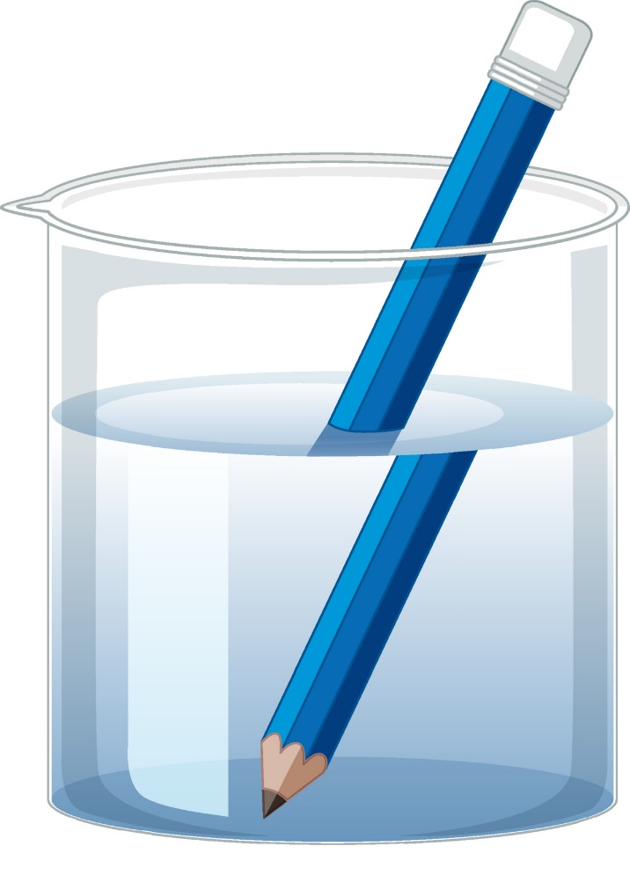
4.10 Refraction
Key Q
What is refraction?
Light refracts when it travels from one medium to another.
When light travels into a denser material it slows down and bends towards the normal. (H)
When light travels into a less dense material it speeds up and bends away from the normal. (H)
Key Term | Definition
Refraction | The change of direction of a wave when it travels from one medium to another.

Slide 29
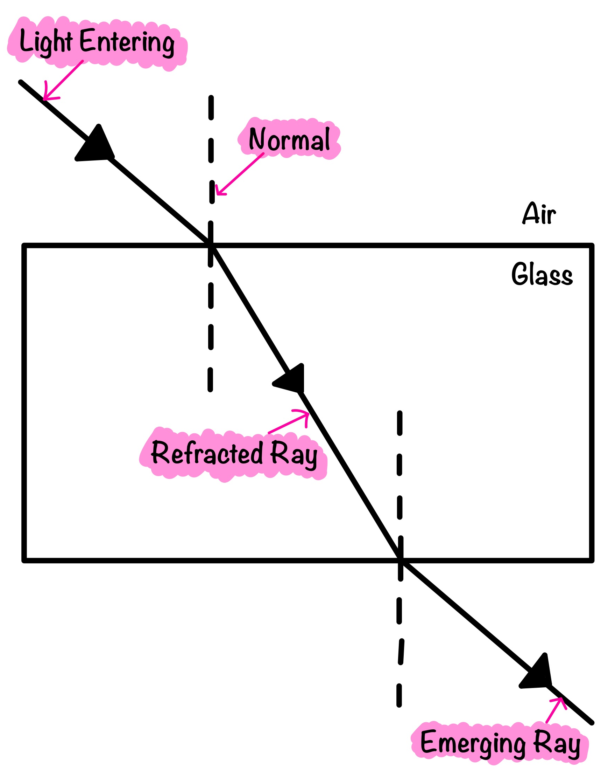
4.10 Refraction
Key Q
What happens during refraction?
When light enters glass, it slows down and so changes direction. It bends towards the normal.
When light leaves the glass and enters air it speeds up and so bends away from the normal.

Slide 30
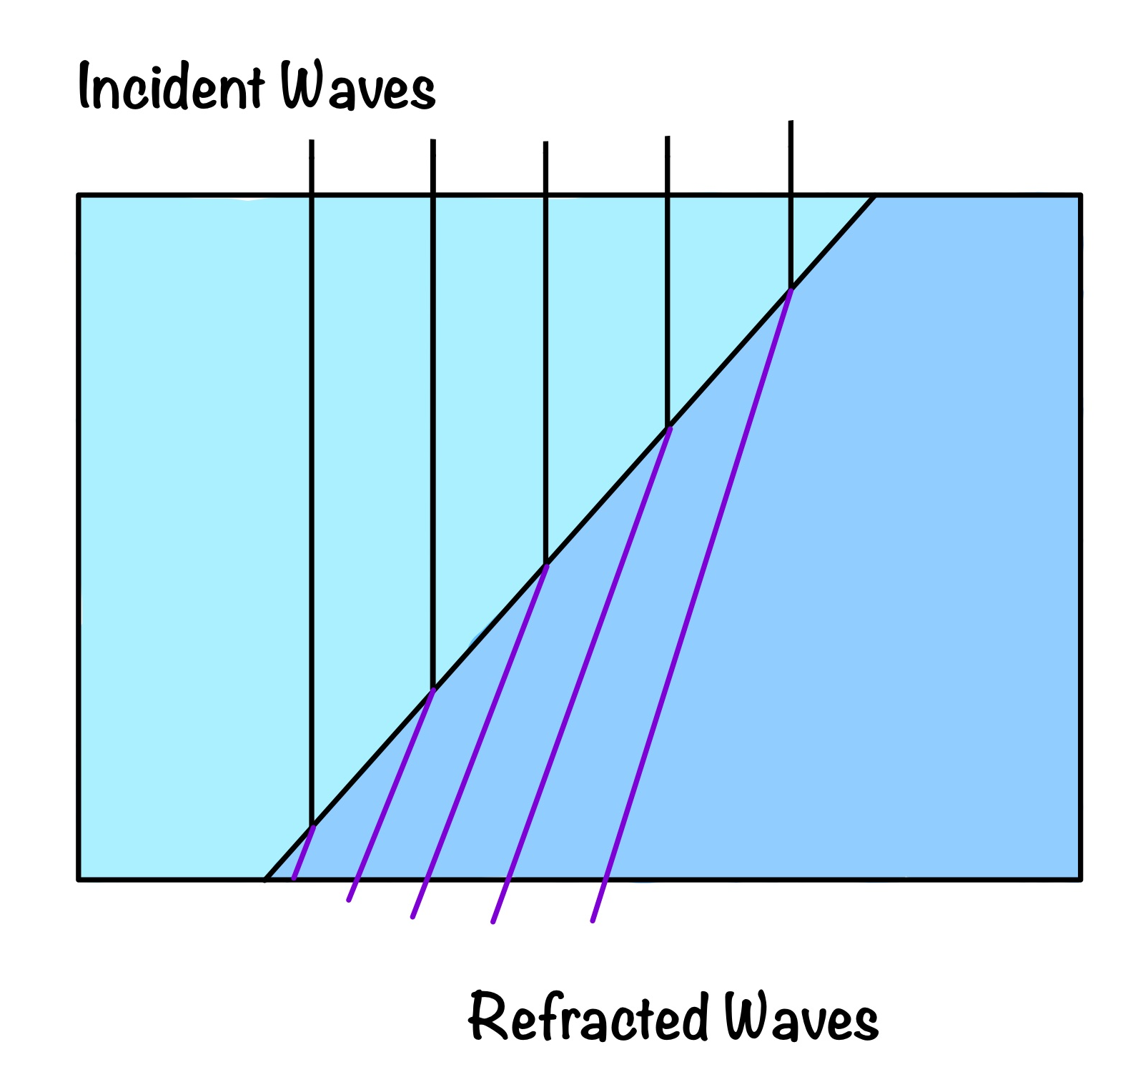
4.10 Refraction
Key Q
What happens during refraction?
When a wave crosses a boundary at a non-zero angle to the boundary each wave front experiences a change in speed and direction.
In this diagram the wave has slowed down and so the refracted waves are closer together and at a smaller angle to the boundary than the incident wavefronts.

Slide 31
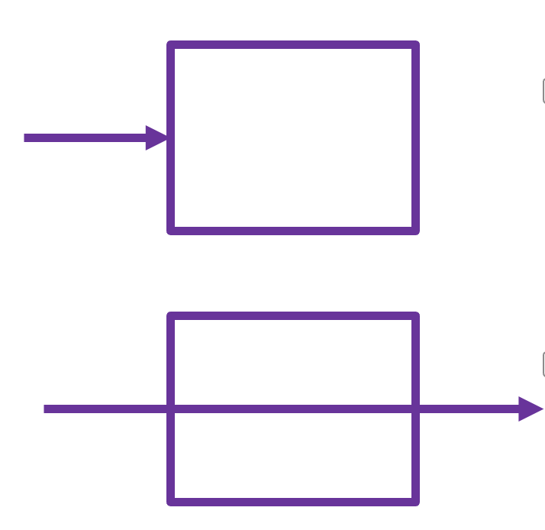
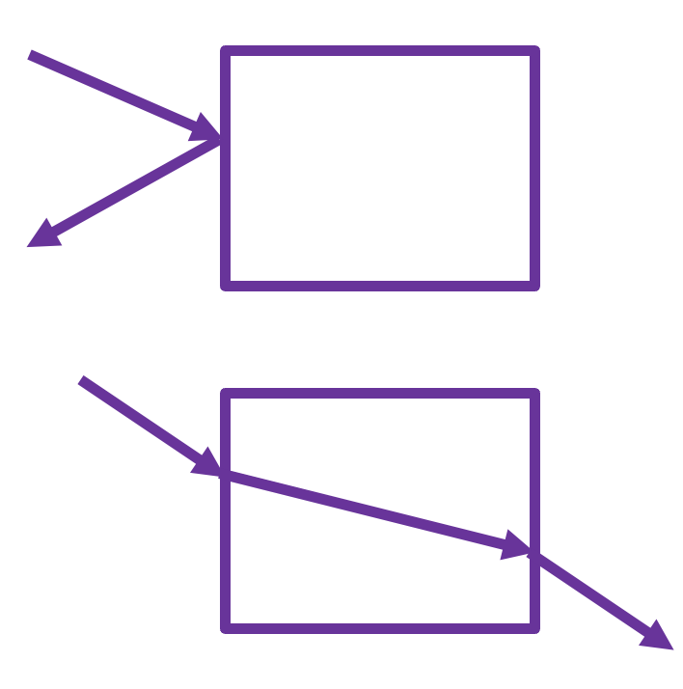
4.11 Effects of Varying Wavelength
Key Q
What is the effect of different wavelengths on absorption and transmission?
Different substances may absorb, transit, refract or reflect waves in ways that vary with wavelength.

Slide 32
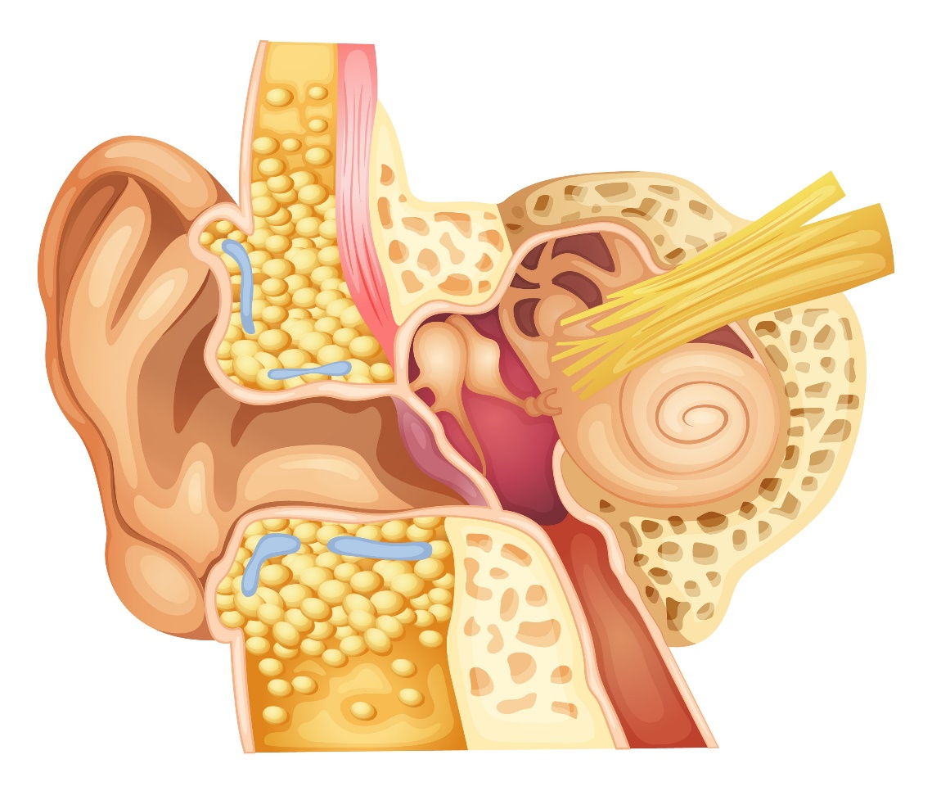
4.12 Converting Sound Waves
Key Q
How are we able to hear?
Sound waves can travel through solids causing vibrations in the solid.
Within the ear, sound waves cause the ear drum and other parts to vibrate which causes the sensation of sound.
The conversion of sound waves to vibrations of solids works over a limited frequency range.
This restricts the limits of human hearing.

Slide 33
4.13 Ultrasound
Key Q
What is the range of human hearing?
The range of normal human hearing is from 20 Hz to 20 kHz.
Any frequency of sound above 20 kHz is known as ultrasound.
Ultrasound is beyond human hearing, but other animals can hear it

Slide 34
4.14 Infrasound
Key Q
What is the range of human hearing?
The range of normal human hearing is from 20 Hz to 20 kHz.
Any frequency of sound below 20Hz is known as ultrasound.
Infrasound is beyond human hearing, but other animals can hear it

Slide 35

4.15 Uses of Ultrasound
Key Q
How can waves be used for detection and exploration?
The differences in velocity, absorption and reflection between different types of wave in solids and liquids can be used both for detection and exploration of structures which are hidden from direct observation.

Slide 36
4.15 Uses of Ultrasound
Key Q
How can waves be used for detection and exploration?
Ultrasound waves have a frequency higher than the upper limit of hearing for humans.
Ultrasound waves are partially reflected when they meet a boundary between two different media.
The time taken for the reflections to reach a detector can be used to determine how far away such a boundary is.
This allows ultrasound waves to be used for both medical and industrial imaging.

Slide 37
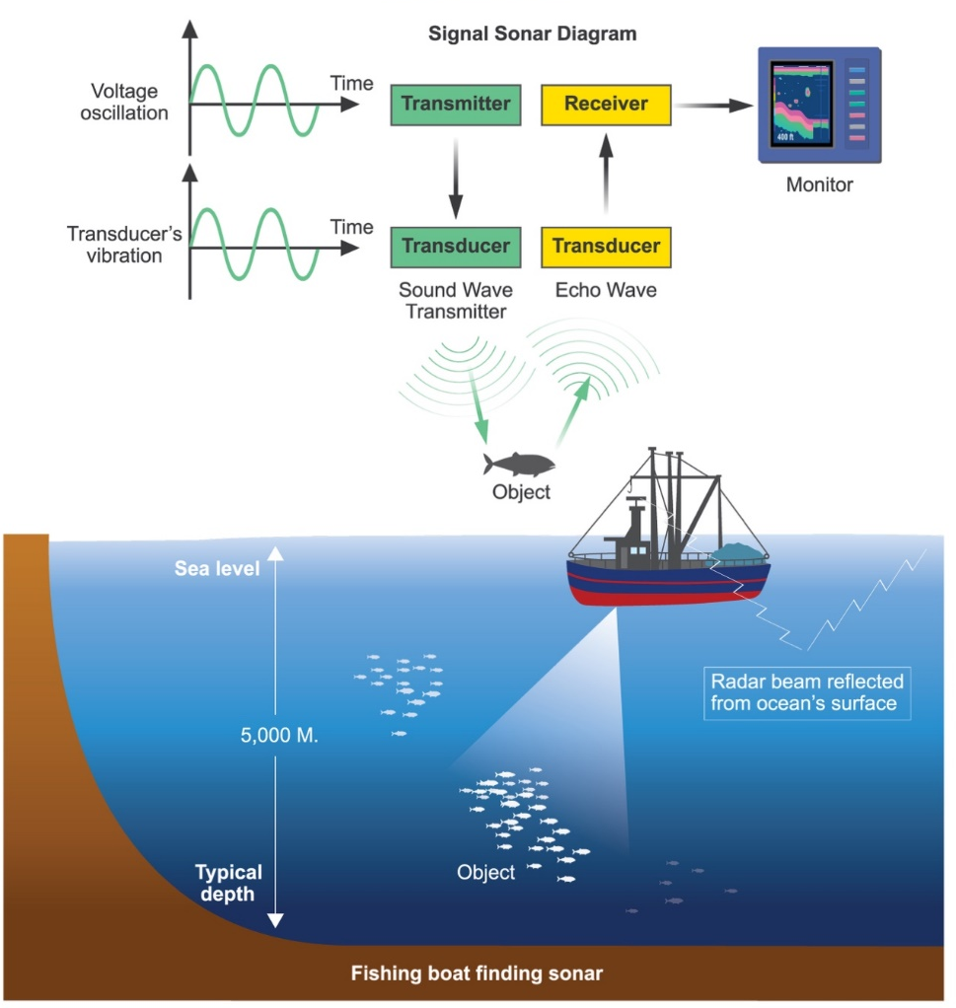
4.15 Uses of Ultrasound
Key Q
How can waves be used for detection and exploration?
Echo sounding, using high frequency sound waves is used to detect objects in deep water and measure water depth.

Slide 38
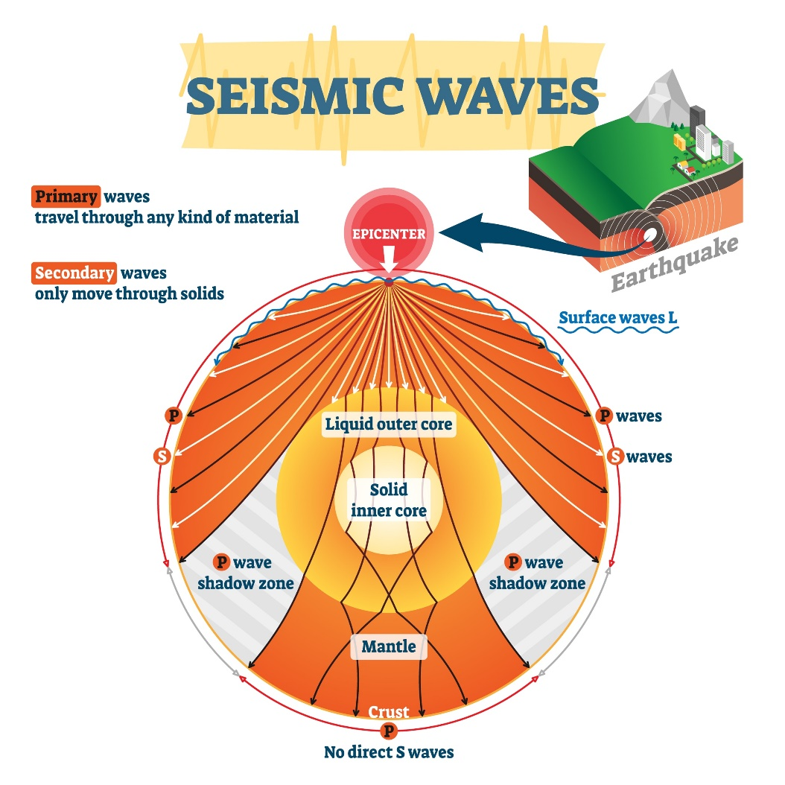
4.15 Uses of Ultrasound
Key Q
How can waves be used for detection and exploration?
Seismic waves are produced by earthquakes.
P-waves are longitudinal, seismic waves.
They travel at different speeds through solids and liquids.
S-waves cannot travel through a liquid.
P-waves and S-waves provide evidence for the structure and size of the Earth’s core.

Slide 39

4.15 Uses of Ultrasound

Slide 40
4.16 Sound Waves
Key Q
How could this equipment be used to investigate the effect of height on the speed of the car?
Sound waves are longitudinal and cause particles to vibrate parallel to the direction of wave travel.
These vibrations can travel through solids, liquids or gases.
The speed of sound depends on the medium through which it is travelling.

Slide 41
4.16 Sound Waves
Key Q
How could this equipment be used to investigate the effect of height on the speed of the car?
The speed of sound in air is around 330m/s.
Sound is unable to travel through a vacuum because there are no particles.
Sound travels fastest through solids, because in a solid particles are arranged closer together.

Slide 42
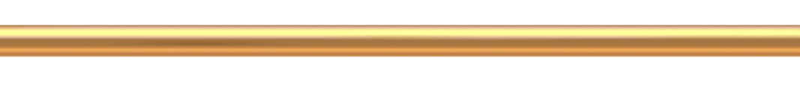

4.17 Core Practical
Key Q
How can we measure the speed of waves in a solid?
1.
Suspend a metal rod using a clamp stand and a piece of string.
2.
Attach a microphone to either end of the rod.
4.
Hit one end of the rod with a hammer.
3.
Attach a datalogger to the microphones

Slide 43
4.17 Core Practical
Key Q
How can we measure the speed of waves in a solid?
5.
The data logger will record the time it took the wave to travel from each microphone.
2.
Attach a microphone to either end of the rod.
4.
Hit one end of the rod with a hammer.
3.
Attach a datalogger to the microphones

Slide 44
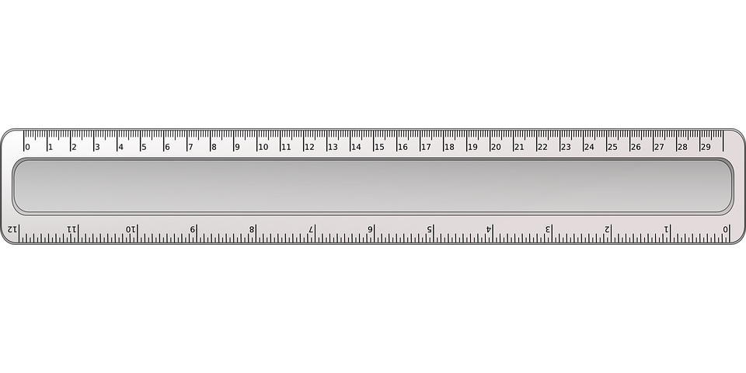
4.17 Core Practical
Key Q
How can we measure the speed of waves in a solid?
7.
Calculate speed using
Wave speed = Distance / Time
6.
Measure the distance between the two microphones using a ruler.

Slide 45
4.17 Core Practical
Key Q
How can we measure the speed of waves in a solid?
OR

Slide 46
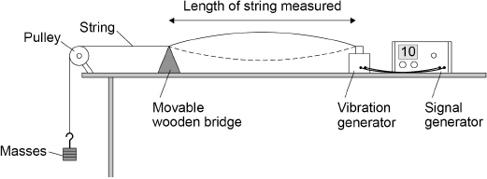
4.17 Core Practical
Key Q
How can we measure the speed of waves in a solid?
Set up equipment as shown in the diagram.
Switch on the signal generator and vibration generator so the string vibrates up and down and move the wooden bridge until a clear wave pattern is formed between the wooden bridge and the vibration generator.

Slide 47
4.17 Core Practical
Key Q
How can we measure the speed of waves in a solid?
Frequency | Record the frequency of the wave from the signal generator.

Slide 48
4.17 Core Practical
Key Q
How can we measure the speed of waves in a solid?
Wavelength | Measure the distance between the wooden bridge and the vibration generator. Count the number of loops in the wave pattern between the wooden bridge and the signal generator. Divide the distance measured by the number of waves counted.

Slide 49
4.17 Core Practical
Key Q
How can we measure the speed of waves in a solid?
Velocity | Determine a mean value of frequency and a mean value of wavelength. Use these in the equation: wave speed = frequency x wavelength.

Slide 50
4.17 Core Practical
Key Q
How are the results from this method used to determine wave speed?
We know the distance between the microphones.
We know the time it took for the wave to travel between these microphones.
Wave Speed = Distance / Time

Slide 51
4.17 Core Practical
Key Q
How can we ensure the results are valid?
We know the distance between the microphones.
We know the time it took for the wave to travel between these microphones.
A datalogger is used as the time for the wave to travel between the 2 microphones is so small.

Slide 52
4.17 Core Practical
Key Q
How are the results from this method used to determine wave speed?
We know the distance and the number of waves.
Wavelength can be determined by dividing distance by number of waves.
We know the frequency
Wave Speed = Frequency x Wavelength

Slide 53
4.17 Core Practical
Key Q
How can we ensure the results are valid?
There are the following control variables:
Number of masses
Length of string
Material of the string

Slide 54
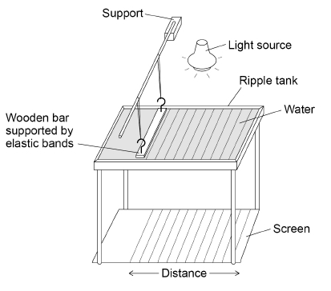
4.17 Core Practical
Key Q
How can the speed of waves on the surface of water be measured?
Set up the equipment as shown in the diagram.
Water should be around 5cm in depth.
The wooden bar should be just touches the surface of the water.
Switch on the lamp and motor.

Slide 55
4.17 Core Practical
Key Q
How can the speed of waves on the surface of water be measured?
Frequency | Use a stopwatch and count the number of waves passing a point in a fixed time period. Then divide the time by the number of waves to determine the time for one wave. To then determine frequency use the equation: f = 1/T

Slide 56
4.17 Core Practical
Key Q
How can the speed of waves on the surface of water be measured?
Wavelength | Use a camera to freeze the image and use a metre rule to measure the distance between two wavefronts. OR Count the number of wavefronts. Then find the wavelength by dividing the total distance by the number of wavefronts counted.

Slide 57
4.17 Core Practical
Key Q
How can the speed of waves on the surface of water be measured?
Velocity | Determine a mean value of frequency and a mean value of wavelength. Use these in the equation: Wave Speed = Frequency x Wavelength

Slide 58
4.17 Core Practical
Key Q
How can the speed of waves on the surface of water be measured?
OR
Velocity | Measure the time it takes one wavefront to travel the length of the screen. Measure the length of the screen To find the speed use the equation: Speed = Distance / Time

Slide 59
4.17 Core Practical
Key Q
What the measurements in this experiment?
Distance measured with a ruler.
Each measurement taken has the potential for error.
Time measured with a stopwatch.
Number of waves counted by eye or using a camera.

Slide 60
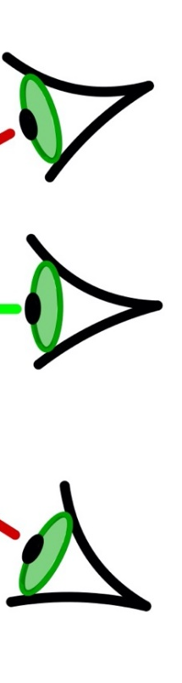
4.17 Core Practical
Key Q
What the measurements in this experiment?
When viewing the length from below the length measured would be less than the true value.
When viewing the length from above the length measured would be more than the true value.

Slide 61
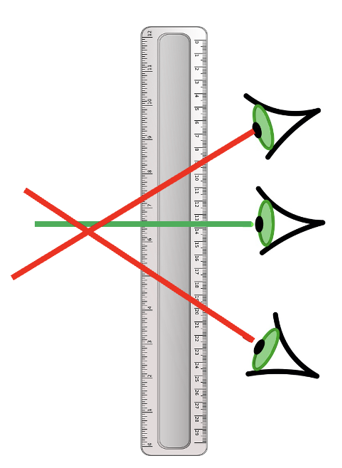
4.17 Core Practical
Key Q
What is parallax error?
This is an example of parallax error.
Key Term | Definition
Parallax Error | A random error that is caused by not taking a measurement at eye level.

Slide 62

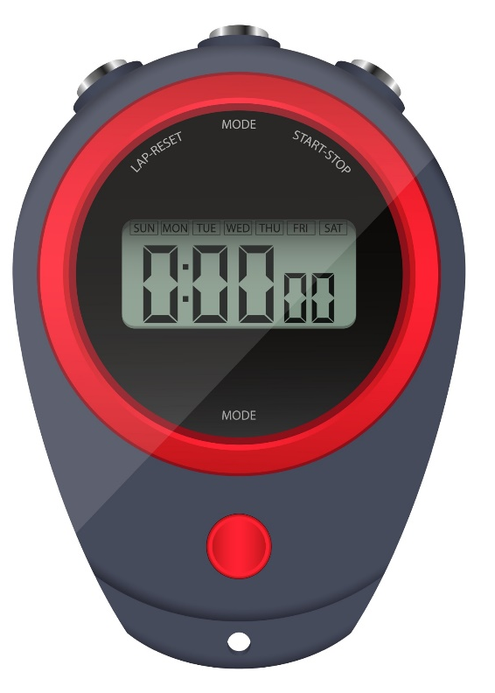
4.17 Core Practical
Key Q
What errors can occur when measuring time?
There will be a delay due to individuals reaction time.
This is an example of a random error.

Slide 63
4.17 Core Practical
Key Q
What errors can occur when measuring time?
Equipment can have different resolutions.
Resolution is the smallest change that the device can detect.
This stopwatch measures to the nearest 1s
This stopwatch measures to the nearest 0.01s
By increasing resolution we decrease uncertainty
+/- 0.5s
+/- 0.005s

Slide 64
4.17 Core Practical
Key Q
How can valid data be collected in this experiment?
Take repeat readings.
This gives an opportunity to identify outliers.
Outliers are discarded before calculating an average.
This reduces the effect of random errors.

Slide 65
4.17 Core Practical
Key Q
How are the results from this method used to determine wave speed?
We know the number of waves and the time which we can use to determine the period.
This can be used to find frequency.
Period = 1 / f
We know the wavelength of the wave.
Wave Speed = Frequency x Wavelength

