Slide 1
Conservation of Energy
Paper 1

Slide 2

3.1 Gravitational Potential Energy
Key Q
What is gravitational potential energy?
Key Term | Definition
Gravitational Potential Energy | The energy stored in an object at a height.

Slide 3
3.1 Gravitational Potential Energy
Key Q
What is the equation that you would use to calculate gravitational potential energy?
Newtons per kilogram
You may need to convert units!
N/kg
Gravitational Potential Energy = Mass x Gravitational Field Strength x Height
E_{p} = m x g x h
Joules
Metres
Kilograms
J
m
kg

Slide 4
3.1 Gravitational Potential Energy
Key Q
What is the equation that you could use to calculate weight?
Weight = Mass x Gravitational Field Strength
You could be given weight in N. To find GPE multiply this by height.

Slide 5
3.1 Gravitational Potential Energy
Worked Example
A 350g book is lifted 2.8m when gravitational field strength is 9.8N/kg. Calculate the GPE.
Convert Units | 350g = 0.35kg
Write down the formula. | E_{p} = m x g x h
Substitute Values | E_{p} = 0.35 x 9.8 x 2.8
Do the Maths | E_{p} = 9.604
Round and add units. | 9.6J
Usually 1 mark for this.
Substitute before you do any rearranging. 1 mark for doing this.
Show each step that you do. 1 mark available here.
Answer to 2 s.f which is the same as the values in the qu.

Slide 6
3.1 Gravitational Potential Energy
Worked Example
Calculate mass when a block is raised 7.21m and have 1.10kJ of GPE. Gravitational field strength is 9.8N/kg(5)
Convert Units | 1.1kJ = 1100J
Write down the formula. | E_{p} = m x g x h
Substitute Values | 1100 = m x 9.8 x 7.21
Do the Maths | 1100 = m x 70.658 m = 1100 / 70.658 m = 15.5679470124
Round and add units. | 15.6kg
Usually 1 mark for this.
Substitute before you do any rearranging. 1 mark for doing this.
Show each step that you do. 2 marks available here.
Answer to 3 s.f which is the same as the values in the qu.

Slide 7
3.1 Gravitational Potential Energy
Task
Complete the calculations for the following questions.
 | Calculate the GPE when height is 30cm, mass is 12kg and g is 9.8N/kg. | Calculate the GPE when height is 3.2m, mass is 888g and g is 9.8N/kg. | Calculate height when mass is 125g, g is 9.8N/kg and GPE is 320J
Convert Units | 30cm = 0.3m | 888g = 0.888kg | 125g = 0.125kg
Write down the formula. | E_{p} = m x g x h | E_{p} = m x g x h | E_{p} = m x g x h
Substitute Values | E_{p} = 12 x 9.8 x 0.3 | E_{p} = 0.888 x 9.8 x 3.2 | 320 = 0.125 x 9.8 x h
Do the Maths | E_{p} = 35.28 | E_{p} = 27.84768 | 320 = 1.225 x h h = 320 / 1.225 h = 261.2244897959
Round and add units. | 35J | 27.8J | 261m

Slide 8

3.2 Kinetic Energy
Key Q
What is kinetic energy?
Key Term | Definition
Kinetic Energy | The energy of a moving object.

Slide 9
3.2 Kinetic Energy
Key Q
What is the equation that you would use to calculate kinetic energy?
Kilograms
kg
You may need to convert units!
Kinetic Energy = 0.5 x Mass x Speed²
E_{k} = ½ x m x v²
Joules
Metres per second
J
m/s

Slide 10
3.2 Kinetic Energy
Worked Example
A 750g book is thrown and has an initial speed of 12m/s. Calculate its kinetic energy. (4)
Convert Units | 750g = 0.75kg
Write down the formula. | E_{k} = ½ x m x v²
Substitute Values | E_{k} = ½ x 0.75 x 12²
Do the Maths | E_{k} = 0.5 x 0.75 x 144 E_{k} = 54
Round and add units. | 54J
Usually 1 mark for this.
Substitute before you do any rearranging. 1 mark for doing this.
Show each step that you do. 1 mark available here.
Answer to 2 s.f which is the same as the values in the qu.

Slide 11
3.2 Kinetic Energy
Worked Example
A 1300kg car has 1.2kJ of kinetic energy. Calculate it speed (5)
Convert Units | 1.2kJ = 1200J
Write down the formula. | E_{k} = ½ x m x v²
Substitute Values | 1200 = ½ x 1300 x v²
Do the Maths | 1200 = 650 x v² v² = 1200 / 650 v² = 1.8461538462 v = √1.8461538462 V = 1.35873244
Round and add units. | 1.4m/s
Usually 1 mark for this.
Substitute before you do any rearranging. 1 mark for doing this.
Show each step that you do. 2 marks available here.
Answer to 2 s.f which is the same as the values in the qu.

Slide 12
3.2 Kinetic Energy
Task
Complete the calculations for the following questions.
 | Calculate kinetic energy when mass is 880g and speed is 5m/s | Calculate kinetic energy when mass is 450g and speed is 9m/s | Calculate speed when a toy has 88J of kinetic energy and a mass of 120g
Convert Units | 880g = 0.88kg | 450g = 0.45kg | 120g = 0.12kg
Write down the formula. | E_{k} = ½ x m x v² | E_{k} = ½ x m x v² | E_{k} = ½ x m x v²
Substitute Values | E_{k} = ½ x 0.88 x 5² | E_{k} = ½ x 0.45 x 9² | 88 = ½ x 0.12 x v²
Do the Maths | E_{k} = 0.44x 25 = 11 | E_{k} = 0.225x 81 =18.225 | 88 = 0.06x v² v² = 88 / 0.06 v² = 1,466.66667 v = √1466.66667 v = 38.2970844
Round and add units. | 11J | 18J | 38J

Slide 13

3.3 Energy Transfers
Key Q
How could this equipment be used to investigate the effect of height on the speed of the car?
Sankey diagrams start off as one arrow that splits into two or more points.
This shows how all of the energy in a system is transferred into different stores.
The width of the arrow is drawn to scale to show the amount of energy.

Slide 14
3.4 Conservation of Energy
Key Q
What is the law of the conservation of energy?
Energy In = Energy Out
Key Term | Definition
Law of the Conservation of Energy | A law that states that energy can be transferred usefully, stored or dissipated, but cannot be created or destroyed.

Slide 15
3.5 Transfers of Energy
Key Q
What is a system?
When a system changes the way energy is stored also changes.
You need to be prepared to describe some energy changes.
Key Term | Definition
System | An object or group of objects.

Slide 16

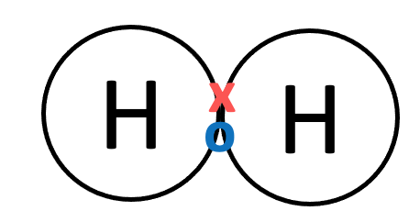
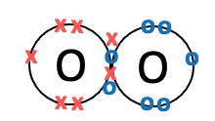
3.5 Transfers of Energy
Energy Store | Description | Image
Magnetic | The energy stored when attracting poles are pulled apart or when repelling poles are pushed together.
Internal | The total kinetic and potential energy of the particles in an object.
Chemical | The energy stored in chemical bonds.

Slide 17

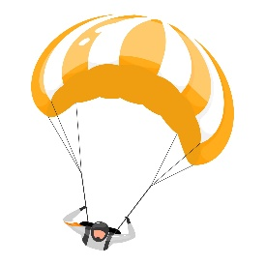
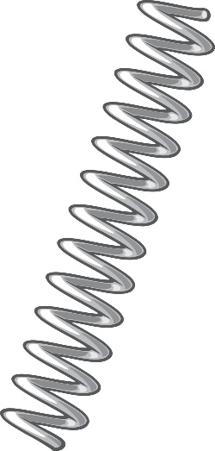
3.5 Transfers of Energy
Energy Store | Description | Image
Kinetic | Energy of a moving object.
Gravitatio-nal Potential | The energy stored in an object a height.
Elastic Potential | The energy stored when an object is stretched or compressed.

Slide 18
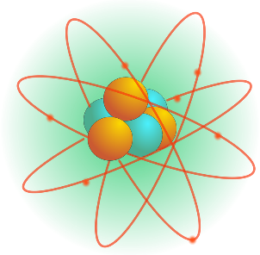
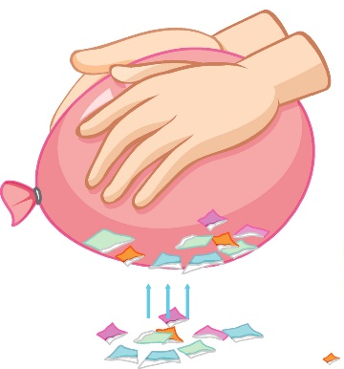
3.5 Transfers of Energy
Energy Store | Description | Image
Nuclear | The energy stored in the nucleus of an atom.
Electrostatic | The energy stored when repelling charges have been moved closer together or when attracting charges have been pulled further apart.
Energy can be transferred from one store to another by processes known as working and heating.

Slide 19
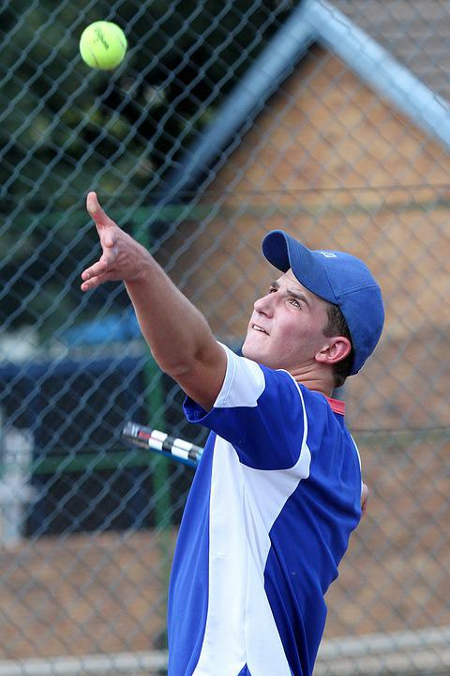
3.5 Transfers of Energy
Scenario:
An object projected upwards.
Energy Changes
Kinetic Energy
Gravitational Potential Energy

Slide 20
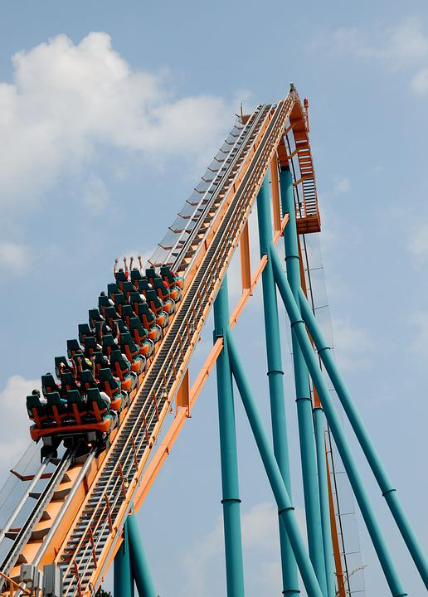
3.5 Transfers of Energy
Scenario:
An object projected up a slope.
Energy Changes
Kinetic Energy
Gravitational Potential Energy

Slide 21
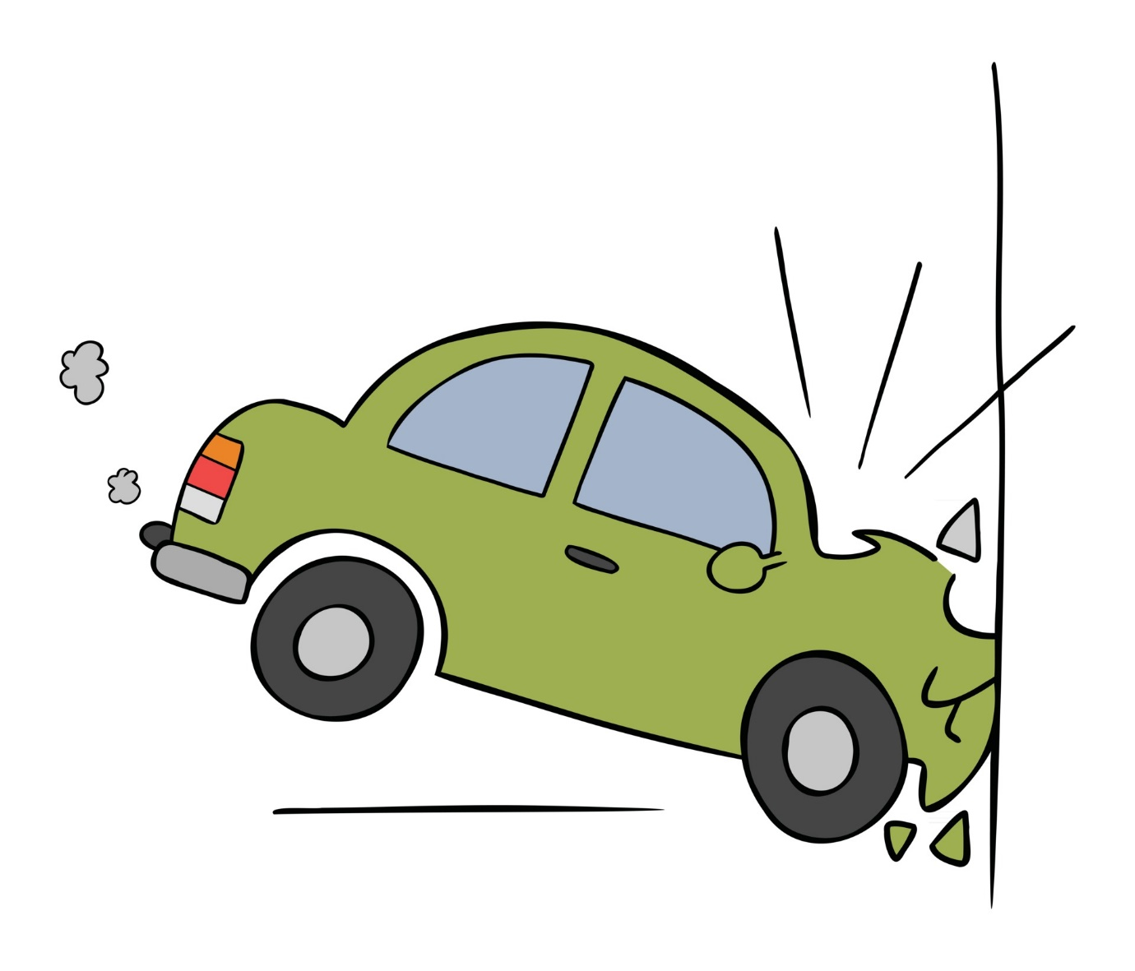
3.5 Transfers of Energy
Scenario:
A moving object hitting an obstacle
Energy Changes
Kinetic Energy
Sound Waves
and
Thermal Energy

Slide 22
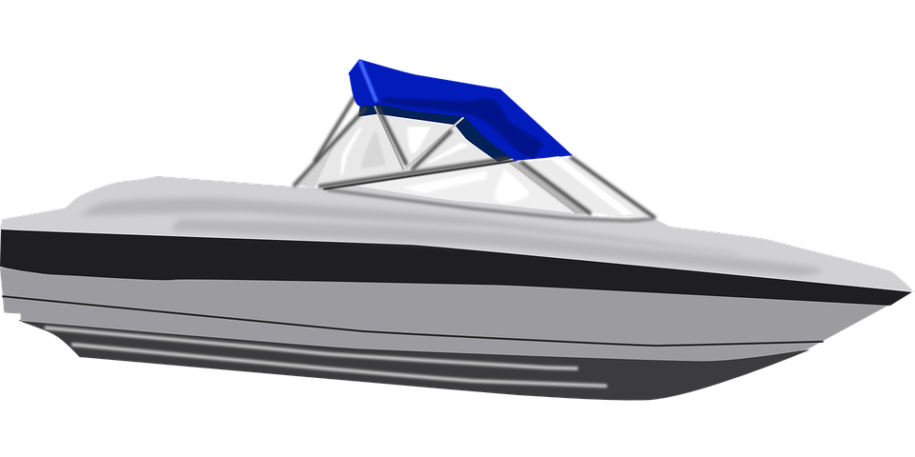
3.5 Transfers of Energy
This depends on the context!
Scenario:
An object accelerated by a constant force.
Energy Changes
Chemical Energy
Kinetic Energy

Slide 23

3.5 Transfers of Energy
This depends on the context!
Scenario:
An object accelerated by a constant force.
Energy Changes
Gravitational Potential Energy
Kinetic Energy

Slide 24
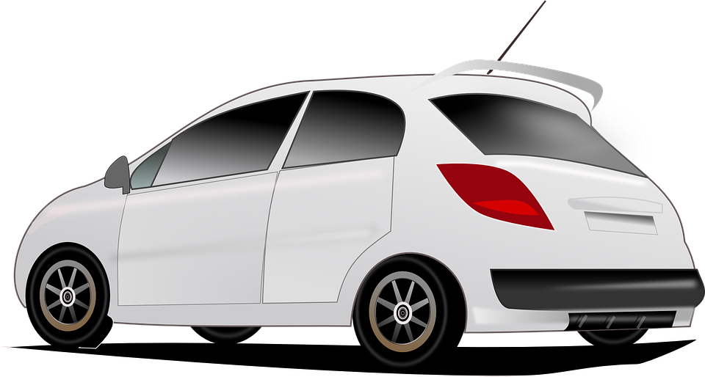
3.5 Transfers of Energy
Scenario:
A vehicle slowing down.
Energy Changes
Kinetic Energy
Thermal Energy

Slide 25
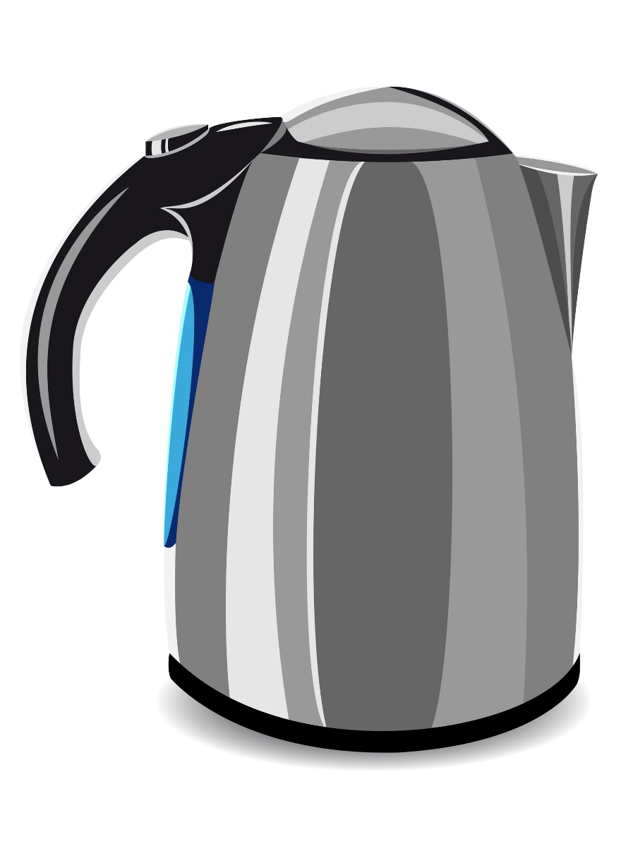
3.5 Transfers of Energy
Scenario:
Bringing water to a boil in an electric kettle.
Energy Changes
Electric Current
Thermal Energy

Slide 26
3.6 Transfers of Energy
Key Q
What is the law of the conservation of energy?
This means that when ever there are energy transfers in a closed system, that there is no net change to the total energy.
Energy In = Energy Out
Key Term | Definition
Law of the Conservation of Energy | A law that states that energy can be transferred usefully, stored or dissipated, but cannot be created or destroyed.

Slide 27
3.7 Wasted Energy
Key Q
How is energy typically wasted?
In all systems energy is dissipated so that it is stored in less useful ways.
For example, in mechanical processes energy is dissipated as heat and is transferred to the surroundings.
The energy is being transferred into an inaccessible thermal store.

Slide 28

3.8 Wasted Energy
Key Q
What is the law of the conservation of energy?
However..
In all system changes energy is dissipated.
The energy is stored in less useful ways.
For example in this TV energy is wasted as thermal energy.

Slide 29
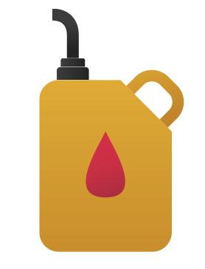
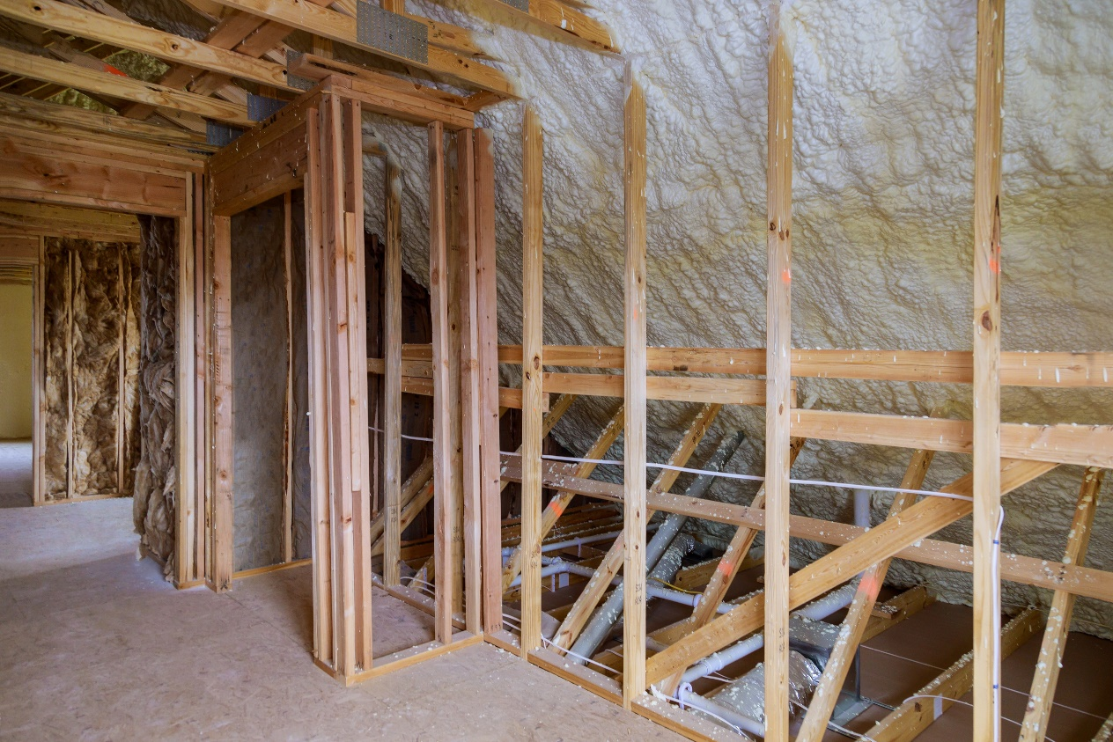
3.9 Increasing Efficiency
Key Q
How can we reduce unwanted energy transfers?

Slide 30
3.9 Increasing Efficiency
Key Q
How can we reduce unwanted energy transfers?
We can use lubricants
This reduces friction between surfaces.
Surfaces will now slide over each other more smoothly.
Less energy will be wasted as heat.

Slide 31

3.9 Increasing Efficiency
Key Q
How can we reduce unwanted energy transfers?
Thermal insulation
Examples in the home include loft insulation, carpets and cavity wall insulation.
The insulation reduces the transfer of energy.

Slide 32
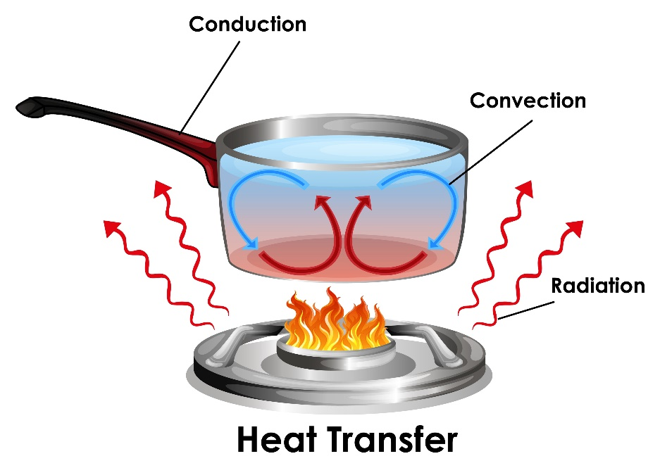
3.10 Rate of Cooling
Key Q
What is conduction?
Conduction can also occur when two objects are touching.
For conduction to occur there must be a temperature difference between the two objects.
Key Term | Definition
Conduction | The process by which thermal energy is transferred through a material.

Slide 33
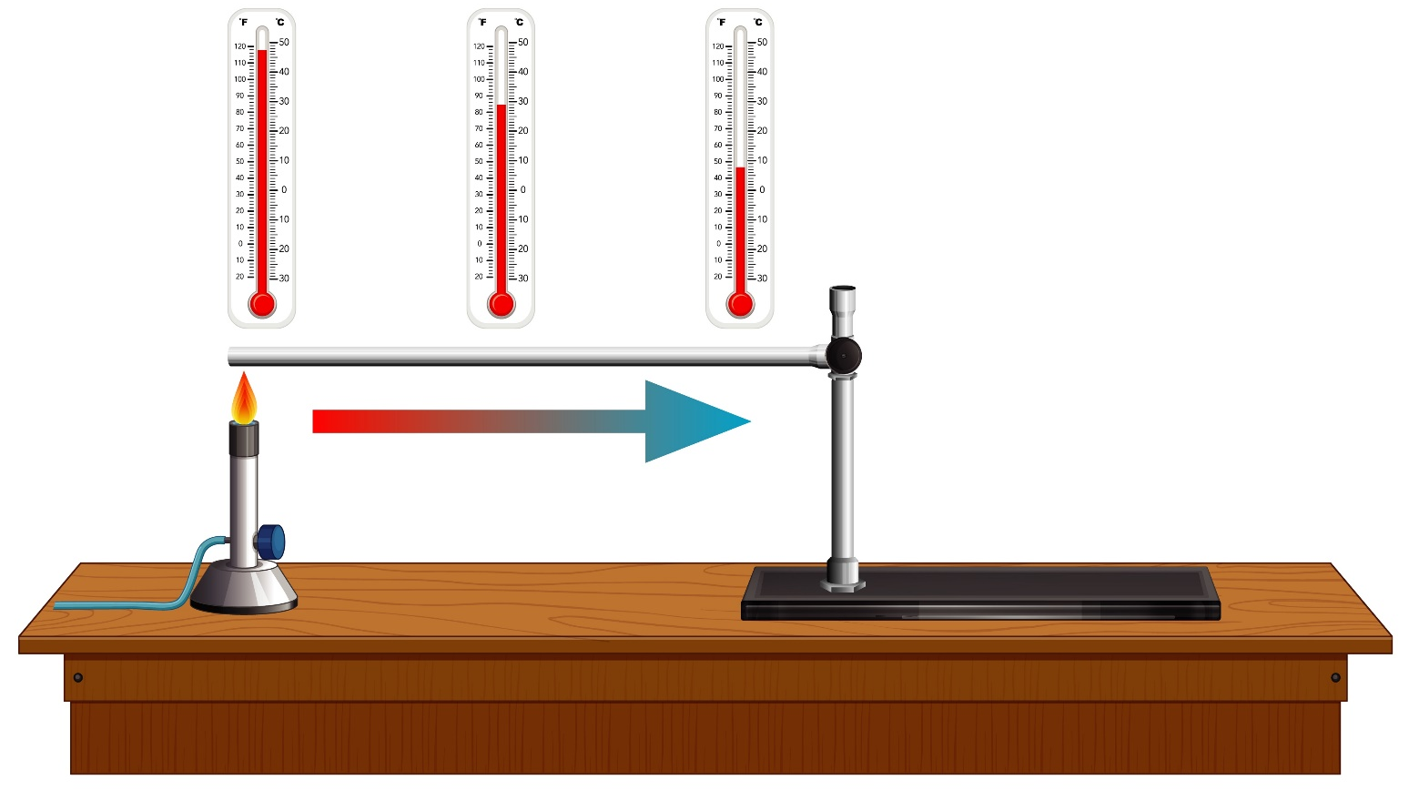
3.10 Rate of Cooling
Some materials are good conductors of heat.
They have a high thermal conductivity.
The higher a materials thermal conductivity, the higher the rate of energy transfer by conduction.

Slide 34
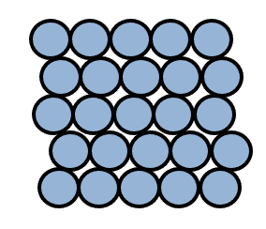
3.10 Rate of Cooling
Key Q
What happens during conduction?
In a solid atoms are in fixed places but are free to vibrate.
When a solid is heated the atoms vibrate faster and further about a fixed position.
These vibrations then pass from atom to atom transferring the energy.
This happens when all solids are heated.

Slide 35
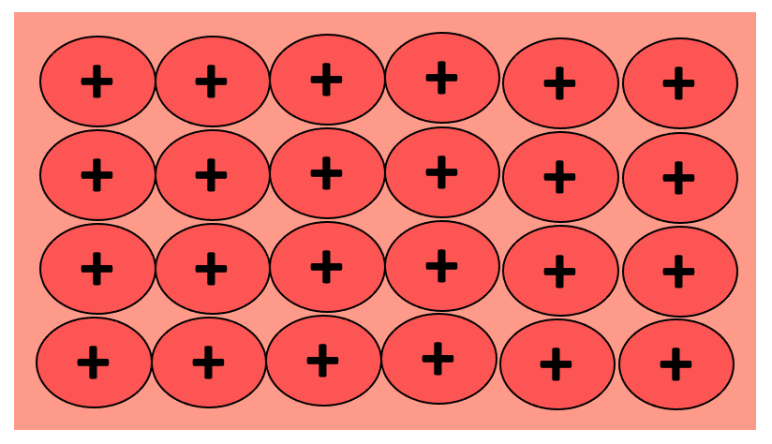
3.10 Rate of Cooling
Key Q
Why are metals good conductors?
Metals have delocalised electrons which are able to move freely.
When a metal is heated these electrons gain kinetic energy and move faster.
They collide with metal ions causing them to vibrate faster.
The collisions of these electrons causes the rate of conduction to increases

Slide 36
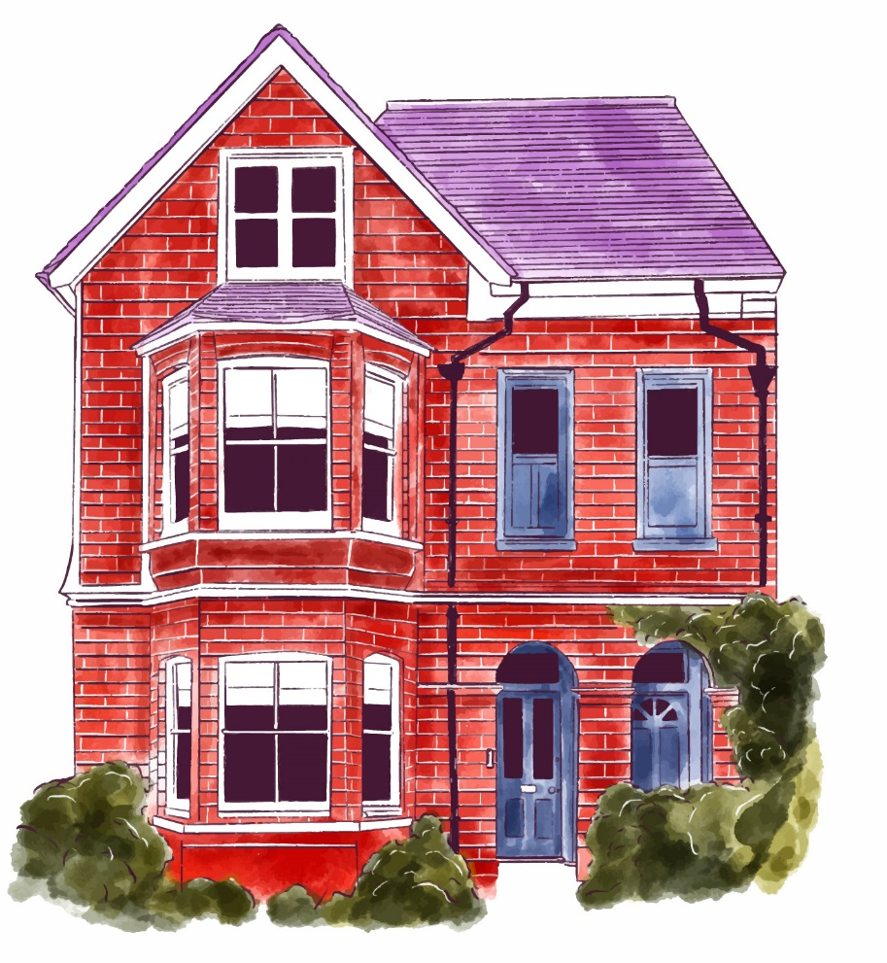
3.10 Rate of Cooling
Key Q
How does thickness and type of conductor effect cooling of a building?
The thicker the walls of a building the slower the building will cool down.
The better the material is as a conductor the faster it will cool.

Slide 37
3.11 Efficiency
Key Q
This could either be in watts or joules.
What is efficiency?
Efficiency = Useful Output / Total Input
Key Term | Definition
Efficiency | The fraction of the energy supplied which is transferred in a useful form.

Slide 38
3.11 Efficiency
The total power input to the solar cell is 2.4 W when the efficiency is 0.20. Calculate the useful power output of the solar cell. (3)
Convert Units | -
Write down the formula. | Efficiency = Useful Output/Input
Substitute Values | 0.2 = Useful Output/ 2.4
Do the Maths | Useful Output = 0.2 x 2.4
Round and add units. | 0.48W
Substitute before you do any rearranging. 1 mark for doing this.
Answer to 2 s.f which is the same as the values in the qu.

Slide 39

3.12 Increasing Efficiency
Key Q
What can be done to decrease heat loss from a building?
Increase thickness of the walls.
Double Glazing
Reduce thermal conductivity of the walls.
Draught excluders
Insultation in the building such as cavity wall insulation

Slide 40
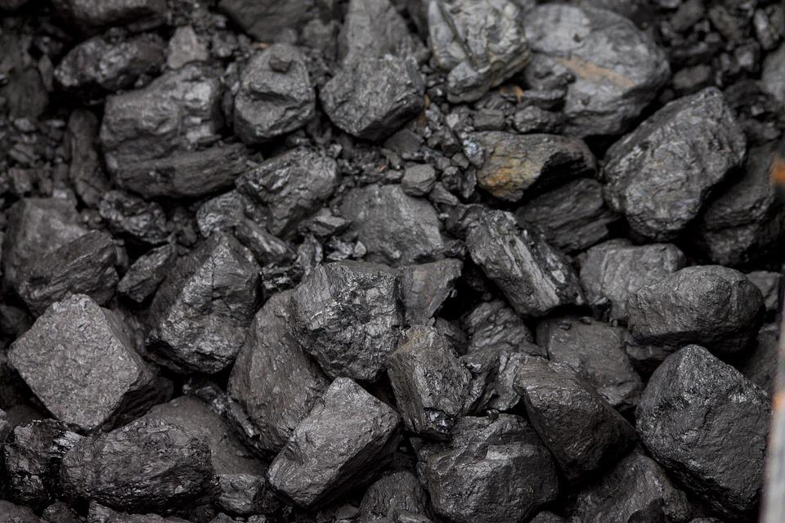
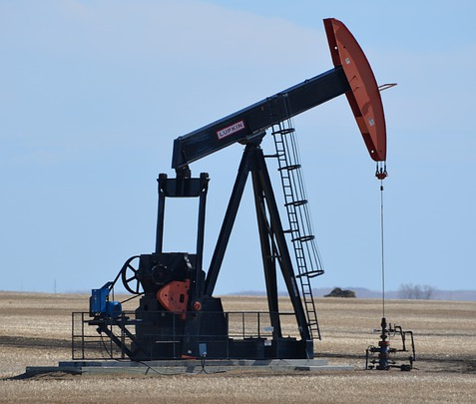

3.13 Energy Sources
Key Q
What are the different non renewable energy resources on Earth?
Key Term | Definition
Non-Renewable Energy Resource | A resource that is being used up much quicker than it is being replenished. Once used up it can’t be replaced.

Slide 41
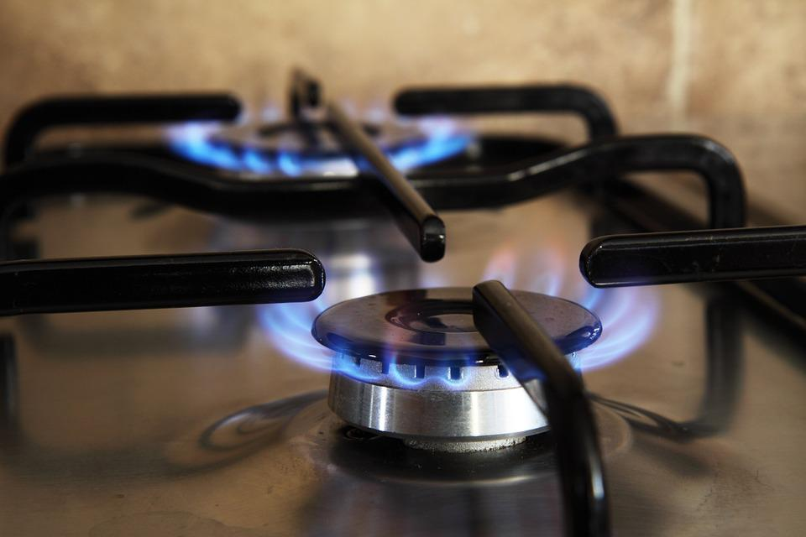
3.13 Energy Sources
Key Q
What are examples of non renewable energy resources?
Coal
Oil
Coal, oil and natural gas are all fossil fuels that have formed over millions of years from the remains of dead organisms.
Natural Gas
Nuclear

Slide 42
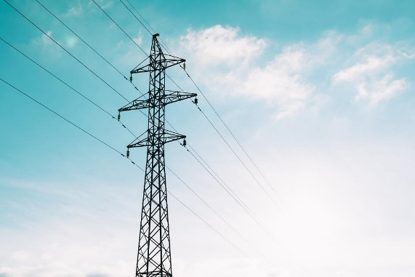

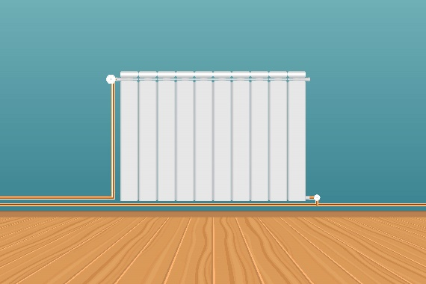
3.13 Energy Sources
Key Q
What are renewable energy resources?
Key Term | Definition
Renewable Energy Resource | A resource that is being replenished as it is being used.
Think
Pair
Share
What uses to we have for energy resources?
Electricity
Transport
Heating

Slide 43
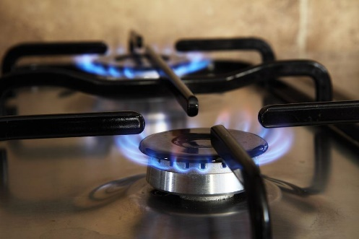
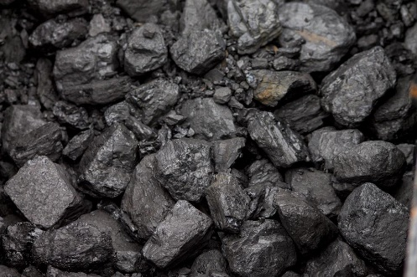
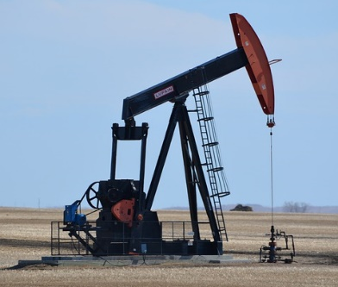
3.13 Energy Sources
Key Q
What are the advantages and disadvantages of these non renewable energy resources?
Energy Resource | Advantages | Disadvantages
Fossil Fuels | Very reliable. | Produce greenhouse gases which contribute towards global warming.

Slide 44
3.13 Energy Sources
Key Q
What are the advantages and disadvantages of these non renewable energy resources?
Energy Resource | Advantages | Disadvantages
Nuclear Fuel | Very reliable. Does not produce greenhouse gases and so does not contribute towards global warming. Nuclear fuel released a large amount of energy per kg of fuel. | Produce radioactive waste which will need to be disposed of safely and correctly. Long start up time. Higher decommissioning costs.

Slide 45
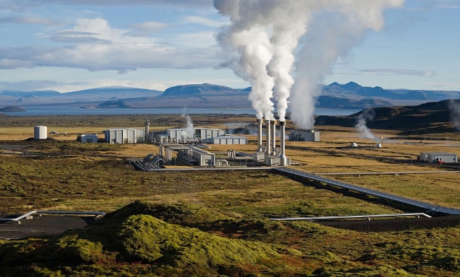
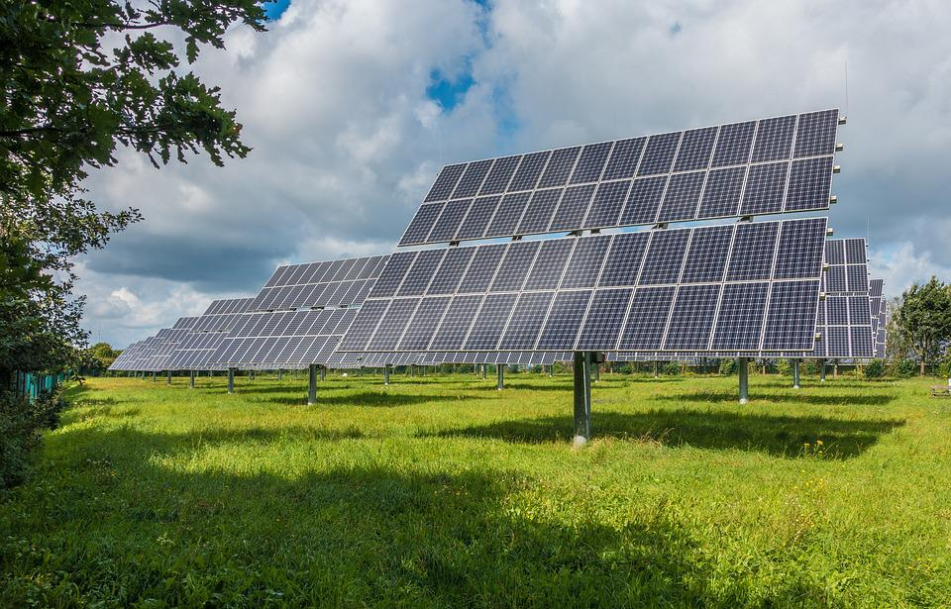
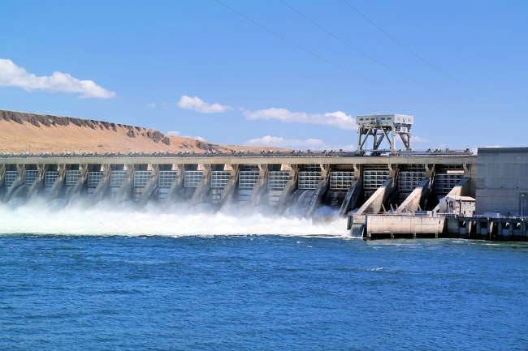
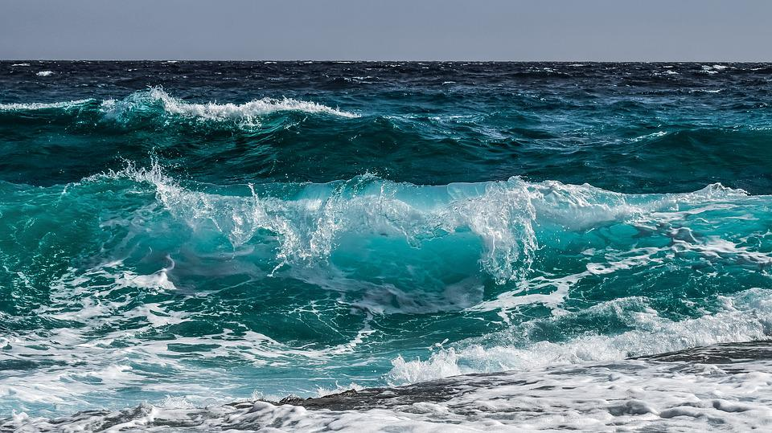
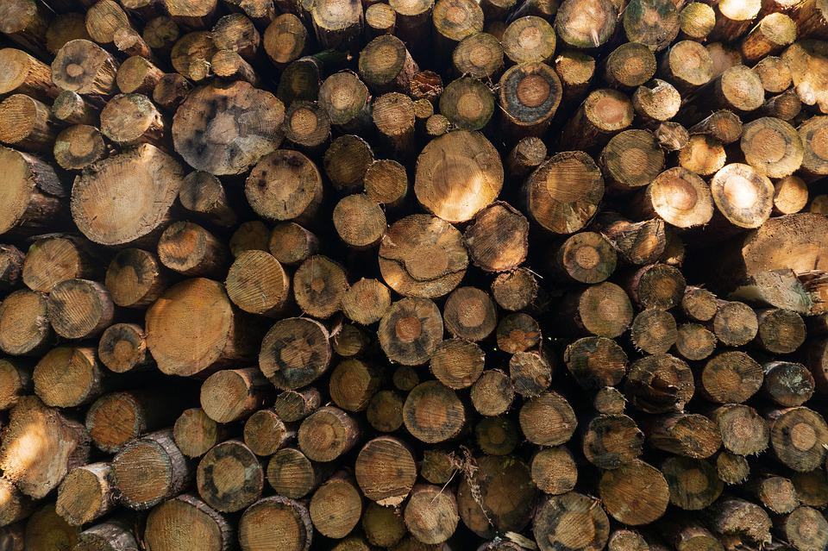
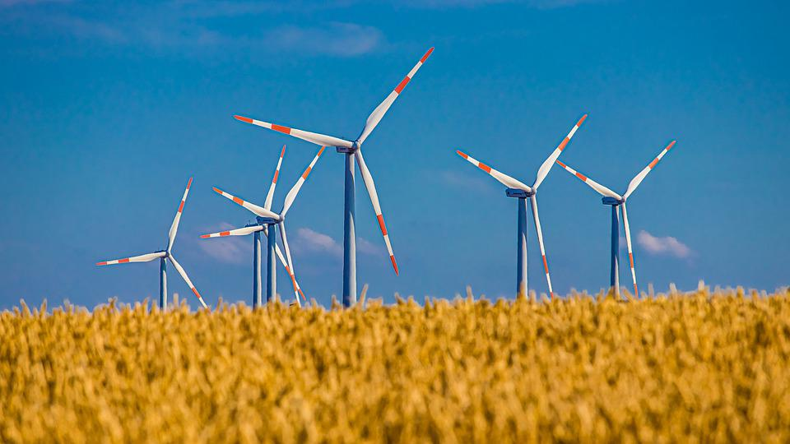
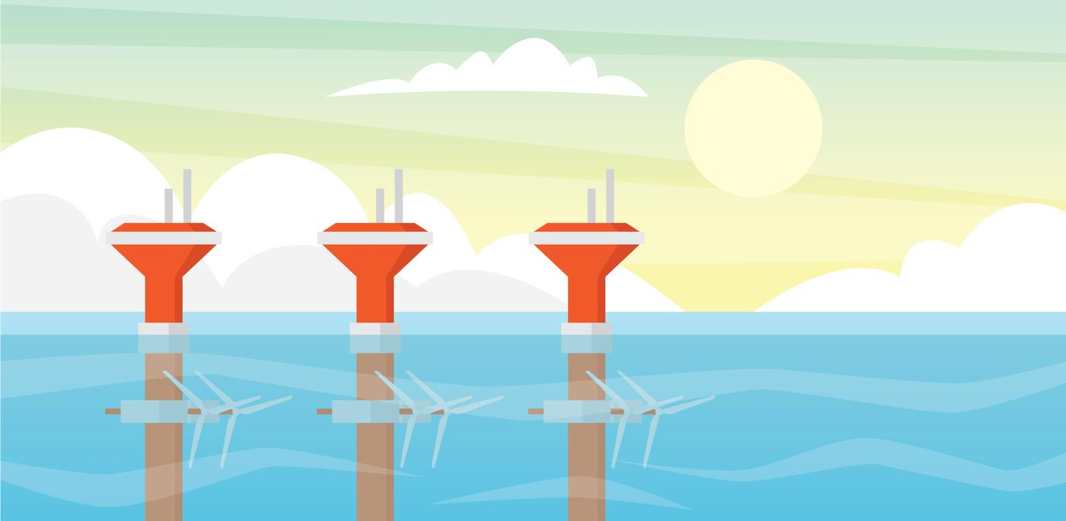
3.13 Energy Sources
Key Q
What are the different renewable energy resources on Earth?
Geothermal
Solar
Hydroelectric
Wave
Tidal
Biomass
Wind

Slide 46
3.13 Energy Sources
Key Q
What are the advantages and disadvantages of these renewable energy resources?
Energy Resource | Advantages | Disadvantages
Biofuel | Reliable It is carbon neutral. | Uses land that would be used for other purposes.
We typically use this for:
Heating
Electricity Generation
Transport

Slide 47
3.13 Energy Sources
Key Q
What are the advantages and disadvantages of these renewable energy resources?
Energy Resource | Advantages | Disadvantages
Wind | Don’t produce greenhouse gases and so do not contribute towards global warming. | Unreliable as when there is no wind they don’t work. Visual pollution.
We typically use this for:
Electricity Generation

Slide 48

3.13 Energy Sources
Key Q
What are the advantages and disadvantages of these renewable energy resources?
Energy Resource | Advantages | Disadvantages
Hydro-electricity | Don’t produce greenhouse gases and so do not contribute towards global warming. | Affected by droughts. Large reservoirs of water needed, and habitats can be flooded to do this.
We typically use this for:
Electricity Generation

Slide 49
3.13 Energy Sources
Key Q
What are the advantages and disadvantages of these renewable energy resources?
Energy Resource | Advantages | Disadvantages
Geothermal | Reliable Don’t produce greenhouse gases and so do not contribute towards global warming. | Expensive Only work in certain locations.
We typically use this for:
Electricity Generation
Heating

Slide 50
3.13 Energy Sources
Key Q
What are the advantages and disadvantages of these renewable energy resources?
Energy Resource | Advantages | Disadvantages
Tidal | Reliable Don’t produce greenhouse gases and so do not contribute towards global warming. | Affect river estuaries and the habitats of animals.
We typically use this for:
Electricity Generation

Slide 51
3.13 Energy Sources
Key Q
What are the advantages and disadvantages of these renewable energy resources?
Energy Resource | Advantages | Disadvantages
Solar | Don’t produce greenhouse gases and so do not contribute towards global warming. | Need to cover large areas to generate adequate electricity. Do not work at night. Generate less electricity depending on the weather and season.
We typically use this for:
Heating
Electricity Generation

Slide 52
3.13 Energy Sources
Key Q
What are the advantages and disadvantages of these renewable energy resources?
Energy Resource | Advantages | Disadvantages
Water Waves | Don’t produce greenhouse gases and so do not contribute towards global warming. | Can spoil the coastline and affect habitats. Affected by storms. Don’t make a constant supply of electricity.
We typically use this for:
Electricity Generation

Slide 53

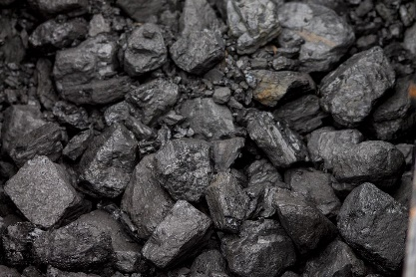
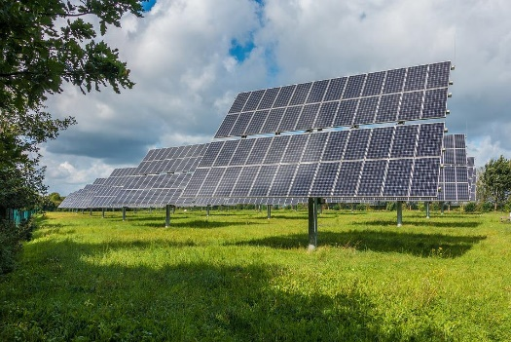




3.13 Energy Sources
Key Q
Why are some energy resources more reliable than others?
Reliable
Unreliable
Solar and wind are unpredictable and so are less reliable than other energy resources.

Slide 54
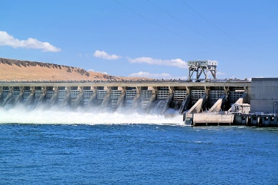

3.13 Energy Sources
Key Q
Why are some energy resources more reliable than others?
Reliable
Unreliable
Solar and wind are unpredictable and so are less reliable than other energy resources.
These resources are always available to be used. This makes them very reliable.

Slide 55
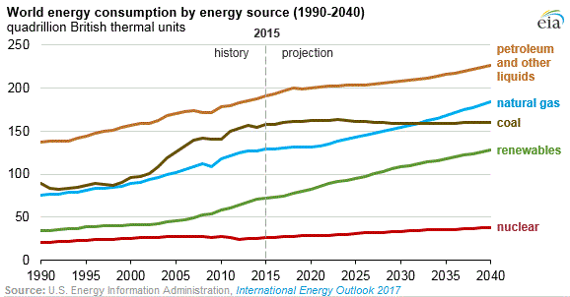
3.14 Use of Energy Sources
Key Q
How are our use of energy resources changing?
Our use of all energy resources are increasing because there are more people.
Our use of renewables is increasing more rapidly due to improvements in technology and they are becoming cheaper.

