Slide 1
Motion and Forces
Paper 1

Slide 2

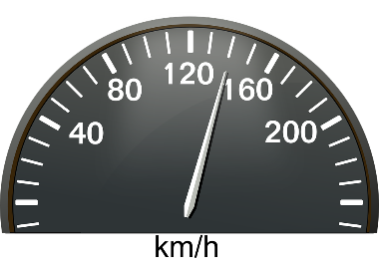
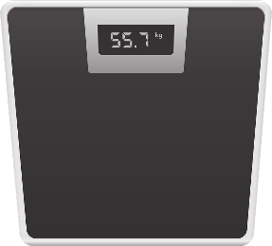
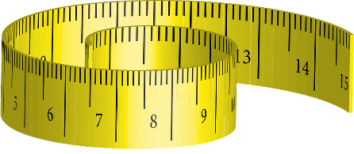

2.1 Scalars
Key Q
What are scalar and vector quantities?
Key Term | Definition
Scalar Quantity | A quantity with magnitude (size) only.
Vector Quantity | A quantity with both magnitude (size) and direction.

Slide 3
2.2 Vectors
Key Q
What are scalar and vector quantities?
Key Term | Definition
Scalar Quantity | A quantity with magnitude (size) only.
Vector Quantity | A quantity with both magnitude (size) and direction.

Slide 4
2.2 Vectors
Key Q
How can we model vector quantities?
The length of the arrow represents the magnitude.
A vector quantity may be represented by an arrow.
The direction of the arrow represents the direction of the vector quantity.
Key Term | Definition
Scalar Quantity | A quantity with magnitude (size) only.
Vector Quantity | A quantity with both magnitude (size) and direction.

Slide 5

2.3 Scalars and Vectors
Key Q
What is the difference between vectors and scalars?
Vectors have direction while scalars do not!
Vectors can therefore be represented with an arrow while scalars cant.
Key Term | Definition
Scalar Quantity | A quantity with magnitude (size) only.
Vector Quantity | A quantity with both magnitude (size) and direction.
@SinclairEducation

Slide 6
2.4 Scalars and Vectors
Momentum
Acceleration
Force
Mass
Displacement
Density
Temperature
Energy
Weight
Distance
Velocity
Speed
Scalar Quantities | Vector Quantities
Mass Density Temperature Energy Distance Speed | Momentum Acceleration Force Displacement Weight Velocity

Slide 7
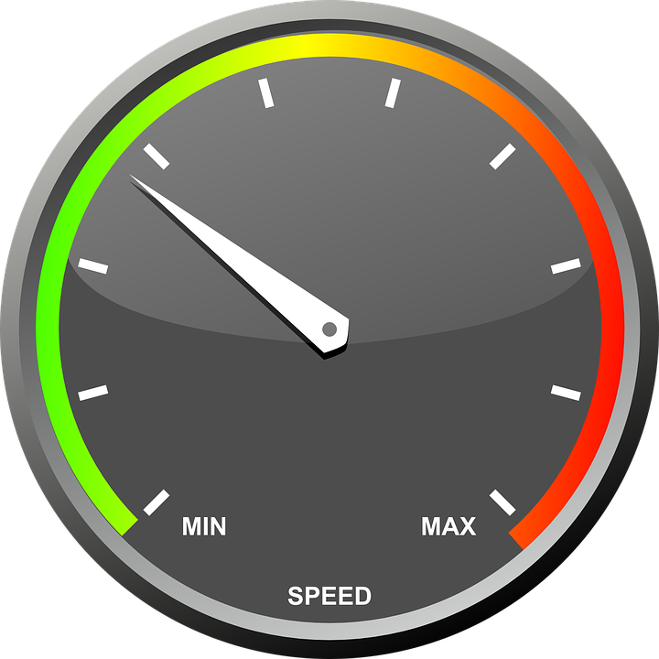
2.5 Velocity
Key Q
What is speed?
Speed is a measure of how far an object travels in a given time.
The more speed an object has the further it will travel in a certain time.
Speed is a term used a lot in everyday life!
Velocity is speed with direction.

Slide 8
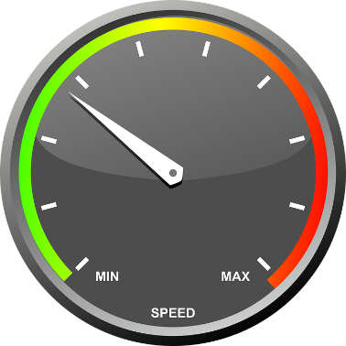
2.6 Calculating Speed
Key Q
What is instantaneous and average speed?
During a journey the speedometer of a car will be changing constantly.
A speedometer measures instantaneous speed.
Key Term | Definition
Instantaneous Speed | The speed of an object at that moment in time.
Average Speed | The speed of an object over its entire journey.

Slide 9

2.6 Calculating Speed
Key Q
How is average speed determined?
You may need to convert units!
Average Speed = Distance / Time Taken
v = s / t
Metres per second
Seconds
m/s
s
Metres
m

Slide 10
2.6 Calculating Speed
Calculate the average speed of a car in m/s that travels 1200m in 2 minutes. (4)
Convert Units
Write down the formula.
Substitute Values
Do the Maths
Round and add units.
2 minutes = 120s
v = s / t
v = 1200 / 120
v = 10
v = 10m/s

Slide 11
2.6 Calculating Speed
Calculate the distance someone will travel if they are moving at 1.5m/s for 1 minute. (3)
Convert Units
Write down the formula.
Substitute Values
Do the Maths
Round and add units.
1 minute = 60s
v = s / t
1.5 = s / 60
s = 1.5 x 60
= 90
s = 90m

Slide 12
2.6 Calculating Speed
 | Calculate the speed of a ball that travels 8m in 1.5seconds. | Calculate speed when a runner sprints 100m in 15.5s | Calculate speed in m/s when 3km is travelled in 1 hour
Convert Units
Write down the formula.
Substitute Values
Do the Maths
Round and add units.
-
3km = 3000m
-
1 hour = 3600s
v = s / t
v = s / t
v = s / t
v = 8 / 1.5
v = 100 / 15.5
v = 3000 / 3600
v = 5.3333
v = 6.4516129032
v = 0.8333333333
v = 5.3m/s
v = 6.45m/s
v = 0.83m/s

Slide 13
2.6 Calculating Speed
Calculate distance travelled when.. | ..an object has a speed of 15m/s and travels for 1 minute. | ..a bike travels at 5m/s for an hour | ..a car travels at 30km/h for 15 minutes.
Convert Units
Write down the formula.
Substitute Values
Do the Maths
Round and add units.
1 minute = 60s
1 hour = 3600s
15 mins = 0.25 hour
v = s / t
v = s / t
v = s / t
15 = s / 60
5 = s / 3600
30 = s / 0.25
s = 15 x 60
= 900
s = 5 x 3600
= 18,000
s = 30 x 0.25
= 7.5
s = 900m
s = 18,000m
s = 7.5km

Slide 14
2.6 Calculating Speed
Calculate the time it will take to… | ..travel 30m at a speed of 2m/s | ..travel 1 km at a speed of 5m/s | …travel 12 miles at a speed of 24 mph.
Convert Units
Write down the formula.
Substitute Values
Do the Maths
Round and add units.
-
1 km = 1000m
-
v = s / t
v = s / t
v = s / t
2 = 30 / t
5 = 1000 / t
24 = 12 / t
t = 30 / 2
= 15
t = 1000 / 5
= 200
t = 12 / 24
= 0.5
t = 15s
t = 200s
t = 0.5hours

Slide 15
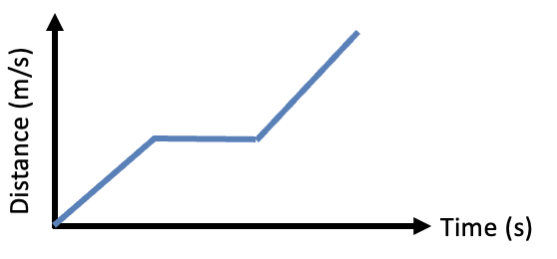
2.7 Distance Time Graphs
Key Q
What are distance time graphs?
Key Term | Definition
Distance-Time Graph | A way of representing the distance travelled by an object moving along a straight line.

Slide 16
2.7 Distance Time Graphs
Key Q
How can the following be represented on a distance time graph?
Stationary Object
Constant Speed
Constant Faster Speed
Constant Speed Backwards
Acceleration
Deceleration
Distance (m)
Time (s)

Slide 17
2.7 Distance Time Graphs
Key Q
How can the following be represented on a distance time graph?
Stationary Object
Constant Speed
Constant Faster Speed
Constant Speed Backwards
Acceleration
Deceleration
Distance (m)
Time (s)

Slide 18
2.7 Distance Time Graphs
Key Q
How can the following be represented on a distance time graph?
Stationary Object
Constant Speed
Constant Faster Speed
Constant Speed Backwards
Acceleration
Deceleration
Distance (m)
Time (s)

Slide 19
2.7 Distance Time Graphs
Key Q
How can the following be represented on a distance time graph?
Steeper gradient models a faster speed
Stationary Object
Constant Speed
Constant Faster Speed
Constant Speed Backwards
Acceleration
Deceleration
Distance (m)
Time (s)

Slide 20
2.7 Distance Time Graphs
Key Q
How can the following be represented on a distance time graph?
Stationary Object
Constant Speed
Constant Faster Speed
Constant Speed Backwards
Acceleration
Deceleration
Distance (m)
Time (s)

Slide 21
2.7 Distance Time Graphs
Key Q
How can the following be represented on a distance time graph?
Stationary Object
Constant Speed
Constant Faster Speed
Constant Speed Backwards
Acceleration
Deceleration
Distance (m)
Time (s)

Slide 22
2.7 Distance Time Graphs
Key Q
How can the following be represented on a distance time graph?
Stationary Object
Constant Speed
Constant Faster Speed
Constant Speed Backwards
Acceleration
Deceleration
Distance (m)
Time (s)

Slide 23
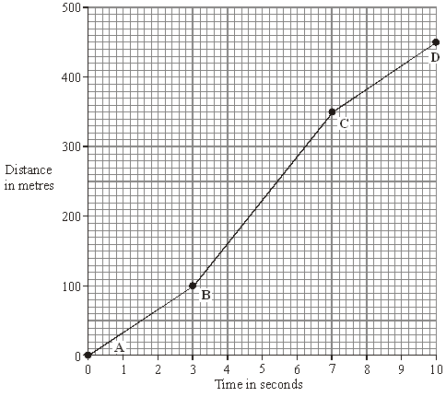
2.7 Distance Time Graphs
Task
Describe the journey between points A and D.
Back to travelling at lower constant speed.
Between B-C it is travelling at a faster constant speed.
Between A-B travelling at a constant speed.

Slide 24
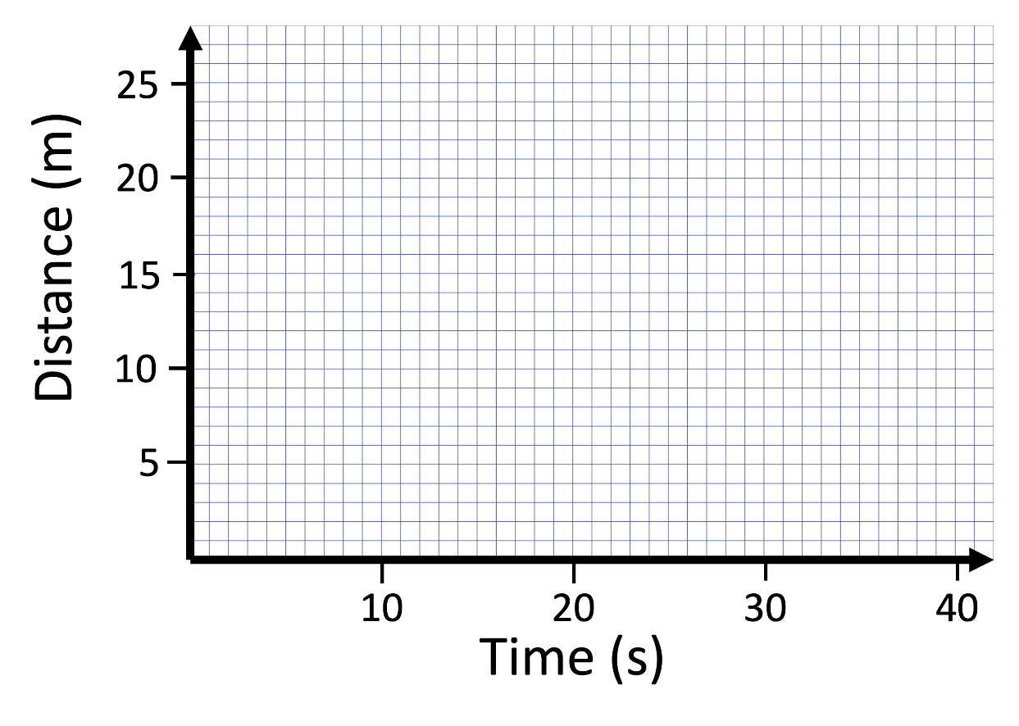
2.7 Distance Time Graphs
Task
Construct a distance time graph for the following journey.
Accelerates for 10 seconds and travels 15m
Accelerates for 10 seconds and travels 15m
Travels a further 5m over the next 10 seconds at a constant speed.
Travels a further 5m over the next 10 seconds at a constant speed.
Stops for 15 seconds.
Stops for 15 seconds.
Travels another 5m in the next 5 seconds at a constant speed.
Travels another 5m in the next 5 seconds at a constant speed.

Slide 25
2.8 Calculating Acceleration
Key Q
How can acceleration be determined?
Metres per second
m/s
Acceleration = Change in Velocity / Time
a = Δv / t
Time
Metres per second squared
s
m/s²
An object that is slowing down is decelerating.

Slide 26
2.8 Calculating Acceleration
Calculate the acceleration when speed increases by 240m/s in 1 minute. (3)
Convert Units | 1 min = 60 seconds
Write down the formula. | a = Δv / t
Substitute Values | a = 240 / 60
Do the Maths | a = 4
Round and add units. | 4m/s²
Usually 1 mark for this.
Show each step that you do. 1 mark available here.

Slide 27
2.8 Calculating Acceleration
What will the change in velocity be when a car accelerates for 5 seconds 2.5m/s²
Convert Units | -
Write down the formula. | a = Δv / t
Substitute Values | 2.5 = Δv / 5
Do the Maths | Δv = 2.5 x 5 = 12.5
Round and add units. | 12.5m/s
Usually 1 mark for this.
Show each step that you do. 1 mark available here.

Slide 28
2.9 Calculating Acceleration
Key Q
What is uniform acceleration?
Metres per second
Metres per second squared
m/s²
m/s
(Final Velocity)² – (Initial Velocity)² = 2 x Acceleration x Distance
v² – u² = 2 x a x s
Metres
m
Key Term | Definition
Uniform Acceleration | When an objects speed is increasing at a constant rate

Slide 29
2.9 Calculating Acceleration
Calculate the acceleration when the initial velocity is 2m/s and the final velocity after 20m is 5m/s (3)
Convert Units | -
Write down the formula. | v² – u² = 2 x a x s
Substitute Values | 5² – 2² = 2 x a 20
Do the Maths | 25-4 = 40 a a = 21 / 40 a = 0.525
Round and add units. | 0.53m/s²
Usually 1 mark for this.
Show each step that you do. 1 mark available here.

Slide 30
2.9 Calculating Acceleration
Calculate acceleration when… | The initial velocity is 7m/s and the final velocity after 10m is 5m/s | The initial velocity is 1m/s and the final velocity after 22m is 4m/s | The initial velocity is 5m/s and the final velocity after 1km is 15m/s
Convert Units | - | - | 1km = 1000m
Write down the formula. | v² – u² = 2 x a x s | v² – u² = 2 x a x s | v² – u² = 2 x a x s
Substitute Values | 5² – 7² = 2 x a 10 | 4² – 1² = 2 x a 22 | 15² – 5² = 2 x a 1000
Do the Maths | 25-49 = 20 a a = -24 / 20 a = -1.2 | 16-1 = 44 a a = 15/ 44 a = 0.3409090909 | 225-25 = 2000 a a = 200/ 2000 a = 0.1
Round and add units. | -1.2m/s² | 0.34m/s² | 0.1m/s²

Slide 31
2.9 Calculating Acceleration
What will the initial velocity be when a car accelerates over 100m at a rate or 2m/s² and has a new velocity of 30m/s
Convert Units | -
Write down the formula. | v² – u² = 2 x a x s
Substitute Values | 30² – u² = 2 x 2 x 100
Do the Maths | 900 – u² = 400 -u² = 400 – 900 -u² = -500 u² = 500 u = √500 u = 22.360679775
Round and add units. | 22.4m/s
Usually 1 mark for this.
Show each step that you do. 1 mark available here.

Slide 32
2.10 Velocity Time Graphs
Key Q
What are velocity time graphs?
Velocity (m/s)
Time (s)
Key Term | Definition
Velocity-Time Graph | A way of representing the speed and direction an object travels over a specific period of time.

Slide 33
2.10 Velocity Time Graphs
Key Q
How can the following be represented on a velocity time graph?
Stationary Object
Constant Velocity
Constant Deceleration
Constant Acceleration

Slide 34
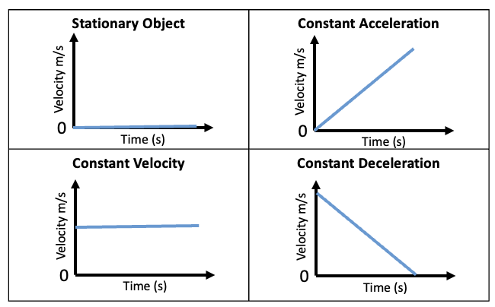
2.10 Velocity Time Graphs
Key Q
How can the following be represented on a velocity time graph?
Stationary Object

Slide 35
2.10 Velocity Time Graphs
Key Q
How can the following be represented on a velocity time graph?
Constant Velocity

Slide 36
2.10 Velocity Time Graphs
Key Q
How can the following be represented on a velocity time graph?
Constant Deceleration

Slide 37
2.10 Velocity Time Graphs
Key Q
How can the following be represented on a velocity time graph?
Constant Acceleration

Slide 38
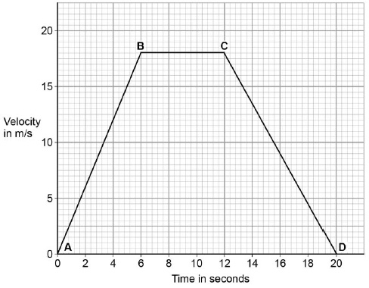
2.10 Velocity Time Graphs
The acceleration of an object can also be calculated from the gradient of a velocity-time graph.
Between A and B
𝚫y = 18
Gradient = 𝚫y / 𝚫x
Gradient = 18 / 6
Gradient = 3m/s²
𝚫x = 6

Slide 39
2.10 Velocity Time Graphs
Key Q
How can the distance that an object moved be determined using a velocity time graph?
You can find the distance that an object moved by finding the area under the velocity-time graph.

Slide 40
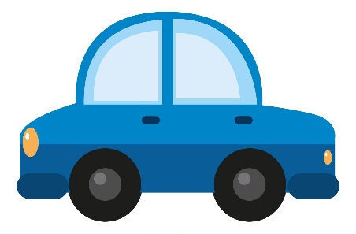

2.11 Determining Speed
Key Q
How can we use the following apparatus to investigate the motion of a toy car?
We could use this apparatus to find out how different factors effect the speed of the car.
For example, we could raise the height of the ramp and investigate how the gradient effects the speed.

Slide 41
2.11 Determining Speed
Key Q
What measurements would need to be taken to determine speed?
Average Speed = Distance / Time Taken
We would need to know the time that this would take for the car to travel between the two points.
We would need to know the distance between these two points.

Slide 42
2.11 Determining Speed
Key Q
How could this equipment be used to investigate the effect of height on the speed of the car?
1. Set up equipment as shown in the diagram.
2. Elevate the ramp 5cm.
3. Measure the distance between A and B
4. Release the car and measure the time to travel between A and B
A
5cm
B

Slide 43
2.11 Determining Speed
Key Q
How could this equipment be used to investigate the effect of height on the speed of the car?
5. Determine speed using speed = distance / time
6. Repeat at the heights: 10, 15, 20 and 25cm.
A
5cm
B

Slide 44
2.11 Determining Speed
Key Q
What are the risks in this experiment and how could these be reduced?
Hazard | Risk | Precaution
Ramp | Falling on feet causing bumps and bruising | Place on floor/low levels to prevent them falling off from a height.
Car | Falling on feet causing bumps and bruising | Use a ‘catch box’ filled with bubble wrap at the end of the ramp.

Slide 45
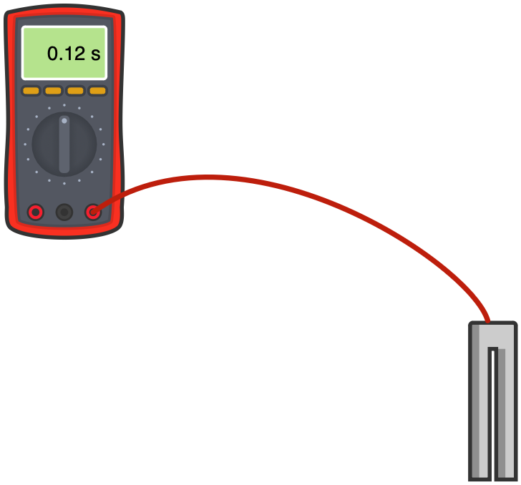
2.11 Determining Speed
Key Q
What equipment could be used instead of a stopwatch to record time?
Use a light gate connected to a digital meter.
This removes timing errors due to human reaction times.

Slide 46
2.11 Determining Speed
Key Q
How can we ensure that our results are valid?
Have control variables
Do repeats!
Valid
These are variables that are kept the same in an experiment
This means we can identify any outliers and calculate a mean
Identify a couple of variables that you would control in the experiment

Slide 47
2.11 Determining Speed
Key Q
What are the possible control variables in this investigation?
Mass of the car
Force the car is pushed with
Surface of the ramp.

Slide 48
2.12 Typical Speeds
Key Q
What are some typical values for speed?
Example | Typical Value of Speed
Walking | 1.5m/s
Running | 3 m/s
Cycling | 6 m/s
Sound in Air | 330 m/s
Wind | 12m/s
The speed for each of these is rarely constant.
The speed someone walks runs or cycles at can depend on their age, the terrain, their fitness and the distance travelled.

Slide 49
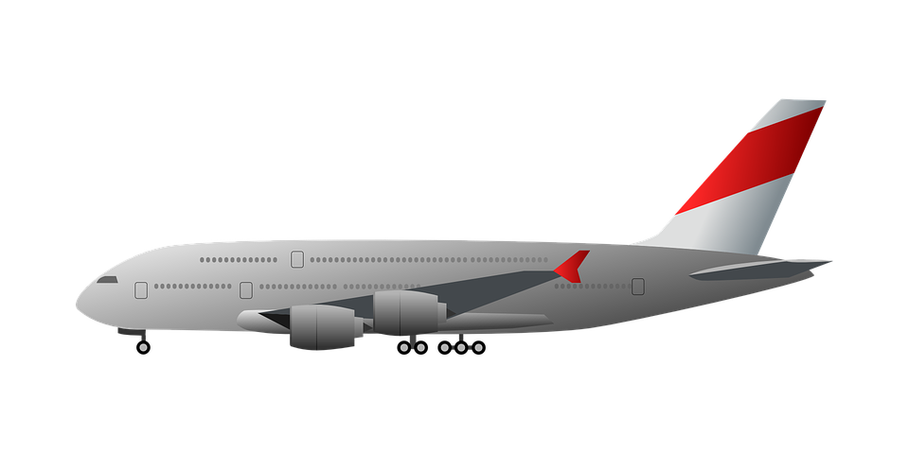
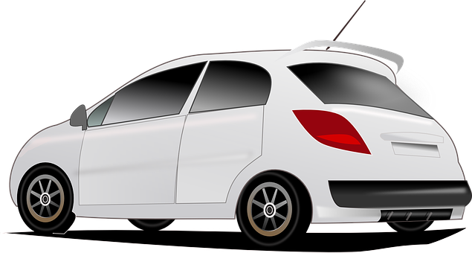
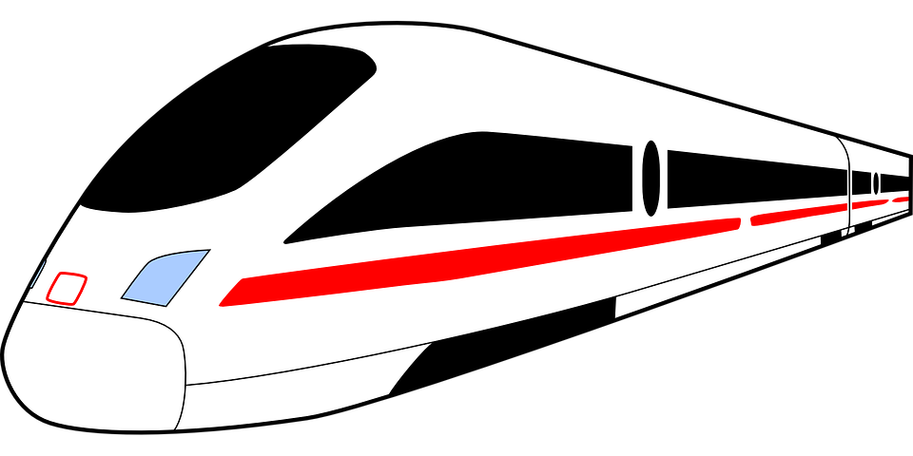
2.12 Typical Speeds
Key Q
What are some typical values for speed?
250m/s
13-30m/s
Again, the speed for each of these is rarely constant.
50m/s

Slide 50

2.13 Freefall Acceleration
Key Q
What is acceleration when an object falls under gravity?
Near the Earth’s surface any object falling freely under gravity has an acceleration of around 10m/s²
An object falling though a fluid will accelerate due to the force of gravity.
In real life objects only accelerate at a constant rate if air resistance and the short distance they fall is ignored.

Slide 51
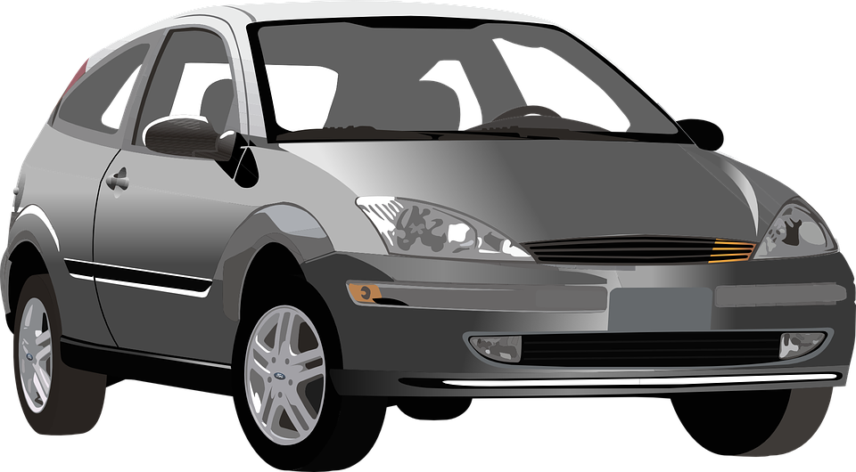
2.14 Newtons 1st Law
If the resultant force acting on an object is zero and:
The object is stationary.
The object will remain stationary.
The object will continue to move at the same speed and direction.
The object is moving.
When a vehicle travels at a steady speed the resistive forces balance the driving force.
So, the velocity (speed and/or direction) of an object will only change if a resultant force is acting on the object.

Slide 52

2.14 Newtons 1st Law
Key Q
What will happen to the motion of each of these cars and why?
Car will travel at a constant velocity.
Forces are balanced
Forward force bigger than backwards
Car will accelerate.
Car will decelerate.
Forward force smaller than backwards

Slide 53
2.15 Newtons 2nd Law
Key Q
Kilograms
What is Newtons 2nd Law?
kg
Resultant Force = Mass x Acceleration
F = m x a
Newtons
Metres per second squared
N
m/s²
Key Term | Definition
Newtons Second Law | A law of motion that states the acceleration of an object is proportional to the resultant force acting on the object and inversely proportional to the mass of the object.

Slide 54
2.15 Newtons 2nd Law
Calculate the resultant force when the mass is 5g and the acceleration is 25m/s². (3)
Convert Units | 5g = 0.005kg
Write down the formula. | F = m x a
Substitute Values | F = 0.005 x 25
Do the Maths | 0.125
Round and add units. | 0.13N
Usually 1 mark for this.
Show each step that you do. 1 mark available here.

Slide 55
2.15 Newtons 2nd Law
What will mass be when the force is 1.8kN and the acceleration is 12m/s²
Convert Units | 1.8kN = 1800N
Write down the formula. | F = m x a
Substitute Values | 1800 = m x 12
Do the Maths | m = 1800 / 12
Round and add units. | 150kg
Usually 1 mark for this.
Show each step that you do. 1 mark available here.

Slide 56
2.15 Newtons 2nd Law
Calculate acceleration when… | Mass is 7kg and force is 12N | Mass is 82g and force is 14N | Mass is 351g and force is 1.71kN
Convert Units |  | 82g = 0.082kg | 351g = 0.351kg 1.71kN = 1710N
Write down the formula. | F = m x a | F = m x a | F = m x a
Substitute Values | 12 = 7 x a | 14 = 0.082 x a | 1710 = 0.351 x a
Do the Maths | a = 12 / 7 = 1.7142857143 | a = 14 / 0.082 = 170.7317073171 | a = 1710/ 0.35 = 4,871.794871795
Round and add units. | 1.7m/s² | 171m/s² | 4,872m/s²

Slide 57
2.16 Weight
Key Q
What is the equation that you would use to calculate weight?
Weight = Mass x Gravitational Field Strength
W = m x g
Newtons
Newtons per kilogram
Kilograms
N
N/kg
kg
Key Term | Definition
Weight | The force acting on an object due to gravity.

Slide 58

2.17 Measuring Weight
Key Q
How is weight measured?
To make a measurement of weight, we have to measure the force pulling the object towards the centre of the Earth.
To do this we use a newton meter.

Slide 59
2.18 Gravitational Field Strength
A book has a mass of 138g and gravitational field strength is 9.8N/kg. Calculate its weight. (4)
Convert Units | 138g = 0.138kg
Write down the formula. | W = m x g
Substitute Values | W = 0.138 x 9.8
Do the Maths | W = 1.3524
Round and add units. | 1.35N
Usually 1 mark for this.
Show each step that you do. 1 mark available here.
Answer to 3 s.f which is the same as the values in the qu.

Slide 60
2.18 Gravitational Field Strength
Calculate mass when gravitational field strength is 9.8N/kg and weight is 2kN. (4)
Convert Units | 2kN = 2000N
Write down the formula. | W = m x g
Substitute Values | 2000 = m x 9.8
Do the Maths | m = 2000 / 9.8 = 204.0816326531
Round and add units. | 204N
Usually 1 mark for this.
Show each step that you do. 1 mark available here.

Slide 61
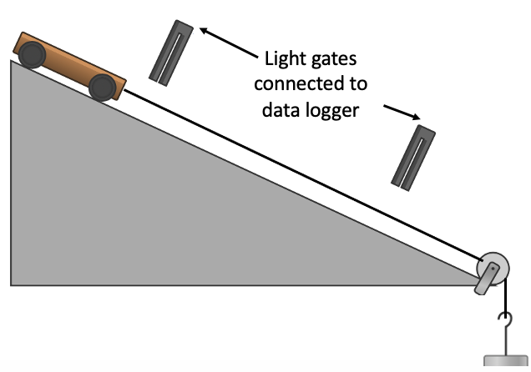
2.19 Core Practical
Key Q
How can you investigate the effect of varying the force on the acceleration of an object?
Set up equipment as shown in the diagram and connect 2 light gates to the data logger.
Add 1 N weight to the pulley and release the trolley.
Light gates A and B will determine the velocity at each point and use this to calculate the acceleration between the 2 points.

Slide 62
2.19 Core Practical
Key Q
How can you investigate the effect of varying the force on the acceleration of an object?
Record the acceleration when 1N is added.
Repeat by adding more weights at 1N intervals.

Slide 63
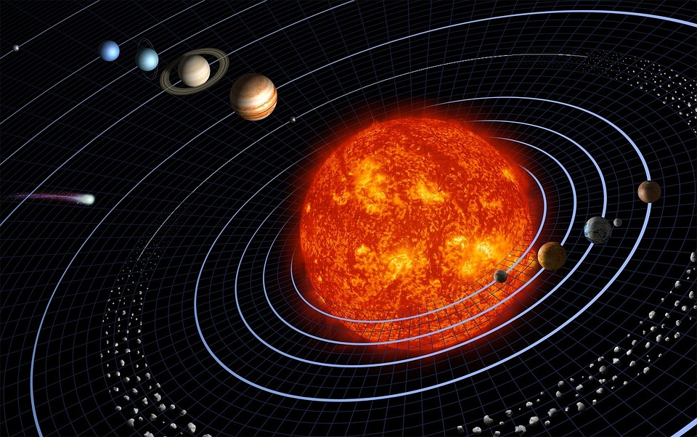
2.20 Circular Motion
Key Q
What happens to velocity and speed during circular motion?
Planets orbiting the sun are an example of circular motion.
The planets have a constant speed in their orbit.
The velocity of the planets is constantly changing.
This is because they are changing direction.

Slide 64
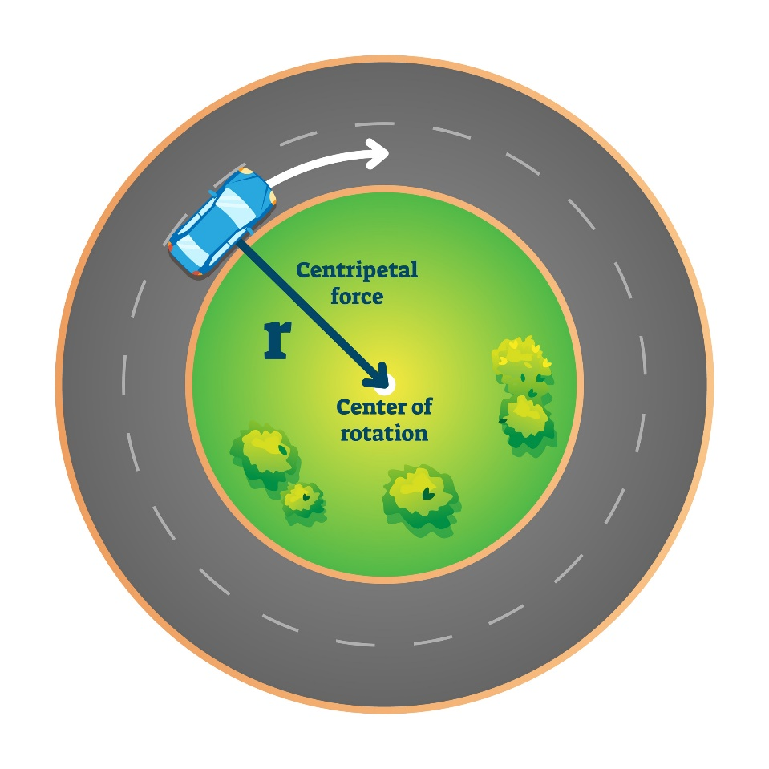
2.21 Centripetal Force
Key Q
What are the different units for the different physical quantities?
An object will only accelerate if a resultant force acts on it.
For an object moving in a circle, this resultant force is the centripetal force that acts towards the middle of the circle.

Slide 65

2.22 Inertial Mass
Key Q
What is inertia?
Key Term | Definition
Inertia | The tendency of objects to continue in their state of rest or of uniform motion.

Slide 66
2.22 Inertial Mass
Key Q
What is inertial mass?
Key Term | Definition
Inertial Mass | A measure of how difficult it is to change the velocity of an object. If is defined as the ratio of force over acceleration.

Slide 67

2.23 Newtons 3rd Law
Key Q
These forces are equal in size and opposite in direction.
What is Newtons 3rd Law?
The cat pulls the Earth up
The Earth pulls the cat down.
Key Term | Definition
Newtons Third Law | A law of motion that states that when ever two objects interact, the forces they exert on each other are equal and opposite.

Slide 68
2.24 Momentum
Key Q
What is the equation that you would use to calculate momentum?
Kilograms
kg
Momentum = Mass x Velocity
⍴ = m x v
Kilograms metres per second
Metres per second
m/s
Kgm/s
Key Term | Definition
Momentum | A vector quantity that is the product of the mass and velocity of an object.

Slide 69
2.24 Momentum
A toy has a mass of 150g and moves forward with a velocity of 0.08 m/s. Calculate its momentum. (3)
Convert Units | 150g = 0.15kg
Write down the formula. | ⍴ = m x v
Substitute Values | ⍴ = 0.15 x 0.08
Do the Maths | ⍴ = 0.012
Round and add units. | 0.012kgm/s
Usually 1 mark for this.
Substitute before you do any rearranging or calculations 1 mark for doing this.
Answer to 2 s.f which is the same as the values in the qu.

Slide 70
2.24 Momentum
Calculate mass when… | Momentum is 5kgm/s and velocity is 2.5m/s | Momentum is 8.1kgm/s and velocity is 3m/s | Momentum is 17.2kgm/s and velocity is 6.21m/s
Convert Units | - | - | -
Write down the formula. | p = m x v | p = m x v | p = m x v
Substitute Values | 5 = m x 2.5 | 8.1 = m x 3 | 17.2 = m x 6.21
Do the Maths | m = 5 / 2.5 | m = 8.1 / 3 | m = 17.2 / 6.21
Round and add units. | 2 | 2.7 | 2.769726248

Slide 71
2.24 Momentum
Calculate velocity when… | Momentum is 12kgm/s and mass is 3kg | Momentum is 15kgm/s and mass is 2.8kg | Momentum is 2.1kgm/s and mass is 45g
Convert Units | - | - | 45g = 0.045kg
Write down the formula. | p = m x v | p = m x v | p = m x v
Substitute Values | 12 = 3 x v | 15 = 2.8 x v | 2.1 = 0.045 x v
Do the Maths | v = 12 / 3 | v = 15 / 2.8 | v = 2.1 / 0.045
Round and add units. | 4 | 5.3571428571 | 46.6666666667

Slide 72
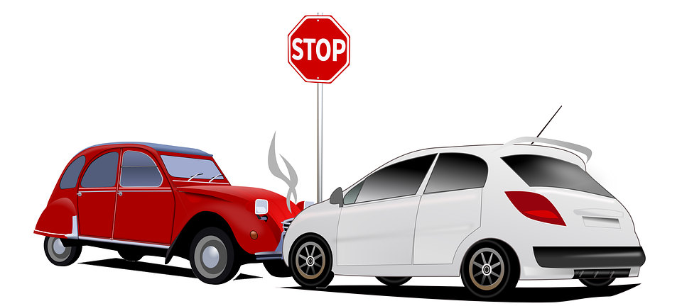
2.25 Collisions
Key Q
What happens to momentum in the event of a collision?
For example, if 2 cars with equal momentum were travelling in opposite directions overall momentum would be 0kgm/s.
If the two cars were to collide they would both come to a stop. Momentum would still be 0.
Key Term | Definition
Conservation of Momentum | In a closed system, the total momentum before an event is equal to the total momentum after the event.

Slide 73

2.25 Collisions
Predict what would happen if a car crashes into the back of a stationary car.
The stationary car will move forwards after the collision
Before the collision one car has momentum and the other doesn’t.
The car that crashed will also move forwards but at a slower speed as it has less momentum
Momentum before the collision is the same after the collision due to the conservation of momentum.

Slide 74
2.26 Newtons 2nd Law
Key Q
When does a change in momentum occur?
Kilogram metres per second
A change in momentum occurs when a force acts on an object that is moving/able to move.
kgm/s
Seconds
s
Force = Change in Momentum / Change in Time
F = m𝛥v / 𝛥t
Newtons
N

Slide 75
2.26 Newtons 2nd Law
A cricket ball has a change in momentum of 9.6kgm/s over 1ms when struck by a bat. Calculate the Force.
Convert Units | 1ms = 0.001s
Write down the formula. | F = m𝛥v / 𝛥t
Substitute Values | F = 9.6 / 0.001
Do the Maths | F = 9600
Round and add units. | 9600N
Usually 1 mark for this.
Substitute before you do any rearranging or calculations 1 mark for doing this.
Answer to 2 s.f which is the same as the values in the qu.

Slide 76
2.26 Newtons 2nd Law
Calculate force when... | The change in momentum is 10kgm/s and the time is 2s | The change in momentum is 12Nkgm/s and the time is 3.2s | The change in momentum is 1.8kgm/s and the time is 120ms
Convert Units | - | - | 120ms = 0.120s
Write down the formula. | F = m𝛥v / 𝛥t | F = m𝛥v / 𝛥t | F = m𝛥v / 𝛥t
Substitute Values | F = 10 x 2 | F = 12 x 3.2 | F = 1.8 x 0.120
Do the Maths | 20 | 38.4 | 0.216
Round and add units. | 20N | 38.4N | 0.22N

Slide 77
2.26 Newtons 2nd Law
Calculate change in momentum when... | Force is 12N and the time is 2s | Force is 13.2N and the time is 22ms | Force is 1kN and the time is 1min
Convert Units | - | 22ms = 0.022s | 1kN = 1000N 1min = 60s
Write down the formula. | F = m𝛥v / 𝛥t | F = m𝛥v / 𝛥t | F = m𝛥v / 𝛥t
Substitute Values | 12 = m𝛥v / 2 | 13.2=m𝛥v / 0.022 | 1000 = m𝛥v / 60
Do the Maths | m𝛥v = 12 x 2 =24 | m𝛥v= 13.2x 0.022 = 0.2904 | m𝛥v = 1000 x 60 = 60,000
Round and add units. | 24kgm/s | 0.29kgm/s | 60,000kgm/s

Slide 78
2.26 Newtons 2nd Law
Calculate change in time when... | Momentum is 5kgm/s force is 10N | Momentum is 8.1kgm/s and force is 88N | Momentum is 17.2kgm/s and force is 1kN
Convert Units | - | - | 1kN = 1000N
Write down the formula. | F = m𝛥v / 𝛥t | F = m𝛥v / 𝛥t | F = m𝛥v / 𝛥t
Substitute Values | 10 = 5 / t | 88 = 8.1 / t | 1000 = 17.2 / t
Do the Maths | t = 5 / 10 = 0.5 | t = 8.1 / 88 = 0.09204545455 | t = 17.2 / 1000 = 0.0172
Round and add units. | 0.5s | 0.092s | 0.0172s

Slide 79

2.27 Measuring Reaction Time
Key Q
How can we determine someone's reaction time?
We can use this method to investigate the effects of caffeine, practice and tiredness on someone's reaction time.

Slide 80
2.27 Measuring Reaction Time
Key Q
How can we determine someone's reaction time?
1.
Person catching sits down, rests weaker arm across the table, with the hand overhanging the edge.
2.
Person dropping the ruler holds it so that the bottom end of the ruler is in line with the catches thumb and forefinger.

Slide 81
2.27 Measuring Reaction Time
Key Q
How can we determine someone's reaction time?
3.
Without warning the ruler is dropped.
4.
The other person catches the ruler and the distance the ruler fell is recorded.
5.
Repeat this several times.
6.
Identify outliers and calculate an average distance dropped.
7.
Convert this distance dropped to a reaction time using a table.`

Slide 82
2.27 Measuring Reaction Time
Key Q
How can we determine someone's reaction time?
6.
Identify outliers and calculate an average distance dropped.
7.
Convert this distance dropped to a reaction time using a table.`

Slide 83
2.27 Measuring Reaction Time
Key Q
How can we ensure that our results are valid?
Do repeats!
Have control variables
Valid
This means we can identify any outliers and calculate a mean
Identify a couple of variables that you would control in the experiment

Slide 84
2.28 Stopping Distance
Key Q
What is stopping distance?
For a given braking force the greater the speed of the vehicle, the greater the stopping distance.
Key Term | Definition
Stopping Distance | The sum of the thinking distance and braking distance.
Thinking Distance | The distance travelled during the driver's reaction time.
Braking Distance | The distance travelled under the braking force.

Slide 85
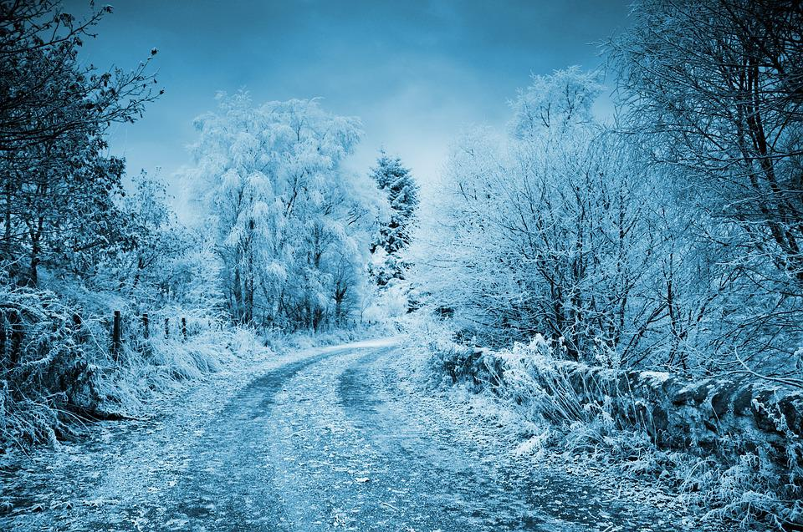
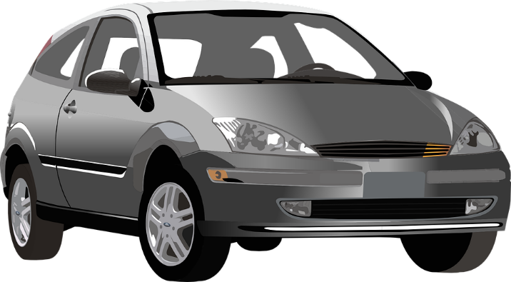
2.28 Stopping Distance
The braking distance of a vehicle can be affected by:
Poor condition of the vehicle.
Adverse road and weather conditions
e.g. worn tyres or brakes
e.g. wet of icy conditions

Slide 86
2.29 Stopping Distance
Key Q
What different factors affect stopping distance? How?
Factor | Explanation
Mass of the Car | The heavier the car the greater the stopping distance. This is because it has more momentum.
Speed of the Car | The faster the car the greater the stopping distance. This is because it has more momentum.
Reaction Time | The slower the reaction time the greater the stopping distance. The car is travelling during this extra time.
State of Brakes | The more worn the brakes the greater the stopping distance as there will be reduced friction.

Slide 87
2.29 Stopping Distance
Key Q
What different factors affect stopping distance? How?
Factor | Explanation
State of the Road | The icier/wetter the roads the greater the stopping distance as there will be reduced friction.
Friction Between Tyre and Surfaces | The less friction between the tyre and the surface the greater the stopping distance as there will be reduced friction.

Slide 88
2.30 Reaction Time
Key Q
What factors can affect a person's reaction time?
Tiredness
Alcohol
Practice
Concentration/Distractions
Age
Gender
Caffeine

Slide 89
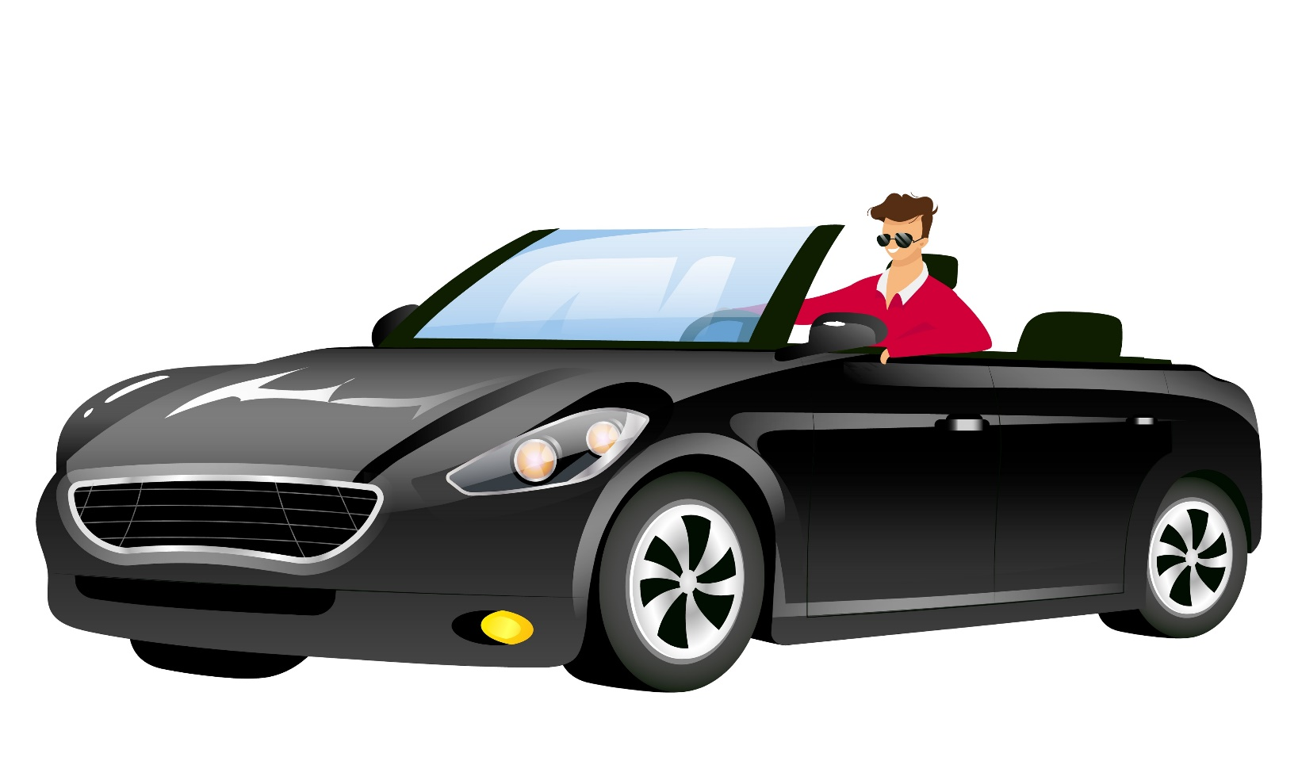
2.30 Reaction Time
Reaction times can vary from person to person.
Typical values range from 0.2 to 0.9s
A drivers reaction time can be affected by:
Drugs
Tiredness
Distractions
Alcohol

Slide 90
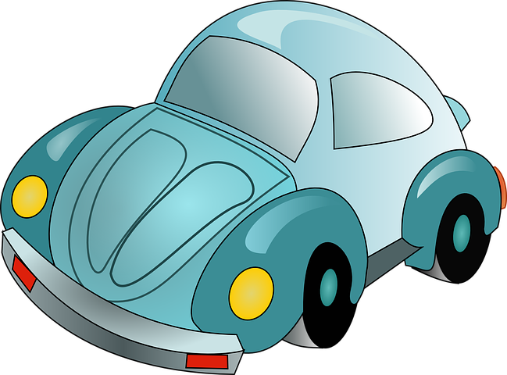
2.31 Dangers of Decelerations
Key Q
What happens when the brakes are used?
When a force is applied to the brakes of a vehicle, work done by the friction force between the brakes and the wheel.
The kinetic energy of the vehicle is reduced.
The temperature of the brakes increases.

Slide 91
2.31 Dangers of Decelerations
Key Q
What happens when the brakes are used?
The greater the speed of a vehicle the greater the braking force needed to stop the vehicle in a certain distance.
The greater the braking force the greater the deceleration of the vehicle.
Large decelerations may lead to brakes overheating and/or loss of control.

Slide 92
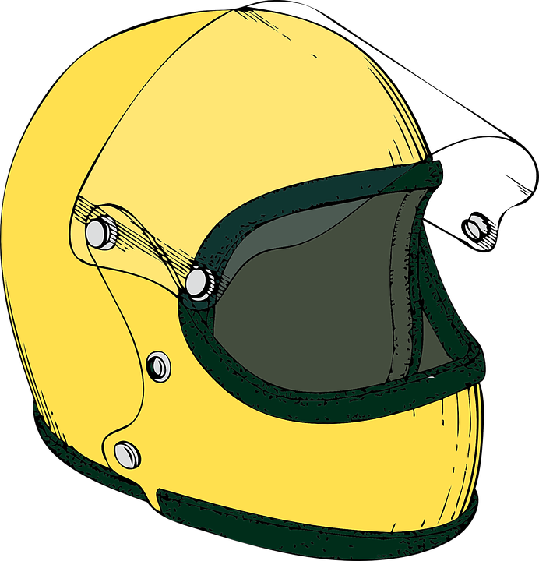
2.31 Dangers of Decelerations
Key Q
How do safety features such as crash helmets work?
The helmet has a lining which is designed to crush in the event of an impact.
This increases the time taken for the head’s momentum to reach 0.
Therefore, it reduces the forces acting on the head and so prevents injury.

Slide 93

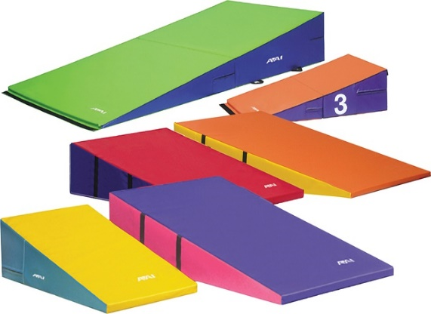
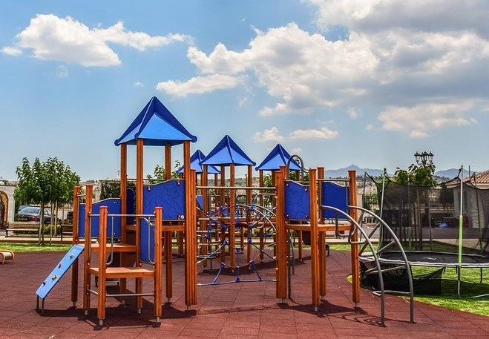
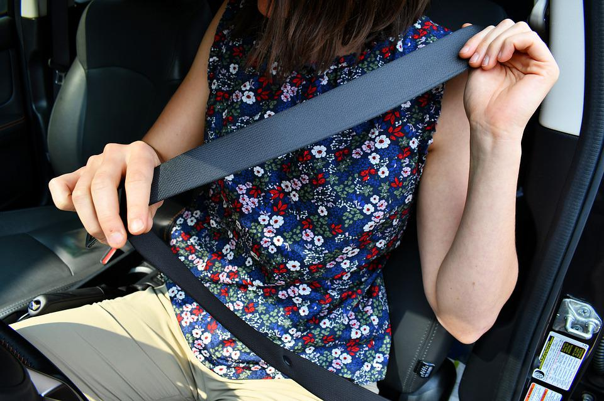
2.31 Dangers of Decelerations
Key Q
What about some other safety features?
Gym mats.
Airbags.
They all increase the time it takes for momentum to reach 0.
Which reduces the forces acting on the person.
Seat belts
This reduces injuries.
Playground floor

Slide 94
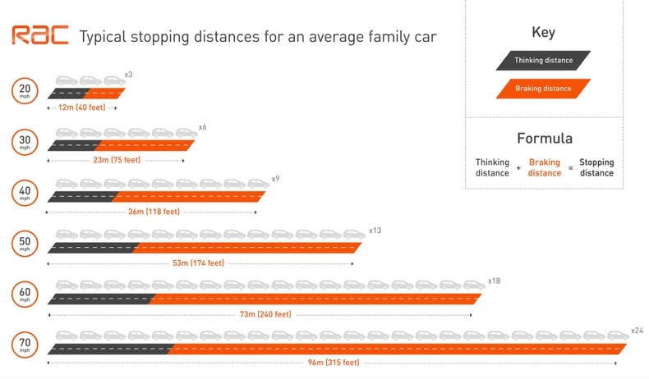
2.32 Work and Braking
Key Q
How does the distance needed for a road vehicle to stop in an emergency vary over different speeds?

Slide 95
2.33 Work Done
Key Q
What happens when the brakes are used?
When a force is applied to the brakes of a vehicle, work done by the friction force between the brakes and the wheel.
The kinetic energy of the vehicle is reduced.
The temperature of the brakes increases.

Slide 96
2.33 Work Done
Key Q
What happens when the brakes are used?
The greater the speed of a vehicle the greater the braking force needed to stop the vehicle in a certain distance.
The greater the braking force the greater the deceleration of the vehicle.
Large decelerations may lead to brakes overheating and/or loss of control.

