Slide 1
Forces and Matter
Paper 2

Slide 2

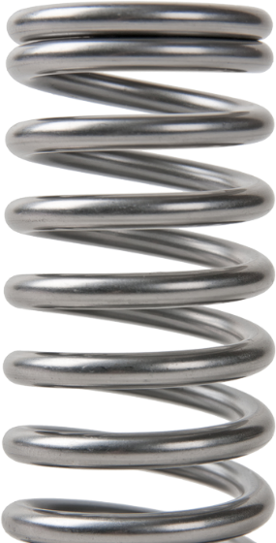
15.1 Springs
Key Q
If you applied a force to compress both a spring and a drinks can what differences would there be? Why do you think this is?
When a force is applied to either of these objects they will change shape. Depending on the force applied they may bend, stretch or compress. A change in shape is known as deformation.

Slide 3
15.2 Deformation
Key Q
If you applied a force to compress both a spring and a drinks can what differences would there be? Why do you think this is?
The spring is an example of an elastic object
The can is an example of an inelastic object
Elastic deformation is reversed when the force is removed. This means that spring will return back to its original shape.
Inelastic deformation is not fully reversed when the force is removed. This means that the can will not return back to its original shape.

Slide 4
15.2 Deformation
Task
Define the following key terms:
Key Term | Definition
Deformation | A change in shape when a force is applied.
Elastic Deformation | Material returns to its original shape and size after being stretched or squashed.
Inelastic Deformation | Material does not return to its original shape and size after being stretched or squashed.

Slide 5
15.3 Force and Extension
Key Q
What is the equation that you would use to calculate extension of a spring?
Newtons per metre
N/m
Force = Spring Constant x Extension
F = k x e
Newtons
Metres
N
m
You may need to convert units!

Slide 6
15.3 Force and Extension
Worked Example
A spring has a spring constant of 8N/m. Calculate the force needed to extend it 20cm
Convert Units | 20cm = 0.2m
Write down the formula. | F = k x e
Substitute Values | F = 8 x 0.2
Do the Maths | F = 1.6
Round and add units. | 1.6N
Usually 1 mark for this.
Substitute the values into your equation
Units included.

Slide 7
15.3 Force and Extension
Worked Example
A force of 20N is applied to a spring that stretches 48cm. Calculate its spring constant.
Convert Units | 48cm = 0.48m
Write down the formula. | F = k x e
Substitute Values | 20 = k x 0.48
Do the Maths | k = 20 / 0.48 = 41.6666666667
Round and add units. | 42N/m
Usually 1 mark for this.
Substitute before you do any rearranging. 1 mark for doing this.
Show each step that you do.
Answer to 2 s.f which is the same as the values in the qu.

Slide 8
15.3 Force and Extension
Task
Complete the calculations for the following questions.
 | Calculate force when spring constant is 2.2N/m and extension is 10mm. | Calculate force when spring constant is 3.5N/m and extension is 82mm. | Calculate spring constant when force is 1kN and extension is 3.21m
Convert Units | 10mm = 0.01m | 82mm = 0.082m | 1kN = 1000N
Write down the formula. | F = k x e | F = k x e | F = k x e
Substitute Values | F = 2.2 x 0.01 | F = 3.5 x 0.082 | 1000 = k x 3.21
Do the Maths | F = 0.022 | F = 0.287 | k = 1000/3.21 = 311.5264797508
Round and add units. | 0.022N | 0.29N | 312N

Slide 9
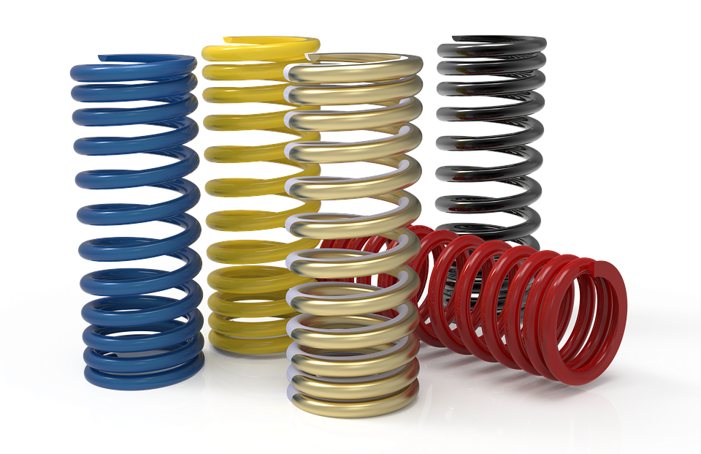
15.4 Energy and Stretching
Key Q
How can you find the work done when a spring is stretched or compressed?
A force that stretches or compresses a spring does work.
This means we can use the elastic potential energy equation to calculate work done.
Elastic potential energy is stored in the spring.
Provided the spring is not inelastically deformed, the work done on the spring and the elastic potential energy stored are equal.

Slide 10
15.4 Energy and Stretching
Key Q
What is the equation that you would use to calculate elastic potential energy?
Newtons per metre
You may need to convert units!
N/m
Elastic Potential Energy = 0.5 x Spring Constant x Extension²
E_{e} = ½ x k x e²
Joules
Metres
J
m
Key Term | Definition
Elastic Potential Energy | The energy stored when an object is stretched or compressed.

Slide 11
15.4 Energy and Stretching
Worked Example
A spring that has a spring constant of 1.2N/m is stretched 22cm. Calculate the work done.
Convert Units | 22cm = 0.22m
Write down the formula. | E_{e} = ½ x k x e²
Substitute Values | E_{e} = ½ x 1.2 x 0.22²
Do the Maths | E_{e} = 0.5 x 1.2 x 0.0484 E_{e} = 0.02904
Round and add units. | 0.029J
Usually 1 mark for this.
Substitute before you do any rearranging. 1 mark for doing this.
Show each step that you do. 1 mark available here.
Answer to 2 s.f which is the same as the values in the qu.

Slide 12
15.4 Energy and Stretching
Worked Example
A spring has 120J of energy and and has a spring constant of 9.2N/m. Calculate its extension. (4)
Substitute before you do any rearranging. 1 mark for doing this.
Convert Units | -
Write down the formula. | E_{e} = ½ x k x e²
Substitute Values | 120 = ½ x 9.2 x e²
Do the Maths | 120 = 4.6 x e² e² = 120 / 4.6 e² = 26.0869565217 e = √26.0869565217 e =5.10753919
Round and add units. | 5.1m
Show each step that you do. Do as much as the calculation that you can before rearranging. 2 marks.
Answer to 2 s.f which is the same as the values in the qu.

Slide 13
15.4 Energy and Stretching
Task
Complete the calculations for the following questions.
 | Calculate work done when extension is 11cm and spring constant is 8N/m. | Calculate work done when extension is 42cm and spring constant is 16N/m. | Calculate extension when spring constant is 82N/m and work is 1.8kJ
Convert Units | 11cm = 0.11m | 42cm = 0.42m | 1.8kJ = 1800
Write down the formula. | E_{e} = ½ x k x e² | E_{e} = ½ x k x e² | E_{e} = ½ x k x e²
Substitute Values | E_{e} = ½ x 8 x 0.11² | E_{e} = ½ x 16 x 0.42² | 1800 = ½ x 82 x e²
Do the Maths | E_{e} = 4 x 0.0121 = 0.0484 | E_{e} = 8 x 0.1764 =1.4112 | 1800 = 41 x e² e² = 1800 / 41 e² = 43.9024390244 e = √43.9024390244 e = 6.62589156
Round and add units. | 0.048J | 1.4J | 6.6m

Slide 14
15.5 Linear & Non-Linear Relationships
Key Q
Below is a graph that shows the extension of a spring when a force is applied. What relationship does this graph show?
The limit of proportionality
At this point the line begins to curve. This means the relationship is no longer directly proportional. The relationship is no longer linear
The line is straight and cuts through the origin. This means the relationship is directly proportional. The relationship is linear
Force (N)
As force increases the extension increases
Extension (m)

Slide 15
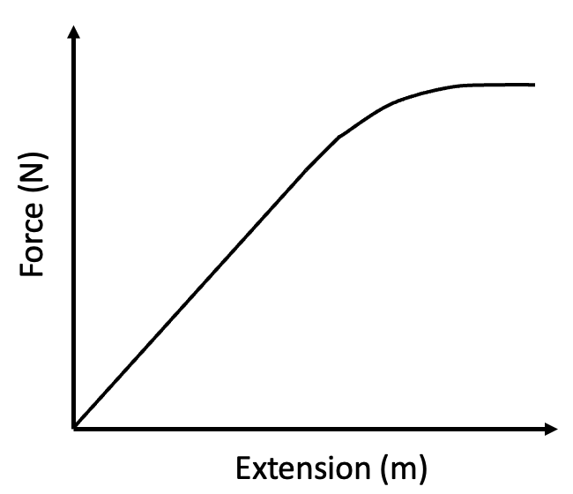
15.5 Linear & Non-Linear Relationships
Key Q
What is Hooke’s Law?
Key Term | Definition
Hooke’s Law | The extension of a spring is directly proportional to the force applied as long as the limit of proportionality is not exceeded.

Slide 16
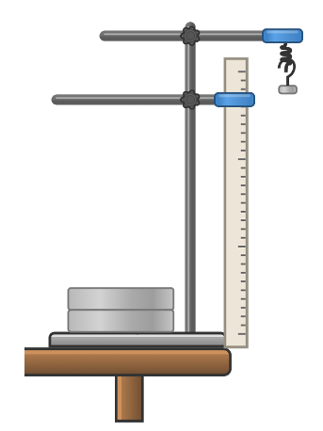
15.6 Core Practical
Key Q
How can we investigate the relationship between force applied to a spring and extension.
Set up equipment as shown in the diagram.
Adjust the ruler so that the zero mark is at the same height as the top of the spring.
Record the length of the spring when no weights are attached.
Hook a 1N weight on the bottom of the spring.
Record the new length of the spring.

Slide 17
15.6 Core Practical
Key Q
How can we investigate the relationship between force applied to a spring and extension.
Add weights at 1N intervals recording the new length of the spring.
Determine the extension of the spring when each weight is added by subtracting the original length from the recorded lengths.

Slide 18
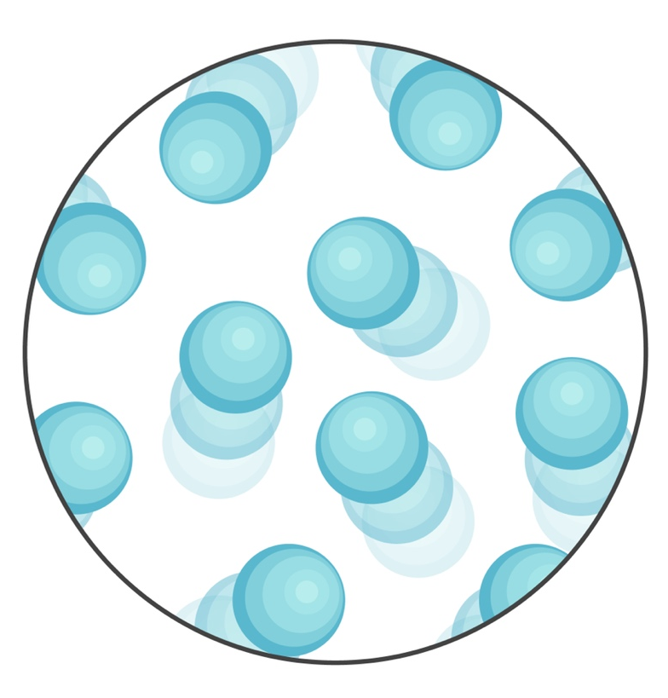
15.7 Atmospheric Pressure
Key Q
What is a fluid?
A fluid can be either a liquid or a gas.
Particles move over each other and so the fluid can flow

Slide 19

15.7 Atmospheric Pressure
Key Q
What is the atmosphere?
The atmosphere is a thin layer (relative to the size of the Earth) of air round the Earth.
The atmosphere gets less dense with increasing altitude.
Air molecules colliding with a surface create atmospheric pressure.

Slide 20

15.7 Atmospheric Pressure
Key Q
What is the atmosphere?
The number of air molecules (and so the weight of air) above a surface decreases as the height of the surface above ground level increases.
So as height increases there is always less air above a surface than there is at a lower height.
So atmospheric pressure decreases with an increase in height.

Slide 21
15.8 Pressure in Fluids
Key Q
What determines the pressure in a fluid?
The pressure in a fluid is due to the fluid and atmospheric pressure.

Slide 22
15.9 Pressure in Fluids
Key Q
What determines the pressure in a fluid?
The pressure in a fluid is due to the fluid and atmospheric pressure.
The pressure causes a force normal to any surface.

Slide 23
15.10 Pressure, Force and Area
Key Q
What causes pressure in a fluid?
The pressure in fluids causes a force normal (at right angles) to any surface.
Pressure = Force Normal to a Surface Area of that Surface
Area of that Surface
Newtons
N
Pascals
Pa
p = F / A
Meters Squared m²

Slide 24
15.11 Calculating Pressure
A toy has a mass of 150g and moves forward with a velocity of 0.08 m/s. Calculate its momentum. (3)
Convert Units | 150g = 0.15kg
Write down the formula. | ⍴ = m x v
Substitute Values | ⍴ = 0.15 x 0.08
Do the Maths | ⍴ = 0.012
Round and add units. | 0.012kgm/s
Usually 1 mark for this.
Substitute before you do any rearranging or calculations 1 mark for doing this.
Answer to 2 s.f which is the same as the values in the qu.

Slide 25
15.11 Calculating Pressure
Calculate pressure when... | Force is 10N and area is 0.2m² | Force is 52.1N and area is 1.8m² | Force is 2.3kN and area is 2.8m²
Convert Units | - | - | 2.3kN = 2300N
Write down the formula. | p = F / A | p = F / A | p = F / A
Substitute Values | p = 10 / 0.2 | p = 52.1 / 1.8 | p = 2300 / 2.8
Do the Maths | 50 | 28.9444444444 | 821.4285714286
Round and add units. | 50Pa | 28.9Pa | 821Pa

Slide 26
15.11 Calculating Pressure
Calculate force when... | Pressure is 250Pa and area is 3.8m² | Pressure is 321Pa and area is 4.2m² | Pressure is 34Pa and area is 0.38m²
Convert Units | - | - | -
Write down the formula. | p = F / A | p = F / A | p = F / A
Substitute Values | 250 = F / 3.8 | 321 = F / 4.2 | 34 = F / 0.38
Do the Maths | F = 250 x 3.8 =950 | F = 321 x 4.2 =1348.2 | F = 34 x 0.38 =12.92
Round and add units. | 950N | 1,348N | 13N

Slide 27

15.12 & 15.13 Pressure and Depth
The pressure in a column can be calculated using the equation:
Pascals
Pa
Kilograms per metre cubed
kg/m³
Pressure = Height of the Column × Density of the Liquid × Gravitational Field Strength
p = h ρ g
Metres
m
Newtons per kilogram
N/kg

Slide 28
15.14 Magnitude of Pressure
A water tank is 500 cm high. If the density of water is 1000 kg/m³ and the gravitational field strength is 9.81 N/kg, what is the pressure at the bottom of the tank?
Convert Units | 500cm = 5m
Write down the formula. | p = h x ⍴ x g
Substitute Values | p = 5 x 1000 x 9.81
Do the Maths | p = 49,050
Round and add units. | 49,050Pa

Slide 29
15.14 Magnitude of Pressure
Calculate pressure when... | Height is 3m, density is 2.2kg/m³ and gravitational field strength is 10N/kg | Height is 3m, density is 2.8kg/m³ and gravitational field strength is 9.8N/kg | Height is 30cm, density is 12.9kg/m³ and gravitational field strength is 9.81N/kg
Convert Units | - | - | 30cm = 0.3m
Write down the formula. | p = h x ⍴ x g | p = h x ⍴ x g | p = h x ⍴ x g
Substitute Values | p = 3 x 2.2 x 10 | p = 3 x 2.8 x 9.8 | p = 0.3 x 12.9 x 9.81
Do the Maths | 66 | 82.32 | 37.9647
Round and add units. | 66Pa | 82Pa | 38.0Pa

Slide 30
15.14 Magnitude of Pressure
Calculate height when... | Pressure is 250Pa and density is 2kg/m³ | Pressure is 321Pa and density is 2.2kg/m³ | Pressure is 3.4kPa and density is 7kg/m³
Convert Units | - | - | 3.4kPa = 3400Pa
Write down the formula. | p = h x ⍴ x g | p = h x ⍴ x g | p = h x ⍴ x g
Substitute Values | 250 = h x 2 x 9.81 | 321 = h x 2.2 x 9.81 | 3400 = h x 7 x 9.81
Do the Maths | 250 = 19.62 h h = 250 / 19.62 | 321 = 21.582 h h = 321 / 21.582 | 3400 = 68.67 h h = 3400 / 68.67
Round and add units. | 12.7420998981 | 14.8735056992 | 49.5121596039

Slide 31

15.15 Objects in Fluids
Key Q
What causes upthrust?
A partially (or totally) submerged object experiences a greater pressure on the bottom surface than on the top surface.
This creates a resultant force upwards.
This force is called the upthrust.

Slide 32
15.16 Upthrust
Key Q
What causes upthrust?
A partially (or totally) submerged object experiences a greater pressure on the bottom surface than on the top surface.
This creates a resultant force upwards.
This force is called the upthrust.
Upthrust is equal to the weight of fluid displaced.

Slide 33
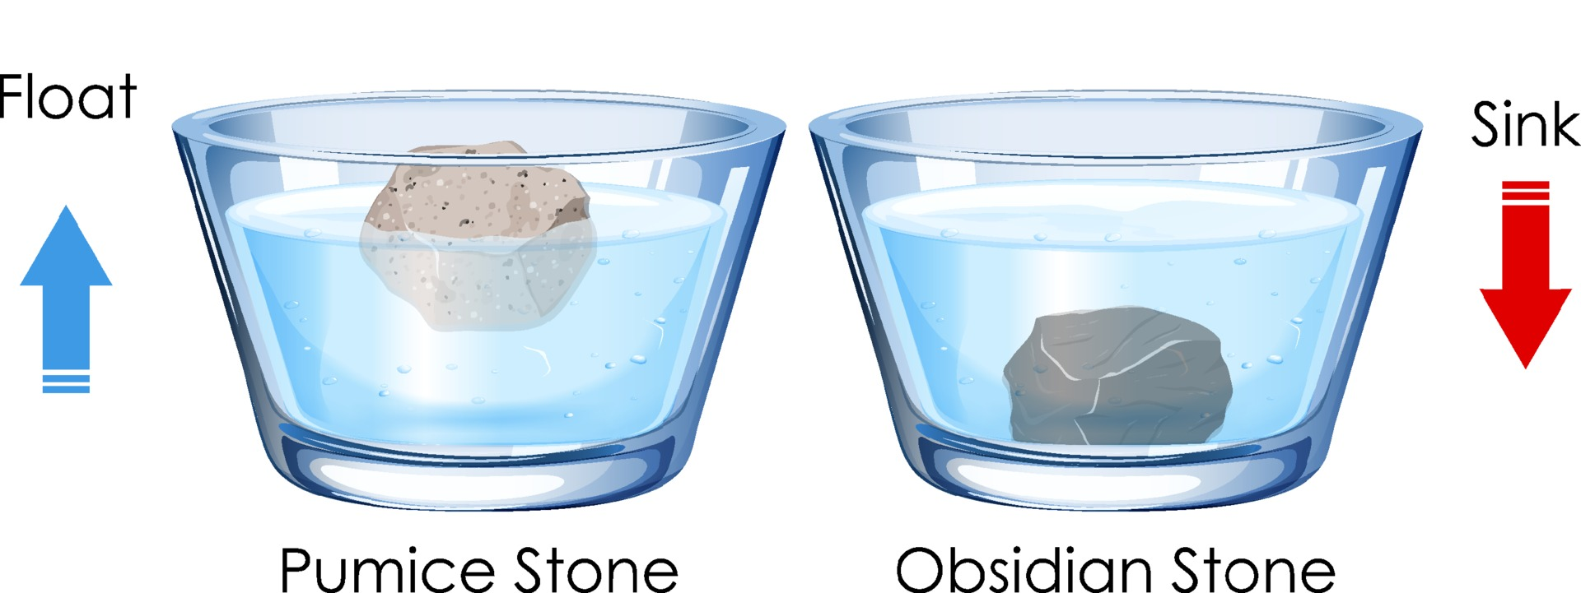
15.17 Floating and Sinking
Key Q
When do objects float and sink?
If the upthrust is less than the weight of the object, the object will sink.
If the upthrust is larger than the weight of the object, the object will rise.

