Slide 1
Particle Model
Paper 2

Slide 2
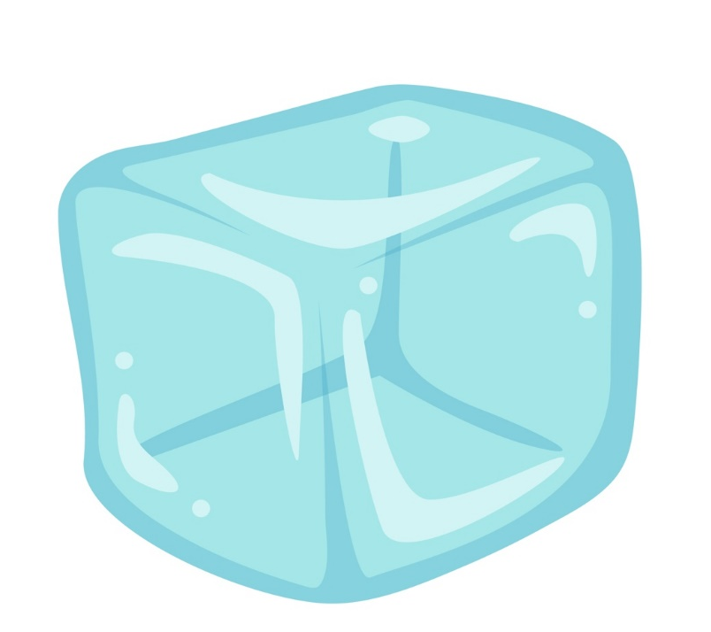
14.1 Kinetic Theory
Key Q
What is matter?
All matter is made up of tiny particles.
There is no other matter except these particles.
Particles of any given substance are all the same.
There are attractive forces between particles which differ from one substance to another.

Slide 3

14.1 Kinetic Theory
Key Q
How do we model the arrangement of particles in solids, liquids and gases?
The arrangement of particles can be modelled by drawing the particles as solid sphere.

Slide 4
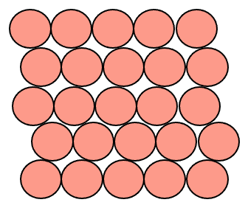
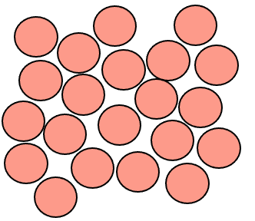
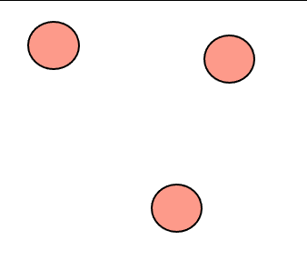
14.1 Kinetic Theory
Particles far apart, in a random arrangement, with gaps.
Solid | Liquid | Gas
Particles all close, in a regular arrangement, with no gaps.
Particles still all close, in a random arrangement, with no gaps.

Slide 5
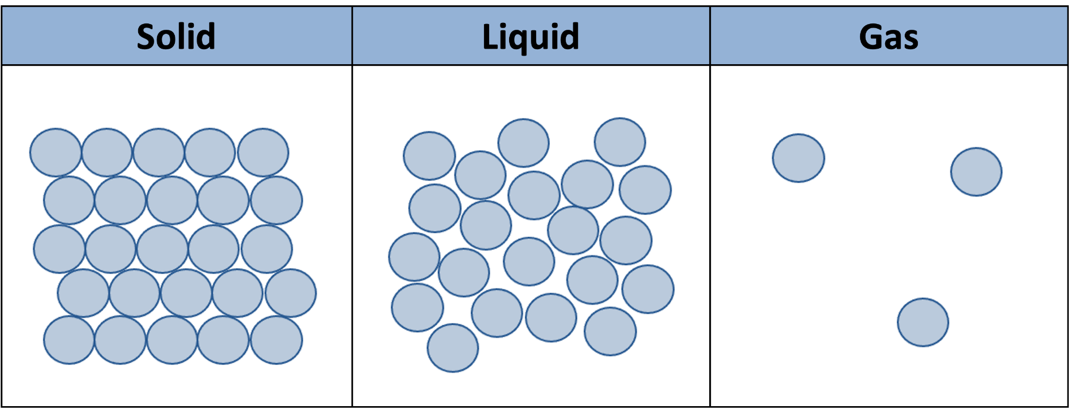
14.1 Kinetic Theory
Key Q
What are the limitations of modelling particle arrangement in this way?
Particles are shown as solids.
Only 2D
Doesn’t show the speed of particles.
Particles are shown as spheres.
Doesn’t show forces between the particles.
Doesn’t show the movement of particles.

Slide 6
14.1 Kinetic Theory
Key Q
What are the typical properties of solids, liquids and gases?

Slide 7
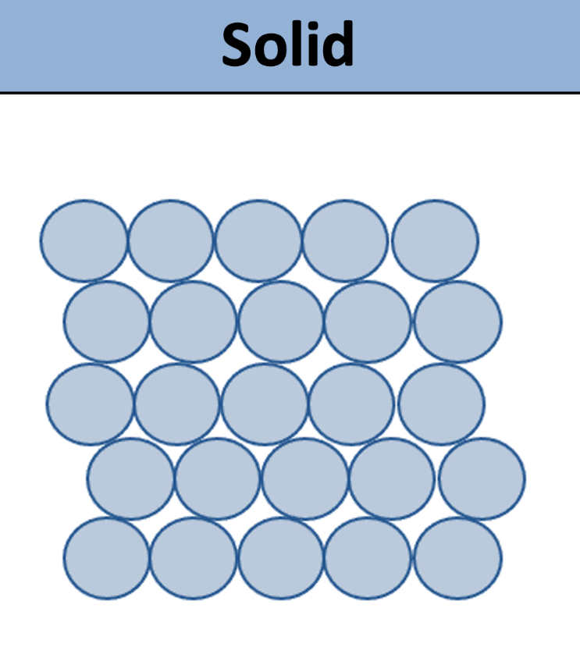
14.1 Kinetic Theory
Key Q
What are the typical properties of solids, liquids and gases?
In a solid state, the particles are close together and unable to move away from their neighbours.
Within a solid the particles are vibrating.
Solids are dense as the particles are close together.

Slide 8
14.1 Kinetic Theory
Key Q
What are the typical properties of solids, liquids and gases?
Typical Properties of Solids | Explanation
High Density | Particles are close together with little space between them.
Hard to Compress | Particles are close together with no room for particles to move closer together.
Shape is Fixed | Strong forces of attraction and the particles are held strongly together.

Slide 9
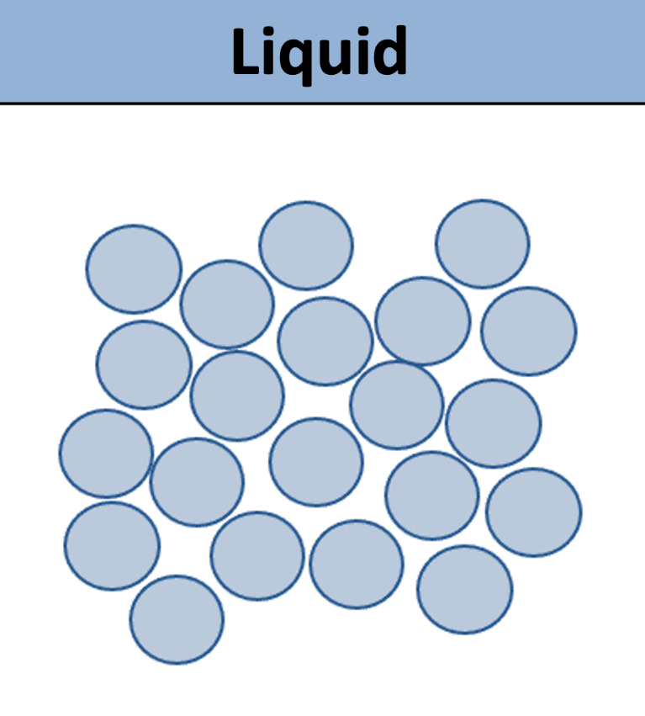
14.1 Kinetic Theory
Key Q
What are the typical properties of solids, liquids and gases?
In a liquid state, the particles are also close together, but can slide past each other.
Within a liquid the particles are vibrating and jostling around.
Liquids tend to be dense as the particles are close together.

Slide 10
14.1 Kinetic Theory
Key Q
What are the typical properties of solids, liquids and gases?
Typical Properties of Liquids | Explanation
Have a Higher Density than Gases | Particles are close together with little space between them.
Hard to Compress | Particles are close together with no room for particles to move closer together.
Flow and Fill the Bottom of a Container | Forces of attraction between particles are weaker than in a solid and so are able to move freely past each other.

Slide 11

14.1 Kinetic Theory
Key Q
What are the typical properties of solids, liquids and gases?
In a gas state, the particles are further apart, and can move freely.
In a gas state, the particles are moving freely in random directions at different speeds.
Gases are not dense as there is lots of space between the particles.

Slide 12
14.1 Kinetic Theory
Key Q
What are the typical properties of solids, liquids and gases?
Typical Properties of Gases | Explanation
Low Density | Particles are far apart with lots of space between them.
Can be Compressed | Particles are far apart with lots of space between them.
Flow and Fill a Container | There are very small forces of attraction between particles and so they move randomly and spread out in all directions.

Slide 13
14.2 Density
Key Q
What is the equation that you would use to calculate density?
Kilograms
kg
Density = Mass / Volume
⍴ = m /v
Kilograms Per Metres Cubed
Metres Cubed
kg/m³
m³
Be careful. You may need to convert units!

Slide 14
14.2 Density
Worked Example
A stone has a mass of 56g and a volume of 11.2cm³. Calculate its density in g/cm³.
Convert Units | -
Write down the formula. | ⍴ = m / V
Substitute Values | ⍴ = 56/11.2
Do the Maths | 5
Round and add units. | 5.0g/cm³
Usually 1 mark for this.
Substitute first. 1 mark for doing this.
Show each step that you do. 1 mark available here.

Slide 15
14.2 Density
Worked Example
An iceberg has a mass of 11,200kg and a volume of 12m³. Calculate its density.
Convert Units | -
Write down the formula. | ⍴ = m / V
Substitute Values | ⍴ = 11,200 / 12
Do the Maths | 933.33333
Round and add units. | 933kg/m³
Usually 1 mark for this.
Substitute first. 1 mark for doing this.
Show each step that you do. 1 mark available here.

Slide 16
14.2 Density
Worked Example
A 1500g piece of acrylic has a density of 1200kg/m³. Calculate its volume.
Convert Units | 1500g = 1.5kg
Write down the formula. | ⍴ = m / V
Substitute Values | 1200 = 1.5 / v
Do the Maths | v = 1.5 / 1200 = 0.00125
Round and add units. | 0.0013m³

Slide 17
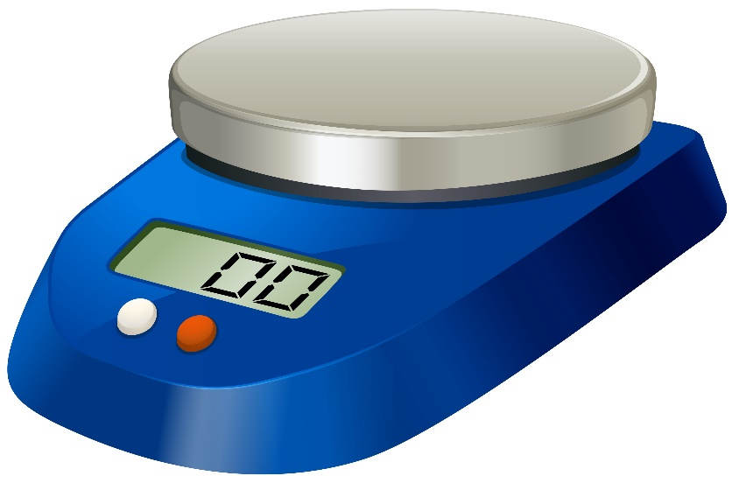
14.3 Core Practical
Density = Mass / Volume
To find the density of an object we need to know the mass and the volume
Key Q
What piece of apparatus can we use to find the mass of an object?
We would use a balance
To use a balance you would reset it to zero before adding the object to be weighed

Slide 18
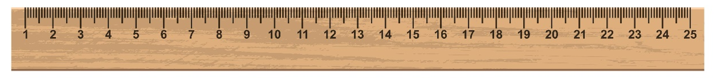

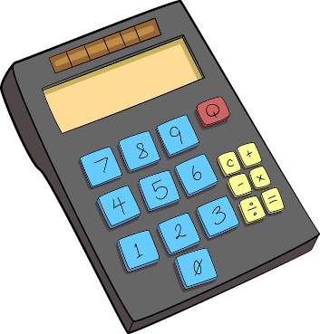
14.3 Core Practical
Density = Mass / Volume
To find the density of an object we need to know the mass and the volume
Key Q
What piece of apparatus can we use to find the volume of a regular shaped object?
You would need to measure the width, depth and height
Volume of a cube = h x w x d

Slide 19
14.3 Core Practical
Density = Mass / Volume
To find the density of an object we need to know the mass and the volume
Key Q
What piece of apparatus can we use to find the volume of a regular shaped object?
Once you know the mass and volume you can calculate the density

Slide 20


14.3 Core Practical
Task
Construct your own method to determine the density of a regularly shaped cube.
3
Multiply length width and height to find volume.
1
Measure the mass of the object using a balance.
2
Measure the length width and height of the object.

Slide 21
14.3 Core Practical
Task
Construct your own method to determine the density of a regularly shaped cube.
4
Use the values for mass and volume in the equation
Density = Mass / Volume to find density.

Slide 22
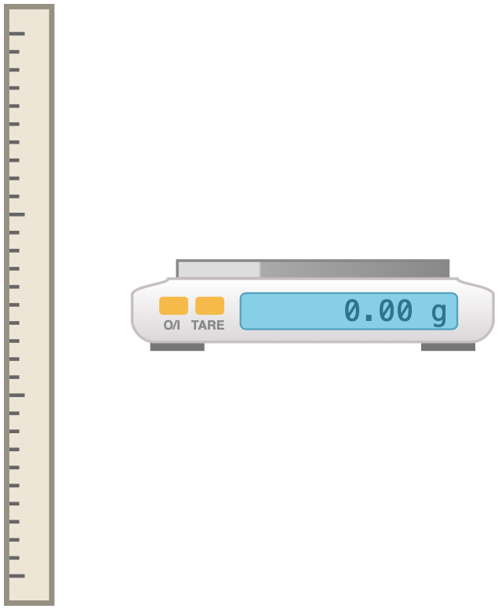
14.3 Core Practical
Task
Construct your own method to determine the density of a regular shaped object.
Finding Volume | Measure the length height and width of the object. Multiply these values together to calculate volume
Finding Mass | Measure the mass of the object using a balance.
Determining Density | Divide the mass by the volume to calculate density. | Density = Mass / Volume

Slide 23
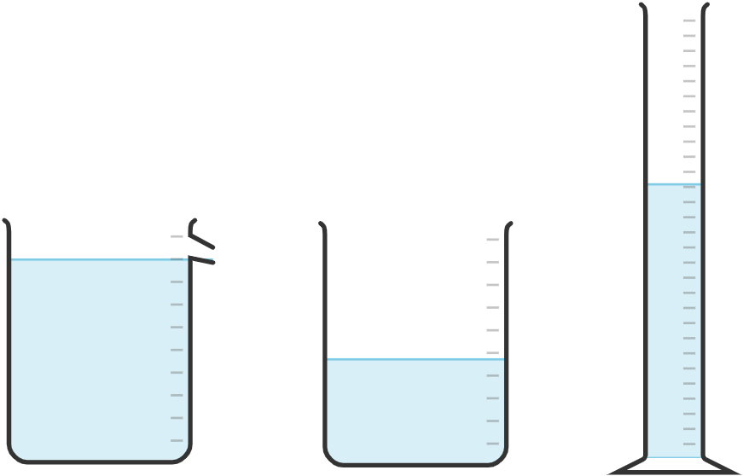
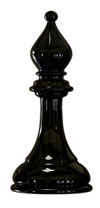
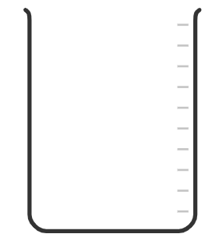
14.3 Core Practical
Key Q
How could you determine the volume of an irregular shaped object?
1.
Fill so that the water level is just below the spout
3.
Add the item to the beaker. It should be submerged below the water
4.
Measure the volume of displaced water
2.
Place an empty beaker below the spout
Displacement Beaker

Slide 24
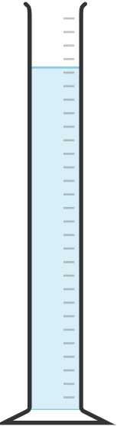

14.3 Core Practical
Key Q
How could you determine the volume of an irregular shaped object?
2.
Add object
3.
Record the new volume
1.
Half fill a measuring cylinder with water and record the start volume
OR
4.
Calculate the change in volume. This gives you the volume of your object.
Once you know the mass and volume you can calculate the density

Slide 25
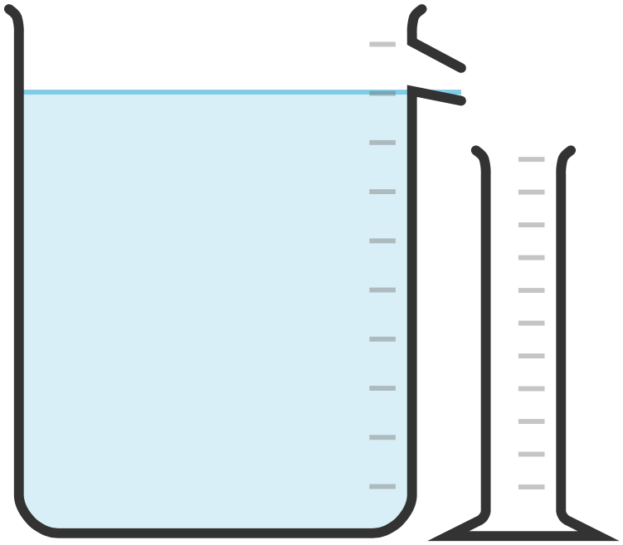
14.3 Core Practical
Task
Construct your own method to determine the density of an irregular shaped object.
Finding Volume | Fill a displacement can with water. Place an empty measuring cylinder under the spout. Add the object to the can. Measure and record the volume displaced into the measuring cylinder.
Finding Mass | Measure the mass of the object using a balance.
Determining Density | Divide the mass by the volume to calculate density. | Density = Mass / Volume

Slide 26



14.3 Core Practical
Key Q
What are the possible sources of error when finding density?
Each piece of equipment that you use to measure something can lead to errors.
Key Term | Definition
Random Error | Errors that are made by the person when taking their measurements.
Zero Error | Error caused by faulty equipment that doesn’t reset to 0 properly.

Slide 27

14.3 Core Practical
Key Q
How do you correct zero error?
To correct the error you could subtract 0.12g from the mass measured when the object is placed on it.
Zero error of 0.12g

Slide 28
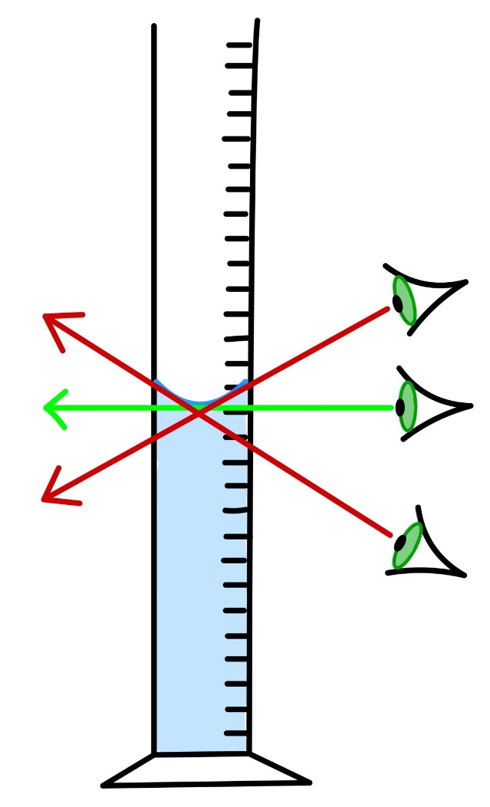
14.3 Core Practical
Key Q
What is parallax error?
When viewing the volume from below the volume measured would be less than the actual volume.
When viewing the volume from above the volume measured would be more than the actual volume.
Key Term | Definition
Parallax Error | A random error that is caused by not taking a measurement at eye level.

Slide 29
14.4 Density of Materials
Key Q
Why do the different states of matter have different densities?
This means that solids are denser than liquids, and liquids are denser than gases.
In a solid the particles are closer together.
This means that in a given space there are more particles present.
Solid | Liquid | Gas

Slide 30

14.5 State Changes
Key Term | Definition
Melting Point | The temperature at which substances turn from solids into liquids and from liquids into solids.
Boiling Point | The temperature at which substances turn from gases into liquids and from liquids into gases.

Slide 31

14.5 State Changes
Key Q
What determines the boiling point and melting point of a substance?
To change state the forces between the particles need to be overcome
The stronger the forces between the particles the higher the melting point.

Slide 32
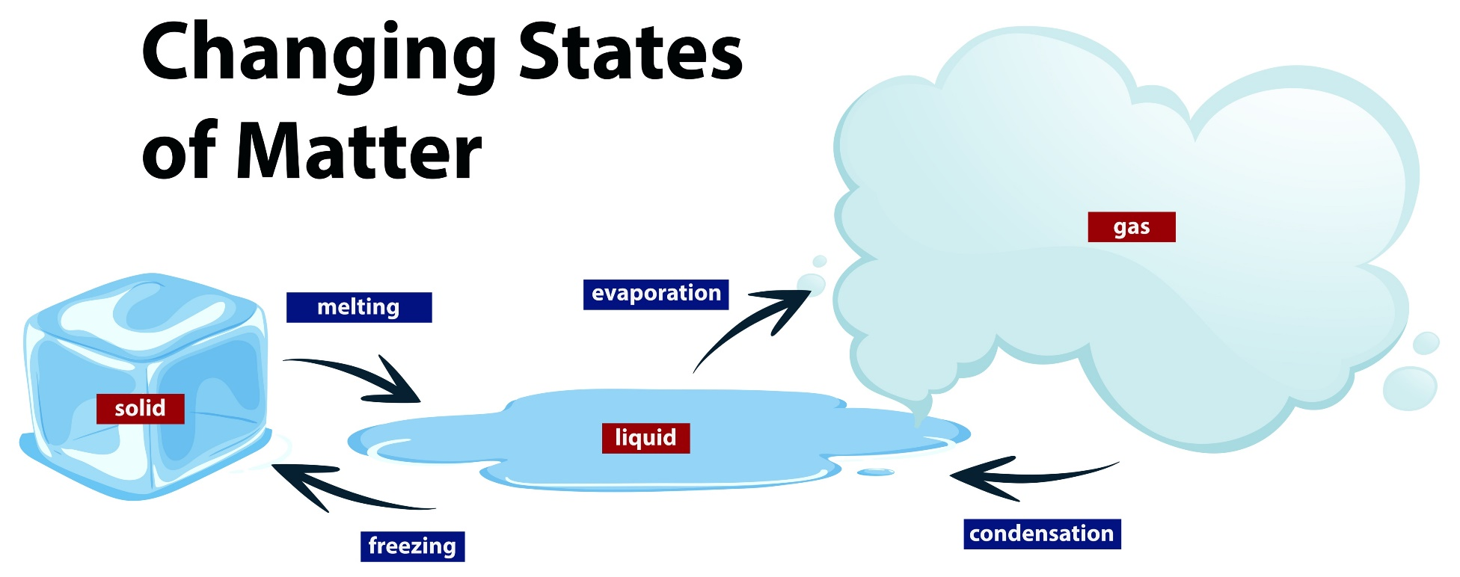
14.5 State Changes
Key Q
What happens to mass when substances change state?
When a substance changes state mass is conserved.
They differ from chemical changes because the material recovers its original properties if the change is reversed.
Changes of state are physical changes.

Slide 33
14.6 Heating a System
Key Q
What happens when a substance is heated ?
When a substance is heated the energy stored within the system will increase.
This increase in energy stored can be used to raise the substances temperature or produce changes in state.

Slide 34
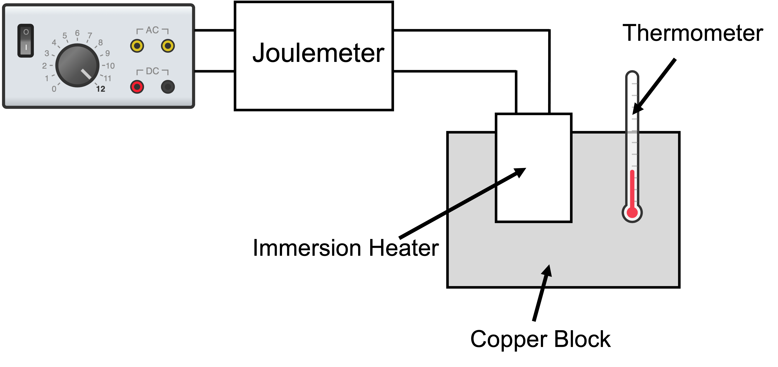
14.7 Specific Heat Capacity
Key Q
What is specific heat capacity?
Key Term | Definition
Specific Heat Capacity | The amount of energy required to raise the temperature of one kilogram of the substance by one degree Celsius.

Slide 35
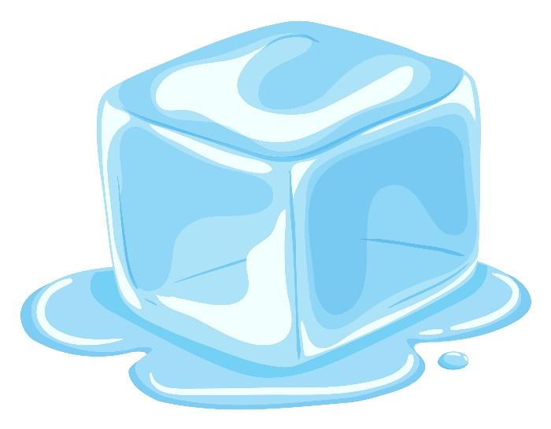
14.7 Specific Heat Capacity
Key Q
What is latent heat?
Key Term | Definition
Latent Heat | The energy needed for a change in state.
Specific Latent Heat | The amount of energy need to change the state of one kilogram of the substance with no change in temperature.

Slide 36
14.7 Specific Heat Capacity
Key Q
What is the difference between specific heat capacity and specific latent heat?
Specific Heat Capacity | The amount of energy required to raise the temperature of one kilogram of the substance by one degree Celsius.
While
Specific Latent Heat | The amount of energy need to change the state of one kilogram of the substance with no change in temperature.
Be prepared for calculations in which you need to use both formulas together!

Slide 37
14.8 Change in Thermal Energy
Key Q
What is specific heat capacity?
Joules per kilogram per degree Celsius
Kilograms
J/kg°C
kg
Change in Thermal Energy = Mass x SHC x Temp Change
𝛥E = m x c x 𝛥θ
Joules
Degrees Celsius
J
°C
Key Term | Definition
Specific Heat Capacity | The amount of energy required to raise the temperature of one kilogram of the substance by one degree Celsius.

Slide 38
14.8 Change in Thermal Energy
Calculate the energy needed to increase the temperature of a 200g gold block by 10°C. Its SHC is 129J/kg°C. (4)
Convert Units | 200g = 0.2kg
Write down the formula. | 𝛥E = m x c x 𝛥θ
Substitute Values | 𝛥E = 0.2 x 129 x 10
Do the Maths | 𝛥E = 258
Round and add units. | 258J
Usually 1 mark for this.
Substitute. 1 mark for doing this.
Show each step that you do. 1 mark available here.
Answer to 3 s.f which is the same as the values in the qu.

Slide 39
14.8 Change in Thermal Energy
Calculate the specific heat capacity of a 0.85kg block of iron that increases in temperature by 25°C with 9.56kJ
Convert Units | 9.56kJ = 9560J
Write down the formula. | 𝛥E = m x c x 𝛥θ
Substitute Values | 9560 = 0.85 x c x 25
Do the Maths | 9560 = 21.25 x c c = 9560 / 21.25 c = 449.8823529412
Round and add units. | 450J/kg°C
Usually 1 mark for this.
Substitute before you do any rearranging. 1 mark for doing this.
Show each step that you do. 2 marks available here.
Answer to 2 s.f which is the same as the values in the qu.

Slide 40
14.8 Change in Thermal Energy
Task
Complete the calculations for the following questions.
SHC Iron = 450J/kg°C Gold = 129J/kg°C | Calculate energy needed to raise the temp of a 500g block of iron by 22°C. | Calculate energy needed to raise the temp of a 820g block of gold by 15°C. | Calculate the temp change when 4.52kJ is used to heat a 3kg iron block.
Convert Units | 500g = 0.5kg | 820g = 0.82kg | 4.52kJ = 4520J
Write down the formula. | 𝛥E = m x c x 𝛥θ | 𝛥E = m x c x 𝛥θ | 𝛥E = m x c x 𝛥θ
Substitute Values | 𝛥E = 0.5 x 450 x 22 | 𝛥E = 0.82 x 129 x 15 | 4520 = 3 x 450 x 𝛥θ
Do the Maths | 𝛥E = 4950 | 𝛥E = 1,586.7 | 4520 = 1350 x 𝛥θ 𝛥θ = 4520 / 1350 𝛥θ = 3.3481481481
Round and add units. | 4950J | 1587J | 3.35°C

Slide 41
14.9 Specific Latent Heat
Key Q
What is latent heat?
Kilograms
kg
Energy For a Change in State = Mass x Specific Latent Heat
E = m x L
Joules
Joules per kilogram
J
J/kg

Slide 42
14.9 Specific Latent Heat
Calculate the energy needed to melt 500g of water which has a latent heat of fusion of 334,000J/kg
Convert Units | 500g = 0.5kg
Write down the formula. | E = m x L
Substitute Values | E = 0.5 x 334,000
Do the Maths | E = 167,000
Round and add units. | 167,000J
Usually 1 mark for this.
Answer to 3 s.f which is the same as the values in the qu.

Slide 43
14.9 Specific Latent Heat
Calculate the mass of water when it takes 125kJ to change it from a solid to liquid. Latent Heat of Fusion 334,000J/kg
Substitute before you do any rearranging. 1 mark for doing this.
Convert Units | 125kJ = 125,000J
Write down the formula. | E = m x L
Substitute Values | 125,000 = m x 334,000
Do the Maths | m = 125,000/334,000 m = 0.374251497
Round and add units. | 0.374kg
Answer to 3 s.f which is the same as the values in the qu.

Slide 44
14.9 Specific Latent Heat
Task
Complete the qu. Each qu. involves water which has a latent heat of fusion of 334,000J/kg.
 | Calculate the energy needed to melt 250g of ice. | Calculate the energy needed to melt 1.8kg of ice. | Calculate the mass of ice when it takes 880kJ to melt it.
Convert Units | 250g = 0.25kg | - | 880kJ = 880,000J
Write down the formula. | E = m x L | E = m x L | E = m x L
Substitute Values | E = 0.25 x 334,000 | E = 1.8 x 334,000 | 880,000 = m x 334,000
Do the Maths | E = 83,500 | E = 601,200 | m = 880,000/334,000 m = 2.6347305389
Round and add units. | 83.500J | 601,200J | 2.6kg

Slide 45
14.9 Specific Latent Heat
Calculate the energy needed to raise the temp of 500g of ice from -16 to 0°C and then melt it. Latent heat of fusion of 334,000J/kg. SHC is 2100 J/kg°C
Convert Units | 500g = 0.5kg
Calculate Energy For Temp Change | 𝛥E = m x c x 𝛥θ 𝛥E = 0.5 x 2100 x 16 𝛥E = 16,800
Calculate Energy For State Change | E = m x L E = 0.5 x 334,000 E = 167,000J
Add Energy Together | E = 16,800 +167,000
Round and add units. | 183,800J

Slide 46
14.9 Specific Latent Heat
Task
Complete the questions. Latent heat of fusion of 334,000J/kg and waters specific heat capacity is 4182 J/kg°C
Calculate the energy needed to... | Warm 1kg of ice from -20°C to 0°C and melt it. | Warm 200g of water from -10°C to 0°C and melt it. | Warm 5g of water from -15°C to 0°C and melt it.
Convert Units | - | 200g = 0.2kg | 5g = 0.005kg
Calculate Energy For Temp Change | 𝛥E = m x c x 𝛥θ 𝛥E = 1 x 4182 x 20 𝛥E = 83,640 | 𝛥E = m x c x 𝛥θ 𝛥E = 0.2 x 2100 x 10 𝛥E = 4,200 | 𝛥E = m x c x 𝛥θ 𝛥E =0.005 x2100 x 15 𝛥E = 157.5
Calculate Energy For State Change | E = m x L E = 1 x 334,000 E = 334,000 | E = m x L E = 0.2 x 334,000 E = 66,800 | E = m x L E = 0.005 x 334,000 E = 1,670
Add Energy Together | E = 83,640 + 334,000 | E = 4,200 + 66,800 | E = 157.5+1670 = 1,827.5
Round and add units. | 417,640J | 71,000J | 1828J

Slide 47
14.9 Specific Latent Heat
An ice cube has a temperature of −15.0 °C. The total thermal energy needed to raise the temperature of this ice cube to 0.0 °C and completely melt the ice cube is 5848 J. Calculate the mass of the ice cube.
Convert Units | -
Calculate Energy For Temp Change | 𝛥E = m x c x 𝛥θ 𝛥E = m x 2100 x 15 E = 31,500
Calculate Energy For State Change | E = m x L E = m x 334,000 E = 334,000m
Add Energy Together | E = 31,500m + 334,000m 5848 = 31,500m + 334,000m 5848 = 365,500m m = 5848 / 365,500
Round and add units. | 0.016kg
Specific heat capacity of ice = 2100 J/kg °C
Specific latent heat of fusion of ice = 334 000J/kg
Make notes as we go through this worked example. It will help with an exam question later.

Slide 48
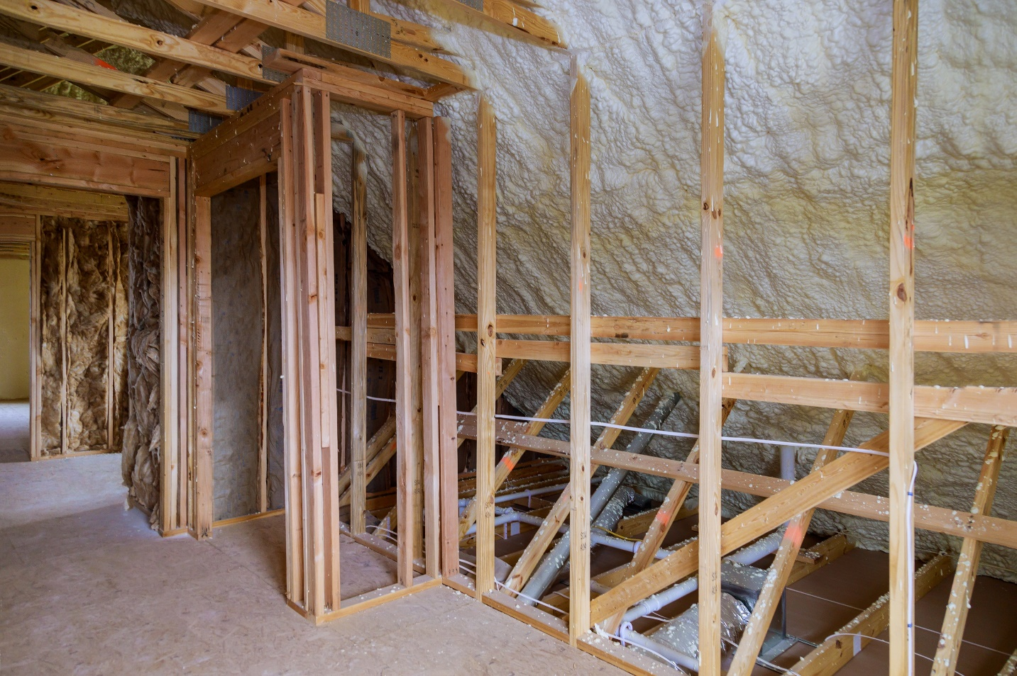
14.10 Thermal Insulation
Key Q
How can we reduce unwanted energy transfers?
Thermal insulation
Examples in the home include loft insulation, carpets and cavity wall insulation.
The insulation reduces the transfer of energy.

Slide 49
14.11 Core Practical
Key Q
How can you use apparatus to determine the specific heat capacity of a material?
1
Measure the mass of the material by using a balance.
2
Add a heater to the block and connect this to a powerpack that is connected to a joulemeter.
3
Add a thermometer and record the start temperature.

Slide 50
14.11 Core Practical
Key Q
How can you use apparatus to determine the specific heat capacity of a material?
4
Turn the powerpack on.
5
After 10 minutes turn the powerpack off, record the energy transferred and the temperature.
6
Use the equation: 𝛥E = m x c x 𝛥θ
to calculate specific heat capacity.

Slide 51
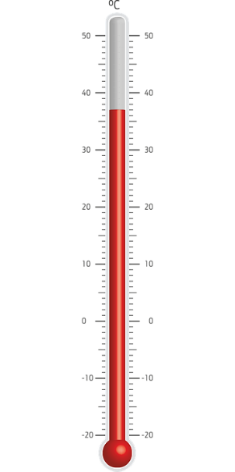
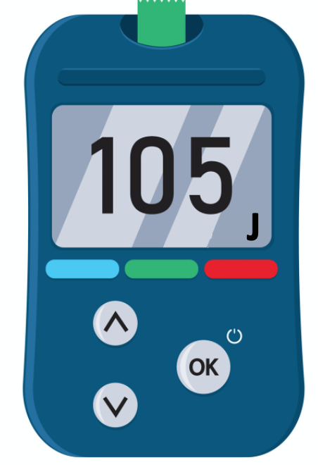
14.11 Core Practical
Finding Mass | Measure the mass of the material by using a balance.
Finding Temperature Change | Use a thermometer to record the start and end temperature of the block. Subtract the start temp from the end temp to find the temperature change.
Finding Energy Supplied | Measure the energy supplied using a joulemeter.
Finding Specific Heat Capacity | Use the equation 𝛥E = m x c x 𝛥θ to calculate specific heat capacity. | 𝛥E = m x c x 𝛥θ

Slide 52
14.11 Core Practical
Key Q
Why may you not find the exact specific heat capacity of a material using this equipment?
This will mean the specific heat capacity calculated will be higher than it should.
To reduce the heat loss the block should be wrapped in insulation.
Some energy will be transferred to the surroundings and won’t heat the block.
The temperature will not rise as high as it should for the energy transferred.

Slide 53
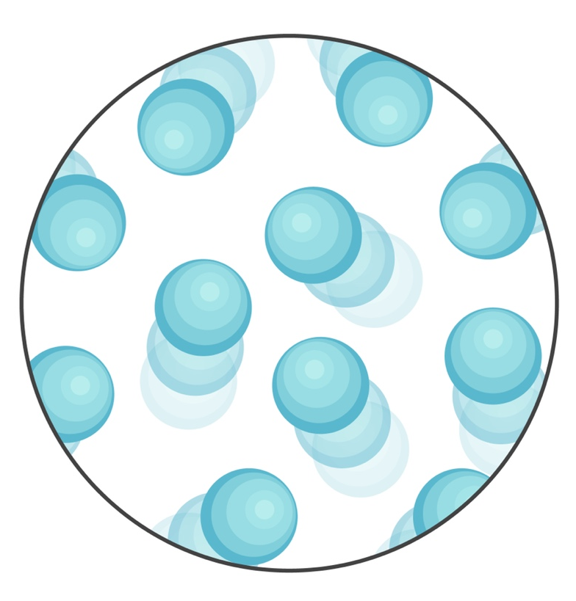
14.12 Pressure of Gas
Key Q
What is the movement of particles in a gas like?
The molecules of a gas are in constant random motion.
Increasing the temperature of a gas increases the pressure exerted by the gas.
The temperature of the gas is related to the average kinetic energy of the molecules.

Slide 54
14.13 Changing Temperature & Gases
Key Q
Why does pressure of a gas increase when its temperature is increased?
When the temperature is increased particles have more kinetic energy.
The particles collide more with the sides of the container per second.
Greater forces exerted in the collisions.
So there is a greater force exerted in the area.

Slide 55
14.14 Absolute Zero
Key Q
What is absolute zero?
Absolute zero is the temperature -273°C
This is the temperature in which there is a lack of any movement of particles

Slide 56
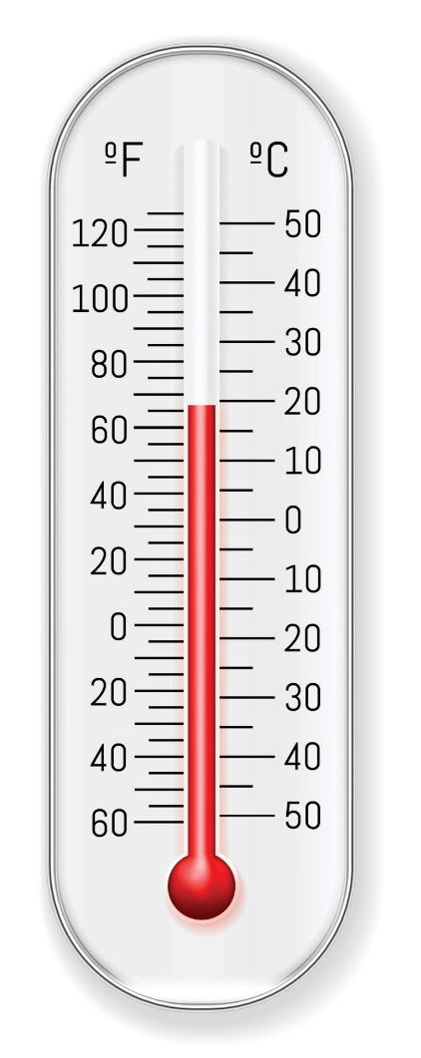
14.15 Kelvin and Celsius
Key Q
How do you convert from kelvin into Celsius?
Each degree Celsius is the same size as one kelvin.
Raising the temperature by one degree Celsius also increases the value on the kelvin temperature scale by one.
To convert from degrees Celsius to Kelvin add 273.
To convert from Kelvin to degrees Celsius subtract 273.

Slide 57
14.16 Compressing and Expanding
Key Q
How can a gas be compressed or expanded?
A gas can be compressed or expanded by pressure changes.
The pressure produces a net force at right angles to the wall of the gas container.

Slide 58
14.17 Pressure of Gases
Key Q
What causes gas pressure?
Gas pressure is the total force per unit area.
Pressure in gases is caused by particles colliding with the walls of the container.
The greater the force the greater the pressure.
When the particles collide with the wall of the container there is a force exerted.
The more collisions the greater the force.

Slide 59
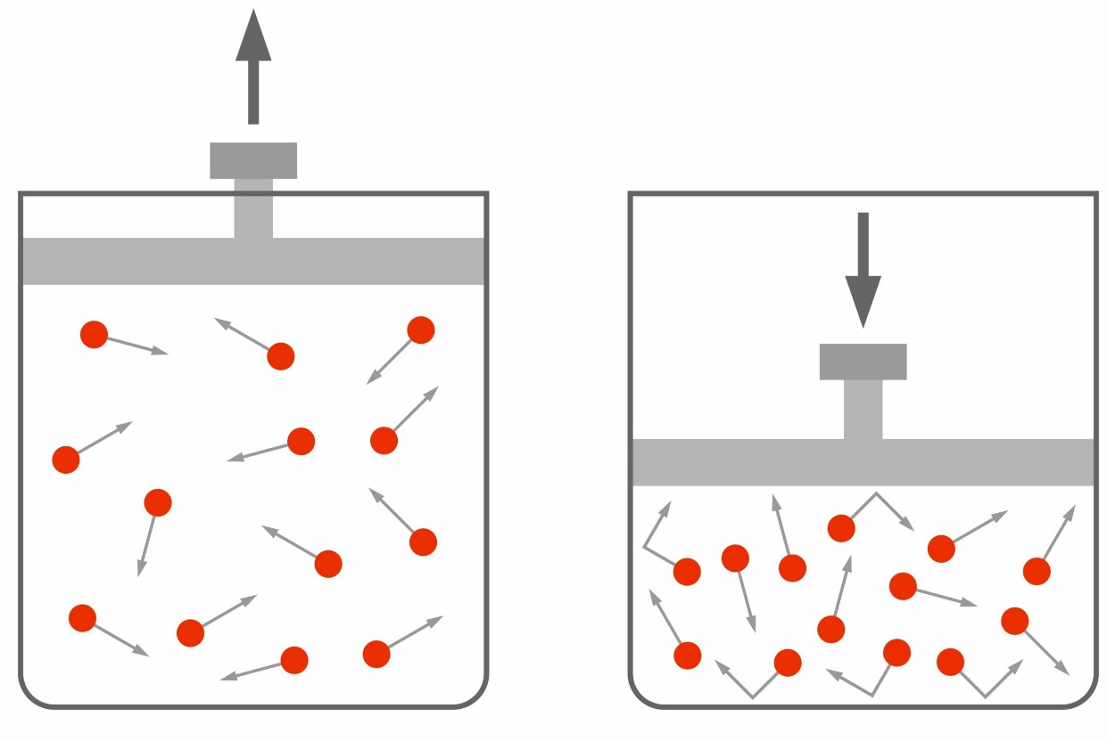
14.18 Changing Volume
Key Q
Why does pressure increase when a gas is compressed?
As the gas is compressed the volume of the gas decreases.
This means that there are more frequent collisions between the particles and the container wall.
Each particle collision with the wall exerts a force and so there is a greater force on the walls.

Slide 60
14.19 Pressure of Gases
Key Q
How can pressure or volume of gases be calculated?
Metres Cubed
m³
Initial Pressure x Initial Volume = Second Pressure x Second Volume
p₁V₁ = p₂V₂
Pascals
Pa
Be careful. You may need to convert units!

Slide 61
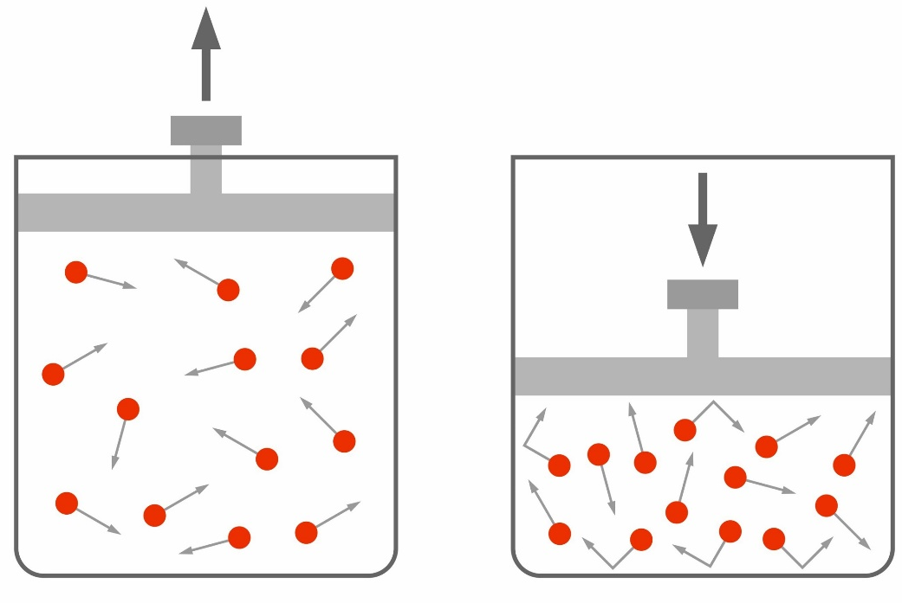
14.20 Work and Pressure
Key Q
What is work?
Doing work on a gas increases the internal energy of the gas and can cause the temperature to increase.
Key Term | Definition
Work | The transfer of energy by a force.

