Slide 1
Electromagnetic Induction
Paper 2

Slide 2
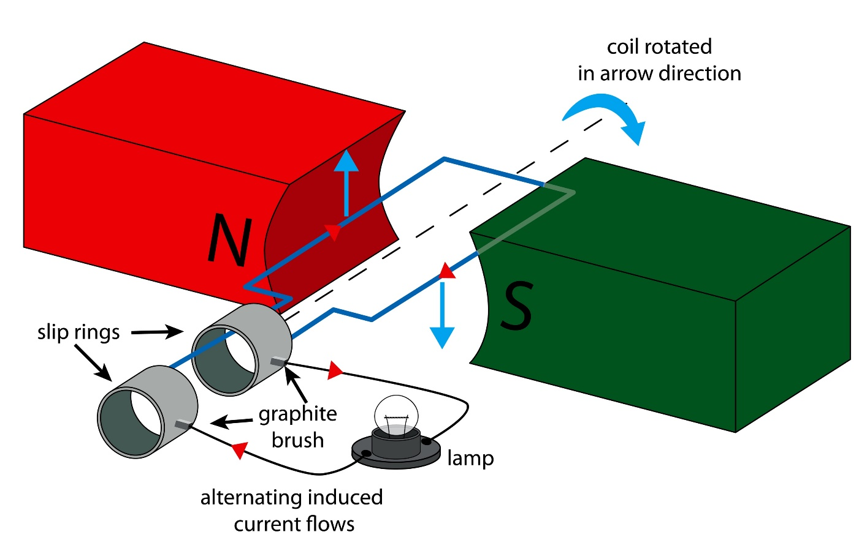
13.1 Making Electric Current
Key Q
How does the generator effect occur?
If an electrical conductor moves relative to a magnetic field or if there is a change in the magnetic field around a conductor, a potential difference is induced across the ends of the conductor.
If the conductor is part of a complete circuit, a current is induced in the conductor.
This is called the generator effect.

Slide 3
13.1 Making Electric Current
Key Q
How does the generator effect occur?
An induced current generates a magnetic field that opposes the original change, either the movement of the conductor or the change in magnetic field.

Slide 4
13.2 Factors Affecting P.D.
Key Q
What affects the direction of the induced potential difference or current?
The direction of the induced potential difference or induce current is affected by:
Moving the magnet out of the coil.
Moving the other pole of the magnet into the coil.

Slide 5
13.2 Factors Affecting P.D.
Key Q
What affects the size of the induced potential difference or current?
The size of the induced potential difference or induce current is increased by:
Increasing the speed of movement.
Increasing the magnetic field strength.
Increasing the number of turns of the coil.

Slide 6
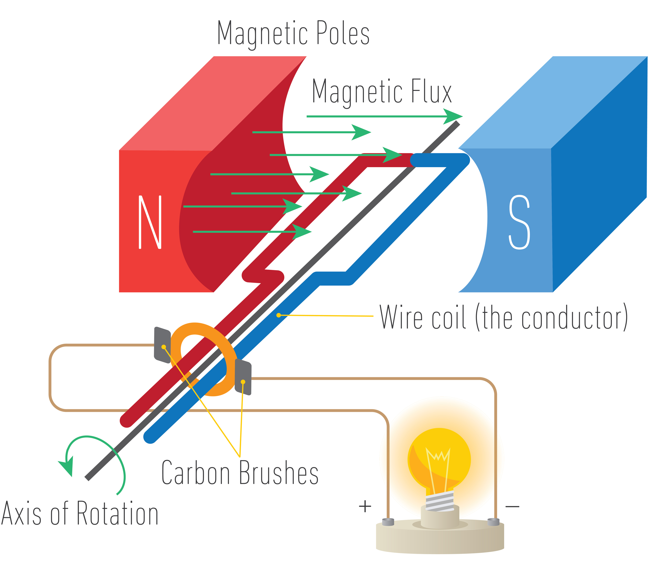
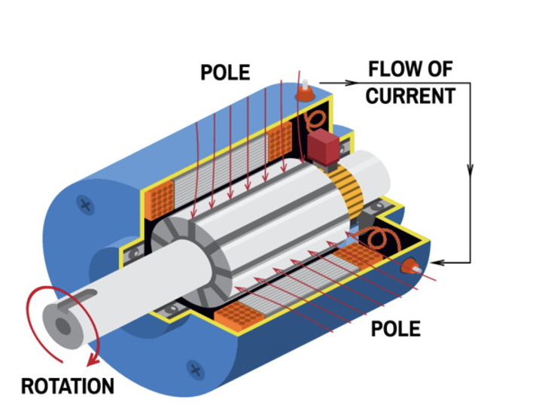
13.3 Alternators and Dynamos
Key Q
How can we generate alternating current?
The generator effect is used in an alternator to generate ac and in a dynamo to generate dc.

Slide 7
13.3 Alternators and Dynamos
Key Q
How can we generate alternating current?
The coil moves through the magnetic field and the coil cuts the magnetic field lines.
A potential difference is induced across the coil
There is a complete circuit, so a current is induced in the coil.
Every half turn the potential difference reverses direction
So every half turn the current changes direction.

Slide 8
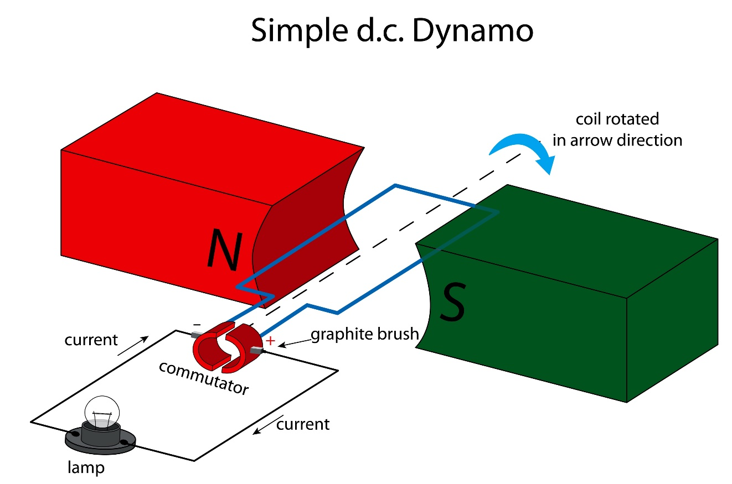
13.3 Alternators and Dynamos
Key Q
How can we generate direct current?
In a dynamo, a split ring commutator changes the coil connections every half turn.
As the induced potential difference is about to change direction, the connections are reversed.
This means that the current to the external circuit always flows in the same direction.
A dynamo can be used to generate a direct current.

Slide 9

13.4 Microphone
Key Q
How do headphones work?
Headphones use the motor effect to convert variations in current in electrical circuits to the pressure variations in sound waves.

Slide 10
13.4 Microphone
Key Q
How do headphones work?
The current in the electrical circuit is varying and passes through the coil.
The coil experiences a force.
The varying current causes the coil to vibrate
The coil causes the cone to vibrate.
The vibrating cone causes air molecules to move
The movement of the air molecules produces the pressure variations in the air needed for a sound wave.

Slide 11

13.4 Microphone
Key Q
How do microphones work?
Microphones use the generator effect to convert the pressure variations in sound waves into variations in current in electrical circuits.
Sound waves cause the diaphragm to vibrate.
The diaphragm causes the wire to vibrate.
The wire moves through the magnetic field.
A potential difference is induced.

Slide 12
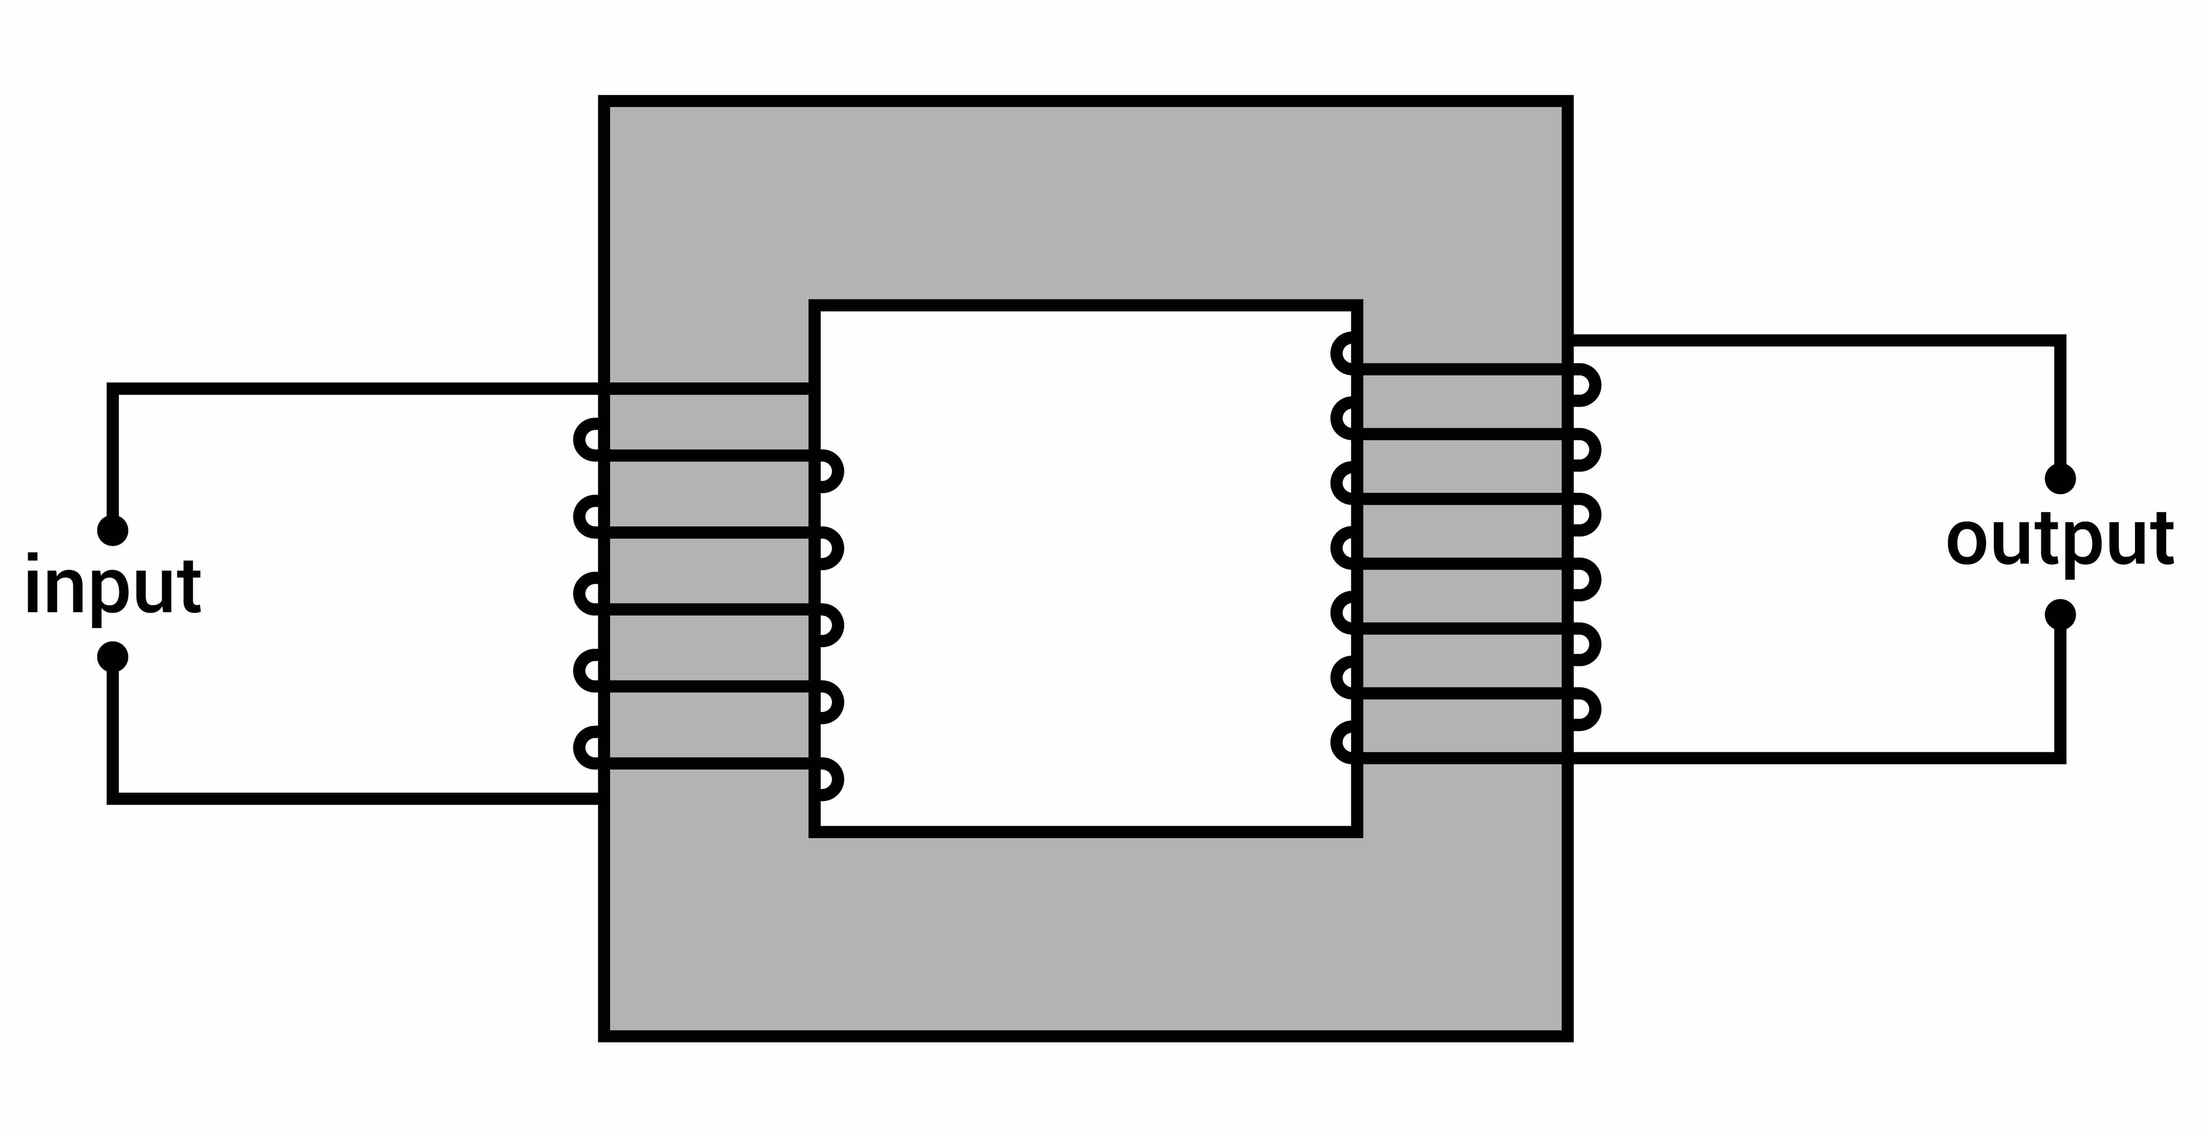
13.5 Transformers
Key Q
..and a secondary coil wound on an iron core.
What are transformers?
A basic transformer consists of:
Iron is used as it is easily magnetised.
A primary coil…

Slide 13
13.5 Transformers
Key Q
How do transformers work?
The ratio of the potential differences across the primary and secondary coils of a transformer depends on the ratio of the number of turns on each coil.

Slide 14
13.5 Transformers
Key Q
How do transformers work?
Alternating current in the primary coil.
Produces a changing magnetic field in the core.
This induces an alternating potential difference across the secondary coil.
The core is made of iron.

Slide 15
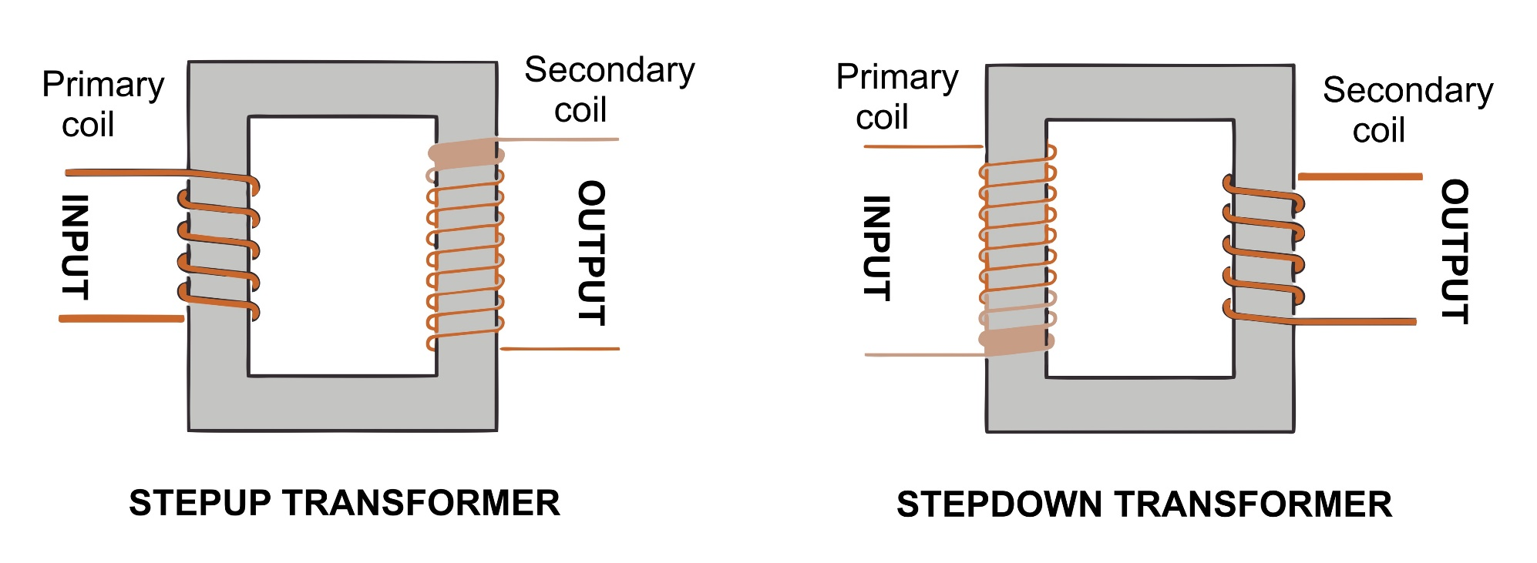
13.6 Transformers
Key Q
How do transformers work?
Step up transformers have more loops on the secondary coil.
Step down transformers have fewer loops on the secondary coil.
Voltage is increased.
Voltage is decreased.

Slide 16
13.7 Transformers
Key Q
What are transformers?
In a step up transformer V_{s} ˃ V_{p}
V_{p}
V_{s}
N_{p}
N_{s}
=
In a step down transformer V_{s} ˃ V_{p}
If transformers were 100% efficient, the electrical power output would equal the electrical power input.
Potential Difference
V

Slide 17
13.7 Transformers
The power supply to a laptop computer contains a transformer designed to change the 230 V mains input to a 15 V output. The transformer has 920 turns on its primary coil. Calculate number of turns on the secondary coil.
Convert Units | -
Write down the formula. | V_{p} / V_{s} = N_{p} / N_{s}
Substitute Values | 230 / 15 = 920 / N_{s}
Do the Maths | 15.33333333 = 920 / N_{s} N_{s} = 920 / 15.33333333 N_{s} = 60.0000000130435
Round and add units. | 60
Show all of your working out.

Slide 18
13.7 Transformers
Calculate number of primary coils… | Primary voltage is 230V, secondary is 1.5V and secondary coils is 8 | Primary voltage is 8V, secondary is 2V and secondary coils is 4 | Primary voltage is 8V, secondary is 24V and secondary coils is 24
Write down the formula. | V_{p} / V_{s} = N_{p} / N_{s} | V_{p} / V_{s} = N_{p} / N_{s} | V_{p} / V_{s} = N_{p} / N_{s}
Substitute Values | 230 / 1.5 = N_{p} / 8 | 8 / 2 = N_{p} / 4 | 8 / 24 = N_{p} / 24
Do the Maths | 153.33333 =N_{p} / 8 N_{p} = 153.3333 x 8 = 1,226.6664 | 4 =N_{p} / 4 N_{p} = 4 x 4 = 16 | 0.33333 =N_{p} / 24 N_{p} = 0.3333 x 24 = 7.999992
Round and add units. | 1227 | 16 | 8

Slide 19
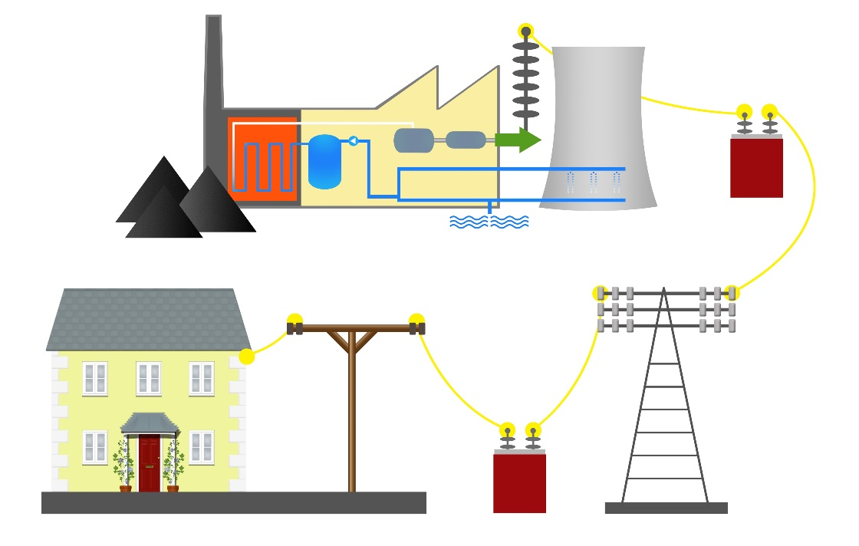
13.8 & 13.9 National Grid
Key Q
What is the potential difference and frequency of electricity in the UK?
Mains electricity in the UK is an ac supply.
It has a frequency of 50Hz.
Potential difference is 230V

Slide 20
13.8 & 13.9 National Grid
Key Q
What is the national grid?
Electrical power is transferred from power stations to consumers using the National Grid.
Key Term | Definition
National Grid | A system of cables and transformers linking power stations to consumers.

Slide 21

13.8 & 13.9 National Grid
Key Q
Why are step up transformers used in the national grid?
Step-up transformers are used to increase the potential difference from the power station to the transmission cables.
This increases the potential difference and reduces the current.
This reduces the amount of thermal energy transfer to the surroundings making transmission more efficient.

Slide 22
13.8 & 13.9 National Grid
Key Q
Why are step down transformers used in the national grid?
Step down transformers are used to decrease the potential difference much lower.
This increases the safety.

Slide 23
13.10 Transformer Equation
Key Q
What are transformers?
V_{s} x I_{s} = V_{p} x I_{p}
The power output of the secondary coil.
The power input of the primary coil.
Power input and output is measured in watts W.

Slide 24
13.10 Transformer Equation
Calculate the current that would need to be supplied if primary voltage is 230V and secondary is 8V with a secondary current of 3A.
Convert Units | -
Write down the formula. | V_{s} x I_{s} = V_{p} x I_{p}
Substitute Values | 8 x 3 = 230 x I_{p}
Do the Maths | 24 = 230 x I_{p} I_{p} = 230 / 24 I_{p} = 9.5833333333
Round and add units. | 9.6A
Show all of your working out.

Slide 25
13.10 Transformer Equation
The secondary power output is 1.2kW. Determine the primary current when the primary potential difference is 230V
Convert Units | 1.2kW = 1200W
Write down the formula. | V_{s} x I_{s} = V_{p} x I_{p}
Substitute Values | 1200 = 230 x I_{p}
Do the Maths | I_{p} = 1200 / 230 I_{p} = 5.2173913043
Round and add units. | 5.2A
Show all of your working out.

Slide 26
13.10 Transformer Equation
Calculate output power when… | Primary voltage is 230V and the primary current is 5A | Primary voltage is 5.2V and the primary current is 0.5A | Primary voltage is 230V and the primary current is 22A
Write down the formula. | V_{s} x I_{s} = V_{p} x I_{p} | V_{s} x I_{s} = V_{p} x I_{p} | V_{s} x I_{s} = V_{p} x I_{p}
Substitute Values | V_{s} x I_{s} = 230 x 5 | V_{s} x I_{s} = 5.2 x 0.5 | V_{s} x I_{s} = 230 x 22
Do the Maths | V_{s} x I_{s} = 1150 | V_{s} x I_{s} = 2.6 | V_{s} x I_{s} = 5060
Round and add units. | 1150W | 2.6W | 5060W

Slide 27
13.10 Transformer Equation
Calculate output current when… | Primary voltage is 230V, primary current is 5A and output voltage is 12V | Primary voltage is 5.2V, primary current is 0.5A and output voltage is 12V | Primary voltage is 230V, primary current is 22A and output voltage is 24V
Write down the formula. | V_{s} x I_{s} = V_{p} x I_{p} | V_{s} x I_{s} = V_{p} x I_{p} | V_{s} x I_{s} = V_{p} x I_{p}
Substitute Values | 12 x I_{s} = 230 x 5 | 12 x I_{s} = 5.2 x 0.5 | 24 x I_{s} = 230 x 22
Do the Maths | 12 x I_{s} = 1150 I_{s} = 1150 / 12 I_{s} = 95.8333333333 | 12 x I_{s} = 2.6 I_{s} = 2.6 / 12 I_{s} = 0.2166666667 | 24 x I_{s} = 5060 I_{s} = 5060 / 24 I_{s} = 210.833333333
Round and add units. | 96A | 0.22A | 211A

Slide 28
13.11 Advantages of Power Transmission
Key Q
Why is power transmitted in high voltage cables?
Transmission cables have resistance.
Energy is dissipated in the transmission wires.
This causes a power loss as Power = Current² x Resistance

Slide 29
13.11 Advantages of Power Transmission
Key Q
Why is power transmitted in high voltage cables?
Transformers are used to step up a high voltage for transmission.
Due to the relationship V_{p}I_{p} = V_{s}I_{s} a higher voltage means a lower current.
This means the power loss is smaller.

