Slide 1
Magnetism and Motor Effect
Paper 2

Slide 2
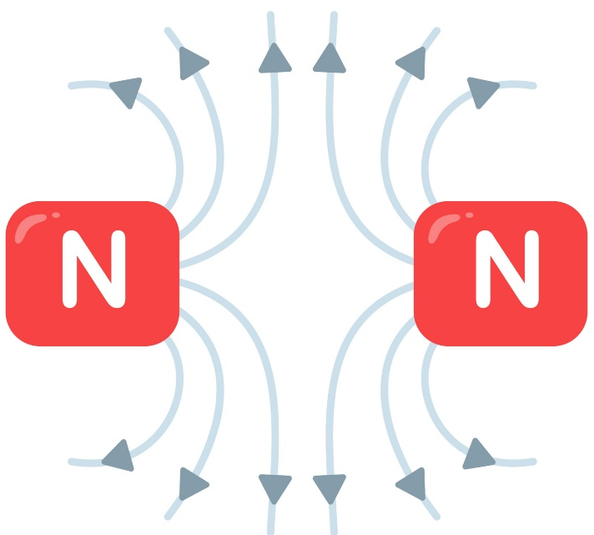
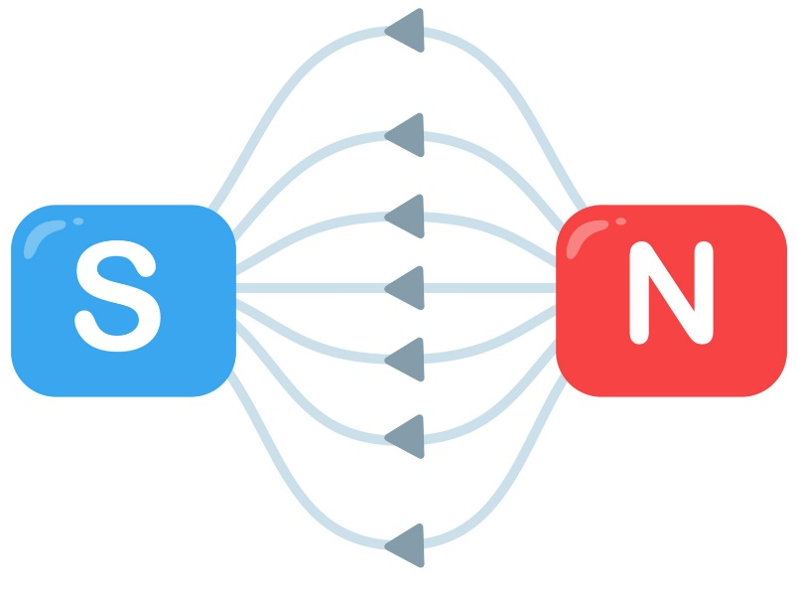
12.1 Poles of a Magnet
Key Q
What are the poles of a magnet?
Key Term | Definition
Magnet Poles | The places on a magnet where the magnetic forces are strongest.

Slide 3
12.1 Poles of a Magnet
Key Q
What are the poles of a magnet?
Two like poles repel each other.
Two unlike poles attract each other.
When two magnets are brought close together they exert a force on each other.
Attraction and repulsion between two magnetic poles are examples of non-contact force.

Slide 4
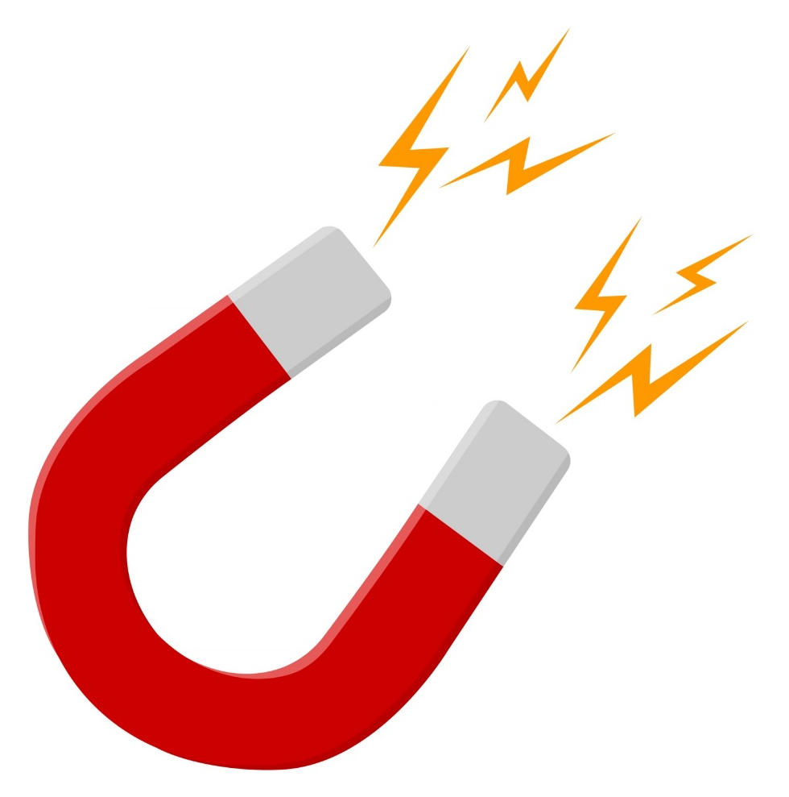
12.2 Uses of Magnetic Materials
Key Q
What are permanent magnets?
An permanent magnet is made up of a magnetic material such as nickel, cobalt, steel and iron.
A permanent magnet always causes a force on other magnets or magnetic materials.
Bar magnets and horseshoe magnets are examples of permanent magnets.

Slide 5
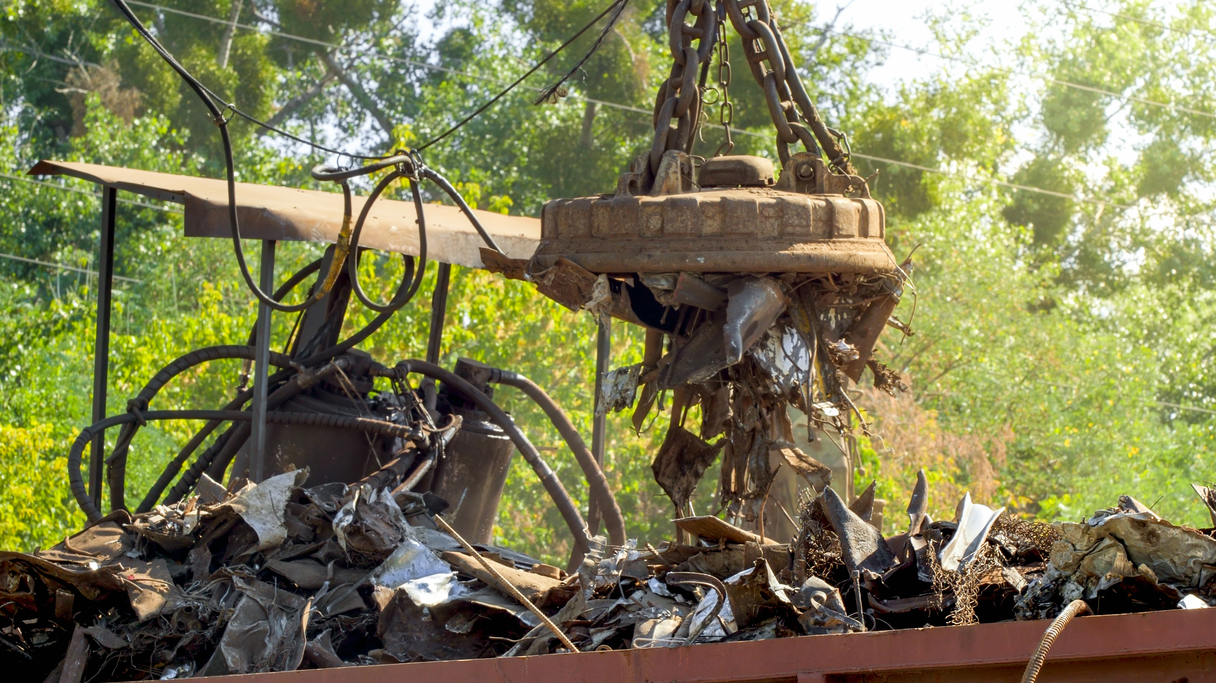
12.2 Uses of Magnetic Materials
Key Q
What are induced magnets?
An induced magnet only becomes magnetised when placed in a magnetic field.
The magnetism is quickly lost when the magnet is removed from the magnetic field.

Slide 6
12.2 Uses of Magnetic Materials
Key Q
What uses do we have for induced magnets?
Electromagnets can be used to sort metal waste.
The magnet can become magnetised and attract metals.
This can then be moved by the magnet and deposited in a different container when the electromagnet is demagnetised

Slide 7
12.3 Permanent & Induced Magnets
Key Q
What are permanent and induced magnets?
When removed from the magnetic field an induced magnet loses most/all of its magnetism quickly.
Permanent magnets do not lose their magnetism.
Induced magnetism always causes a force of attraction.
Key Term | Definition
Permanent Magnet | A material that produces its own magnetic field.
Induced Magnet | A material that becomes a magnet when it is placed in a magnetic field.

Slide 8
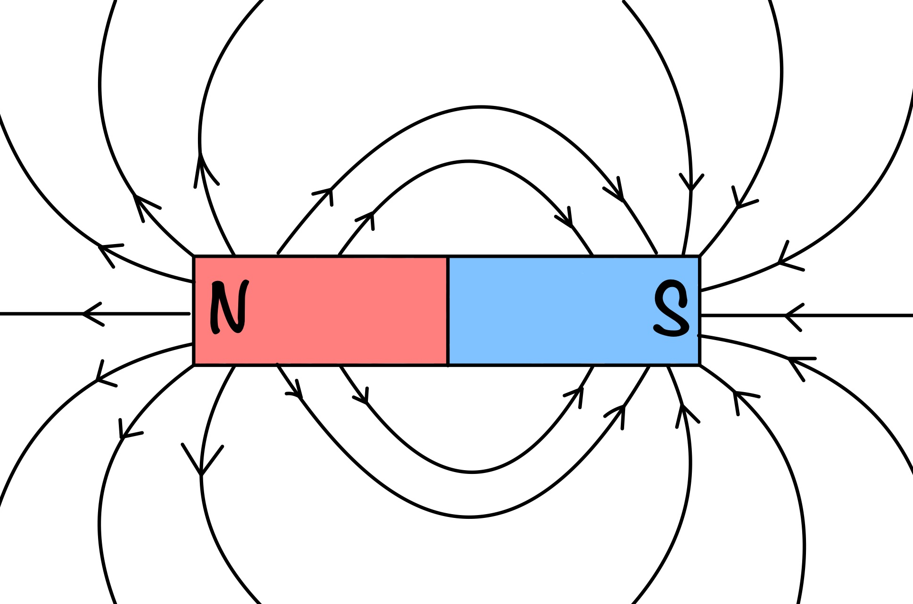
12.4 Shape of Magnetic Fields
Key Q
What is a magnetic field?
Iron, steel, cobalt and nickel are magnetic materials.
The force between a magnet and a magnetic material is always one of attraction.
Key Term | Definition
Magnetic Field | The region around a magnet where a force acts on another magnet or magnetic material.

Slide 9
12.4 Shape of Magnetic Fields
Key Q
What is a magnetic field?
The strength of the magnetic field depends on the distance from the magnet.
The direction of the magnetic field at any point is given by the direction of the force that would act on another north pole placed at that point.
The direction of a magnetic field line is from the north (seeking) pole of a magnet to the south(seeking) pole of the magnet.

Slide 10
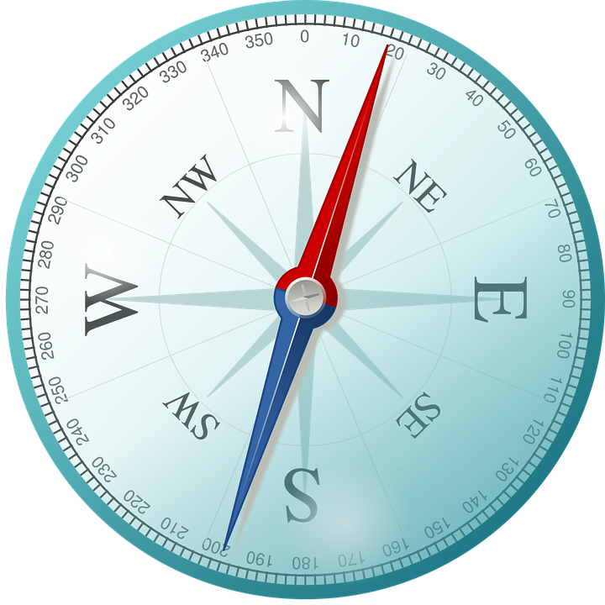
12.4 Shape of Magnetic Fields
Key Q
What is a magnetic field?
A magnetic compass contains a small bar magnet.
The Earth has a magnetic field.
The compass needle points in the direction of the Earth’s magnetic field.
The behaviour of a compass proves the Earth has a magnetic field. This means it must have a magnetic core.

Slide 11
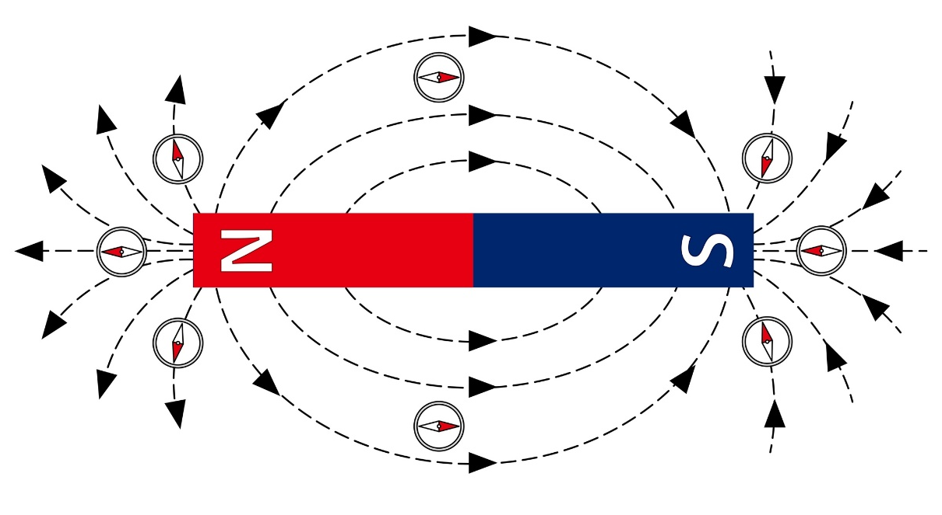
12.5 Plotting Compasses
Key Q
How can we plot a magnetic field of a magnet?
1
Place the magnet on a piece of paper and draw around it.
2
Mark the north and south poles.
3
Place the compass by a pole of the magnet.

Slide 12
12.5 Plotting Compasses
Key Q
How can we plot a magnetic field of a magnet?
4
Make a dot at the tip of the compass needle and then move the compass tail to this dot.
5
Make another dot at the tip and repeat until the compass reaches the other pole of the magnet.

Slide 13
12.5 Plotting Compasses
Key Q
How can we plot a magnetic field of a magnet?
6
Draw a line through the dots and add an arrow to show the direction of the field line.
7
Repeat for different starting positions at the poles.

Slide 14
12.6 Behaviour of a Compass
Key Q
How does the behaviour of a compass prove that the core of the Earth is magnetic?
When a plotting compass is placed in the Earth's magnetic field, the north pole of the compass will line up with the Earth's magnetic field lines and point to magnetic south.
This proves that the Earth has a magnetic core.

Slide 15
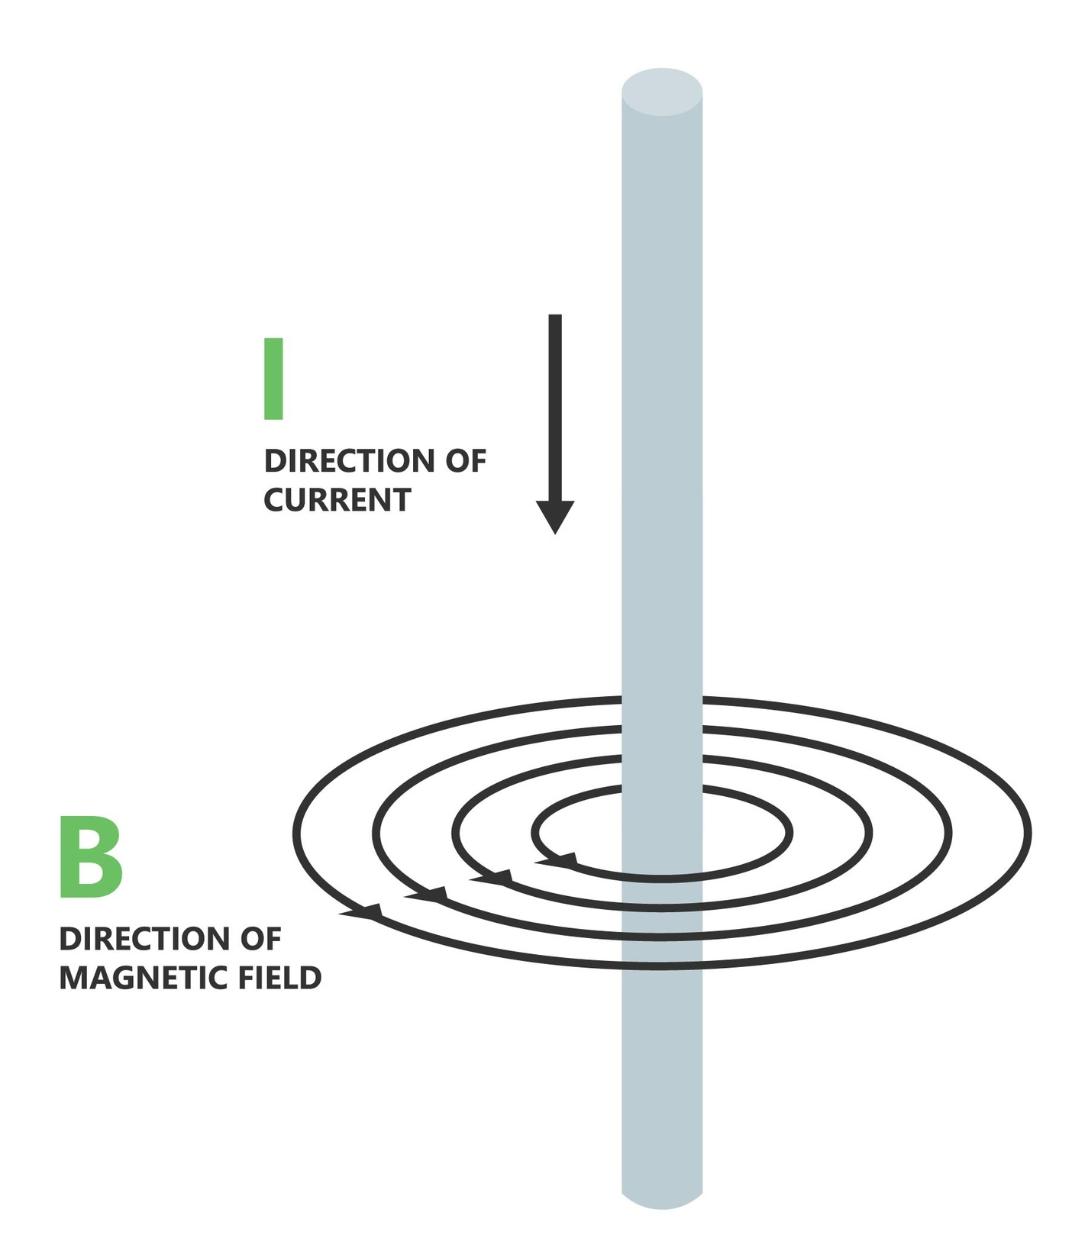
12.7 Current & Magnetic Effect
Key Q
How are magnetic fields induced?
When a current flows through a conducting wire a magnetic field is produced around the wire.

Slide 16
12.7 Current & Magnetic Effect
Key Q
How can the direction of the field be determined?
The direction of the current and magnetic field can be found using the right hand grip rule.
Coil the fingers of the right hand as if holding the handlebars of a bicycle, with the thumb pointing away from the hand.
The thumb indicates the direction of the current, and the fingers then indicate the direction of the magnetic field.

Slide 17
12.7 Current & Magnetic Effect
Key Q
How can the magnetic field around a wire be modelled?
When a current flows in a wire it creates a circular magnetic field around the wide.
If the direction of the current is reversed the magnetic field will be in the opposite direction.

Slide 18
12.8 Strength of Fields
Key Q
What does the strength of the field depend on?
The strength of the magnetic field depends on the current through the wire and the distance from the wire.

Slide 19
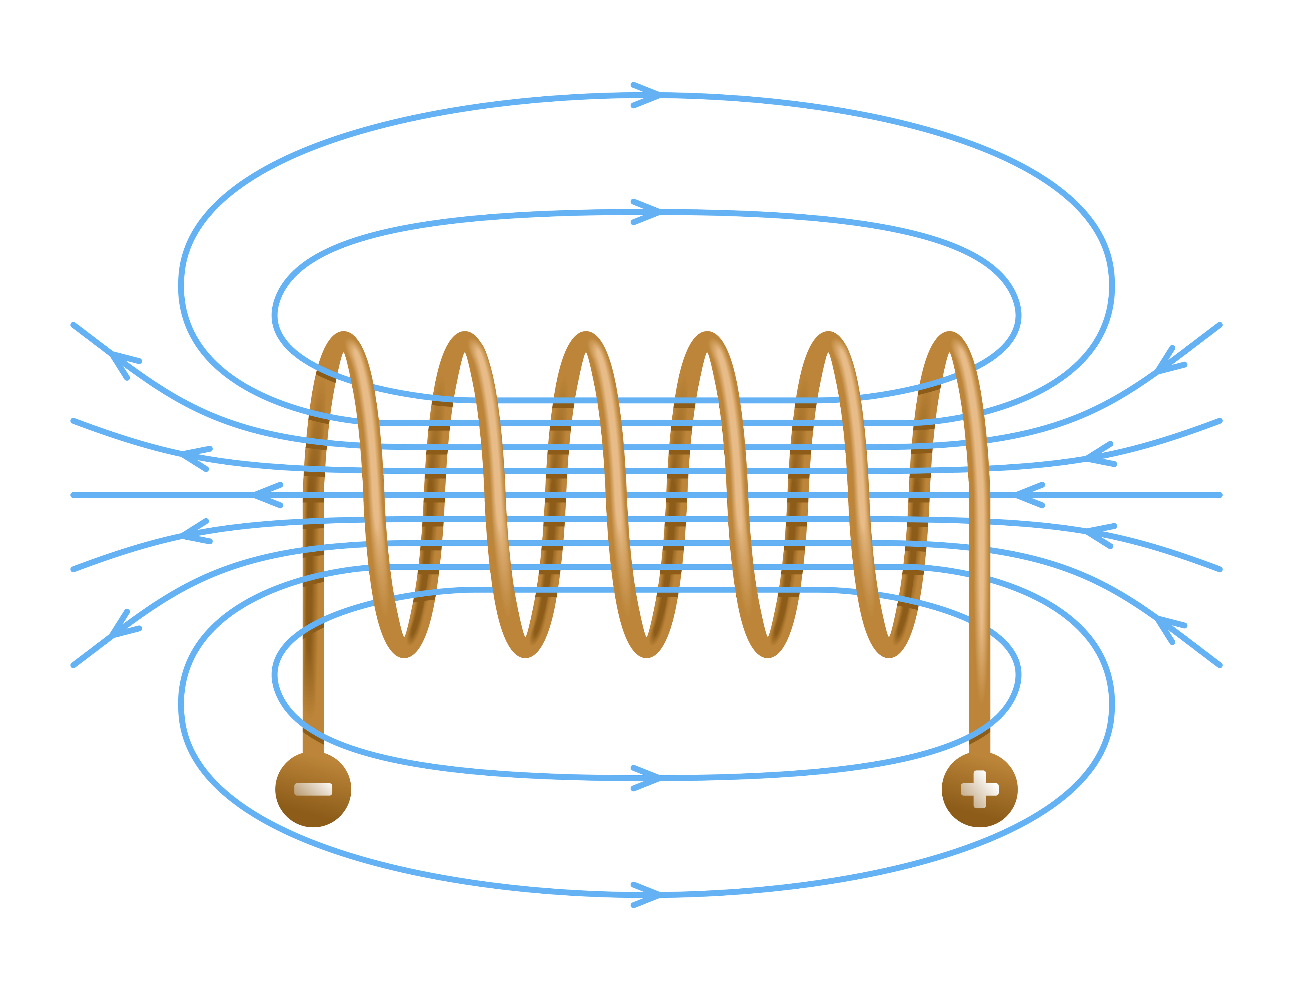
12.9 Solenoids
Key Q
What is a solenoid?
A solenoid is a wire that has been wrapped into a coil.
When an electric current flows, the shape of the magnetic field is very similar to the field of a bar magnet.
The field inside a solenoid is strong and uniform.

Slide 20
12.9 Solenoids
Key Q
How can the strength of a solenoid be increased?
Adding a magnetic material such as an iron core increases the strength of the magnetic field of a solenoid.
A solenoid with an iron core is known as an electromagnet.

Slide 21
12.9 Solenoids
Key Q
What uses do we have for electromagnets?
Electromagnets can be used to sort metal waste.
The magnet can become magnetised and attract metals.
This can then be moved by the magnet and deposited in a different container when the electromagnet is demagnetised

Slide 22
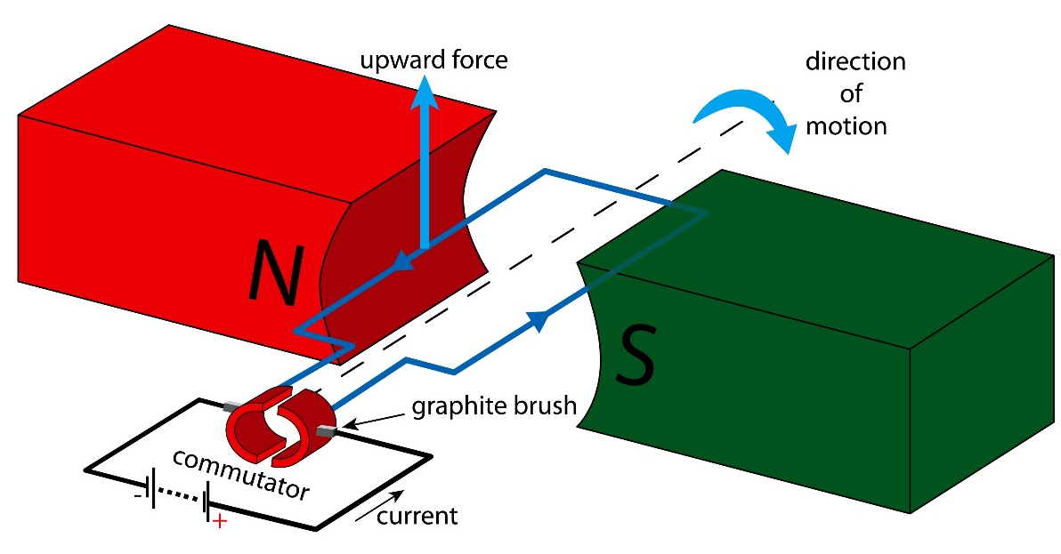
12.10 Conductors
A current carrying conductor when placed near a magnet experiences a force
An equal and opposite force acts on the magnet.

Slide 23
12.11 Magnetic Forces
Key Q
When do magnetic forces occur?
Magnetic forces occur due to interactions between magnetic fields.

Slide 24
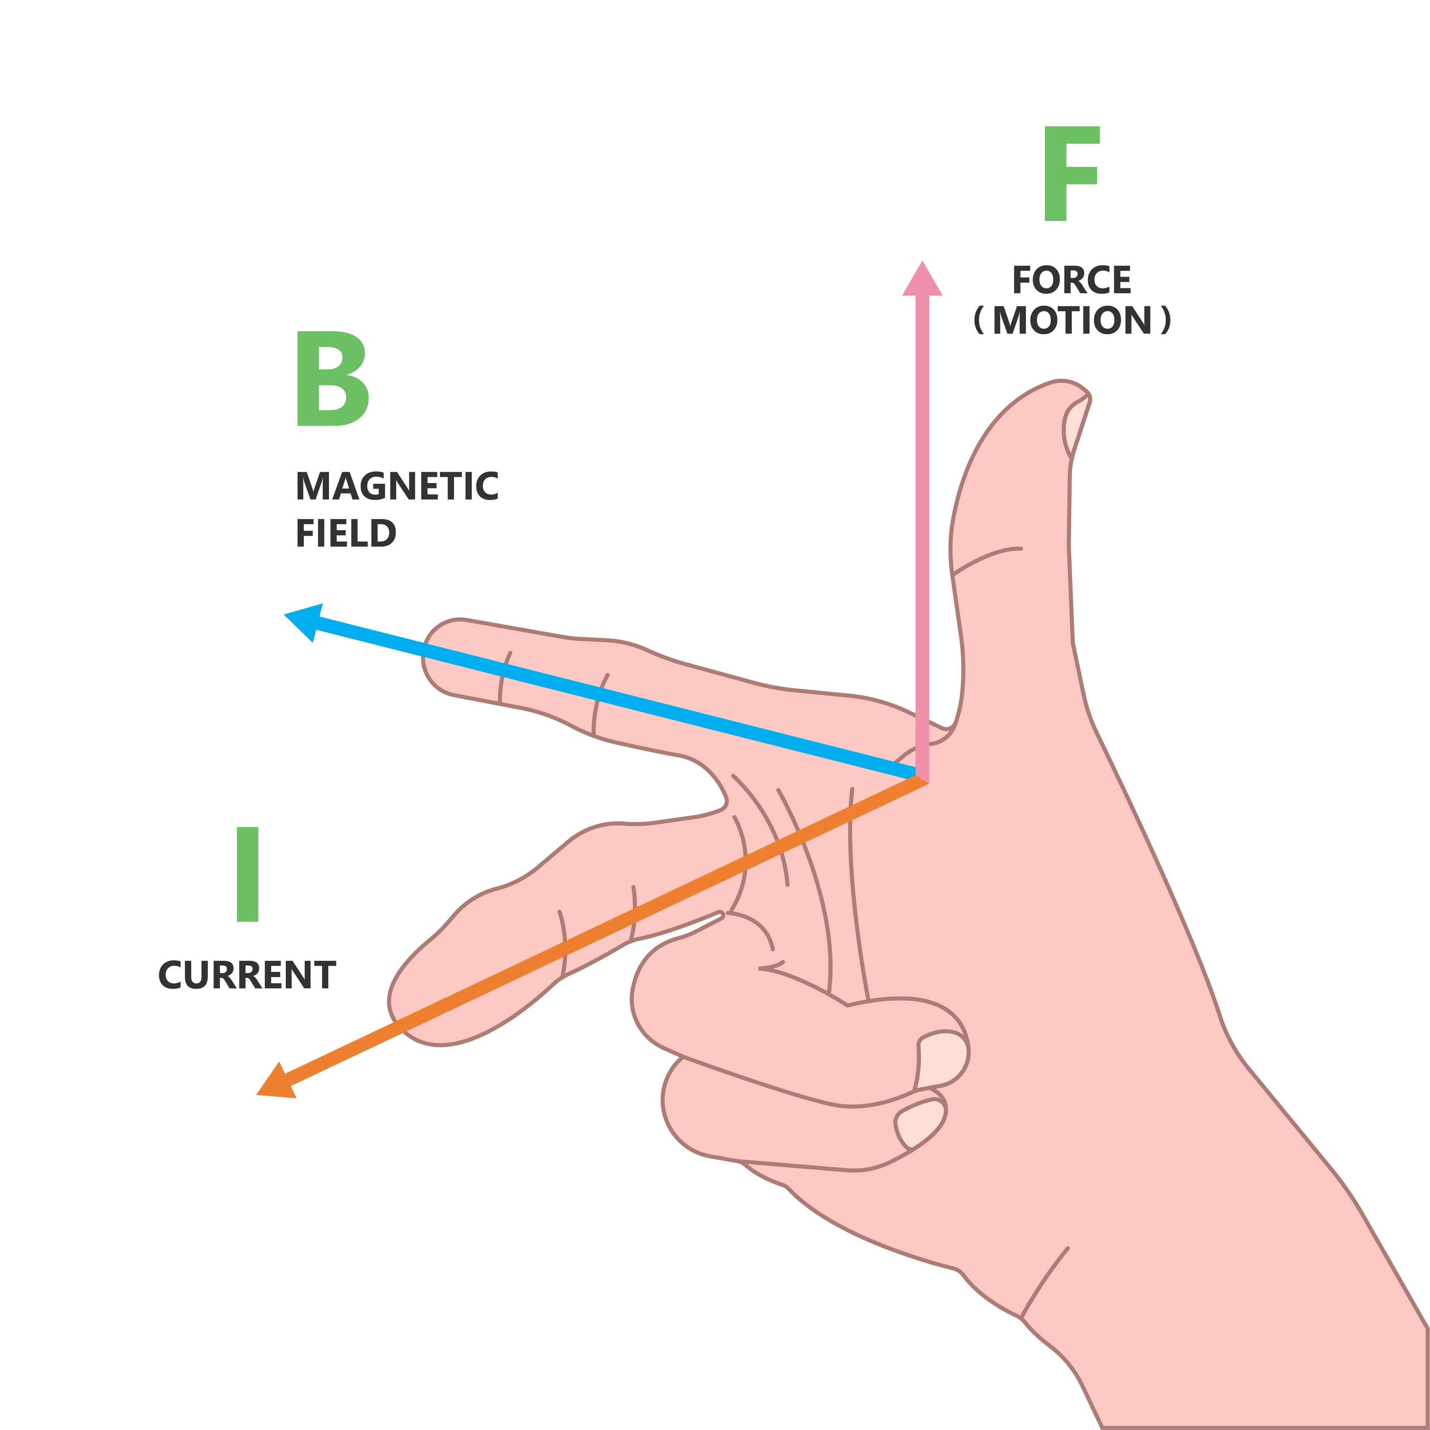
12.12 Flemings Left Hand Rule
Key Q
What is the motor effect?
Fleming's left-hand rule represents the relative orientation of the force, the current in the conductor and the magnetic field.
Key Term | Definition
Motor Effect | When a conductor carrying a current is placed in a magnetic field the magnet producing the field and the conductor exert a force on each other.

Slide 25

12.12 Flemings Left Hand Rule
Key Q
In what direction do you position the middle and index finger when determining force?
When pointing the index finger in the direction of the magnetic field point it from north to south pole.

Slide 26
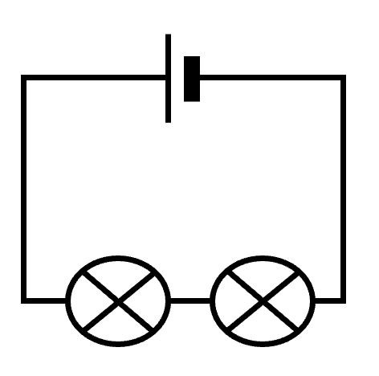
12.12 Flemings Left Hand Rule
Key Q
In what direction do you position the middle and index finger when determining force?
When pointing the middle finger for the direction of current remember that current flows from the positive to negative terminal.
Positive Terminal

Slide 27
12.13 Magnetic Flux
Key Q
What is the equation for magnetic flux density?
Newtons
N
Metres
m
Force = Magnetic Flux Density x Current x Length
F = B x I x l
Tesla
T
Amperes
A

Slide 28
12.13 Magnetic Flux
Calculate force when magnetic flux density is 2T, current is 2.5A and length is 45cm.
Convert Units | 45cm = 0.45m
Write down the formula. | F = B x I x l
Substitute Values | F = 2 x 2.5 x 0.45
Do the Maths | 2.25
Round and add units. | 2.25N
Usually 1 mark for this.
Answer to 2 s.f which is the same as the values in the qu.

Slide 29
12.13 Magnetic Flux
Calculate force when.. | Magnetic flux density is 2T, current is 3A and length is 1.5m | Magnetic flux density is 10T, current is 5A and length is 30cm | Magnetic flux density is 1.5T, current is 300mA and length is 10cm
Convert Units | - | 30cm = 0.3m | 300mA =0.3A 10cm = 0.1m
Write down the formula. | F = B x I x l | F = B x I x l | F = B x I x l
Substitute Values | F = 2 x 3 x 1.5 | F = 10 x 5 x 0.3 | F = 1.5 x 0.3 x 0.1
Do the Maths | 9 | 15 | 0.045
Round and add units. | 9N | 15N | 0.045N

Slide 30
12.13 Magnetic Flux
Calculate length when the current is 50A and the force is 2.8N
Convert Units | -
Write down the formula. | F = B x I x l
Substitute Values | 2.8 = 0.01 x 50 x l
Do the Maths | 2.8 = 0.5 l l = 2.8 / 0.5 = 5.6
Round and add units. | 5.6m
Usually 1 mark for this.
Answer to 2 s.f which is the same as the values in the qu.

Slide 31
12.13 Magnetic Flux
Calculate length when... | The current is 10A and the force is 2N | The current is 950mA and the force is 0.02N | The current is 25A and the force is 1.5N
Convert Units | - | 950mA = 0.95A | -
Write down the formula. | F = B x I x l | F = B x I x l | F = B x I x l
Substitute Values | 2 = 0.01 x 10 x l | 0.02 = 0.01 x 0.95 x l | 1.5 = 0.01 x 25 x l
Do the Maths | 2 = 0.1 x l l = 2 / 0.1 = 20 | 0.02 = 0.0095 x l l = 0.02 / 0.009 = 2.1052631579 | 1.5 = 0.25 x l l = 1.5 / 0.25 = 6
Answer with Units | 20m | 2.1m | 6m

Slide 32
12.13 Magnetic Flux
Calculate current when the force on a 1km wire is 1.2kN
Convert Units | 1.2kN = 1200N 1km =1000m
Write down the formula. | F = B x I x l
Substitute Values | 1200 = 0.01 x I x 1000
Do the Maths | 1200 = 10 I I = 1200 / 10 = 120
Round and add units. | 120A
Usually 1 mark for this.
Answer to 2 s.f which is the same as the values in the qu.

Slide 33
12.13 Magnetic Flux
Calculate current when... | The force on a 1m wire is 10N | The force on a 10cm wire is 0.5N | The force on a 25cm wire is 0.82N
Convert Units | - | 10cm = 0.1m | 25cm = 0.25m
Write down the formula. | F = B x I x l | F = B x I x l | F = B x I x l
Substitute Values | 10 = 0.01 x I x 1 | 0.5 = 0.01 x I x 0.1 | 0.82 = 0.01 x I x 0.25
Do the Maths | 10 = 0.01 I I = 10 / 0.01 = 1000 | 0.5 = 0.001 I I = 0.5 / 0.001 = 500 | 0.82 = 0.0025 I I = 0.82 / 0.002=328
Answer with Units | 1000A | 500A | 328A

Slide 34
12.14 Motor Effect
Key Q
How does an electric motor work?
A simple electric motor can be built using a coil of wire that is free to rotate between two opposite magnetic poles.
When an electric current flows through the coil, the coil experiences a force and moves.
Key Term | Definition
Electric Motor | A device that has a coil of wire carrying a magnetic field that tends to rotate.

Slide 35
12.14 Motor Effect
Key Q
What does the split ring do?
This makes sure that the current in each side of the coil of wire is going in the same direction.
This means the force continues to act downwards on one side and upwards on the other.

Slide 36
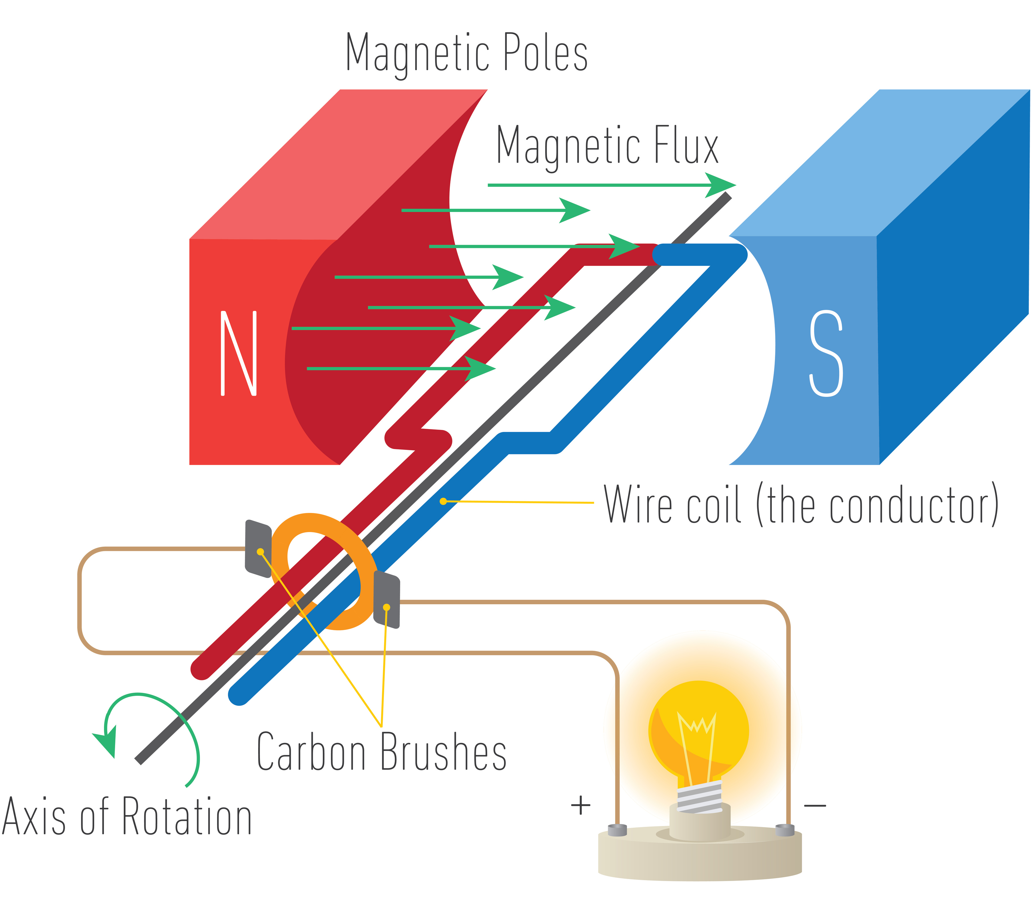
12.14 Motor Effect
Key Q
How can the direction in which a motor spins be changed?
The direction of the magnets can be reversed.
OR the direction of the current can be changed.

Slide 37
12.14 Motor Effect
Key Q
How can the speed in which a motor spins be increased?
The strength of the magnets can be increased.
The strength of the current can also be increased.

