Slide 1
Static Electricity
Paper 2

Slide 2
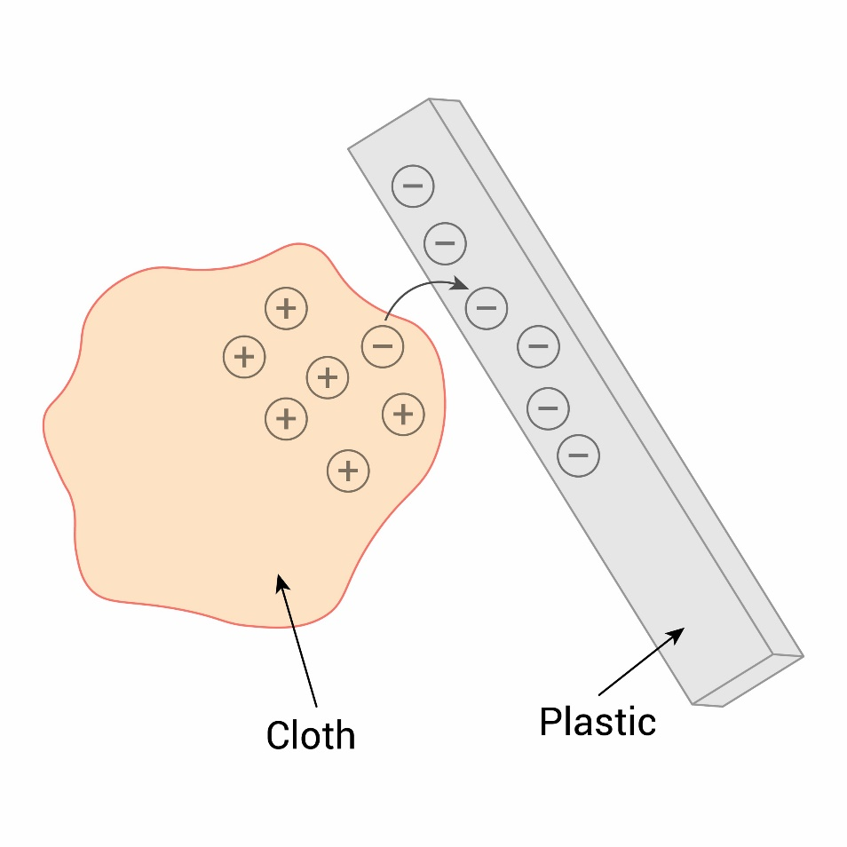
11.1 Charging Insulators
Key Q
How may insulating materials become electrically charged?
When certain insulating materials are rubbed against each other they become electrically charged.
Negatively charged electrons are rubbed off one material and on to the other.

Slide 3
11.2 Charging Insulators
Key Q
How may insulating materials become electrically charged?
When certain insulating materials are rubbed against each other they become electrically charged.
Negatively charged electrons are rubbed off one material and on to the other.
The material that gains electrons becomes negatively charged.
The material that loses electrons is left with an equal positive charge.

Slide 4
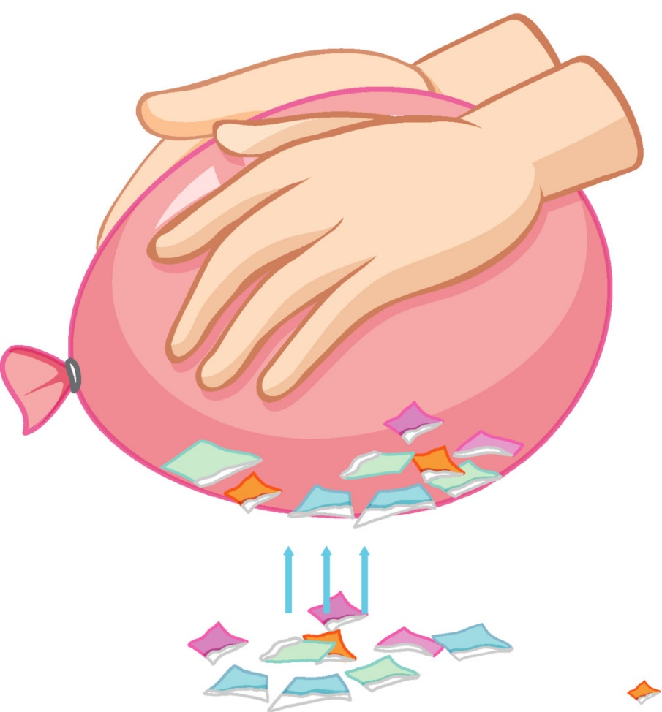
11.3 Charged Objects
Key Q
What happens when two electrically charged objects are brought close together?
When two electrically charged objects are brought close together they exert a force on each other.
Two objects that carry different types of charge attract.
Two objects that carry the same type of charge repel.
Attraction and repulsion between two charged objects are examples of non-contact force.

Slide 5

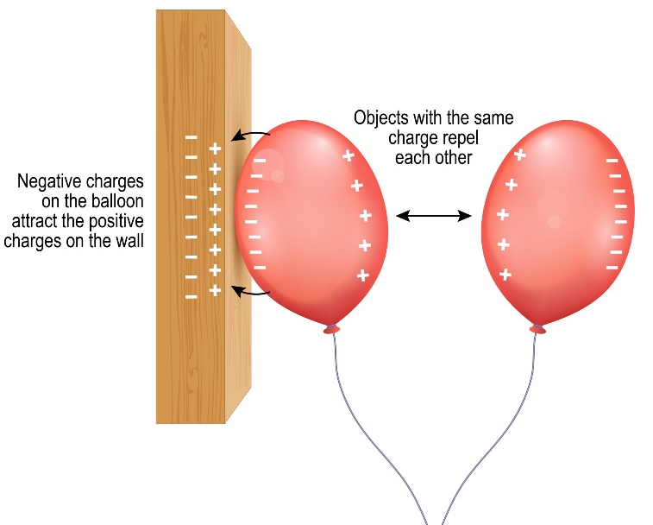
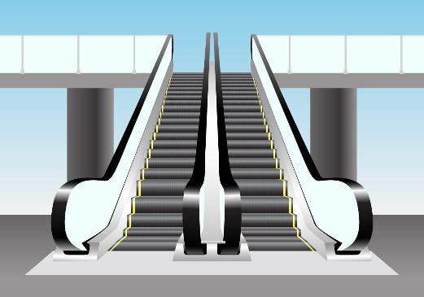
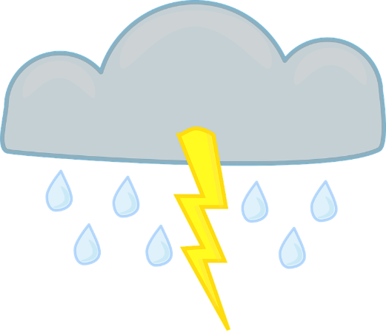
11.4 Electrostatic Phenomena
Key Q
What are some examples of electrostatic phenomena?
Charged comb picking up paper
Attraction of a charged balloon to a wall.
Lightening
Static Shock

Slide 6

11.4 Electrostatic Phenomena
Key Q
Why does a balloon stick to a wall when it is charged?
The balloon has become charged and has a negative charge.
The negative charges on the balloon attract the positive charges on the wall

Slide 7

11.4 Electrostatic Phenomena
Key Q
Why does a charged comb pick up pieces of paper?
The comb now has a charge.
It will induce an opposite charge in the paper.
The oppositely charged object will now attract each other.

Slide 8
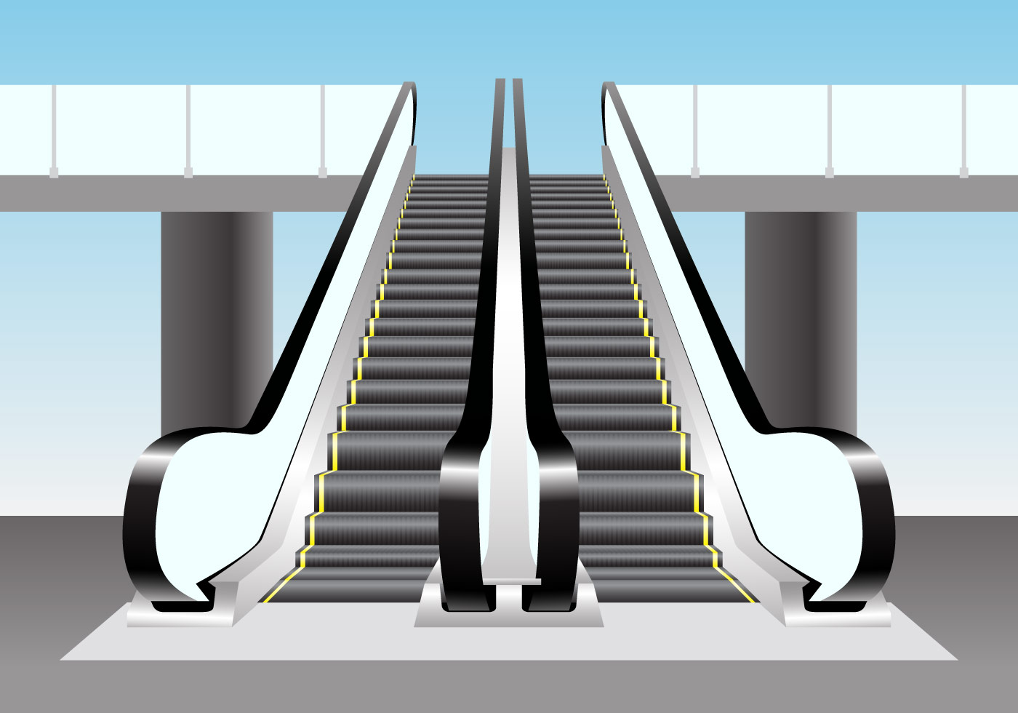
11.4 Electrostatic Phenomena
Key Q
Why do we sometimes get static shocks?
As a person has been walking there has been a transfer of electrons from their socks/shoes/carpet to them.
When they next touch another object there is a potential difference between them and the object.
Electrons transfer from the person to the object and earths the charge.
A static shock is an example of sparking!

Slide 9
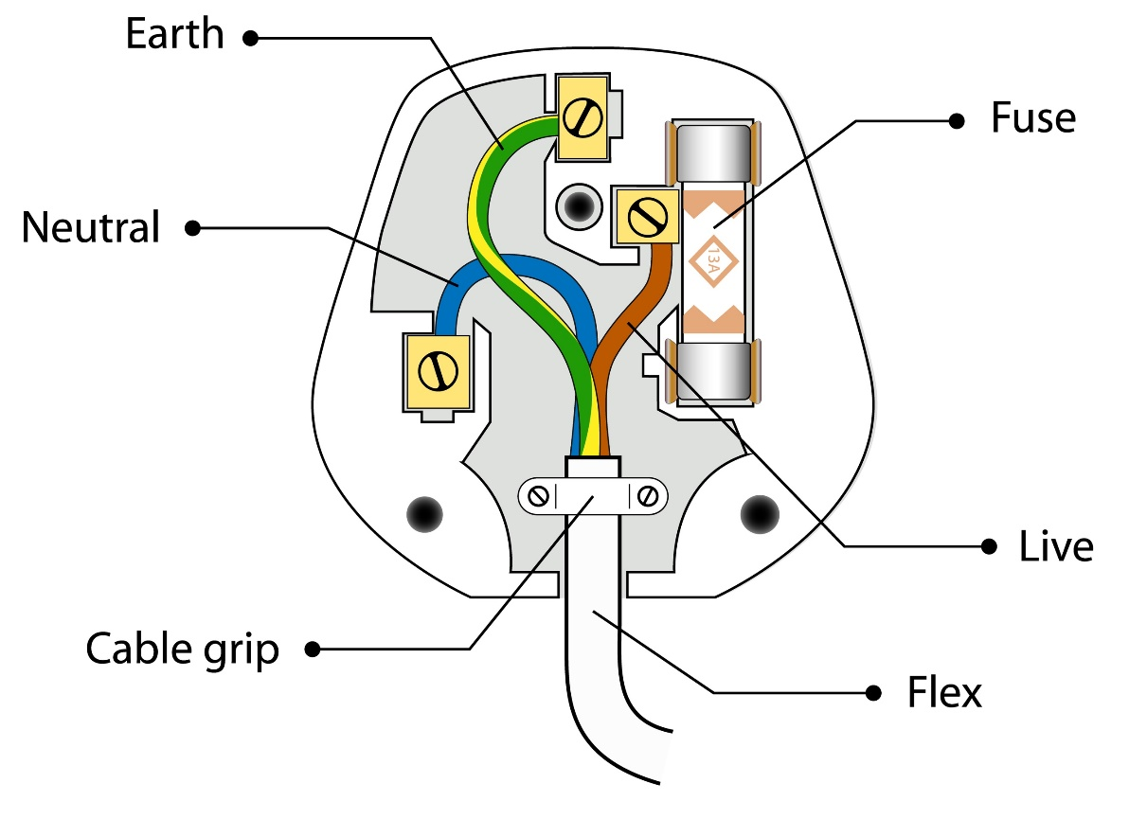
11.5 Earthing
Key Q
How can dangerous levels of charge be removed?
Earthing removes excess charge by movement of electrons.

Slide 10
11.6 Uses of Electrostatic Charges
Key Q
What are some of our uses in everyday life of electrostatic charges?
Use | Description
Insecticide Sprayers | The spray is electrostatically charged. All particles have similar charges and will repel each other as they fall.
Photocopiers | Small particles from the photocopier are charged to be attracted to the paper.
Spraying a car | The car will be negatively charged. If the paint particles are positively charged, they will repel each other as they are sprayed and be attracted to the car.

Slide 11

11.7 Dangers of Sparking
Key Q
How does sparking occur?
Lightening is an example of sparking.
If the field is strong enough, charges can be forced though insulators such as air and a spark will occur.
It can also happen if a charged person touches a conductor. This is when we experience static shocks.

Slide 12
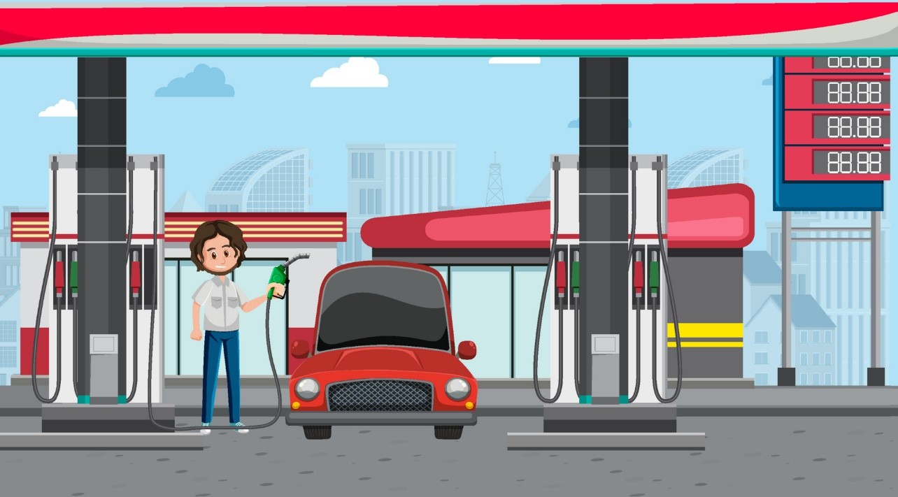
11.7 Dangers of Sparking
Key Q
What are some dangers of sparking?
Sparking is particularly dangerous when there are flammable fuels/gases or a high concentration of oxygen.
A spark could ignite the fuels/gases and cause an explosion.
This is why mobile phones should not be used at petrol stations.

Slide 13

11.7 Dangers of Sparking
Key Q
What are some dangers of sparking?
It is also dangerous when you touch something with a large electric charge on it.
The charge will flow through your body causing an electric shock.
This could cause burns or cause the heart to stop.

Slide 14
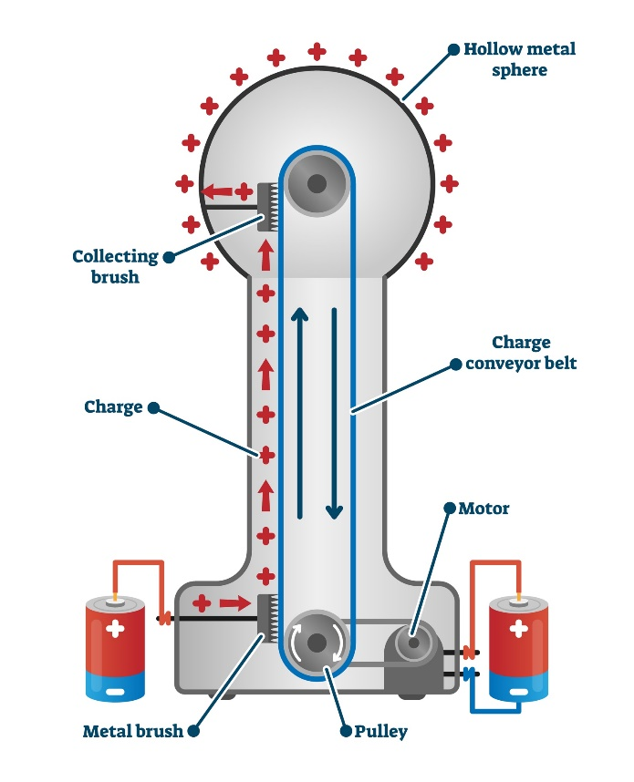
11.8 Electric Field
Key Q
What is an electric field?
A charged object creates an electric field around itself.
The electric field is strongest close to the charged object.
The further away from the charged object, the weaker the field.
Key Term | Definition
Electric Field | An area surrounding an electric charge that may influence other charged particles.

Slide 15
11.8 Electric Field
Key Q
What is an electric field?
A second charged object placed in the field experiences a force.
The force gets stronger as the distance between the objects decreases.
Key Term | Definition
Electric Field | An area surrounding an electric charge that may influence other charged particles.

Slide 16
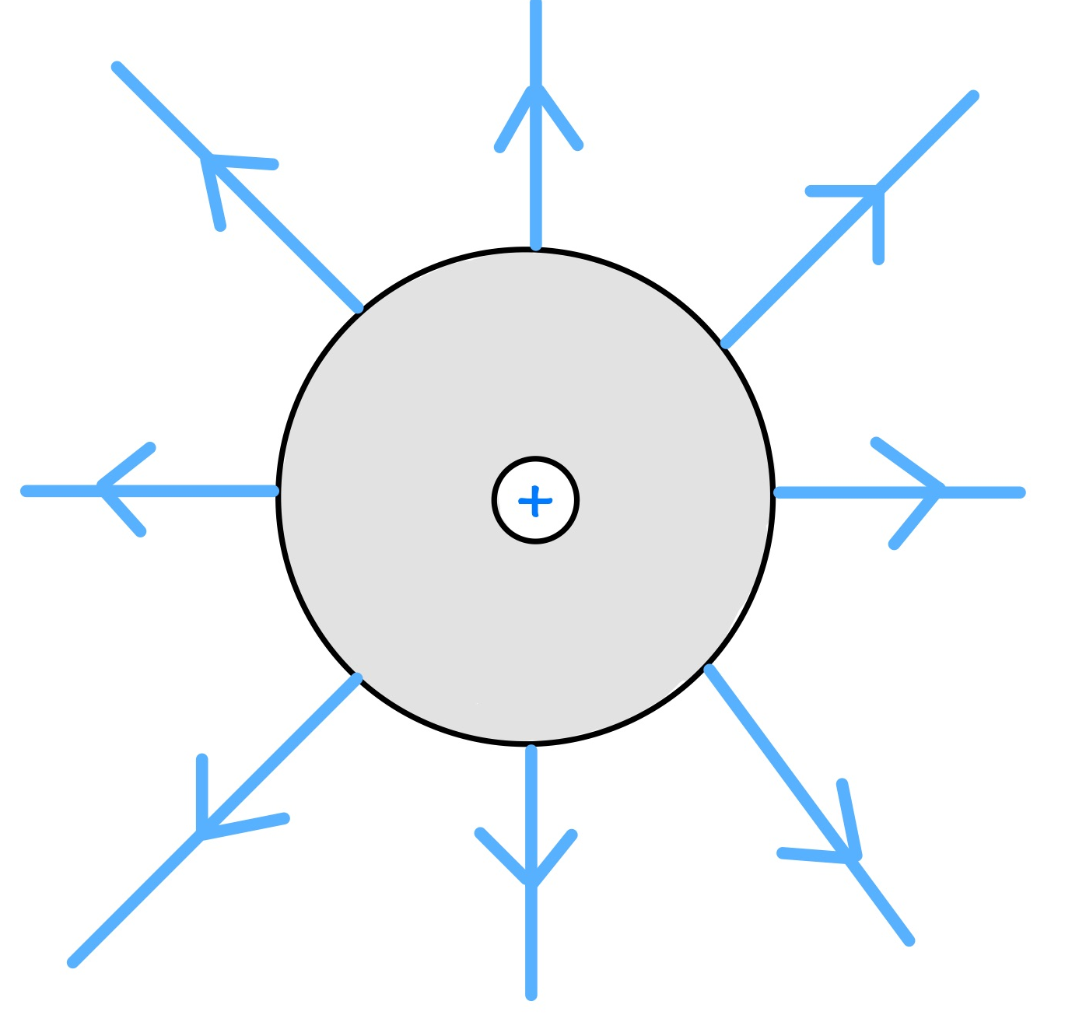
11.9 Shape of Fields
Key Q
What is the electric field pattern for an isolated sphere?
Be prepared to draw this in your exam!
This is an isolated sphere with a positive charge. If it had a negative charge the arrows would be in the opposite direction.

