Slide 1
Electricity and Circuits
Paper 2

Slide 2
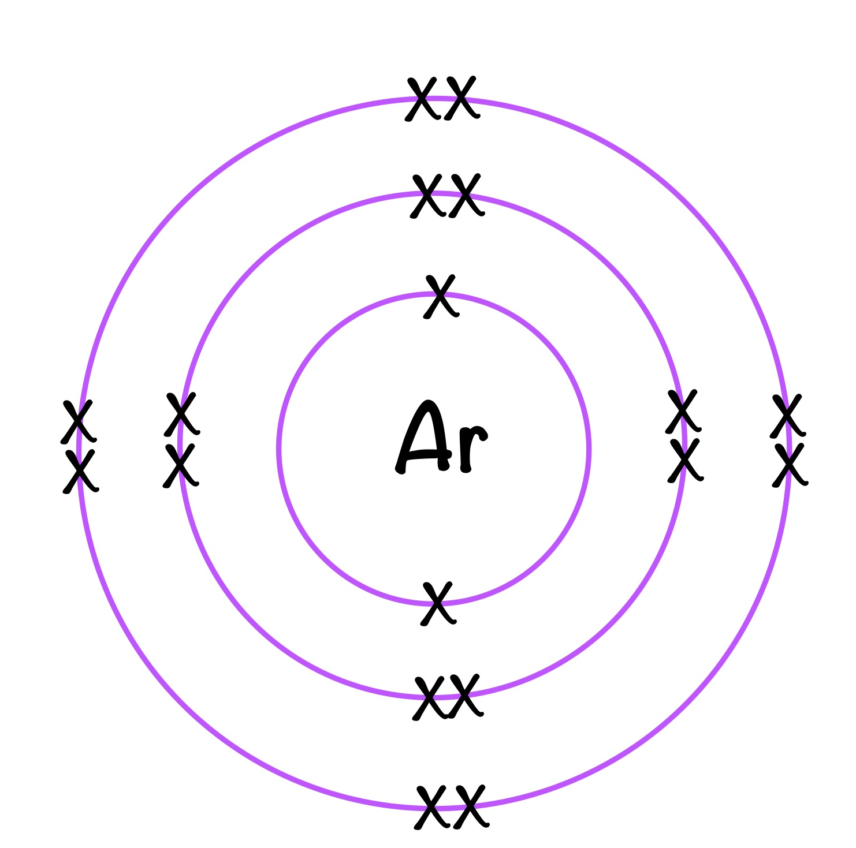
10.1 Structure of the Atom
Key Q
What is the structure of an atom?
Most of the mass is concentrated in the nucleus.
The electrons are arranged at different distances from the nucleus (different energy levels).

Slide 3
10.1 Structure of the Atom
Key Q
Why are atoms neutral?
Particle | Relative Charge
Proton | +1
Neutron | 0
Electron | -1
In an atom the number of electrons is equal to the number of protons in the nucleus.
This means that atom has no overall electrical charge.
Key Term | Definition
Atomic Number | The number of protons in an atom.
All atoms of a particular element have the same number of protons.

Slide 4
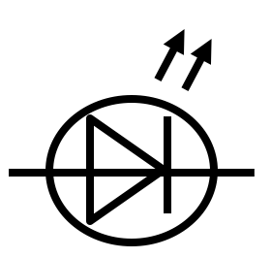




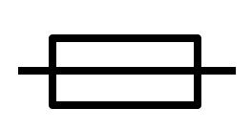

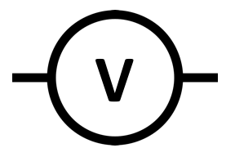

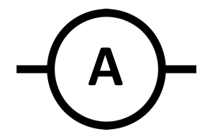
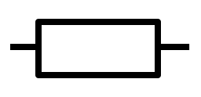
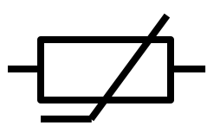
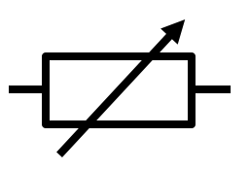
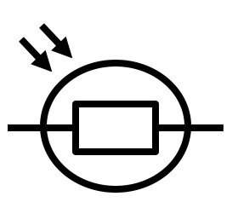
10.2 Electric Circuit Diagrams
Key Q
What are the different symbols for circuit components?
Component | Symbol | Component | Symbol
Open Switch |  | LED
Closed Switch |  | Lamp
Cell |  | Fuse
Battery |  | Voltmeter
Diode |  | Ammeter
Resistor |  | Thermistor
Variable Resistor |  | LDR

Slide 5
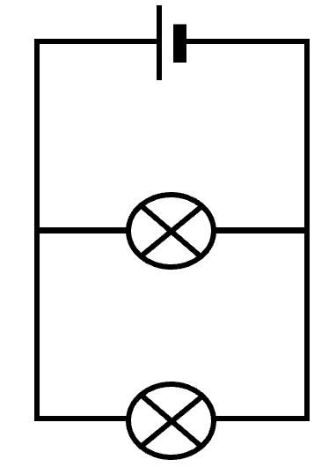
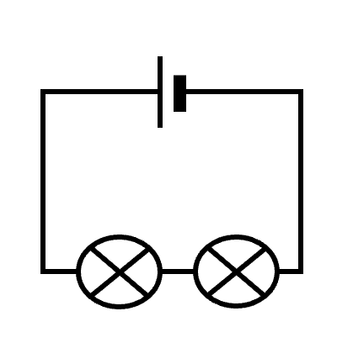
10.3 Series and Parallel
Key Q
What are series and parallel circuits?
Parallel Circuit
Series Circuit

Slide 6
10.3 Series and Parallel
Key Q
What are series and parallel circuits?
There are two ways of joining electrical components, in series and in parallel.
Some circuits include both series and parallel parts.
Parallel Circuit
Series Circuit

Slide 7
10.3 Series and Parallel
Key Q
What are the similarities and differences between series and parallel circuits?
In a series circuit..
The charge passes through all of the components so the current through each component is the same.
The potential difference is largest across the component with the greatest resistance.
The change in resistance of one component will cause a change in potential difference across all components

Slide 8
10.3 Series and Parallel
Key Q
What are the similarities and differences between series and parallel circuits?
In a series circuit..
The total resistance of two components is the sum of the resistance of each component.
There is the same current through each component
Rtotal = R1 + R2
The total potential difference of the power supply is shared between the components.

Slide 9
10.3 Series and Parallel
Key Q
What are the similarities and differences between series and parallel circuits?
In a parallel circuit..
Each charge passes through only one branch of the circuit.
The current is largest through the component with the smallest resistance.

Slide 10
10.3 Series and Parallel
Key Q
What are the similarities and differences between series and parallel circuits?
In a parallel circuit..
The total resistance of two resistors is less than the resistance of the smallest individual resistor.
The potential difference across each component is the same.
The total current through the whole circuit is the sum of the currents through the separate components

Slide 11
10.4 Voltmeter
Key Q
How are ammeters and voltmeters connected within a circuit?

Slide 12
10.4 Voltmeter
Key Q
How are ammeters and voltmeters connected within a circuit?
Voltmeters are connected in parallel across a component in a circuit
V

Slide 13
10.5 Potential Difference
Key Q
What is potential difference?
Potential difference is the energy transferred per unit of charge that passes.
A volt is a joule per coulomb.

Slide 14
10.6 Energy Transferred
Key Q
What is the equation that links charge moved, energy transferred and potential difference?
You may need to convert units!
Coulombs
C
Energy Transferred = Charge x Potential Difference
E = Q x V
Volts
Joules
J
V

Slide 15
10.9 Charge
A torch worked for 14,400seconds before needing to be replaced. The current in the LED was 50mA. Calculate the charge flow. (3)
Usually 1 mark for this.
Convert Units | 50mA = 0.05
Write down the formula. | Q = I x t
Substitute Values | Q = 0.05 x 14,400
Do the Maths | Q = 720
Round and add units. | 720C
Show all of your working out.

Slide 16
10.7 Ammeter
Key Q
How are ammeters and voltmeters connected within a circuit?

Slide 17
10.7 Ammeter
Key Q
How are ammeters and voltmeters connected within a circuit?
Ammeters are connected in series within a circuit
A

Slide 18
10.8 Current
Key Q
What is electric current?
Key Term | Definition
Electric Current | The flow of electrical charge.

Slide 19
10.8 Current
Key Q
What is electric current?
An electric current is the rate of flow of charge in a circuit.
In an electric circuit the metal conductors (components and wires) contain many charges that are free to move.
When a circuit is made, the battery causes free charges to move.
These charges are not used up but flow in a continuous loop.

Slide 20
10.9 Charge
Key Q
What is electric current?
Amperes
A
You may need to convert units!
Charge Flow= Current x Time
Q = I x t
Seconds
Coulombs
C
s
Key Term | Definition
Electric Current | The flow of electrical charge.

Slide 21
10.9 Charge
A torch worked for 14,400seconds before needing to be replaced. The current in the LED was 50mA. Calculate the charge flow. (3)
Usually 1 mark for this.
Convert Units | 50mA = 0.05
Write down the formula. | Q = I x t
Substitute Values | Q = 0.05 x 14,400
Do the Maths | Q = 720
Round and add units. | 720C
Show all of your working out.

Slide 22
10.9 Charge
Calculate the time when charge flow is 8C and current is 2mA. (3)
Convert Units | 2mA = 0.02A
Write down the formula. | Q = I x t
Substitute Values | 8 = 0.02 x t
Do the Maths | t = 8 / 0.02 t = 400
Round and add units. | 400s
Usually 1 mark for this.
Substitute before you do any rearranging. 1 mark for doing this.
Show each step that you do.

Slide 23
10.10 Closed Circuits
Key Q
When will there be a current in a circuit?
There will be a current in a circuit if the system is closed…
..and there is a potential difference.
This is a closed system.

Slide 24
10.11 Conservation of Current
Key Q
What happens at a junction of a circuit?
At the junction of a circuit current is conserved.

Slide 25
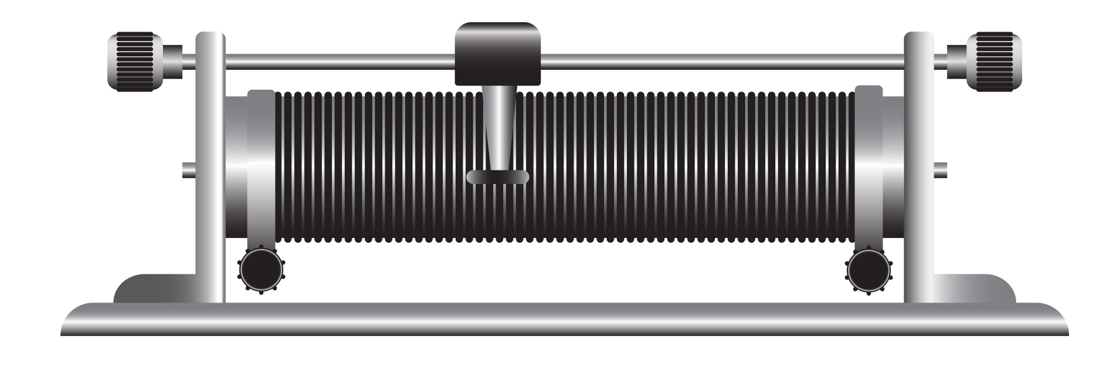
10.12 Variable Resistors
Key Q
What happens to current when resistance is increased?
When resistance is high it is harder for electrons to move..
..this means that current will be lower.
When resistance is low it is easier for electrons to move..
..this means that current will be higher

Slide 26
10.12 Variable Resistors
Key Q
What happens to current when resistance is increased?
A variable resistor can be used to change the resistance.

Slide 27
10.13 Potential Difference
Key Q
What does current through a component depend on?
The current through a component depends on both the resistance of the component and the potential difference across it.
The greater the resistance of the component the smaller the current for a given potential difference.
Amperes
You may need to convert units!
A
Potential Difference = Current x Resistance
V = I x R
Ohms
Volts
V
Ω

Slide 28
10.13 Potential Difference
Key Q
What does current through a component depend on?
In a given circuit, the larger the potential difference across the power supply the bigger the current.
Components such as resistors and lamps resist the flow of charge through them.
Amperes
A
The resistance of connecting wires is usually so small that it can be ignored.
The larger the resistance in a given circuit, the smaller the current will be.
Ohms
Ω

Slide 29
10.13 Potential Difference
A filament lamp has a current of 800mA through it and its resistance is 2.5Ω. Calculate the potential difference. (3)
Usually 1 mark for this.
Convert Units | 800mA = 0.8A
Write down the formula. | V = I x R
Substitute Values | V = 0.8 x 2.5
Do the Maths | V = 2
Round and add units. | 2V
Show all of your working out.

Slide 30
10.13 Potential Difference
A hob draws a current of 26 A from the 230 V mains electricity supply. Calculate the resistance. (3)
Convert Units | -
Write down the formula. | V = I x R
Substitute Values | 230 = 26 x R
Do the Maths | R = 230 / 26 R = 8.8461538462
Round and add units. | 8.8Ω
Substitute before you do any rearranging. 1 mark for doing this.
Show each step that you do.

Slide 31
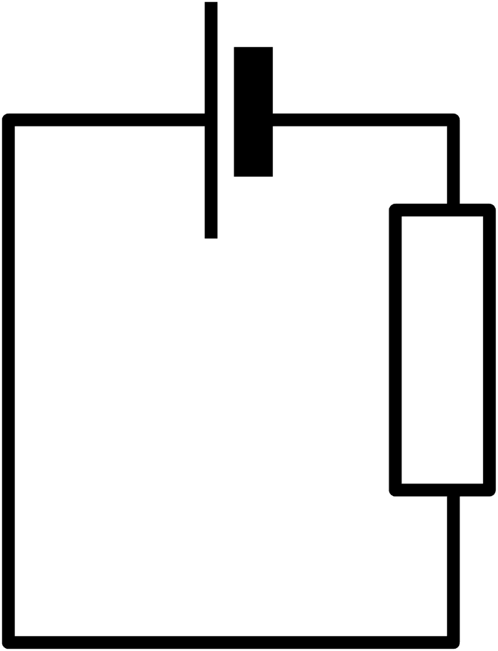
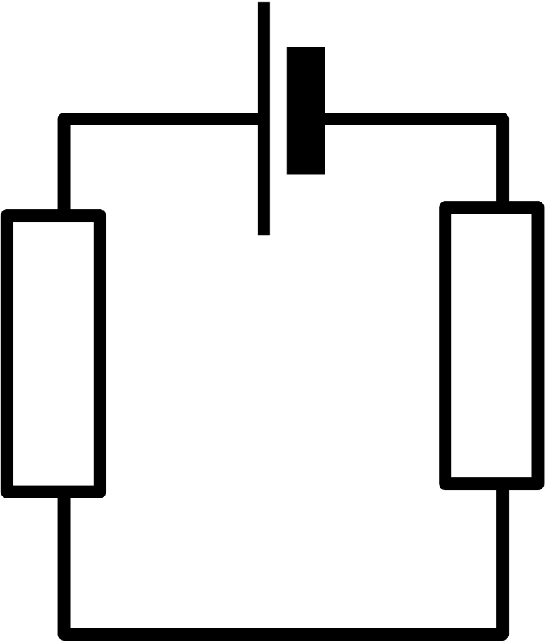
10.14 Resistance
Key Q
Which circuit has the higher resistance and why?
A
B

Slide 32
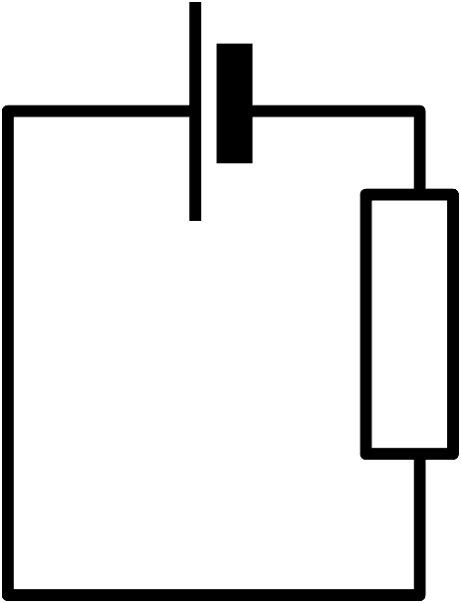

10.14 Resistance
Key Q
Which circuit has the higher resistance and why?
B has the higher resistance.
This is because in a series circuit the current the resistance of components is combined
A
B

Slide 33
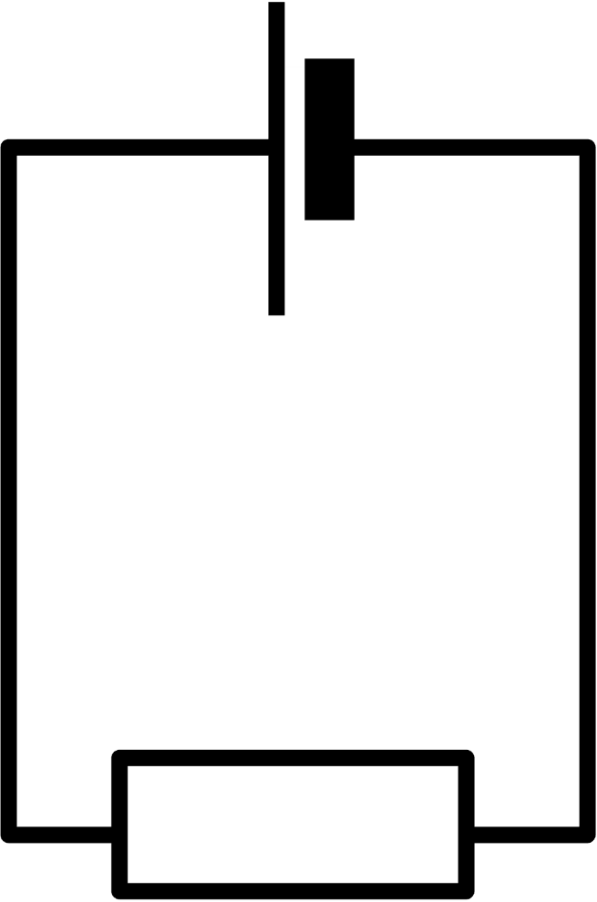
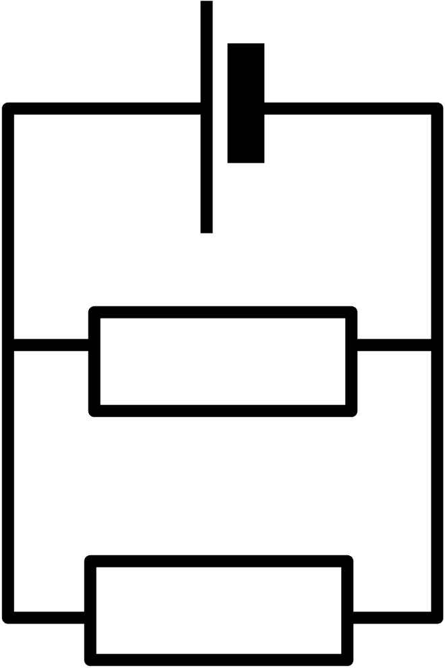
10.14 Resistance
Key Q
Which circuit has the higher resistance and why?
A
B

Slide 34


10.14 Resistance
Key Q
Which circuit has the higher resistance and why?
A
B
A has the higher resistance.
This is because in a parallel circuit the resistance drops when there are more paths for the current to flow.

Slide 35
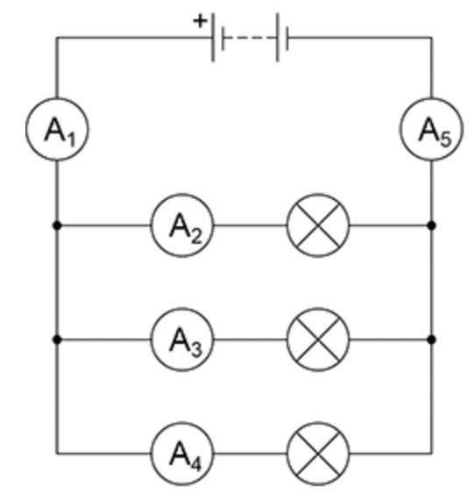
10.15 Calculations in Circuits
A₁ has a reading of 0.36A. What is the current through A₂?
A | 0.36A
B | 0.12A
C | 0A

Slide 36
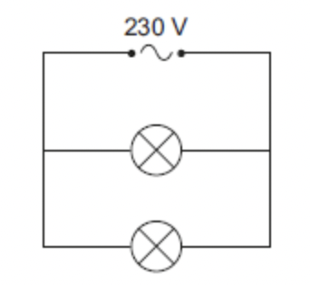
10.15 Calculations in Circuits
What is the potential difference if two lamps are connected in parallel?
A | 230V
B | 0V
C | 115V

Slide 37
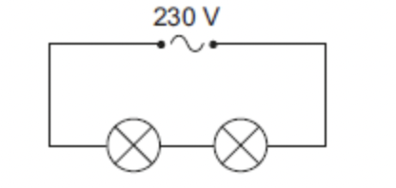
10.15 Calculations in Circuits
What is the potential difference if two lamps are connected in series?
A | 230V
B | 0V
C | 115V

Slide 38
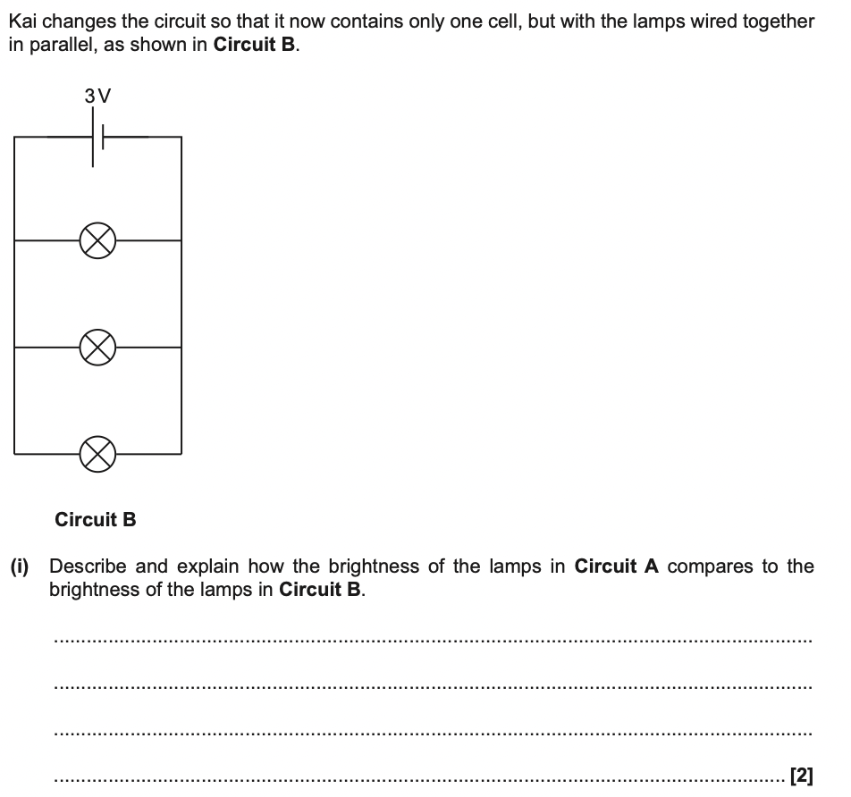
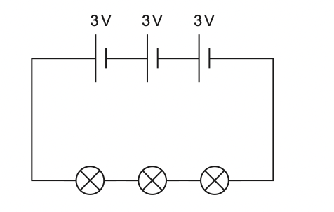
10.15 Calculations in Circuits
Brightness stays the same
Potential difference across each bulb in the same

Slide 39
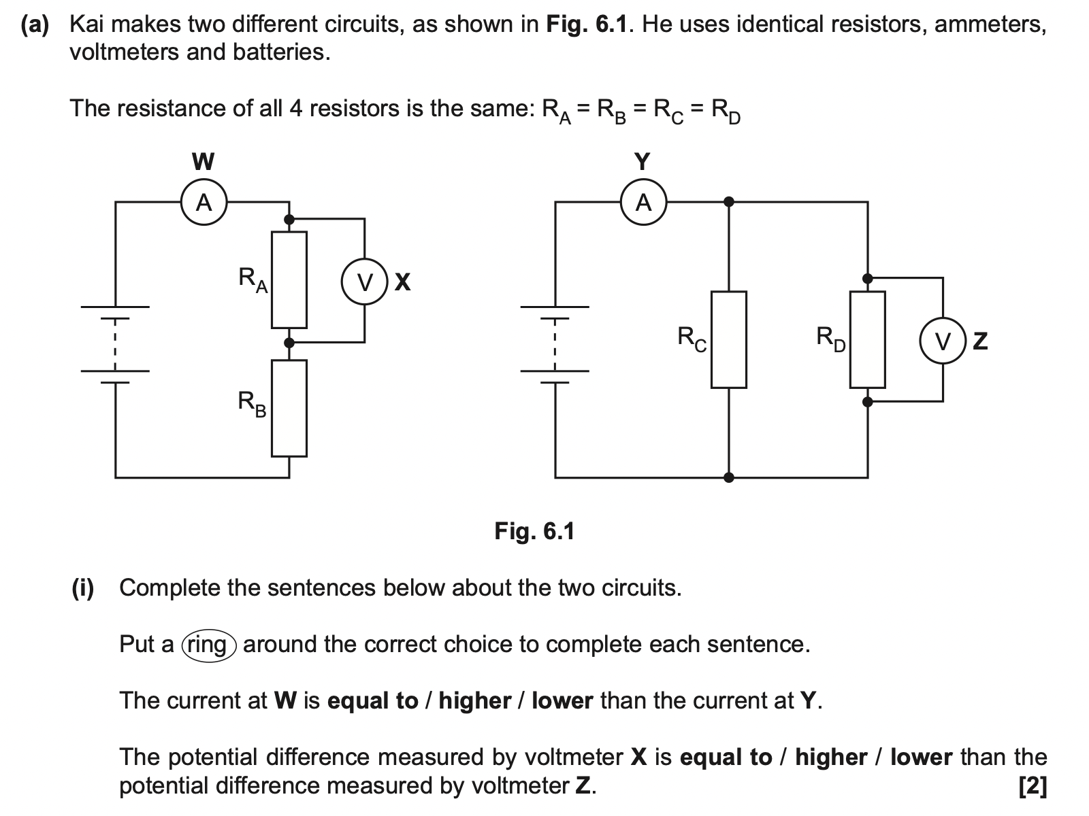
10.15 Calculations in Circuits

Slide 40
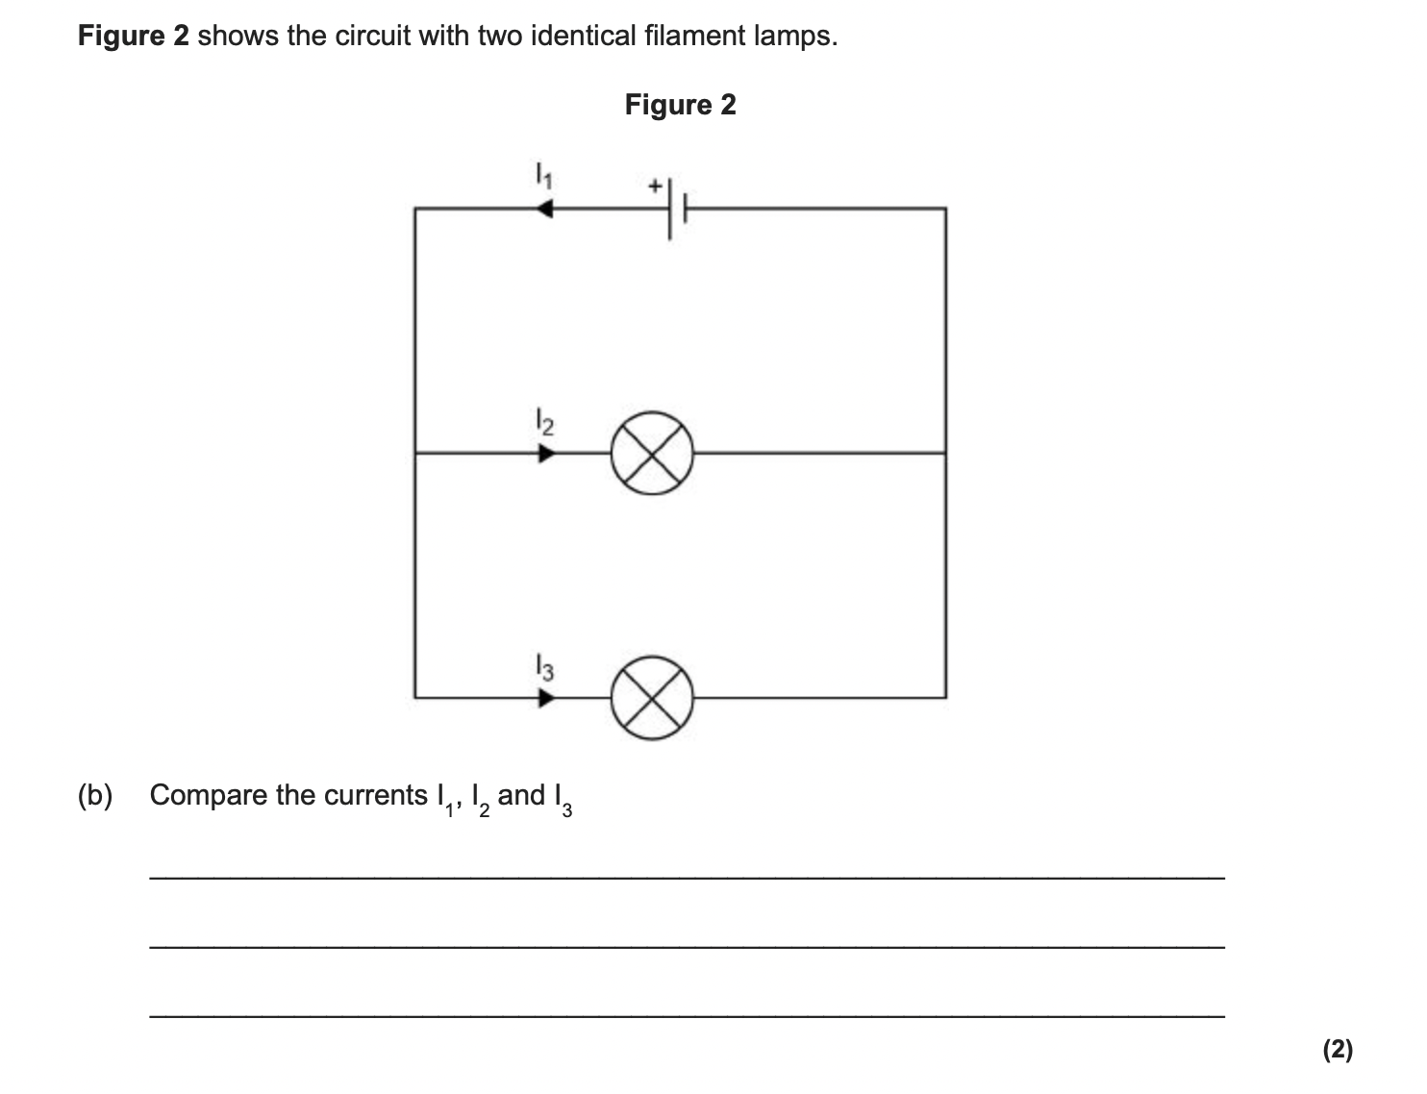
10.15 Calculations in Circuits
I₁ = I₂ + I₃
I₁ = 2I₃
I₂ = I₃
I₁ = 2I₂

Slide 41
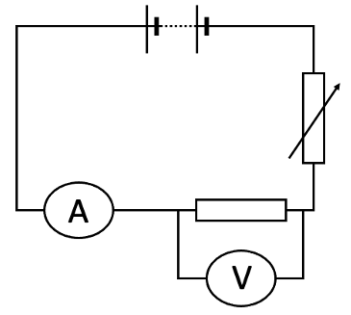
10.16 and 17 Core Practical
Key Q
How can we determine the resistance of a component in a circuit?
Measure the current in the circuit using an ammeter.
Test
Component
Measure the voltage across the component.

Slide 42
10.16 and 17 Core Practical
Key Q
How can we investigate the IV characteristics of a resistor?
1
Set up equipment as shown in the diagram.

Slide 43
10.16 and 17 Core Practical
Key Q
How can we investigate the IV characteristics of a resistor?
4
Swap the leads on the battery so that the reading on the ammeter and voltmeter is negative.
1
Set up equipment as shown in the diagram.
2
Record the current and voltage.
5
Record the current and voltage 5 times adjusting the variable resistor between each reading.
3
Adjust the variable resistor 4 more times recording the new current and voltage each time.

Slide 44
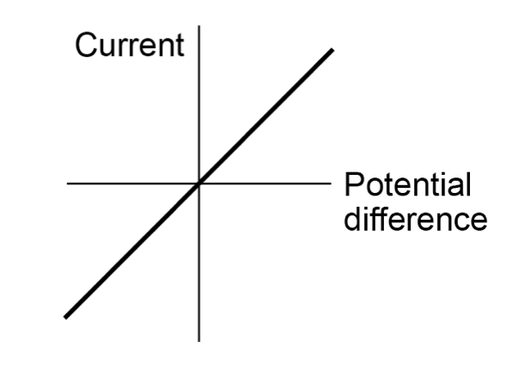
10.16 and 17 Core Practical
Key Q
How can we investigate the IV characteristics of a resistor?
6
Plot a graph of current against potential difference.

Slide 45
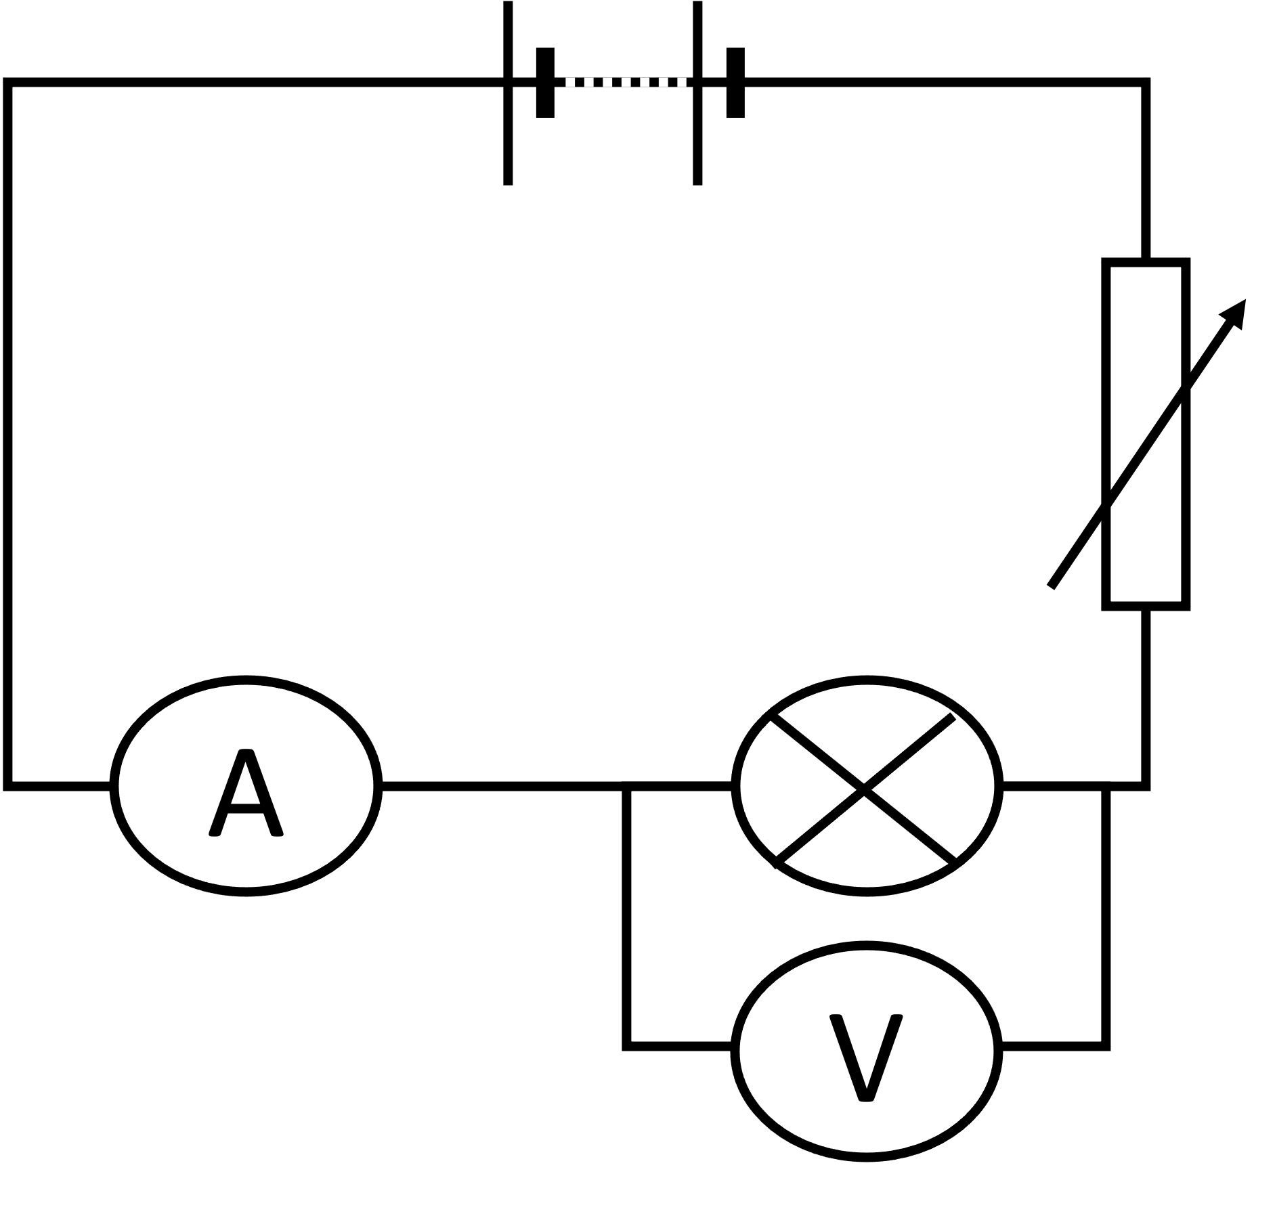
10.16 and 17 Core Practical
Key Q
How can we investigate the IV characteristics of a filament lamp?
Set up equipment as shown in the diagram.
Notice it is the same as the earlier circuit with a filament lamp rather than a resistor.
Repeat using the same method that was used for the resistor.

Slide 46
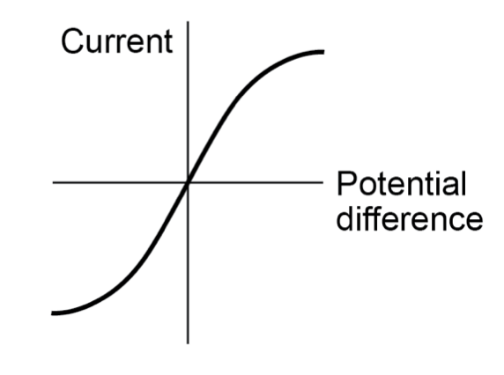
10.16 and 17 Core Practical
Key Q
How can we investigate the IV characteristics of a filament lamp?
Plot a graph of current against potential difference.

Slide 47
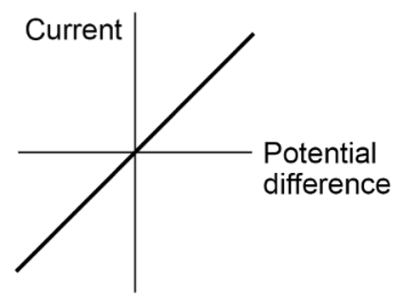
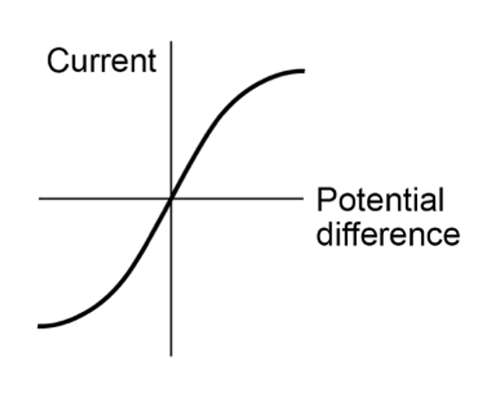
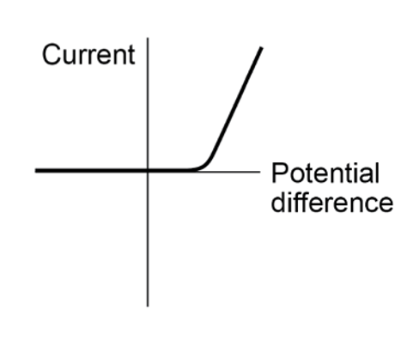
10.18 Current & Potential Difference
Key Q
What is the relationship between current and potential difference for different components?
For some resistors, the value of R remains constant but that in others it can change as the current changes.

Slide 48
10.18 Current & Potential Difference
Key Q
What is the relationship between current and potential difference for ohmic resistors?
The current through an ohmic conductor (at a constant temperature) is directly proportional to the potential difference across the resistor.
This means that the resistance remains constant as the current changes.

Slide 49
10.18 Current & Potential Difference
Key Q
What is the relationship between current and potential difference for a filament lamp?
The resistance of a filament lamp increases as the temperature of the filament increases.
This means that the resistance is not constant as the current changes.

Slide 50
10.18 Current & Potential Difference
Key Q
What is the relationship between current and potential difference for a diode?
The current through a diode flows in one direction only. The diode has a very high resistance in the reverse direction.

Slide 51
10.19 Light Dependent Resistors
Key Q
What is an LDR and how does its resistance vary?
In the dark and at low light levels, the resistance of an LDR is high and little current can flow through it.
The resistance of an LDR decreases as light intensity increases.
LDR’s are used in circuits to switch on lights when it gets dark.
In bright light, the resistance of an LDR is low and more current can flow through it

Slide 52
10.20 Thermistors
Key Q
What is a thermistor and how does its resistance vary?
The resistance of a thermistor decreases as the temperature increases.
At high temperatures, the resistance of a thermistor is low and more current can flow through them.
At high temperatures, the resistance of a thermistor is low and more current can flow through them.
Thermistors are used in thermostats.

Slide 53
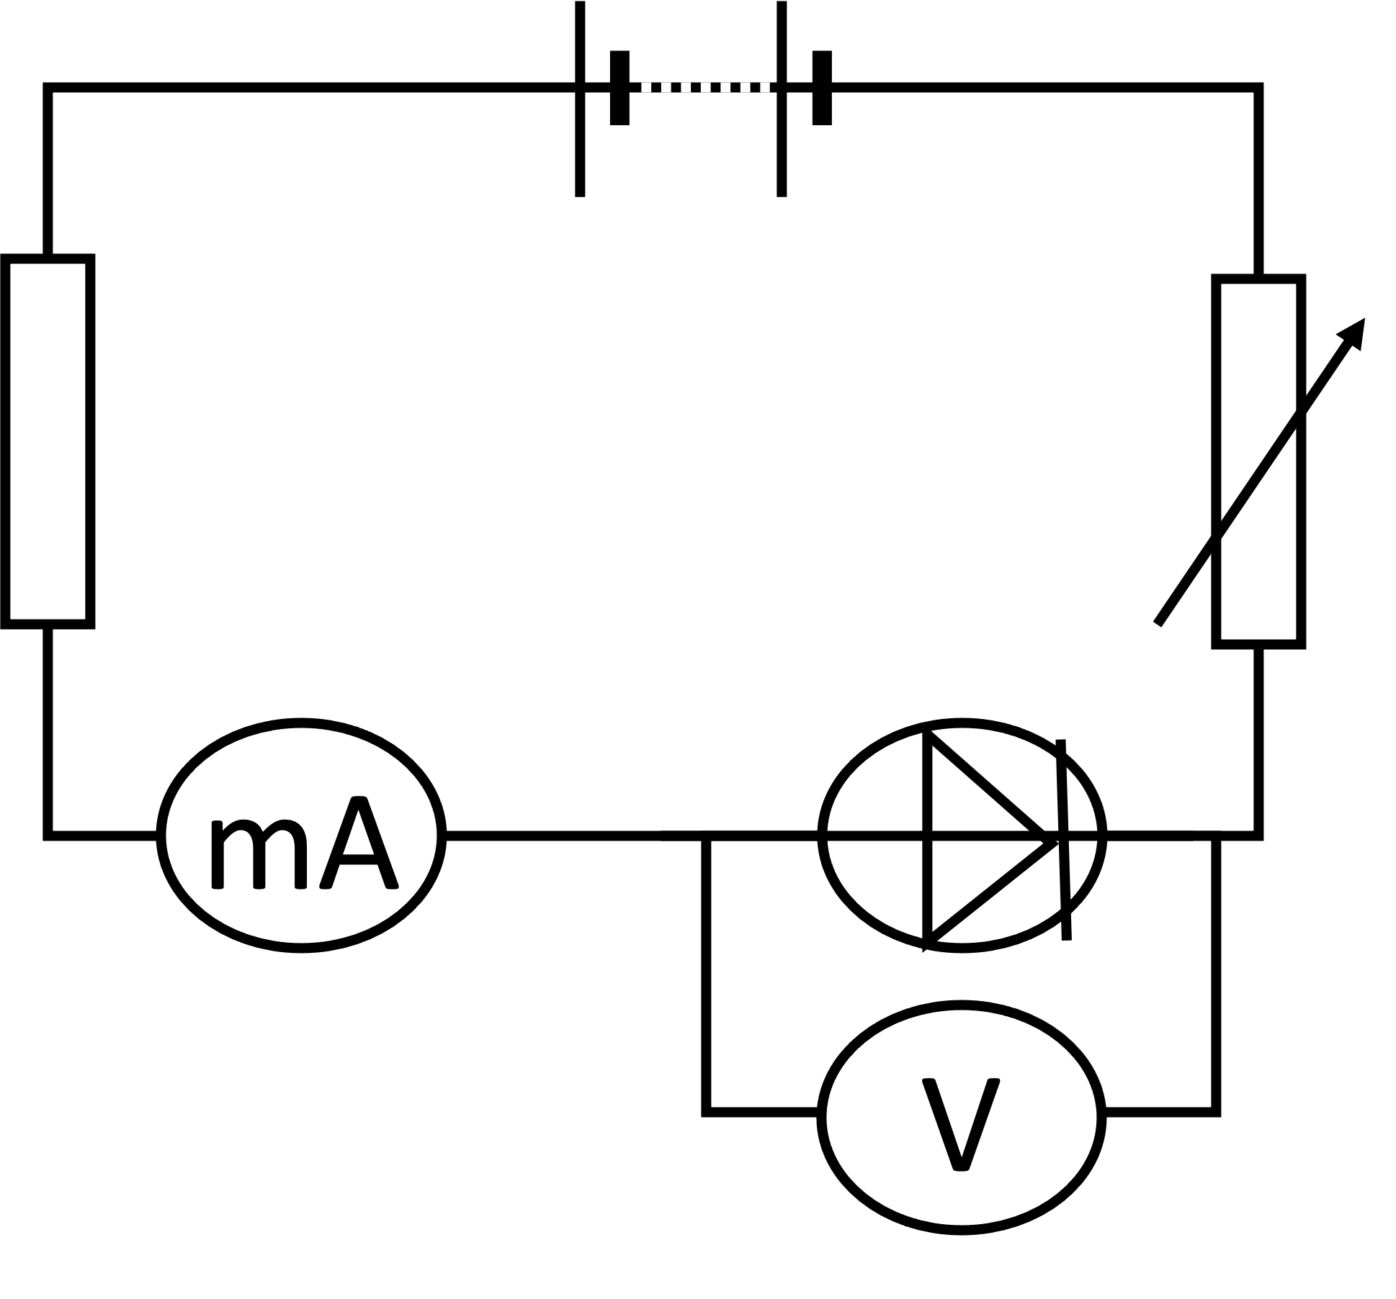
10.21 Design of Circuits
Key Q
How can we investigate the IV variation in resistance in components such as diodes?
Set up equipment as shown in the diagram.
Notice it is the same as the earlier circuit with a diode rather than a resistor or a filament lamp.
Repeat using the same method that was used for the resistor and filament lamp.

Slide 54
10.22 Energy Transfers
Key Q
What happens to a resistor when a current passes through it?
When a current passes through a resistor there is a transfer of energy.
This causes the resistor to warm up.

Slide 55

10.23 Dissipation of Electrical Energy
Key Q
What happens to the electrical energy when work is done in a circuit?
Electrical energy is dissipated as thermal energy when an electric current does work against electrical resistance.
This is why filament light bulbs tend to get hot.
The filament has a high resistance and lots of energy is transferred to thermal energy.

Slide 56
10.24 Energy Transfers
Key Q
Why is energy dissipated in electric circuits when work is done?
Energy is transferred to thermal energy because there are collisions between electrons and the ions in the metallic lattice.

Slide 57
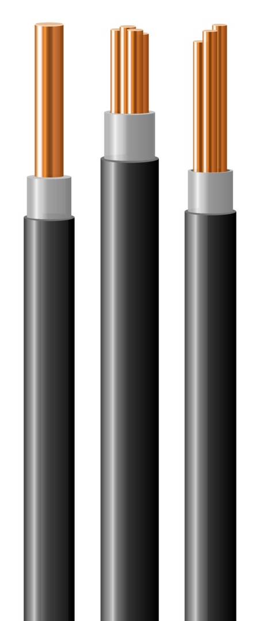
10.25 Reducing Energy Transfers
Key Q
How can unwanted energy transfers be reduced in electrical circuits?
Thicker wires could be used to reduce unwanted energy transfers.
Thicker wires have a lower resistance.
This means that less thermal energy is transferred in the wires.

Slide 58
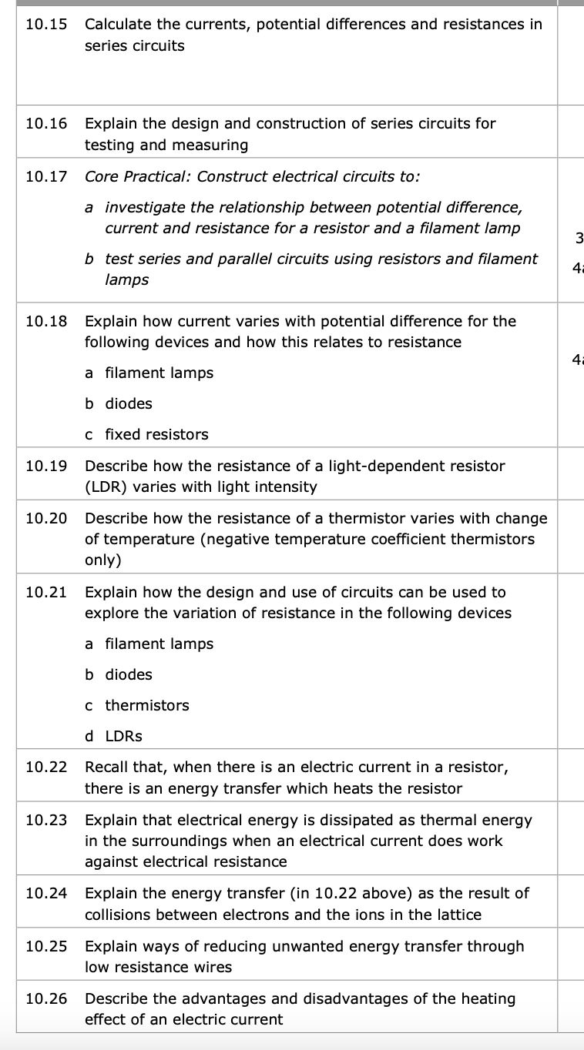
10.26 Heating Effect on Circuit
Key Q
What are the advantages and disadvantages of the heating effect in circuits?
Advantages | Disadvantages
Energy efficient way of transferring heat when used in heaters. | Energy can be wasted as heat
 | Warmth produced can damage the insulating wires
 | Pose a fire hazard
 | Can cause burns

Slide 59
10.27 Energy Transferred
Key Q
What does the amount of energy an appliance transfer depend on?
Watts
W
You may need to convert units!
Energy Transferred = Power x Time
E = P x t
Joules
Seconds
J
s

Slide 60
10.27 Energy Transferred
A toaster is on for 1 minute and has a power rating of 800W. Calculate the energy transferred (4)
Convert Units | 1 minute = 60 seconds
Write down the formula. | E = P x t
Substitute Values | E = 800 x 60
Do the Maths | E = 48,000
Round and add units. | 48,000J
Usually 1 mark for this.
Substitute before you do any rearranging. 1 mark for doing this.
Show each step that you do. 1 mark available here.
Answer to 2 s.f which is appropriate from values in the qu.

Slide 61
10.27 Energy Transferred
A 900W microwave transfers 1.2kJ of energy. Calculate how long its turned on for.
Convert Units | 1.2kJ = 1200J
Write down the formula. | E = P x t
Substitute Values | 1200 = 900 x t
Do the Maths | t = 1200/900 t = 1.333333333
Round and add units. | 1.3s
Usually 1 mark for this.
Substitute before you do any rearranging. 1 mark for doing this.
Show each step that you do. 2 marks available here.
Answer to 2 s.f which is the same as the values in the qu.

Slide 62
10.27 Energy Transferred
Task
Complete the calculations for the following questions.
 | Calculate energy transferred when time is 2 mins and power is 900W. | Calculate energy transferred when time is 30s and power is 1.8kW | Calculate power when 2.8kJ is transferred over 30 seconds.
Convert Units | 2mins = 120s | 1.8kW = 1800W | 2.8kJ = 2800J
Write down the formula. | E = P x t | E = P x t | E = P x t
Substitute Values | E = 900 x 120 | E = 1800 x 30 | 2800 = P x 30
Do the Maths | E = 108,000 | E = 54,000 | P = 2800 / 30 P = 93.33333333
Round and add units. | 108,000J | 54,000J | 93W

Slide 63

10.28 Energy Transferred
Key Q
What is power?
Power is the energy transferred per second.
It is measured in watts.

Slide 64
10.29 Power
Key Q
What does the amount of energy an appliance transfer depend on?
Joules
J
You may need to convert units!
Power = Energy Transferred / Time
P = E / t
Watts
Seconds
W
s

Slide 65
10.29 Power
A microwave is on for 5 minutes and has a power rating of 750W. Calculate the energy transferred (4)
Convert Units | 5 minutes = 300 seconds
Write down the formula. | P = E / t
Substitute Values | 750 = E / 300
Do the Maths | E = 750 x 300 = 225,000
Round and add units. | 225,000J
Usually 1 mark for this.
Substitute before you do any rearranging.
Show each step that you do.

Slide 66
10.29 Power
A 1200W microwave transfers 1.3kJ of energy. Calculate how long its turned on for.
Convert Units | 1.3kJ = 1300J
Write down the formula. | P = E / t
Substitute Values | 1200 = 1300 / t
Do the Maths | t = 1300/1200 t = 1.08333333333
Round and add units. | 1.1s
Usually 1 mark for this.
Substitute before you do any rearranging.
Show each step that you do.
Answer to 2 s.f which is the same as the values in the qu.

Slide 67
10.30 Power
Key Q
What determines the power transfer in any circuit device?
The power transferred in a circuit device is determined by…
The potential difference across the circuit.
The current in the circuit

Slide 68
10.31 Electrical Power
Amperes
Key Q
A
How can we calculate power?
Power = Potential Difference x Current
P = V x I
Watts
Potential Difference
W
V
OR
Ohms
Ω
Power = (Current)² x Resistance
P = I² x R

Slide 69

10.32 Domestic Devices
Key Q
What are domestic electrical appliances?
The energy an appliance transfers depends on the power of the appliance and the time it is turned on for.
Key Term | Definition
Domestic Electrical Appliance | An object in the home that is designed to bring about energy transfers.

Slide 70
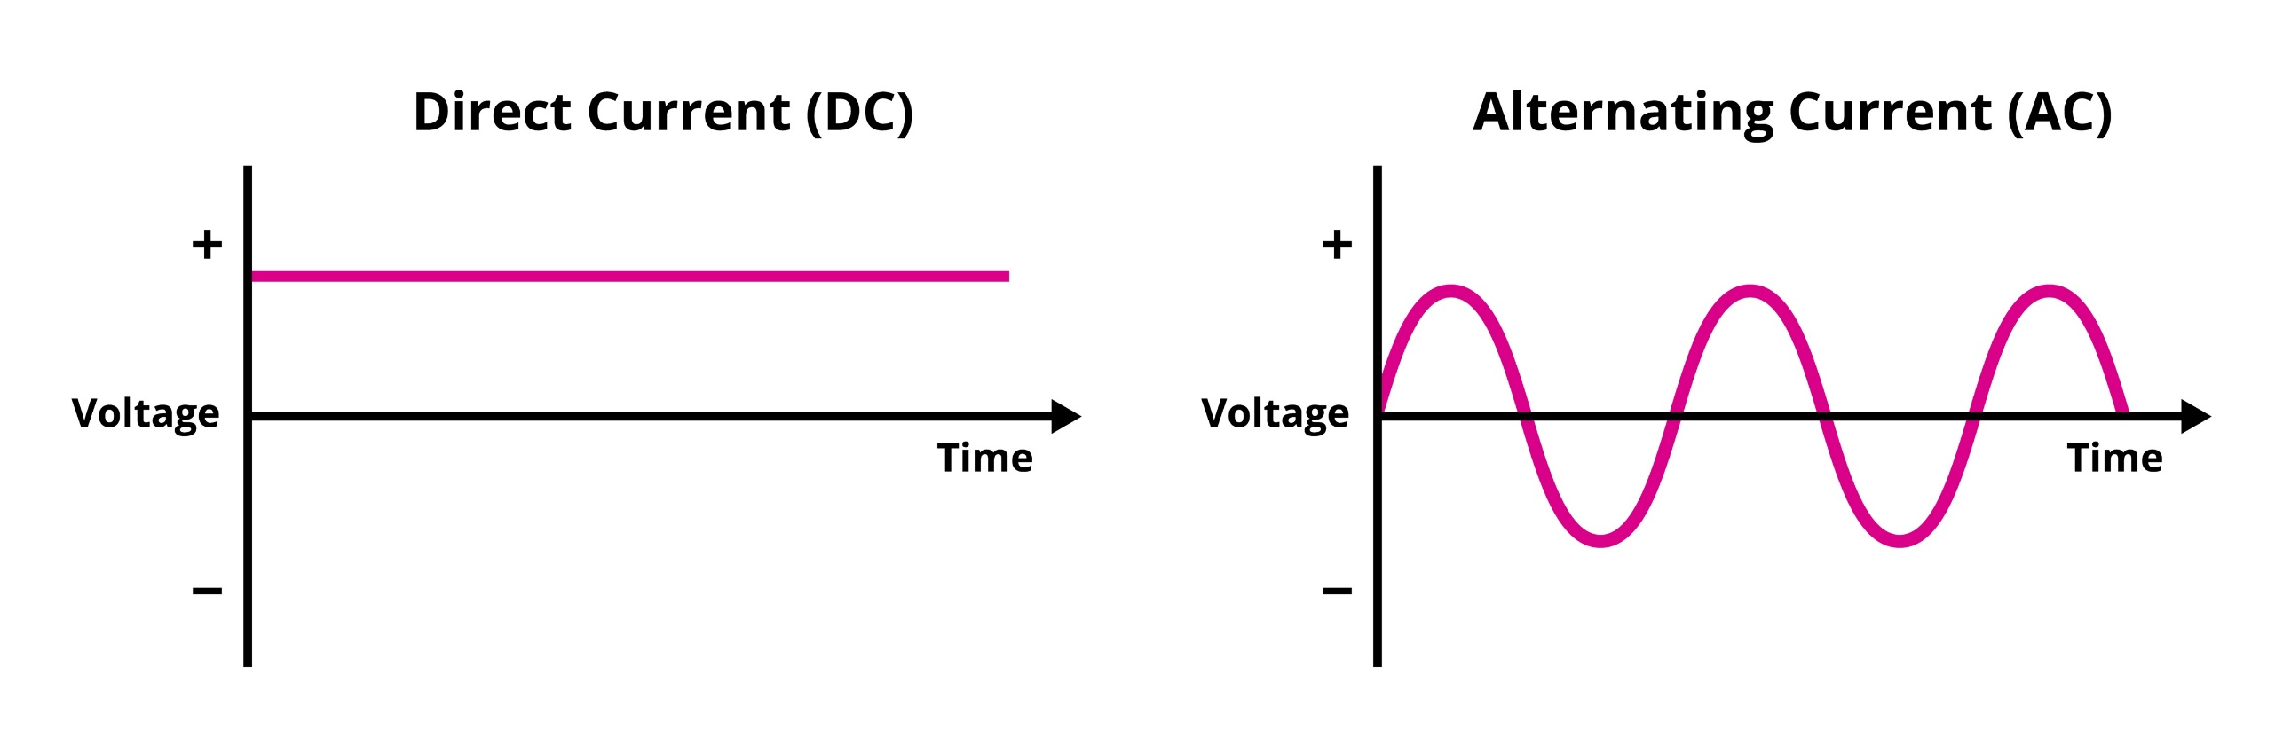
10.33 Direct and Alternating Voltage
Key Q
What is the difference between direct and alternating voltage?
The voltage in direct voltage is always constant.
This can be either positive or negative.
The current in the circuit will also be direct.

Slide 71
10.33 Direct and Alternating Voltage
Key Q
What is the difference between direct and alternating voltage?
The voltage in alternating voltage is constantly changing.
The voltage will periodically change from positive to negative and visa versa
The current in the circuit will also be alternating

Slide 72
10.34 Direct Current
Key Q
What is direct and alternating current?
Key Term | Definition | Example of Source
Direct Current | A current that passes in the same direction | Current produced by cells and batteries.
Alternating Current | A current that changes direction. | Current in the national grid.

Slide 73
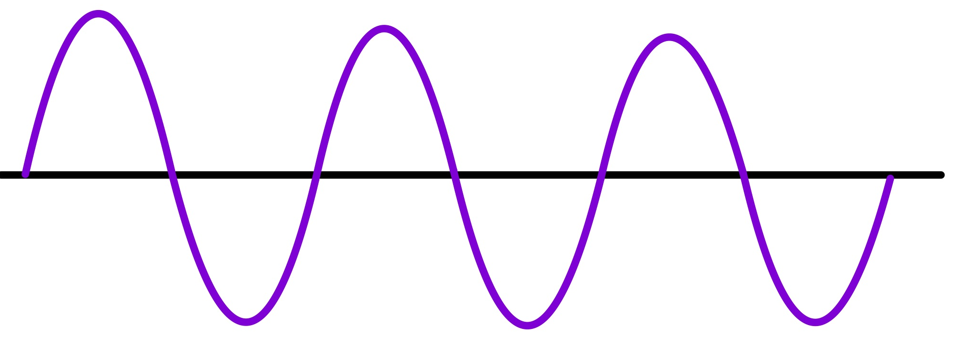
10.35 Alternating Current
Key Q
What is alternating current?
On a voltage-time graph, this would appear as a curve alternating between positive and negative voltages.
An electric current that regularly changes its direction and size.
The positive and negative values indicate the direction of current flow.

Slide 74
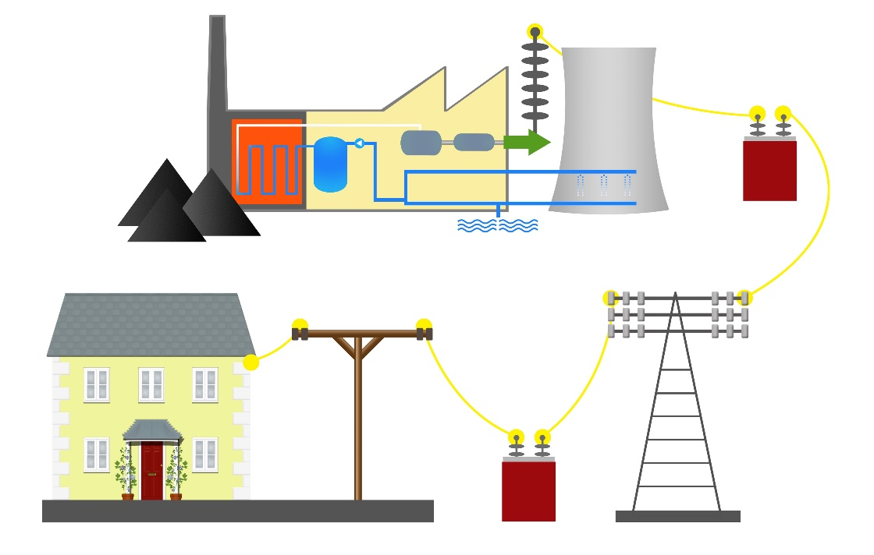
10.36 UK Domestic Supply
Key Q
What is the potential difference and frequency of electricity in the UK?
Mains electricity in the UK is an ac supply.
It has a frequency of 50Hz.
Potential difference is 230V

Slide 75
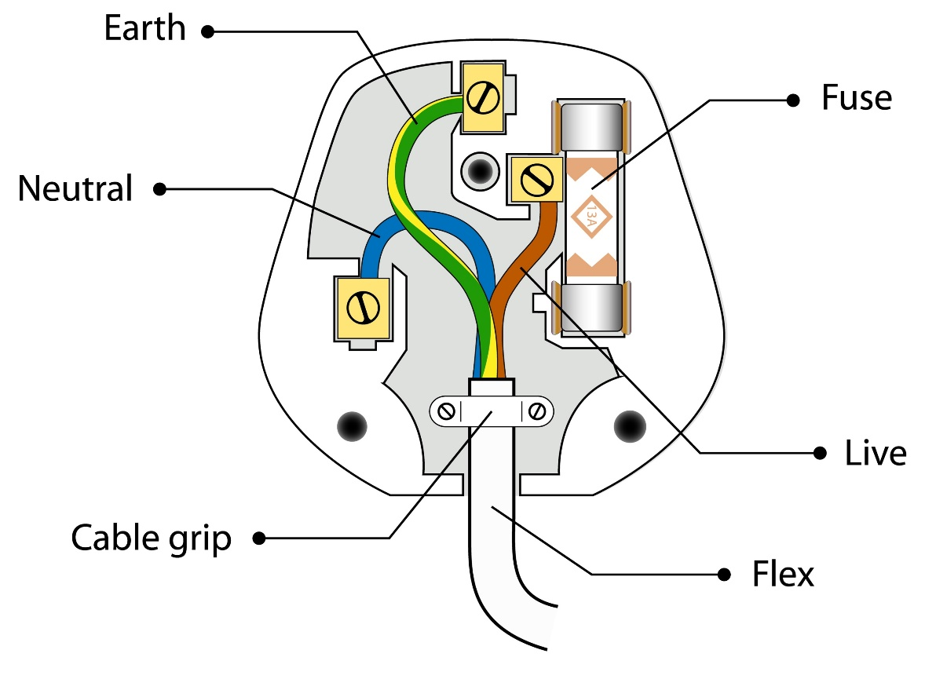
10.37 Live and Neutral Wires
Key Q
How does a plug work?
Most electrical appliances are connected to the mains using three-core cable.
The insulation covering each wire is colour coded for easy identification.

Slide 76
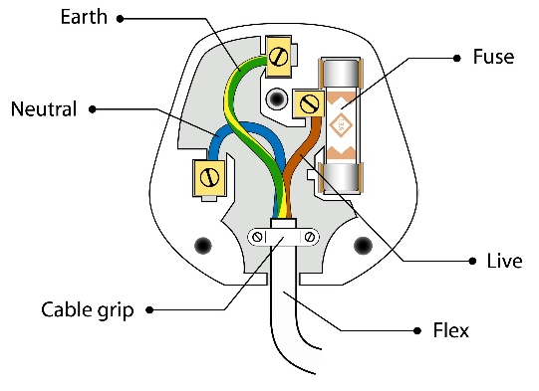
10.37 Live and Neutral Wires
Key Q
How does a plug work?
Wire | Colour | Description | Potential Difference
Live Wire | Brown | Carries the alternating potential difference from the supply. | 230V
Neutral Wire | Blue | Completes the circuit. | 0V (or close to)
Earth Wire | Green and Yellow Stripes | Safety wire to stop the appliance becoming live. | 0V

Slide 77
10.38 Earth Wire
Key Q
How does a plug work?
Wire | Colour | Description | Potential Difference
Live Wire | Brown | Carries the alternating potential difference from the supply. | 230V
Neutral Wire | Blue | Completes the circuit. | 0V (or close to)
Earth Wire | Green and Yellow Stripes | Safety wire to stop the appliance becoming live. | 0V

Slide 78
10.39 Switches and Fuses
Key Q
What happens if the current in a circuit is too high?
If the current in a circuit were to be too high the fuse in the plug should melt.
This will break the circuit and will stop the flow of current and protects the appliance if something goes wrong.

Slide 79
10.40 Potential Difference in Wires
Key Q
How does a plug work?
Wire | Colour | Description | Potential Difference
Live Wire | Brown | Carries the alternating potential difference from the supply. | 230V
Neutral Wire | Blue | Completes the circuit. | 0V (or close to)
Earth Wire | Green and Yellow Stripes | Safety wire to stop the appliance becoming live. | 0V

Slide 80
10.41 Dangers of Live Wire
Key Q
Why a live wire may be dangerous even when a switch is open?
A live wire may be dangerous even when a switch is open.
This is because if the circuit were to be accidently complete then there would be a large potential difference.
This large potential difference could then cause electrocution.

Slide 81
10.41 Dangers of Live Wire
Key Q
Why it is dangerous if a live wire and earth wire are connected?
A live wire and earth wire should not be connected together.
This is because if they were to touch there would be a complete circuit from the live circuit to the ground. T
This can cause shocks or fires.

Slide 82
10.42 Power Ratings
Key Q
What are domestic electrical appliances?
An object in the home that is designed to bring about energy transfers.

Slide 83
10.42 Power Ratings
Key Q
What does the amount of energy an appliance transfer depend on?
The energy an appliance transfers depends on the power of the appliance and the time it is turned on for.

Slide 84

10.42 Power Ratings
Key Q
What is the relationship between power ratings for domestic electrical appliances and the changes in stored energy?
All electrical appliances transfer energy from one store to another.
The higher the power rating of an appliance the greater the transfer of energy in a fixed period of time.
1000W

