Slide 1
Key Concepts
Paper 1

Slide 2
1.1 Physical Quantity Units
Key Q
What are the different units for the different physical quantities?
Quantity | Unit
Length | Metre (m)
Mass | Kilogram (kg)
Time | Seconds (s)
Current | Amperes (A)
Temperature | Kelvin (K)
Amount of Substance | Mole (mol)

Slide 3
1.1 Physical Quantity Units
Key Q
What are the different units for the different physical quantities?
Quantity | Unit
Frequency | Hertz (Hz)
Force | Newtons (N)
Energy | Joules (J)
Power | Watt (W)
Pressure | Pascal (Pa)

Slide 4
1.1 Physical Quantity Units
Key Q
What are the different units for the different physical quantities?
Quantity | Unit
Charge | Coulomb (C)
Potential Difference | Volt (V)
Resistance | Ohm (Ω)
Magnetic Flux Density | Tesla (T)

Slide 5
1.2 Multiples of Units
Key Q
What are the different multiples for different units?
Multiple Size | Power of 10 | Prefix | Abbreviation
1,000,000,000,000 | 12 | Tera- | T
1,000,000,000 | 9 | Giga- | G
1,000,000 | 6 | Mega- | M
1,000 | 3 | Kilo- | k

Slide 6
1.2 Multiples of Units
Key Q
What are the different sub-multiples for different units?
Multiple Size | Power of 10 | Prefix | Abbreviation
0.01 | -2 | Centi- | c
0.001 | -3 | Milli- | m
0.000001 | -6 | Micro- | µ
0.000000001 | -9 | Nano- | n

Slide 7

1.3 Hours and Seconds
Key Q
How can values be converted from hours into seconds?
To convert from hours into minutes multiply by 60.
To then convert minutes into seconds multiply by 60 again.

Slide 8
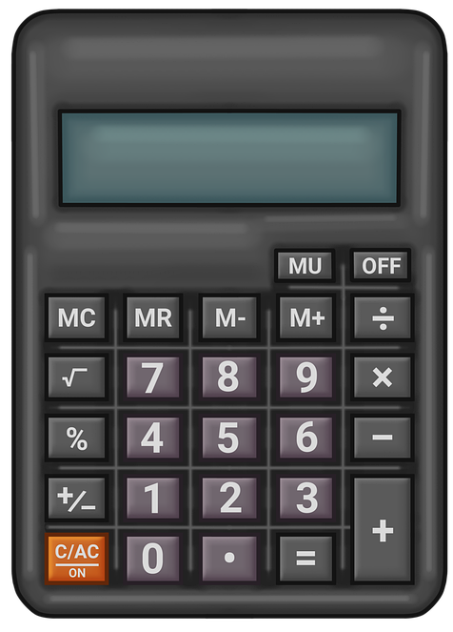
1.4 Significant Figures & Standard Form
Key Q
What is standard form?
Standard form is a system in which numbers are written as a number greater than 1, but less than 10.
740000000
These values are then multiplied by a power of 10 which can either be positive or negative.
For example 740000000 in standard form would be 7.4x10⁸

Slide 9
1.4 Significant Figures & Standard Form
Key Q
What are significant figures?
Giving a number to a specified number of significant figures is a method of rounding.
7.4567
For example 7.4567 to 1 significant figure is 7.
7.4567 to 2 significant figure is 7.5.
While 7.4567 to 3 significant figure is 7.46.

