Slide 1


Paragraphing for Effect
Communication
Although the wind was howling through the trees like wolves chasing their prey, she was not afraid. She knew what she had to do and nothing and no one was going to stop her.
Just let them try.
She brushed aside the reaching branches, determined to make her way through the dense forest.
Tone, style, register
Vocabulary
Structure
Ideas
Paragraphs
Sentences
What do you notice about the paragraphs in this short extract?
How does the use of paragraphs in this extract affect the reader?
Why is paragraphing such a useful tool for affecting a reader? Provide examples.
Punctuation
Grammar
Spelling

Slide 2
Although the wind was howling through the trees like wolves chasing their prey, she was not afraid. She knew what she had to do and nothing and no one was going to stop her.
Just let them try.
She brushed aside the reaching branches, determined to make her way through the dense forest.
The first paragraph helps to build up atmosphere and tone by making the wind seem like it is attacking the character, but we are told she will not be deterred or stopped from what she needs to do.
The second paragraph is just one sentence, but it is powerful because it conveys how focused and determined the character is to carry on.
The next paragraph returns to describing the character’s actions.

Slide 3
Learning outcomes
To describe how we can use paragraphs for effects in stories
To explain different ways of using paragraphs for effect in story writing
To evaluate our use of paragraphing and organisation in our story plans

Slide 4
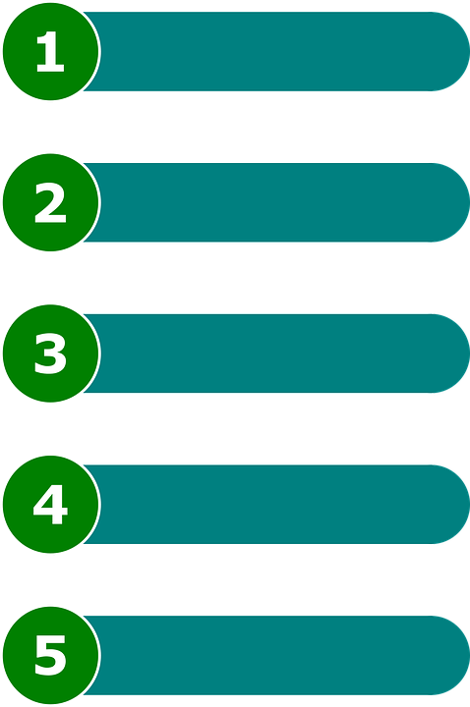
Why is paragraphing important?
Writers use paragraphs to create an order and a structure to their texts.
If texts were one huge mass of writing, then it would be difficult for a reader to break down the ideas presented to them.
However, dividing up a text into smaller sections is useful for a writer and helpful for a reader.

Slide 5

There is an easier way to remember the rules for using paragraphs effectively
We can use the acronym ToPTiPs to help us remember where to put new paragraphs:
New Topic: Whenever you start a new topic, add in a new paragraph.
New Person: Whenever you talk about a new person or have a new person talking, add in a new paragraph.
New Time: Whenever you change the time in your writing (so back to the past or move forwards to the future), you put a new paragraph in.
New Place: Whenever you switch places in a piece of writing, you add in a new paragraph.

Slide 6
It felt like there was something missing. Life was great for me: a decent flat, a job that I enjoyed, I was living in a town full of friendly folk and with my family nearby. I should have been happy, but I’d had this nagging feeling at the back of my mind for a while now. Ultimately, the flat was wonderful but often too quiet.
So now I found myself on the way to the local dog rehoming centre! I’m always filled with a little trepidation when going to these places. They serve a fantastic purpose, but it can be incredibly challenging to see so many saddened and desperate animals, all longing for their own identity with a new owner and a new home. Unsurprisingly, it can be tremendously tough to choose just one animal out of hundreds, but I do believe in some sort of fate, and when you see your future canine, you just know. At least I hoped so.
Based on the outskirts of my hometown, surrounded by countryside and located close to a dairy farm, the air at the home consisted of smells of fertiliser before a wave of doggy odours hits you. Putting together hundreds of dogs together is never going to greet your nose with pleasant fragrances, and the overwhelming ‘eau du parfam’ is made up of urine, defecation, and cheap meat. When you’ve filled in the numerous piles of paper, put your signature on every dotted line, you’re allowed into the enclosures.
Walking in a straight line on a faded concrete floor, I felt like a visitor to a particularly intimidating prison, which in some ways I suppose I was. Going past each cage, the howls and whines increased. Some of the animals barked, others lay down and cried. Honestly, I really wanted to take them all home with me, but I knew that was just a far-fetched fantasy.
Just as I was about to reach the end of the corridor, I noticed a little creature curled up in the corner of their cell. She wasn’t interested in getting my attention, it was as if she was resigned to being bottom of the pile and last in the queue for a new place to live. She was a little Jack Russell-type dog, with a beautiful brown head, a predominantly white body and a large black patch on her back that was shaped similarly to a heart. Was this ordained by some force above? I didn’t know, but I had a good feeling about this one.
As I walked into her cage, she looked up at me for the first time and her tail immediately began to wag. Its speed accelerated, to the point where I was worried she was going to fly off into the air and disappear for good. She jumped up and put her paws on my knees. If I didn’t know better, I’d say she was smiling at me.
We headed out for a stroll amongst the fields and trees around the home. She didn’t pull on her lead, even though she was excited to get out of her enclosure. She was the one for me!
The sun began to head towards the horizon as the daylight was drawing to a close, but what a successful few hours this had been. Having considered giving my new friend a moniker, I went with ‘Lethe’. It’s a bit unusual, isn’t it? It’s the name of a Greek goddess, the goddess of forgotten things, which felt particularly apt for such a beautiful little creature trapped in a prison cell many miles from people.
Finally, I helped her into the back of my car and attached her to the special harness fitted in the back seat. Smiling at Lethe, we drove off, both on our way to our new lives.

Slide 7




The narrator hints at their sadness.
The structure of the story is designed to keep us engaged by building up to the happy ending.
The narrator starts off very sad and offers a pretty miserable description of the dog rescue centre, but when he meets one specific dog, he begins to feel happier.
His happiness only increases towards the end, and the ending shows him now joyful that he has found his new pet.
The narrator visits the local dog centre.
The narrator describes the local dog centre.
The narrator describes the local dog centre.
The narrator notices one specific dog.
The narrator describes meeting the dog.
The narrator walks the dog.
The narrator gives the dog a name.
The narrator and his new dog head home together.

Slide 8
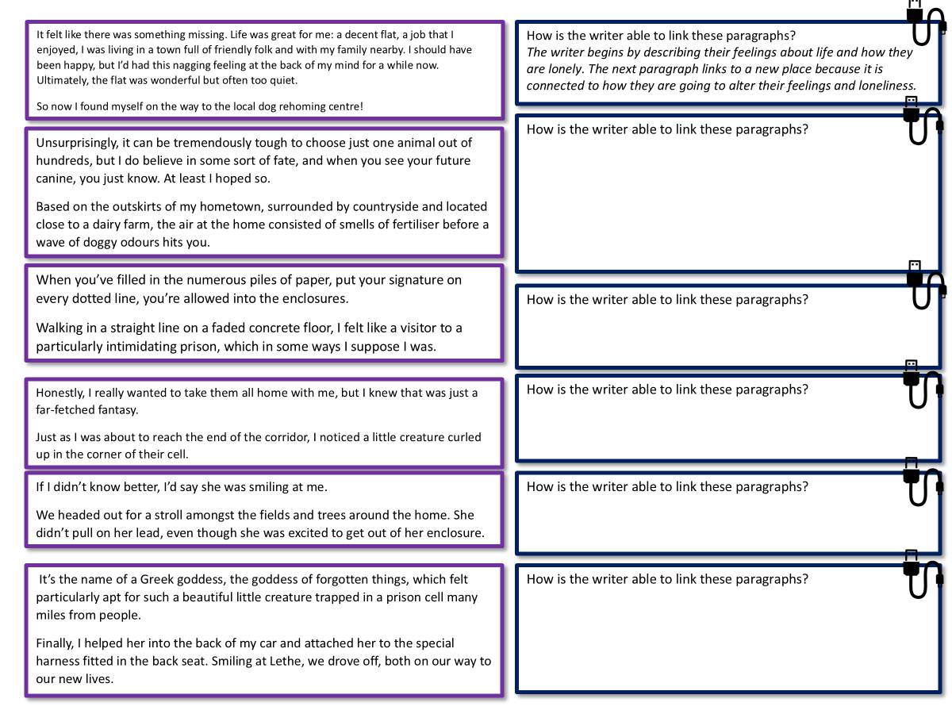
However, being able to make paragraphs ‘seamless’ and ‘flow’ into each other is quite a skill
On your worksheet, explain how the writer is able to link each set of paragraphs together.
Bonus Challenge: Explain how each link may help to affect readers.

Slide 9

It felt like there was something missing. Life was great for me: a decent flat, a job that I enjoyed, I was living in a town full of friendly folk and with my family nearby. I should have been happy, but I’d had this nagging feeling at the back of my mind for a while now. Ultimately, the flat was wonderful but often too quiet.
So now I found myself on the way to the local dog rehoming centre!
How is the writer able to link these paragraphs?
The writer begins by describing their feelings about life and how they are lonely. The next paragraph links to a new place because it is connected to how they are going to alter their feelings and loneliness.
Unsurprisingly, it can be tremendously tough to choose just one animal out of hundreds, but I do believe in some sort of fate, and when you see your future canine, you just know. At least I hoped so.
Based on the outskirts of my hometown, surrounded by countryside and located close to a dairy farm, the air at the home consisted of smells of fertiliser before a wave of doggy odours hits you.
How is the writer able to link these paragraphs?
When you’ve filled in the numerous piles of paper, put your signature on every dotted line, you’re allowed into the enclosures.
Walking in a straight line on a faded concrete floor, I felt like a visitor to a particularly intimidating prison, which in some ways I suppose I was.
How is the writer able to link these paragraphs?
Honestly, I really wanted to take them all home with me, but I knew that was just a far-fetched fantasy.
Just as I was about to reach the end of the corridor, I noticed a little creature curled up in the corner of their cell.
How is the writer able to link these paragraphs?
If I didn’t know better, I’d say she was smiling at me.
We headed out for a stroll amongst the fields and trees around the home. She didn’t pull on her lead, even though she was excited to get out of her enclosure.
How is the writer able to link these paragraphs?
It’s the name of a Greek goddess, the goddess of forgotten things, which felt particularly apt for such a beautiful little creature trapped in a prison cell many miles from people.
Finally, I helped her into the back of my car and attached her to the special harness fitted in the back seat. Smiling at Lethe, we drove off, both on our way to our new lives.
How is the writer able to link these paragraphs?

Slide 10
It felt like there was something missing. Life was great for me: a decent flat, a job that I enjoyed, I was living in a town full of friendly folk and with my family nearby. I should have been happy, but I’d had this nagging feeling at the back of my mind for a while now. Ultimately, the flat was wonderful but often too quiet.
So now I found myself on the way to the local dog rehoming centre!
The writer begins by describing their feelings about life and how they are lonely. The next paragraph links to a new place because it is connected to how they are going to alter their feelings and loneliness.
Unsurprisingly, it can be tremendously tough to choose just one animal out of hundreds, but I do believe in some sort of fate, and when you see your future canine, you just know. At least I hoped so.
Based on the outskirts of my hometown, surrounded by countryside and located close to a dairy farm, the air at the home consisted of smells of fertiliser before a wave of doggy odours hits you.
The writer ended the first paragraph with a blunt short sentence to highlight the character’s sense of doubt about whether they would find a dog that is right for them or not.
The next paragraph then changes to a new place – describing the dog centre and its surroundings. It’s linked to the previous paragraph because the character wants to find a dog at a rescue centre.
When you’ve filled in the numerous piles of paper, put your signature on every dotted line, you’re allowed into the enclosures.
Walking in a straight line on a faded concrete floor, I felt like a visitor to a particularly intimidating prison, which in some ways I suppose I was.
These two paragraphs are linked because the first says you can go into the enclosures after filling in the paperwork, and the next the next describes the narrator walking through the enclosures.

Slide 11
Honestly, I really wanted to take them all home with me, but I knew that was just a far-fetched fantasy.
Just as I was about to reach the end of the corridor, I noticed a little creature curled up in the corner of their cell.
Here the narrator shows their feelings about wanting to rescue all the dogs but knows that is impossible.
They then focus in on one specific dog in the next paragraph.
If I didn’t know better, I’d say she was smiling at me.
We headed out for a stroll amongst the fields and trees around the home. She didn’t pull on her lead, even though she was excited to get out of her enclosure.
The writer describes how the dog seemed to be smiling at the narrator.
The next paragraph sees a change in place as they both go out onto the fields together.
It’s the name of a Greek goddess, the goddess of forgotten things, which felt particularly apt for such a beautiful little creature trapped in a prison cell many miles from people.
Finally, I helped her into the back of my car and attached her to the special harness fitted in the back seat. Smiling at Lethe, we drove off, both on our way to our new lives.
The narrator describes the dog as a beautiful creature trapped in a prison.
The final paragraph then describes the dog being put into the narrator’s car and heading off for freedom.

Slide 12
Revisit your story plan from previous lessons
In the next lesson we will be writing out our final stories that will then be assessed.
Look at how you have planned your story and how you will link your paragraphs together.
Bonus Challenge: Consider whether you could include a one sentence paragraph in your story for effect.
Success criteria
Used ToPTiPs to organise paragraphs
Linked the endings and beginnings of paragraph together
Bonus criterion
Included a one sentence paragraph for effect

Slide 13
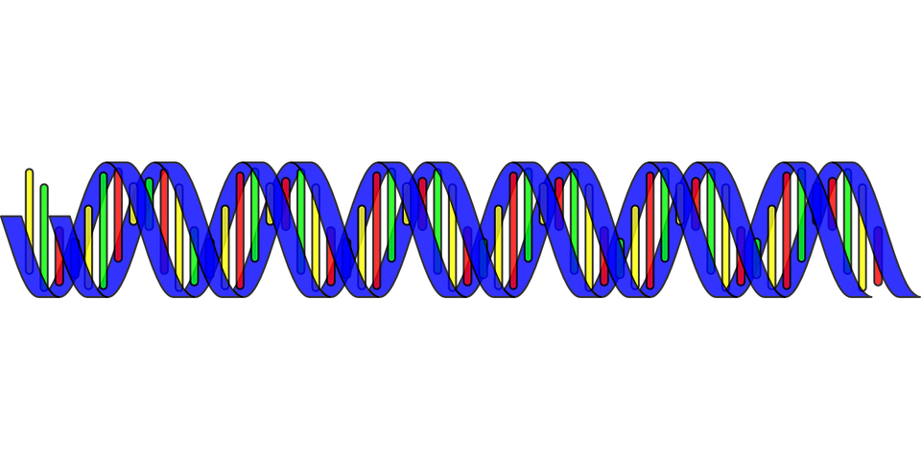
Story Writing doesn’t just involve writing in paragraphs but being able to link and sequence paragraphs together!
The better organised a text is, the more engaging it is for a reader.
The more engaging a text is for a reader, the better the writer you become!

Slide 14

Plenary: PIN peer assessment
Success criteria
Used ToPTiPs to organise paragraphs
Linked the endings and beginnings of paragraph together
Bonus criterion
Included a one sentence paragraph for effect
Using our success criteria, we are now going to PIN peer assess our story plans.
P = Praise
I = Improvement
N = Now – What can the student do right NOW to improve?
To describe how we can use paragraphs for effects in stories
To explain different ways of using paragraphs for effect in story writing
To evaluate our use of paragraphing and organisation in our story plans

