Slide 1

Magazine Article Features
This term we have already explored speeches and writing to argue texts.
We are now focusing on writing magazine articles.
What are the key features of a magazine article that you should include in your exam task answer?
How is a magazine article different to a speech?
Why would a magazine article have a very different audience to a speech and how would this affect the language of the writing? Provide examples.

Slide 2
Learning outcomes
To describe the key features of magazine articles
To explain how these features can help engage an audience
To evaluate the effectiveness of our own headlines and straplines

Slide 3

‘People protest about the cruelty of keeping animals in captivity, but they seem happy enough to eat meat, keep pets and visit zoos. All animals should be free!’
Write an article for a magazine in which you explain your point of view on this
statement.
Writing to Explain
What is it? | Explaining your opinion on a topic to your reader.
What does it involve? | You are not convincing people or advising. You are explaining your perspective on a topic.
What key features do you often find in this type of writing? | Includes facts, opinions, a complex and detailed perspective.
Here are the basic features to include:
a clear/apt/original title
a strapline (heading beneath the main headline)
subheadings
an introductory (overview) paragraph
effectively/fluently sequenced paragraphs.
Article
When you are writing to explain, it is different to writing to argue.
You are explaining your view on a topic, you are not trying to persuade people to agree with you or convince someone about an argument you have.

Slide 4
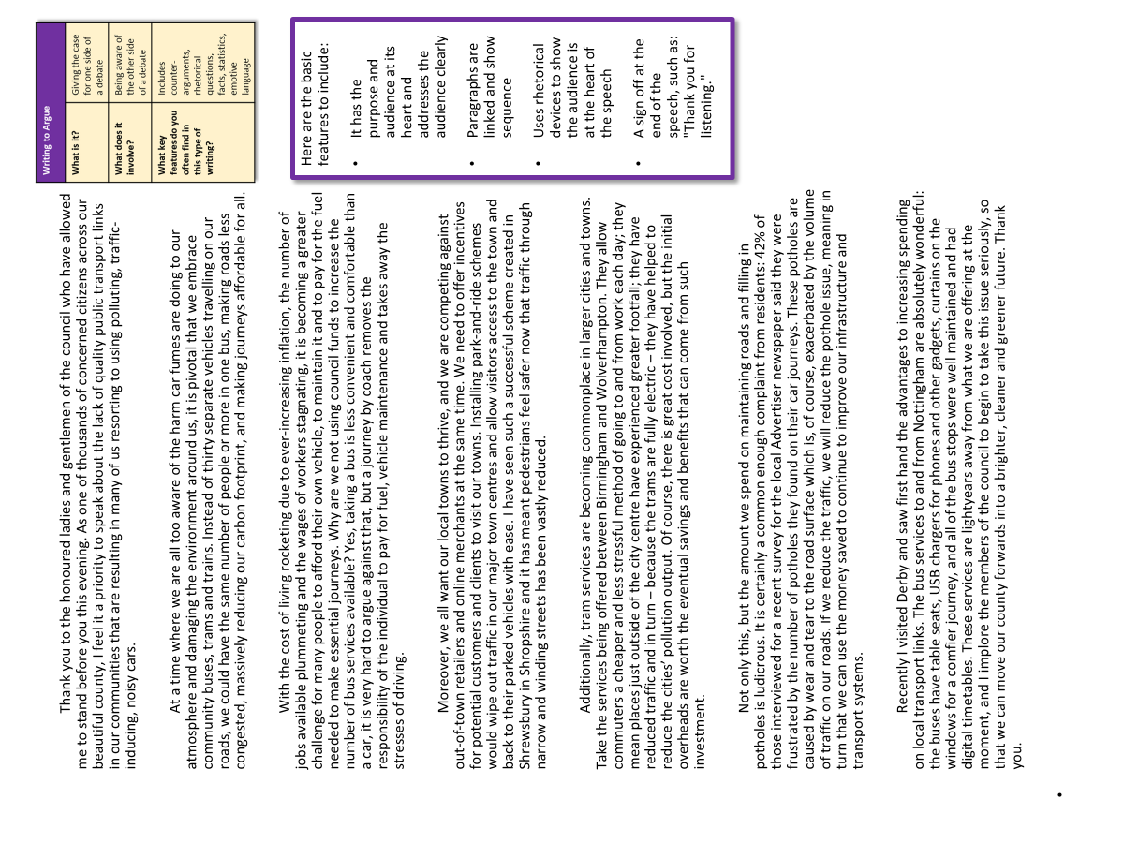
Now, let’s use our learning to analyse an example article
Using your table and your new learning from today’s lesson, work with the person nearest to you to decide:
What makes this a good magazine article?
How does the writer make this a writing to explain piece?
Why does this article meet the requirements of the exam task? Provide examples.

Slide 5
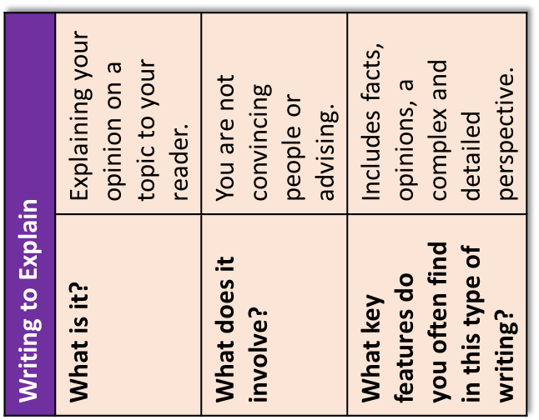
Here are the basic features to include:
a clear/apt/original title
a strapline (heading beneath the main headline)
subheadings
an introductory (overview) paragraph
effectively/fluently sequenced paragraphs.
Zoo You Realise?
It’s time to talk about captivity
Imagine being taken away from all that you know, all those you care for and your entire world as it has been. Imagine being forced to live within walls for the first time, behind bars and limited to eating only what others give you. That is what happens to thousands of animals every year when they are removed from their natural environments and placed into captivity – a less connotative term than ‘prison’.
In some countries, particularly in the US, for instance, animals are held captive for the sake of money. Many of us will be familiar with the recent Netflix documentary that gripped us during 2020: The Tiger King. In this example, Joe Exotic was one of a number of US citizens who have built private zoos and opened them to the public for a fee. The programme highlighted the issues that occur when these businesses are not properly regulated and monitored.
However, captivity is not simply a case of greedy or manipulative business people looking to exploit innocent animals to make a tidy profit. Many zoos across the world are ethically responsible and keep animals for the sake of conservation; if an animal is threatened with extinction because its natural habitat is being wiped out by human influence, then it is only right that humans should take responsibility for preserving and aiding the animals whose lives we have irrevocably damaged.
In one zoo in Birmingham, United Kingdom, there is a door with the sign ‘The Most Dangerous Animal in the World’ on it. When you pull the handle and open to reveal what is on the other side, you discover there is nothing but a mirror. When you consider the impact of human activities such as poaching, deforestation and climate change, that truly is a powerful symbol for all of us.
Therefore, what needs to be addressed is the consistency of conservation work and regulation right across the globe. Children and adults alike both learn so much about the world around them by visiting zoos and seeing the damage human influence can cause to other species, whilst providing different generations the opportunity to reflect on their own behaviours that may be contributing to these issues, such as single-use plastics, using microplastics, and buying palm oil products.
Zoos should not be forms of entertainment for paying customers and opportunistic businesses, but instead charities or non-profit foundations that are there to serve their local communities, aid the ailing animals they house, and educate the wider public about the dangers humans pose to the world around us. Only then can we truly start to feel comfortable and potentially even proud of the work that zoos across the globe carry out each and every day.

Slide 6
Zoo You Realise?
It’s time to talk about captivity
Here are the basic features to include:
a clear/apt/original title
a strapline (heading beneath the main headline)
subheadings
an introductory (overview) paragraph
effectively/fluently sequenced paragraphs.
Imagine being taken away from all that you know, all those you care for and your entire world as it has been. Imagine being forced to live within walls for the first time, behind bars and limited to eating only what others give you. That is what happens to thousands of animals every year when they are removed from their natural environments and placed into captivity – a less connotative term than ‘prison’.
In some countries, particularly in the US, for instance, animals are held captive for the sake of money. Many of us will be familiar with the recent Netflix documentary that gripped us during 2020: The Tiger King. In this example, Joe Exotic was one of a number of US citizens who have built private zoos and opened them to the public for a fee. The programme highlighted the issues that occur when these businesses are not properly regulated and monitored.
Article
The writer has included a title and strapline to engage the audience straight away. The headline is a pun on ‘Do you realise?’ and the strapline uses alliteration “time to talk” and “captivity”. These are designed to hook in the audience in and provide a clue as to what the article will be about.
The first paragraph sets out the writer’s perspective on captivity, explaining that zoos are forms of prisons for animals, and it uses direct address to ask the reader to place themselves in the position of an animal in captivity, thus helping them to understand the writer’s perspective on the treatment of animals.
However, captivity is not simply a case of greedy or manipulative business people looking to exploit innocent animals to make a tidy profit. Many zoos across the world are ethically responsible and keep animals for the sake of conservation; if an animal is threatened with extinction because its natural habitat is being wiped out by human influence, then it is only right that humans should take responsibility for preserving and aiding the animals whose lives we have irrevocably damaged.

Slide 7
Zoo You Realise?
It’s time to talk about captivity
Here are the basic features to include:
a clear/apt/original title
a strapline (heading beneath the main headline)
subheadings
an introductory (overview) paragraph
effectively/fluently sequenced paragraphs.
Imagine being taken away from all that you know, all those you care for and your entire world as it has been. Imagine being forced to live within walls for the first time, behind bars and limited to eating only what others give you. That is what happens to thousands of animals every year when they are removed from their natural environments and placed into captivity – a less connotative term than ‘prison’.
In some countries, particularly in the US, for instance, animals are held captive for the sake of money. Many of us will be familiar with the recent Netflix documentary that gripped us during 2020: The Tiger King. In this example, Joe Exotic was one of a number of US citizens who have built private zoos and opened them to the public for a fee. The programme highlighted the issues that occur when these businesses are not properly regulated and monitored.
Article
The writer links together their ideas through the use of linking sentences and connectives. The end of the introductory paragraph links directly to the second which focuses in on one specific example of animal captivity.
The writer uses the preposition sentence ‘In sone countries’ to allow the paragraphs to flow together.
Next, the writer uses the connective ‘However’ to link the idea of private businesses exploiting animals to zoos that are ethically run to help animals rather than harm them.
However, captivity is not simply a case of greedy or manipulative business people looking to exploit innocent animals to make a tidy profit. Many zoos across the world are ethically responsible and keep animals for the sake of conservation; if an animal is threatened with extinction because its natural habitat is being wiped out by human influence, then it is only right that humans should take responsibility for preserving and aiding the animals whose lives we have irrevocably damaged.

Slide 8
In one zoo in Birmingham, United Kingdom, there is a door with the sign ‘The Most Dangerous Animal in the World’ on it. When you pull the handle and open to reveal what is on the other side, you discover there is nothing but a mirror. When you consider the impact of human activities such as poaching, deforestation and climate change, that truly is a powerful symbol for all of us.
Therefore, what needs to be addressed is the consistency of conservation work and regulation right across the globe. Children and adults alike both learn so much about the world around them by visiting zoos and seeing the damage human influence can cause to other species, whilst providing different generations the opportunity to reflect on their own behaviours that may be contributing to these issues, such as single-use plastics, using microplastics, and buying palm oil products.
Here are the basic features to include:
a clear/apt/original title
a strapline (heading beneath the main headline)
subheadings
an introductory (overview) paragraph
effectively/fluently sequenced paragraphs.
Article
The writer links their paragraphs together uses connectives and linking sentences that allow the sections of the article to flow into each other.
They end the article with an answer to how animal captivity should be perceived: as a way of helping animals who need protecting from the harm humans have done to the world, rather than as a way of making money privately.
Zoos should not be forms of entertainment for paying customers and opportunistic businesses, but instead charities or non-profit foundations that are there to serve their local communities, aid the ailing animals they house, and educate the wider public about the dangers humans pose to the world around us. Only then can we truly start to feel comfortable and potentially even proud of the work that zoos across the globe carry out each and every day.

Slide 9


Creating an effective headline or title
Alliteration: Callous Captivity
Repetition/Anaphora: Change for Good, Change for Animals
Making a huge statement: How we can save the planet
Asking a rhetorical question: What can we do to help our animals?
Using pronouns to engage the reader: Animal welfare is a responsibility for all of us
Emotive language: Our last chance to change
If you’re asked to write magazine article in the exam the question may give you a headline, but sometimes it won’t.
Therefore, you will have to come up with your own.
It needs to be short, to-the-point and sum up all of your ideas that you will write about in your article.
Using these examples, write your headline for your article on animal captivity.
Bonus Challenge: Which of the techniques on the left do you think is the most engaging for an audience and why?

Slide 10


A strapline is a short heading that goes underneath the headline
It provides the reader with a little more information about the purposes and focus of the article and helps to hook them into reading the whole piece.
Callous Captivity
Headline
Strapline
Unless we change our ways now, our animals will be doomed forever
Create a strapline to go with the headline you’ve created in this lesson.
Success criteria:
Short and to-the-point
Adds extra detail for the reader
Sums up what the article is about
You could employ one of these key techniques to engage the reader:
Alliteration
Repetition/Anaphora
Making a huge statement
Asking a rhetorical question
Using pronouns to engage the reader
Emotive language

Slide 11

Swap books with another student
Success criteria
Headline
Short and to-the-point
Uses a language technique to engage the reader
Strapline (below the headline)
Adds extra detail for the reader
Sums up what the article is about
Look at their headline and strapline for their article
What did they do well? Use the success criteria to help you assess this
How could they improve their headline and strapline? Provide examples based on the success criteria

Slide 12
When you write to ‘explain’ your ideas, you’re not arguing for them
This means you are less likely to use techniques such as emotive language or repetition because you are calmly explaining your opinions about a topic, rather than arguing for one side or persuading people to agree with you.
Therefore, the tone of your writing will change as the purpose is about conveying your opinions to the reader, rather than making them think you are correct.

Slide 13
Plenary: Connect Game
Using your new understanding and learning from today’s lesson, work in pairs to ask each other questions from the lesson.
Each correct answer earns a circle on the connect board. You have to get four in a row to win!
To describe the key features of magazine articles
To explain how these features can help engage an audience
To evaluate the effectiveness of our own headlines and straplines

