Slide 1

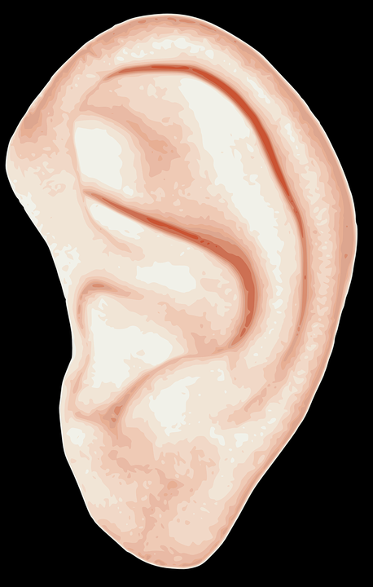
Tone of Writing
You will hear five song clips.
Write the numbers 1-4 in your exercise book.
For each song, how would you describe the tone or sound of the music? For instance, you may find it sad or mysterious.
Explain the choices you made – why did you choose each tone for each song?
Why is it important to think about tone when creating a piece of writing? Provide specific examples.
https://www.youtube.com/playlist?list=PLOJNnC8jXlNkR-zdnfeIZPYD1wEOr2W9W
(Play the first 30 seconds of each song)

Slide 2
Learning outcomes
To describe how tone can impact on a non-fiction text
To analyse how different examples use tone to impact on the audience
To evaluate how we can alter our language to change our tone in our non-fiction writing

Slide 3
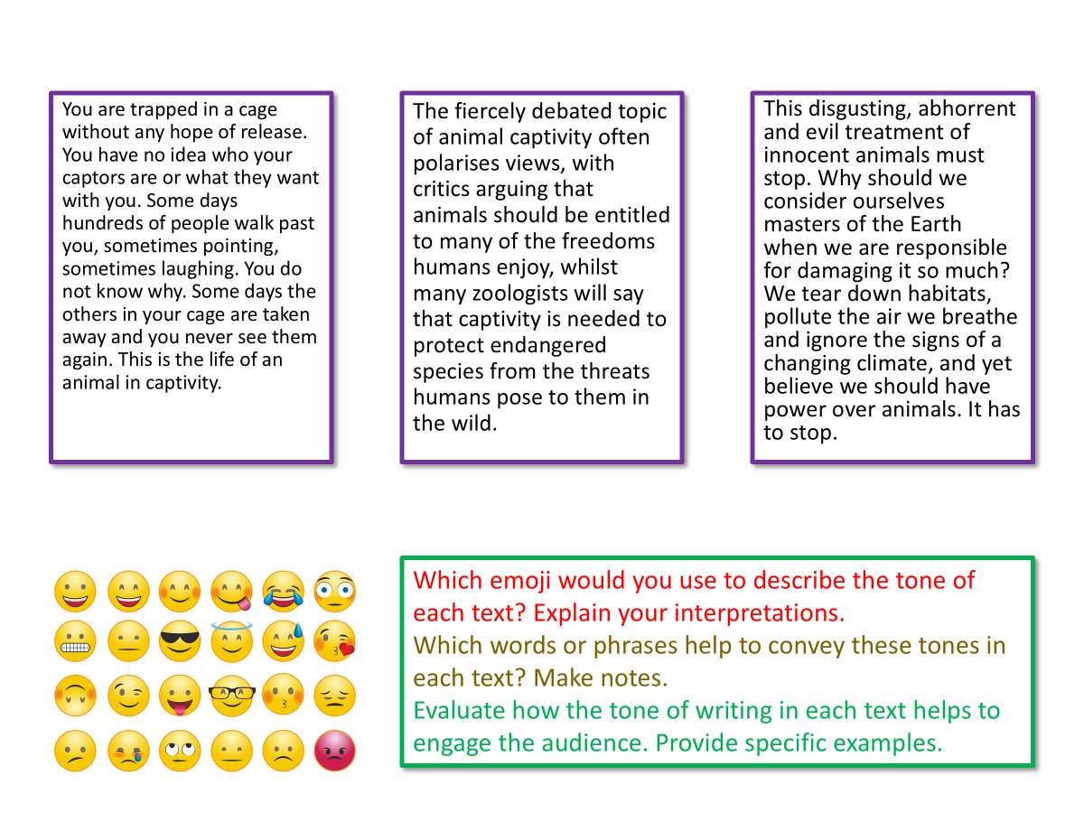
Let’s explore how tone is used in three different texts
Which emoji would you use to describe the tone of each text? Explain your interpretations.
Which words or phrases help to convey these tones in each text? Make notes.
Evaluate how the tone of writing in each text helps to engage the audience. Provide specific examples.

Slide 4
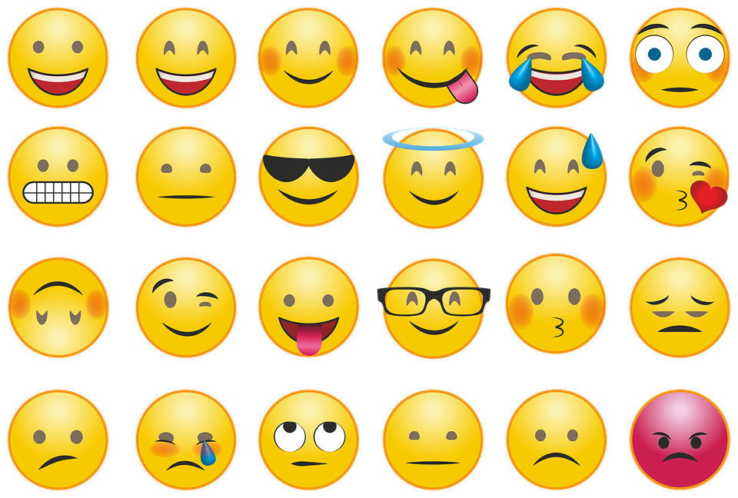
You are trapped in a cage without any hope of release. You have no idea who your captors are or what they want with you. Some days hundreds of people walk past you, sometimes pointing, sometimes laughing. You do not know why. Some days the others in your cage are taken away and you never see them again. This is the life of an animal in captivity.
The fiercely debated topic of animal captivity often polarises views, with critics arguing that animals should be entitled to many of the freedoms humans enjoy, whilst many zoologists will say that captivity is needed to protect endangered species from the threats humans pose to them in the wild.
  This disgusting, abhorrent and evil treatment of innocent animals must stop. Why should we consider ourselves masters of the Earth when we are responsible for damaging it so much? We tear down habitats, pollute the air we breathe and ignore the signs of a changing climate, and yet believe we should have power over animals. It has to stop.
Which emoji would you use to describe the tone of each text? Explain your interpretations.
Which words or phrases help to convey these tones in each text? Make notes.
Evaluate how the tone of writing in each text helps to engage the audience. Provide specific examples.

Slide 5
You are trapped in a cage without any hope of release. You have no idea who your captors are or what they want with you. Some days hundreds of people walk past you, sometimes pointing, sometimes laughing. You do not know why. Some days the others in your cage are taken away and you never see them again. This is the life of an animal in captivity.
The fiercely debated topic of animal captivity often polarises views, with critics arguing that animals should be entitled to many of the freedoms humans enjoy, whilst many zoologists will say that captivity is needed to protect endangered species from the threats humans pose to them in the wild.
  This disgusting, abhorrent and evil treatment of innocent animals must stop. Why should we consider ourselves masters of the Earth when we are responsible for damaging it so much? We tear down habitats, pollute the air we breathe and ignore the signs of a changing climate, and yet believe we should have power over animals. It has to stop.
This example argues that animal captivity is wrong and uses both emotive language and hyperbole to argue this perspective.
The emotive language conveys the writer’s angry and disgusted tone, and the hyperbole helps to emphasise the argument to the audience.
In this example, the writer is explaining the different perspectives and arguments around animal captivity.
So as not to seem biased, they use neutral language to help convey this disconnection from any one perspective, and they provide multiple perspectives to explain the topic rather than argue or persuade.
Finally, in this example the writer is trying to persuade the audience that animal captivity is wrong. They use hyperbole to help reinforce the writer’s opinions to the audience and also uses emotive language to convey their bitterness and resentment towards how people treat animals.

Slide 6
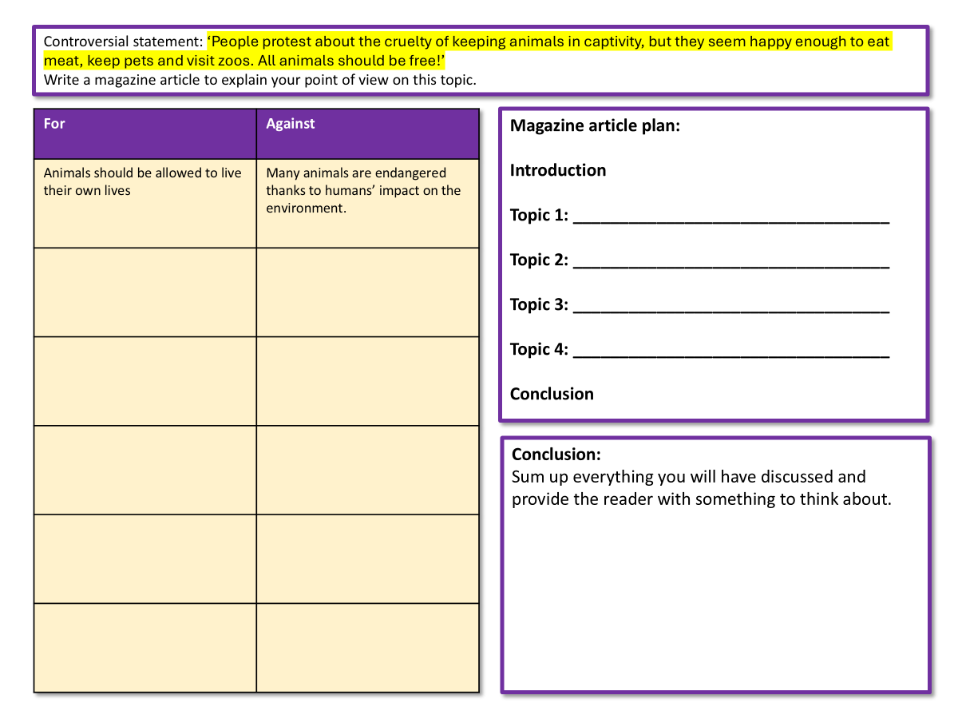
Complete your planning sheet for a magazine article on this topic
Complete the table with different arguments for and against freeing animals from captivity.
Plan out the different topics for your magazine article.
Leave the conclusion section for now.

Slide 7
Controversial statement: ‘People protest about the cruelty of keeping animals in captivity, but they seem happy enough to eat meat, keep pets and visit zoos. All animals should be free!’
Write a magazine article to explain your point of view on this topic.
For | Against
Animals should be allowed to live their own lives | Many animals are endangered thanks to humans’ impact on the environment.
Magazine article plan:
Introduction
Topic 1: __________________________________
Topic 2: __________________________________
Topic 3: __________________________________
Topic 4: __________________________________
Conclusion
Conclusion:
Sum up everything you will have discussed and provide the reader with something to think about.

Slide 8

‘People protest about the cruelty of keeping animals in captivity, but they seem happy enough to eat meat, keep pets and visit zoos. All animals should be free!’
Write an article for a magazine in which you explain your point of view on this
statement.
Write your introduction for this article. Remember that you are writing to explain and not writing to persuade or argue.
Success criteria
Write in a neutral tone that helps to explain your perspective
Set out your perspective on this issue in your introduction.
Remember to vary your sentence openers (-ispaced)
Not sure how to start? Here are some ideas:
It is estimated that up to 6,000,000 animals are held in captivity around the world.
Whilst visiting a zoo can be seen as a harmless form of fun for adults and children, this is far from the case.

Slide 9

How does the writer of the article end their text?
How does the writer end their article?
How does the ending of the article link to the beginning? Why is this important?
Look at the list of strategies. Which one of these has the writer chosen and why?
Zoos should not be forms of entertainment for paying customers and opportunistic businesses, but instead charities or non-profit foundations that are there to serve their local communities, aid the ailing animals they house, and educate the wider public about the dangers humans pose to the world around us. Only then can we truly start to feel comfortable and potentially even proud of the work that zoos across the globe carry out each and every day.
Reiterate or repeat your main arguments
Summarise your main arguments well.
Have you asked the readers a question before? This could provide an answer
Give the readers a challenge. Tell them to think or act in a different way
Think about the future. How does it compare to now?
End the scenario you began with
Circle back to the start with a cyclical structure
End with a powerful quotation
Give a solution to the arguments raised
End with a rhetorical question

Slide 10
How does the writer of the article end their text?
The ending of the article summarises what the writer thinks about animal captivity, but also offers a solution for how zoos should be run. The writer challenges the audience to think about zoos in a different way – as there to help animals and not act as a form of entertain for paying customers.
Zoos should not be forms of entertainment for paying customers and opportunistic businesses, but instead charities or non-profit foundations that are there to serve their local communities, aid the ailing animals they house, and educate the wider public about the dangers humans pose to the world around us. Only then can we truly start to feel comfortable and potentially even proud of the work that zoos across the globe carry out each and every day.
Reiterate or repeat your main arguments
Summarise your main arguments well.
Have you asked the readers a question before? This could provide an answer
Give the readers a challenge. Tell them to think or act in a different way
Think about the future. How does it compare to now?
End the scenario you began with
Circle back to the start with a cyclical structure
End with a powerful quotation
Give a solution to the arguments raised
End with a rhetorical question

Slide 11
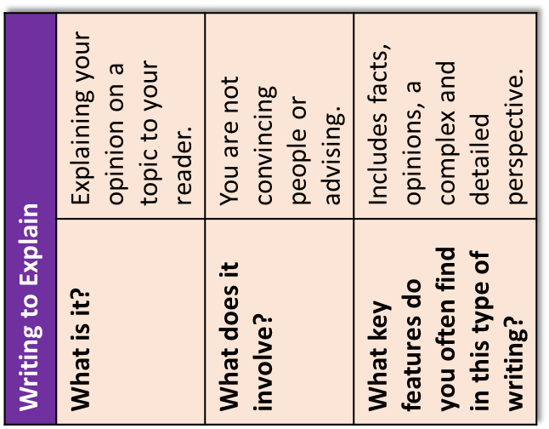
Here are the basic features to include:
a clear/apt/original title
a strapline (heading beneath the main headline)
subheadings
an introductory (overview) paragraph
effectively/fluently sequenced paragraphs.
Zoo You Realise?
It’s time to talk about captivity
Imagine being taken away from all that you know, all those you care for and your entire world as it has been. Imagine being forced to live within walls for the first time, behind bars and limited to eating only what others give you. That is what happens to thousands of animals every year when they are removed from their natural environments and placed into captivity – a less connotative term than ‘prison’.
In some countries, particularly in the US, for instance, animals are held captive for the sake of money. Many of us will be familiar with the recent Netflix documentary that gripped us during 2020: The Tiger King. In this example, Joe Exotic was one of a number of US citizens who have built private zoos and opened them to the public for a fee. The programme highlighted the issues that occur when these businesses are not properly regulated and monitored.
However, captivity is not simply a case of greedy or manipulative business people looking to exploit innocent animals to make a tidy profit. Many zoos across the world are ethically responsible and keep animals for the sake of conservation; if an animal is threatened with extinction because its natural habitat is being wiped out by human influence, then it is only right that humans should take responsibility for preserving and aiding the animals whose lives we have irrevocably damaged.
In one zoo in Birmingham, United Kingdom, there is a door with the sign ‘The Most Dangerous Animal in the World’ on it. When you pull the handle and open to reveal what is on the other side, you discover there is nothing but a mirror. When you consider the impact of human activities such as poaching, deforestation and climate change, that truly is a powerful symbol for all of us.
Therefore, what needs to be addressed is the consistency of conservation work and regulation right across the globe. Children and adults alike both learn so much about the world around them by visiting zoos and seeing the damage human influence can cause to other species, whilst providing different generations the opportunity to reflect on their own behaviours that may be contributing to these issues, such as single-use plastics, using microplastics, and buying palm oil products.
Zoos should not be forms of entertainment for paying customers and opportunistic businesses, but instead charities or non-profit foundations that are there to serve their local communities, aid the ailing animals they house, and educate the wider public about the dangers humans pose to the world around us. Only then can we truly start to feel comfortable and potentially even proud of the work that zoos across the globe carry out each and every day.

Slide 12
Complete your planning sheet for a magazine article on this topic
Now complete the conclusion section of the worksheet.

Slide 13
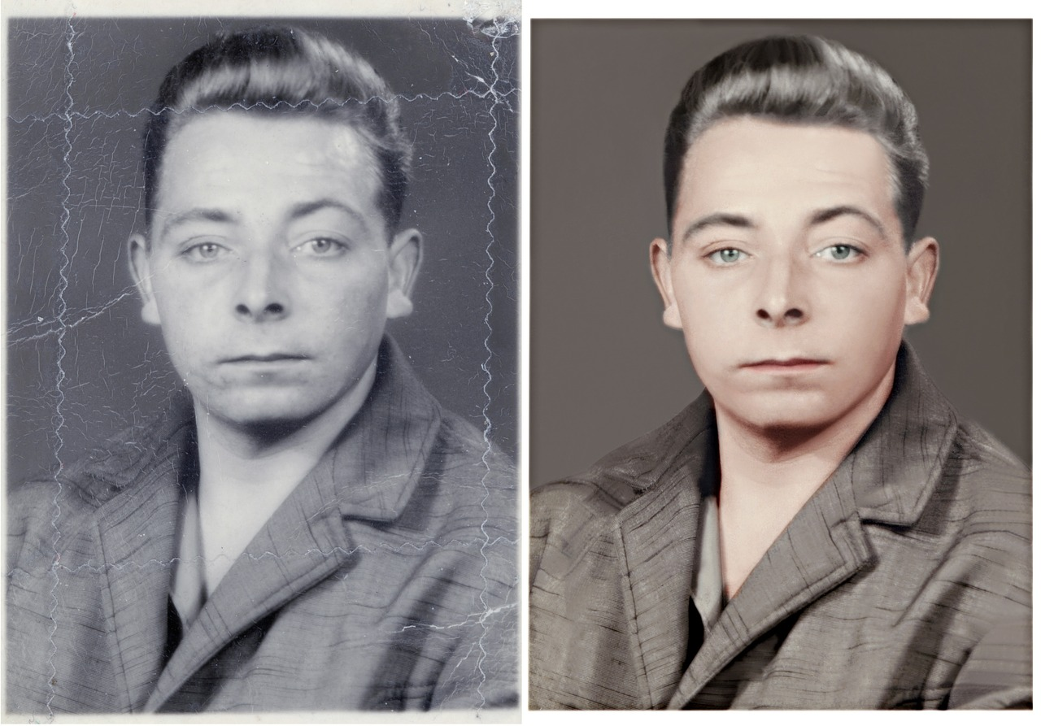
Plenary: Before And After
Think about what you knew about letter writing at the start of the lesson and what you know now.
What has changed? Why?
To describe how tone can impact on a non-fiction text
To analyse how different examples use tone to impact on the audience
To evaluate how we can alter our language to change our tone in our non-fiction writing

