Slide 1
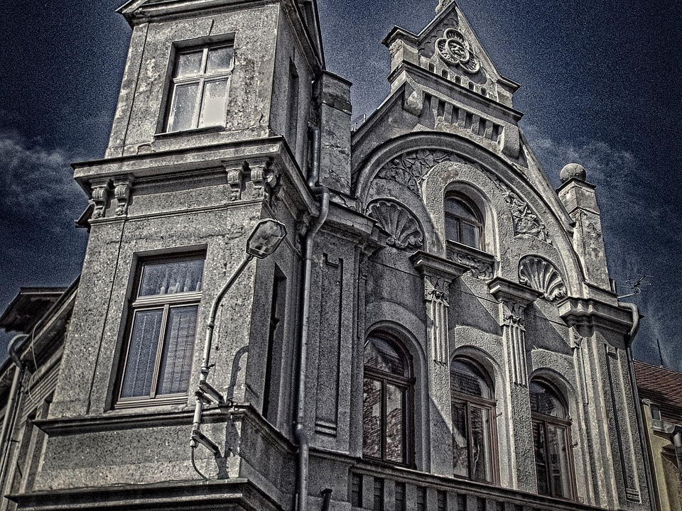

Understanding Genre
Look at this house.
What kind of story would be set here?
Why would this kind of story be set here?
What other characters, objects, themes or places would you expect to see in this kind of story?
Key term: Genre – A style or category of art, literature or film. Each type has different conventions.

Slide 2
You would most likely find this kind of setting in a horror story or a Gothic story.
Stories are categorised into genres by the key conventions they include, such as settings, objects, character types, themes and plot events.

Slide 3

Learning outcomes
To describe genre and key conventions of different genres
To explain how genre can impact on a reader or audience
To evaluate how a text uses genre conventions to affect its readers

Slide 4

Let’s analyse different genres:
Action/Adventure
Crime/Detective Fiction
Comedy
Fable
Fairy tale
Fantasy
Historical fiction
Horror
Mystery
Science fiction
Suspense/Thriller
Tragedy
Choose one of these genres that you know well.
What objects, characters and settings would you expect to see in each genre?
What ideas or themes would you expect to see in each genre? Example: Violence in horror texts
Why would you expect to see these ideas or objects in this genre? Example: I expect to see violence in a horror text because the writer wants to terrify and disgust the reader
Key term: Genre – A style or category of art, literature or film. Each type has different conventions.

Slide 5


Action
Car chases
Fighting
Gunplay or shootouts
Similar to thriller and adventure, can sometimes can spy fiction.
Horror
Set in towns or cities, dark streets and narrow alleyways, or abandoned houses, barns, farms
Can use dark colours like red and black (to represent evil, blood and danger)
Usually have some sort of monster or supernatural being
Can have a main protagonist that is a hero or victim
Often have stupid or immoral teenagers that get killed
Police officers
Often end in a terrifying and shocking finale
Crime Fiction
Conflict and suspense coming from it
Time - They have a time frame in which suspense is built over it
Red herrings - Clues that aren't relevant to solving the crime
Foreshadowing - Hints at what is to come
Strong characters in conflict with each other
Usually a protagonist as a kind of hero with a nemesis or enemy that is their equal.
Fables
Animals and plants that are anthropomorphized or talk and act like humans
Legendary creatures
Plants, inanimate
Usually leads to a moral lesson
Comedy
Can contain slapstick or physical comedy
Designed to make people laugh and be entertained
Exaggerated characters either good or bad
Comedic situations are engineered which are often unlikely or exaggerated
Usually have happy endings for the good characters and not so happy for the bad characters
Fairy Tale
Folklore characters (Fairies, goblins, elves, trolls, witches, giants, talking animals)
Magic
Can begin with 'Once upon a time' and end with 'And they lived happily ever after'
Sometimes there is a surprise ending or a twist
Contains royalty and poor characters
Usually has an evil character and a very good character
Fantasy
Magic
Supernatural events
Imagined monsters and creatures
Worlds very different to our own
Can contain characters from myths
Historical Fiction
It reconstructs past events
It is usually inspired by real events from the past
Writers will end in their own elements which is why it is fiction and not non-fiction
Notes:
Useful for students to have as notes in their exercise book and to refer to for the rest of the lesson

Slide 6

Mystery
A strong hook at the beginning to engage the reader
Red herrings - Clues that aren't helpful or relevant
Building suspense and tension
Similar to crime fiction
Science Fiction
Stories that talk about science and technology of the future
Usually set in a futuristic world different from our own because of advances in science and technology
Usually questions the morality of our own world by showing the advantages and disadvantages of the growing power of science and technology
Can contain aliens, monsters, time travel, space and look at both utopias and dystopias
Thriller
Covering-up important information
Red herrings
Plot twists
Cliffhangers
Usually driven by a villain
A hero must thwart or stop the villain
Contains suspense, excitement, surprise, anxiety and anticipation
Tragedy
Serious plot
Main protagonist can be a hero but often has a 'flaw' that leads to their downfall
Looks at moral weakness and issues, social pressures and having to conform to them
Usually has a sad ending that can include loss and death
Can contains villains or antagonists that can sometimes succeed
There are literally hundreds of genres and sub-genres out there. Each of the genres listed here have many more sub-genres which are combinations of other genres.
Genre is all about being able to categorise different types of media (books, films, music, etc) into different areas.

Slide 7

You are marked out of 24 marks for AO5
AO5 Content and organisation
Communicate clearly, effectively and imaginatively, selecting and adapting tone, style and register for different forms, purposes and audiences.
Organise information and ideas, using structural and grammatical features to support coherence and cohesion of texts.

Slide 8

We’ll watch two short trailers to two films
Dracula: https://www.youtube.com/watch?v=VoaMw91MC9k
Hotel Transylvania: https://www.youtube.com/watch?v=FYgzizpCTKU
 | Dracula | Hotel Transylvania
What do you notice about the music? | The scary music helps to make the film full of suspense at the start.
What tone/atmosphere is built?
What type of characters do you see?
What is the aim of this film?
How does ‘Hotel Transylvania’ combine the conventions of ‘comedy’ and ‘horror’?
Why do you think the writers of the film chose to do this? How does this film make the audience feel?
Notes:
For KS3 students

Slide 9
Let’s explore how the two films use genre conventions
Dracula is a horror film, and it was designed to scare audiences from which they derive entertainment (a ‘pleasing terror’).
It contains many horror conventions such as monsters, specific character types, dark and mysterious settings, conflict between humans and monsters, archaic objects and so on.
Hotel Transylvania takes many horror conventions (character types, the supernatural, monsters, dark and mysterious settings, conflict between humans and monsters) and combines them with comedic conventions (slapstick or physical comedy; designed to make people laugh and be entertained; exaggerated characters either good or bad; comedic situations are engineered which are often unlikely or exaggerated; usually have happy endings for the good characters and not so happy for the bad characters).
It is also designed to appeal to children, and so there is little in the way of violence, it has clear moral messages, it has some toilet humour and it is fun!

Slide 10
We’ll watch two short trailers to two films
28 Days Later: https://www.youtube.com/watch?v=FcDhdb6J3rM
Zombieland:
https://www.youtube.com/watch?v=w8faZ9LRors
 | 28 Days Later | Zombieland
What do you notice about the music?
What tone/atmosphere is built?
What type of characters do you see?
What is the aim of this film?
How does ‘Zombieland’ combine the conventions of ‘comedy’ and ‘horror’?
Why do you think the writers of the film chose to do this? How does this film make the audience feel?
Notes:
For KS4 students

Slide 11
Let’s explore how the two films use genre conventions
28 Days Later is a horror film, but it is also a zombie film. Zombie films have become incredibly popular in the later 20th and early 21st centuries.
28 Days Later twists some conventions because zombies don’t usually run – they walk slowly and menacingly. Making the zombies run as fast as the characters add greater tension and fear.
28 Days Later is also uses some science fiction conventions as the ‘zombies’ are infected by an engineered virus.
Zombieland uses horror genre conventions such as zombies, end-of-the-world settings and plot events and conflict between characters and monsters, but it also uses comedic conventions.
In Zombieland, a small group of survivors battle the monsters, and they use slapstick or physical comedy; it is designed to make people laugh and be entertained; exaggerated characters either good or bad; comedic situations are engineered which are often unlikely or exaggerated; usually have happy endings for the good characters and not so happy for the bad characters).

Slide 12

It’s important to consider genre in a text to see if it sticks to genre conventions or not.
Writers use conventions to help a text stay in a particular genre, e.g. horror, romance, science fiction, etc.
However, a writer can also go against these conventions to surprise, shock or humour their readers.

Slide 13
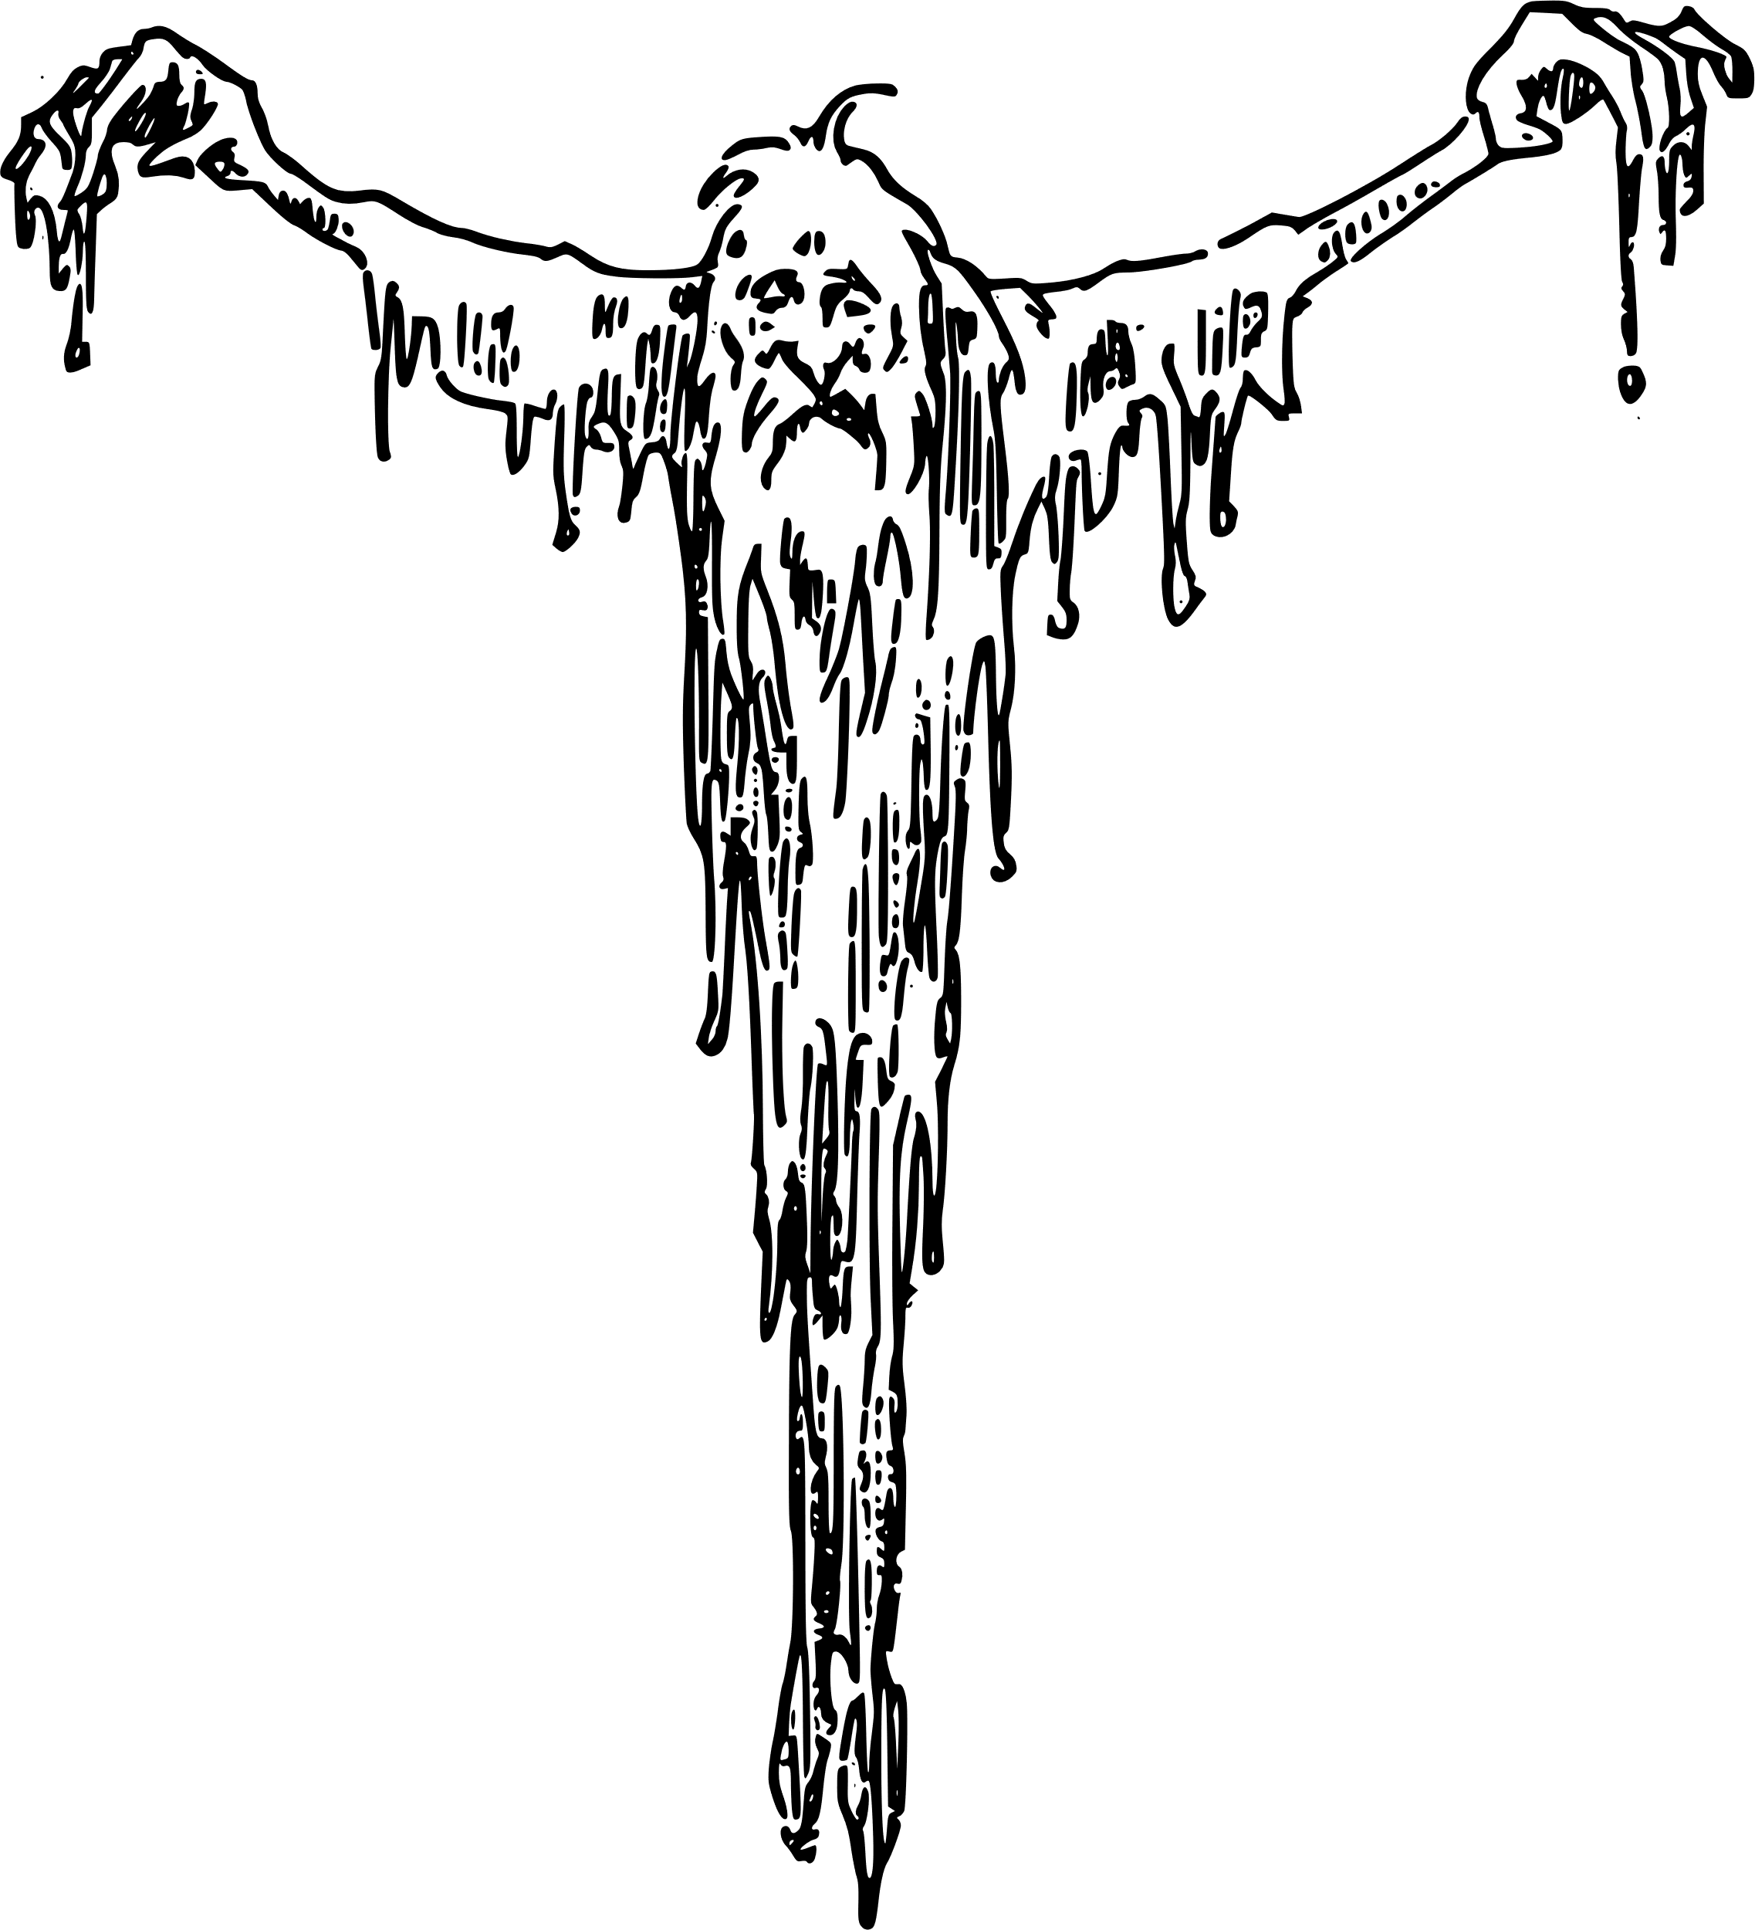
Let’s look at a short extract from a narrative
“I can assure you,” said I, “that it will take a very tangible ghost to frighten me.” And I stood up before the fire with my glass in my hand.
“It is your own choosing,” said the man with the withered arm, and glanced at me askance.
“Eight-and-twenty years,” said I, “I have lived, and never a ghost have I seen as yet.”
The old woman sat staring hard into the fire, her pale eyes wide open. “Ay,” she broke in; “and eight-and-twenty years you have lived and never seen the likes of this house, I reckon. There’s a many things to see, when one’s still but eight-and-twenty.” She swayed her head slowly from side to side. “A many things to see and sorrow for.”
What parts of this story suggest that it is a ghost story?
Look at the last paragraph carefully. What do you think is likely to happen next if this is a ghost story? Why?
How does the writer set up this story using genre conventions to engage the reader?

Slide 14
“I can assure you,” said I, “that it will take a very tangible ghost to frighten me.” And I stood up before the fire with my glass in my hand.
“It is your own choosing,” said the man with the withered arm, and glanced at me askance.
“Eight-and-twenty years,” said I, “I have lived, and never a ghost have I seen as yet.”
The old woman sat staring hard into the fire, her pale eyes wide open. “Ay,” she broke in; “and eight-and-twenty years you have lived and never seen the likes of this house, I reckon. There’s a many things to see, when one’s still but eight-and-twenty.” She swayed her head slowly from side to side. “A many things to see and sorrow for.”
Some ghost story conventions:
Suspense
Fear
Atmosphere
The Supernatural
Psychology
Disturbing settings
Revenge
Justice
Use of the five senses for tension
Victims
Tragic events from the past
Unusual characters
We have a confident protagonist who does not believe in ghosts because he is 28 and has never seen one. The man and the old woman are critical of him and seem full of fear, reflected in their serious natures. The man has a withered arm which may hint at previous tragedy, whilst he looks at the protagonist with askance or deep suspicion.
The old woman stares into the fire and eyes are wide open, which suggests she too has experienced tragedy in the past. Her movements are also unusual and add to the building sense of tension.

Slide 15
Consider how you will use genre conventions in your own story
AO5 Content and organisation
Communicate clearly, effectively and imaginatively, selecting and adapting tone, style and register for different forms, purposes and audiences.
Organise information and ideas, using structural and grammatical features to support coherence and cohesion of texts.
If you have a favourite genre then it may be useful to base your story for the exam question around that.
It doesn’t have to be books: you may be interested in films or television programmes within a specific genre.
Use your knowledge of genre conventions to help give your writing a consistent tone and style that will impress the examiners.

Slide 16

Plenary: My Word
Choose a word to describe your learning from this lesson.
You will then choose a student to explain how it relates to the learning.
Be prepared to share your ideas.
To describe genre and key conventions of different genres
To explain how genre can impact on a reader or audience
To evaluate how a text uses genre conventions to affect its readers

