Slide 1



AQA English Language Paper 2 Section B: Sentences
Imagine being taken away from all that you know, all those you care for and your entire world as it has been. Imagine being forced to live within walls for the first time, behind bars and limited to eating only what others give you. That is what happens to thousands of animals every year when they are removed from their natural environments and placed into captivity – a less connotative term than ‘prison’.
Today we are going to explore how we can use our sentence structures to create effects and impact an audience.
Read this short extract from an example non-fiction article.
What do you notice about how the sentences start?
How is the final sentence different to the others?
Why do these sentence structures engage us as an audience? Provide examples.
Sentences
Effects

Slide 2
Learning outcomes
To describe how we can vary sentences for effect
To analyse how sentence types can affect an audience
To evaluate the use of sentence openers and types in an example article

Slide 3
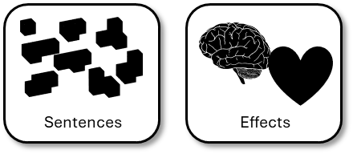
The first two sentences use the same structure
Repeating the same structures of sentences is called anaphora. It helps to reiterate an idea. Here the writer is trying to emphasise how terrifying it can be for wild animals to be held in captivity.
The first two sentences are complex sentences that are designed to provide a vivid analogy of what it is like for animals in captivity by making the audience consider what it would be like for them.
Imagine being taken away from all that you know, all those you care for and your entire world as it has been. Imagine being forced to live within walls for the first time, behind bars and limited to eating only what others give you. That is what happens to thousands of animals every year when they are removed from their natural environments and placed into captivity – a less connotative term than ‘prison’.
The third sentence is different, but it is used to emphasise the point that animals in captivity have to go through these experiences.
The writer uses a dash before the last clause to convey how animals in captivity could be seen as a form of prison.

Slide 4
‘People protest about the cruelty of keeping animals in captivity, but they seem happy enough to eat meat, keep pets and visit zoos. All animals should be free!’
Write an article for a magazine in which you explain your point of view on this
statement.
(24 marks for content and organisation
16 marks for technical accuracy)
[40 marks]
Discuss: What are the text type, purpose and audience for this task?
Bonus Challenge: Which key features would you need to include in your writing piece?

Slide 5

‘People protest about the cruelty of keeping animals in captivity, but they seem happy enough to eat meat, keep pets and visit zoos. All animals should be free!’
Write an article for a magazine in which you explain your point of view on this
statement.
Writing to Explain
What is it? | Explaining your opinion on a topic to your reader.
What does it involve? | You are not convincing people or advising.
What key features do you often find in this type of writing? | Includes facts, opinions, a complex and detailed perspective.
Here are the basic features to include:
a clear/apt/original title
a strapline (heading beneath the main headline)
subheadings
an introductory (overview) paragraph
effectively/fluently sequenced paragraphs.
Article
When you are writing to explain, it is different to writing to argue.
You are explaining your view on a topic, you are not trying to persuade people to agree with you or convince someone about an argument you have.

Slide 6
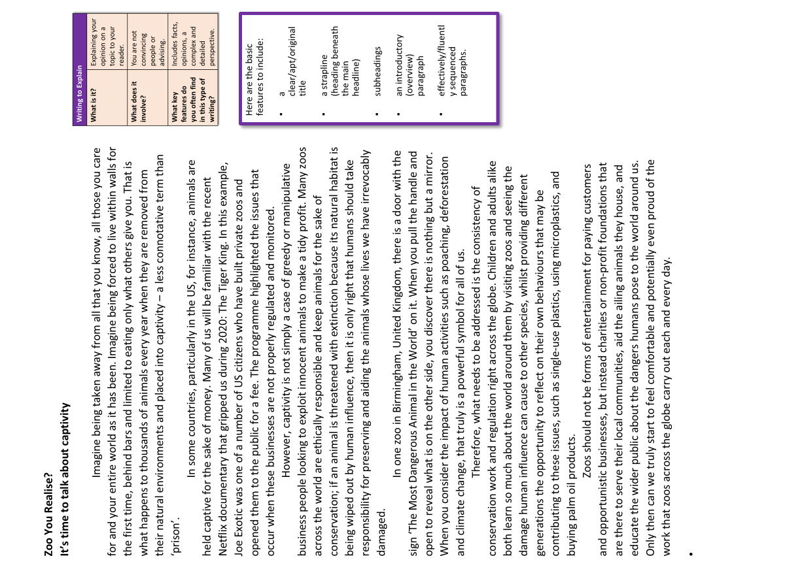
Now, let’s use our learning to analyse an example article
Using iSpaced and the information sheet given to you:
What types of sentence starters does the writer use?
How do these sentence starters help to engage the audience?
Why do these sentence starters help to meet the purpose of the article? Provide examples.
-ing sentence openers
Simile sentence openers
Preposition sentence openers
Adverbial sentence openers
Connective sentence openers
-ed sentence openers
Dialogue sentence openers

Slide 7
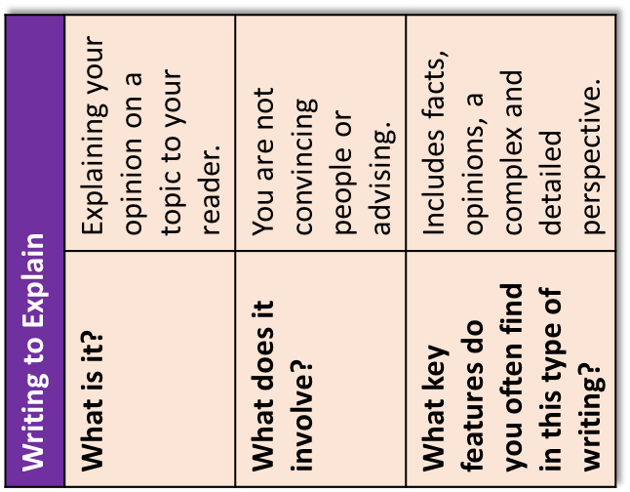
Here are the basic features to include:
a clear/apt/original title
a strapline (heading beneath the main headline)
subheadings
an introductory (overview) paragraph
effectively/fluently sequenced paragraphs.
Zoo You Realise?
It’s time to talk about captivity
Imagine being taken away from all that you know, all those you care for and your entire world as it has been. Imagine being forced to live within walls for the first time, behind bars and limited to eating only what others give you. That is what happens to thousands of animals every year when they are removed from their natural environments and placed into captivity – a less connotative term than ‘prison’.
In some countries, particularly in the US, for instance, animals are held captive for the sake of money. Many of us will be familiar with the recent Netflix documentary that gripped us during 2020: The Tiger King. In this example, Joe Exotic was one of a number of US citizens who have built private zoos and opened them to the public for a fee. The programme highlighted the issues that occur when these businesses are not properly regulated and monitored.
However, captivity is not simply a case of greedy or manipulative business people looking to exploit innocent animals to make a tidy profit. Many zoos across the world are ethically responsible and keep animals for the sake of conservation; if an animal is threatened with extinction because its natural habitat is being wiped out by human influence, then it is only right that humans should take responsibility for preserving and aiding the animals whose lives we have irrevocably damaged.
In one zoo in Birmingham, United Kingdom, there is a door with the sign ‘The Most Dangerous Animal in the World’ on it. When you pull the handle and open to reveal what is on the other side, you discover there is nothing but a mirror. When you consider the impact of human activities such as poaching, deforestation and climate change, that truly is a powerful symbol for all of us.
Therefore, what needs to be addressed is the consistency of conservation work and regulation right across the globe. Children and adults alike both learn so much about the world around them by visiting zoos and seeing the damage human influence can cause to other species, whilst providing different generations the opportunity to reflect on their own behaviours that may be contributing to these issues, such as single-use plastics, using microplastics, and buying palm oil products.
Zoos should not be forms of entertainment for paying customers and opportunistic businesses, but instead charities or non-profit foundations that are there to serve their local communities, aid the ailing animals they house, and educate the wider public about the dangers humans pose to the world around us. Only then can we truly start to feel comfortable and potentially even proud of the work that zoos across the globe carry out each and every day.

Slide 8
-ing sentence openers
  Considering his future, he went to the Careers Advisor
  During the evening, it snowed heavily.
  Shouting, she ran away from the ghost.
Simile sentence openers
  As fast as a cheetah, he made his escape.
  Like a fish in the sea, she swam across the water.
Preposition sentence openers
  At the end of the evening, they returned home.
  Through the streets of Birmingham, there are thousands of shops.
  Inside the cupboard, it was dark and scary.
Adverbial sentence openers
  Quickly, he packed his bag for school.
  Silently, she read the book in the Library.
  Surprisingly, no one was in the classroom.
Connective sentence openers
  Although you worked hard today, it wasn’t quite enough for a merit.
  However, I will say well done for your effort.
  Despite his disappointment, the student kept smiling.
-ed sentence openers
  Disguised in her costume, she was a hit at Halloween
  Shocked by the score, the football team gave up.
  Challenged to a staring contest, the student reluctantly agreed.
Dialogue sentence openers
  “You can start a sentence with dialogue!” shouted the teacher.
  “That is amazing,” said the student, “I didn’t realise that!”
iSpaced!

Slide 9
Imagine being taken away from all that you know, all those you care for and your entire world as it has been. Imagine being forced to live within walls for the first time, behind bars and limited to eating only what others give you. That is what happens to thousands of animals every year when they are removed from their natural environments and placed into captivity – a less connotative term than ‘prison’.
In some countries, particularly in the US, for instance, animals are held captive for the sake of money. Many of us will be familiar with the recent Netflix documentary that gripped us during 2020: The Tiger King. In this example, Joe Exotic was one of a number of US citizens who have built private zoos and opened them to the public for a fee. The programme highlighted the issues that occur when these businesses are not properly regulated and monitored.
Preposition sentence opener
Connective sentence opener
The writer tries to vary their sentence openers as much as possible to engage their audience and explain their perspective in lots of detail.
We can see both preposition sentence openers and connective sentence openers being used. We explored connectives previously and saw how they can be used to link ideas together.
Using different sentence openers gives the writer a professional tone and highlights how they have organised their ideas carefully and coherently.
However, captivity is not simply a case of greedy or manipulative business people looking to exploit innocent animals to make a tidy profit. Many zoos across the world are ethically responsible and keep animals for the sake of conservation; if an animal is threatened with extinction because its natural habitat is being wiped out by human influence, then it is only right that humans should take responsibility for preserving and aiding the animals whose lives we have irrevocably damaged.
In one zoo in Birmingham, United Kingdom, there is a door with the sign ‘The Most Dangerous Animal in the World’ on it. When you pull the handle and open to reveal what is on the other side, you discover there is nothing but a mirror. When you consider the impact of human activities such as poaching, deforestation and climate change, that truly is a powerful symbol for all of us.

Slide 10
Therefore, what needs to be addressed is the consistency of conservation work and regulation right across the globe. Children and adults alike both learn so much about the world around them by visiting zoos and seeing the damage human influence can cause to other species, whilst providing different generations the opportunity to reflect on their own behaviours that may be contributing to these issues, such as single-use plastics, using microplastics, and buying palm oil products.
Zoos should not be forms of entertainment for paying customers and opportunistic businesses, but instead charities or non-profit foundations that are there to serve their local communities, aid the ailing animals they house, and educate the wider public about the dangers humans pose to the world around us. Only then can we truly start to feel comfortable and potentially even proud of the work that zoos across the globe carry out each and every day.
Preposition sentence opener
Connective sentence opener
Adverbial sentence opener
The writer tries to vary their sentence openers as much as possible to engage their audience and explain their perspective in lots of detail.
We can see both preposition sentence openers and connective sentence openers being used. We explored connectives previously and saw how they can be used to link ideas together.
Using different sentence openers gives the writer a professional tone and highlights how they have organised their ideas carefully and coherently.

Slide 11



Sentences have effects on a reader
Using different sentence types, sentence openers and sentence structures all affect how an audience understands your writing.
These effects all impact on the organisation of your non-fiction text, your communication, your use of tone and the style of your writing.
That is why it is crucial to think carefully about how you use your sentences in your non-fiction writing.

Slide 12
You can also use different sentence types to engage your readers
Read the example article we have been analysing again.
Find and annotate (label) at least one simple sentence, one compound sentence and one complex sentence.
Bonus Challenge: Explain how the use of these different sentence types creates effects for the audience.

Slide 13

Simple sentences have only one verb. They can be quite short.
Compound sentences:
these are two or more simple sentences joined by words like ‘for’ ‘and’, ‘nor, ‘but’, ‘or’, ‘yet’, ‘so’ (these are called conjunctions).
Complex sentences:
These are sentences that have more than one verb
They have more than one clause (part)
They can use connectives
They can use ‘ing’ or ‘ed’ verbs at the beginning.
Joe works hard.
Molly whispered to Isabelle.
Miss Smith asked for silence.
Boris plays the keyboard.
Caitlin likes reading.
Joe works hard and enjoys English lessons.
Miss Smith asked for silence but Molly whispered to Isabelle.
Connectives:
because,
whenever,
despite,
even though,
however,
although, whilst,
until, before,
after
Running towards the ball, Matt tripped.
Despite not feeling confident, Gertrude did well in the assessment.

Slide 14
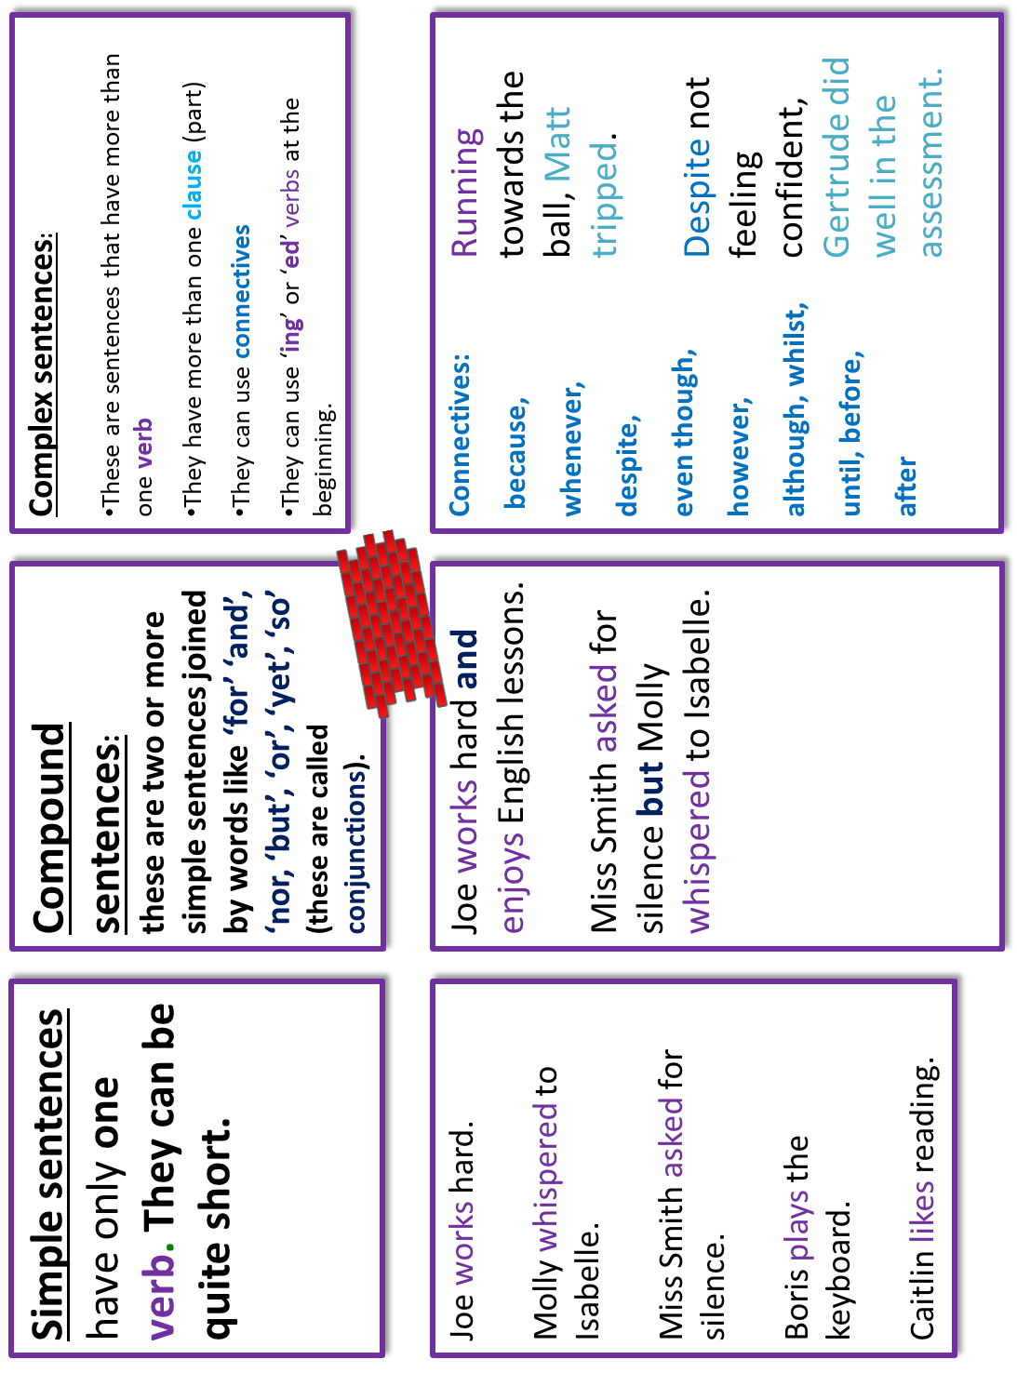

Slide 15
The programme highlighted the issues that occur when these businesses are not properly regulated and monitored.
This complex sentence helps to convey how concerned the writer is about the issues with captivity.
When you pull the handle and open to reveal what is on the other side, you discover there is nothing but a mirror.
This complex sentence is used to reveal what is behind the door and why it is important in terms of captivity.
Therefore, what needs to be addressed is the consistency of conservation work and regulation right across the globe.
This compound sentence is used to highlight the areas that need to be addressed around conservation work.

Slide 16






Plenary: Which picture?
Which picture best describes your learning today? Why? Be prepared to share your ideas.
To describe how we can vary sentences for effect
To analyse how sentence types can affect an audience
To evaluate the use of sentence openers and types in an example article

