Slide 1
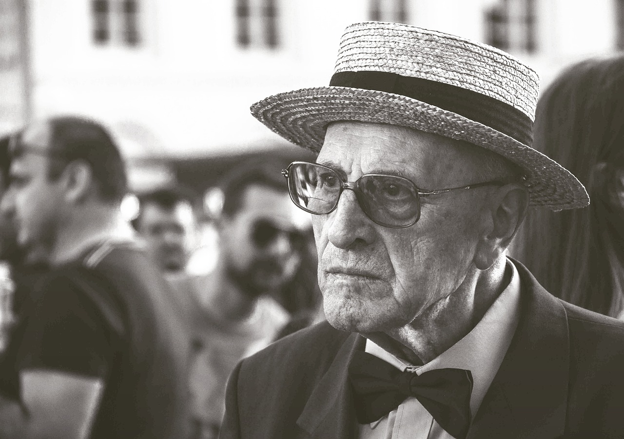

AQA English Language Paper 1 Section B: Using Language for Effect
As you come in you will find a picture of a character on your table.
On your post-it note write down:
Five powerful adjectives to describe this character (Example: Lonely, mysterious, curious).
Three effective similes to describe this character (Example: He stared at me like a portrait).
Three effective metaphors to describe this character (Example: He was a statue in the middle of the square).

Slide 2
Learning outcomes
To describe a character using language
To analyse the effects of language devices on readers
To evaluate the effectiveness of our own character descriptions using success criteria

Slide 3
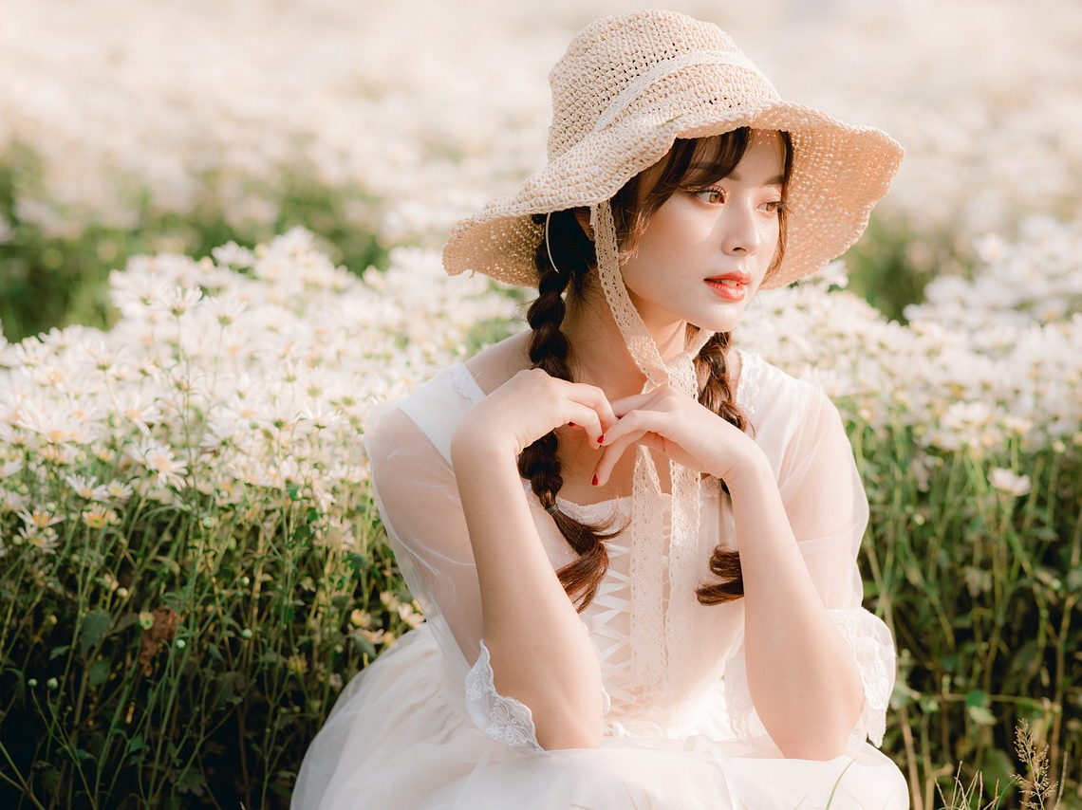

Slide 4


Slide 5


Slide 6


Slide 7


Slide 8
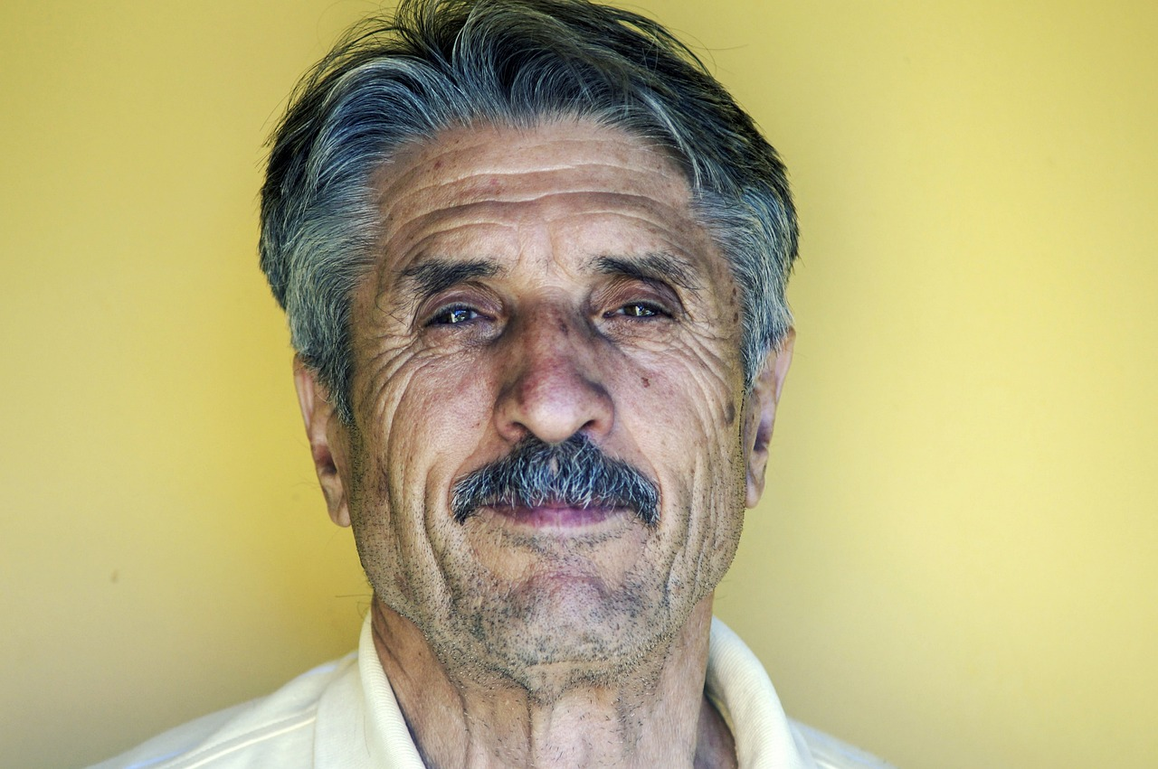

Slide 9


Place your post-it notes on the board
We now have an amazing idea bank that we can use throughout this lesson!

Slide 10

You are marked out of 24 marks for AO5
AO5 Content and organisation
Communicate clearly, effectively and imaginatively, selecting and adapting tone, style and register for different forms, purposes and audiences.
Organise information and ideas, using structural and grammatical features to support coherence and cohesion of texts.

Slide 11
He stood in the distance amongst the swirling crowds of people, a statue of isolation amongst waves of activity.
His pitch-black eyes from behind his hazel lenses slowly moved towards me, and he caught my puzzled gaze. Since I had last seen him, his skin had worn away and crinkled so it now resembled ancient parchment.
Although his formal blazer, clean white shirt and charming bowtie were designed to give him an air of friendliness and conviviality, his shrunken smile and horizontal brow suggested he was less than pleased to recognise me.
What language devices does the writer employ in this character description?
How do the language devices help us understand the character?
Why does the writer offer a contrast between setting and character? Provide examples.

Slide 12
He stood in the distance amongst the swirling crowds of people, a statue of isolation amongst waves of activity.
His pitch-black eyes from behind his hazel lenses slowly moved towards me, and he caught my puzzled gaze. Since I had last seen him, his skin had worn away and crinkled so it now resembled ancient parchment.
Although his formal blazer, clean white shirt and charming bowtie were designed to give him an air of friendliness and conviviality, his shrunken smile and horizontal brow suggested he was less than pleased to recognise me.
The writer uses metaphors to describe the crowds and the character. Crowds don’t really ‘swirl’ like water, but the image helps to emphasise how still the character is amongst moving people. The character is described as a statue to amplify how still they are, plus the ‘waves’ of activity links back to the image of swirling crowds.
Adjectives are employed to describe the facial features of the character, as well the metaphor of his skin being ‘worn away’ as if it is an item of clothing. A simile is employed to describe his skin as being like “ancient parchment”. An adverb is used to describe the movement of his eyes.
More adjectives are employed to convey how his clothes seem to give a friendly mood, but in fact his shrunken smile (sibilance – a specific form of alliteration) conveys how he is not friendly at all.

Slide 13
Today you are going to write out a short description of one of your characters, focusing on your use of language for effect.
Choose one character from your story. Remember that you will only need one or two characters for your story as it is only one chapter or section.
Type of character: | What does it mean?
Protagonist | The protagonist is the main character – they could be the narrator or the character the narrator focuses on the most.
Antagonist | Opposes the protagonist and is similar to a villain, although isn’t as hyperbolic or exaggerated in terms of personality. They are usually a bad or dishonest person, although this sometimes isn’t the case.
Confidante | Someone that the protagonist confides in. This helps readers to find out more about the protagonist's personality. They can help to bring the best out in the protagonist.
Dynamic character | This type of character changes as the story progresses. Sometimes a good character may turn bad, or the other way around, but it is usually a permanent change.
Static/ stock character | A character that doesn't change and we learn little about them. They serve a purpose in terms of moving a plot (story) forward. They can sometimes be quite stereotypical or play a specific role, perhaps to make people laugh.
Write out a short description of your character.
You could describe: their appearance, their clothes, their facial features, their height or size, their actions and mannerisms, how they make others think or feel, and so on.
Success criterion
Use language devices for effect

Slide 14
Simile
Using like/as to compare one thing to another.
The man was as tall as a skyscraper.
She moved like a snail!
Similes help readers to picture a particular object, person or place by comparing something they don’t know to something they do. They can also be used for exaggeration.
Metaphor
Transforming one thing into another.
He was a monster truck on the football field.
She is over the moon about her exam results.
Metaphors help readers to picture a particular object, person or place by transforming them into something they understand better. They can also be used for exaggeration.
Personification
This is a type of metaphor, where something non-human is described in a human way.
The wind whistled past his face.
The trees danced in the breeze.
Personification can help bring objects and places to life and help build a mood or atmosphere in a story. You could use personification to describe your character’s clothes or how their facial features move.
Alliteration
This where a number of words begin with the same letter or sound.
The angry, aggressive aardvark ate all the apricots.
Mr W wrote wildly on the whiteboard.
Alliteration creates a memorable sound in the readers’ head that means they notice that particular line more or they can remember it quite well. This means it can be used to emphasise a particular point, idea or feeling.
Adjectives and Adverbs
Adjectives are words that describe nouns. E.g. tall, short, wide, skinny, ugly, beautiful, amazing, spectacular, boring, etc.
Adverbs are words that describe verbs. E.g. quickly, amazingly, powerfully, slowly, shockingly. They usually end in ly.
These are both used to add to descriptions and help build specific images or feelings in the readers’ heads. They can be used to build mood and atmosphere as well.
Repetition
Repetition is where you repeat a word, phrase or idea again and again.
E.g. “Run! Run! Run!” she shouted at him.
Repetition helps to stick an idea in the readers’ heads or helps to emphasise a particular idea or feeling.

Slide 15
Peer assessment
Swap character descriptions with another student.
What did they do well?
Example: You included adjectives to describe your character.
What could they improve on?
Example: Use metaphors to convey how the character appears to us.

Slide 16
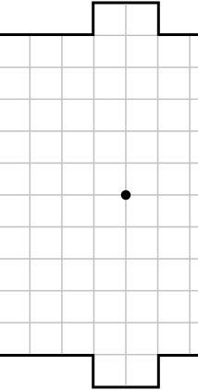
Plenary: Paper Soccer
In pairs, you will play a game of ‘paper soccer’.
Each person takes a turn to draw a line from the centre dot either horizontal, vertical or diagonally one space.
The next person then moves the line one space in those directions.
The first person to get the ball into the other person’s goal wins!
Before every go, you have to state one thing you’ve learnt from today’s lesson
To describe a character using language
To analyse the effects of language devices on readers
To evaluate the effectiveness of our own character descriptions using success criteria

