Slide 1
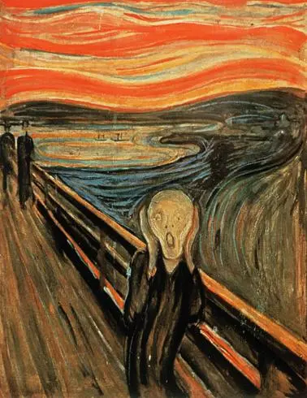
AQA English Language Paper 1 – Q4: Critical Evaluation
What do you think about this painting?
“In my view, this painting shows what it is like to feel fear.”
How far do you agree with this opinion?
Provide some examples to support your opinion.

Slide 2
The ‘sky’ is made up of unusual shapes and colours – this is no ordinary sky. Does this represent how the world can seen frightening and unexpected at times?
The ‘sea’ is made up of intense, dark colours and huge ‘waves’ that reach up to the sky. Does this make you feel unsettled? How does this describe fear?
These people are far off in the distance. Does this represent how you can feel alone in fear?
This figure is at the centre of the painting, has unusually shaped features that match the waves of the sea and the sky, and is isolated from other people. What does this tell us about the nature of fear?

Slide 3
Learning outcomes
To describe how much we agree or disagree with the statement in Q4
To explain our views regarding the statement in Q4
To evaluate how far we agree or disagree with the statement in Q4

Slide 4
Evaluating a text is similar to evaluating art
You look at how much you agree with a statement about the text, supported by examples or evidence.
The final question of Section A in Paper 1 asks you to evaluate how much you agree with a statement given about the extract.

Slide 5

Let’s explore Q4
For this question focus on the second part of the source, from line 20 to the end.
In this part of the source, the hyena could be seen as funny or threatening.
To what extent do you agree or disagree with this statement?
In your response, you could:
• consider your impressions of how the hyena behaves
• comment on the methods the writer uses to present the hyena as funny or threatening
• support your response with references to the text.
Discuss: What do you need to do to answer Q4?
Bonus Challenge: What is different about Q4 compared to Q2 and Q3?

Slide 6
Let’s explore Q4
For this question focus on the second part of the source, from line 20 to the end.
In this part of the source, the hyena could be seen as funny or threatening.
To what extent do you agree or disagree with this statement?
In your response, you could:
• consider your impressions of how the hyena behaves
• comment on the methods the writer uses to present the hyena as funny or threatening
• support your response with references to the text.
Q4 asks you to explore a section of the text rather than the whole text.
Unlike Q2 and Q3, you are given a statement, and you must evaluate how far you agree or disagree with it.
This question is worth 20 marks, whereas Q2 and Q3 are worth 8 marks each. You will need to give a detailed and in depth answer to get full marks on it.

Slide 7
You have been given scale. Glue it into your book and then write down where you would put yourself on the scale.
Now, discuss with your partner where you would put yourself on this scale and why.
Be prepared to share your opinion and your reasons.
In this part of the source, the hyena could be seen as funny or threatening.
It is really funny
It is somewhat funny
Both funny and threatening
It is somewhat threatening
It is really threatening
Notes:
Note for teachers: It may be more practical to draw a scale on a separate whiteboard rather than have lots of post-its on your IWB.

Slide 8
It is really funny
It is somewhat funny
Both funny and threatening
It is somewhat threatening
It is really threatening
It is really funny
It is somewhat funny
Both funny and threatening
It is somewhat threatening
It is really threatening
It is really funny
It is somewhat funny
Both funny and threatening
It is somewhat threatening
It is really threatening
It is really funny
It is somewhat funny
Both funny and threatening
It is somewhat threatening
It is really threatening
It is really funny
It is somewhat funny
Both funny and threatening
It is somewhat threatening
It is really threatening
It is really funny
It is somewhat funny
Both funny and threatening
It is somewhat threatening
It is really threatening

Slide 9
Re-read the second half of the text (line 20 onwards)
Reasons why I think the hyena is funny | Reasons why I think the hyena is threatening
“And the whole time, lap after lap, it went yip yip yip yip yip in a high-pitched way.” Even though Pi is in a terrifying position of being in a small space with a vicious predator, the repetition of the “yip” sound from the hyena makes it seem comical. It appears it is just as confused by its surroundings at is thinking about finding something to eat. | “I was seized by fear and could only watch.” We already know that the hyena is a terrifying predator from earlier in the text, and Pi reiterates to us that he is “seized with fear”, the personification amplifying to us how terrified he is. He is also helpless: he can only watch the hyena as he awaits to see what will happen.
In this part of the source, the hyena could be seen as funny or threatening.
Complete your table. You may put more reasons on one side than the other. You the examples provided to help you.

Slide 10
Reasons why I think the hyena is funny | Reasons why I think the hyena is threatening
“And the whole time, lap after lap, it went yip yip yip yip yip in a high-pitched way.” Even though Pi is in a terrifying position of being in a small space with a vicious predator, the repetition of the “yip” sound from the hyena makes it seem comical. It appears it is just as confused by its surroundings at is thinking about finding something to eat. | “I was seized by fear and could only watch.” We already know that the hyena is a terrifying predator from earlier in the text, and Pi reiterates to us that he is “seized with fear”, the personification amplifying to us how terrified he is. He is also helpless: he can only watch the hyena as he awaits to see what will happen.

Slide 11
It did one lap-two-three-four-five-and onwards, non-stop, till I lost count.
This sounds like a cartoon character or a caricature of the animal rather than a terrifying beast.
I wondered what it was going to do next.
Pi doesn’t know how the hyena will respond to being trapped on the lifeboat, and the unpredictable behaviour is both comical and terrifying, given its natural inclination to kill.
it went yip yip yip yip yip in a high-pitched way
The repetition of the onomatopoeia ‘yip’ conjures an amusing image in our heads.
My reaction, once again, was very slow.
Pi reminds us regularly that he is terrified
I was seized by fear and could only watch.
He is ‘seized’ by fear, the personification reinforcing this animal could attack and kill him at any moment, and he says he hoped the animal would stay under the tarpaulin, but “I was disappointed.”

Slide 12
The beatings of its legs against the benches made the whole boat shake
The previous humour is replaced with tenser descriptions of the animal’s behaviour. This is a powerful and ferocious creature, and this description is reminiscent of a horror or action film where the protagonist is being hunted by a dinosaur or monster.
Each time it came from the stern I tensed.
The pace slows down, to fill us with suspense and anticipation.
blank and frank, jaw hanging open, big ears sticking up rigidly, eyes bright and black.
The adjectives here make the animal sound both innocent and vicious simultaneously. It is ‘blank’ but also ‘bright’, ‘big ears’ stick up ‘rigidly’. It is a comical in appearance but also potentially very dangerous, and that ambiguity serves the writer well in giving us mixed emotions through the whole extract.
It did not move from the restricted space for the rest of the day
The ending of the extract only serves to exacerbate this uncertainty.
“Every time the hyena paused at the stern bench, my heart jumped.”
Despite the inaction of the animal at this point, Pi can never relax. The inaction of hyena causes terrible fright in Pi, accentuated through the personification of his heart ‘jumping’.

Slide 13
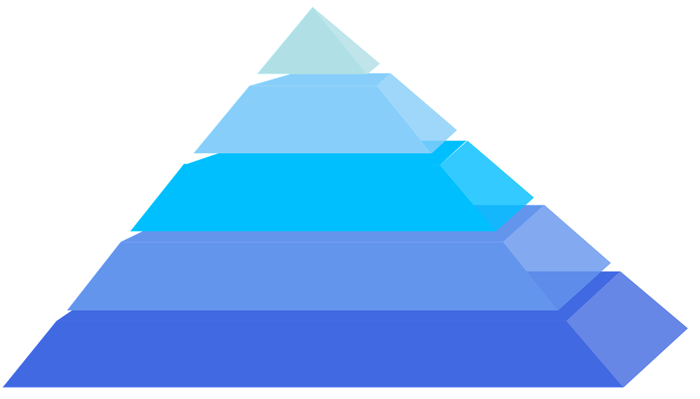
Plenary: Learning Pyramid
To describe how much we agree or disagree with the statement in Q4
To explain our views regarding the statement in Q4
To evaluate how far we agree or disagree with the statement in Q4
Most important element learnt
Second most important element learnt
Third most important element learnt
Fourth most important element learnt
Fill in your pyramid with the five most important elements you have learnt from the lesson.
Fifth most important element learnt

