Slide 1
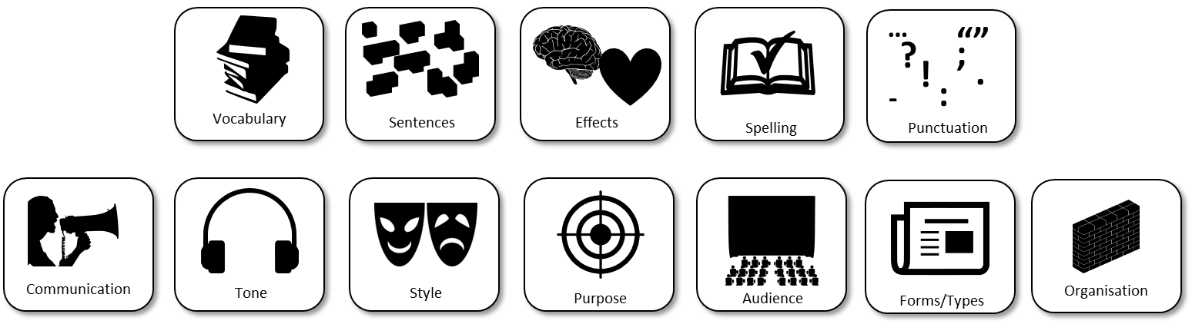
AQA English Language Paper 2 Section B: Speech Writing Lesson
'Cars are convenient, comfortable and save time. However, we need to use them less by making public transport such as trains, trams, and buses cheaper, more reliable and easier to access.'
Write a speech to be given at a meeting of your local council in which you are to argue your point of view on this statement.
Write a list of success criteria for getting a top mark for this question.
Bonus Challenge: Which areas will you need to focus on today to make sure you have made improvements for your speech?

Slide 2
Learning outcomes
To describe how to gain a top mark in Paper 2 Section B (non-fiction writing)
To explain how you can improve your speech based on your previous learning
To evaluate the effectiveness of your learning based on success criteria

Slide 3
Use vocabulary that is ambitious, impressive and professional to add weight to your perspectives.
Use sentence structures for effect to ensure you engage with your audience and meet the purpose of the text.
Ensure your writing affects how the audience feels about the topic you are addressing, including through the use of language (DAFORREST)
Double check your spelling, punctuation and grammar to make sure it is accurate and effective.
Convey your perspectives to the audience clearly and effectively so that the audience can be convinced about your ideas and perspectives.
Provide a consistent tone to your writing so you come across as knowledgeable, professional and convincing.
Use all of the conventions of speech writing and writing to argue to make sure you address the purpose and audience of the text.
Ensure your writing addresses the purpose (why you are writing), the audience (who you are writing to and the form/type (what you are writing).
Think about how you are starting and ending your speech and how you have organised your ideas into clear paragraphs with links to make them flow well.

Slide 4

This is what you need to achieve for top marks for AO5 (24 marks)
Content
• Communication is convincing and compelling and directly relevant to focus and task
• Tone, style and register are assuredly matched to purpose and audience
• Extensive and ambitious vocabulary with sustained crafting of linguistic devices
You need to communicate your ideas well, so you need to think about what effects your speecj is having on your audience. Will it interest them and convince them to listen to your perspective?
We’ve spent lots of time exploring tone. It is crucial to create a professional and authoritative tone so your audience will take your ideas seriously.
Use the conventions of speech writing to engage your audience
Consider your use of vocabulary and language and how these can interest and engage your audience.

Slide 5






This is what you need to achieve for top marks for AO5 (24 marks)
Organisation
• Varied and inventive use of structural features
• Writing is compelling, incorporating a range of convincing and complex ideas
• Fluently linked paragraphs with seamlessly integrated discourse markers
We have spent some time exploring how we can use connectives to link ideas and we will spend more time on sentences soon
Consider how you are using language and structure to engage your audience.
Remember ToPTiPs and how you can link paragraphs together using connectives and linking sentences.
…
“”
?
;
!
.
-
:
Vocabulary
Sentences
Effects
Spelling
Punctuation

Slide 6




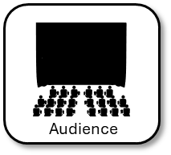


Examiners are given this list of success criteria to help them mark your speech
Convincing argument.
• Conceptualised focus on task.
• Detailed/complex ideas.
• Fluid sequencing of ideas/
argument.
• Judicious choice of register.
• Confident and varied tone.
• Convincing and impressive
vocabulary.
• Deliberate crafting of language
and use of rhetorical devices.
• Subtle variation of pace.
The examiner wants your argument to be convincing. That means your ideas need to be set out in detail and you show you are aware of counter-arguments and how you respond to them.
Remember to make your paragraphs flow well together with the use of connectives and linked sentences between the endings and beginnings of paragraphs.
You will need to make your tone and register match the purpose and audience, so for our speeches they need to sound professional, authoritative and convincing.
Don’t forget to upgrade your vocabulary and use technical terms to show your argument is convincing.
Remember to use your DAFORREST techniques to convince your audience to listen to your perspective.

Slide 7
This is what you need to achieve for top marks for AO6 (16 marks)
Sentence demarcation is consistently secure and consistently accurate
Wide range of punctuation is used with a high level of accuracy
Uses a full range of appropriate sentence forms for effect
Uses Standard English consistently and appropriately with secure control of complex grammatical structures
High level of accuracy in spelling, including ambitious vocabulary
Extensive and ambitious use of vocabulary
Make sure you’ve put your full stops and commas in the right places.
Use other types of punctuation such as: colons, semicolons, speech marks, dashes, hyphens, exclamation marks, question marks and so on.
Check your grammar and sentence structures to make sure they read well.
Check your spelling of difficult words to make sure you haven’t made any mistakes.
Try to impress with your vocabulary, but don’t sacrifice your style by putting too many impressive words just for the sake of it!
…
?
;
!
.
-
:
Vocabulary
Sentences
Effects
Spelling
Punctuation

Slide 8
Re-read your notes from the previous lessons
Communication
Write down three targets for yourself to improve on your draft when writing your speech.
Here are a few examples:
Use a rhetorical question at the beginning of my speech to engage the audience
Use ToPTiPs for paragraphing
Replace simple vocabulary like good with more impressive synonyms
Tone, style, register
Vocabulary
Structure
Ideas
Paragraphs
Sentences
Punctuation
Grammar
Spelling

Slide 9
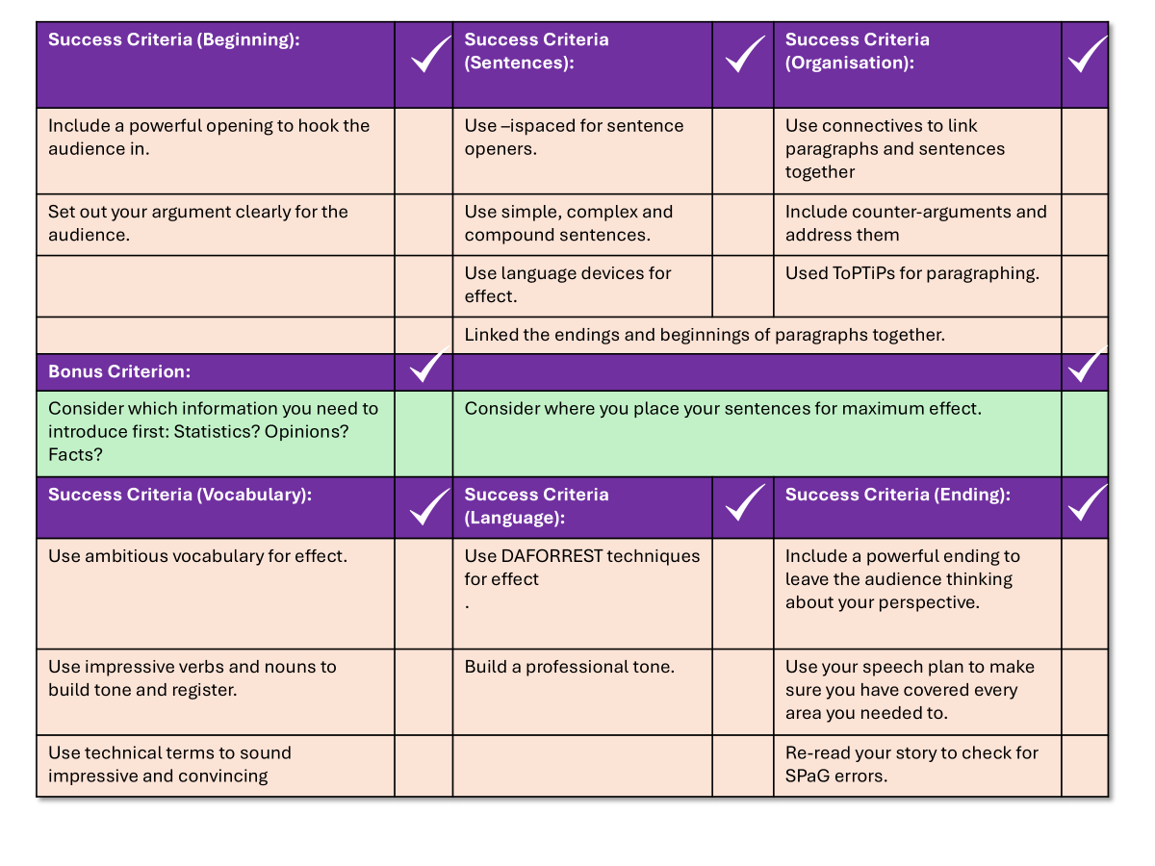
You now have one hour to write your speech
'Cars are convenient, comfortable and save time. However, we need to use them less by making public transport such as trains, trams, and buses cheaper, more reliable and easier to access.'
Write a speech to be given at a meeting of your local council in which you are to argue your point of view on this statement.
Use your checklist to help you write out your speech.
You may refer to your notes from this term if you wish.
You have one hour to complete your speech.
Good luck!

Slide 10

Success Criteria (Beginning): |  | Success Criteria (Sentences): |  | Success Criteria (Organisation):
Include a powerful opening to hook the audience in. |  | Use –ispaced for sentence openers. |  | Use connectives to link paragraphs and sentences together
Set out your argument clearly for the audience. |  | Use simple, complex and compound sentences. |  | Include counter-arguments and address them
 |  | Use language devices for effect. |  | Used ToPTiPs for paragraphing.
 |  | Linked the endings and beginnings of paragraphs together.
Bonus Criterion:
Consider which information you need to introduce first: Statistics? Opinions? Facts? |  | Consider where you place your sentences for maximum effect.
Success Criteria (Vocabulary): |  | Success Criteria (Language): |  | Success Criteria (Ending):
Use ambitious vocabulary for effect. |  | Use DAFORREST techniques for effect . |  | Include a powerful ending to leave the audience thinking about your perspective.
Use impressive verbs and nouns to build tone and register. |  | Build a professional tone. |  | Use your speech plan to make sure you have covered every area you needed to.
Use technical terms to sound impressive and convincing |  |  |  | Re-read your speech to check for SPaG errors.

Slide 11




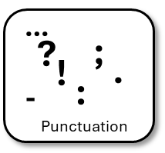
Plenary: Self-assessment reflection sheet
How confident do you feel about this area?
Not confident
Very confident
Which areas do you feel you need to spend more time on?
1) ______________________________________________________________________________________
2)
______________________________________________________________________________________

