Slide 1
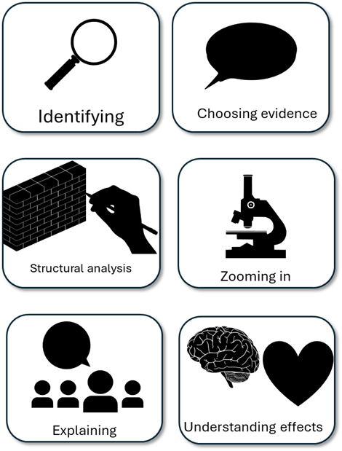
English Language Paper 1 – Q3: Improving Structure Analyses
“Pi says he is worried about the hyena and then he moves on to talking about how the hyena moves in the boat. Next he talks about how the hyena looks at him. The hyena eventually stops moving and is sick.”
Read the student answer to Q3 above.
What skills did they use in their answer?
How could they improve this answer?
Why does this answer not address AO3 effectively? Provide examples.
AO2
Explain, comment on and analyse how writers use structure to achieve effects and influence readers, using relevant subject terminology to support their views

Slide 2
Learning outcomes
To describe ways of improving our Q3 answers
To explain how student answers can better meet the requirements of the mark scheme
To evaluate the effectiveness of our improved Q3 answers

Slide 3


AO2
Explain, comment on and analyse how writers use structure to achieve effects and influence readers, using relevant subject terminology to support their views
This is the mark scheme that examiners use to mark Q3:
Shows perceptive and detailed understanding of structural features:
• Analyses the effects of the writer’s choices of structural features
• Selects a range of judicious examples
• Makes sophisticated and accurate use of subject terminology
Student’s answer
Analysed the effects of the structure
Included examples to support ideas
Included subject terminology to support ideas

Slide 4
The student did include examples, but…
“Pi says he is worried about the hyena and then he moves on to talking about how the hyena moves in the boat. Next he talks about how the hyena looks at him. The hyena eventually stops moving and is sick.”
• Selects a range of judicious examples
Judicious means showing good judgement and sense.
… They didn’t explain the effects of structure on the reader, and one good way to do this is by using a range of examples that back up your interpretations.

Slide 5
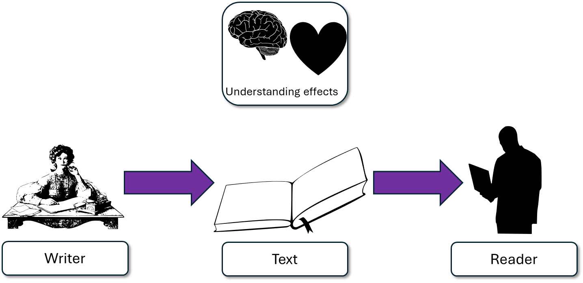
The extract begins with an abrupt short sentence: “It was the hyena that worried me”. As this is from the middle of a novel, as readers we would already know much about the characters, plot and themes, but starting the extract this way allows the writer to focus on the hyena in the boat and Pi’s concern regarding the predator being in close proximity.
This student’s answer uses the same example but look at how they’ve zoomed in on that example and explained the effects on the reader.
The extract begins with Pi telling us that he is worried about the hyena, but it is the short sentence at the start that amplifies his sense of fear and sets up the rest of the extract to highlight Pi’s growing sense of fear and the growing tension for us as readers.

Slide 6
“I want the reader to experience the fear Pi has about the hyena.”
“Oh no! There is a predator on the lifeboat, and it could attack Pi! I wonder what will happen next…”
The text begins with the short sentence, “It was the hyena that worried me”.

Slide 7
Let’s help this student to improve part of their answer
Next, he talks about how the hyena looks at him.
“It lifted its eyes and rested
them upon me.”
Student’s answer
Analysed the effects of the structure
Included examples to support ideas
Included subject terminology to support ideas
Using your understanding of the Q3 mark scheme, transform this into a more effective answer.

Slide 8
Let’s look at another student’s answer
Previously, the hyena was doing laps of the boat and its gaze was downwards, but shockingly the hyena's gaze changes and it "lifted its eyes and rested them upon me." The short sentence alters the pace and focus of the extract, which in turn ramps up the tension as we understand the hyena has noticed Pi and may now attack him. Time slows down as Pi prepares for his end and the text reaches its climax.
This student’s answer includes the same example as before, but now they explain how the short sentence slows down the pace and the focus is altered so that we know the hyena is staring at Pi. The student explains that this has the effect of making the reader feel tense, worried about whether Pi will be attacked or not, as the text reaches its climax.

Slide 9
We should also include some structural devices…
Previously, the hyena was doing laps of the boat and its gaze was downwards, but shockingly the hyena's gaze changes and it "lifted its eyes and rested them upon me." The short sentence alters the pace and focus of the extract, which in turn ramps up the tension as we understand the hyena has noticed Pi and may now attack him. Time slows down as Pi prepares for his end and the text reaches its climax.
Previously, the hyena was doing laps of the boat and its gaze was downwards, but shockingly the hyena's gaze changes and it "lifted its eyes and rested them upon me." This ramps up the tension as we understand the hyena has noticed Pi and may now attack him.
Student 1
Student 2
Discuss: What has the Student 1 included that Student 2 has not?

Slide 10
You must explain your interpretations
Remember that it is crucial that you include explanations as to why the examples and devices have effects on the reader.
How do those examples and changes in structure make the reader think and feel?

Slide 11
Last lesson we wrote our own Q3 answers
Drafting and redrafting is an important activity in English because it helps you to become a more effective English analyst.
Using your learning from today and the success criteria, rewrite your answer.
Your answer for Q3
Analysed the effects of the structure
Included examples to support ideas
Included subject terminology (devices) to support ideas
Bonus criteria:
Included analytical verbs
Used a range of examples to support your ideas

Slide 12
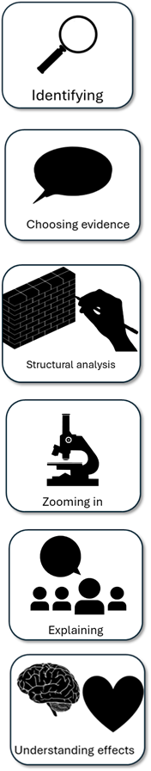
We will now peer assess our new answers
Swap your answers with another student.
Student’s Q2 answer |  | What could they add or change to improve their answer?
Analysed the effects of the language
Included quotes to support ideas
Included subject terminology (devices) to support ideas
Bonus criteria:
Included analytical verbs
Used a range of quotes to support your ideas

Slide 13
Student’s Q3 answer: |  | What could they add or change to improve their answer?
Analysed the effects of the structure
Included examples to support ideas
Included subject terminology (devices) to support ideas
Bonus criteria:
Included analytical verbs
Used a range of examples to support your ideas
Notes:
To print out for students

Slide 14
Let’s recap Paper 1 Section A so far
Close your exercise books and cover up your notes.
What skills do you need to show for Q1? (4 marks)
What skills do you need to show for Q2? (8 marks)
What skills do you need to show for Q3? (8 marks)

Slide 15

Q1 Recap
Q1: You are given a short extract from the beginning of the text.
You are given four multiple choice questions: three options in each one.
Put a tick next to the correct answer for each question.
Do not put more than one tick per question.
Identifying

Slide 16



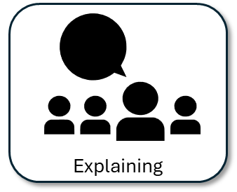
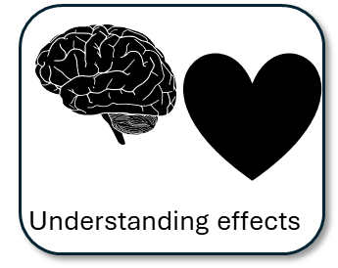
Q2 Recap
Q2: You are given a short extract from the text.
You are asked to explain how the writer describes something in that part of the text.
You must include quotes or evidence to support your ideas.
You should include some language devices.
You must explain how those quotes and devices support your ideas.

Slide 17
Q3 Recap
Q3: You must explore the whole extract
You are asked to explain how the writer uses structure to build a particular area (such as tension).
You must include examples to support your ideas.
You should include some structural devices.
You must explain how those examples and devices support your ideas.

Slide 18

Plenary: Feelings
How you felt about the learning outcomes at the start of the lesson:
How you feel at the end of the lesson:
What you want to feel like next lesson:
To describe ways of improving our Q3 answers
To explain how student answers can better meet the requirements of the mark scheme
To evaluate the effectiveness of our improved Q3 answers

