Slide 1



AQA English Language Paper 1 Section B: Settings
For a writer establishing a setting is incredibly important. It helps to build an atmosphere in a narrative (story) and develop plot and character further.
Where will you set your story?
How will your setting help to build an atmosphere?
Why is it important to consider tone when writing out a description of a setting? Provide examples.

Slide 2
Learning outcomes
To describe how we can create a powerful setting
To explain how we can use the five senses and tone in our settings
To evaluate the effectiveness of our own setting descriptions based on success criteria

Slide 3

Including a short description of setting will help communicate your ideas and make your writing be more cohesive
AO5 Content and organisation
Communicate clearly, effectively and imaginatively, selecting and adapting tone, style and register for different forms, purposes and audiences.
Organise information and ideas, using structural and grammatical features to support coherence and cohesion of texts.

Slide 4





Let’s re-read the description of the setting from the example story we have previously analysed
Based on the outskirts of my hometown, surrounded by countryside and located close to a dairy farm, the air at the home consisted of smells of fertiliser before a wave of doggy odours hits you. Putting together hundreds of dogs together is never going to greet your nose with pleasant fragrances, and the overwhelming ‘eau du parfam’ is made up of urine, defecation, and cheap meat. When you’ve filled in the numerous piles of paper, put your signature on every dotted line, you’re allowed into the enclosures.
Walking in a straight line on a faded concrete floor, I felt like a visitor to a particularly intimidating prison, which in some ways I suppose I was. Going past each cage, the howls and whines increased. Some of the animals barked, others lay down and cried. Honestly, I really wanted to take them all home with me, but I knew that was just a far-fetched fantasy.
Discuss: Which of the five senses has the writer used in their description?
Bonus Challenge: How does the use of the five senses help the reader to build up an idea of mood and atmosphere in their heads?

Slide 5
Based on the outskirts of my hometown, surrounded by countryside and located close to a dairy farm, the air at the home consisted of smells of fertiliser before a wave of doggy odours hits you. Putting together hundreds of dogs together is never going to greet your nose with pleasant fragrances, and the overwhelming ‘eau du parfam’ is made up of urine, defecation, and cheap meat. When you’ve filled in the numerous piles of paper, put your signature on every dotted line, you’re allowed into the enclosures.
Walking in a straight line on a faded concrete floor, I felt like a visitor to a particularly intimidating prison, which in some ways I suppose I was. Going past each cage, the howls and whines increased. Some of the animals barked, others lay down and cried. Honestly, I really wanted to take them all home with me, but I knew that was just a far-fetched fantasy.

Slide 6

The setting is a dog rescue centre and the writer begins by describing where it is and what its surroundings look like before describing the rescue centre itself.
Based on the outskirts of my hometown, surrounded by countryside and located close to a dairy farm, the air at the home consisted of smells of fertiliser before a wave of doggy odours hits you. Putting together hundreds of dogs together is never going to greet your nose with pleasant fragrances, and the overwhelming ‘eau du parfam’ is made up of urine, defecation, and cheap meat. When you’ve filled in the numerous piles of paper, put your signature on every dotted line, you’re allowed into the enclosures.
Walking in a straight line on a faded concrete floor, I felt like a visitor to a particularly intimidating prison, which in some ways I suppose I was. Going past each cage, the howls and whines increased. Some of the animals barked, others lay down and cried. Honestly, I really wanted to take them all home with me, but I knew that was just a far-fetched fantasy.
Notes:
Photo used under a Creative Commons Licence: https://www.geograph.org.uk/photo/1764215

Slide 7
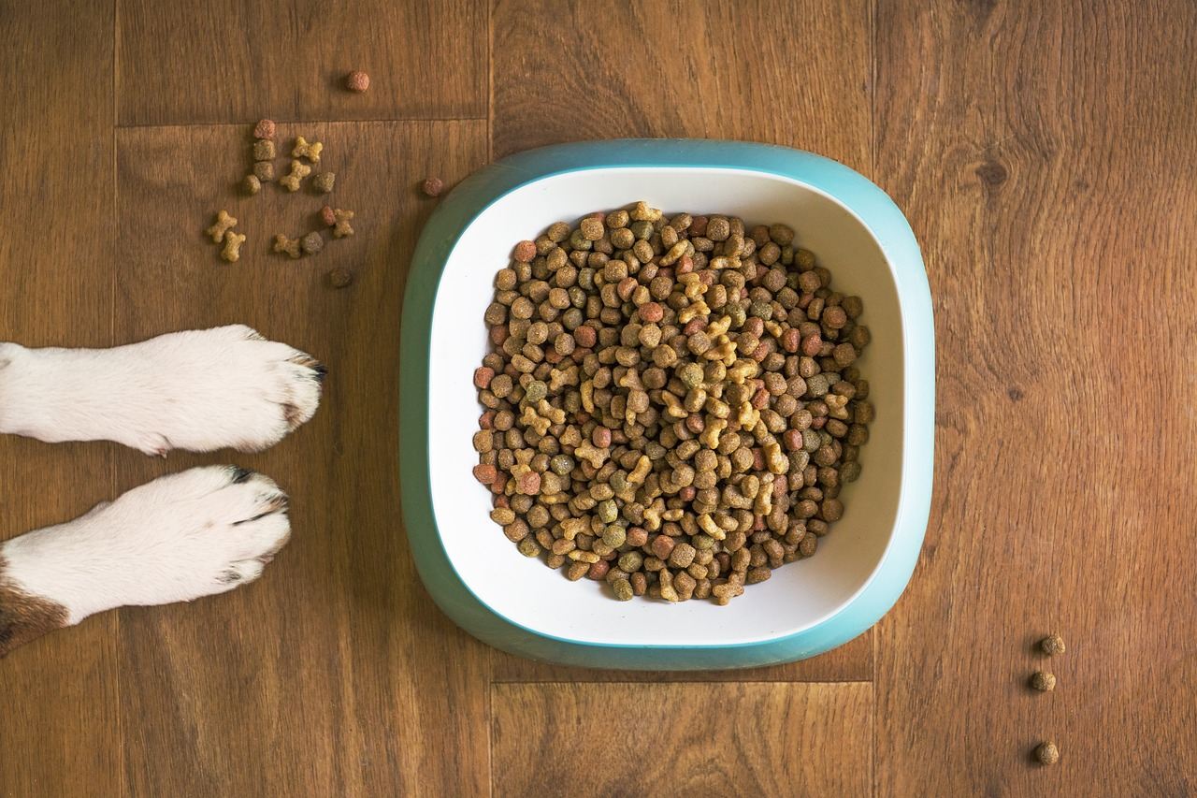


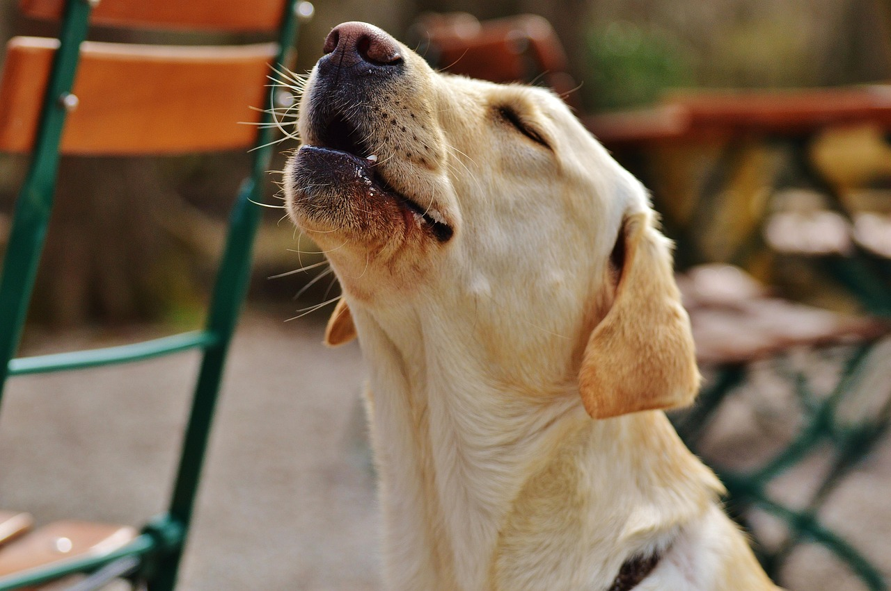
The description includes specific images or parts of the whole that have been ‘zoomed’ in on and described.
Based on the outskirts of my hometown, surrounded by countryside and located close to a dairy farm, the air at the home consisted of smells of fertiliser before a wave of doggy odours hits you. Putting together hundreds of dogs together is never going to greet your nose with pleasant fragrances, and the overwhelming ‘eau du parfam’ is made up of urine, defecation, and cheap meat. When you’ve filled in the numerous piles of paper, put your signature on every dotted line, you’re allowed into the enclosures.
Walking in a straight line on a faded concrete floor, I felt like a visitor to a particularly intimidating prison, which in some ways I suppose I was. Going past each cage, the howls and whines increased. Some of the animals barked, others lay down and cried. Honestly, I really wanted to take them all home with me, but I knew that was just a far-fetched fantasy.
Notes:
Photo used under a Creative Commons Licence: https://www.geograph.org.uk/photo/1764215

Slide 8

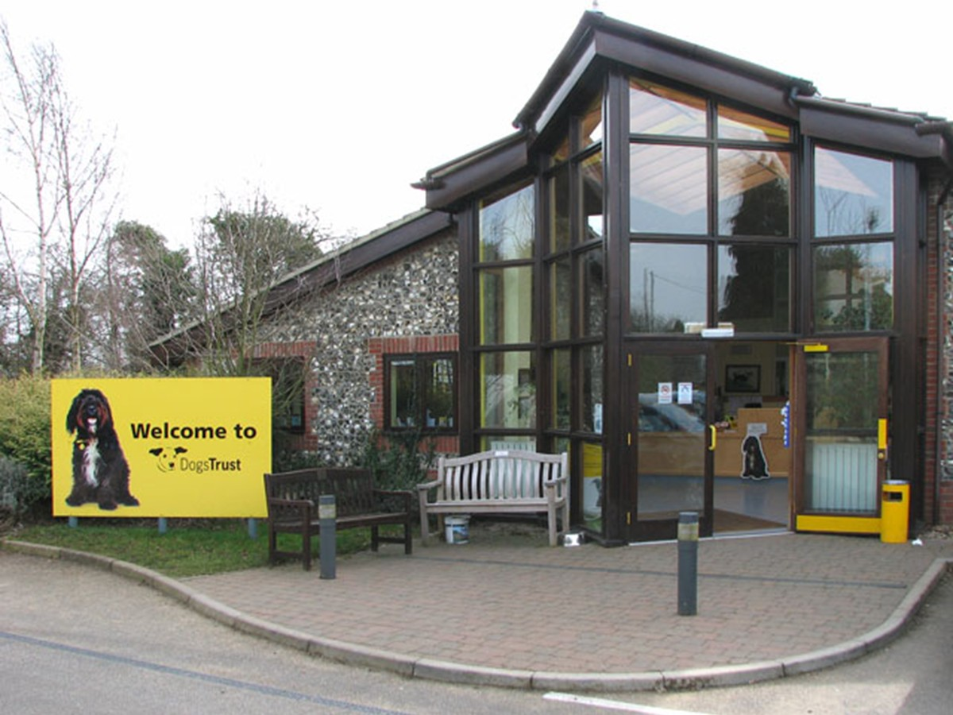


Tone
It’s really important to get the sound of your writing consistent.
Will it be angry? Will it be disappointed? Will it be joyful? Will it be a combination of different tones?
Discuss: What is the tone of the setting from the example story we have explored? Why do you think that?
Notes:
Photo used under a Creative Commons Licence: https://www.geograph.org.uk/photo/1764215

Slide 9
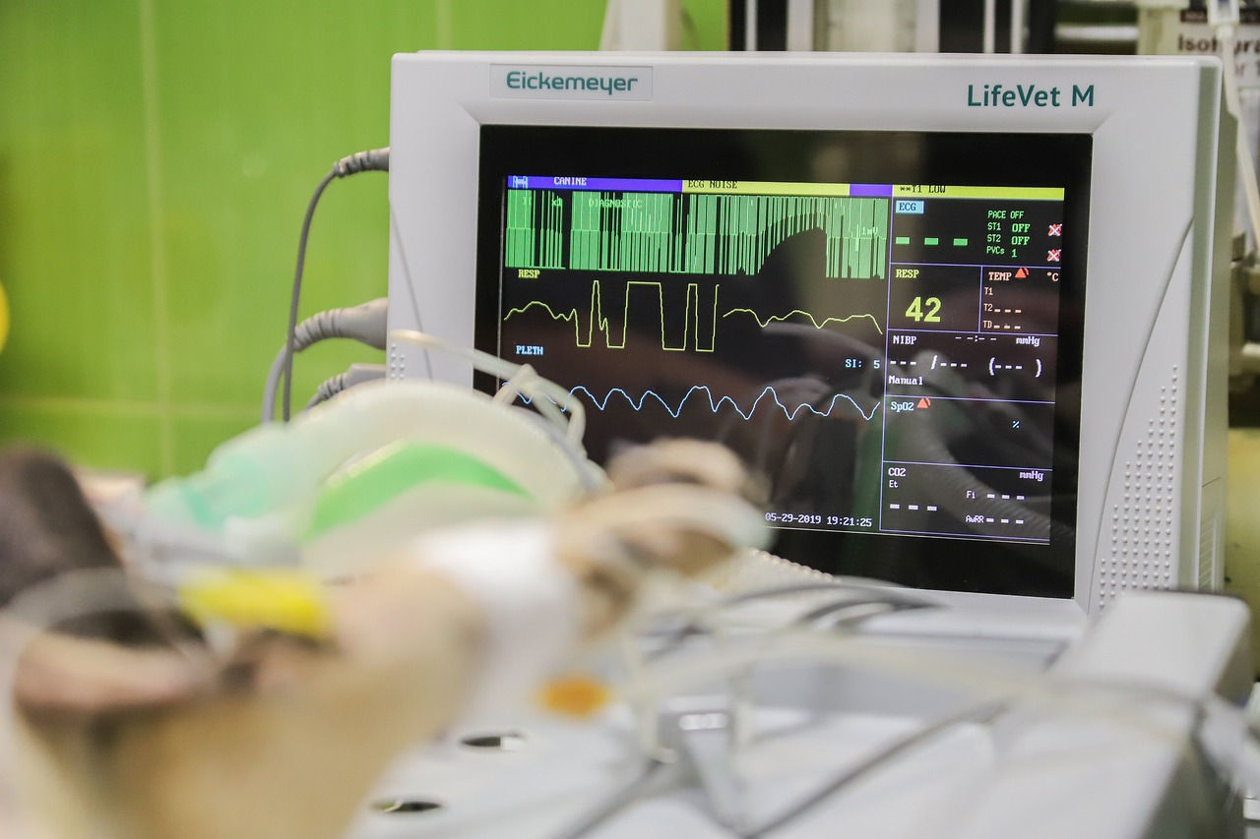
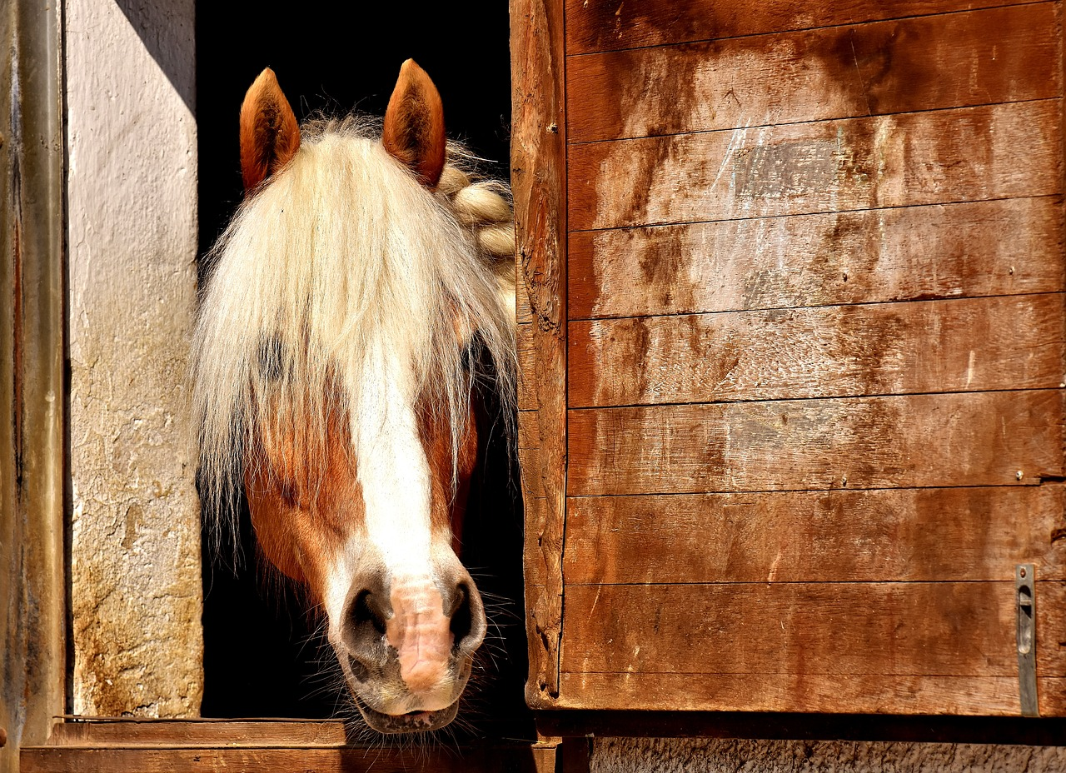



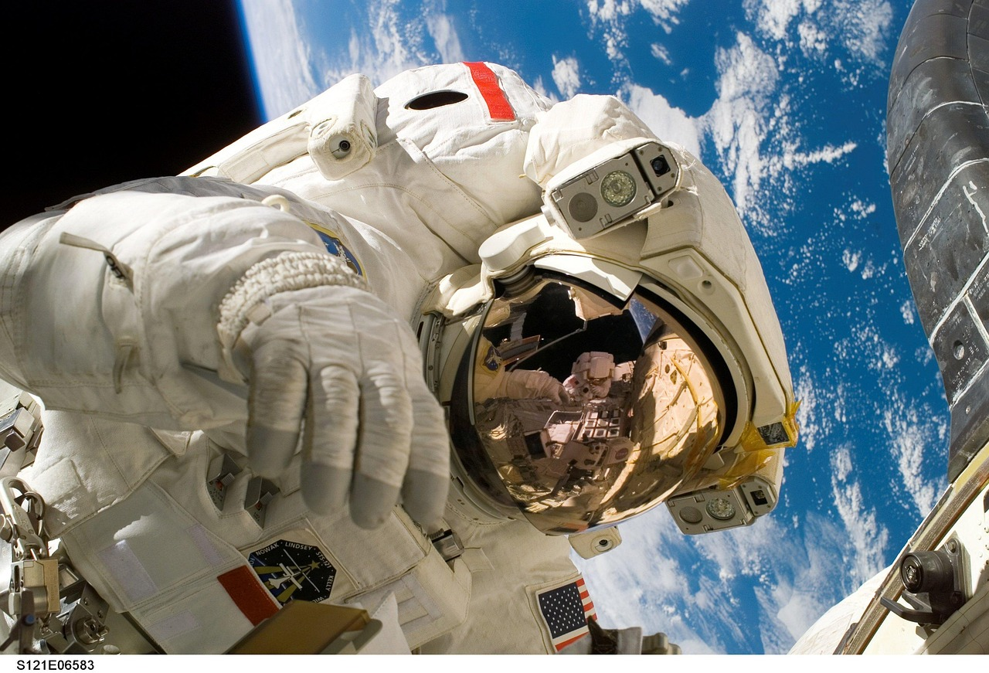
You should include one setting description in your story to help establish mood, tone and atmosphere.
Complete your worksheet which will ask you to use the five senses to help you describe your setting to the reader.

Slide 10


Thoughts and emotions:
What mood do you want to establish in your story?
How will you show this mood in your setting description?
Sounds:
Yellow
Tan
Beige
Marigold
Eggnog
Canary
Mustard
Pineapple
Blonde
Tuscan sun
Honey
Lemon
Corn
Flaxen
Green
Juniper
Sage
Pistachio
Lime
Mint
Mossy
Emerald
Grassy
Blue
Cobalt
Navy
Azure
Denim
Berry
Indigo
Teal
Cerulean
Red
Cherry
Rose
Jam
Merlot
Crimson
Ruby
Brick
Blood
Candy
Scarlet
Apple
Vermillion
Maroon
Cerise
Pink
Fuchsia
Watermelon
Strawberry
Magenta
Bubble-gum
Green
Juniper
Sage
Pistachio
Lime
Mint
Mossy
Emerald
Grassy
Sights:
Smells:
White
Pearl
Alabaster
Snow
Ivory
Cream
Eggshell
Cotton
Chiffon
Salt
Lace
Coconut
Linen
Porcelain
Parchment
Choose FIVE key areas to ‘zoom’ in on when creating your setting description:
_____________________
_____________________
_____________________
_____________________
_____________________
Black
Ebony
Raven
Oily
Leather
Midnight
Sooty
Inky
Purple
Violet
Lavender
Amethyst
Lilac
Plum
Raisin
Mauve
Heather
Orange
Tiger
Tangerine
Apricot
Sandstone
Squash
Marmalade
Carrot
Amber
Ginger
Clay
Bronze
Peach
Cantaloupe
Coral
Nectarine
Citrus
What can you touch or feel?
What can you taste?
Planning Sheet

Slide 11

Using your planning sheet, write out your setting description
Success criteria:
Include at least some of the five senses
Zoom in one specific details of the setting
Build a consistent tone

Slide 12



Peer Assessment: Evaluating Our Descriptions
Success criteria:
Include at least some of the five senses
Zoom in one specific details of the setting
Build a consistent tone
Put the numbers 1, 2, and 3 where you think they have met the success criteria we have agreed on as a class.
What areas do you think they need to work on based on the success criteria? Write these in their book.
You did well at ___________ and ___________.
However, you need to improve on ____________ and ______________.
Once you’ve seen your feedback use it to make improvements to your paragraph, and then you’ve made progress! Whoop!

Slide 13
Plenary: Emojis
To describe how we can create a powerful setting
To explain how we can use the five senses and tone in our settings
To evaluate the effectiveness of our own setting descriptions based on success criteria
Draw an emoji to describe your learning today. Why do you feel that way?

