Slide 1
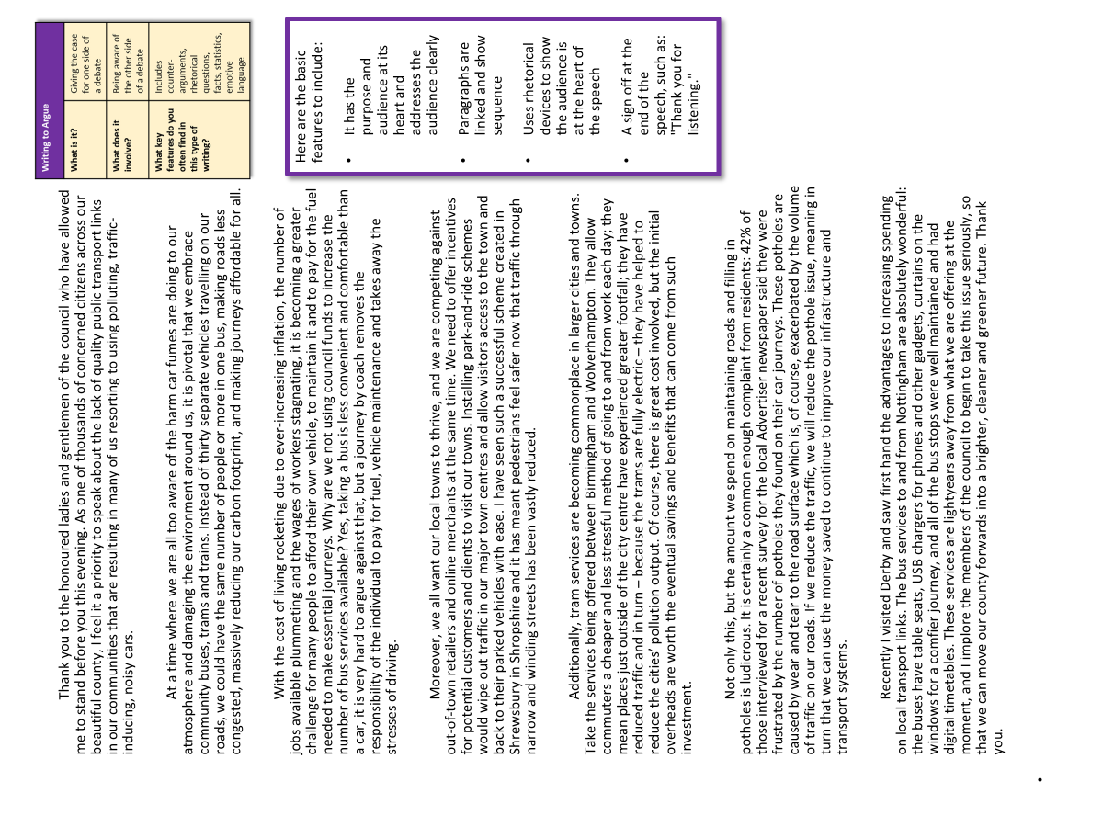
AQA English Language Paper 2 Q5: Structuring a Speech
We previously explored how we can begin and end speeches, but we also need to consider how we will organise the rest of our writing.
Re-read the example speech we have been analysing.
For each paragraph, write down what the writer focuses on (such as environmental issues or local costs).
Bonus Challenge: Explain how the writer has linked together their paragraphs so that they flow well.

Slide 2
Learning outcomes
To describe how an example speech is structured
To explain how we can structure our own speeches
To evaluate the effectiveness of the structure of an example speech

Slide 3
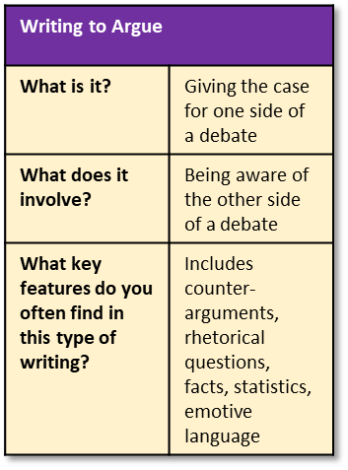
Here are the basic features to include:
It has the purpose and audience at its heart and addresses the audience clearly
Paragraphs are linked and show sequence
Uses rhetorical devices to show the audience is at the heart of the speech
A sign off at the end of the speech, such as: "Thank you for listening."
Thank you to the honoured ladies and gentlemen of the council who have allowed me to stand before you this evening. As one of thousands of concerned citizens across our beautiful county, I feel it a priority to speak about the lack of quality public transport links in our communities that are resulting in many of us resorting to using polluting, traffic-inducing, noisy cars.
At a time where we are all too aware of the harm car fumes are doing to our atmosphere and damaging the environment around us, it is pivotal that we embrace community buses, trams and trains. Instead of thirty separate vehicles travelling on our roads, we could have the same number of people or more in one bus, making roads less congested, massively reducing our carbon footprint, and making journeys affordable for all.
With the cost of living rocketing due to ever-increasing inflation, the number of jobs available plummeting and the wages of workers stagnating, it is becoming a greater challenge for many people to afford their own vehicle, to maintain it and to pay for the fuel needed to make essential journeys. Why are we not using council funds to increase the number of bus services available? Yes, taking a bus is less convenient and comfortable than a car, it is very hard to argue against that, but a journey by coach removes the responsibility of the individual to pay for fuel, vehicle maintenance and takes away the stresses of driving.
Moreover, we all want our local towns to thrive, and we are competing against out-of-town retailers and online merchants at the same time. We need to offer incentives for potential customers and clients to visit our towns. Installing park-and-ride schemes would wipe out traffic in our major town centres and allow visitors access to the town and back to their parked vehicles with ease. I have seen such a successful scheme created in Shrewsbury in Shropshire and it has meant pedestrians feel safer now that traffic through narrow and winding streets has been vastly reduced.
Additionally, tram services are becoming commonplace in larger cities and towns. Take the services being offered between Birmingham and Wolverhampton. They allow commuters a cheaper and less stressful method of going to and from work each day; they mean places just outside of the city centre have experienced greater footfall; they have reduced traffic and in turn – because the trams are fully electric – they have helped to reduce the cities’ pollution output. Of course, there is great cost involved, but the initial overheads are worth the eventual savings and benefits that can come from such investment.
Not only this, but the amount we spend on maintaining roads and filling in potholes is ludicrous. It is certainly a common enough complaint from residents: 42% of those interviewed for a recent survey for the local Advertiser newspaper said they were frustrated by the number of potholes they found on their car journeys. These potholes are caused by wear and tear to the road surface which is, of course, exacerbated by the volume of traffic on our roads. If we reduce the traffic, we will reduce the pothole issue, meaning in turn that we can use the money saved to continue to improve our infrastructure and transport systems.
Recently I visited Derby and saw first hand the advantages to increasing spending on local transport links. The bus services to and from Nottingham are absolutely wonderful: the buses have table seats, USB chargers for phones and other gadgets, curtains on the windows for a comfier journey, and all of the bus stops were well maintained and had digital timetables. These services are lightyears away from what we are offering at the moment, and I implore the members of the council to begin to take this issue seriously, so that we can move our county forwards into a brighter, cleaner and greener future. Thank you.

Slide 4
Introduction that thanks the council for allowing the writer to speak to them.
The writer argues that local transport is a priority for local people and the lack of action by the council means people are still using cars.
Thank you to the honoured ladies and gentlemen of the council who have allowed me to stand before you this evening. As one of thousands of concerned citizens across our beautiful county, I feel it a priority to speak about the lack of quality public transport links in our communities that are resulting in many of us resorting to using polluting, traffic-inducing, noisy cars.
At a time where we are all too aware of the harm car fumes are doing to our atmosphere and damaging the environment around us, it is pivotal that we embrace community buses, trams and trains. Instead of thirty separate vehicles travelling on our roads, we could have the same number of people or more in one bus, making roads less congested, massively reducing our carbon footprint, and making journeys affordable for all.
With the cost of living rocketing due to ever-increasing inflation, the number of jobs available plummeting and the wages of workers stagnating, it is becoming a greater challenge for many people to afford their own vehicle, to maintain it and to pay for the fuel needed to make essential journeys. Why are we not using council funds to increase the number of bus services available? Yes, taking a bus is less convenient and comfortable than a car, it is very hard to argue against that, but a journey by coach removes the responsibility of the individual to pay for fuel, vehicle maintenance and takes away the stresses of driving.
The writer focuses on the impact of transport on the environment as a reason for turning to public transport.
They explain how public transport can have a positive effect on the local environment.
The writer focuses on the cost of living and how the economy is offering challenges for local public.
They then argue that public transport will mean fewer costs for local people, and fewer responsibilities that go with private transport.

Slide 5
Moreover, we all want our local towns to thrive, and we are competing against out-of-town retailers and online merchants at the same time. We need to offer incentives for potential customers and clients to visit our towns. Installing park-and-ride schemes would wipe out traffic in our major town centres and allow visitors access to the town and back to their parked vehicles with ease. I have seen such a successful scheme created in Shrewsbury in Shropshire and it has meant pedestrians feel safer now that traffic through narrow and winding streets has been vastly reduced.
Additionally, tram services are becoming commonplace in larger cities and towns. Take the services being offered between Birmingham and Wolverhampton. They allow commuters a cheaper and less stressful method of going to and from work each day; they mean places just outside of the city centre have experienced greater footfall; they have reduced traffic and in turn – because the trams are fully electric – they have helped to reduce the cities’ pollution output. Of course, there is great cost involved, but the initial overheads are worth the eventual savings and benefits that can come from such investment.
The writer then changes focus to the effects of local transport on local businesses.
The writer argues that better local transport systems would result in more visitors to the town centre and fewer accidents or risks for pedestrians.
The writer continues to argue that public transport in local areas means a greater footfall, and therefore better for local businesses, but also that the environmental outcomes have a positive effect as well, resulting in savings in the long term.

Slide 6
The writer focuses onto the costs that private transport causes the council for damages to roads, including potholes.
They include statistics to add weight to their argument.
Not only this, but the amount we spend on maintaining roads and filling in potholes is ludicrous. It is certainly a common enough complaint from residents: 42% of those interviewed for a recent survey for the local Advertiser newspaper said they were frustrated by the number of potholes they found on their car journeys. These potholes are caused by wear and tear to the road surface which is, of course, exacerbated by the volume of traffic on our roads. If we reduce the traffic, we will reduce the pothole issue, meaning in turn that we can use the money saved to continue to improve our infrastructure and transport systems.
Recently I visited Derby and saw first hand the advantages to increasing spending on local transport links. The bus services to and from Nottingham are absolutely wonderful: the buses have table seats, USB chargers for phones and other gadgets, curtains on the windows for a comfier journey, and all of the bus stops were well maintained and had digital timetables. These services are lightyears away from what we are offering at the moment, and I implore the members of the council to begin to take this issue seriously, so that we can move our county forwards into a brighter, cleaner and greener future. Thank you.
The writer focuses on a specific example of how local transport systems can be run, and then ends their speech by arguing these services are far better than the ones that are offered in their own local area. Therefore, they ask the council to prioritise these services.

Slide 7
Look at how the writer links their paragraphs together
Instead of thirty separate vehicles travelling on our roads, we could have the same number of people or more in one bus, making roads less congested, massively reducing our carbon footprint, and making journeys affordable for all.
With the cost of living rocketing due to ever-increasing inflation, the number of jobs available plummeting and the wages of workers stagnating, it is becoming a greater challenge for many people to afford their own vehicle, to maintain it and to pay for the fuel needed to make essential journeys.
Discuss: What do you notice about how the paragraphs begin and end?
Bonus Challenge: Why is it crucial to carefully consider how you begin and end your paragraphs in non-fiction writing?

Slide 8

Thanking the audience (council) and setting out their argument
You are going to plan your speech now.
Divide up your speech into six or seven sections.
Choose a focus for each section.
Environmental factors
Cost and living and benefits of local transport
Speech success criteria
Introduction that acknowledges the audience (local council)
Has an effective opening paragraph that engages the audience
Includes awareness of others’ arguments
Paragraphs are linked together so they flow
Includes DAFORREST techniques for effect
Has an effective closing paragraph that leaves the audience with a powerful argument
The benefits of public transport for pedestrians and businesses
Environmental benefits that come with local public transport
Pothole damage caused by traffic
Comparison between Derby and local area. Thanks the council for listening.

Slide 9
Notes:
To print out if students need a diagram to structure their plans

Slide 10






There are many connectives we can use to link our ideas together
Adding
Moreover,
Furthermore,
Additionally,
As well as this,
In addition,
Besides this,
Cause and Effect
Therefore
Thus
Consequently,
As a result of
Comparing
Similarly,
Likewise,
In the same way,
In comparison,
Equally,
As with
Contrasting
In contrast,
However,
Despite this,
Conversely,
On the other hand,
Nevertheless,
Whereas
Illustrating
For example,
For instance,
As shown by
In the case of
Emphasising
Most of all,
In particular,
Above all,
Significantly,
Indeed,
Notably,
Ordering
Firstly,
Secondly,
Next,
Meanwhile,
Finally,
Revisit the paragraphs you have written for your speech so far and add in connectives to help them flow effectively.

Slide 11
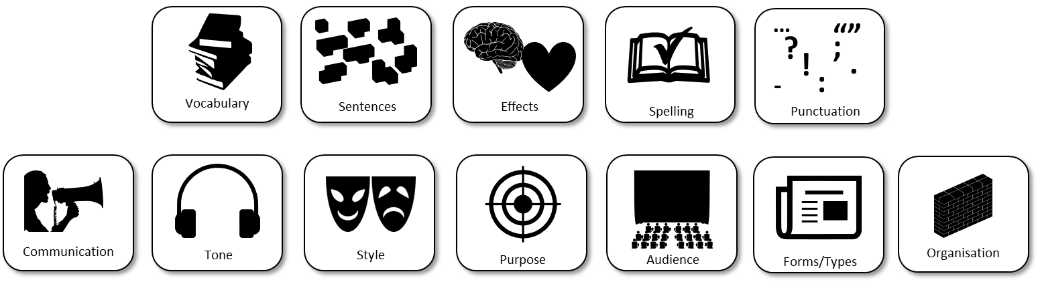
Next lesson we will be writing out our speeches in full
Let’s recap what we need to include in our speeches to make them effective.
Write down a list of success criteria for writing out your speech.
You will be able to use these for the next lesson.

Slide 12
Use vocabulary that is ambitious, impressive and professional to add weight to your perspectives.
Use sentence structures for effect to ensure you engage with your audience and meet the purpose of the text.
Ensure your writing affects how the audience feels about the topic you are addressing, including through the use of language (DAFORREST)
Double check your spelling, punctuation and grammar to make sure it is accurate and effective.
Convey your perspectives to the audience clearly and effectively so that the audience can be convinced about your ideas and perspectives.
Provide a consistent tone to your writing so you come across as knowledgeable, professional and convincing.
Use all of the conventions of speech writing and writing to argue to make sure you address the purpose and audience of the text.
Ensure your writing addresses the purpose (why you are writing), the audience (who you are writing to and the form/type (what you are writing).
Think about how you are starting and ending your speech and how you have organised your ideas into clear paragraphs with links to make them flow well.

Slide 13




Plenary: Head, Heart, Heave, Hold
Head: Write down one thing that has made you think in this lesson.
Heart: Write down what you have felt this lesson.
Heave: Write down one thing that you disagreed with in this lesson.
Hold: Write down one thing you will remember from this lesson.
To describe how an example speech is structured
To explain how we can structure our own speeches
To evaluate the effectiveness of the structure of an example speech

