Slide 1

AQA English Language Paper 1 Section A – Q3: Structure
Last lesson we began to explore structure and how we can analyse the structure of a text.
What skills are needed for Q3?
How can you analyse a text’s structure?
Why is structure just as important for a writer as language? Provide examples.

Slide 2
Learning outcomes
To describe the use of narrative perspective and empathy in the extract
To explain how we can improve our structural analysis in Q3
To apply our understanding of Q3 skills to our own answers

Slide 3

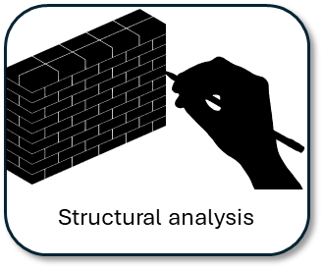

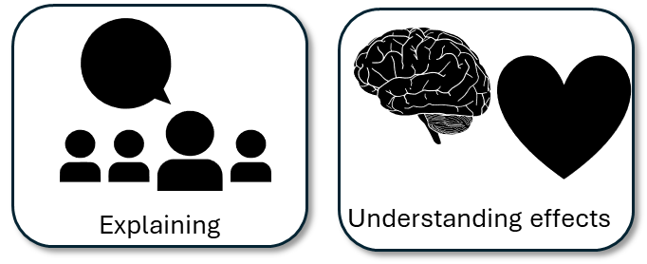
Q3 is worth 8 marks
Unlike Q2, you are asked to explore the whole text, not just a small part of it.
You will be given a particular area of structure to focus on, such as tension.

Slide 4
The question will also give you some potential areas to explore
You could write about:
• how tension has increased or decreased by the end of the source
• how the writer uses structure to create an effect
• the writer’s use of any other structural features, such as changes in mood, tone or perspective
Always read these bullet points carefully as they give you some really ideas for answering the question.
In this example the question suggests exploring the changes in tension throughout the text.
It highlights the importance of analysing the effects the structure has on the reader’s thoughts and feelings
Additionally, it suggest exploring changes in mood, tone or perspective.

Slide 5



Narrative perspectives
1st person
Use ‘I’ and ‘We’
Told as if the events are happening to you
Or you could be a character in the story
Example:
I stumble slowly through the dense forest, the branches smacking my face every couple of footsteps.
2nd person
Uses ‘You’ and talks directly to the reader.
Example:
You stumble slowly through the dense forest, the branches smacking your face every couple of footsteps.
3rd person
Uses ‘They’ or character names.
It is as if the narrator is telling the reader about other people.
Example:
Gertrude stumbles slowly through the dense forest, the branches smacking her face every couple of footsteps.
  What kind of narrative perspective is shown in the Life of Pi extract?
  How would using third-person in the Life of Pi extract change the tone and perspective?
  Why do you think the writer chose the narrative perspective used in the extract we have explored? Provide examples.

Slide 6
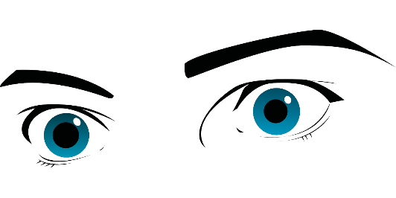



Perspectives
Who is telling the story? Who is your narrator?
1st Person (“I”, “Me”)
Told from the viewpoint of a character in the actual story or from a narrator who gets involved in the story. Really useful for getting across the main characters’ thoughts and feelings and making a story more personal and emotive.
2nd Person (“You”)
Told from the viewpoint of a narrator talking to you.
Example: You see the iron door in front of you, imposing. Hesitating, you slowly move your hand to towards the handle.
It can help to bring a reader into a story, but it’s quite a hard perspective to use well and powerfully.
3rd Person (“They”)
Told from the viewpoint of a narrator talking about other people.
Example: Michael saw the door in front of him, imposing. Hesitating, he slowly moved his hand to towards the handle.
This is a really common perspective in creative writing as it allows the narrator to be neutral or detached from the story, allowing you to make up your own mind about the events taking place.

Slide 7
The Life of Pi extract is told from a first-person narrative perspective
It was the hyena that worried me. I had not forgotten Father’s words.
This allows us to understand Pi’s thoughts and feelings as he finds himself trapped on the boat with a predator who could potentially kill him.
If the writer had chosen a third-person narration then we would experience the story and the tension as if told by an outsider looking in on what is happening.
Arguably, using a first-person narrator helps us to build empathy for the character.
Discuss: What is empathy? Why might we feel empathy for Pi?

Slide 8
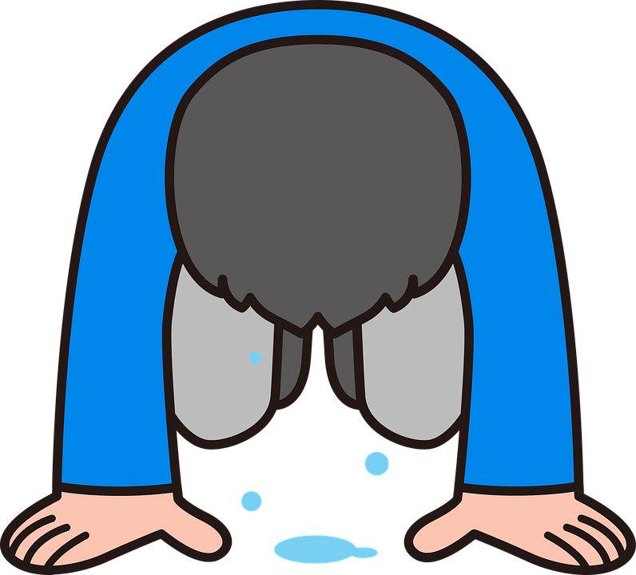
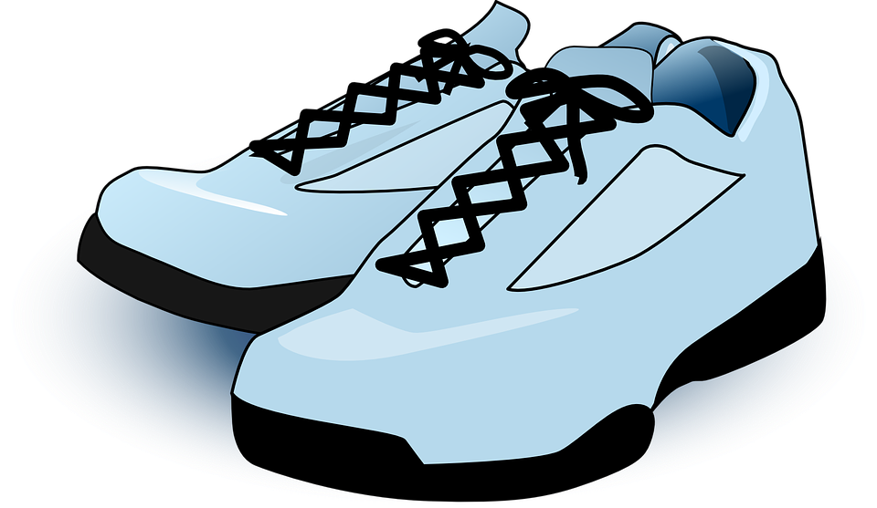
When analysing characters, it is important to think about sympathy and empathy
Sympathy is when we feel pity for a character.
For instance, if a character has suffered a tragedy or heart-breaking loss, this may make us as readers feel sorry for them.
Empathy is when we know how a character feels and we can picture ourselves in their situation.
For instance, if a character experiences something we can ourselves relate to, perhaps if they are ambitious or uncertain about something.

Slide 9
How do writers make us empathise with characters?
How a writer can make readers empathise with characters:
1) They have good values or characteristics like love, loyalty or bravery.
2) They are skilled at something.
3) They are forced into danger.
4) They show that they care for other people.
5) They are confident and in control of their situation.
6) They exist in a setting familiar to readers.
7) They go through similar experiences to the ones readers have been through themselves.
Read through this list of techniques for making readers feel empathy for characters.
Discuss: Why do you think we as readers tend to feel empathy for Pi in the extract?

Slide 10
How do writers make us empathise with characters?
How a writer can make readers empathise with characters:
1) They have good values or characteristics like love, loyalty or bravery.
2) They are skilled at something.
3) They are forced into danger.
4) They show that they care for other people.
5) They are confident and in control of their situation.
6) They exist in a setting familiar to readers.
7) They go through similar experiences to the ones readers have been through themselves.
Pi is clearly very knowledgeable about animals, with some of his knowledge having been acquired from his father.
Additionally, he is forced into a dangerous situation with a predator near him in an enclosed space.
Because Pi knows how hyenas behave and how unpredictable they can be, that makes us feel empathy towards him.

Slide 11

Q3: Structural analysis
This question asks you to focus on the WHOLE SOURCE. It is not about a small extract, but the whole text given to you.
You’re told that the text is from the middle of a novel. That information is important as it changes how structure is used by the writer.
You are also given three bullet points to look at:
• how tension has increased or decreased by the end of the source
• how the writer uses structure to create an effect
• the writer’s use of any other structural features, such as changes in mood, tone or perspective
  [8 marks]
Possible sentence starters to use:
In the extract the writer structures the chapter so at the beginning the reader can understand…
The use of the abrupt sentence at the beginning“…” makes clear to the reader that…
When the writer moves on to the next paragraph they… for the reader because…
As the extract progresses, the narrator focusses on… This helps the reader to understand that…
By the end of the extract, the narrator is focussing on… because it has the reader to see that…
Key terms:
Tension
Mood
Perspective
First-person narrative
Empathy
Focus
Climax
Cliff-hanger
Middle of the novel
Plan and write out your answer to this question
Timed conditions: 12 minutes

Slide 12
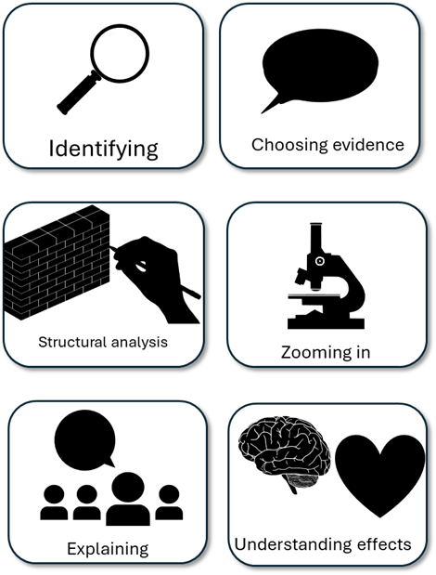
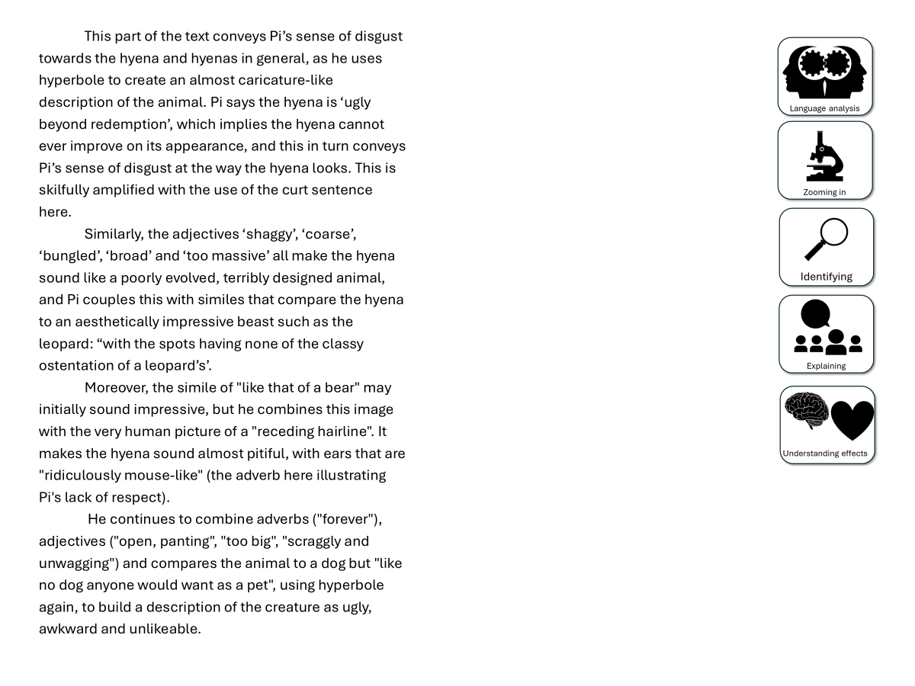
You have been given a good answer for Q3
Go through the answer and find one good example for each of the six skills shown. You could this through arrows, annotations or highlighting.
Bonus Challenge: The student has avoided using words like “shows” too often. What other analytical verbs have they used instead?

Slide 13

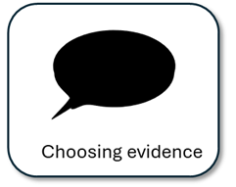
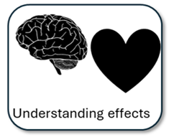
The extract begins with an abrupt short sentence: “It was the hyena that worried me”. As this is from the middle of a novel, as readers we would already know much about the characters, plot and themes, but starting the extract this way allows the writer to focus on the hyena in the boat and Pi’s concern regarding the predator being in close proximity. Next, Pi explains to us what his father told him about hyenas as a species: “Hyenas attack in packs whatever animal can be run down. They go for zebras, gnus and water buffaloes.” This description of the species sets up the reader to see the animals as vicious, ruthless and smart, which explains why Pi is worried about the hyena on his boat and turn begins to build up tension for the reader.
As the text moves onwards, Pi explains that he hopes the hyena will focus on the zebra or the orangutan, so that Pi will not become prey to the ferocious animal, whilst at the same time allowing Pi to focus on keeping the boat afloat: “I kept one eye on the horizon, one eye on the other end of the lifeboat.” At this point the text has been designed to fill us with fear and anticipation for what will happen next.
Despite this, the writer chooses to switch the focus to Pi’s thoughts on the appearance of the hyena, to begin with as a species as a whole: “It is ugly beyond redemption. "The whole description gives the impression of an animal that is poorly evolved and looks both stupid and ugly, quite the contrast to how the animal is described at the beginning of the text. Despite Pi’s fear, he still shows disgust and disrespect to the animal because of what it looks like: “with a high forehead, like that of a bear, but suffering from a receding hairline.”
This then allows Pi to refocus on the hyena on the boat, and he describes its behaviour: “I wondered what it was going to do next.” Despite knowing the animals well, a hyena is not normally trapped on a lifeboat in the middle of the ocean, making it unpredictable, and its actions make it sound almost comical: “And the whole time, lap after lap, it went yip yip yip yip yip in a high-pitched way.” These sudden changes in behaviour and movement help us to empathise with Pi, coupled with the use of first-person narration as we think and feel what Pi does in an incredibly tense situation.
For the rest of the extract, the writer mixes together descriptions of the hyena’s behaviour (“its claws were loudly clicking on the surface”), Pi’s deep-seated fear that he will be attacked, and his uncertainty over whether he will live or not (“I prepared for my end. For nothing.”) and the unpredictability of this animal given its new alien setting. Mixing together Pi’s in-depth knowledge of the animal with its new living conditions create this uncertainty, and this in turn keeps us in suspense, to the point where the animal stands and does nothing for the rest of the day. We feel Pi’s constant anxiety, which is only emphasised by the juxtaposition of the animal’s physical description with that of its usual behaviours, and its behaviours on the boat. The structure here truly amplifies this anxiety for the reader.

Slide 14
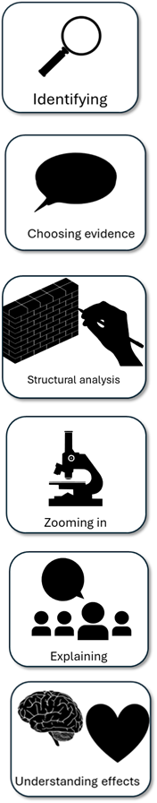
We will now peer assess our own answers
Swap your answers with another student.
1) What skills did the student use well in their answer?
Example: They showed how the focus shifted from P’s disgust for the hyena to the hyena’s behaviour
2) What skills could the student improve on in their answer?
Example: They need to explain why changing from Pi’s focus made us feel more tense as the extract went on.

Slide 15
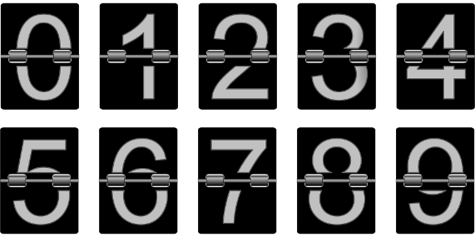
Plenary: Countdown
Q E S T A P V O U
In a pair, one person chooses nine random letters.
The other person then has to make a word that helps to describe their learning from today’s lesson!
You then switch around and swap roles.
To describe the use of narrative perspective and empathy in the extract
To explain how we can improve our structural analysis in Q3
To apply our understanding of Q3 skills to our own answers

