Slide 1



AQA English Language Paper 1 Section B: Using Sentences for Effect
Slowly, I opened the door. I felt the cold rust of the handle coarsely scrape my hand as I moved it downwards. My heart raced. The pitch-black darkness beyond the crumbling wooden frame grew as the door edged forwards. The beating core in my ribcage sped faster. Faster and faster. An ominous musty scent emanated from within. I stepped inside.
Read the short extract.
What do you notice about the sentences?
How do the sentences work to build mood?
Why do these sentence structures engage us as readers? Provide examples.
Sentences
Effects

Slide 2
Learning outcomes
To describe how we can use sentences for effect
To analyse how sentence types can affect a reader
To evaluate the effectiveness of our draft stories based on success criteria

Slide 3
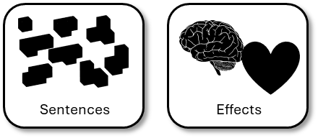
The extract begins with an adverbial starter and also a short sentence. It describes what the narrator does and nothing more.
The writer juxtaposes the opening short sentence with a much longer descriptive sentence.
Slowly, I opened the door. I felt the cold rust of the handle coarsely scrape my hand as I moved it downwards. My heart raced. The pitch-black darkness beyond the crumbling wooden frame grew as the door edged forwards. The beating core in my ribcage sped faster. Faster and faster. An ominous musty scent emanated from within. I stepped inside.
The longer descriptive sentence then places greater emphasis on the next short sentence. The image of the narrator’s heart racing next to the descriptive details and slow moments builds tension.
The final short sentence at the end of the paragraph allows the narrator to move on to the next plot event: what happens inside the house. It makes the reader desperate to know what will happen.
Again, the writer mixes long descriptive sentences with punchy short sentences that zoom in on specific images to amplify the tension. Very little action happens here, but the images and the sentence structures make us feel tense about what is about to happen. The writer creates suspense.

Slide 4

Using sentences for effect will get you marks
AO5 Content and organisation
Communicate clearly, effectively and imaginatively, selecting and adapting tone, style and register for different forms, purposes and audiences.
Organise information and ideas, using structural and grammatical features to support coherence and cohesion of texts.

Slide 5



Using sentences for effect will get you marks
AO6 Technical accuracy
Students must use a range of vocabulary and sentence structures for clarity, purpose and effect, with accurate spelling and punctuation.
…
“”
?
;
!
.
-
:
Vocabulary
Sentences
Effects
Spelling
Punctuation

Slide 6


Use your story plan from previous lessons to write out on section of your story
Write out one paragraph of your story and use sentences for effect.
Success Criteria:
Include at least one short sentence for effect.
Include longer descriptive sentences to build mood.
Bonus Criterion:
Consider where you place your sentences for maximum effect.

Slide 7
Success Criteria:
Include at least one short sentence for effect.
Include longer descriptive sentences to build mood.
Bonus Criterion:
Consider where you place your sentences for maximum effect.
Success Criteria:
Include at least one short sentence for effect.
Include longer descriptive sentences to build mood.
Bonus Criterion:
Consider where you place your sentences for maximum effect.
Success Criteria:
Include at least one short sentence for effect.
Include longer descriptive sentences to build mood.
Bonus Criterion:
Consider where you place your sentences for maximum effect.
Success Criteria:
Include at least one short sentence for effect.
Include longer descriptive sentences to build mood.
Bonus Criterion:
Consider where you place your sentences for maximum effect.
Success Criteria:
Include at least one short sentence for effect.
Include longer descriptive sentences to build mood.
Bonus Criterion:
Consider where you place your sentences for maximum effect.
Success Criteria:
Include at least one short sentence for effect.
Include longer descriptive sentences to build mood.
Bonus Criterion:
Consider where you place your sentences for maximum effect.

Slide 8
Peer assessment
Swap paragraphs with another student.
What did they do well?
Example: You included short sentences for effect.
What could they improve on?
Example: Put a short sentence at the end of the paragraph to link to the next section of the story.

Slide 9
Pace is another important tool for writers
You can use sentence structures to speed up or slow down how your readers interpret your story.
The train sped towards us. I tried to loosen the rope digging into my wrists. It was no use. The train came closer. Closer and closer. Steve’s panic grew greater as his eyes flashed bright white in the moonlight. Closer and closer. The monstrous black engine and its piercing lamps expanded out like unfriendly suns coming to engulf us.
Slow
Fast
Discuss: Do the sentence structures in this example slow down or speed up the writing?

Slide 10
We are now going to write out our draft stories
Write the opening to a story about a human meeting an animal.
Success Criteria: |  | Success Criteria: |  | Success Criteria:
Include a powerful opening to hook the reader in. |  | Use –ispaced for sentence openers. |  | Include at least one short sentence for effect.
Use a narrative hook. |  | Use simple, complex and compound sentences. |  | Include longer descriptive sentences to build mood.
Include a powerful ending to leave the reader wanting more.
Bonus Criterion:
Consider using flashforward or flashback to engage your readers. |  |  |  | Consider where you place your sentences for maximum effect.
You can use your notes and story plan from previous lessons to help you.

Slide 11
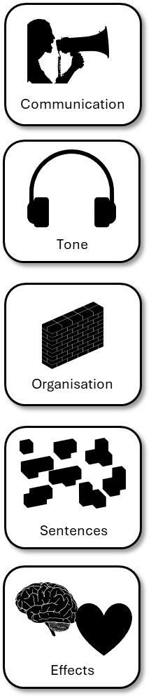
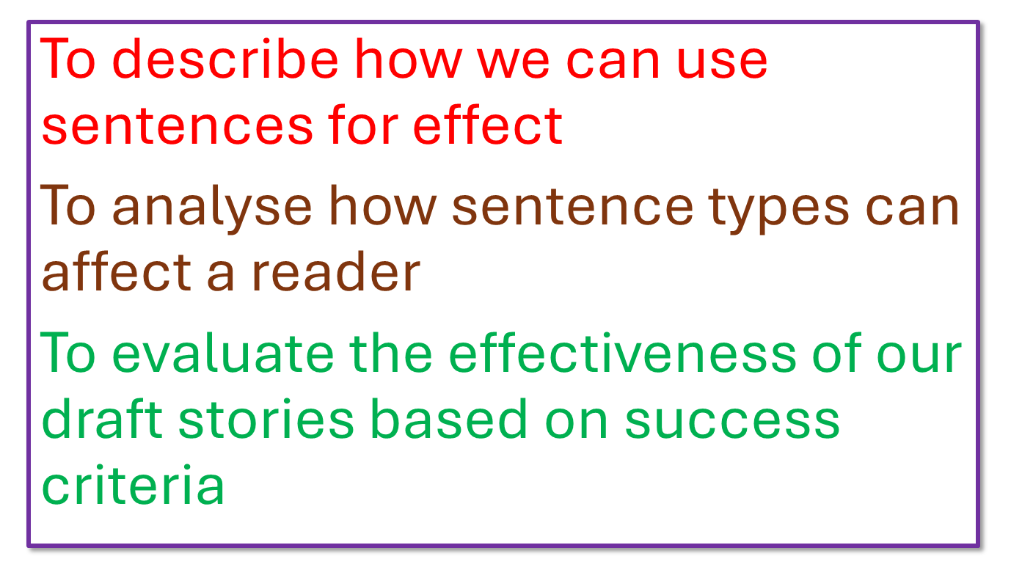
Plenary: Self-assessment reflection sheet
How confident do you feel about this area?
Which areas do you feel you need to spend more time on?
1) ______________________________________________________________________________
2)
______________________________________________________________________________
Not confident
Very confident

