Slide 1

AQA English Language Paper 1 Section – Q3: Structure
We are now going to focus on structure and structural analysis.
What does ‘structure’ mean when you are talking about texts?
How can writers change the structure of a text?
Why is structure just as important for a writer as language?
Mood
Tone
Character
Perspective
Place
Time
Beginning
Topic
Middle
Ending

Slide 2
Beginning
Place
Tone
Character
Perspective
Mood
Middle
Time
Topic
Ending
A writer will think about the structure of their text just as much as the language they use.
You may think that a text always starts with a beginning, but sometimes writers will start at the middle or even the ending! Have you heard of flashbacks and flashforwards?
Sometimes a writer will alter the mood, tone and perspective in a text to affect how the reader thinks and feels.
This is what we mean by structural analysis. We analyse a text to see how the writer has put together different building blocks and why.

Slide 3
Learning outcomes
To describe how the writer builds tension within an extract
To explain how the writer alters tension within the extract
To evaluate why the structure affects us as readers

Slide 4


Let’s look at how one person analyses structure
https://www.youtube.com/watch?v=oP3c1h8v2ZQ
Discuss: Why might this be a useful way of analysing structure?
Notes:
If link is broken, please get in touch at info@englishgcse.co.uk so we can help.

Slide 5
The extract we have been exploring is from the middle of a novel
Because the extract is from the middle of a novel, a number of areas have already been addressed.
Any reader of this text will already know about some of the characters, the plot so far, the settings and the key themes.
Therefore, the focus is likely to be on developing these areas further, perhaps with a particular focus (such as the hyena and how it reacts to being in this new setting).
Q3 will always tell whether the text is from the beginning, the middle or the end of the story it is from. Make sure you look out for this information when sitting your exam.

Slide 6

Q3 gives you an area of structure to focus on: tension
Short, snappy simple sentences that mean the reader has to keep pausing
Ellipses (…)
Keeping the action away from the reader as long as possible.
Powerful verbs (Thrashing, hitting, pummeling)
Including the 5 senses (See, hear, touch, taste, smell)
Emotive language
A change in the behaviour of characters
Creating an anxious mood and atmosphere to begin with
Changing to a chaotic mood and atmosphere
Speeding up or slowing down time
Repetition
Onomatopoeia (Crash! Bang! Wallop!)
Foreshadowing and foreboding (Hinting at what will happen)
Italics for emphasis
In the text we are looking at, the examiner wants you to focus on tension.
We will listen to a couple of audio clips with very different moods.
What do these two pieces of
music make you feel?
Which one of these two
pieces of music is more tense?
Why did one piece of music make you feel more tense than the other?
Notes:
Click on the audio symbols to begin playing the music.

Slide 7
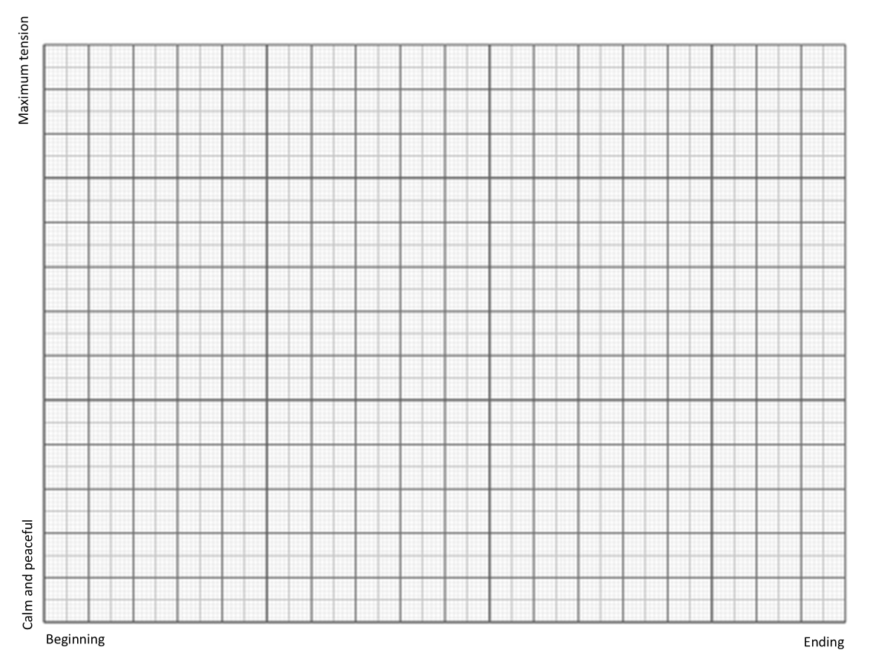
We will now explore the changing tension in the extract
On your graph:
Put an ‘x’ where you would place each paragraph.
Add a quote in for each ‘x’ to support your interpretations.
Explain why you chose each quotation.
x
x
x
x
x
x
x
x
Don’t copy this graph – it’s just an example and deliberately not accurate!

Slide 8
Maximum tension
Calm and peaceful
Beginning
Ending

Slide 9
Maximum tension
The tension increases as Pi hopes the zebra or orangutan “would distract it from thoughts of me”. He is terrified the hyena may attack him.
x
x
x
x
x
The focus shifts to the description of the hyena and its ugly appearance: it was ugly beyond redemption”. Arguably this is less tense as the focus is on its appearance and Pi’s disgust for the animal, rather than on its immediate danger to him.
x
x
Pi describes his worry about the hyena based on what his father has told him in the past: “It was the hyena that worried me.” Straight away, the beginning of the extract is tense.
x
Calm and peaceful
Beginning
Ending

Slide 10
Maximum tension
The sudden movements of the hyena raise the tension dramatically: “Nearly
immediately it leapt over the zebra and onto the stern bench.” The sudden shift from description to action makes us feel incredibly tense.
x
x
x
At this point our hearts are pounding! The hyena looks directly at Pi and he uses short sentences to slow down the pace but increase the tension: “I prepared for my end. For nothing.” He thinks he is going to die.
x
The tension increases again as Pi is seized with fear and slows down his description so that we hear every little sound he does: “The beating of its
legs against the benches made the whole boat shake”. This feels like a horror movie now as time seems to slow down and we wonder what will happen next.
x
x
x
x
Calm and peaceful
Beginning
Ending

Slide 11
Maximum tension
x
Pi tells us that the animal continues to run around the boat and “Every time the hyena paused at the stern bench, my heart jumped.” We thought Pi was going to die in the previous paragraph, but we are kept in suspense as the animal’s unpredictable behaviour continues.
x
x
x
x
x
x
x
In the final paragraph of the extract, the tension drops as the hyena vomits and then lies down: “. It
did not move from the restricted space for the rest of the day.” Whilst the tension remains, we know Pi is safe… for now.
Calm and peaceful
Beginning
Ending

Slide 12
Wow! That structure was intense
Can you see how the writer manipulated our thoughts and feelings about Pi as we read through the extract?
We felt genuine sympathy but also terror for Pi as we waited to see whether the hyena would attack and kill him, but it doesn’t.
However, because it hasn’t acted yet it keeps us in suspense, and we are not sure what will happen in the next chapter. This is not a happy ending, but also not a terrifying one either.

Slide 13
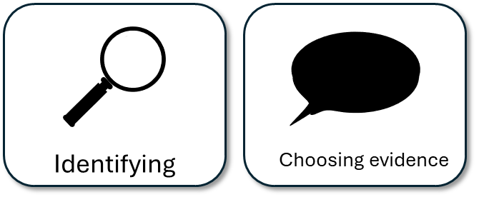
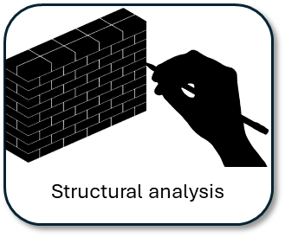

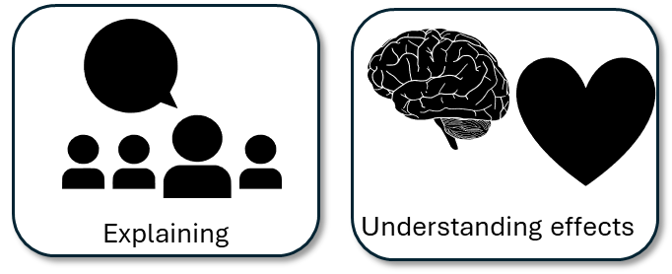
Next lesson we will transform our ideas into detailed analyses
We will be using many of the same skills we used for Q2, but this time our focus will on structure and its effects, rather than language.

Slide 14

Plenary: True or False
To describe how the writer builds tension within an extract
To explain how the writer alters tension within the extract
To evaluate why the structure affects us as readers
We will now ask each other true or false questions about what we have learnt today, for example:
“Structure isn’t as important as language.”
Be prepared to explain your answers.

