Slide 1



AQA English Language Paper 1 Section B: Sentences
So now I found myself on the way to the local dog rehoming centre! I’m always filled with a little trepidation when going to these places. They serve a fantastic purpose, but it can be incredibly challenging to see so many saddened and desperate animals, all longing for their own identity with a new owner and a new home. Unsurprisingly, it can be tremendously tough to choose just one animal out of hundreds, but I do believe in some sort of fate, and when you see your future canine, you just know. At least I hoped so.
Today we are going to explore how we can use our sentence structures to create effects and impact the reader.
Read this short extract from the story we have been analysing.
What do you notice about how the sentences start?
How is the final sentence different to the others?
Why do these sentence structures engage us as readers? Provide examples.
Sentences
Effects

Slide 2
Learning outcomes
To describe how we can vary sentences for effect
To analyse how sentence types can affect a reader
To evaluate the effectiveness of our use of sentence in our writing

Slide 3
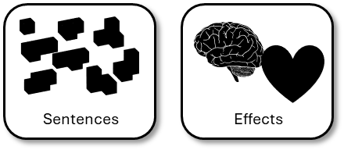
Each sentence begins in a different way.
You can repeat the beginning of sentences to create effects, but using a variety of sentence openers makes a text easier to read, provides a greater fluidity or clarity of writing, and keeps the reader engaged throughout.
This is a compound sentence. It is made up of different clauses (parts of a sentence) linked together by a conjunction (but).
So now I found myself on the way to the local dog rehoming centre! I’m always filled with a little trepidation when going to these places. They serve a fantastic purpose, but it can be incredibly challenging to see so many saddened and desperate animals, all longing for their own identity with a new owner and a new home. Unsurprisingly, it can be tremendously tough to choose just one animal out of hundreds, but I do believe in some sort of fate, and when you see your future canine, you just know. At least I hoped so.
The writer chose to use an adverbial starter for this sentence. Using –ly words at the beginning of sentences is an easy way to provide variety in your sentence openers.
The writer has chosen to end the paragraph with a short sentence. It highlights their doubt about finding the right dog for you but also reveals some hope they have that it might happen.

Slide 4

You are marked out of 24 marks for AO5
AO5 Content and organisation
Communicate clearly, effectively and imaginatively, selecting and adapting tone, style and register for different forms, purposes and audiences.
Organise information and ideas, using structural and grammatical features to support coherence and cohesion of texts.

Slide 5



You are marked out of 16 marks for AO6
AO6 Technical accuracy
Students must use a range of vocabulary and sentence structures for clarity, purpose and effect, with accurate spelling and punctuation.
…
“”
?
;
!
.
-
:
Vocabulary
Sentences
Effects
Spelling
Punctuation

Slide 6



Sentences have effects on a reader
Using different sentence types, sentence openers and sentence structures all affect how a reader understands your writing.
These effects all impact on the organisation of your story, your communication, your use of tone and the style of your writing.
That is why it is crucial to think carefully about how you use your sentences in your writing.

Slide 7
iSpaced!
-ing sentence openers
Simile sentence openers
Preposition sentence openers
Adverbial sentence openers
Connective sentence openers
-ed sentence openers
Dialogue sentence openers
Using iSpaced and the worksheet given to you:
Write out the first paragraph of your story
Write out the first paragraph of your story and include at least two different sentence openers
Write out the first paragraph of your story and see which sentence openers work best for creating effects.

Slide 8
-ing sentence openers
  Considering his future, he went to the Careers Advisor
  During the evening, it snowed heavily.
  Shouting, she ran away from the ghost.
Simile sentence openers
  As fast as a cheetah, he made his escape.
  Like a fish in the sea, she swam across the water.
Preposition sentence openers
  At the end of the evening, they returned home.
  Through the streets of Birmingham, there are thousands of shops.
  Inside the cupboard, it was dark and scary.
Adverbial sentence openers
  Quickly, he packed his bag for school.
  Silently, she read the book in the Library.
  Surprisingly, no one was in the classroom.
Connective sentence openers
  Although you worked hard today, it wasn’t quite enough for a merit.
  However, I will say well done for your effort.
  Despite his disappointment, the student kept smiling.
-ed sentence openers
  Disguised in her costume, she was a hit at Halloween
  Shocked by the score, the football team gave up.
  Challenged to a staring contest, the student reluctantly agreed.
Dialogue sentence openers
  “You can start a sentence with dialogue!” shouted the teacher.
  “That is amazing,” said the student, “I didn’t realise that!”
iSpaced!

Slide 9
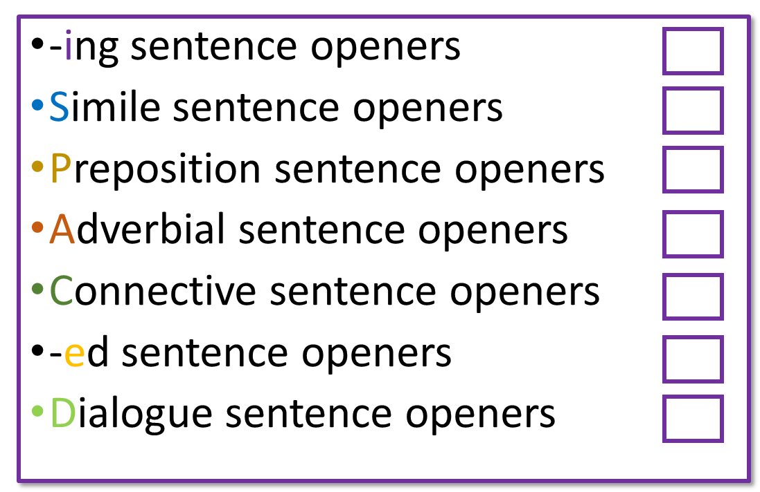
We will now peer assess our paragraphs
Glue in your sentence opener colour key into your book or onto your work.
Swap books with another student.
Feedback to your partner:
What did they do well?
Example: You used –ly words at the start of two sentences.
What could they improve on?
Example: Try to use an –ing sentence opener in your paragraph.

Slide 10
Notes:
To print off

Slide 11
You can also use different sentence types to engage your readers
Read the example story we have been analysing again.
Find and annotate (label) at least one simple sentence, one compound sentence and one complex sentence.
Bonus Challenge: Explain how the use of these different sentence types creates effects for the reader.

Slide 12
It felt like there was something missing. Life was great for me: a decent flat, a job that I enjoyed, I was living in a town full of friendly folk and with my family nearby. I should have been happy, but I’d had this nagging feeling at the back of my mind for a while now. Ultimately, the flat was wonderful but often too quiet.
So now I found myself on the way to the local dog rehoming centre! I’m always filled with a little trepidation when going to these places. They serve a fantastic purpose, but it can be incredibly challenging to see so many saddened and desperate animals, all longing for their own identity with a new owner and a new home. Unsurprisingly, it can be tremendously tough to choose just one animal out of hundreds, but I do believe in some sort of fate, and when you see your future canine, you just know. At least I hoped so.
Based on the outskirts of my hometown, surrounded by countryside and located close to a dairy farm, the air at the home consisted of smells of fertiliser before a wave of doggy odours hits you. Putting together hundreds of dogs together is never going to greet your nose with pleasant fragrances, and the overwhelming ‘eau du parfam’ is made up of urine, defecation, and cheap meat. When you’ve filled in the numerous piles of paper, put your signature on every dotted line, you’re allowed into the enclosures.
Walking in a straight line on a faded concrete floor, I felt like a visitor to a particularly intimidating prison, which in some ways I suppose I was. Going past each cage, the howls and whines increased. Some of the animals barked, others lay down and cried. Honestly, I really wanted to take them all home with me, but I knew that was just a far-fetched fantasy.
Just as I was about to reach the end of the corridor, I noticed a little creature curled up in the corner of their cell. She wasn’t interested in getting my attention, it was as if she was resigned to being bottom of the pile and last in the queue for a new place to live. She was a little Jack Russell-type dog, with a beautiful brown head, a predominantly white body and a large black patch on her back that was shaped similarly to a heart. Was this ordained by some force above? I didn’t know, but I had a good feeling about this one.
As I walked into her cage, she looked up at me for the first time and her tail immediately began to wag. Its speed accelerated, to the point where I was worried she was going to fly off into the air and disappear for good. She jumped up and put her paws on my knees. If I didn’t know better, I’d say she was smiling at me.
We headed out for a stroll amongst the fields and trees around the home. She didn’t pull on her lead, even though she was excited to get out of her enclosure. She was the one for me!
The sun began to head towards the horizon as the daylight was drawing to a close, but what a successful few hours this had been. Having considered giving my new friend a moniker, I went with ‘Lethe’. It’s a bit unusual, isn’t it? It’s the name of a Greek goddess, the goddess of forgotten things, which felt particularly apt for such a beautiful little creature trapped in a prison cell many miles from people.
Finally, I helped her into the back of my car and attached her to the special harness fitted in the back seat. Smiling at Lethe, we drove off, both on our way to our new lives.

Slide 13

Simple sentences have only one verb. They can be quite short.
Compound sentences:
these are two or more simple sentences joined by words like ‘for’ ‘and’, ‘nor, ‘but’, ‘or’, ‘yet’, ‘so’ (these are called conjunctions).
Complex sentences:
These are sentences that have more than one verb
They have more than one clause (part)
They can use connectives
They can use ‘ing’ or ‘ed’ verbs at the beginning.
Joe works hard.
Molly whispered to Isabelle.
Miss Smith asked for silence.
Boris plays the keyboard.
Caitlin likes reading.
Joe works hard and enjoys English lessons.
Miss Smith asked for silence but Molly whispered to Isabelle.
Connectives:
because,
whenever,
despite,
even though,
however,
although, whilst,
until, before,
after
Running towards the ball, Matt tripped.
Despite not feeling confident, Gertrude did well in the assessment.

Slide 14
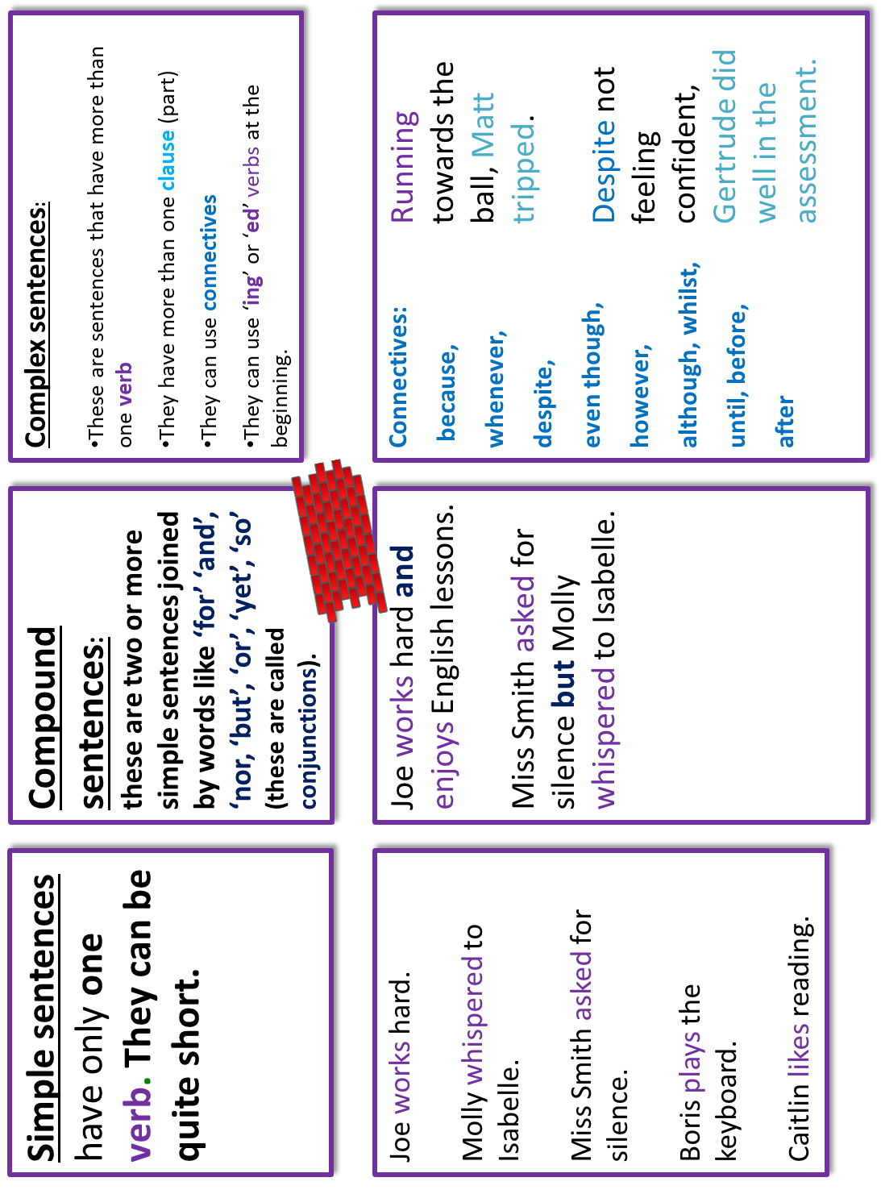

Slide 15
Based on the outskirts of my hometown, surrounded by countryside and located close to a dairy farm, the air at the home consisted of smells of fertiliser before a wave of doggy odours hits you.
This paragraph begins with an –ed sentence opener, but it also includes a complex sentence that has four clauses. This helps to build a powerful description of the rescue centre.
Was this ordained by some force above? I didn’t know, but I had a good feeling about this one.
This section features a compound sentence that allows the narrator to explain how they are feeling about the dog.
If I didn’t know better, I’d say she was smiling at me.
This is a complex sentence that conveys how the narrator sees the dog, convincing themselves that the chosen dog may even be smiling at them.
She was the one for me!
This short sentence at the end of the paragraphs gets across how excited the narrator is about their new dog.

Slide 16
Next lesson we will continue to explore how we can use sentences for effect

Slide 17






Plenary: Which picture?
Which picture best describes your learning today? Why? Be prepared to share your ideas.
To describe how we can vary sentences for effect
To analyse how sentence types can affect a reader
To evaluate the effectiveness of our use of sentence in our writing

