Slide 1
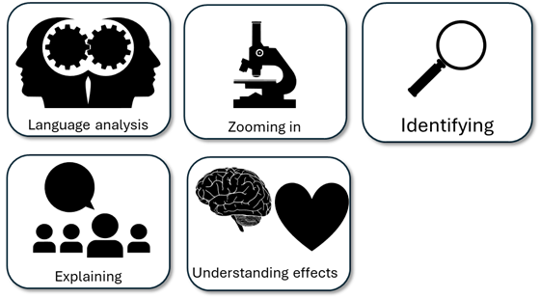
English Language Paper 1 – Q2: Improving Language Analyses
“Pi describes the hyena as ugly and he doesn’t like it because he says it is ugly.
“He says it is shaggy and coarse so that makes it sound really bad.”
Read the student answer to Q2 above.
What skills did they use in their answer?
How could they improve this answer?
Why does this answer not address AO2 effectively? Provide examples.
AO2
Explain, comment on and analyse how writers use language to achieve effects and
influence readers, using relevant subject terminology to support their views

Slide 2
Learning outcomes
To describe ways of improving our Q2 answers
To explain how student answers can better meet the requirements of the mark scheme
To evaluate the effectiveness of our improved Q2 answers

Slide 3


AO2
Explain, comment on and analyse how writers use language to achieve effects and influence readers, using relevant subject terminology to support their views
This is the mark scheme that examiners use to mark Q2:
Shows perceptive and detailed understanding of language:
• Analyses the effects of the writer’s choices of language
• Selects a range of judicious textual detail
• Makes sophisticated and accurate use of subject terminology
Student’s answer
Analysed the effects of the language
Included quotes to support ideas
Included subject terminology to support ideas

Slide 4
The student did include quotes, but…
“Pi describes the hyena as ugly and he doesn’t like it because he says it is ugly.
“He says it is shaggy and coarse so that makes it sound really bad.”
• Selects a range of judicious textual detail
Judicious means showing good judgement and sense.
… They didn’t explain the effects of language on the reader, and one good way to do this is by using a range of quotes that back up your interpretations.

Slide 5
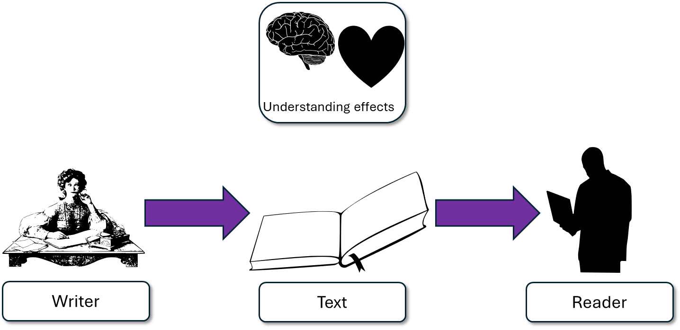
This part of the text conveys Pi’s sense of disgust towards the hyena and hyenas in general, as he uses hyperbole to create an almost caricature-like description of the animal. Pi says the hyena is ‘ugly beyond redemption’, which implies the hyena cannot ever improve on its appearance, and this in turn conveys Pi’s sense of disgust at the way the hyena looks. This is skilfully amplified with the use of the curt sentence here.
This student’s answer uses the same quote but look at how they’ve zoomed in on that quote and explained the effects on the reader.
Pi does say the hyena is ugly, but ‘ugly beyond redemption’. This means it is doomed to be like this forever, and that makes us as readers think the hyena is hideously ugly.
The student even goes on to say the short or curt sentence amplifies that sense of ugliness.

Slide 6
“I want to convey how much Pi is disgusted by the hyena.”
“Wow, this hyena isn’t just ugly, it is ugly beyond any hope! Pi is really disgusted by the hyena.”
“ugly beyond redemption”

Slide 7
Let’s help this student to improve part of their answer
“He says it is shaggy and coarse so that makes it sound really bad.”
“Its shaggy, coarse coat is a bungled mix of colours”
Student’s answer
Analysed the effects of the language
Included quotes to support ideas
Included subject terminology to support ideas
Using your understanding of the Q2 mark scheme, transform this into a more effective answer.

Slide 8
Let’s look at another student’s answer
Similarly, the adjectives ‘shaggy’, ‘coarse’, ‘bungled’, ‘broad’ and ‘too massive’ all make the hyena sound like a poorly evolved, terribly designed animal, and Pi couples this with similes that compare the hyena to an aesthetically impressive beast such as the leopard: “with the spots having none of the classy ostentation of a leopard’s”.
This student’s answer includes a range of evidence or quotes from the text that all help to support their idea: that the hyena is described as poorly designed. Using evidence from different parts of the extract can help to convince the examiner that you’re using evidence judiciously.

Slide 9
We should also include some language devices…
Similarly, the adjectives ‘shaggy’, ‘coarse’, ‘bungled’, ‘broad’ and ‘too massive’ all make the hyena sound like a poorly evolved, terribly designed animal, and Pi couples this with similes that compare the hyena to an aesthetically impressive beast such as the leopard: “with the spots having none of the classy ostentation of a leopard’s”.
Similarly, the adjectives ‘shaggy’, ‘coarse’, ‘bungled’, ‘broad’ and ‘too massive’ make it sound ugly, and also similes : “with the spots having none of the classy ostentation of a leopard’s”.
Student 1
Student 2
Discuss: What has the Student 1 included that Student 2 has not?

Slide 10
You must explain your interpretations
Remember that it is crucial that you include explanations as to why the quotes and devices have effects on the reader.
How do those quotes make the reader think and feel?

Slide 11
Last lesson we wrote our own Q2 answers
Drafting and redrafting is an important activity in English because it helps you to become a more effective English analyst.
Using your learning from today and the success criteria, rewrite your answer.
Your answer for Q2
Analysed the effects of the language
Included quotes to support ideas
Included subject terminology (devices) to support ideas
Bonus criteria:
Included analytical verbs
Used a range of quotes to support your ideas

Slide 12
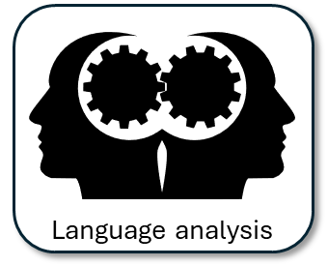


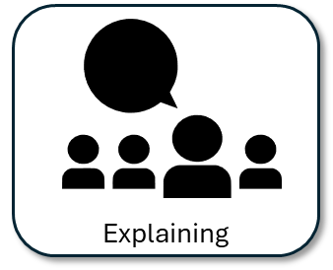
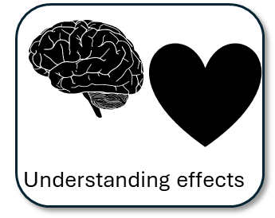
We will now peer assess our new answers
Swap your answers with another student.
Student’s Q2 answer |  | What could they add or change to improve their answer?
Analysed the effects of the language
Included quotes to support ideas
Included subject terminology (devices) to support ideas
Bonus criteria:
Included analytical verbs
Used a range of quotes to support your ideas

Slide 13
Student’s Q2 answer: |  | What could they add or change to improve their answer?
Analysed the effects of the language
Included quotes to support ideas
Included subject terminology (devices) to support ideas
Bonus criteria:
Included analytical verbs
Used a range of quotes to support your ideas
Notes:
To print out for students

Slide 14
Let’s recap Paper 1 Section A so far
Close your exercise books and cover up your notes.
What skills do you need to show for Q1? (4 marks)
What skills do you need to show for Q2? (8 marks)

Slide 15

Q1 Recap
Q1: You are given a short extract from the beginning of the text.
You are given four multiple choice questions: three options in each one.
Put a tick next to the correct answer for each question.
Do not put more than one tick per question.
Identifying

Slide 16
Q2 Recap
Q2: You are given a short extract from the text.
You are asked to explain how the writer describes something in that part of the text.
You must include quotes or evidence to support your ideas.
You should include some language devices.
You must explain how those quotes and devices support your ideas.

Slide 17
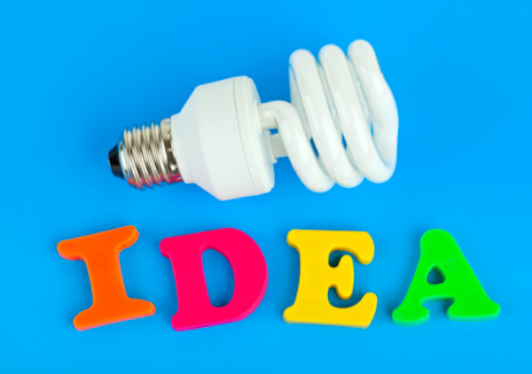

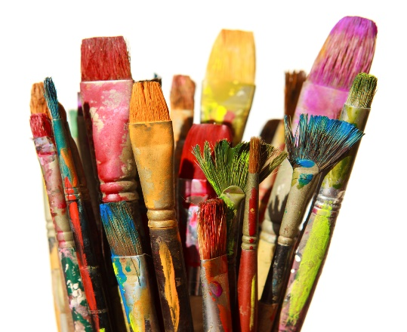

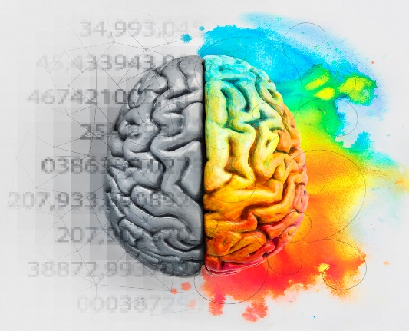

Plenary: Which picture?
Which picture best describes your learning today? Why? Be prepared to share your ideas.
To describe ways of improving our Q2 answers
To explain how student answers can better meet the requirements of the mark scheme
To evaluate the effectiveness of our improved Q2 answers

