Slide 1



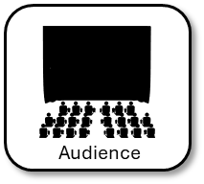
AQA English Language Paper 2 Section B: Language Devices
Direct address (“you”)
A
F
O
R
R
E
S
T
There are a number of language devices that are often used in non-fiction texts.
Write down all of the DAFORREST techniques you can remember.
Bonus Challenge:
Explain how each one can be used to affect the audience of a non-fiction text.
Example: Direct address means the writer is speaking to the audience directly and making them feel aware or a part of the issues being discussed.

Slide 2
Learning outcomes
To describe key non-fiction language devices and their effects
To explain how the writer uses language devices in an example speech
To evaluate the effectiveness of our own paragraphs based on language technique success criteria.

Slide 3

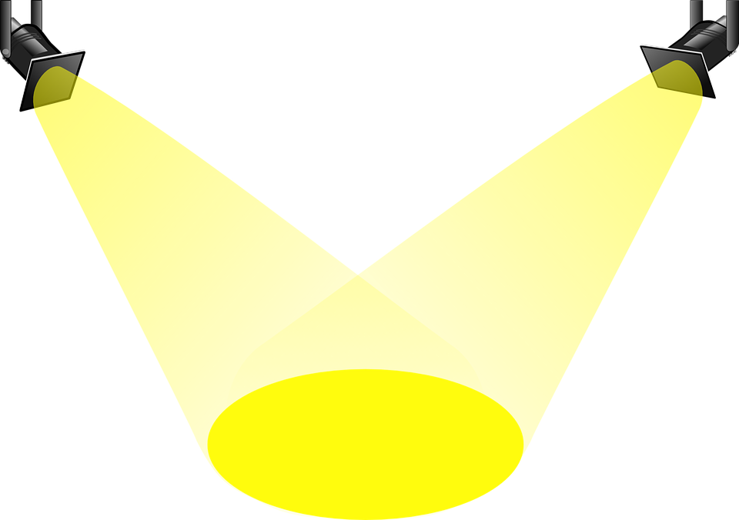

One easy way to remember non-fiction language devices is DAFORREST
Direct address (“you”)
Alliteration / Adjectives
Facts
Opinions
Rhetorical questions
Repetition
Exaggeration / Emotive language / Examples
Statistics
Tone / Triplets
These are common features found in non-fiction texts, but there are many, many more and it’s best to know as many as you can before you sit an assessment or exam.
Direct address means the writer is speaking to the audience directly and making them feel aware or a part of the issues being discussed.
Adjectives are a useful way of describing something in a positive or negative way, which can help to convince an audience to think the same way as you do.
Facts are used to add weight to a viewpoint.

Slide 4
One easy way to remember non-fiction language devices is DAFORREST
Direct address (“you”)
Alliteration / Adjectives
Facts
Opinions
Rhetorical questions
Repetition
Exaggeration / Emotive language / Examples
Statistics
Tone / Triplets
These are common features found in non-fiction texts, but there are many, many more and it’s best to know as many as you can before you sit an assessment or exam.
Opinions are needed for most types of non-fiction writing to show a writer’s perspective on a topic.
Rhetorical questions are often used in writing to persuade and writing to argue to convince an audience to agree with the writer’s viewpoint.
Repetition helps to reiterate or refocus on a central idea and highlight its importance.

Slide 5
One easy way to remember non-fiction language devices is DAFORREST
Direct address (“you”)
Alliteration / Adjectives
Facts
Opinions
Rhetorical questions
Repetition
Exaggeration / Emotive language / Examples
Statistics
Tone / Triplets
These are common features found in non-fiction texts, but there are many, many more and it’s best to know as many as you can before you sit an assessment or exam.
Exaggeration or hyperbole can be used to convince an audience to see the importance of the viewpoint.
Emotive language highlights how passionate or strongly a writer believes in a topic.
Statistics add weight to the writer’s perspective.
Tone is crucial in convincing an audience to support a writer’s viewpoint. It is how the writing sounds to an audience.
Triples or rule of three are another way of adding weight to a viewpoint.

Slide 6
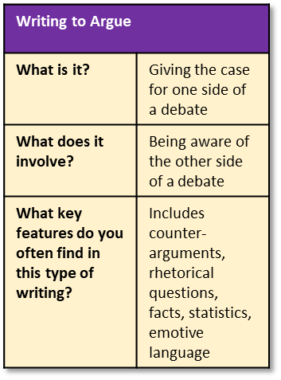
Here are the basic features to include:
It has the purpose and audience at its heart and addresses the audience clearly
Paragraphs are linked and show sequence
Uses rhetorical devices to show the audience is at the heart of the speech
A sign off at the end of the speech, such as: "Thank you for listening."
Thank you to the honoured ladies and gentlemen of the council who have allowed me to stand before you this evening. As one of thousands of concerned citizens across our beautiful county, I feel it a priority to speak about the lack of quality public transport links in our communities that are resulting in many of us resorting to using polluting, traffic-inducing, noisy cars.
At a time where we are all too aware of the harm car fumes are doing to our atmosphere and damaging the environment around us, it is pivotal that we embrace community buses, trams and trains. Instead of thirty separate vehicles travelling on our roads, we could have the same number of people or more in one bus, making roads less congested, massively reducing our carbon footprint, and making journeys affordable for all.
With the cost of living rocketing due to ever-increasing inflation, the number of jobs available plummeting and the wages of workers stagnating, it is becoming a greater challenge for many people to afford their own vehicle, to maintain it and to pay for the fuel needed to make essential journeys. Why are we not using council funds to increase the number of bus services available? Yes, taking a bus is less convenient and comfortable than a car, it is very hard to argue against that, but a journey by coach removes the responsibility of the individual to pay for fuel, vehicle maintenance and takes away the stresses of driving.
Moreover, we all want our local towns to thrive, and we are competing against out-of-town retailers and online merchants at the same time. We need to offer incentives for potential customers and clients to visit our towns. Installing park-and-ride schemes would wipe out traffic in our major town centres and allow visitors access to the town and back to their parked vehicles with ease. I have seen such a successful scheme created in Shrewsbury in Shropshire and it has meant pedestrians feel safer now that traffic through narrow and winding streets has been vastly reduced.
Additionally, tram services are becoming commonplace in larger cities and towns. Take the services being offered between Birmingham and Wolverhampton. They allow commuters a cheaper and less stressful method of going to and from work each day; they mean places just outside of the city centre have experienced greater footfall; they have reduced traffic and in turn – because the trams are fully electric – they have helped to reduce the cities’ pollution output. Of course, there is great cost involved, but the initial overheads are worth the eventual savings and benefits that can come from such investment.
Not only this, but the amount we spend on maintaining roads and filling in potholes is ludicrous. It is certainly a common enough complaint from residents: 42% of those interviewed for a recent survey for the local Advertiser newspaper said they were frustrated by the number of potholes they found on their car journeys. These potholes are caused by wear and tear to the road surface which is, of course, exacerbated by the volume of traffic on our roads. If we reduce the traffic, we will reduce the pothole issue, meaning in turn that we can use the money saved to continue to improve our infrastructure and transport systems.
Recently I visited Derby and saw first hand the advantages to increasing spending on local transport links. The bus services to and from Nottingham are absolutely wonderful: the buses have table seats, USB chargers for phones and other gadgets, curtains on the windows for a comfier journey, and all of the bus stops were well maintained and had digital timetables. These services are lightyears away from what we are offering at the moment, and I implore the members of the council to begin to take this issue seriously, so that we can move our county forwards into a brighter, cleaner and greener future. Thank you.

Slide 7
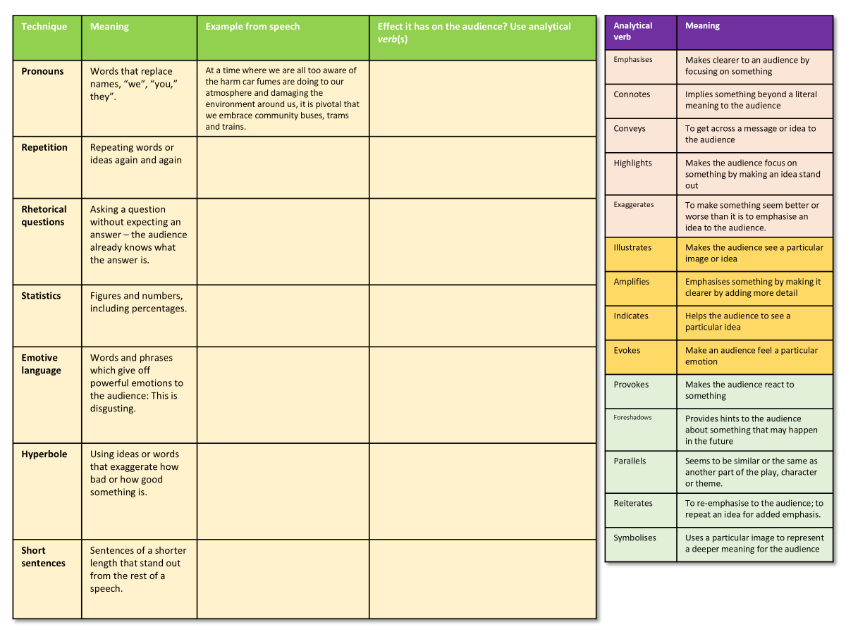
Let’s focus on how the writer is able to use language devices to engage their audience
Challenge: Complete the table, finding examples of each type of technique being used in the example speech.
Extra Challenge: Explain how each technique helps to have a particular effect on the audience.
Mega Challenge: Include at least one analytical verb (see table on sheet) in each of your analyses.
'Cars are convenient, comfortable and save time. However, we need to use them less by making public transport such as trains, trams, and buses cheaper, more reliable and easier to access.'

Slide 8
Technique | Meaning | Example from speech | Effect it has on the audience? Use analytical verb(s)
Pronouns | Words that replace names, “we”, “you,” they”. | At a time where we are all too aware of the harm car fumes are doing to our atmosphere and damaging the environment around us, it is pivotal that we embrace community buses, trams and trains.
Repetition | Repeating words or ideas again and again
Rhetorical questions | Asking a question without expecting an answer – the audience already knows what the answer is.
Statistics | Figures and numbers, including percentages.
Emotive language | Words and phrases which give off powerful emotions to the audience: This is disgusting.
Hyperbole | Using ideas or words that exaggerate how bad or how good something is.
Triplets / Rule of Three | The use of three ideas or adjectives in a row.
Analytical verb | Meaning
Emphasises | Makes clearer to an audience by focusing on something
Connotes | Implies something beyond a literal meaning to the audience
Conveys | To get across a message or idea to the audience
Highlights | Makes the audience focus on something by making an idea stand out
Exaggerates | To make something seem better or worse than it is to emphasise an idea to the audience.
Illustrates | Makes the audience see a particular image or idea
Amplifies | Emphasises something by making it clearer by adding more detail
Indicates | Helps the audience to see a particular idea
Evokes | Make an audience feel a particular emotion
Provokes | Makes the audience react to something
Foreshadows | Provides hints to the audience about something that may happen in the future
Parallels | Seems to be similar or the same as another part of the play, character or theme.
Reiterates | To re-emphasise to the audience; to repeat an idea for added emphasis.
Symbolises | Uses a particular image to represent a deeper meaning for the audience

Slide 9
Technique | Meaning | Example from speech | Effect it has on the audience? Use analytical verb(s)
Pronouns | Words that replace names, “we”, “you,” they”. | At a time where we are all too aware of the harm car fumes are doing to our atmosphere and damaging the environment around us, it is pivotal that we embrace community buses, trams and trains. | The writer helps to convince the audience that their perspective is valid and one that affects the audience as well. Rather than using ‘I’ or ‘they’, using the pronoun ‘we’ makes the audience feel that the issue of public transport is also one that concerns them.
Repetition | Repeating words or ideas again and again | If we reduce the traffic, we will reduce the pothole issue | The writer repeats the verb ‘reduce’ to highlight how taking cars off the road will also affect the number of potholes created on roads. Repeating ‘reduce’ makes the audience think improving public transport will add benefits in terms of reducing costs.
Rhetorical questions | Asking a question without expecting an answer – the audience already knows what the answer is. | Why are we not using council funds to increase the number of bus services available? | This rhetorical question does not need an answer. The writer is implying that there is no excuse for not improving bus services given the benefits they provide. The writer is trying to convince the audience that bus services must improve in order to help with issues related to local transport.
Statistics | Figures and numbers, including percentages. | 42% of those interviewed for a recent survey for the local Advertiser newspaper said they were frustrated by the number of potholes they found on their car journeys | This statistic gives weight to the writer’s claims that local public transport needs to improve, and money needs to be spent on it by the council. They claim 42% of people in a recent survey are frustrated by potholes. All of those people vote in local elections and the council will take notice of their views as a result.

Slide 10
Emotive language | Words and phrases which give off powerful emotions to the audience: This is disgusting. | Not only this, but the amount we spend on maintaining roads and filling in potholes is ludicrous. | The adjective ‘ludicrous’ is emotive and highlights the writer’s frustration that little action is being taken to address potholes in the local area. This language is used to make the council consider changes to their spending and convince them that the writer/speaker is arguing with passion and sincerity.
Hyperbole | Using ideas or words that exaggerate how bad or how good something is. | The lack of quality public transport links in our communities that are resulting in many of us resorting to using polluting, traffic-inducing, noisy cars. | Arguably, adjectives like “polluting, traffic-inducing, noisy” are a form of hyperbole, given the number of people who use cars in the local area, but the hyperbole is used to convince the council that buses offer alternatives to people and that more spending should be used on public transport.
Triplets / Rule of Three | The use of three ideas or adjectives in a row. | Making roads less congested, massively reducing our carbon footprint, and making journeys affordable for all. | The writer has written three reasons why public transport offers benefits to the public in a row to add weight to their viewpoint and convince the council that more money should be spent on local services.

Slide 11

We will write a new paragraph for our own speeches
Example
At a time where we are all too aware of the harm car fumes are doing to our atmosphere and damaging the environment around us, it is pivotal that we embrace community buses, trams and trains. Instead of thirty separate vehicles travelling on our roads, we could have the same number of people or more in one bus, making roads less congested, massively reducing our carbon footprint, and making journeys affordable for all.
In the last lesson we wrote out our draft opening paragraphs.
Let’s move on to one specific topic we want to cover.
Sentence starters
Initially, we should focus on…
To begin with, it’s important we consider…
Our first priority must be…
Write out one paragraph for your speech.
Remember to include language devices that will help engage and influence the audience.
Language devices success criteria
Pronouns
Repetition
Rhetorical questions
Statistics
Emotive language
Hyperbole
Triplets / Rule of Three

Slide 12
Language devices success criteria
Pronouns
Repetition
Rhetorical questions
Statistics
Emotive language
Hyperbole
Triplets / Rule of Three
Language devices success criteria
Pronouns
Repetition
Rhetorical questions
Statistics
Emotive language
Hyperbole
Triplets / Rule of Three
Language devices success criteria
Pronouns
Repetition
Rhetorical questions
Statistics
Emotive language
Hyperbole
Triplets / Rule of Three
Language devices success criteria
Pronouns
Repetition
Rhetorical questions
Statistics
Emotive language
Hyperbole
Triplets / Rule of Three

Slide 13
Swap paragraphs with another student
Language devices success criteria
Pronouns
Repetition
Rhetorical questions
Statistics
Emotive language
Hyperbole
Triplets / Rule of Three
Use the success criteria checklist to see which DAFORREST techniques they have included in their paragraph.
What did they do well?
How could they improve their paragraph using language devices?

Slide 14

Plenary: The Hand of Progress
Draw around your hand in your exercise book.
On each finger, write down one thing you’ve learnt from today’s lesson.
To describe key non-fiction language devices and their effects
To explain how the writer uses language devices in an example speech
To evaluate the effectiveness of our own paragraphs based on language technique success criteria.

