Slide 1

AQA English Language Paper 1 Section B: Assessment Planning
Write the opening of a story about a life-saving rescue.
We have spent the last nine lessons planning and drafting our writing piece.
Today is your chance to put together all your learning and create your final story.
Write a list of success criteria for getting a top mark for this question.
Bonus Challenge: Which areas will you need to focus on today to make sure you have made improvements from your draft to your final piece?

Slide 2
Learning outcomes
To describe how to gain a top mark in Paper 1 Section B (story writing)
To explain how you can improve from your draft when writing out your final piece
To evaluate the effectiveness of your learning based on success criteria

Slide 3

This is what you need to achieve for top marks for AO5 (24 marks)
Content
• Communication is convincing and compelling and directly relevant to focus and task
• Tone, style and register are assuredly matched to purpose and audience
• Extensive and ambitious vocabulary with sustained crafting of linguistic devices
You need to communicate your ideas well, so you need to think about what effects your story is having on your reader. Will it interest and excite them?
We’ve spent lots of time exploring tone. It is crucial to build up mood and atmosphere to engage your readers.
Think about genre and the story style you will use.
Consider your use of vocabulary and language and how these can interest and engage your readers in your story.

Slide 4
This is what you need to achieve for top marks for AO5 (24 marks)
Organisation
• Varied and inventive use of structural features
• Writing is compelling, incorporating a range of convincing and complex ideas
• Fluently linked paragraphs with seamlessly integrated discourse markers
We’ve spent lots of time exploring sentence types, sentence openers, short sentences and long sentences for effect, and how we use our sentences within our paragraphs and overall structure.
Consider how you are using language and structure to engage your readers.
Remember ToPTiPs and how you can link paragraphs together using connectives and linking sentences.

Slide 5




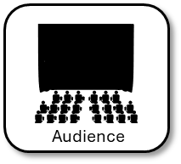


Examiners are given this list of success criteria to help them mark your story
Distinctive and original narrative perspective.
Convincing character/s.
Impressive vocabulary, used judiciously.
Detailed and convincing setting.
Conceptualized ideas.
Convincing sequence of events, skilful temporal and spatial shifts.
Impressive control of phrasing.
Subtle and skilful shifts in mood/ atmosphere.
Crafted style.
The examiner wants your narrative to be original and distinctive. This means it is a good idea to consider what genre of text you will adapt for the style of your writing.
Your characters need to be convincing, so think about the way they speak, they act, they are described and what they think and feel.
You should include a setting and make it detailed and convincing.
Your structure and organisation can be shown through changes in time or place.
Tone is very important and changing the mood or atmosphere within your story can help you to get top marks.
Make sure your vocabulary and sentences are used for effect to impact on your readers.

Slide 6






This is what you need to achieve for top marks for AO6 (16 marks)
Sentence demarcation is consistently secure and consistently accurate
Wide range of punctuation is used with a high level of accuracy
Uses a full range of appropriate sentence forms for effect
Uses Standard English consistently and appropriately with secure control of complex grammatical structures
High level of accuracy in spelling, including ambitious vocabulary
Extensive and ambitious use of vocabulary
Make sure you’ve put your full stops and commas in the right places.
Use other types of punctuation such as: colons, semicolons, speech marks, dashes, hyphens, exclamation marks, question marks and so on.
Check your grammar and sentence structures to make sure they read well.
Check your spelling of difficult words to make sure you haven’t made any mistakes.
Try to impress with your vocabulary, but don’t sacrifice your style by putting too many impressive words just for the sake of it!
…
?
;
!
.
-
:
Vocabulary
Sentences
Effects
Spelling
Punctuation

Slide 7
Re-read your draft story
Communication
Write down three targets for yourself to improve on your draft when writing your final story.
Here are a few examples:
Use a narrative hook at the beginning of my story
Use ToPTiPs for paragraphing
Include some short sentences for effect.
Tone, style, register
Vocabulary
Structure
Ideas
Paragraphs
Sentences
Punctuation
Grammar
Spelling

Slide 8
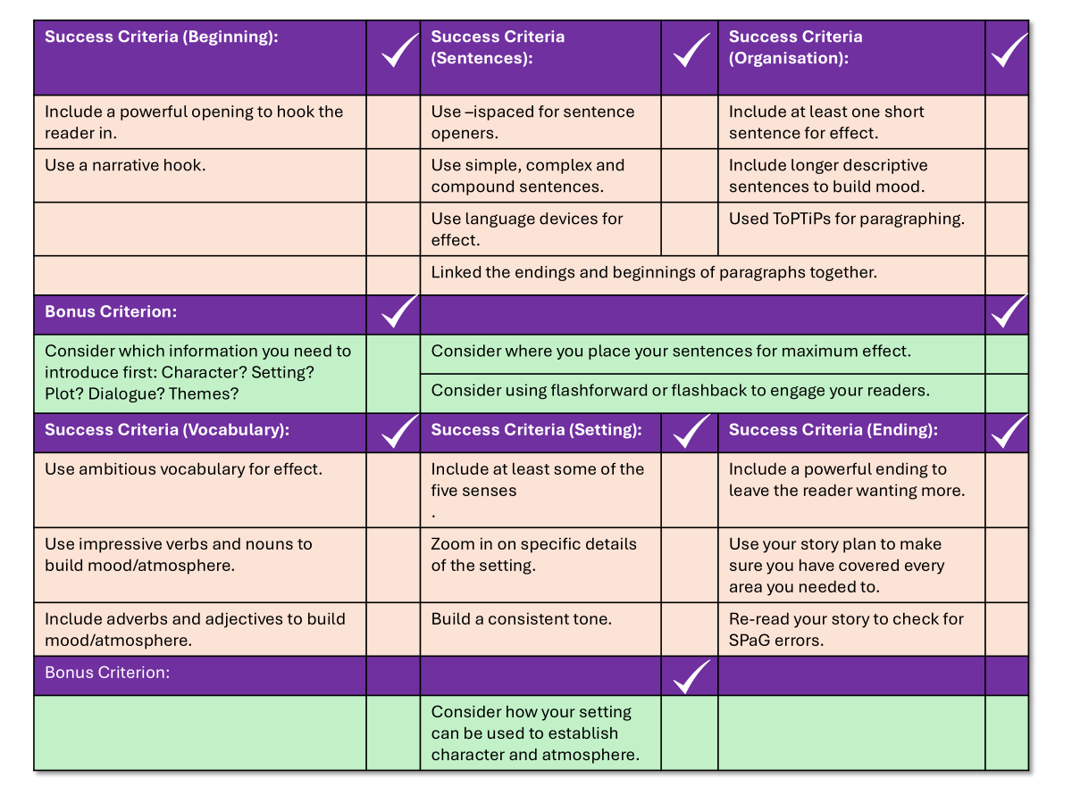
You now have one hour to write your story
Write the opening of a story about a life-saving rescue.
Use your checklist to help you write out your final story.
You may refer to your notes from this term if you wish.
You have one hour to complete your story.
Good luck!

Slide 9

Success Criteria (Beginning): |  | Success Criteria (Sentences): |  | Success Criteria (Organisation):
Include a powerful opening to hook the reader in. |  | Use –ispaced for sentence openers. |  | Include at least one short sentence for effect.
Use a narrative hook. |  | Use simple, complex and compound sentences. |  | Include longer descriptive sentences to build mood.
Think about how you introduce your themes straight away |  | Use language devices such as pathetic fallacy and personification for effect. |  | Used ToPTiPs for paragraphing.
 |  | Linked the endings and beginnings of paragraphs together.
Bonus Criterion:
Consider which information you need to introduce first: Character? Setting? Plot? Dialogue? Themes? |  | Consider where you place your sentences for maximum effect.
 |  | Consider using flashforward or flashback to engage your readers.
Success Criteria (Vocabulary): |  | Success Criteria (Setting): |  | Success Criteria (Ending):
Use ambitious vocabulary for effect. |  | Include at least some of the five senses . |  | Include a powerful ending to leave the reader wanting more.
Use impressive verbs and nouns to build mood/atmosphere. |  | Zoom in on specific details of the setting. |  | Use your story plan to make sure you have covered every area you needed to.
Include adverbs and adjectives to build mood/atmosphere. |  | Build a consistent tone. |  | Re-read your story to check for SPaG errors.
Bonus Criterion:
 |  | Consider how your setting can be used to establish character and atmosphere. |  | Double check your use of speech punctuation and commas.

Slide 10

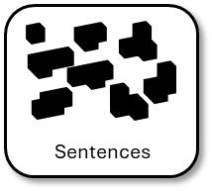


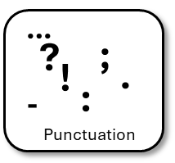
Plenary: Self-assessment reflection sheet
How confident do you feel about this area?
Not confident
Very confident
Which areas do you feel you need to spend more time on?
1) ______________________________________________________________________________________
2)
______________________________________________________________________________________

