Slide 1
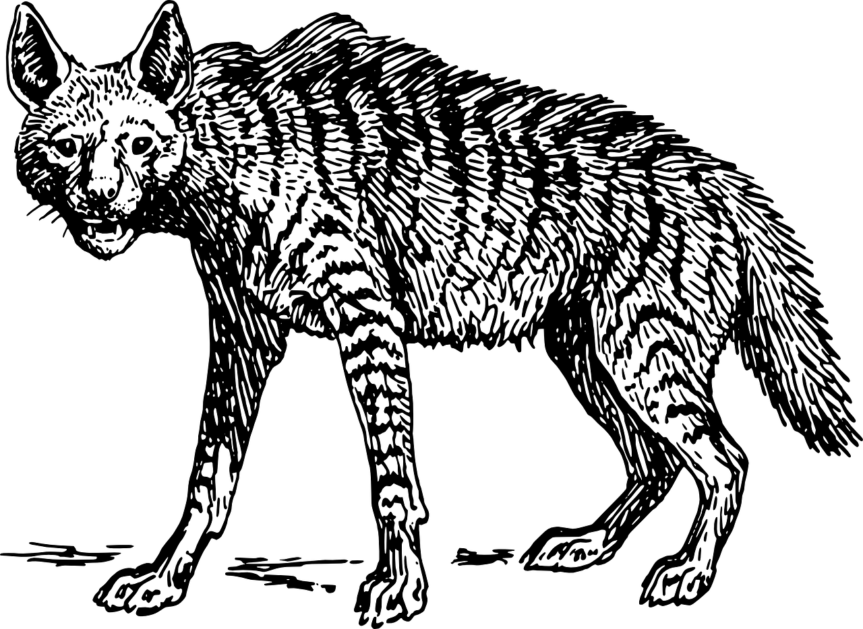
English Language Paper 1 – Q2: Language Analysis
In the previous lesson we began to explore Paper 1 Section A.
What skills are you asked to show off for this exam paper?
How can you ensure you answer Q1 effectively?
Why is it so important to find evidence to back up your interpretations?

Slide 2

Q1 (4 marks)
Identifying
Question 1 will ask you to focus on a specific section of the text.
In the case of the Life of Pi text, the question asks you to focus on lines 1 to 9.
There are four sections to this question which are all multiple choice.
Success criteria for Q1
Read this part of the text carefully
Identify the information that best fits the three options for each question

Slide 3
Learning outcomes
To describe the use of language in the extract
To explain how we can improve our language analysis in Q2
To apply our understanding of Q2 skills to our own answers

Slide 4


Today we will focus on language analysis
Q2 will always ask you to analyse the language in a specific part of the text, for a specific reason.
In this paper, the exam task asks: “How does the writer use language here to describe the hyena’s appearance?”
We know the narrator wants to show us that he thinks the hyena is ugly, but he uses his language to convey his sense of disgust for the animal.
The hyena is ugly
It is ugly beyond redemption.

Slide 5
There is so much language you can analyse in this short extract
Its shaggy, coarse coat is a bungled mix of colours, with the spots having none of
the classy ostentation of a leopard’s
The adjectives ‘shaggy’ and ‘coarse’ are combined with the metaphor of a ‘bungled’ mix to imply that the hyena is disjointed and a mess. A comparison between the hyena’s spots and the “classy ostentation of a leopard’s” convey how the hyena is ugly compared to other animals.
they look rather like the symptoms of a skin disease
A simile is used to highlight how the hyena’s spots are like a skin disease – something unpleasant and unhealthy. Compare that to the “classy ostentation” of a leopard’s spots!
The head is broad and too massive, with a high forehead, like that of a
bear, but suffering from a receding hairline,
More adjectives are employed to highlight the disproportionate aspects of the hyena: its head is broad and “too massive”. The narrator says its head is “like that of a bear”, but it also has a receding hairline: a sign of old age in human men!

Slide 6
and with ears that look ridiculously
mouse-like, large and round, when they haven’t been torn off in battle.
The adverb ‘ridiculously’ amplifies how disgusted the narrator is with the hyena’s appearance, plus the ears are described “mouse-like”. Already the hyena has been compared to a bear, a leopard and a mouse all in one, which fits in well to the metaphor of a “bungled mess”.
The mouth is forever open and panting.
The adverb “forever” is also a form of hyperbole (exaggeration) because it gives the impression that the hyena’s mouth is always open. This is not an attractive quality for the narrator.
The nostrils are too big.
Again, the narrator talks about how the hyena’s features are out of proportion.
he tail is scraggly and unwagging. All the parts put together look doglike, but like no dog anyone would
want as a pet
The narrator describes the hyena as ‘doglike’, but it isn’t a dog anyone would want as a pet. This conveys how the narrator feels no warmth or affection for the animal: it is ugly and disgusting to him.

Slide 7

Q2: Language analysis
This question asks you to explore another short section of the extract, this time focusing on how the writer uses language to describe the hyena’s appearance.
You are asked to look at these areas in your analysis:
  • words and phrases
  • language features and techniques
  • sentence forms. [8 marks]
Possible sentence starters to use:
The description of the hyena as… helps the reader to understand that Pi sees it as…
When we are told: “…” [quotation]
This helps the reader to… because…
The use of [technique] emphasises to the reader…
In particular, the word(s) “…” show us that…
Therefore, the writer makes the reader see…
In this question you will always be given a short extract from the chapter or text you are provided with. You must only write about this extract and not the rest of the chapter.
Plan and write out your answer to this question.
Timed conditions: 12 minutes

Slide 8
It is far more important to explain your interpretations than find language devices
It is good to know a range of devices when you head into the exam, but the most important thing for Q2 is to be able to explain your interpretations.
That shows you understand how the language affects the reader’s thoughts and feelings.
We will explore improving our analyses now.

Slide 9
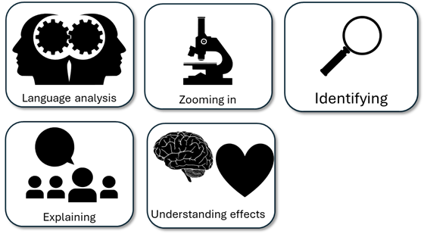
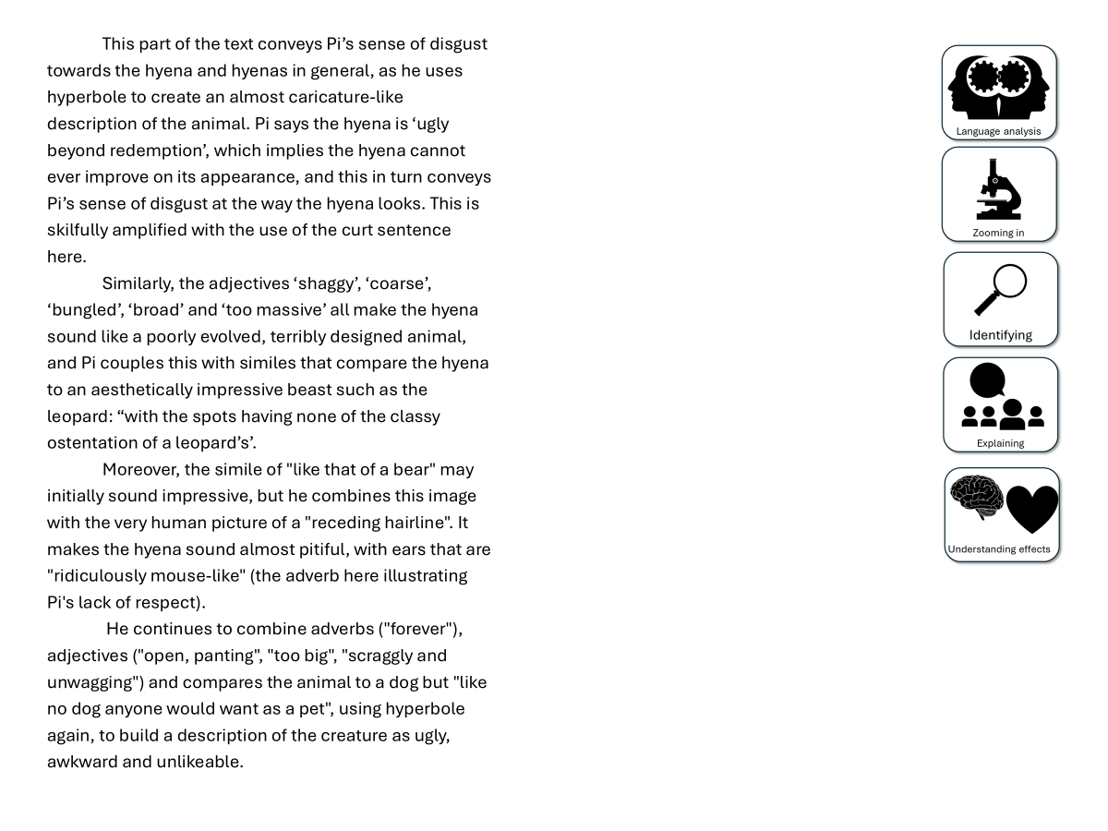
You have been given a good answer for Q2
Go through the answer and find one good example for each of the five skills shown. You could this through arrows, annotations or highlighting.
Bonus Challenge: The student has avoided using words like “shows” too often. What other analytical verbs have they used instead?

Slide 10
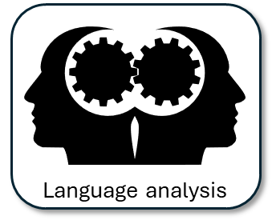


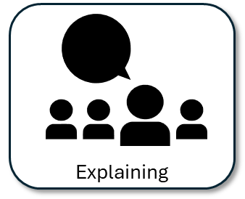
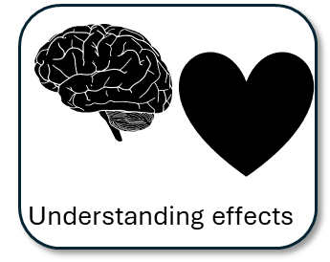
This part of the text conveys Pi’s sense of disgust towards the hyena and hyenas in general, as he uses hyperbole to create an almost caricature-like description of the animal. Pi says the hyena is ‘ugly beyond redemption’, which implies the hyena cannot ever improve on its appearance, and this in turn conveys Pi’s sense of disgust at the way the hyena looks. This is skilfully amplified with the use of the curt sentence here.
Similarly, the adjectives ‘shaggy’, ‘coarse’, ‘bungled’, ‘broad’ and ‘too massive’ all make the hyena sound like a poorly evolved, terribly designed animal, and Pi couples this with similes that compare the hyena to an aesthetically impressive beast such as the leopard: “with the spots having none of the classy ostentation of a leopard’s’.
Moreover, the simile of "like that of a bear" may initially sound impressive, but he combines this image with the very human picture of a "receding hairline". It makes the hyena sound almost pitiful, with ears that are "ridiculously mouse-like" (the adverb here illustrating Pi's lack of respect).
He continues to combine adverbs ("forever"), adjectives ("open, panting", "too big", "scraggly and unwagging") and compares the animal to a dog but "like no dog anyone would want as a pet", using hyperbole again, to build a description of the creature as ugly, awkward and unlikeable.
Notes:
Print for students

Slide 11
We will now peer assess our own answers
Swap your answers with another student.
1) What skills did the student use well in their answer?
Example: They found two really good examples like “doglike” that showed how the narrator thinks the hyena is ugly.
2) What skills could the student improve on in their answer?
Example: They need to explain why describing the hyena as “doglike” conveys how ugly it is to the reader.

Slide 12
Did you notice how the student used a range of analytical verbs?
Pi says the hyena is ‘ugly beyond redemption’, which shows the hyena cannot ever improve on its appearance, and this in turn tells us Pi’s sense of disgust at the way the hyena looks. This is shown with the use of the curt sentence here.
Pi says the hyena is ‘ugly beyond redemption’, which implies the hyena cannot ever improve on its appearance, and this in turn conveys Pi’s sense of disgust at the way the hyena looks. This is skilfully amplified with the use of the curt sentence here.
Discuss: Why does a range of analytical verbs improve the student’s answer?

Slide 13
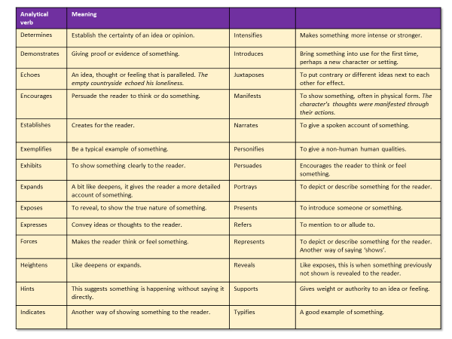

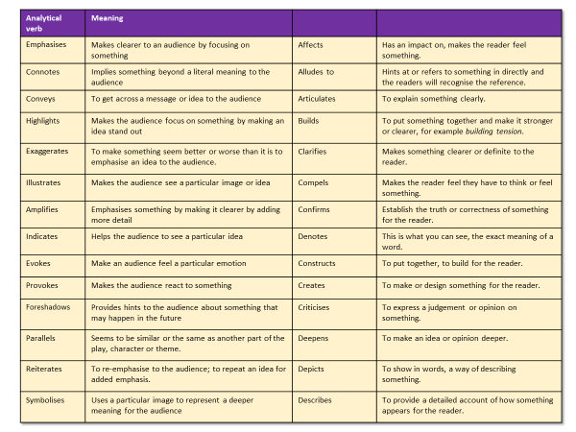
It’s time to upgrade our analyses!
Highlight all the basic analytical verbs you used like ‘shows’ or ‘tells’.
Now, use your detailed tables to replace them with more specific and impressive analytical verbs.

Slide 14
Analytical verb | Meaning
Emphasises | Makes clearer to an audience by focusing on something | Affects | Has an impact on, makes the reader feel something.
Connotes | Implies something beyond a literal meaning to the audience | Alludes to | Hints at or refers to something in directly and the readers will recognise the reference.
Conveys | To get across a message or idea to the audience | Articulates | To explain something clearly.
Highlights | Makes the audience focus on something by making an idea stand out | Builds | To put something together and make it stronger or clearer, for example building tension.
Exaggerates | To make something seem better or worse than it is to emphasise an idea to the audience. | Clarifies | Makes something clearer or definite to the reader.
Illustrates | Makes the audience see a particular image or idea | Compels | Makes the reader feel they have to think or feel something.
Amplifies | Emphasises something by making it clearer by adding more detail | Confirms | Establish the truth or correctness of something for the reader.
Indicates | Helps the audience to see a particular idea | Denotes | This is what you can see, the exact meaning of a word.
Evokes | Make an audience feel a particular emotion | Constructs | To put together, to build for the reader.
Provokes | Makes the audience react to something | Creates | To make or design something for the reader.
Foreshadows | Provides hints to the audience about something that may happen in the future | Criticises | To express a judgement or opinion on something.
Parallels | Seems to be similar or the same as another part of the play, character or theme. | Deepens | To make an idea or opinion deeper.
Reiterates | To re-emphasise to the audience; to repeat an idea for added emphasis. | Depicts | To show in words, a way of describing something.
Symbolises | Uses a particular image to represent a deeper meaning for the audience | Describes | To provide a detailed account of how something appears for the reader.

Slide 15
Analytical verb | Meaning
Determines | Establish the certainty of an idea or opinion. | Intensifies | Makes something more intense or stronger.
Demonstrates | Giving proof or evidence of something. | Introduces | Bring something into use for the first time, perhaps a new character or setting.
Echoes | An idea, thought or feeling that is paralleled. The empty countryside echoed his loneliness. | Juxtaposes | To put contrary or different ideas next to each other for effect.
Encourages | Persuade the reader to think or do something. | Manifests | To show something, often in physical form. The character’s thoughts were manifested through their actions.
Establishes | Creates for the reader. | Narrates | To give a spoken account of something.
Exemplifies | Be a typical example of something. | Personifies | To give a non-human human qualities.
Exhibits | To show something clearly to the reader. | Persuades | Encourages the reader to think or feel something.
Expands | A bit like deepens, it gives the reader a more detailed account of something. | Portrays | To depict or describe something for the reader.
Exposes | To reveal, to show the true nature of something. | Presents | To introduce someone or something.
Expresses | Convey ideas or thoughts to the reader. | Refers | To mention to or allude to.
Forces | Makes the reader think or feel something. | Represents | To depict or describe something for the reader. Another way of saying ‘shows’.
Heightens | Like deepens or expands. | Reveals | Like exposes, this is when something previously not shown is revealed to the reader.
Hints | This suggests something is happening without saying it directly. | Supports | Gives weight or authority to an idea or feeling.
Indicates | Another way of showing something to the reader. | Typifies | A good example of something.

Slide 16
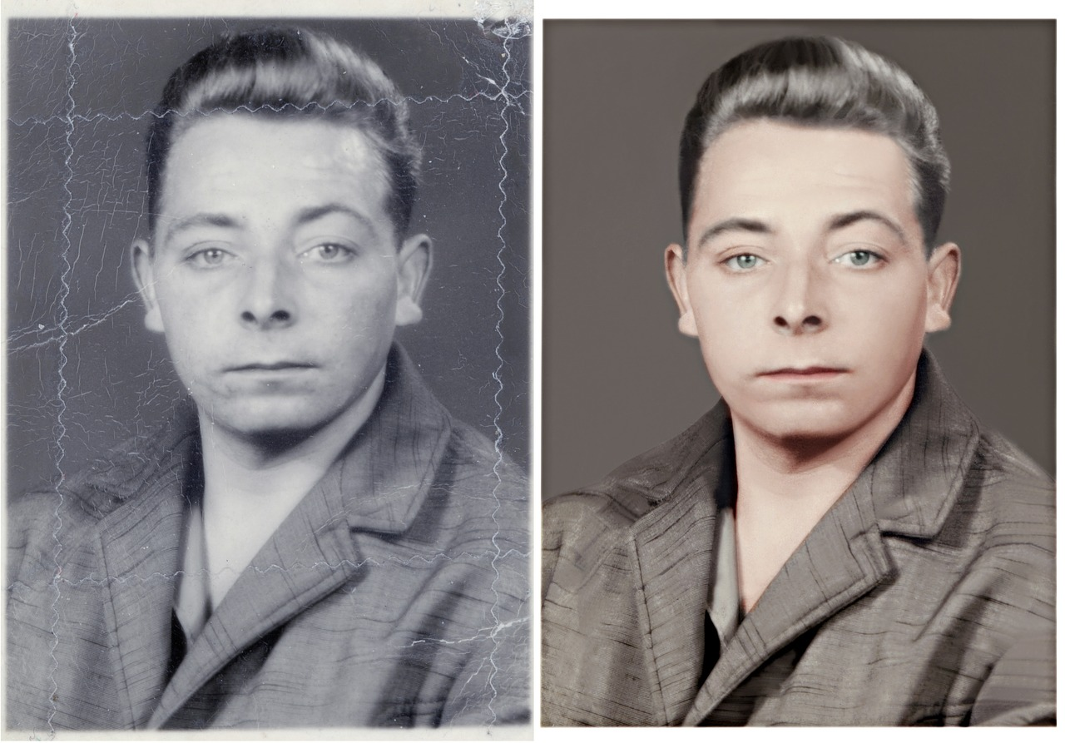
Plenary: Before And After
Think about what you knew about language analysis at the start of the lesson and what you know now. What has changed?
To describe the use of language in the extract
To explain how we can improve our language analysis in Q2
To apply our understanding of Q2 skills to our own answers

