Slide 1
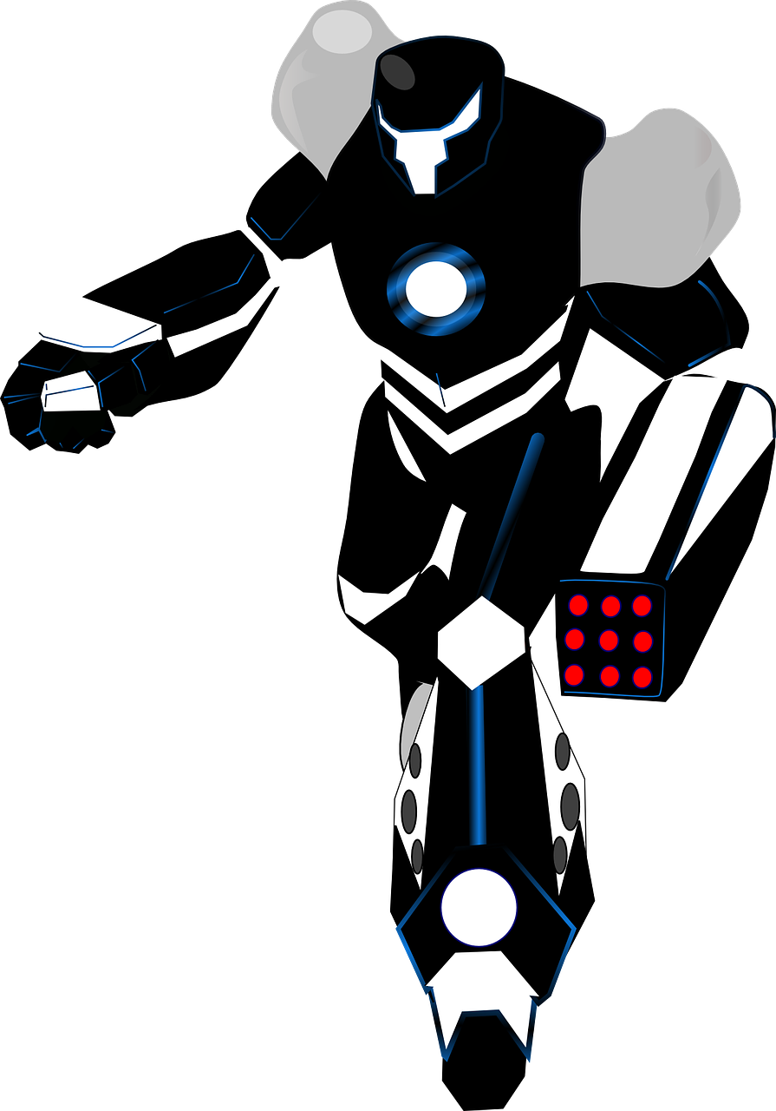
Writing Speech Punctuation
“What is your mission?” asked the scientist to the robot.
“I have been created to assist humans in any way I can,” replied the robot.
“Excellent,” responded the scientist, “You are ready.”
Look at the conversation above.
How do you use “speech marks”?
Which three places can you put a speaker in a line of speech?
How do you use punctuation when writing speech?

Slide 2
Learning outcomes
To describe the rules of writing speech
To explain how we can improve our vocabulary when writing speech
To evaluate the effectiveness of our own speech writing in our stories

Slide 3
Some of the general rules of writing speech:
Everything said is surrounded with “speech marks.”
The first word spoken by someone begins with a capital letter.
The last word spoken has a full stop attached to its end if it’s the end of the sentence.
You must start a new line for a new speaker.
You must use commas to split up parts of speech.
Here’s an example:
“Today is our first day in space,” said the space captain.
“Yes, sir,” replied the lieutenant, “it is very exciting.”
Turning to the window, the captain sighed: “It will take us many years, but our mission will be worth it in the end.”
“I completely agree, it will be worth it,” suggested the lieutenant.
A very useful video is available here: https://www.youtube.com/watch?v=6-YFmLctwDY

Slide 4
Three ways of including a speaker:
Here’s an example:
“Today is our first day in space,” said the space captain.
“Yes, sir,” replied the lieutenant, “it is very exciting.”
Turning to the window, the captain sighed: “It will take us many years, but our mission will be worth it in the end.”
“I completely agree, it will be worth it,” suggested the lieutenant.
The speaker at the end.
The speaker at the beginning.
The speaker in the middle.

Slide 5
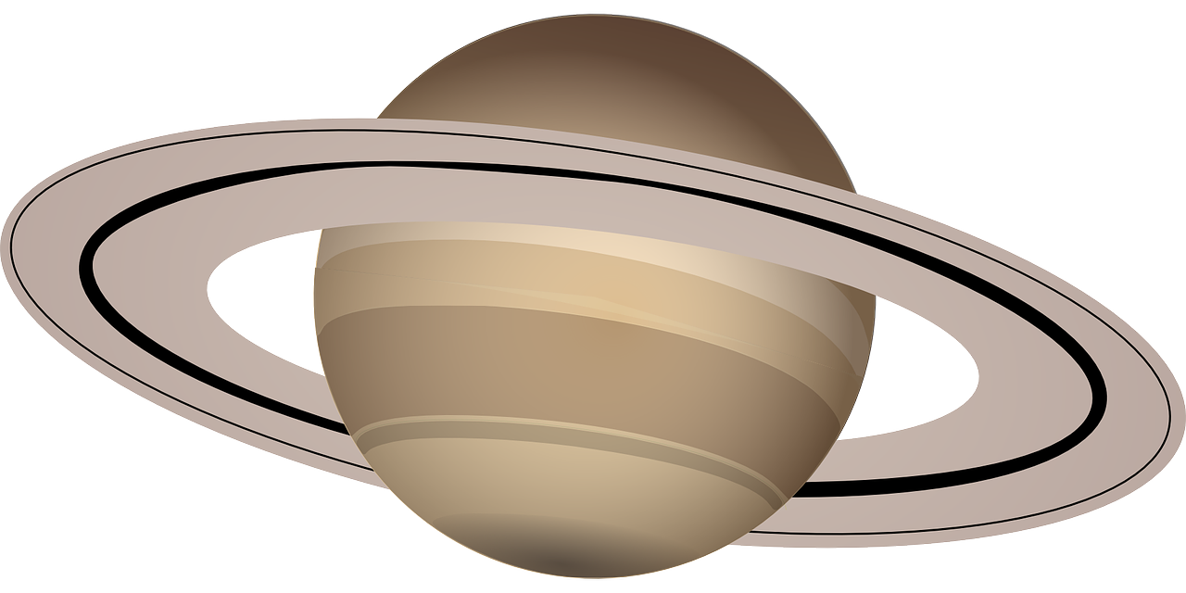
The speech punctuation in this example is inaccurate
“What is the status of this planet. said the space captain.
“It is full of life.” said the cyborg.
Discuss: Using your understanding of speech punctuation, how would you fix this?

Slide 6
The speech punctuation in this example is inaccurate
“What is the status of this planet?” said the space captain.
“It is full of life,” said the cyborg.
We’ve now repaired the speech punctuation! Good job.

Slide 7
“What is the status of this planet?” said the space captain.
“It is full of life,” said the cyborg.
said
asked
cried
shouted
whispered
yelled
shrieked
laughed
lied
spoke
enquired
exploded
yelled
muttered
screamed
roared
chortled
hinted
hissed
squeaked
murmured
sighed
squawked
shrieked
hollered
warned
suggested
snorted
sneered
bellowed
growled
snickered
responded
stated
bragged
echoed
claimed
sneered
taunted
snapped
cajoled
Sometimes students can end up repeating the same verbs within speech punctuation:
“Said, said, said, said, said!”
It’s important to vary your vocabulary when writing dialogue.
Upgrade this conversation using some of the words here.
Bonus Challenge: Extend the conversation and use accurate punctuation and varied vocabulary.

Slide 8
Here is some dialogue from a science fiction story:
“It appears that we have reached Earth” stated the captain.
Yes sir said the lieutenant, “we have travelled for so long and we have finally arrived”
Lieutenant shouted the captain prepare the ship for landing. We are home. He sounded relieved.
The lieutenant, with a smile, replied joyfully of course sir.
Unfortunately, the writer has forgotten to include a lot of their speech punctuation!
Using your understanding of speech punctuation:
Rewrite this dialogue so the punctuation is accurate.
Rewrite this dialogue so it uses a range of vocabulary AND accurate speech punctuation.
Rewrite this dialogue so it uses a range of vocabulary, accurate speech punctuation AND all the ways of including a speaker.

Slide 9

Now we’ll revisit our narrative pieces from the previous lessons
Find somewhere within your story that you can add a short conversation or look at part of your story featuring conversation.
Rewrite your conversation now so it uses accurate speech punctuation, a range of vocabulary and all three ways of including a speaker.
Success criteria:
Accurate speech punctuation
A range of words besides “said”.
All three ways of including a speaker.

Slide 10
Peer assessment: 3 steps to success
Go through the student’s work and make any corrections to their speech punctuation.
1
Go through the student’s work and make any improvements to their vocabulary.
2
Have they used all three ways of including a speaker? If not, make changes.
3

Slide 11
Plenary: One Word
Write down one word that describes what you have learnt about this lesson.
Be prepared to share your ideas.
Learning outcomes:
To describe the rules of writing speech
To explain how we can improve our vocabulary when writing speech
To evaluate the effectiveness of our own speech writing in our stories

