Slide 1

Non-Fiction Writing
Escape Room!
A journalist has accidentally locked you in the editorial room! You’ve got to solve the mysteries to find the key and get out!
Escape Crew #1:
Escape Crew #2:
Escape Crew #3:
Escape Crew #4:
Escape Crew #5:
Escape Crew #6:

Slide 2

Learning outcomes
To describe key terminology, skills and ideas related to non-fiction writing
To explain the importance of key terminology and skills in relation to non-fiction writing
To evaluate the significance of these terms and skills in relation to non-fiction writing

Slide 3

Today, I am not your teacher. Today I am…
I look after all the different mysteries that you have to solve AND I can give you clues to help you along the way to getting out of the classroom.
All completed mysteries must be seen by me before you can move on to the next one.
The Cluemaster!

Slide 4
How a writer starts a text, ends a text and changes the focus throughout. It is how a writer organises and puts together a text.
How a writer ends their text and sums up their ideas, or leaves the audience with a powerful final idea. Very important for structuring a text effectively.
Looking at multiple opinions and analysing how people can have different viewpoints on a similar topic and including these in our own writing where relevant.
The people who are reading the text or the people who are being targeted by a writer. Important for analysing travel writing texts.
How a text ‘sounds’ – it could be very enthusiastic and happy, or angry and determined, or balanced and neutral. It affects how an audience engages with a text.
How a writer starts a text – very important for engaging an audience right from the start.
The reasons why a writer has made a text. It can include writing to explain, writing to advise, writing to persuade, writing to argue and so on.
How a writer chooses their words, their sentence types, their way of writing so it fits a certain approach or style. It also involves writing in a formal or informal way.
The words we choose to use in our writing that help to convey our ideas, opinions, thoughts and feelings. Choosing these words carefully can totally alter how an audience engages with our writing.
Purpose
Audience
Language
Structure
Perspectives
Tone
Introduction
Conclusion
Style and register
Mystery #1: Put the right number next to the right name, e.g. Tone = 9, for instance (This is an example – it might be wrong!) Show your completed mystery to the Cluemaster for the next mystery!

Slide 5
Purpose 7
How a writer starts a text, ends a text and changes the focus throughout. It is how a writer organises and puts together a text.
How a writer ends their text and sums up their ideas, or leaves the audience with a powerful final idea. Very important for structuring a text effectively.
Looking at multiple opinions and analysing how people can have different viewpoints on a similar topic and including these in our own writing where relevant.
The people who are reading the text or the people who are being targeted by a writer. Important for analysing travel writing texts.
How a text ‘sounds’ – it could be very enthusiastic and happy, or angry and determined, or balanced and neutral. It affects how an audience engages with a text.
How a writer starts a text – very important for engaging an audience right from the start.
The reasons why a writer has made a text. It can include writing to explain, writing to advise, writing to persuade, writing to argue and so on.
How a writer chooses their words, their sentence types, their way of writing so it fits a certain approach or style. It also involves writing in a formal or informal way.
The words we choose to use in our writing that help to convey our ideas, opinions, thoughts and feelings. Choosing these words carefully can totally alter how an audience engages with our writing.
Audience 4
Language 9
Structure 1
Perspectives 3
Tone 5
Introduction 6
Conclusion 2
Style and register 8
Answers for the Cluemaster

Slide 6

Can you crack the code?
A = 7
B = ?
C = ?
D = ?
E = 1
F = ?
G = ?
H = ?
I = ?
J = ?
K = ?
L = ?
M = ?
N = 3
O = ?
P =?
Q = ?
R = 9 S = 5
T = ?
U = ?
V = ?
W = 4
X = ?
Y = ?
Z = ?
_ _ _ _ _ _ _ _ _
Mystery #2: Use the order of the numbers from your first mystery to work out what the code words are to move on to the next mystery! Show your answer to the Cluemaster.
Notes:
The answer is AWARENESS
If you really want to push students then ask them about what ‘AWARENESS’ means and why it is so important in non-fiction writing.
Any non-fiction text must show AWARENESS of the purpose and audience. We change our writing dependent on our reason for writing and the people we are writing to.

Slide 7

Extra Clue:
A = 7
B = ?
C = ?
D = ?
E = 1
F = ?
G = ?
H = ?
I = ?
J = ?
K = ?
L = ?
M = ?
N = 3
O = ?
P =?
Q = ?
R = 9 S = 5
T = ?
U = ?
V = ?
W = 4
X = ?
Y = ?
Z = ?
The code is 747913155
_ _ _ _ _ _ _
Have you cracked the code? Tell the Cluemaster.
Notes:
747913155 - AWARENESS
Show this in case the students get stuck!

Slide 8

Seared Up
Mystery #3
All of these anagrams are ideas linked to key terminology or skills useful for writing non-fiction texts.
Work out what each one is and then explain why they are significant for WRITING non-fiction texts.
Once the Cluemaster is happy with your answers, he or she will issue you with the next mystery.
Axle Pin
I Saved
Outrage Writing
Science On TV
Piranhas Glad Perk
Notes:
Seared Up = Persuade
Axle Pin= Explain
I Saved = Advise
Outrage Writing = Writing to Argue
Science On TV = Connectives
Piranhas Glad Perk = Linked Paragraphs

Slide 9

Mystery #4: Riddle me this, riddle me that…
What’s black and white and red all over?
Once you know what the answer to the riddle is, write down an explanation of why you think this is important in terms of AQA English Language Paper 2.
Show this to the Cluemaster and they will give you the next mystery.
Notes:
The answer is… A NEWSPAPER!
A newspaper article is one type of writing students may encounter in non-fiction reading and writing, as well as leaflets, speeches, magazine articles, letters and essays.
Ask students to explain the key features of newspaper articles, what purposes they usually have and what kinds of audiences, and how they are different to other forms of non-fiction writing.

Slide 10




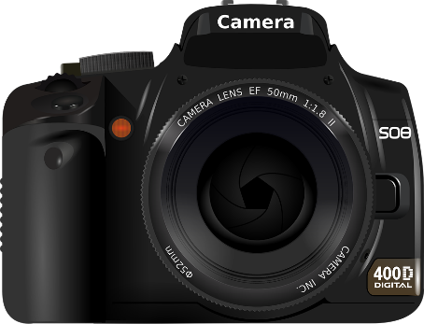

Time to take a stand! Find all the objects in the room related to making newspapers! Under one of those is the next mystery!
Notes:
Place the next mystery sheets under an object related to newspapers.

Slide 11
Incredibly important
Mystery #5
Create a bar chart which evaluates the importance of different aspects of writing non-fiction texts. Once you’ve completed it show your graph to the Cluemaster for the final mystery!
Explain your interpretations about why the elements are important or not.
Include at least one example to support your interpretation.
Example
Purpose
Audience
Language
Structure
Tone
Vocabulary
Punctuation
Paragraphing

Slide 12
Incredibly important
Of little significance
Purpose
Audience
Language
Structure
Tone
Vocabulary
Punctuation
Paragraphing
Notes:
To print off for groups

Slide 13

The Final Mystery: Clue Jigsaw
The jigsaw you have been given contains the final code words needed to leave the room and win the escape room game!
The first crew to tell the Cluemaster what the magic words are wins!

Slide 14

T_c_n_ _ u _ _
Notes:
TECHNIQUES
You’ll need to cut up the jigsaw pieces for each group (so about 6 packs) and mix them up. Students need to put them all together and work out the final code, but they also need to tell you why it’s so important to think about TECHNIQUES. Remind them not to shout out the answer and to come to you to speak it. It’s probably a good idea to stand near the door at this point!

Slide 15

The key has been found! One of the crews has escaped the room!

Slide 16

Plenary: Hot Seat!
You all have one minute to prepare questions to ask a student about what we have learnt today.
Next, one of you must come to the front and answer the questions.
To describe key terminology, skills and ideas related to non-fiction writing
To explain the importance of key terminology and skills in relation to non-fiction writing
To evaluate the significance of these terms and skills in relation to non-fiction writing

Slide 17


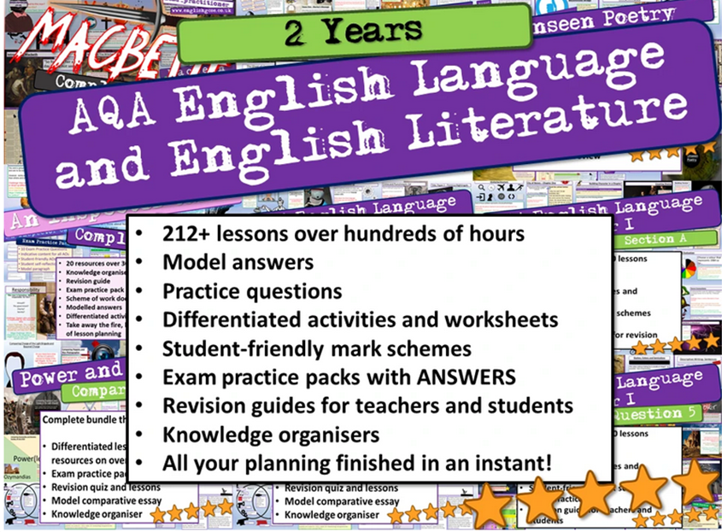
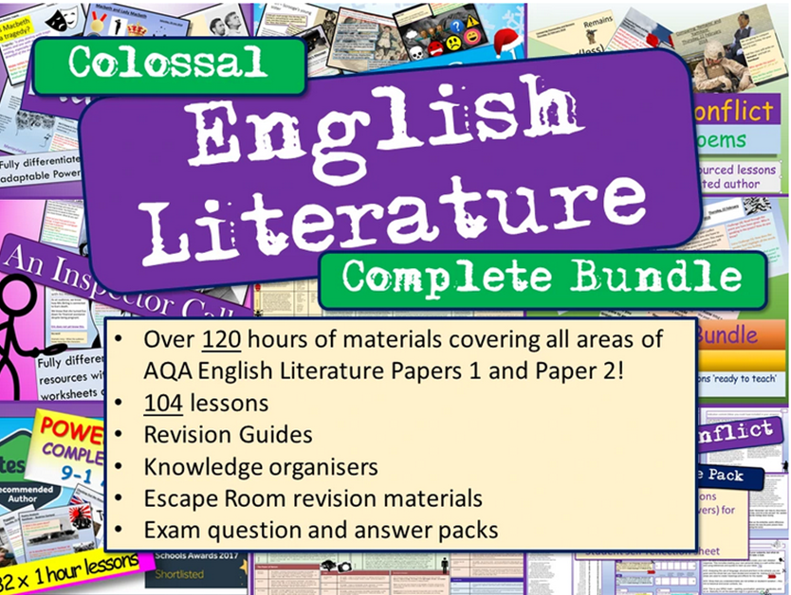
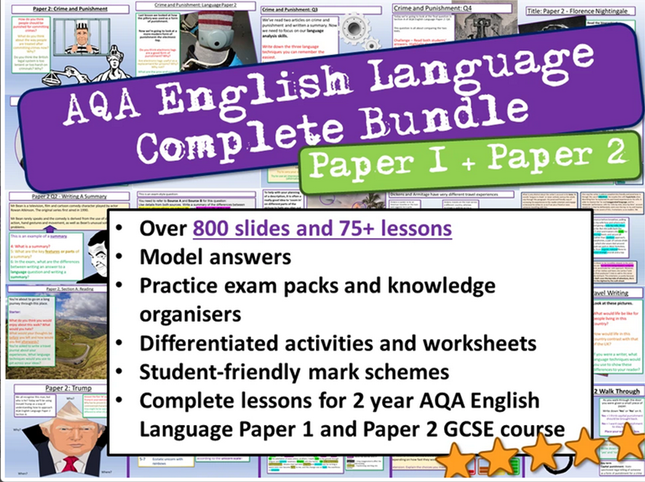




Check out our website for offers and freebies. Right click here, follow the link.
One of the most popular authors on TES!
Email:
info@englishgcse.co.uk
Website:
www.englishgcse.co.uk
This product, or any part of it, is not to be distributed, or resold under any circumstances, including through any websites, groups or organisations, without written permission from the author. Group and whole school licenses are available at request to the publisher.
Thanks for choosing EC Resources
©EC Publishing Ltd August 25
©Lead Practitioner English August 25
Follow us on twitter: @ec_publishing2 or Facebook

