Slide 1


Writing to Persuade – Social Media
We are all aware of social media and the different platforms available to users, and today we will use this topic to explore writing to persuade.
What is social media?
How can social media be useful and how can it cause problems?
Why should students be aware of both the benefits and problems of social media?

Slide 2
Learning outcomes
To describe persuasive techniques and how they can persuade an audience
To explain how we can use persuasive techniques to engage an audience
To evaluate how a writer uses specific techniques in a speech and why

Slide 3
What is social media?
In simple terms, social media is internet-based forms of communication. It enables users to have conversations, share information and create content to be shared with others.
It includes blogging sites, photo-sharing media, messaging, podcasts, instant messaging and more.
Social media has existed since the late 1990s, but it became particularly popular with the rise of sites such as Myspace, Facebook and Twitter in the mid-2000s.
Before the rise of social media, communication was made in person, via television and radio and in written form such as traditional media.

Slide 4
What are the benefits of social media?
https://www.youtube.com/watch?v=DnKpnojwz2M
https://www.youtube.com/watch?v=bLigKXy3uBs
We will watch a couple of videos outlining the benefits of social media.
Make notes about the benefits of social media as you watch. You will need these for later in the lesson.
Notes:
If links are broken then please get in touch at info@englishgcse.co.uk

Slide 5
What are the problems with social media?
https://www.youtube.com/watch?v=ij_xXZAhJPs
https://www.youtube.com/watch?v=2SvqoaZzyVs
We will watch a couple of videos outlining the problems of social media.
Make notes about the problems of social media as you watch. You will need these for later in the lesson.

Slide 6
What are the differences between persuading and arguing?
We’ve spent the last week analysing articles and writing our own, but with a focus on writing to argue.
Now, we will look at writing to persuade.
Discuss: What are the differences between these two purposes? How are they shown in the style of writing?

Slide 7
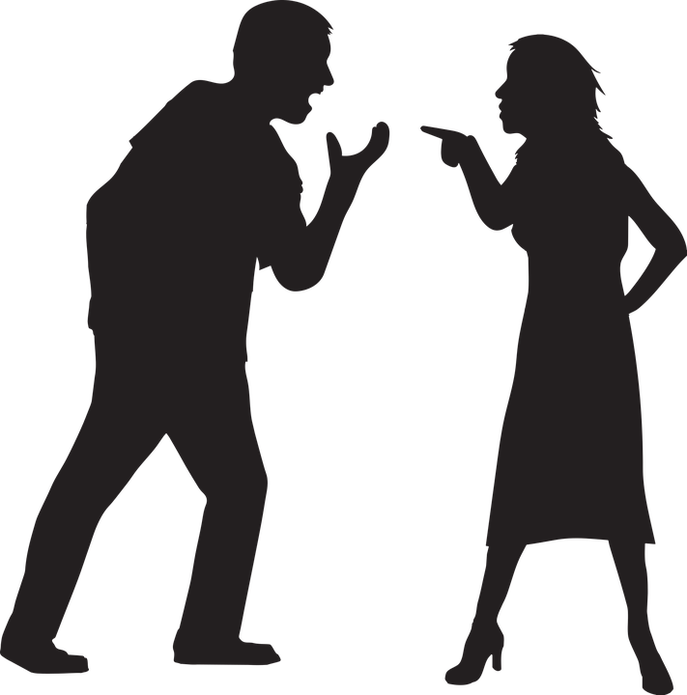
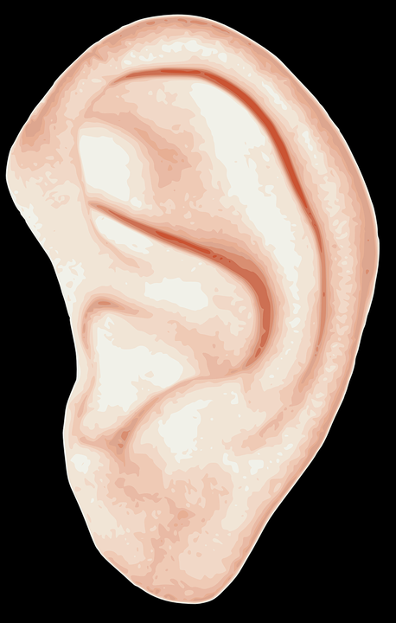
 | WRITING TO ARGUE | WRITING TO PERSUADE
What is it? | Giving the case for one side of a debate | Convincing someone that your opinion is right
What does it involve? | Being aware of the other side of a debate | Using your language to convince your leader.
What key features do you often find in this type of writing? | Includes counter-arguments, rhetorical questions, facts, statistics, emotive language | Includes triplets, repetition, emotive language, rhetorical questions, direct address and more…
There are similarities between these two purposes, but generally writing to argue is about putting forward your own ideas AND showing an awareness of other perspectives, whilst writing to persuade focuses on your own perspective and convincing the audience you are right.
Writing to argue often involves more facts and statistics to support ideas, whereas writing to persuade focuses on use of language to change a reader’s mind.

Slide 8

Persuasive techniques
Today we’re going to focus on persuasive writing. Did you know there are many techniques you can use to help you to persuade someone to think or do something? An easy way to remember some of these is the acronym DAFORREST.
Direct address (“you”)
A
F
O
R
R
E
S
T
Complete the ‘DAFORREST’ acronym which lists many of the persuasive techniques you can use when writing to persuade.
Extension: What are the best techniques to use when writing to persuade? Why?

Slide 9
Persuasive techniques
Direct address (“you”)
Alliteration / Adjectives
Facts
Opinions
Rhetorical questions
Repetition
Exaggeration / Emotive language
Statistics
Tone / Triplets
Complete the ‘DAFORREST’ acronym which lists many of the persuasive techniques you can use when writing to persuade.
Extension: What are the best techniques to use when writing to persuade? Why?

Slide 10
Read the social media speech with the person nearest to you
Direct address (“you”)
Alliteration / Adjectives
Facts
Opinions
Rhetorical questions
Repetition
Exaggeration / Emotive language
Statistics
Tone / Triplets
Work together to annotate any DAFORREST techniques you can see being used.
For each one, explain how the writer has used them and why.
Evaluate how the writer is able to use DAFORREST techniques to engage the audience. Provide specific examples.

Slide 11
Like and subscribe. Reacts. Stories. These are all terms that we are likely all very familiar with given the impact social media has on our lives, but how often do we consider how social media affects us? Most of us probably spend a lot of our spare time communicating with friends and family on social media platforms, as well as absorbing content related to our interests and hobbies, but is social media more harmful to us than we might think?
If we consider the social impact these technologies have had on our lives, we should think about the by-products of sharing materials online. We have witnessed the terrifying rise of cyberbullying, where students are subjected to traumatic hate campaigns by others that can be incredibly damaging to their mental health, and is far harder for parents, carers and educators to monitor and deal with. The dangers of cyberbullying are shocking, disturbing and sadly all too common now.
As well as this, social media has allowed the spread of misinformation, where deliberately misleading material is shared across platforms that is intended to influence people’s ways of thinking, when it is often based on a lack of facts, context, or entirely fictional. In the past traditional media came through a small selection of channels or platforms that were given credibility through their years of reporting, research and accountability. However, social media means anyone can post virtually anything and very often it is shared widely before fact-checking or imposed community standards by platforms can remove the content or warn users about it. By that time, the damage is done.
Not only this, but social media is proven to be addictive. Every like, comment or subscriber makes our brains release a small amount of dopamine: a chemical in the brain that ‘rewards’ you with feelings of pleasure, satisfaction and motivation. Because of this, users can often end up endlessly scrolling through social media platforms, desperate for the next ‘react’ or subscriber to boost their mood. A side effect of this is social media can leave us with long term mental health issues such as depression and anxiety; there have been scientific studies which have linked the rise of these problems in people with their regular – and in cases almost constant – use of social media.
So why am I speaking to you today? No, I am not asking you to put down your phones and your tablets and leave social media forever. There are plenty of benefits to using them and they have made our lives a lot easier since they came into existence, but I am suggesting you take a step back when using social media: think about how long you have been using it, whether you are ignoring the people around you for the content of your glowing white screen. Are you missing out on socialising with friends in person or taking part in activities and interest away from a computer or smartphone?
We can’t ignore social media – it is a huge part of our lives in the modern world and it will continue to be, but it is time for all of us to take more responsibility for how we are using it and reflecting on how much of an impact it is making on our lives. Does constant social media use make you happy or could its benefits be better suited in moderation? When you leave the hall today, think about these ideas before immediately unlocking your phone or tablet. Thank you.

Slide 12
Like and subscribe. Reacts. Stories. These are all terms that we are likely all very familiar with given the impact social media has on our lives, but how often do we consider how social media affects us? Most of us probably spend a lot of our spare time communicating with friends and family on social media platforms, as well as absorbing content related to our interests and hobbies, but is social media more harmful to us than we might think?
If we consider the social impact these technologies have had on our lives, we should think about the by-products of sharing materials online. We have witnessed the terrifying rise of cyberbullying, where students are subjected to traumatic hate campaigns by others that can be incredibly damaging to their mental health, and is far harder for parents, carers and educators to monitor and deal with. The dangers of cyberbullying are shocking, disturbing and sadly all too common now.
The opening paragraph of the speech hooks the audience in by using terminology that the student audience will be very aware of.
The speaker uses pronouns such as “us”, “our” and “we” to make the audience think that the speaker is one of them, which in turn is likely to persuade the audience that the speaker is right.
They move on to focusing on a specific issue of social media: cyberbullying. They use emotive language such as “terrifying”, “disturbing”, “damaging” and shocking” to convey their views on the dangers of social media.

Slide 13
As well as this, social media has allowed the spread of misinformation, where deliberately misleading material is shared across platforms that is intended to influence people’s ways of thinking, when it is often based on a lack of facts, context, or entirely fictional. In the past traditional media came through a small selection of channels or platforms that were given credibility through their years of reporting, research and accountability. However, social media means anyone can post virtually anything and very often it is shared widely before fact-checking or imposed community standards by platforms can remove the content or warn users about it. By that time, the damage is done.
Not only this, but social media is proven to be addictive. Every like, comment or subscriber makes our brains release a small amount of dopamine: a chemical in the brain that ‘rewards’ you with feelings of pleasure, satisfaction and motivation. Because of this, users can often end up endlessly scrolling through social media platforms, desperate for the next ‘react’ or subscriber to boost their mood. A side effect of this is social media can leave us with long term mental health issues such as depression and anxiety; there have been scientific studies which have linked the rise of these problems in people with their regular – and in cases almost constant – use of social media.
The speaker moves on to talking about misinformation. Did you notice how often they use triplets to emphasise their views? This is a great technique to use in persuasive writing because it helps to convey how powerful or impactful a topic can be.
The speaker also employed shorter sentences for impact. This helps the audience to focus on one particular idea within the text.
Additionally, the writer also used hyperbole to reiterate the problems of social media.

Slide 14
So why am I speaking to you today? No, I am not asking you to put down your phones and your tablets and leave social media forever. There are plenty of benefits to using them and they have made our lives a lot easier since they came into existence, but I am suggesting you take a step back when using social media: think about how long you have been using it, whether you are ignoring the people around you for the content of your glowing white screen. Are you missing out on socialising with friends in person or taking part in activities and interest away from a computer or smartphone?
We can’t ignore social media – it is a huge part of our lives in the modern world and it will continue to be, but it is time for all of us to take more responsibility for how we are using it and reflecting on how much of an impact it is making on our lives. Does constant social media use make you happy or could its benefits be better suited in moderation? When you leave the hall today, think about these ideas before immediately unlocking your phone or tablet. Thank you.
Towards the end of the speech the speaker asks the audience a question about why they think the speaker is talking to them today. They use hyperbole again to show that they’re trying to be reasonable in asking students to think about their social media use.
The speaker offers a clear way forward for the student audience in how they use social media, and they try to persuade the audience to think carefully about how often they are using platforms rather than enjoying the world around them.
The speech ends with the speaker directly telling the audience to think about the perspectives they have offered today.

Slide 15

Plenary: Three Ideas
Write down three ideas you will take away from today’s lesson to better prepare you for…
To describe persuasive techniques and how they can persuade an audience
To explain how we can use persuasive techniques to engage an audience
To evaluate how a writer uses specific techniques in a speech and why

