Slide 1

Punctuation Recap
We’re going on a journey today, a journey to improve our use of punctuation!
Type of punctuation or grammar: | I feel confident about using this in my own work:
Capital letters and full stops
Commas
Apostrophes
Hyphens
Dashes
Complete your punctuation and grammar audit table as soon as you come in the room. Put a tick on the areas you feel confident about at the moment.
What other types of punctuation do you know about? Which ones do you find easy and which ones harder? This will help me to plan my lessons in future!
Bonus Challenge:

Slide 2
Type of punctuation or grammar: | I feel confident about using this in my own work:
Capital letters and full stops
Commas
Apostrophes
Hyphens
Dashes
Type of punctuation or grammar: | I feel confident about using this in my own work:
Capital letters and full stops
Commas
Apostrophes
Hyphens
Dashes
Type of punctuation or grammar: | I feel confident about using this in my own work:
Capital letters and full stops
Commas
Apostrophes
Hyphens
Dashes
Type of punctuation or grammar: | I feel confident about using this in my own work:
Capital letters and full stops
Commas
Apostrophes
Hyphens
Dashes
Type of punctuation or grammar: | I feel confident about using this in my own work:
Capital letters and full stops
Commas
Apostrophes
Hyphens
Dashes
Type of punctuation or grammar: | I feel confident about using this in my own work:
Capital letters and full stops
Commas
Apostrophes
Hyphens
Dashes

Slide 3
Learning outcomes
To describe our strengths in punctuation
To explain how to use a variety of new punctuation
To apply our new understanding to our own non-fiction writing pieces

Slide 4
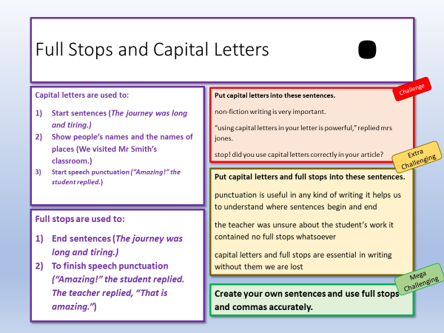
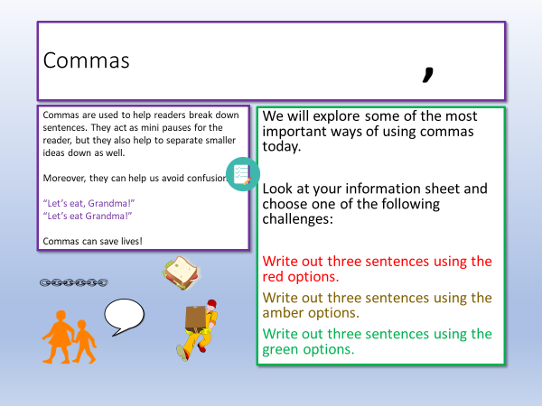
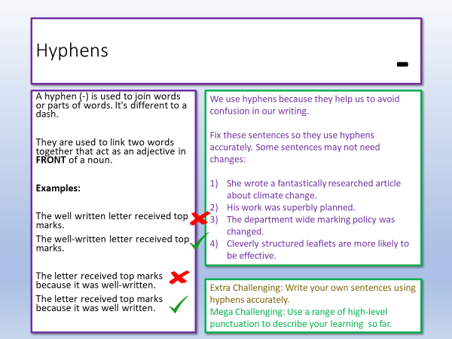
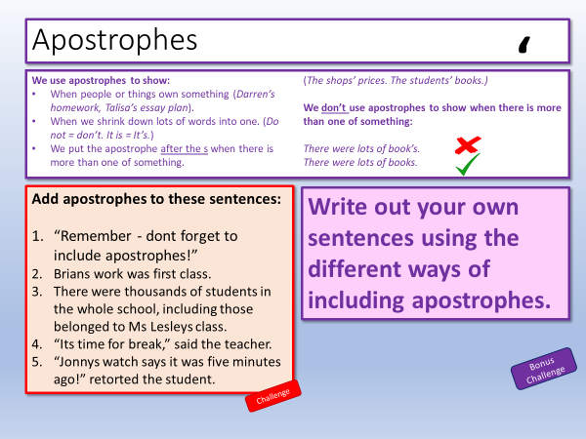
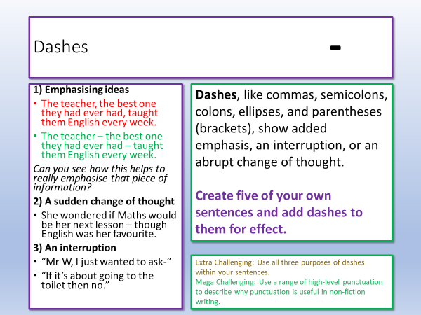
There are five different worksheets to choose from today
Choose three areas you’re least confident in.
Complete the challenges on these worksheets.

Slide 5
Full Stops and Capital Letters
.
Capital letters are used to:
Start sentences (The journey was long and tiring.)
Show people’s names and the names of places (We visited Mr Smith’s classroom.)
Start speech punctuation (“Amazing!” the student replied.)
Challenge
Put capital letters into these sentences.
non-fiction writing is very important.
“using capital letters in your letter is powerful,” replied mrs jones.
stop! did you use capital letters correctly in your article?
Extra Challenging
Put capital letters and full stops into these sentences.
punctuation is useful in any kind of writing it helps us to understand where sentences begin and end
the teacher was unsure about the student’s work it contained no full stops whatsoever
capital letters and full stops are essential in writing without them we are lost
Full stops are used to:
End sentences (The journey was long and tiring.)
To finish speech punctuation (“Amazing!” the student replied. The teacher replied, “That is amazing.”)
Mega Challenging
Create your own sentences and use full stops and commas accurately.

Slide 6




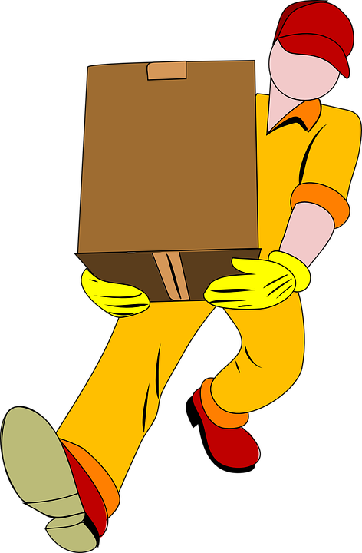

Commas
,
Commas are used to help readers break down sentences. They act as mini pauses for the reader, but they also help to separate smaller ideas down as well.
Moreover, they can help us avoid confusion:
“Let’s eat, Grandma!”
“Let’s eat Grandma!”
Commas can save lives!
We will explore some of the most important ways of using commas today.
Look at your information sheet and choose one of the following challenges:
Write out three sentences using the red options.
Write out three sentences using the amber options.
Write out three sentences using the green options.

Slide 7
Link together two independent clauses for longer sentences (for and nor but or yet so - FANBOYS):
We weren’t feeling particularly hungry, but the breakfast was just too tempting.
Akito was desperate for a new console, and he made sure his parents knew it!
Using commas for embedded sentences.
Embedded sentences include a dependent clause in the middle of a sentence.
Kadeem, who was organised and smart, managed to save up for his holiday.
Sally, who was prepared for every eventuality, carried a pencil case full of items.
Using commas in lists:
The school was busy, full of information, interesting and enormous.
Using commas for speech punctuation:
The tour guide shouted, “Please stay with the group!”
Robin laughed and replied, “Sorry!”
“We must follow the route,” retorted the tour guide.
“Yes,” replied Robin, “I’m sorry, I’m just really excited.”
Using commas for dependent clauses:
Although she was scared, Dericia managed to perform at the school show.
A dependent clause cannot exist on its own, it is dependent on another clause to make sense.
Dericia managed to perform at the school show – Independent
Although she was scared, … Dependent
Using commas for transition words such as connectives and adverbial starters:
Consequently, the group moved on to the next exhibit.
However, it wasn’t quite as interesting as the previous stops.

Slide 8


Hyphens
-
A hyphen (-) is used to join words or parts of words. It's different to a dash.
They are used to link two words together that act as an adjective in FRONT of a noun.
Examples:
The well written letter received top marks.
The well-written letter received top marks.
The letter received top marks because it was well-written.
The letter received top marks because it was well written.
We use hyphens because they help us to avoid confusion in our writing.
Fix these sentences so they use hyphens accurately. Some sentences may not need changes:
She wrote a fantastically researched article about climate change.
His work was superbly planned.
The department wide marking policy was changed.
Cleverly structured leaflets are more likely to be effective.
Extra Challenging: Write your own sentences using hyphens accurately.
Mega Challenging: Use a range of high-level punctuation to describe your learning so far.

Slide 9
Dashes
-
1) Emphasising ideas
The teacher, the best one they had ever had, taught them English every week.
The teacher – the best one they had ever had – taught them English every week.
Can you see how this helps to really emphasise that piece of information?
2) A sudden change of thought
She wondered if Maths would be her next lesson – though English was her favourite.
3) An interruption
“Mr W, I just wanted to ask-”
“If it’s about going to the toilet then no.”
Dashes, like commas, semicolons, colons, ellipses, and parentheses (brackets), show added emphasis, an interruption, or an abrupt change of thought.
Create five of your own sentences and add dashes to them for effect.
Extra Challenging: Use all three purposes of dashes within your sentences.
Mega Challenging: Use a range of high-level punctuation to describe why punctuation is useful in non-fiction writing.

Slide 10
Apostrophes
‘
We use apostrophes to show:
When people or things own something (Darren’s homework, Talisa’s essay plan).
When we shrink down lots of words into one. (Do not = don’t. It is = It’s.)
We put the apostrophe after the s when there is more than one of something.
(The shops’ prices. The students’ books.)
We don’t use apostrophes to show when there is more than one of something:
There were lots of book’s.
There were lots of books.
Add apostrophes to these sentences:
“Remember - dont forget to include apostrophes!”
Brians work was first class.
There were thousands of students in the whole school, including those belonged to Ms Lesleys class.
“Its time for break,” said the teacher.
“Jonnys watch says it was five minutes ago!” retorted the student.
Write out your own sentences using the different ways of including apostrophes.
Bonus Challenge
Challenge

Slide 11
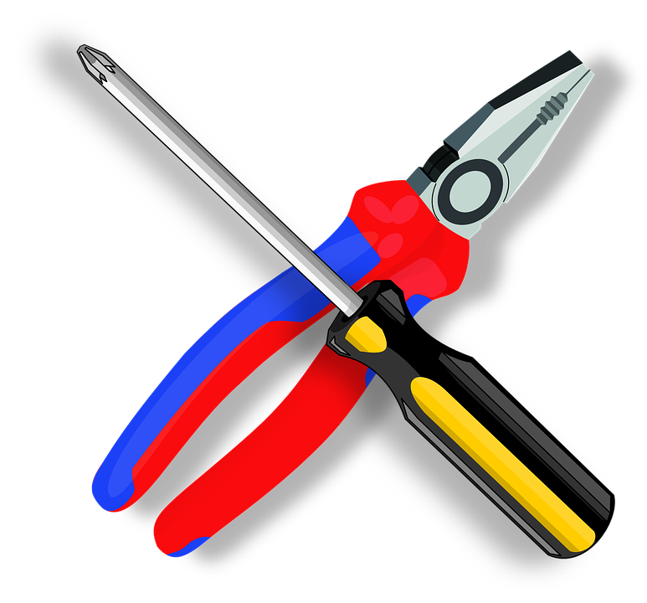
Revisit one of your non-fiction writing pieces from this term
Using your new learning from today’s lesson, make improvements or changes to your use of punctuation.

Slide 12
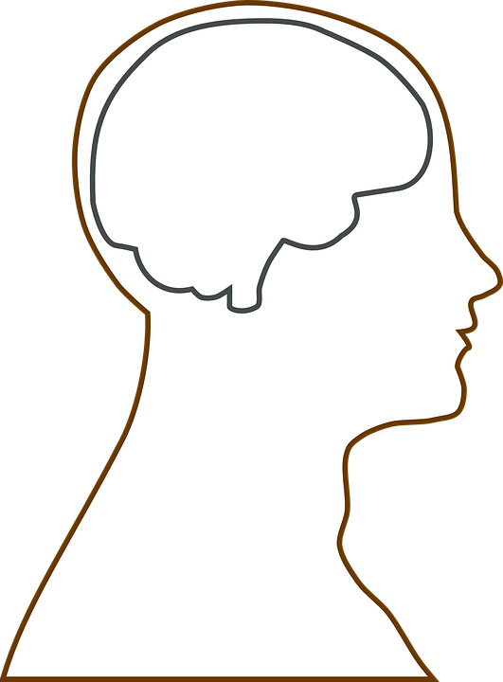
Plenary: Brain Gain
In your diagram of the person’s brain, right down all the ideas that have gone into your brain today during our lesson.
To describe our strengths in punctuation
To explain how to use a variety of new punctuation
To apply our new understanding to our own non-fiction writing pieces

Slide 13
Notes:
To print

