Slide 1




Narrative Writing Assessment Review
Re-read your assessment piece on a human meeting an animal.
Write down one element you are really proud of about your narrative.
Write down one element you think will engage your reader.
Write down one element you think will make your reader engage with the characters.
Write down one element you think you can improve about your narrative.

Slide 2

Learning outcomes
To describe our strengths and our areas to improve in our narratives
To explain to our peers how they can improve their answers
To evaluate the effectiveness of our own answers and use success criteria to make improvements

Slide 3



Whole class feedback
WWW:
We used different sentence openers well
We used basic punctuation like full stops and commas very well.
We are improving our vocabulary in our writing.
EBI:
We need to plan out the order of our paragraphs more and link them together.
We need to change our sentence types to create effects on the reader.
We need to use a higher levels of punctuation like semicolons and dashes.
Notes:
Teacher can edit this to reflect their findings from their own class marking.

Slide 4

Structure
Ideas
Flows from one idea to the next
Engaging opening to the writing.
Powerful finish to the writing.
A carefully chosen and crafted order of ideas including within paragraphs and sentences.
Use of discourse markers/connectives to link complex ideas.
Complex, detailed ideas with specific examples used to develop them and make them relevant for the reader.
Wide-ranging ideas that cover multiple areas and avoid repetition.
Paragraphs
Tone, style, register
Paragraphs are linked together and in an order that engages the reader and makes their argument easy to follow.
Paragraphs allow the structure of the piece to come through to the reader easily.
The tone (sound of writing) is confident and changes dependent on the point being made.
The writing is appropriately formal or informal (register).
The pace (speed) of the writing changes depending on the point being made.
Communication
Vocabulary
Your argument is clear and makes sense to the reader.
You sound confident in the way you write
The writing is engaging and genuinely interesting for the reader.
The writing has a distinctive voice that flows and feels natural not robotic.
Really impressive vocabulary choices chosen for effect
The choice of vocabulary makes the writing interesting and engaging for the reader.
AO5
Student mark scheme – what you should see

Slide 5
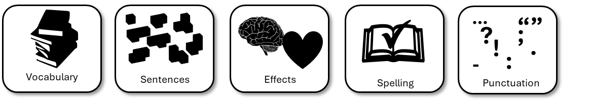
Sentences
Punctuation
Sentences are grammatically correct and read well.
Different types of sentences are used for deliberate effects.
Short sentences, longer sentences, simple, complex and compound sentences are used for a variety of reasons, but deliberately chosen.
A wide range of punctuation is used accurately.
Punctuation is chosen for deliberate effects and helps support the writer’s argument(s).
Grammar/Spelling
Sentences are grammatically accurate.
Spelling is consistently accurate, including more complex words.
Writing is appropriately formal and written in what is called ‘Standard English’ rather than in a regional/informal dialect.
Student mark scheme – what you should see
AO6

Slide 6
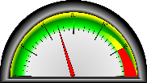
Using the following scales, peer assess your partner’s writing piece
AO5
Give the student a mark out of 4 for writing an authentic story.
Give the student a mark out of 4 for engaging the reader.
Give the student a mark out of 4 for paragraphing.
Give them a mark out of 4 for using connectives/discourse markers.
Give them a mark out of 4 for vocabulary.
Give them a mark out of 4 for ideas.
Total = /24
AO6
Give them a mark out of 4 for punctuation
Give them a mark out of 4 for vocabulary
Give them a mark out of 4 for sentences
Give them a mark out of 4 for spelling
Total = /16
1 = Occasional
2 = Some
3 = Mostly
4 = Effective
When you’ve given them marks, provide them with PIN feedback:
P = Praise (What is good about the work)
I = Improvement (What could get better)
N = Now (What they should do now to show improvement)

Slide 7
Student by marked: _____________________
Student examiner:_______________________
AO5
Writing an authentic story | __/4
Engaging the reader | __/4
Paragraphing | __/4
Using connectives/discourse markers | __/4
Matching vocabulary to purpose and audience | __/4
Strength of ideas | __/4
Total: | __/24
1 = Occasional
2 = Some
3 = Mostly
4 = Effective
When you’ve given them marks, provide them with PIN feedback:
P = Praise (What is good about the work)
________________________________________________
________________________________________________
I = Improvement (What could get better)
________________________________________________
________________________________________________
N = Now (What they should do now to show improvement)
________________________________________________________________________________________________________________
AO6
Use of punctuation | __/4
Using vocabulary accurately | __/4
Using sentences | __/4
Accurate spelling | __/4
Total: | __/16
Notes:
To print out for students to use

Slide 8

Plenary: Roadmap to Success
On your roadmap, write down all the steps you will need to take in order to be successful from the start to the end of the assessment.
Finish
To describe our strengths and our areas to improve in our narratives
To explain to our peers how they can improve their answers
To evaluate the effectiveness of our own answers and use success criteria to make improvements
Start

Slide 9
Finish
Finish
Start
Start
Finish
Finish
Start
Start
Notes:
To print out for students

