Slide 1
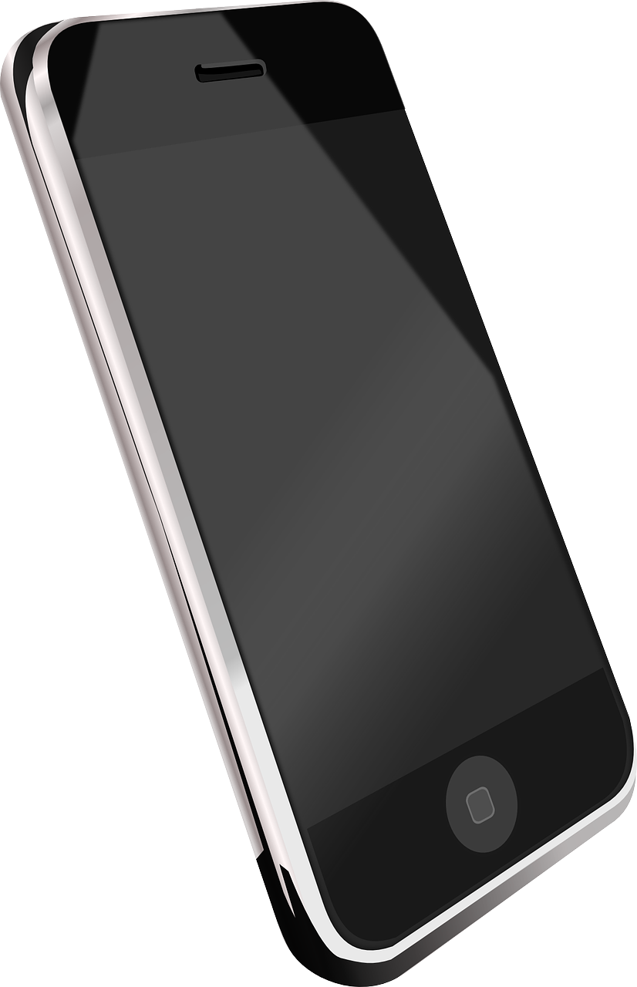
Writing an Essay Continued
Last lesson we explored the key features of essays.
What are the key features we should include in an essay?
How can we ensure our essays are structured well and flow effectively?
Why is an essay a very different type of non-fiction writing to the others we have explored this term? Provide examples.

Slide 2

Here are some key features to include within essay writing:
an effective introduction and convincing conclusion
effectively/fluently linked paragraphs to sequence a range of ideas.
But a great essay must also take into account:
extensive and impressive vocabulary;
a clear structure;
a variety and control of sentence structures;
a clear awareness of purpose and audience.

Slide 3
Learning outcomes
To describe our opinions on mobile phones in schools
To explain the key features of an essay
To evaluate the effectiveness of our own essays based on success criteria

Slide 4

"Students have too many distractions in their daily lives. Mobile phones should be banned."
Write an essay in which you explain your point of view on this statement.
Smart phones have become an everyday essential for students across the country and it is easy to see why. They are a gateway into the world wide web; they are powerful and effective communication devices that have become integral to all social aspects of young people’s lives and they allow us to share and explore all kinds of information. So much of youngsters’ lives are now dominated and controlled by these magical devices, but they do cause problems.
Success criteria
An introduction that clearly sets out your view on the topic.
A powerful opening sentence that engages the reader with the topic straight away
Using the example above to help you, write out your own introduction to your essay.
Not sure how to start? Here are some ideas:
The beeping of a smartphone is a noise that can be the dread of teachers across the country.
Although capable of expanding learning beyond the walls of the classroom, the mobile phone is often viewed negatively by educators.

Slide 5
To begin with, sitting down in a classroom and listening to someone else for an hour or writing down great chunks of text onto paper have become almost alien to youths. Outside of the school walls students tap away on their tablets or computers, speaking to others via the myriad of social media apps that now exist. To go into a space where children sit in rows or around tables and actually speak to each other is becoming stranger and stranger to them.
However, responsibility for this issue should not come down to just students. Adults themselves see their own lives increasingly through the glow of a screen rather than in actual social interaction with each other and their own children. When a student goes home, are they greeted with smiles and prolonged discussion or are they confronted with brothers and sisters and assorted family members eerily focussed on small black boxes?
Music players are now no longer such a problem for young people as they have become totally integrated into smartphones. Music is shared between devices and with students sharing earphones plugged into their tech so they can immerse themselves in audio euphoria as well.
Yet to suggest phones should be banned is a concept that evokes tremendous controversy and frustration from many sections of society. Smartphones do cause issues in the school environment, but at the same time it is possible to further integrate technology into education rather than banning their use completely. In the fast-paced modern world students have to know the ins-and-outs of the latest technology in order to be able to compete with others in the jobs market. Schools have a responsibility to get young people ready for the world of work and beyond, yet by seeing smartphones as evil they are failing to provide this support.
Success criteria:
an effective introduction and convincing conclusion
effectively/fluently linked paragraphs to sequence a range of ideas.
extensive and impressive vocabulary;
a clear structure;
a variety and control of sentence structures;
a clear awareness of purpose and audience.
You can see that the writer has used a variety of sentence structures and openers to engage their audience, they have consistently addressed the exam topic throughout their essay, have a clear sense of purpose and audience, and have used connectives and linking sentences to have a clear sequence for their range of ideas.

Slide 6
"Students have too many distractions in their daily lives. Mobile phones should be banned."
Write an essay in which you explain your point of view on this statement.
Write down three or four topic areas you could discuss in your essay. Look back at the notes we have made previously to help you.
Introduction
Topic 1:
Topic 2:
Topic 3:
Topic 4:
Conclusion

Slide 7

"Students have too many distractions in their daily lives. Mobile phones should be banned."
Write an essay in which you explain your point of view on this statement.
Now, write out the main content of your essay.
Use the success criteria and your topic to help you write effective main content
Success criteria
Write in a neutral tone that helps to explain your perspective
Use connectives to link your ideas together
Remember to vary your sentence openers (-ispaced)
Not sure how to start? Here are some ideas:
The beeping of a smartphone is a noise that can be the dread of teachers across the country.
Although capable of expanding learning beyond the walls of the classroom, the mobile phone is often viewed negatively by educators.

Slide 8
To begin with, sitting down in a classroom and listening to someone else for an hour or writing down great chunks of text onto paper have become almost alien to youths. Outside of the school walls students tap away on their tablets or computers, speaking to others via the myriad of social media apps that now exist. To go into a space where children sit in rows or around tables and actually speak to each other is becoming stranger and stranger to them.
However, responsibility for this issue should not come down to just students. Adults themselves see their own lives increasingly through the glow of a screen rather than in actual social interaction with each other and their own children. When a student goes home, are they greeted with smiles and prolonged discussion or are they confronted with brothers and sisters and assorted family members eerily focussed on small black boxes?
Music players are now no longer such a problem for young people as they have become totally integrated into smartphones. Music is shared between devices and with students sharing earphones plugged into their tech so they can immerse themselves in audio euphoria as well.
Yet to suggest phones should be banned is a concept that evokes tremendous controversy and frustration from many sections of society. Smartphones do cause issues in the school environment, but at the same time it is possible to further integrate technology into education rather than banning their use completely. In the fast-paced modern world students have to know the ins-and-outs of the latest technology in order to be able to compete with others in the jobs market. Schools have a responsibility to get young people ready for the world of work and beyond, yet by seeing smartphones as evil they are failing to provide this support.
Success criteria:
an effective introduction and convincing conclusion
effectively/fluently linked paragraphs to sequence a range of ideas.
extensive and impressive vocabulary;
a clear structure;
a variety and control of sentence structures;
a clear awareness of purpose and audience.
You can see that the writer has used a variety of sentence structures and openers to engage their audience, they have consistently addressed the exam topic throughout their essay, have a clear sense of purpose and audience, and have used connectives and linking sentences to have a clear sequence for their range of ideas.

Slide 9






There are many connectives we can use to link our ideas together
Adding
Moreover,
Furthermore,
Additionally,
As well as this,
In addition,
Besides this,
Cause and Effect
Therefore
Thus
Consequently,
As a result of
Comparing
Similarly,
Likewise,
In the same way,
In comparison,
Equally,
As with
Contrasting
In contrast,
However,
Despite this,
Conversely,
On the other hand,
Nevertheless,
Whereas
Illustrating
For example,
For instance,
As shown by
In the case of
Emphasising
Most of all,
In particular,
Above all,
Significantly,
Indeed,
Notably,
Ordering
Firstly,
Secondly,
Next,
Meanwhile,
Finally,
Revisit the paragraphs you have written for your essay so far and add in connectives to help them flow effectively.

Slide 10
Let’s look at the conclusion to the essay
Overall then phones do cause issues in certain environments, and students have a responsibility to use their devices in the right way at the right time, but at the same time parents and guardians and teachers all have their own roles in making sure they embrace this technology rather than simply shunning it.
The conclusion to the essay sums up the writer’s perspective on the issue of mobile phones in schools: students have a responsibility to use their phones in the right way, but also parents and teachers have roles to play to ensure technology is used in the right way in schools. It is not simply a case of blocking all phones all the time.
You can see how the conclusion to this essay links well back to the introduction.

Slide 11
Let’s now write our own conclusions to our essays
Overall then phones do cause issues in certain environments, and students have a responsibility to use their devices in the right way at the right time, but at the same time parents and guardians and teachers all have their own roles in making sure they embrace this technology rather than simply shunning it.
Success criteria
A conclusion that clearly sums up your views on the exam statement.
A powerful closing sentence that makes the reader consider your views carefully, even after reading the essay.
Using the example above to help you, write out your own conclusion to your essay.

Slide 12
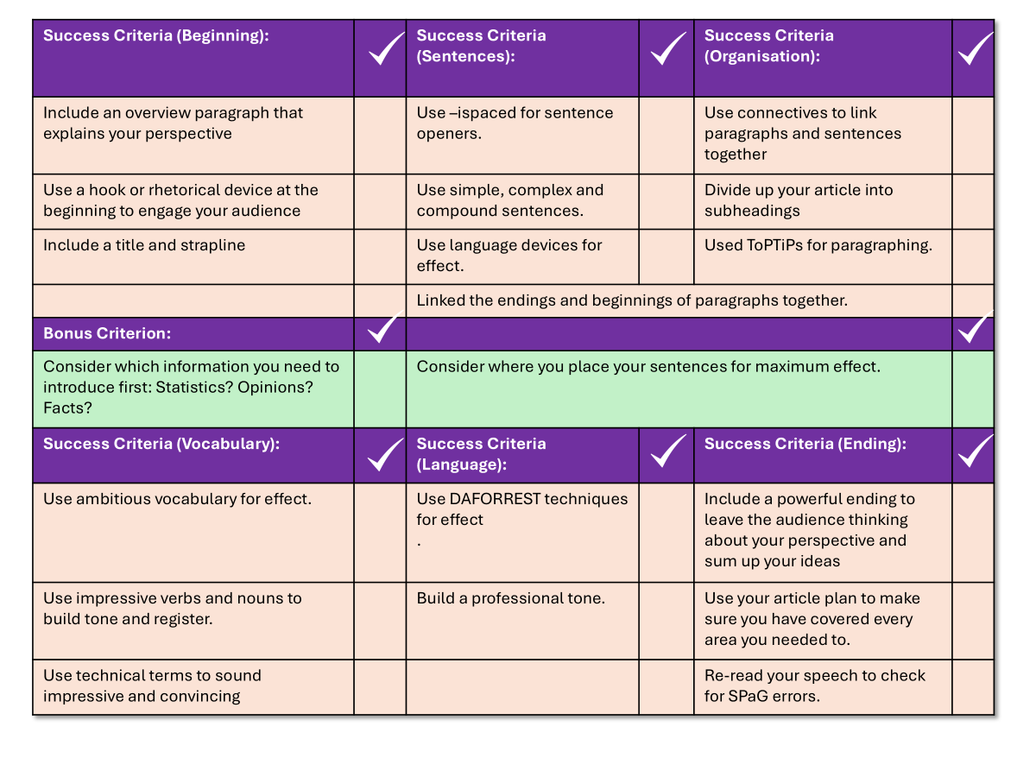
You now have one hour to write your article
"Students have too many distractions in their daily lives. Mobile phones should be banned."
Write an essay in which you explain your point of view on this statement.
Use your checklist to help you self-assess your essay.

Slide 13
Success Criteria (Beginning): |  | Success Criteria (Sentences): |  | Success Criteria (Organisation):
Include an overview paragraph that explains your perspective clearly |  | Use –ispaced for sentence openers. |  | Use connectives to link paragraphs and sentences together
Use a hook or rhetorical device at the beginning to engage your audience |  | Use simple, complex and compound sentences. |  | Used ToPTiPs for paragraphing
 |  | Use language devices for effect. |  | .
 |  | Linked the endings and beginnings of paragraphs together.
Bonus Criterion:
Consider which information you need to introduce first: Statistics? Opinions? Facts? |  | Consider where you place your sentences for maximum effect.
Success Criteria (Vocabulary): |  | Success Criteria (Language): |  | Success Criteria (Ending):
Use ambitious vocabulary for effect. |  | Use DAFORREST techniques for effect . |  | Include a powerful ending to leave the audience thinking about your perspective and sum up your ideas
Use impressive verbs and nouns to build tone and register. |  | Build a professional tone. |  | Use your topic plan to make sure you have covered every area you needed to.
Use technical terms to sound impressive and convincing |  |  |  | Re-read your speech to check for SPaG errors.

Slide 14


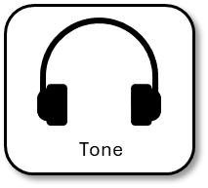
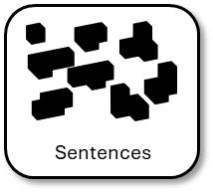
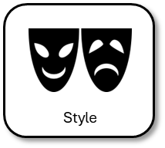
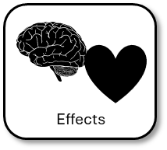
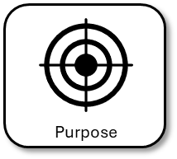
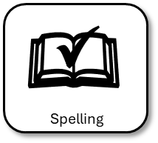
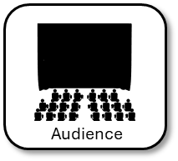
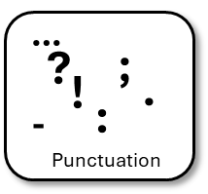
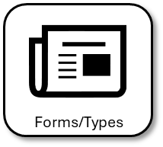
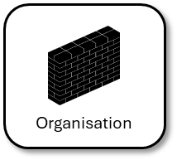
Plenary: Self-assessment reflection sheet
How confident do you feel about this area?
Not confident
Very confident
Which areas do you feel you need to spend more time on?
1) ______________________________________________________________________________________
2)
______________________________________________________________________________________

