Slide 1
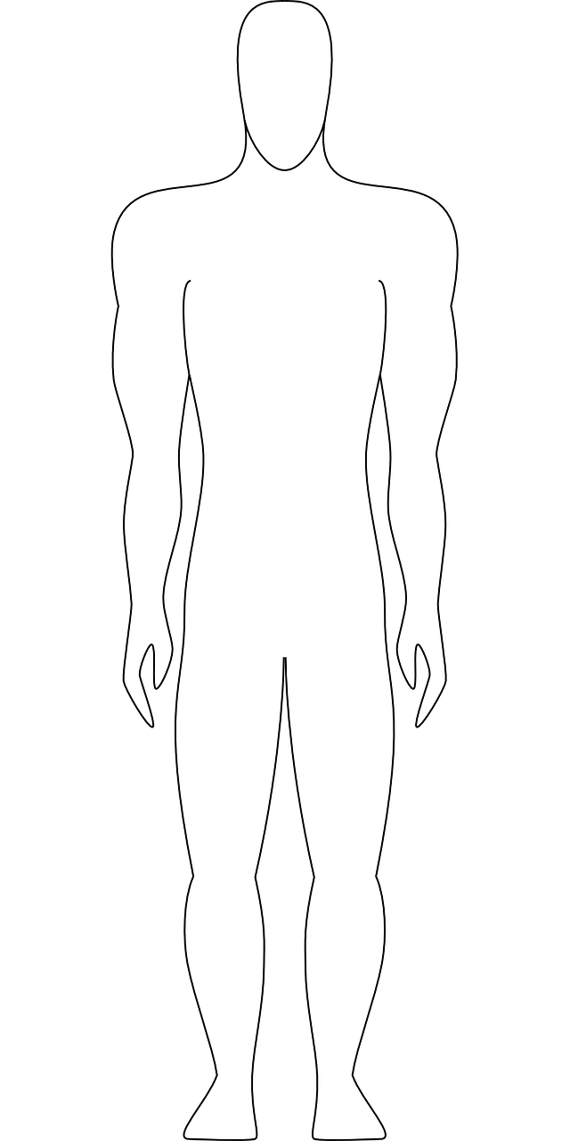

AQA English Language Paper 1 Section B: Characters and Narrative Perspectives
What characters will you include in your ‘life-saving rescue’ story?
How will you introduce these characters?
Why is it important not to reveal everything about the characters straight away? Provide examples.

Slide 2
Learning outcomes
To describe how the new character of the example story is developed
To explain how developing character can change the atmosphere of a story
To evaluate how narrative perspective can help alter how a reader responds to a story

Slide 3
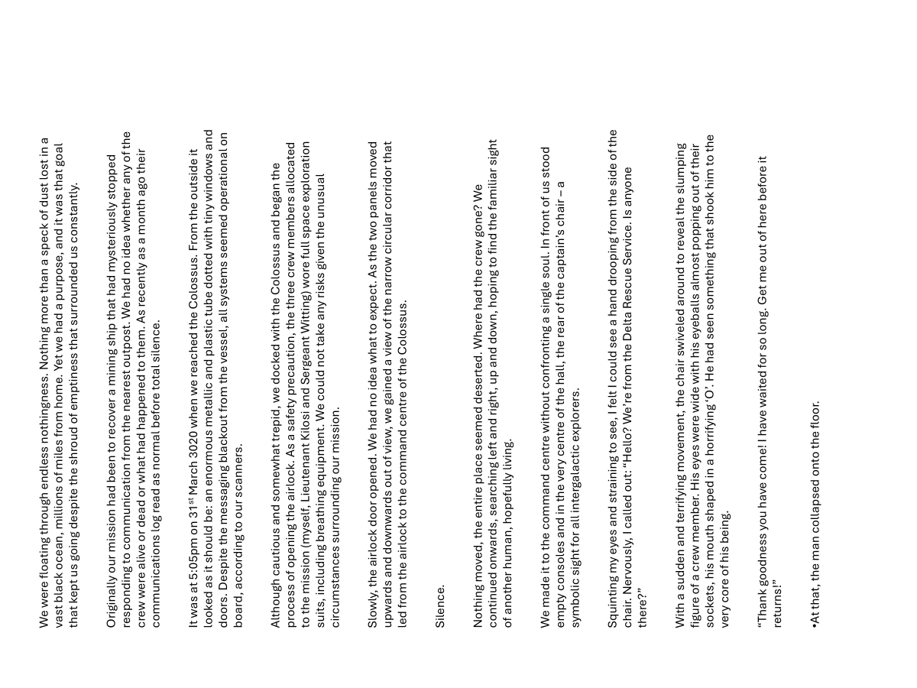
We’ll read through an example story for the ‘life-saving rescue’ task
This story introduces a mysterious new character.
Challenge: What do we find out about the crew member?
Extra Challenge: How does the character make us feel? Why?
Mega Challenge: Why does the writer only give us some details about the crew member without revealing everything? Provide examples.

Slide 4
We were floating through endless nothingness. Nothing more than a speck of dust lost in a vast black ocean, millions of miles from home. Yet we had a purpose, and it was that goal that kept us going despite the shroud of emptiness that surrounded us constantly.
Originally our mission had been to recover a mining ship that had mysteriously stopped responding to communication from the nearest outpost. We had no idea whether any of the crew were alive or dead or what had happened to them. As recently as a month ago their communications log read as normal before total silence.
It was at 5:05pm on 31st March 3020 when we reached the Colossus. From the outside it looked as it should be: an enormous metallic and plastic tube dotted with tiny windows and doors. Despite the messaging blackout from the vessel, all systems seemed operational on board, according to our scanners.
Although cautious and somewhat trepid, we docked with the Colossus and began the process of opening the airlock. As a safety precaution, the three crew members allocated to the mission (myself, Lieutenant Kilosi and Sergeant Witting) wore full space exploration suits, including breathing equipment. We could not take any risks given the unusual circumstances surrounding our mission.
Slowly, the airlock door opened. We had no idea what to expect. As the two panels moved upwards and downwards out of view, we gained a view of the narrow circular corridor that led from the airlock to the command centre of the Colossus.
Silence.
Nothing moved, the entire place seemed deserted. Where had the crew gone? We continued onwards, searching left and right, up and down, hoping to find the familiar sight of another human, hopefully living.
We made it to the command centre without confronting a single soul. In front of us stood empty consoles and in the very centre of the hall, the rear of the captain’s chair – a symbolic sight for all intergalactic explorers.
Squinting my eyes and straining to see, I felt I could see a hand drooping from the side of the chair. Nervously, I called out: “Hello? We’re from the Delta Rescue Service. Is anyone there?”
With a sudden and terrifying movement, the chair swiveled around to reveal the slumping figure of a crew member. His eyes were wide with his eyeballs almost popping out of their sockets, his mouth shaped in a horrifying ‘O’. He had seen something that shook him to the very core of his being.
“Thank goodness you have come! I have waited for so long. Get me out of here before it returns!”
At that, the man collapsed onto the floor.

Slide 5
This new character offers more mystery and tension for the reader
Squinting my eyes and straining to see, I felt I could see a hand drooping from the side of the chair. Nervously, I called out: “Hello? We’re from the Delta Rescue Service. Is anyone there?”
With a sudden and terrifying movement, the chair swiveled around to reveal the slumping figure of a crew member. His eyes were wide with his eyeballs almost popping out of their sockets, his mouth shaped in a horrifying ‘O’. He had seen something that shook him to the very core of his being.
“Thank goodness you have come! I have waited for so long. Get me out of here before it returns!”
At that, the man collapsed onto the floor.
The writer only gives us a few details about the crew member in order to build up suspense and tension.
We are provided with only a few descriptive details before this character suddenly moves and we are then give a more detailed description, including how he sits, what his face looks like and clues about what has happened to him.

Slide 6
Characters can be used to build atmosphere within stories
Often there is a character that seems different to others, that behaves in strange ways that intrigue the reader precisely because they’re so different.
We will now create our own mysterious figure that is designed to intrigue readers.

Slide 7
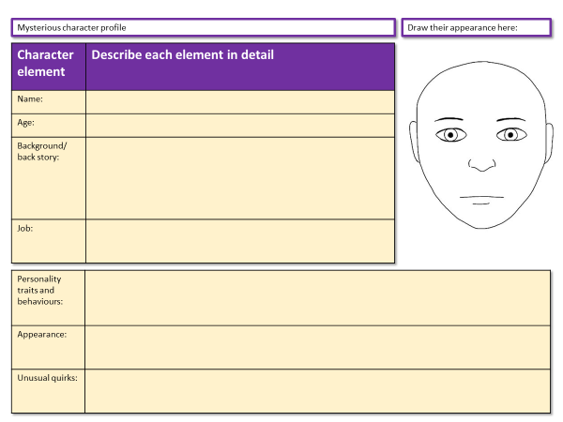
Using our new understanding of characters, let’s create one!
Create a character profile for the someone mysterious that could feature in your own story.
Challenge: Complete your profile worksheet in as much detail as possible.
Extra Challenge: When describing their appearance and clothing, explain how you get across key ideas about what their personality is like.
Mega Challenge: Instead of a profile, write a descriptive paragraph of your character, hinting at what will happen to them or how they intrigue the reader.
Stuck for ideas? Use the mystery short story prompt sheet to help!

Slide 8
A person who visits a shop every day and buys the same thing every time. The shopkeeper decides to ask them about it.
Someone who has been presumed dead for ten years suddenly returns.
A stranger arrives at a remote village and a local resident introduces themselves.
The narrator ends up stuck in a lift with a stranger and they strike a conversation.
Someone hands the narrator a slip of paper telling them to meet at a specific time or location with no other details.
A stranger knocks on the narrator’s door and reveals they are their long-lost relative.
The narrator strikes up a conversation with a taxi driver with an unusual tale.
The narrator accidentally picks up the wrong bag on a train and decides to return it to the owner.
A detective is hired to follow a mysterious stranger.
The narrator sees a light on top of a hill each night and decides to investigate who or what is causing it.

Slide 9
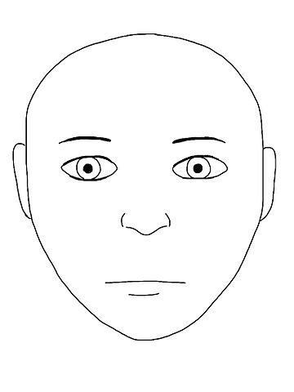
Mysterious character profile
Draw their appearance here:
Character element | Describe each element in detail
Name:
Age:
Background/ back story:
Job:
Personality traits and behaviours:
Appearance:
Unusual quirks:
Notes:
To print

Slide 10



Narrative perspectives
1st person
Use ‘I’ and ‘We’
Told as if the events are happening to you
Or you could be a character in the story
2nd person
Uses ‘You’ and talks directly to the reader.
3rd person
Uses ‘They’ or character names.
It is as if the narrator is telling the reader about other people.
Discuss: Why do you think the writer chose to use first person narration in the story we have explored?

Slide 11
When writing mystery stories, first person narration can help to add to the sense of mystery
We are only told about the narrator’s perspectives, so how they see things, rather than from other people.
The narrator can put their own slant and opinion on the other characters, and in the story we have explored, the narrator’s sense of fear and tension builds up to the new details about the crew member and the ‘it’ that has terrified him.
When writing your own short story, it is important to consider what narrative perspective you will use and why.

Slide 12




Perspectives
Who is telling the story? Who is your narrator?
1st Person (“I”, “Me”)
Told from the viewpoint of a character in the actual story or from a narrator who gets involved in the story. Really useful for getting across the main characters’ thoughts and feelings and making a story more personal and emotive.
2nd Person (“You”)
Told from the viewpoint of a narrator talking to you.
Example: You see the iron door in front of you, imposing. Hesitating, you slowly move your hand to towards the handle.
It can help to bring a reader into a story, but it’s quite a hard perspective to use well and powerfully.
3rd Person (“They”)
Told from the viewpoint of a narrator talking about other people.
Example: Michael saw the door in front of him, imposing. Hesitating, he slowly moved his hand to towards the handle.
This is a really common perspective in creative writing as it allows the narrator to be neutral or detached from the story, allowing you to make up your own mind about the events taking place.

Slide 13

Plenary: Emojis
To describe how the new character of the example story is developed
To explain how developing character can change the atmosphere of a story
To evaluate how narrative perspective can help alter how a reader responds to a story
Draw an emoji to describe your learning today. Why do you feel that way?

