Slide 1
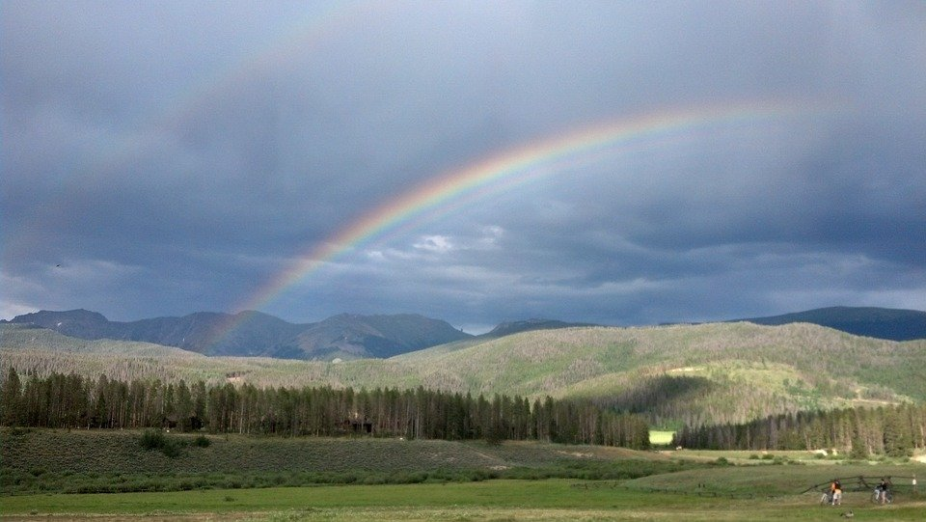
Pathetic Fallacy and Personification
How does this landscape make you feel? Why?
How can the world and weather around us affect how we feel?
Why might descriptions of landscape and weather help writers to establish mood?

Slide 2
Pathetic Fallacy and Personification
Rainbows often have connotations of happiness, of the end of sadness and the beginning of something new and positive.
In reality, rainbows are just caused by reflection, refraction and dispersion of light in water droplets, so that we see a spectrum of light in the sky. However, they are often used in literature to show the reader a change in mood and tone.
We can use both pathetic fallacy and personification to help our readers understand the mood and tone of a story better.

Slide 3
Learning outcomes
To describe what pathetic fallacy and personification are
To explain how these techniques can impact readers’ understanding of mood, tone and character
To evaluate how specific examples of these techniques affect readers

Slide 4

Pathetic fallacy
Pathetic fallacy is a technique where the writer gives human feelings to objects or animals, to describe the mood of a story.
Example: “The friendly sun was up in the sky.”
Challenge: Use pathetic fallacy to describe each of the landscapes on your worksheet.
Extra Challenge: Choose one of your ideas from the worksheet and explain how it impacts on the reader.
Mega Challenge: Make notes on how you could use pathetic fallacy in your own short story and how it might help you engage your readers.

Slide 5

Personification
Personification is a technique where the writer gives human any human attribute to objects or animals, to describe the mood of a story.
Example: “The sun smiled at me.”
Challenge: What is the difference between personification and pathetic fallacy?
Extra Challenge: Decide which of the examples on your worksheet are personification and which are pathetic fallacy.
Mega Challenge: Make notes on how you could use personification in your own short story and how it might help you engage your readers.

Slide 6




Pathetic fallacy
Challenge: Use pathetic fallacy to describe each of the landscapes on your worksheet.
Extra Challenge: Choose one of your ideas from the worksheet and explain how it impacts on the reader.
Mega Challenge: Make notes on how you could use pathetic fallacy in your own short story and how it might help you engage your readers.
Pathetic fallacy and personification
The sun stared at me.
The wind whispered through the trees.
As he danced through the trees, the angry wind made his presence clear.
The sky was crying.
The sky was sad.
Challenge: What is the difference between personification and pathetic fallacy?
Extra Challenge: Decide which of the examples on your worksheet are personification and which are pathetic fallacy.
Mega Challenge: Make notes on how you could use personification in your own short story and how it might help you engage your readers.

Slide 7

The bored sad was everywhere.
The calm water looked so welcoming.
The curious sun was appearing in the sky.
The miserable mist moved through the trees.
The sun stared at me.
The wind whispered through the trees.
As he danced through the trees, the angry wind made his presence clear.
The sky was crying.
The sky was sad.
Most of these sentences are examples of personification, because they gave human attributes to non-human objects. However, the third sentence uses pathetic fallacy as the wind is described as angry, whilst the fifth sentence describes the sky as sad.
Generally, pathetic fallacy is used to describe the environment or setting in a story. It helps to convey the mood of a story or how a character feels.
If a character is feeling sad, they may be walking through rain. If a character is happy, they may be running through the sunshine.

Slide 8



Let’s explore some examples of pathetic fallacy
Discuss: How does this example of pathetic fallacy help the reader to understand how the character feels? Why?
“I wandered lonely as a cloud
That floats on high o’er vales and hills,”

Slide 9
Let’s explore some examples of pathetic fallacy
This example is from a poem by William Wordsworth.
Here, the pathetic fallacy helps us as readers to understand that the character is alone and isolated, like a cloud that floats about hills and vales.
“I wandered lonely as a cloud
That floats on high o’er vales and hills,”

Slide 10
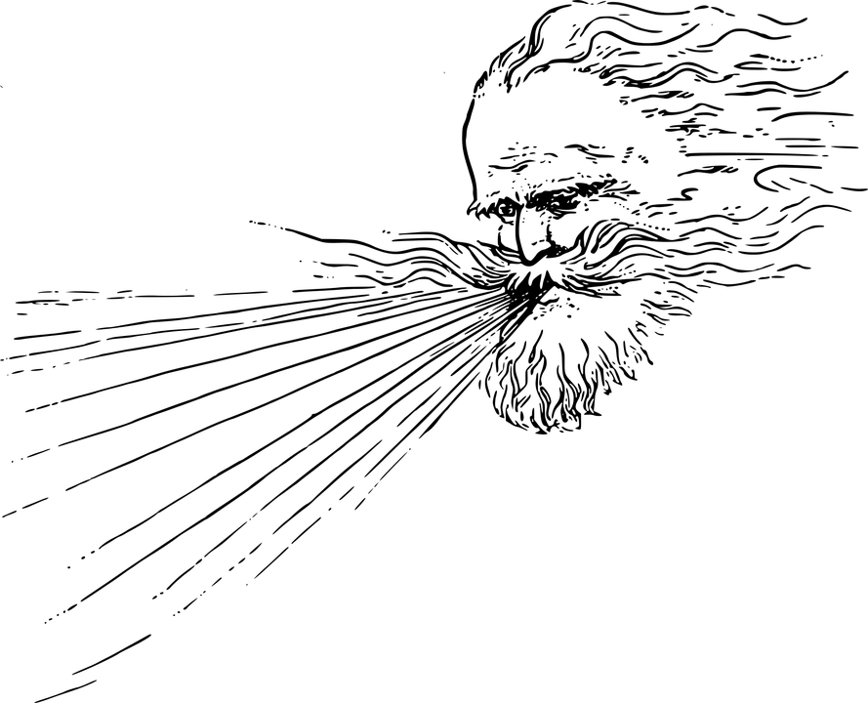
Let’s explore some examples of pathetic fallacy
Discuss: How do these examples of pathetic fallacy help the reader to understand the mood of the story?
“Day after day, a vast heavy veil had been driving over London from the East, and it drove still, as if in the East there were an Eternity of cloud and wind. So furious had been the gusts, that high buildings in town had had the lead stripped off their roofs; and in the country, trees had been torn up, and sails of windmills carried away; and gloomy accounts had come in from the coast, of shipwreck and death. Violent blasts of rain had accompanied these rages of wind, and the day just closed as I sat down to read had been the worst of all.”

Slide 11
Let’s explore some examples of pathetic fallacy
The writer makes the wind sound angry and aggressive, so that it is both furious and it rages. It makes us think the wind is attacking us and this helps the reader to picture the strength and ferocity of the storm.
“Day after day, a vast heavy veil had been driving over London from the East, and it drove still, as if in the East there were an Eternity of cloud and wind. So furious had been the gusts, that high buildings in town had had the lead stripped off their roofs; and in the country, trees had been torn up, and sails of windmills carried away; and gloomy accounts had come in from the coast, of shipwreck and death. Violent blasts of rain had accompanied these rages of wind, and the day just closed as I sat down to read had been the worst of all.”

Slide 12
Create a description of your setting for your new story
Use your new understanding of pathetic fallacy and personification to write out an effective description of your setting.

Slide 13

Plenary: Drawing
Draw what you have learnt today. It could be a symbol or an image, something that comes into your head based on what you’ve learnt.
Ask the person nearest to you to write in your exercise book how they interpret your picture.
Example: “I think _____ drew this because…”
To describe what pathetic fallacy and personification are
To explain how these techniques can impact readers’ understanding of mood, tone and character
To evaluate how specific examples of these techniques affect readers.

