Slide 1
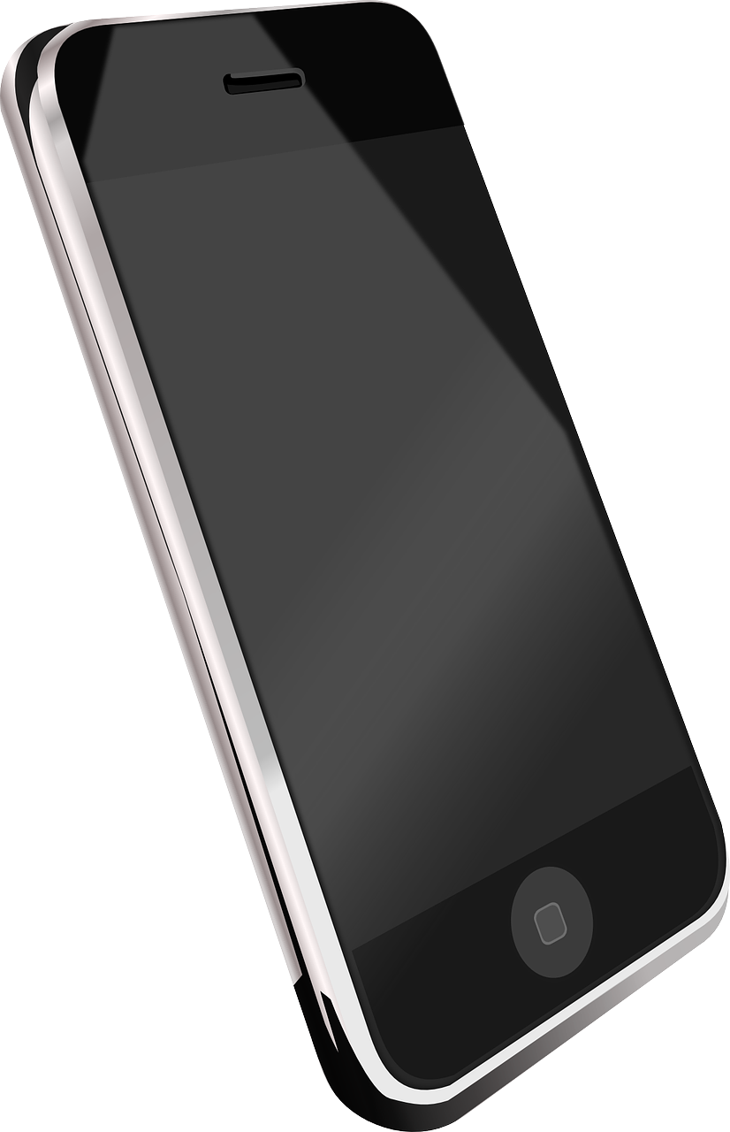
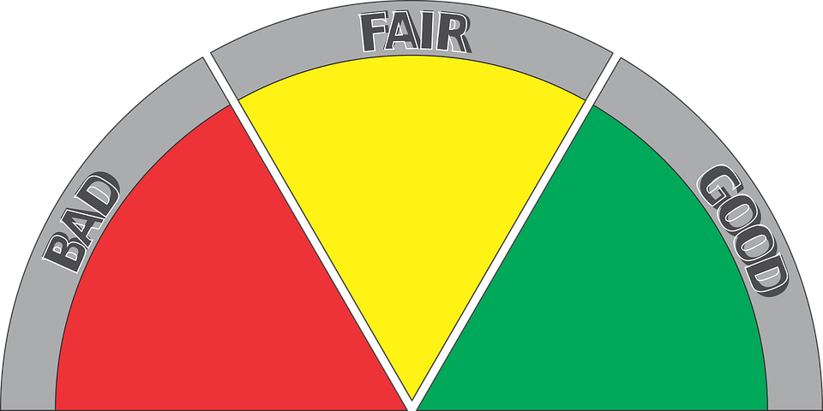
Writing an Essay
There has been a lot of news coverage about mobile phones and their use in schools.
Should mobile phones be banned in schools?
What kind of ban would you want to see in schools, if any?
Why might phones be a useful learning aid in schools? Why might they be harmful to learning? Provide examples.

Slide 2
Learning outcomes
To describe our opinions on mobile phones in schools
To explain the key features of an essay
To evaluate how well a student’s essay uses these key features

Slide 3
Here is an exam-style question
"Students have too many distractions in their daily lives. Mobile phones should be banned."
Write an essay in which you explain your point of view on this statement
(24 marks for content and organisation
16 marks for technical accuracy)
[40 marks]

Slide 4
We will watch a couple of videos on mobile phones in school
https://www.youtube.com/watch?v=bLq9gMddr10
https://www.youtube.com/watch?v=bKKkw2mGenE
Discuss: What is your view on a mobile phone ban in schools? Has it changed from the beginning of the lesson?
Notes:
If the links are broken, please get in touch at info@englishgcse.co.uk

Slide 5
Working in groups, complete your table to show the different perspectives around this issue
Mobile phones should be banned in schools | Mobile phones shouldn’t be banned in schools
Teachers dealing with phone use in lessons means they cannot focus on teaching and students cannot focus on learning. | Students will sometimes need to contact home in an emergency and phones allow them to do this easily.
Group 1:
Group 2:
Group 3:
Group 4:
Group 5:
Group 6:

Slide 6
Mobile phones should be banned in schools | Mobile phones shouldn’t be banned in schools
Teachers dealing with phone use in lessons means they cannot focus on teaching and students cannot focus on learning. | Students will sometimes need to contact home in an emergency and phones allow them to do this easily.
Mobile phones should be banned in schools | Mobile phones shouldn’t be banned in schools
Teachers dealing with phone use in lessons means they cannot focus on teaching and students cannot focus on learning. | Students will sometimes need to contact home in an emergency and phones allow them to do this easily.
Notes:
To print out for each group

Slide 7
What do you need to put into a good essay?
Here’s an example of the kind of question you could get in the exam:
"Students have too many distractions in their daily lives. Mobile phones should be banned."
Write an essay in which you explain your point of view on this statement.
Discuss: What features would you need to include in an essay if you were given this non-fiction task?

Slide 8
ADVISE ARGUE PERSUADE EXPLAIN/INFORM
 | WRITING TO ARGUE | WRITING TO PERSUADE | WRITING TO ADVISE | WRITING TO EXPLAIN/INFORM
What is it? | Giving the case for one side of a debate | Convincing someone that your opinion is right | Providing ways forward for someone. | Explaining ideas on a topic to your reader.
What does it involve? | Being aware of the other side of a debate | Using your language to convince your leader. | Not telling someone what to do but giving them options. | You are not convincing people or advising. You are explaining different perspectives and attitudes on a topic.
What key features do you often find in this type of writing? | Includes counter-arguments, rhetorical questions, facts, statistics, emotive language | Includes triplets, repetition, emotive language, rhetorical questions, direct address and more… | Includes modal verbs, imperatives, an understanding tone but one that is direct. Provide helpful information. | Includes facts, opinions, a complex and detailed perspective.

Slide 9

"Students have too many distractions in their daily lives. Mobile phones should be banned."
Write an essay in which you explain your point of view on this statement.
We know from previous lessons that writing to explain means getting across your opinion to the reader without trying to convince them or argue for or against an idea.
You need facts, opinions and a complex and detailed perspective gets across your opinions on a topic.
So, what exactly needs to go into an essay?

Slide 10

Here are some key features to include within essay writing:
an effective introduction and convincing conclusion
effectively/fluently linked paragraphs to sequence a range of ideas.
But a great essay must also take into account:
extensive and impressive vocabulary;
a clear structure;
a variety and control of sentence structures;
a clear awareness of purpose and audience.

Slide 11

Purpose: Writing to Explain
Purpose: | WRITING TO EXPLAIN
What is it? | Explaining your opinion on a topic to your reader.
What does it involve? | You are not convincing people or advising, you are explaining.
What key features do you often find in this type of writing? | Facts Opinions A neutral and unbiased tone that gets across your opinions on a topic
When you are writing to explain, you are showing you understand what this purpose of writing involves.
It means you are presenting your opinions around a topic, but you do so in a neutral and factual way, rather than trying to show bias and persuade or argue a point.

Slide 12
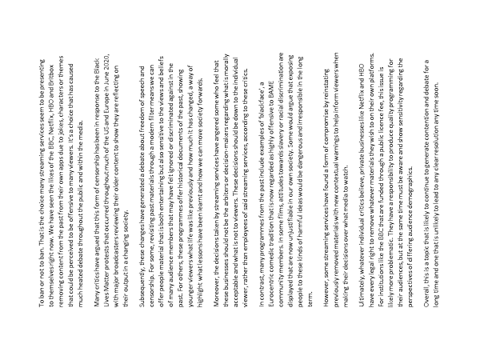
We’ll analyse an example of an essay to see how these features are included:
Success criteria:
an effective introduction and convincing conclusion
effectively/fluently linked paragraphs to sequence a range of ideas.
extensive and impressive vocabulary;
a clear structure;
a variety and control of sentence structures;
a clear awareness of purpose and audience.
How well does this essay meet the success criteria?
How does the writer think about purpose and audience in their essay?
How does the writer help to put together a clear structure to their essay?

Slide 13
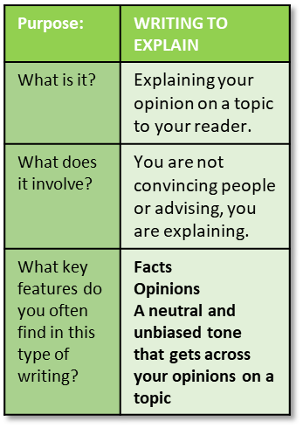
Success criteria:
an effective introduction and convincing conclusion
effectively/fluently linked paragraphs to sequence a range of ideas.
extensive and impressive vocabulary;
a clear structure;
a variety and control of sentence structures;
a clear awareness of purpose and audience.
Smart phones have become an everyday essential for students across the country and it is easy to see why. They are a gateway into the world wide web; they are powerful and effective communication devices that have become integral to all social aspects of young people’s lives and they allow us to share and explore all kinds of information. So much of youngsters’ lives are now dominated and controlled by these magical devices, but they do cause problems.
To begin with, sitting down in a classroom and listening to someone else for an hour or writing down great chunks of text onto paper have become almost alien to youths. Outside of the school walls students tap away on their tablets or computers, speaking to others via the myriad of social media apps that now exist. To go into a space where children sit in rows or around tables and actually speak to each other is becoming stranger and stranger to them.
However, responsibility for this issue should not come down to just students. Adults themselves see their own lives increasingly through the glow of a screen rather than in actual social interaction with each other and their own children. When a student goes home, are they greeted with smiles and prolonged discussion or are they confronted with brothers and sisters and assorted family members eerily focussed on small black boxes?
Music players are now no longer such a problem for young people as they have become totally integrated into smartphones. Music is shared between devices and with students sharing earphones plugged into their tech so they can immerse themselves in audio euphoria as well.
Yet to suggest phones should be banned is a concept that evokes tremendous controversy and frustration from many sections of society. Smartphones do cause issues in the school environment, but at the same time it is possible to further integrate technology into education rather than banning their use completely. In the fast-paced modern world students have to know the ins-and-outs of the latest technology in order to be able to compete with others in the jobs market. Schools have a responsibility to get young people ready for the world of work and beyond, yet by seeing smartphones as evil they are failing to provide this support.
Overall then phones do cause issues in certain environments, and students have a responsibility to use their devices in the right way at the right time, but at the same time parents and guardians and teachers all have their own roles in making sure they embrace this technology rather than simply shunning it.

Slide 14
Let’s look at the introduction to the essay
Smart phones have become an everyday essential for students across the country and it is easy to see why. They are a gateway into the world wide web; they are powerful and effective communication devices that have become integral to all social aspects of young people’s lives and they allow us to share and explore all kinds of information. So much of youngsters’ lives are now dominated and controlled by these magical devices, but they do cause problems.
The introduction sets out why mobile phones in schools is such a controversial and debated topic.
It sets out why some people view mobile phones as helpful and why others view them as damaging to students and their learning.
This then allows the writer to go on to explain their views in greater detail throughout the rest of the essay.

Slide 15
Let’s look at the conclusion to the essay
Overall then phones do cause issues in certain environments, and students have a responsibility to use their devices in the right way at the right time, but at the same time parents and guardians and teachers all have their own roles in making sure they embrace this technology rather than simply shunning it.
The conclusion to the essay sums up the writer’s perspective on the issue of mobile phones in schools: students have a responsibility to use their phones in the right way, but also parents and teachers have roles to play to ensure technology is used in the right way in schools. It is not simply a case of blocking all phones all the time.
You can see how the conclusion to this essay links well back to the introduction.

Slide 16
To begin with, sitting down in a classroom and listening to someone else for an hour or writing down great chunks of text onto paper have become almost alien to youths. Outside of the school walls students tap away on their tablets or computers, speaking to others via the myriad of social media apps that now exist. To go into a space where children sit in rows or around tables and actually speak to each other is becoming stranger and stranger to them.
However, responsibility for this issue should not come down to just students. Adults themselves see their own lives increasingly through the glow of a screen rather than in actual social interaction with each other and their own children. When a student goes home, are they greeted with smiles and prolonged discussion or are they confronted with brothers and sisters and assorted family members eerily focussed on small black boxes?
Music players are now no longer such a problem for young people as they have become totally integrated into smartphones. Music is shared between devices and with students sharing earphones plugged into their tech so they can immerse themselves in audio euphoria as well.
Yet to suggest phones should be banned is a concept that evokes tremendous controversy and frustration from many sections of society. Smartphones do cause issues in the school environment, but at the same time it is possible to further integrate technology into education rather than banning their use completely. In the fast-paced modern world students have to know the ins-and-outs of the latest technology in order to be able to compete with others in the jobs market. Schools have a responsibility to get young people ready for the world of work and beyond, yet by seeing smartphones as evil they are failing to provide this support.
Success criteria:
an effective introduction and convincing conclusion
effectively/fluently linked paragraphs to sequence a range of ideas.
extensive and impressive vocabulary;
a clear structure;
a variety and control of sentence structures;
a clear awareness of purpose and audience.
You can see that the writer has used a variety of sentence structures and openers to engage their audience, they have consistently addressed the exam topic throughout their essay, have a clear sense of purpose and audience, and have used connectives and linking sentences to have a clear sequence for their range of ideas.

Slide 17
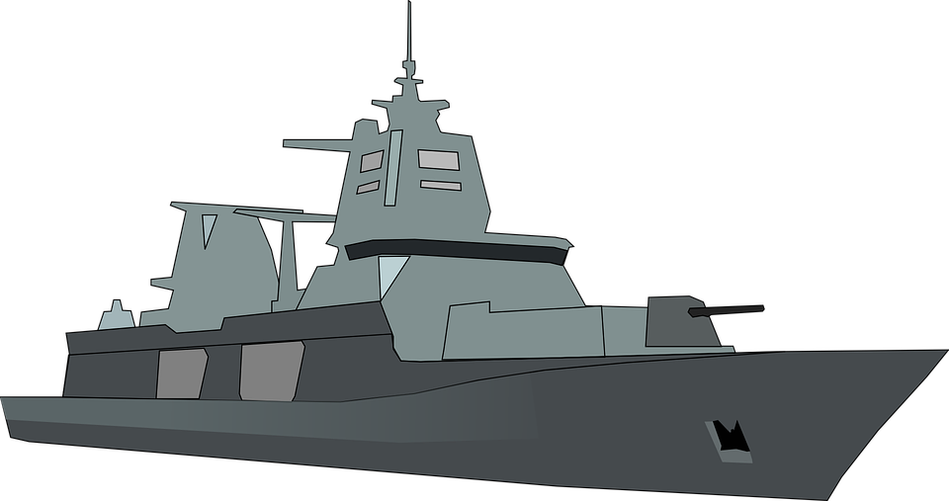
Plenary: Battleships!
You have each been given a 10x10 grid. You can now draw your navy onto your paper!
Each player's fleet consists of the
following ships:
1 x Aircraft carrier - 5 squares
1 x Battleship - 4 squares
1 x Cruiser - 3 squares
2 x Destroyers - 2 squares each
2 x Submarines - 1 square each
Each person talks about one thing they’ve learnt from today’s lesson. If the other person is happy with the answer then they can choose one square to fire at. Once all the boats are hit then that player wins the game!
To describe our opinions on mobile phones in schools
To explain the key features of an essay
To evaluate how well a student’s essay uses these key features

Slide 18

A
B
C
D
E
F
G
H
I
J
1 2 3 4 5 6 7 8 9 10
1 2 3 4 5 6 7 8 9 10
A
B
C
D
E
F
G
H
I
J
1 2 3 4 5 6 7 8 9 10
1 2 3 4 5 6 7 8 9 10
A
B
C
D
E
F
G
H
I
J
A
B
C
D
E
F
G
H
I
J

