Slide 1

AQA English Language Paper 1 Section B: Narrative Writing
Section B of Paper 1 is the creative writing section.
You choose ONE question from a choice of two.
There is usually a choice between narrative writing (story) and descriptive writing.
In this unit we will focus on narrative writing.
You have been asked to write the opening to a story about a life-saving rescue.
Plan out an idea for a narrative about this. If you’re not sure, plan a narrative about someone getting a new pet.
Bonus Challenge: Plan a clear beginning, middle and end to your narrative.

Slide 2
Learning outcomes
To describe ways of opening stories
To analyse how one writer begins their story
To evaluate the impact of our own story beginnings

Slide 3
These are the types of questions you will see in the exam
Here are the kinds of questions you’ll get:
Write a description of… using your imagination. You may choose to use
the picture provided for ideas.
Write a story about…
Write a story that begins with the sentence…
Write the opening to a story about…
Describe… using your imagination.
Write a story about… using your imagination. You may choose to use
the picture provided for ideas.
The questions highlighted are the types we will be focusing on in this unit.
The exam task will usually include a central idea or theme for you to work around, but it still gives you lots of flexibility in terms of what you could write about…

Slide 4

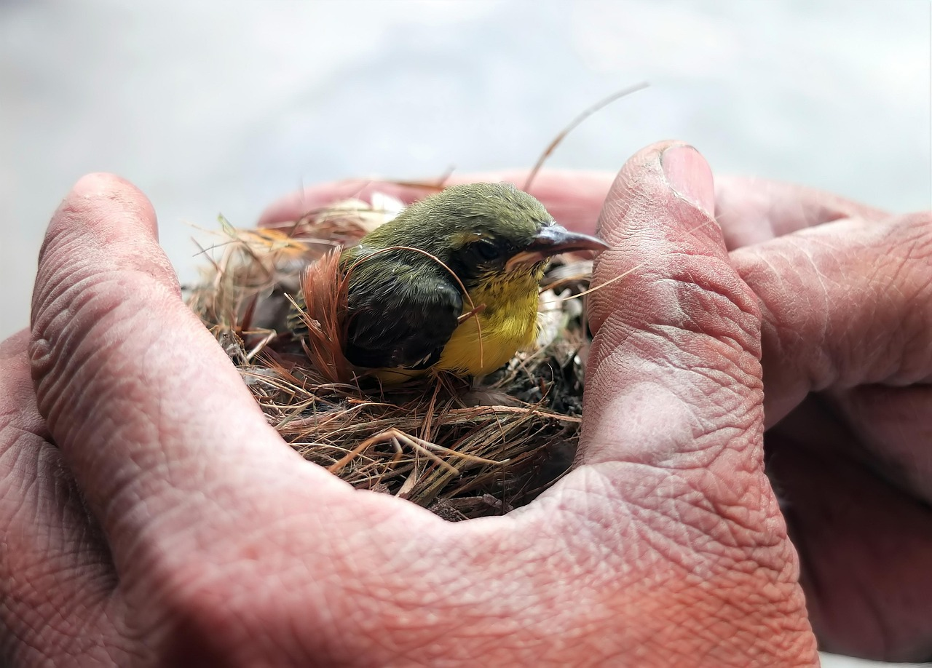




A life-saving rescue is a brilliant idea to work with!
Rescuing an animal
Rescuing someone hurt during sport or exercise
Space rescue
Rescue on another planet
Rescuing an alien!
A rescue at sea.
A rescue on a mountain.
A rescue underground.
A story from the perspective of a firefighter, police officer or paramedic
Rescue during a conflict
Rescuing an enemy or foe
You can choose any ‘life-saving rescue’ you want! Like Sci-Fi? Write a Sci-Fi story. Like romance stories? Write about rescuing someone and falling in love!

Slide 5
Your narrative needs to have a clear structure
Beginning
Middle
Ending
How will you hook the reader into your story?
What will you introduce first? A character? A setting? Plot?
How will you keep the reader interested?
Will the story build to a climax or will it change direction?
How will you leave the reader at the end?
Will they be left on a cliff-hanger? Will you bring it to a climax or an anticlimax?
Plan out a clear beginning, middle and end for your story.
Bonus Challenge: How will you hook the reader into your story? How will you ensure you keep the reader engaged for the entire story?

Slide 6
Let’s look at two potential beginnings to a story
Student 1
We were lost in space and had to rescue a crew from a mining ship. We found the captain and he gave us a warning.
Student 2
We were floating through endless nothingness. Nothing more than a speck of dust lost in a vast black ocean, millions of miles from home. Yet we had a purpose, and it was that goal that kept us going despite the shroud of emptiness that surrounded us constantly.
What are the differences between the two beginnings?
How do the two beginnings make you feel? Why?
Why is ‘show not tell’ so important when planning stories?

Slide 7
Student 1
Student 2
We were lost in space and had to rescue a crew from a mining ship. We found the captain and he gave us a warning.
We were floating through endless nothingness. Nothing more than a speck of dust lost in a vast black ocean, millions of miles from home. Yet we had a purpose, and it was that goal that kept us going despite the shroud of emptiness that surrounded us constantly.
This student has chosen to tell us what happens straight away. We know they will find the captain and he will give them a warning.
However, one of the most exciting parts of the story has already been revealed.
Great story writers will build up to important plot events. They will show not tell.
This student hasn’t even mentioned about getting a dog, but instead focuses on developing setting and mood.
We learn lots about the mood out in deep space and just how isolated it is. However, we have no idea what will happen next.
They are pacing their story well before they go on to introduce the rest of the plot.

Slide 8







A puzzle! Hook your reader in with something that isn’t clear at the beginning, perhaps something unusual has happened?
Visual hook. Use a powerful image or description to engage the reader at the start.
Direct address. Talk directly to your readers as a way of engaging them.
Visual hook. Use a powerful image or description to engage the reader at the start.
We were floating through endless nothingness.
Amusing hook. Use a joke to establish a comedic tone at the beginning of your text.
Dialogue. Have characters talking to each other right from the beginning to establish characters and relationships.
Write out the opening sentence of your story using a visual hook.
Bonus Challenge: Write a different opening using one of the other hooks. Which one works better for your story? Why?
Subtle hook. Hint at what is going to happen in the rest of the text/chapter.
Atmospheric hook. Use your descriptive language to build up a particular tone and atmosphere right at the very beginning.
Mid-action: Start a narrative right in the middle of action and hook the reader in straight away. No need for long-winded introductions or descriptions.

Slide 9

Switch opening sentences with another student
We were floating through endless nothingness.
Use your success criteria table to assess the effectiveness of their opening sentence.
Explain why their opening sentence was effective.
Success criteria
Did they use show not tell?
Does it use a narrative hook?
Why did this opening hook you into the story? | It establishes the mood of the story without revealing much.

Slide 10
Success criteria
Did they use show not tell?
Does it use a narrative hook?
Why did this opening hook you into the story?
Success criteria
Did they use show not tell?
Does it use a narrative hook?
Why did this opening hook you into the story?
Success criteria
Did they use show not tell?
Does it use a narrative hook?
Why did this opening hook you into the story?
Success criteria
Did they use show not tell?
Does it use a narrative hook?
Why did this opening hook you into the story?
Success criteria
Did they use show not tell?
Does it use a narrative hook?
Why did this opening hook you into the story?
Success criteria
Did they use show not tell?
Does it use a narrative hook?
Why did this opening hook you into the story?

Slide 11


Every story is a journey, and you need to plan your destination
Beginning
We were floating through endless nothingness.
Ending
At that, the man collapsed onto the floor.

Slide 12
Next lesson we will explore personification and pathetic fallacy to help us create effective descriptions of settings for our stories.
Beginning
We were floating through endless nothingness.
Ending
At that, the man collapsed onto the floor.

Slide 13

Plenary: Feelings
How you felt about the learning outcomes at the start of the lesson:
How you feel at the end of the lesson:
What you want to feel like next lesson:
To describe ways of opening stories
To analyse how one writer begins their story
To evaluate the impact of our own story beginnings

