Slide 1



AQA English Language Paper 1 – Q3: Structure
Past
Present
Future
We previously explored the impact of changes of tone and place in the structure of a text.
Today we will look at the impact of changes of time in the structure of a text.
Which parts of the text are written in the past?
How does time change throughout the extract?
Why does the writer choose to alter time throughout the extract? Provide examples.

Slide 2
Learning outcomes
To describe how time changes throughout the extract
To explain how changes in time affect how the reader interprets the text
To evaluate the effectiveness of our Q3 answers through key skills used

Slide 3
Paragraph 1:
Present
Football fans at the game in the present day.
Paragraph 2:
Present
The narrator describes their seat at the stadium.
Paragraph 3:
Present
The narrator describes the weather and the game.
Paragraph 4:
Past
The narrator thinks about their father and his death in the past.
Paragraph 5:
Past and Present
The narrator thinks about being at a game with his father in the past before switching to the present and being there with his own son.

Slide 4
Paragraph 6:
Immediate Past
The narrator describes the morning of the game where fans arrive at the stadium.
Paragraph 7:
Immediate Past
The narrator describes travelling to the stadium with his son James.
Paragraph 8:
Present
The narrator describes the beginning of the match.
Paragraph 9:
Present
The narrator describes the striker being fouled in the box.
Paragraph 10:
Present
The narrator describes the referee awarding a penalty and the striker preparing to take it.
Paragraph 11:
Present
The narrator describes the atmosphere and the ball travelling through the air.

Slide 5
The extract we have been exploring is from the beginning of a novel
Because the extract is from the beginning of a novel, it needs to provide the reader with a lot of information quite quickly.
In short stories, writers have less time to develop the following areas:
Characters;
Settings;
Plot;
Themes.
Therefore, a lot of this information will need to be revealed at the start of a novel.
Q3 will always tell whether the text is from the beginning, the middle or the end of the story it is from. Make sure you look out for this information when sitting your exam.

Slide 6
Paragraph 1:
Present
Paragraph 6:
Immediate Past
Most of the story takes place in the present, but the narrator switches to the past, recalling the death of his father, before switching to the immediate past and the morning of the game, before going back to the present.
Discuss: Why do you think the writer chose to structure the text in this way?
Paragraph 7:
Immediate Past
Paragraph 2:
Present
Paragraph 8:
Present
Paragraph 3:
Present
Paragraph 9:
Present
Paragraph 4:
Past
Paragraph 10:
Present
Paragraph 5:
Past and Present
Paragraph 11:
Present

Slide 7
The changes in time are integral to the structure of the text
Whilst much of the text is spent describing the atmosphere of the game and the stadium, the memory of the death of the narrator’s father radically alters the mood of the extract, but it also helps us to understand why football is so important to the narrator, and how he perceives it as being an integral part of his identity.
He sees the game as so important because he has inherited his love of it from his father, and he is passing it on to his own son.

Slide 8



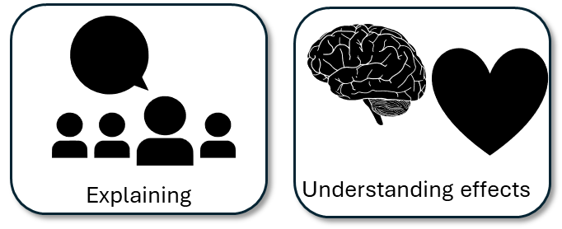
Q3 is worth 8 marks
Unlike Q2, you are asked to explore the whole text, not just a small part of it.
You will be given a particular area of structure to focus on, such as atmosphere.

Slide 9
Here is an example Q3-style task
You now need to think about the structure of the source as a whole.
This text is from the beginning of a novel.
How has the writer structured the text to create atmosphere?
You could write about:
• how the atmosphere has changed by the end of the source
• how the writer uses structure to create an effect
• the writer’s use of any other structural features, such as changes in mood, tone or perspective.

Slide 10
The question will also give you some potential areas to explore
You could write about:
• how the atmosphere has changed by the end of the source
• how the writer uses structure to create an effect
• the writer’s use of any other structural features, such as changes in mood, tone or perspective.
Always read these bullet points carefully as they give you some really ideas for answering the question.
In this example the question suggests exploring the changes in atmosphere throughout the text.
It highlights the importance of analysing the effects the structure has on the reader’s thoughts and feelings
Additionally, it suggest exploring changes in mood, tone or perspective.

Slide 11

Q3: Structural analysis
This question asks you to focus on the WHOLE SOURCE. It is not about a small extract, but the whole text given to you.
You’re told that the text is from the beginning of a novel. That information is important as it changes how structure is used by the writer.
You are also given three bullet points to look at:
• how the atmosphere has changed by the end of the source
• how the writer uses structure to create an effect
• the writer’s use of any other structural features, such as changes in mood, tone or perspective.
  [8 marks]
Possible sentence starters to use:
In the extract the writer structures the chapter so at the beginning the reader can understand…
The use of the abrupt sentence at the beginning“…” makes clear to the reader that…
When the writer moves on to the next paragraph they… for the reader because…
As the extract progresses, the narrator focusses on… This helps the reader to understand that…
By the end of the extract, the narrator is focussing on… because it has the reader to see that…
Key terms:
Tension
Mood
Perspective
Second-person narrative
Empathy
Sympathy
Focus
Climax
Cliff-hanger
Beginning of the novel
Plan and write out your answer to this question
Timed conditions: 12 minutes

Slide 12
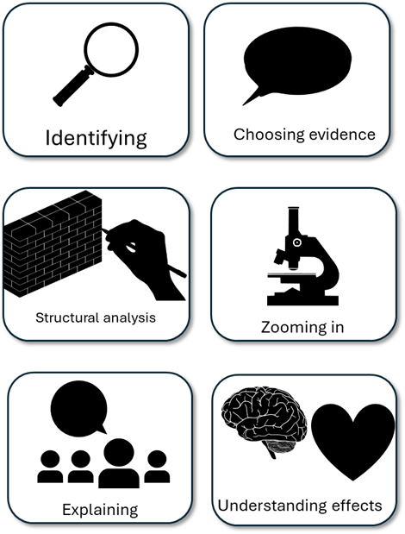
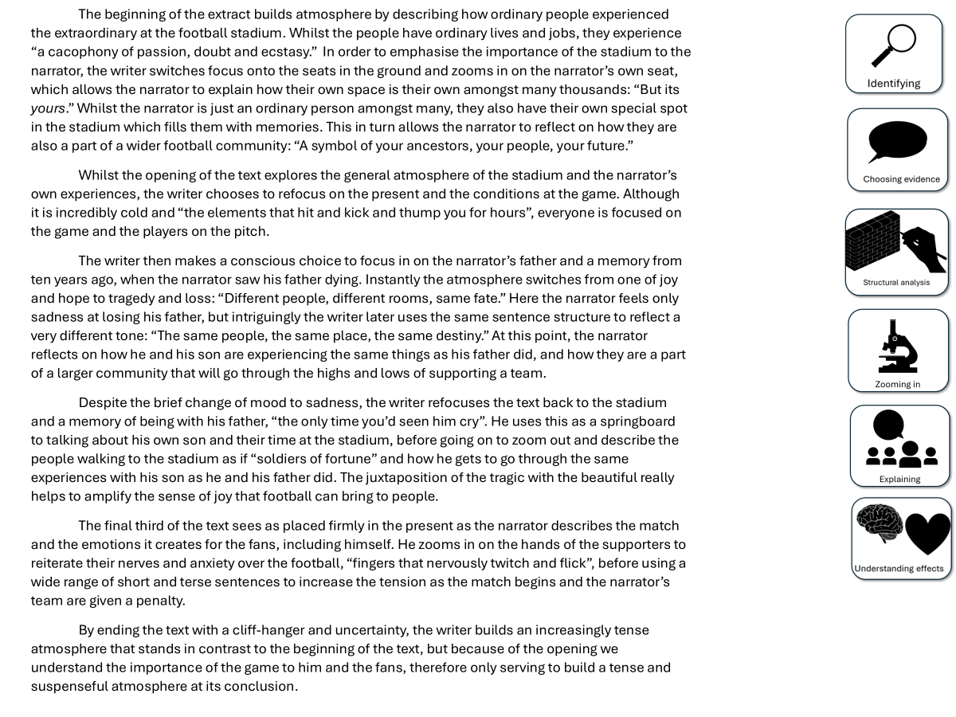
You have been given a good answer for Q3
Go through the answer and find one good example for each of the six skills shown. You could this through arrows, annotations or highlighting.
Bonus Challenge: The student has avoided using words like “shows” too often. What other analytical verbs have they used instead?

Slide 13


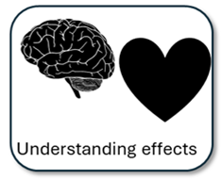
The beginning of the extract builds atmosphere by describing how ordinary people experienced the extraordinary at the football stadium. Whilst the people have ordinary lives and jobs, they experience “a cacophony of passion, doubt and ecstasy.” In order to emphasise the importance of the stadium to the narrator, the writer switches focus onto the seats in the ground and zooms in on the narrator’s own seat, which allows the narrator to explain how their own space is their own amongst many thousands: “But its yours.” Whilst the narrator is just an ordinary person amongst many, they also have their own special spot in the stadium which fills them with memories. This in turn allows the narrator to reflect on how they are also a part of a wider football community: “A symbol of your ancestors, your people, your future.”
Whilst the opening of the text explores the general atmosphere of the stadium and the narrator’s own experiences, the writer chooses to refocus on the present and the conditions at the game. Although it is incredibly cold and “the elements that hit and kick and thump you for hours”, everyone is focused on the game and the players on the pitch.
The writer then makes a conscious choice to focus in on the narrator’s father and a memory from ten years ago, when the narrator saw his father dying. Instantly the atmosphere switches from one of joy and hope to tragedy and loss: “Different people, different rooms, same fate.” Here the narrator feels only sadness at losing his father, but intriguingly the writer later uses the same sentence structure to reflect a very different tone: “The same people, the same place, the same destiny.” At this point, the narrator reflects on how he and his son are experiencing the same things as his father did, and how they are a part of a larger community that will go through the highs and lows of supporting a team.
Despite the brief change of mood to sadness, the writer refocuses the text back to the stadium and a memory of being with his father, “the only time you’d seen him cry”. He uses this as a springboard to talking about his own son and their time at the stadium, before going on to zoom out and describe the people walking to the stadium as if “soldiers of fortune” and how he gets to go through the same experiences with his son as he and his father did. The juxtaposition of the tragic with the beautiful really helps to amplify the sense of joy that football can bring to people.
The final third of the text sees as placed firmly in the present as the narrator describes the match and the emotions it creates for the fans, including himself. He zooms in on the hands of the supporters to reiterate their nerves and anxiety over the football, “fingers that nervously twitch and flick”, before using a wide range of short and terse sentences to increase the tension as the match begins and the narrator’s team are given a penalty.
By ending the text with a cliff-hanger and uncertainty, the writer builds an increasingly tense atmosphere that stands in contrast to the beginning of the text, but because of the opening we understand the importance of the game to him and the fans, therefore only serving to build a tense and suspenseful atmosphere at its conclusion.

Slide 14
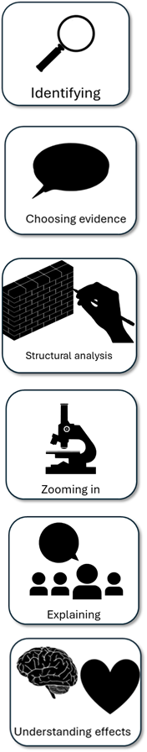
We will now peer assess our own answers
Swap your answers with another student.
1) What skills did the student use well in their answer?
Example: They showed how the focus shifted from the stadium to the tragedy of the father dying.
2) What skills could the student improve on in their answer?
Example: They need to explain why changing this focus changes the atmosphere of the text.

Slide 15


Plenary: Paper Telephone
Step 1: On the top a piece of paper write down one thing you’ve learnt from today’s lesson.
Step 2: Your partner needs to draw what you have written. Then fold over the paper so only the picture can be seen, not the sentence.
Step 3: Pass your paper to someone else. They need to write down what the picture is. Fold over the paper so only the new sentence can be seen.
Repeat this process again!
To describe how time changes throughout the extract
To explain how changes in time affect how the reader interprets the text
To evaluate the effectiveness of our Q3 answers through key skills used

