Slide 1
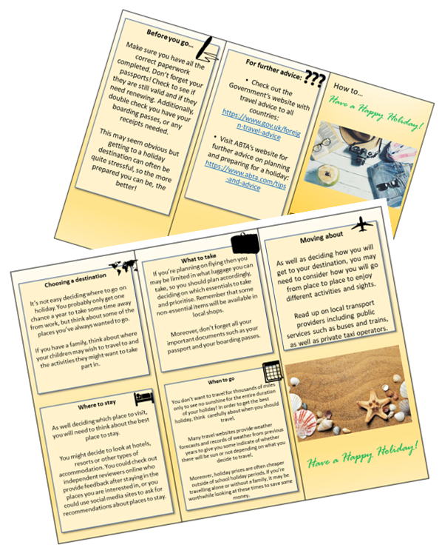
Writing the Texts of Leaflets
We have previously explored letters, articles and speeches, and today we are going to look at a new type of non-fiction writing: leaflets.
What is a leaflet?
How are leaflets different to other types of non-fiction writing?
Why might the use of language in leaflets be very different to those of a speech, article or letter? Provide examples.

Slide 2
Learning outcomes
To describe the key features of leaflets
To explain how we can use language to write to advise or instruct
To evaluate the effectiveness of our leaflets based on success criteria

Slide 3
Leaflets are usually produced to advise or instruct people on specific topics
You may have seen leaflets at a doctor’s surgery, schools, hospitals, businesses, sporting clubs or other associations. Charities often use leaflets to show the services they can offer to people.
They usually offer advice to readers – giving them options rather than telling them what to do. They can provide instructions on how to use a facility or service.

Slide 4
Here is what the examiner is looking for from the text of a leaflet
As a minimum you should include:
A simple title
Paragraphs or sections
You could also include:
An apt, clear or original title
Organisational devices such as inventive subheadings or boxes
bullet points
effectively/fluently sequenced paragraphs.
In the exam you don’t need to divide up your leaflet into different pages or lay it out exactly as it would be printed, but you CAN include boxes, subheadings, bullet points and different sections.
We will look at an example exam task answer.

Slide 5
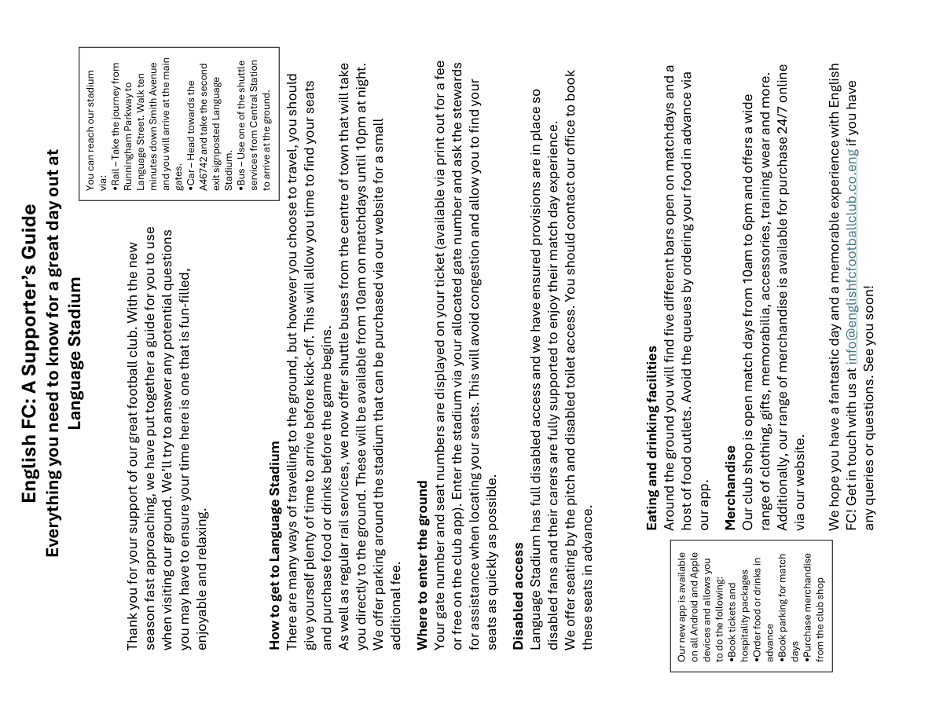
Let’s look at an example exam answer
Write the text of a leaflet advising people how to use a facility or service.
Read through the example.
What features did the writer include?
How does the organisation help the reader to understand the advice and instructions?
Why is the use of language different to other non-fiction texts we have explored? Provide examples.

Slide 6
You can reach our stadium via:
Rail – Take the journey from Runningham Parkway to Language Street. Walk ten minutes down Smith Avenue and you will arrive at the main gates.
Car – Head towards the A46742 and take the second exit signposted Language Stadium.
Bus – Use one of the shuttle services from Central Station to arrive at the ground.
How to get to Language Stadium
There are many ways of travelling to the ground, but however you choose to travel, you should give yourself plenty of time to arrive before kick-off. This will allow you time to find your seats and purchase food or drinks before the game begins.
As well as regular rail services, we now offer shuttle buses from the centre of town that will take you directly to the ground. These will be available from 10am on matchdays until 10pm at night.
We offer parking around the stadium that can be purchased via our website for a small additional fee.
Where to enter the ground
Your gate number and seat numbers are displayed on your ticket (available via print out for a fee or free on the club app). Enter the stadium via your allocated gate number and ask the stewards for assistance when locating your seats. This will avoid congestion and allow you to find your seats as quickly as possible.
Disabled access
Language Stadium has full disabled access and we have ensured provisions are in place so disabled fans and their carers are fully supported to enjoy their match day experience.
We offer seating by the pitch and disabled toilet access. You should contact our office to book these seats in advance.
Eating and drinking facilities
Around the ground you will find five different bars open on matchdays and a host of food outlets. Avoid the queues by ordering your food in advance via our app.
Merchandise
Our club shop is open match days from 10am to 6pm and offers a wide range of clothing, gifts, memorabilia, accessories, training wear and more. Additionally, our range of merchandise is available for purchase 24/7 online via our website.
We hope you have a fantastic day and a memorable experience with English FC! Get in touch with us at info@englishfcfootballclub.co.eng if you have any queries or questions. See you soon!
English FC: A Supporter’s Guide
Everything you need to know for a great day out at Language Stadium
Thank you for your support of our great football club. With the new season fast approaching, we have put together a guide for you to use when visiting our ground. We’ll try to answer any potential questions you may have to ensure your time here is one that is fun-filled, enjoyable and relaxing.
Our new app is available on all Android and Apple devices and allows you to do the following:
Book tickets and hospitality packages
Order food or drinks in advance
Book parking for match days
Purchase merchandise from the club shop

Slide 7
You can reach our stadium via:
Rail – Take the journey from Runningham Parkway to Language Street. Walk ten minutes down Smith Avenue and you will arrive at the main gates.
Car – Head towards the A46742 and take the second exit signposted Language Stadium.
Bus – Use one of the shuttle services from Central Station to arrive at the ground.
English FC: A Supporter’s Guide
Everything you need to know for a great day out at Language Stadium
Thank you for your support of our great football club. With the new season fast approaching, we have put together a guide for you to use when visiting our ground. We’ll try to answer any potential questions you may have to ensure your time here is one that is fun-filled, enjoyable and relaxing.
The writer included an apt title that explains the leaflet is for supporters who are travelling to a football stadium for a game.
Direct address is used in the strapline and main text to make the reader feel they are the one being written to. They included an introduction which sets out what the leaflet will advise and instruct you about.
They included a text box and bullet points to relay key travel information to the reader.

Slide 8
How to get to Language Stadium
There are many ways of travelling to the ground, but however you choose to travel, you should give yourself plenty of time to arrive before kick-off. This will allow you time to find your seats and purchase food or drinks before the game begins.
As well as regular rail services, we now offer shuttle buses from the centre of town that will take you directly to the ground. These will be available from 10am on matchdays until 10pm at night.
We offer parking around the stadium that can be purchased via our website for a small additional fee.
Where to enter the ground
Your gate number and seat numbers are displayed on your ticket (available via print out for a fee or free on the club app). Enter the stadium via your allocated gate number and ask the stewards for assistance when locating your seats. This will avoid congestion and allow you to find your seats as quickly as possible.
Disabled access
Language Stadium has full disabled access and we have ensured provisions are in place so disabled fans and their carers are fully supported to enjoy their match day experience.
We offer seating by the pitch and disabled toilet access. You should contact our office to book these seats in advance.
The next sections cover different concerns a supporter may have about getting to or using the ground.
Each section directly addresses the reader and offers advice throughout: “you should”, “you could”, “you must” and so on.

Slide 9
Our new app is available on all Android and Apple devices and allows you to do the following:
Book tickets and hospitality packages
Order food or drinks in advance
Book parking for match days
Purchase merchandise from the club shop
Eating and drinking facilities
Around the ground you will find five different bars open on matchdays and a host of food outlets. Avoid the queues by ordering your food in advance via our app.
Merchandise
Our club shop is open match days from 10am to 6pm and offers a wide range of clothing, gifts, memorabilia, accessories, training wear and more. Additionally, our range of merchandise is available for purchase 24/7 online via our website.
We hope you have a fantastic day and a memorable experience with English FC! Get in touch with us at info@englishfcfootballclub.co.eng if you have any queries or questions. See you soon!
The final section is a summary of the information in the leaflet and provides contact details for the reader to get in touch if they have any questions for the club.
The writer also included another textbox with bullet points to outline what the club’s app could be used for.

Slide 10
Today, we’re focusing on writing to advise
This is a different type of purpose to writing to argue, persuade or explain.
When you offer advice to friends, do you think about how you say it or change the way you talk? How? Why?
What is the difference between ‘informing’ and ‘advising’ someone? Provide some examples.
How might tone change from informing people to advising them? Why? Why is ‘writing to advise’ different to ‘writing to persuade’ or ‘argue’?

Slide 11
There are a number of techniques that can be used in writing to advise pieces
Modal verbs (Should, could, would, will, must, won’t, etc – they modify or alter the meanings of verbs).
Pronouns (You, he, she, they, I, etc – they replace names).
An empathetic and understanding tone.
Imperative sentences (A sentence where you command someone to do something: Visit our website, book your tickets in advance, order food from our app).
Discuss: How do these techniques help to engage the reader when writing to advise?

Slide 12
Disabled access
Language Stadium has full disabled access and we have ensured provisions are in place so disabled fans and their carers are fully supported to enjoy their match day experience.
We offer seating by the pitch and disabled toilet access. You should contact our office to book these seats in advance.
Eating and drinking facilities
Around the ground you will find five different bars open on matchdays and a host of food outlets. Avoid the queues by ordering your food in advance via our app.
The text of the leaflet directly addresses the reader, using the pronoun ‘you’ often’ to ensure the reader feels the information is relevant to them and targeted at them.
Additionally, the text includes modal verbs to show the reader the options they have and recommend ways forward to them.
Also, imperative verbs are used to ensure advice is taken seriously and the reader feels some obligation to move forward with the recommendations provided by the leaflet.

Slide 13
A leaflet usually has a title which offers insight into what information will be contained within the leaflet, for instance:
English FC: A Supporter’s Guide
Everything you need to know for a great day out at Language Stadium
We know that a series of topics will be covered, including travel, shopping, disabled access, food and drink and more. The leaflet provides helpful, empathetic and relevant information to the reader about using the football ground.
Each topic is often presented as its own section, and within each of those sections connectives such as ‘However’, ‘Moreover’, ‘Additionally’ and ‘Finally’ are used to link ideas together.

Slide 14
As well as being a writing to advise piece, we are going to be creating leaflets today
Leaflets are usually organised and laid out very differently to other text types.
How are leaflets often organised?
How can information be organised in a leaflet differently to an article?
Why might a leaflet be a useful format for writing to advise?

Slide 15

Write the text of a leaflet advising people how to use a facility or service.
Using your new learning on writing to advise/instruct and leaflets, create a leaflet on a facility or service of your choice.
This information needs to be particularly relevant to your chosen audience.
Decide what information you will need to include.
Plan out the different sections and the organisation of your leaflet.
Once you’re happy with notes, create your leaflet.
Success criteria | Included?
Modal verbs: Should, could, must, will, won’t, etc.
Imperatives: Go, visit, find, discover, try, consider…
Pronouns: You, I, he, she, they…
Empathetic tone: I understand that… We all know that…
Overall structure and linked sections

Slide 16



Plenary: PIN peer assessment
PIN assess your partner’s leaflet.
Praise
Brilliant use of tone that made me feel the guidance was helpful and relevant.
Improvement
You didn’t include any imperative sentences.
Now
Using a red pen go back and add these in to your leaflet and I’ll give you some feedback on them
Success criteria:
Modal verbs: Should, could, must, will, won’t, etc.
Imperatives: Go, buy, find, discover, try, enjoy…
Pronouns: You, I, he, she, they…
Empathetic tone: I understand that… We all know that…
Banned targets:
Write more
Correct spellings
Add more detail.

