Slide 1
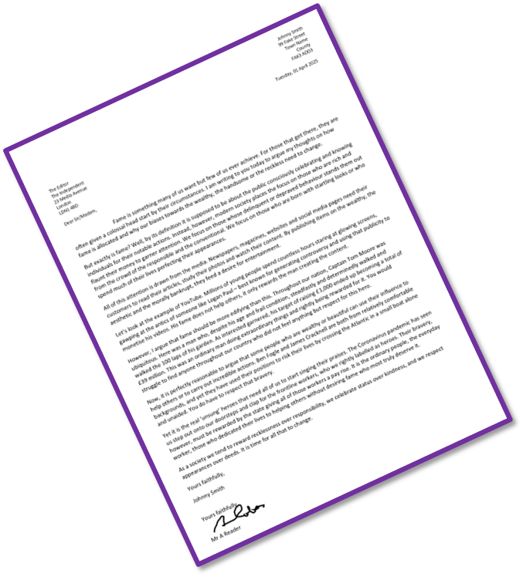
Writing Letters Continued
Last lesson we began exploring letters and how to include their key features.
Let’s recap our learning.
What are the main features of a letter?
How do you layout a formal letter?
Why do we need to consider language and tone carefully when writing out a letter? Provide examples.

Slide 2
Learning outcomes
To describe the key features of a formal letter
To explain how to write effective conclusions to our letters
To evaluate the effectiveness of our letters based on success criteria

Slide 3
The address of the receiver This is included on the left below the writer’s address.
Writer’s address at the top right and the date written below.
Directly addressing the receiver: If you know the name of the person you are writing it, you write it down formally (Mr A Name, Mrs A Name). However, if you don’t know their name you would put ‘Dear Sir/Madam’.
The date is usually included so the reader knows when it was sent.
Introductory paragraph: This sets out why you are writing to the receiver and what you hope to achieve through the letter.
Paragraphs linked with connectives: This is to ensure your writing flows well for the reader and links your ideas together. It provides a clear structure to your letter and writing.
The language used is very formal, so extensive vocabulary is employed and a serious tone is established.
However, the writer also uses writing to argue techniques like rhetorical questions and emotive language to attempt to make their argument convincing.
Signed off with ‘Yours sincerely’ or ‘Yours faithfully’. If you were writing to someone whose name you don’t know, you would sign off with ‘Yours faithfully’. A signature shows the letter is genuine and authentic. If you know their name then you put ‘Yours sincerely’.

Slide 4
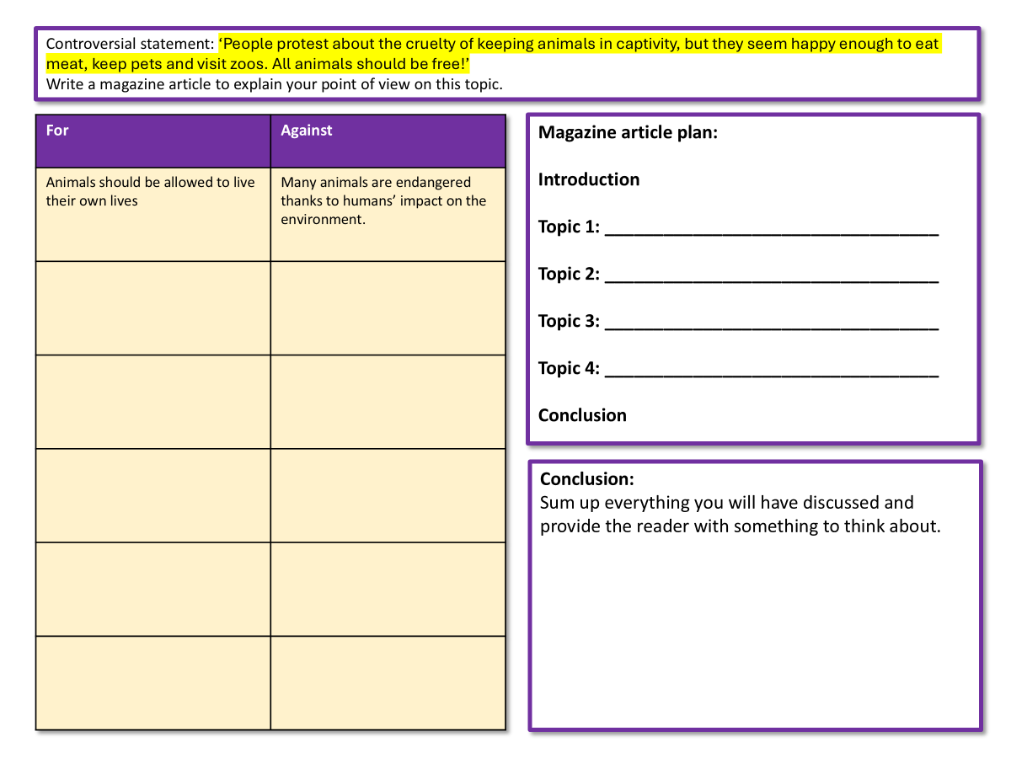
Complete your planning sheet for a letter on the exam task we have previously explored
Complete the table with different arguments for and against the statement on fame.
Plan out the different topics your letter.

Slide 5
‘It is people who have extraordinary skill, courage and determination who deserve to be famous, not those who have good looks or lots of money or behave badly.’
Write a letter to the editor of a newspaper in which you argue your point of view in response to this statement.
For | Against
People who help others in society deserver better recognition and rewards for the important work that they do. | Anyone who is famous has earnt that respect from the public, regardless of what they have done.
Letter plan:
Introduction
Topic 1: __________________________________
Topic 2: __________________________________
Topic 3: __________________________________
Topic 4: __________________________________
Conclusion

Slide 6
Let’s look at the topics covered in the example letter
All of this attention is drawn from the media. Newspapers, magazines, websites and social media pages need their customers to read their articles, study their photos and watch their content. By publishing items on the wealthy, the aesthetic and the morally bankrupt, they feed a desire for entertainment.
Let’s look at the example of YouTube. Millions of young people spend countless hours staring at glowing screens, gawping at the antics of someone like Logan Paul – best known for generating controversy and using that publicity to monetise his videos. His fame does not help others, it only rewards the man creating the content.
However, I argue that fame should be more edifying than this. Throughout our nation, Captain Tom Moore was ubiquitous. Here was a man who, despite his age and frail condition, steadfastly and determinedly walked and walked the 100 laps of his garden. As interested garnered, his target of raising £1,000 ended up becoming a total of £39 million. This was an ordinary man doing extraordinary things and rightly being rewarded for it. You would struggle to find anyone throughout our country who did not feel anything but respect for this hero.
Now, it is perfectly reasonable to argue that some people who are wealthy or beautiful can use their influence to help others or to carry out incredible actions. Ben Fogle and James Cracknell are both from relatively comfortable backgrounds, and yet they have used their positions to risk their lives by crossing the Atlantic in a small boat alone and unaided. You do have to respect that bravery.
This section focuses on how the media offers fame to people based on their looks, their lack of morals or their wealth, according to the writer.
This section explores the example of a YouTube influencer and how the writer doesn’t agree that this influencer should get so much fame.
This section explores someone who the writer thinks deserves fame and the writer provides statistics to support their argument.
This section acknowledges that people from wealthy backgrounds can still have fantastic achievements and deserve fame as a result.

Slide 7
Using your plan, write out the content of your letter
We will write out conclusions later in the lesson.
Use your topic plan to help you cover the areas you want to in your letter.
‘It is people who have extraordinary skill, courage and determination who deserve to be famous, not those who have good looks or lots of money or behave badly.’
Success criteria | I have included this (Tick):
Varied sentence openers (-ispaced)
Appropriate tone
Connectives and linked sentences used to link paragraphs

Slide 8
Let’s look at the conclusion of the example letter
Yet it is the real ‘unsung’ heroes that need all of us to start singing their praises. The Coronavirus pandemic has seen us step out onto our doorsteps and clap for the frontline workers, who we rightly labelled as heroes. Their bravery, however, must be rewarded by the state giving all of those workers a pay rise. It is the ordinary people, the everyday worker, those who dedicated their lives to helping others without desiring fame who most truly deserve it.
As a society we tend to reward recklessness over responsibility, we celebrate status over kindness, and we respect appearances over deeds. It is time for all that to change.
Yours faithfully,
Johnny Smith
How does the writer end their letter?
How does the ending of the letter link to the beginning? Why is this important?
Look at the list of strategies. Which one of these has the writer chosen and why?
Reiterate or repeat your main arguments
Summarise your main arguments well.
Have you asked the readers a question before? This could provide an answer
Give the readers a challenge. Tell them to think or act in a different way
Think about the future. How does it compare to now?
End the scenario you began with
Circle back to the start with a cyclical structure
End with a powerful quotation
Give a solution to the arguments raised
End with a rhetorical question

Slide 9
Let’s look at the conclusion of the example letter
Yet it is the real ‘unsung’ heroes that need all of us to start singing their praises. The Coronavirus pandemic has seen us step out onto our doorsteps and clap for the frontline workers, who we rightly labelled as heroes. Their bravery, however, must be rewarded by the state giving all of those workers a pay rise. It is the ordinary people, the everyday worker, those who dedicated their lives to helping others without desiring fame who most truly deserve it.
As a society we tend to reward recklessness over responsibility, we celebrate status over kindness, and we respect appearances over deeds. It is time for all that to change.
Yours faithfully,
Johnny Smith
The writer challenges the readers of the newspaper to think in a different way by suggesting unsung heroes such as public sector workers should be rewarded with pay rises for their work.
Their final paragraph repeats their main argument – that we reward people for recklessness or status, rather than responsibility or kindness, and that needs to change, according to the writer.
Reiterate or repeat your main arguments
Summarise your main arguments well.
Have you asked the readers a question before? This could provide an answer
Give the readers a challenge. Tell them to think or act in a different way
Think about the future. How does it compare to now?
End the scenario you began with
Circle back to the start with a cyclical structure
End with a powerful quotation
Give a solution to the arguments raised
End with a rhetorical question

Slide 10
Write out the finish of your letter now
Key feature | I have included this (Tick):
A concluding paragraph that sums up my thoughts
Yours faithfully/yours sincerely included
My tone is appropriately formal
Write out your concluding paragraph summing up your argument and the sign off now.
‘It is people who have extraordinary skill, courage and determination who deserve to be famous, not those who have good looks or lots of money or behave badly.’
Not sure how to start?
Therefore we need to think about fame differently because…

Slide 11

Plenary: Self-assessment
Key feature | I have included this (Tick):
Address at the top-right
Dear…
Indented first paragraph
Introductory paragraph that sets out the purpose of my letter
My tone is appropriately formal.
Linked paragraphs through the use of connectives
A concluding paragraph that sums up my thoughts
Yours faithfully/yours sincerely included
Use the checklist you have been given to self-assess the quality and accuracy of your formal letter.
Once you can see your strengths and your areas to improve, go back and make your changes.

